Slide 1
ENGLISH FOR IT
LO 1 VOCABULARY
Input and output devices

Slide 2
Today you will:
Describe input and output devices
Identify different keys on a keyboard and explain their functions
Learn about OCR
Describe mouse actions
Discuss speech recognition software
Talk about scanner functions
Understand how computer displays work
Understand functionalities of touch screen
Name the types and describe technical functions of printers
Learn some more IT initialisms

Slide 3
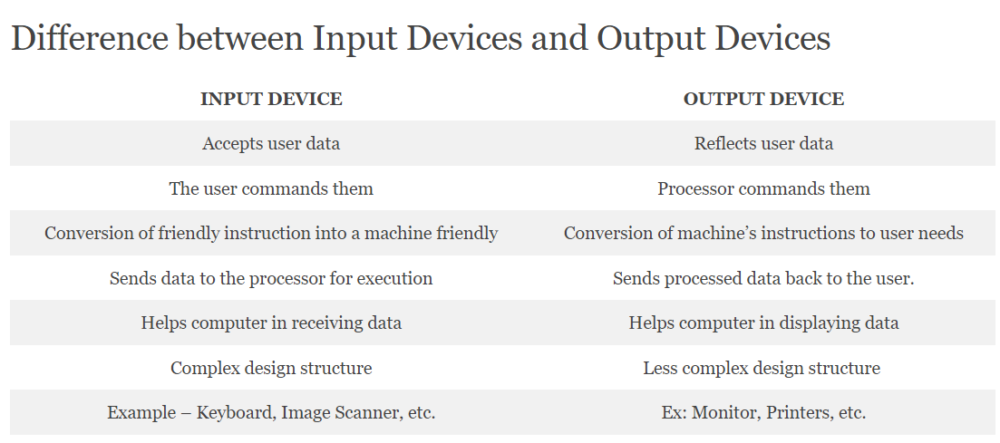

Slide 4
INPUT DEVICES

Slide 5

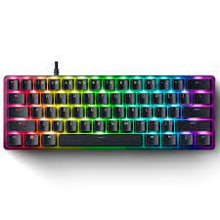
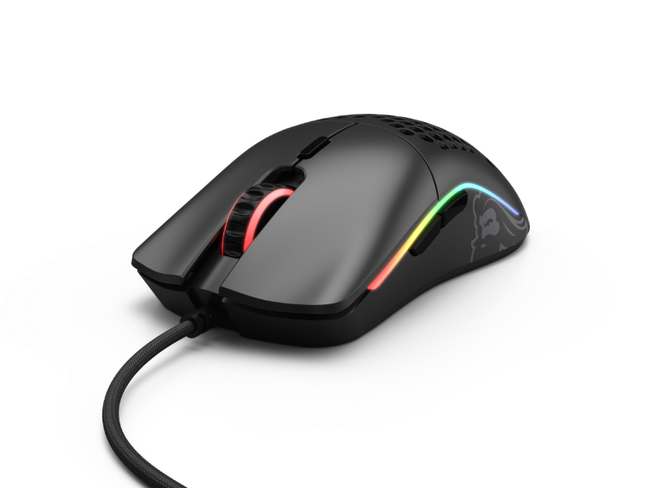
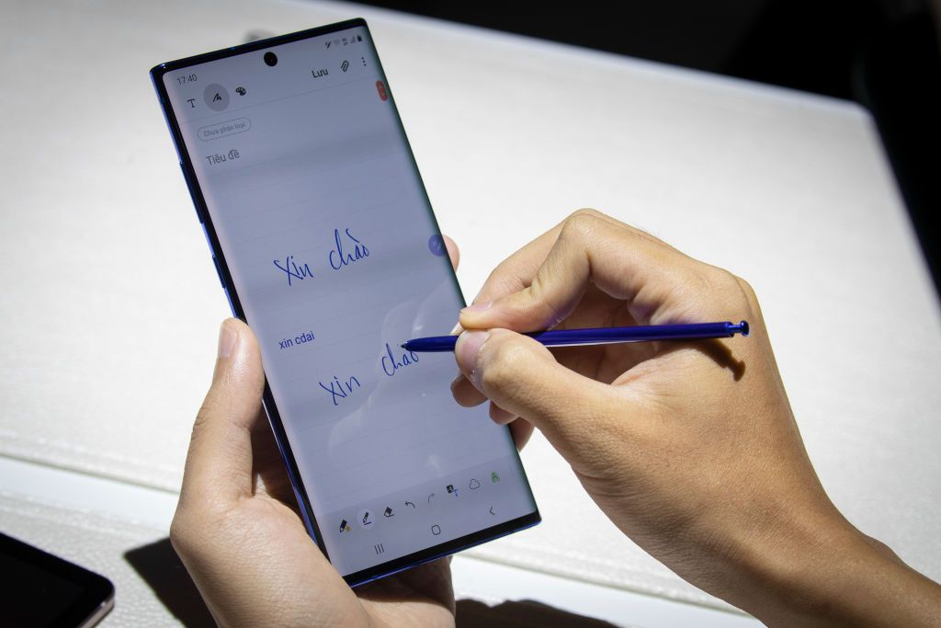
Listen to a computer technician describing 3 input devices. Write down which device he’s talking about.
_______________________
2. _______________________
3. _______________________
Notes:
Keyboard, mouse, stylus/ light pen

Slide 6
Read and write the name of the input device
The most basic input device to enter data on the system or any other device with the help of the keys.
A hand-supported input device that allows users to move the cursor on the screen. It works on a flat surface with a wheel between the left and right buttons. Laptops have a touchpad with the same function.
A pen-like structure allowing users to select on the screen and even draw on it. Photocells and optical systems are inbuilt inside the small tube allowing the flow of signals to the CPU.
A common accessory for notebooks and laptops, that works as a replacement for a mouse. With a similar structure, it has a half- inserted ball which the fingers move to send signals for cursor movement. It is kind of stationary, taking very little space. It comes in a ball, button, and square shape as well.
It works like a photocopy machine as an input device to make information available on a PC from paper.

Slide 7
Check your answers
The most basic input device to enter data on the system or any other device with the help of the keys. | KEYBOARD
A hand-supported input device that allows users to move the cursor on the screen. It works on a flat surface with a wheel between the left and right buttons. Laptops have a touchpad with the same function. | MOUSE
A pen-like structure allowing users to select on the screen and even draw on it. Photocells and optical systems are inbuilt inside the small tube allowing the flow of signals to the CPU. | STYLUS / OPTICAL PEN / LIGHT PEN
A common accessory for notebooks and laptops, that works as a replacement for a mouse. With a similar structure, it has a half- inserted ball which the fingers move to send signals for cursor movement. It is kind of stationary, taking very little space. It comes in a ball, button, and square shape as well. | TRACK BALL
It works like a photocopy machine as an input device to make information available on a PC from paper. | SCANNER

Slide 8
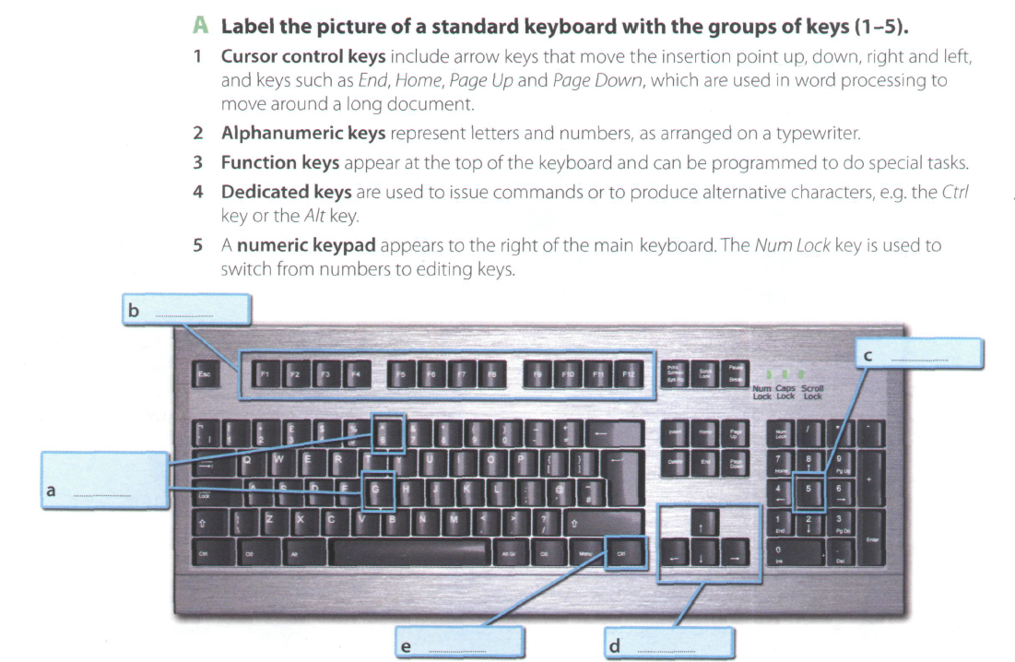

Slide 10
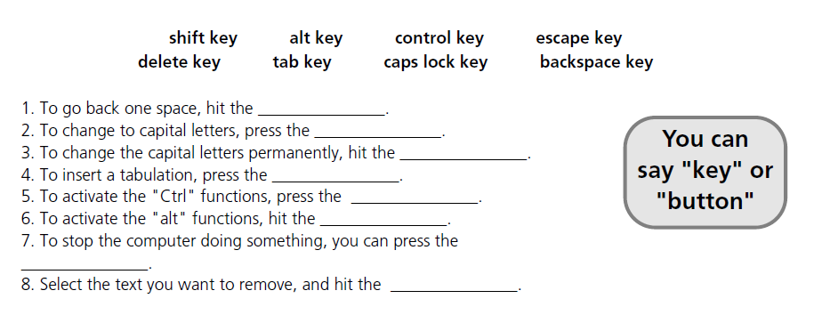

Slide 11
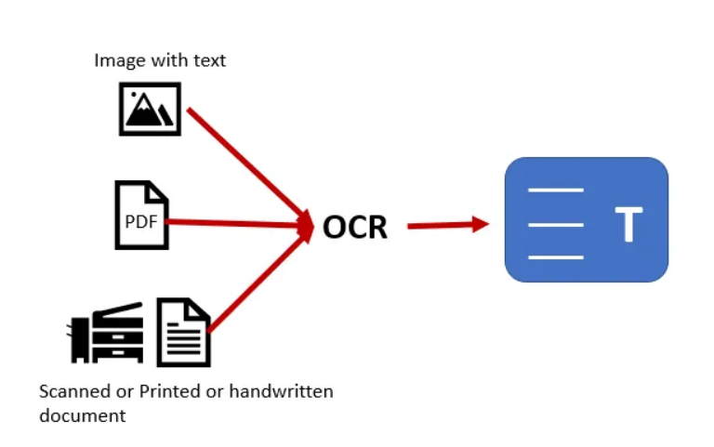
Optical Character Recognition / Reader (OCR)
OCR (optical character recognition or optical character reader) is the electronic or mechanical conversion of receipt images, receipt paper, and handwritten or printed text into machine-encoded text using software. In other words, transforming physical documents into digital data.

Slide 12
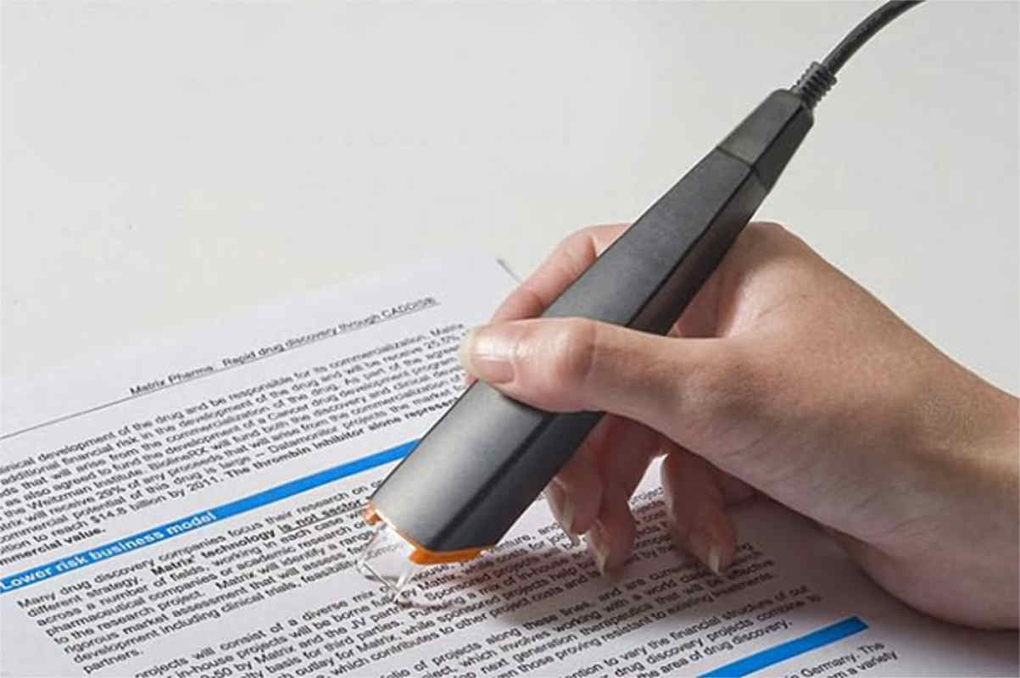
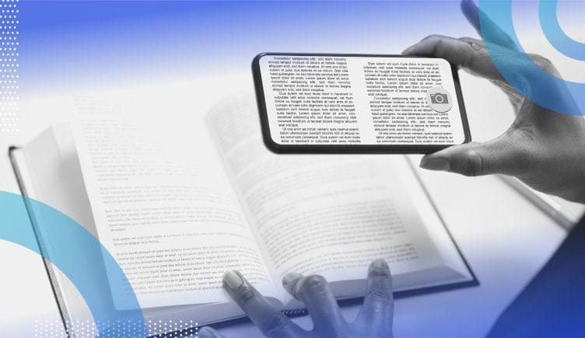
Optical character recognition devices
Do you use OCR and what for? Which apps do you use? What are the benefits of OCR?

Slide 13
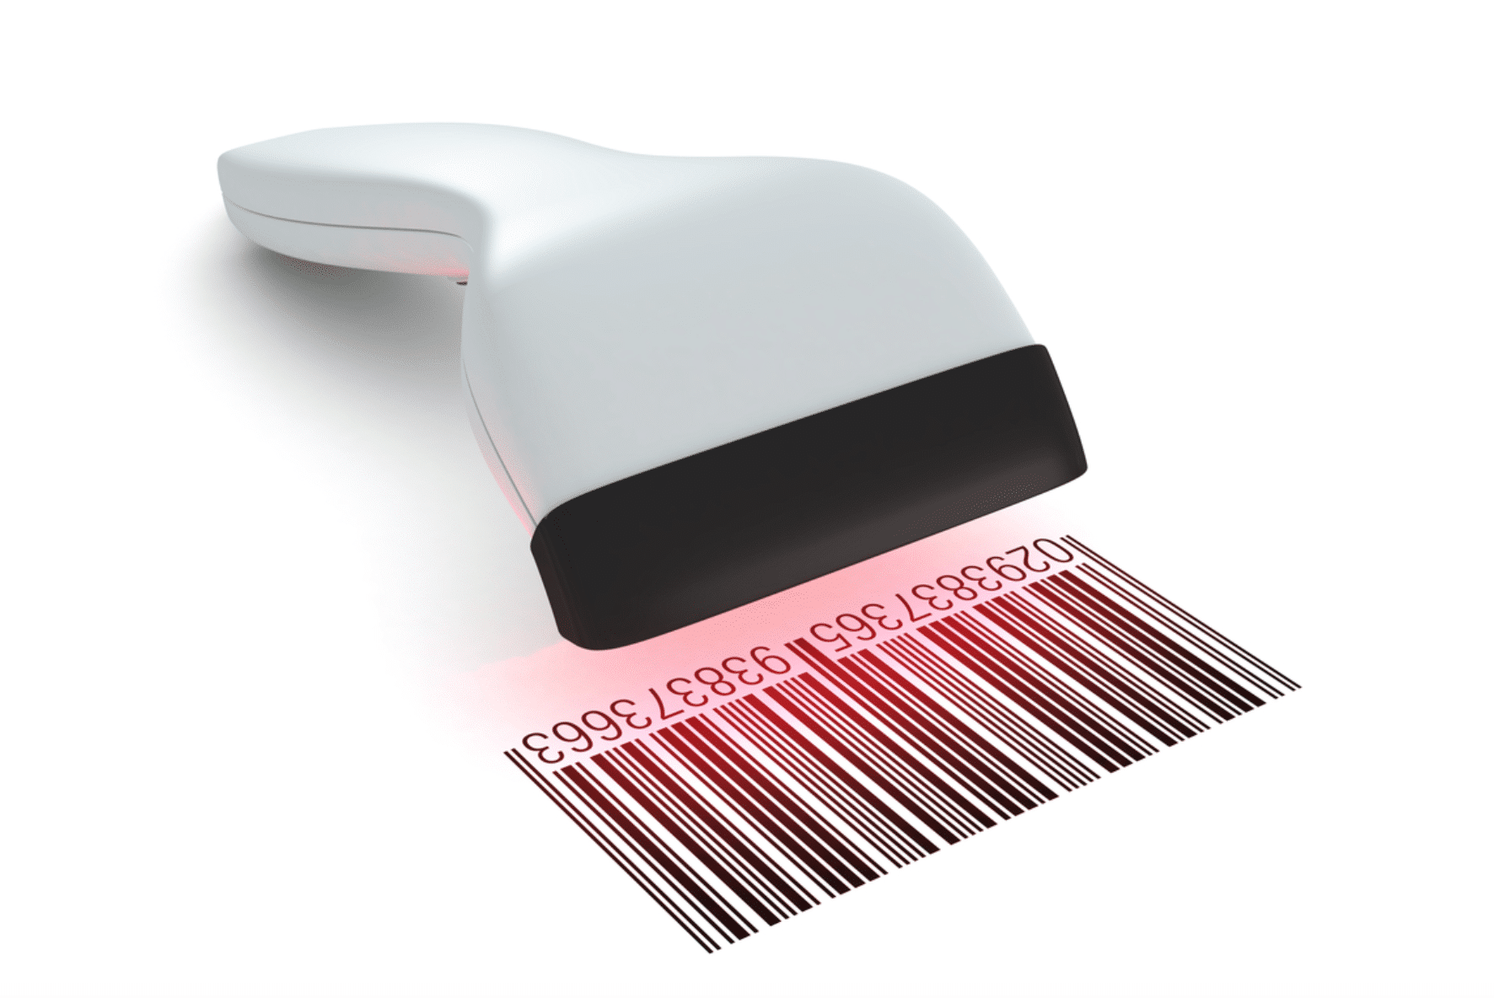
Bar code reader
Bar Code Reader is a reading device used to read barcode data like on goods, books, etc. It can be a handheld scanner or a stationary one but they both scan the image by converting it to alphanumeric value on the computer.

Slide 14
Speech recognition systems. Listen and answer.
Do you use voice commands?
In what situations?
Notes:
The keyboard and the mouse
By using high quality headset microphone
Around 98%
By reading aloud sample text for a few minutes
Proper names, abbreviations and unusual words

Slide 16
Scanners
Notes:
Photocopier
Computer
OCR (optical character recognition)
Text, colored pictures and even small 3D objects
35mm slides
Small pictures and logos

Slide 17
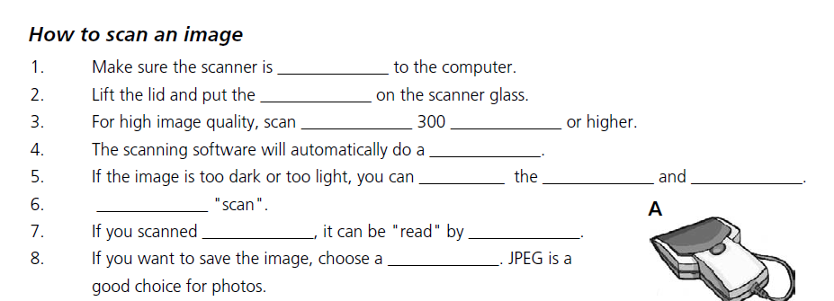
Complete the text.
Use: click, OCR software, connected, contrast, text, original, file format, preview, at, dpi, brightness, adjust

Slide 18
Check your answers:
Connected
Original
At / dpi
Preview
Adjust / brightness / contrast
Click
Text / OCR software
File format

Slide 19
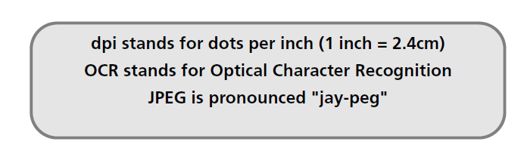
More initialisms
Do you know what JPEG’s short for and why? Google it!
Notes:
JPEG (Joint Photographic Experts Group) Named as a Group of Experts in Still Photography, this name refers to a standard in data compression for still images.
In particular, the work of the group has been developed with images encoded with the ITU-R 601 standard. JPEG uses DCT compression and offers data compression of between 2 and 100 times the original size.

Slide 20
OUTPUT DEVICES

Slide 21
How screen displays work

Slide 22
Check your answers:
PIXEL
VIDEO ADAPTER
ASPECT RATIO
PLASMA SCREEN
RESOLUTION
COLOUR DEPTH

Slide 23
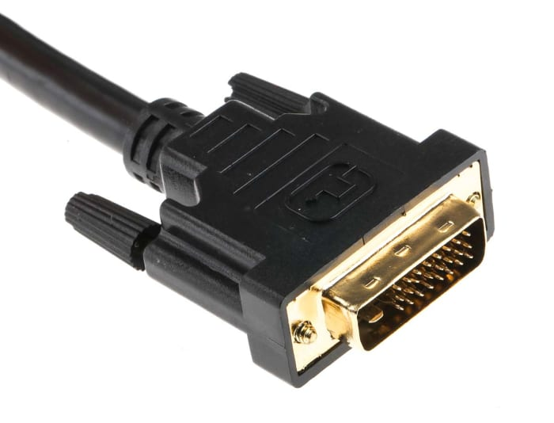
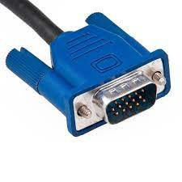
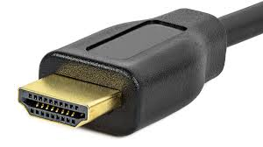
Cables
VGA | DVI | HDMI
Video graphics adapter | Digital video interface | High-Definition Multimedia Interface
Used in old CRT monitors; primarily to link a computer to a display device – OUTDATED TODAY | Used in LCD monitors; DVI only supports video signals (not audio) | Widely used today - HDMI supports features such as Ethernet connectivity, both video and audio

Slide 24
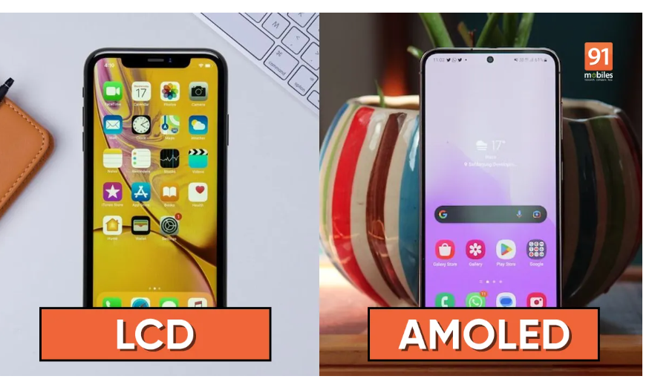
New displays
LCD and AMOLED are the two most common displays found on consumer electronics, including smartphones, tablets, wearables, TVs, and more.
LCD = liquid crystal display – uses TFT (thin film transistor) technology
AMOLED = active matrix organic light-emitting diode – uses OLED technology
Read the article to find out more: https://www.91mobiles.com/hub/lcd-vs-amoled/

Slide 25
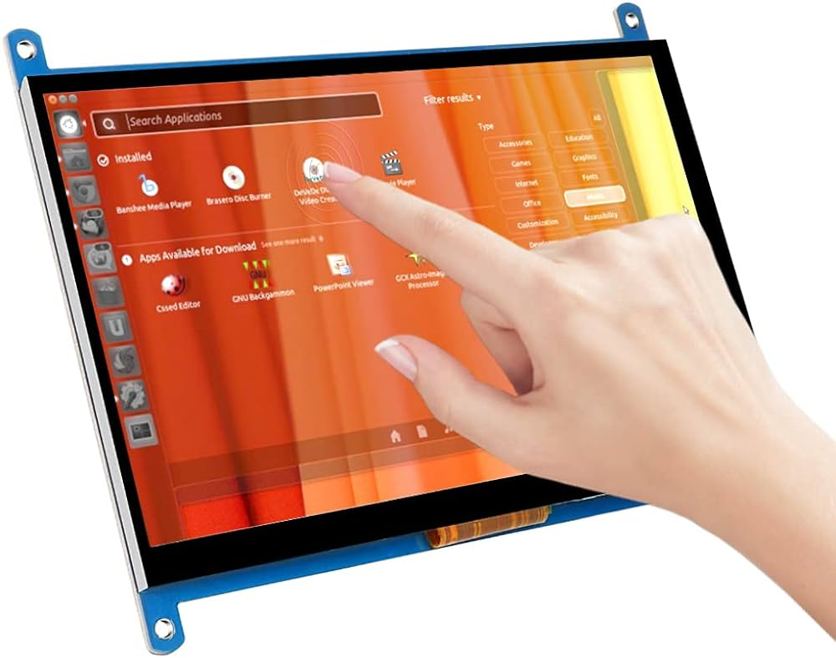
Touchscreen
Navigating Win10 with Touch Interface
Windows 10 was built with touch in mind.
Instead of using a mouse or keyboard to manipulate Windows 10, you use your fingers to touch the screen in specific ways.
These actions are called GESTURES:
tap and hold
tap
double-tap
spread
pinch
slide
turn
swipe
Extra activity: file named “Touch screen gestures – exercise”
Both an Input & Output Device

Slide 26
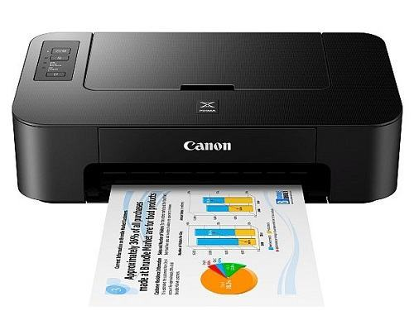
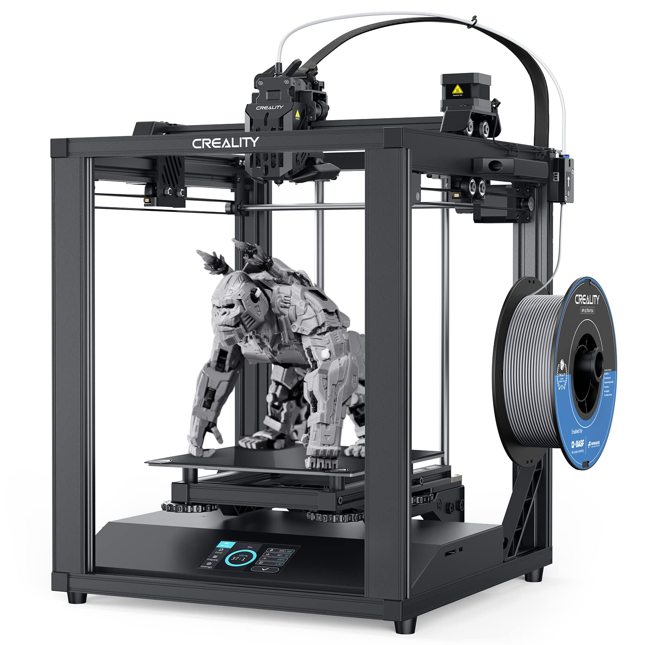
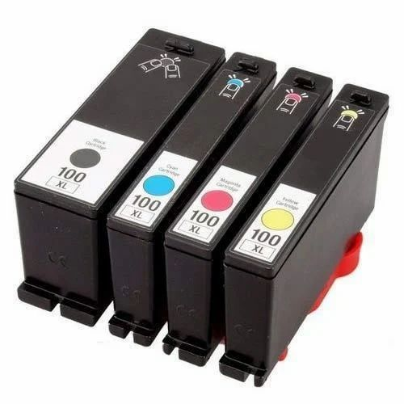
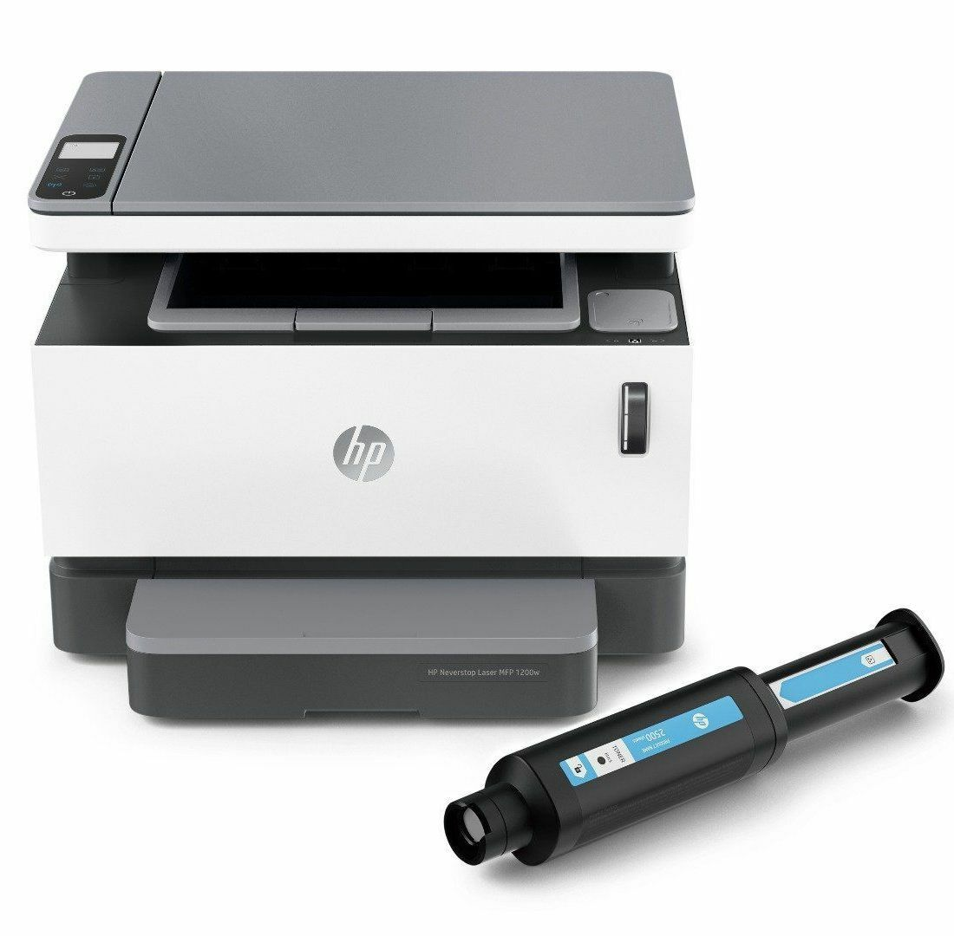
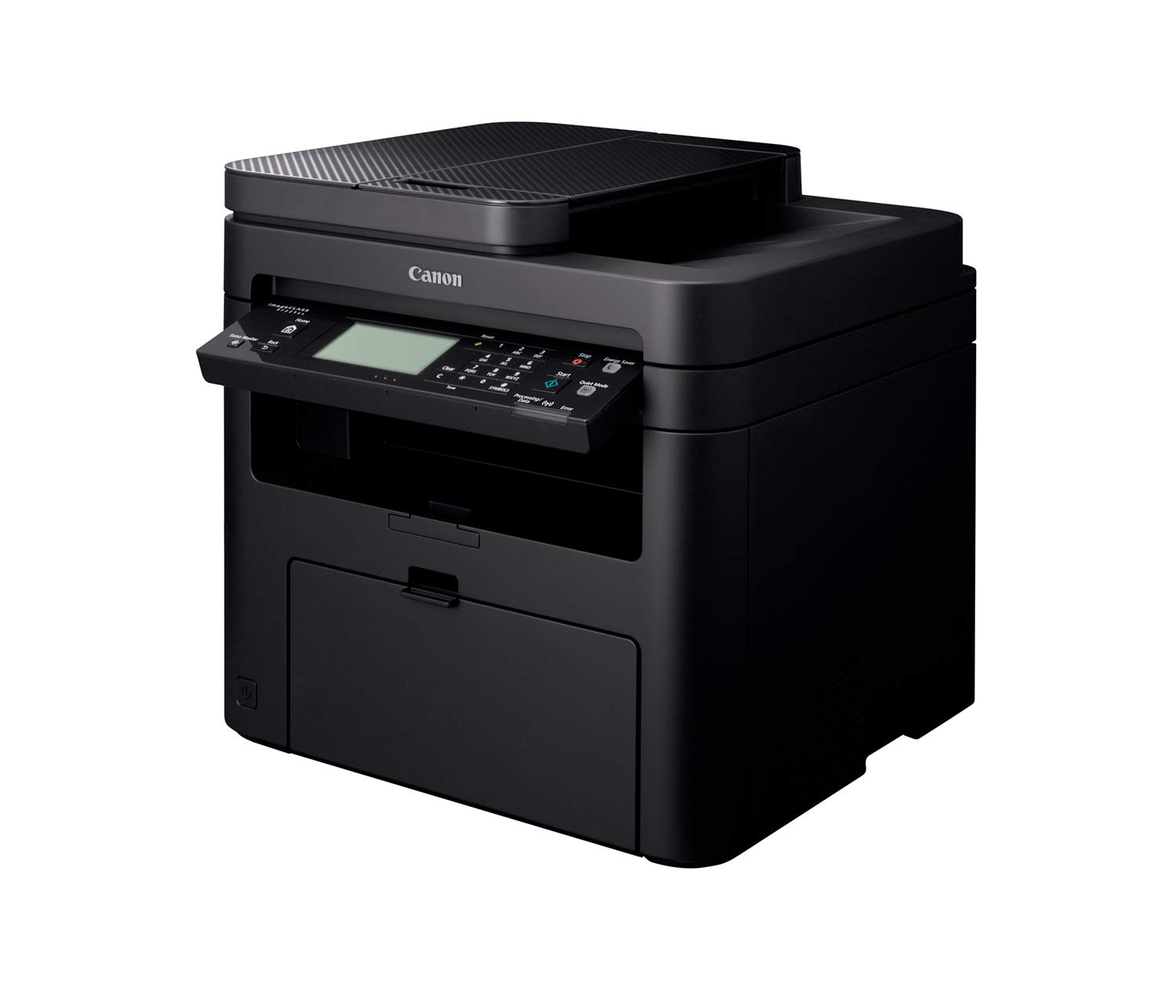
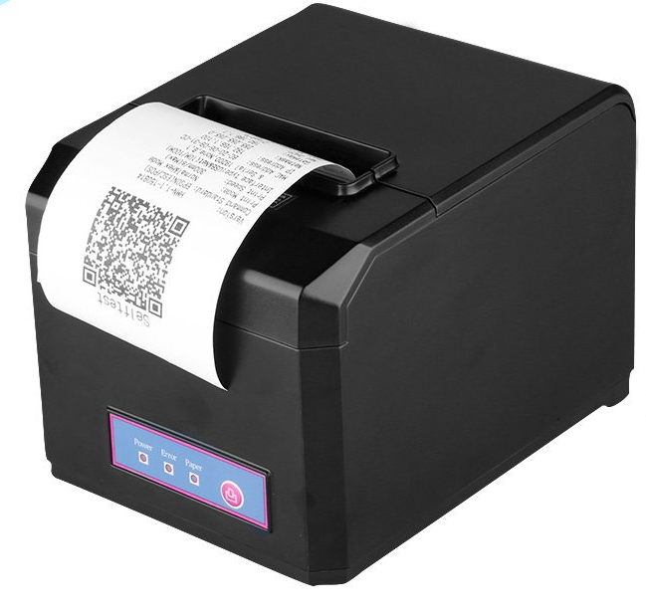
Can you name these types of printers?

Slide 27
INK-JET PRINTER
3D PRINTER
CARTRIDGE
LASER PRINTER
THERMAL PRINTER
MULTIFUNCTIONAL PRINTER
TONER

Slide 28
Common printer types
Inkjet printers recreate a digital image by spraying ink onto paper. These are the most common type of personal printer.
Laser printers are used to create high-quality prints by passing a laser beam at a high speed over a negatively charged drum to define an image. Color laser printers are more often found in professional settings.
3D printers are a relatively new printer technology. 3D printing creates a physical object from a digital file. It works by adding layer upon layer of material ((including plastics, metals, food, cement, wood) until the print job is complete and the object is whole.
Thermal printers produce an image on paper by passing paper with a thermochromic coating over a print head comprised of electrically heated elements and produces an image in the area where the heated coating turns black. Useful for printing codes, labels, receipts…
All-in-one printers are multifunction devices that combine printing with other technologies such as a copier, scanner and/or fax machine.

Slide 29
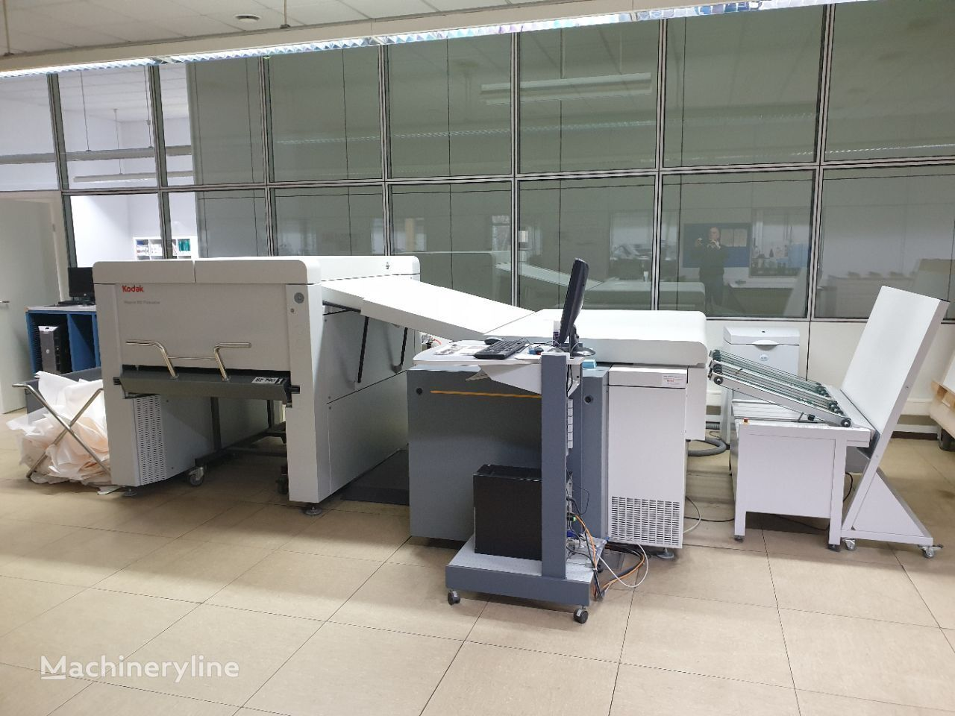
Imagesetters
An ultra-high-resolution large-format computer output device, able to produce quality surpassing that of a typical home or office printer. The resolution of a home printer is generally up to 300 dots per inch (dpi), with an office printer having 600 dpi, whereas the dpi of an imagesetter is 1270, 2540 or up to 4000 dpi
Used in graphic design industry and DTP (desktop publishing)

Slide 30
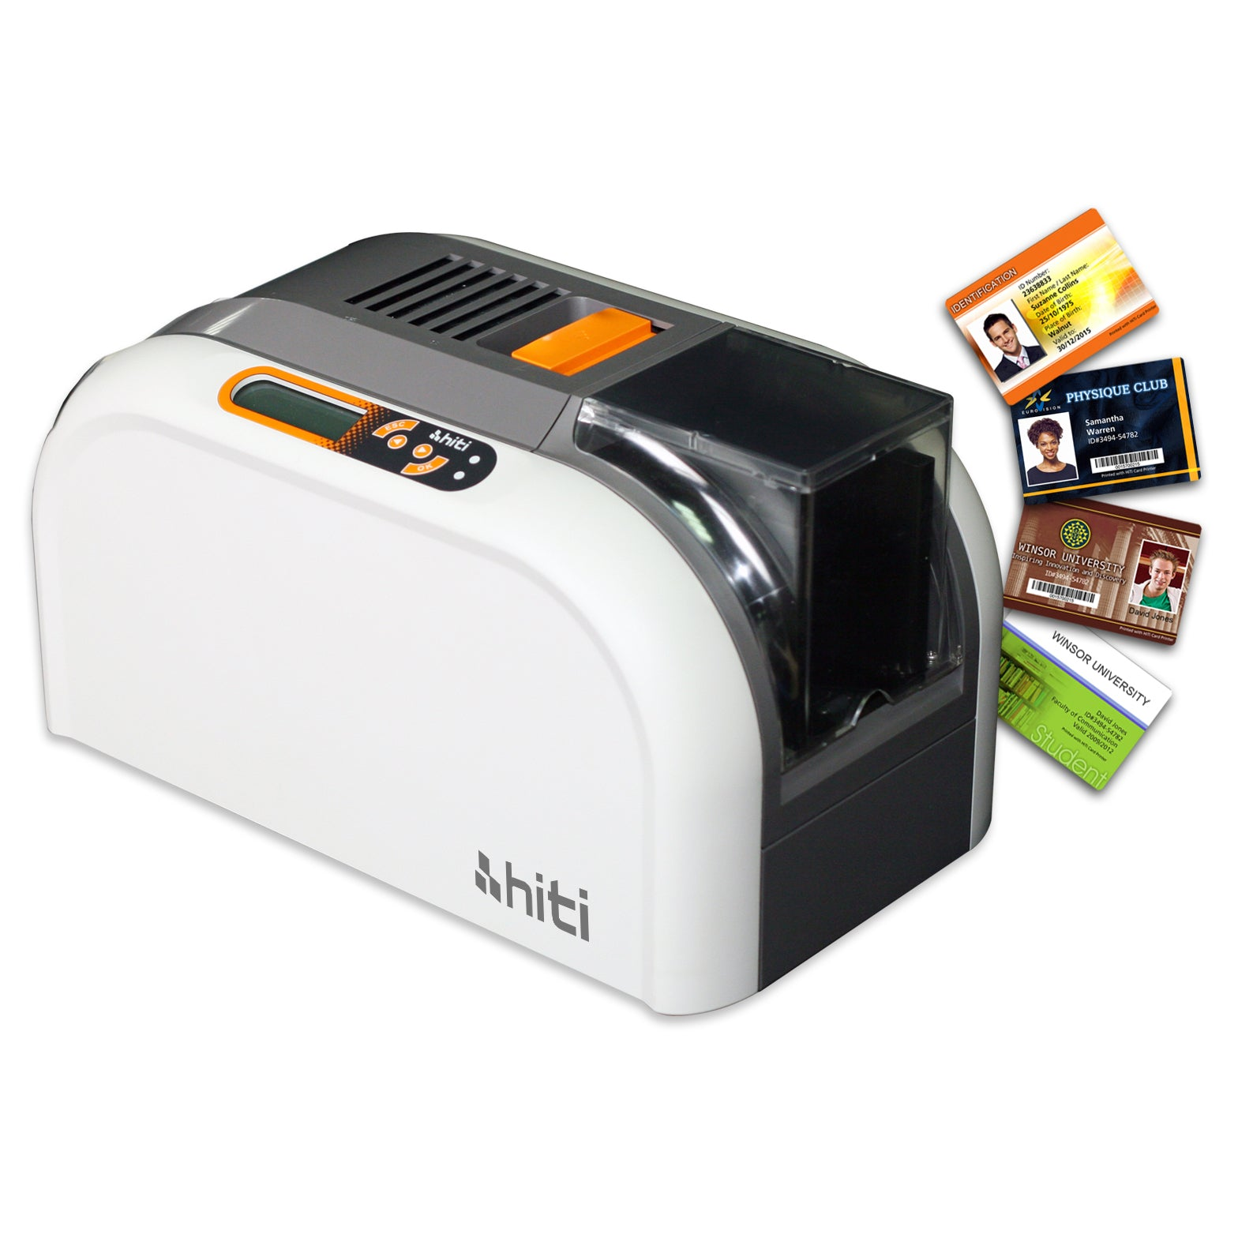
Card printers
electronic desktop printers with single card feeders which print and personalize plastic cards. This format is used in ID-cards, credit cards, driver's licenses, health insurance cards etc.
designed with laminating, striping, and punching functions, and use desktop or web-based software

Slide 31
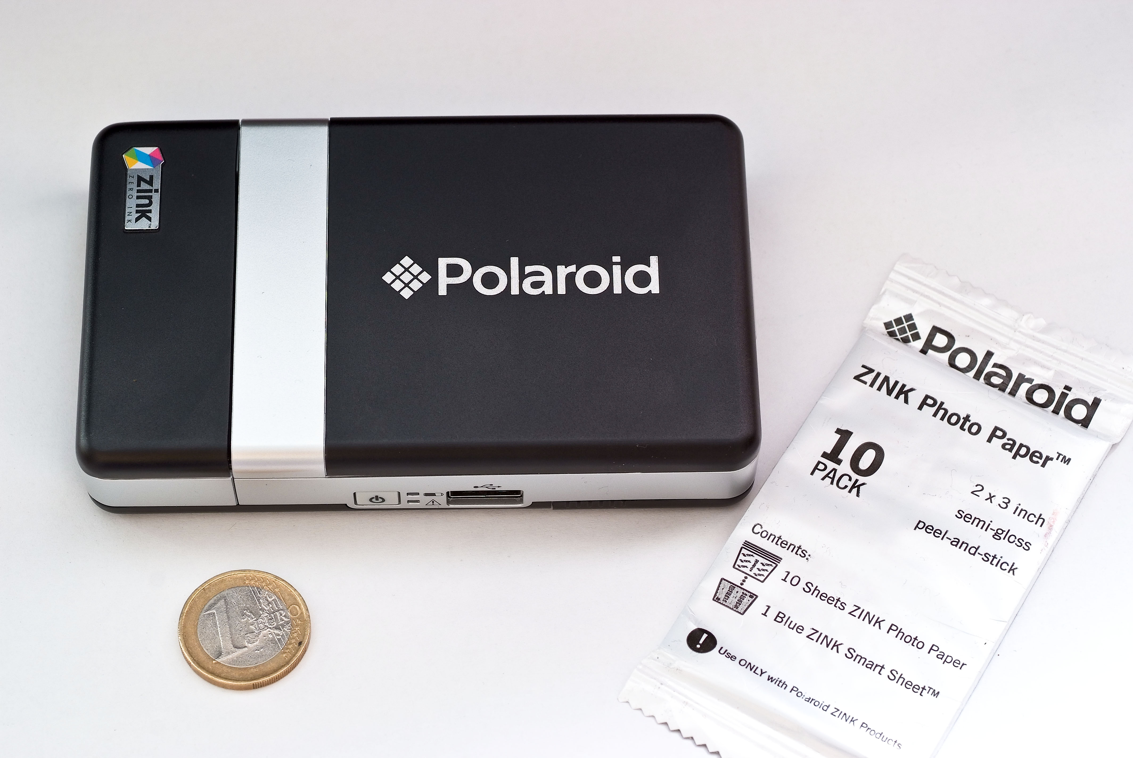
ZINK
a portmanteau of zero and ink
a full-color printing technology for digital devices that does not require ink cartridges and prints in a single pass
The printing technology and its thermal paper are developed by Zink Holdings LLC, which started as a project inside Polaroid Corporation
The paper has several layers: a backing layer with optional pressure sensitive adhesive, heat-sensitive layers with cyan, magenta and yellow dyes in colorless form, and an overcoat.

Slide 32
Older printer types
So called first-generation printer types (obsolete, outdated)
Dot matrix printers: use pins to print dots required to shape a character. Dot matrix printers offer very basic print quality. Today’s modern retailers that work with Point of Sale (POS) systems have two options when it comes to receipt printers- thermal receipt printers and dot matrix printers.
A plotter is a machine that produces vector graphics drawings. Plotters draw lines on paper using a pen, or in some applications, use a knife to cut a material like vinyl or leather. Used in CAD, but since the mid 1980s superseded by laser printers and digital technologies such as Solvent, Aqueous, and UV.

Slide 33
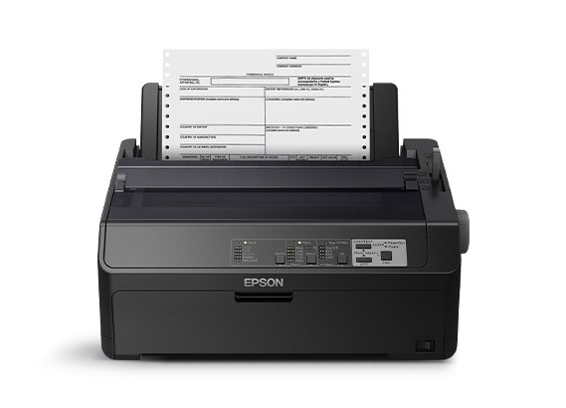
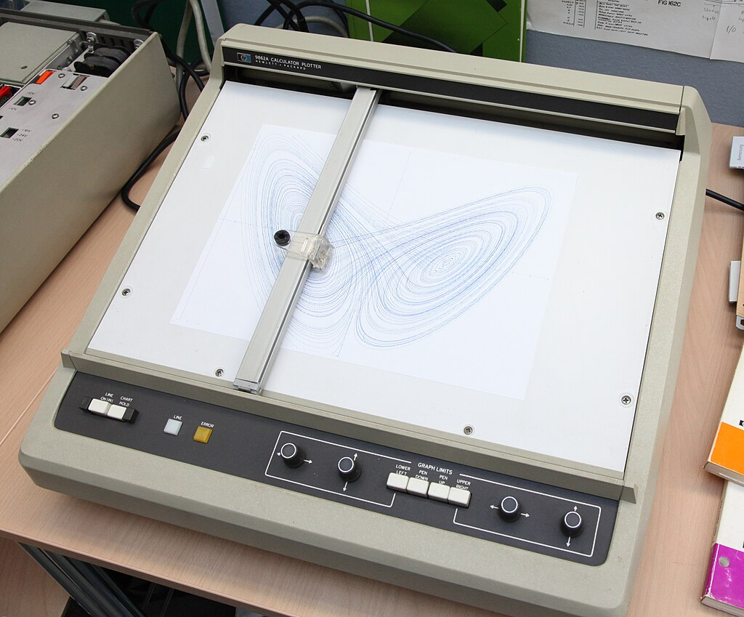
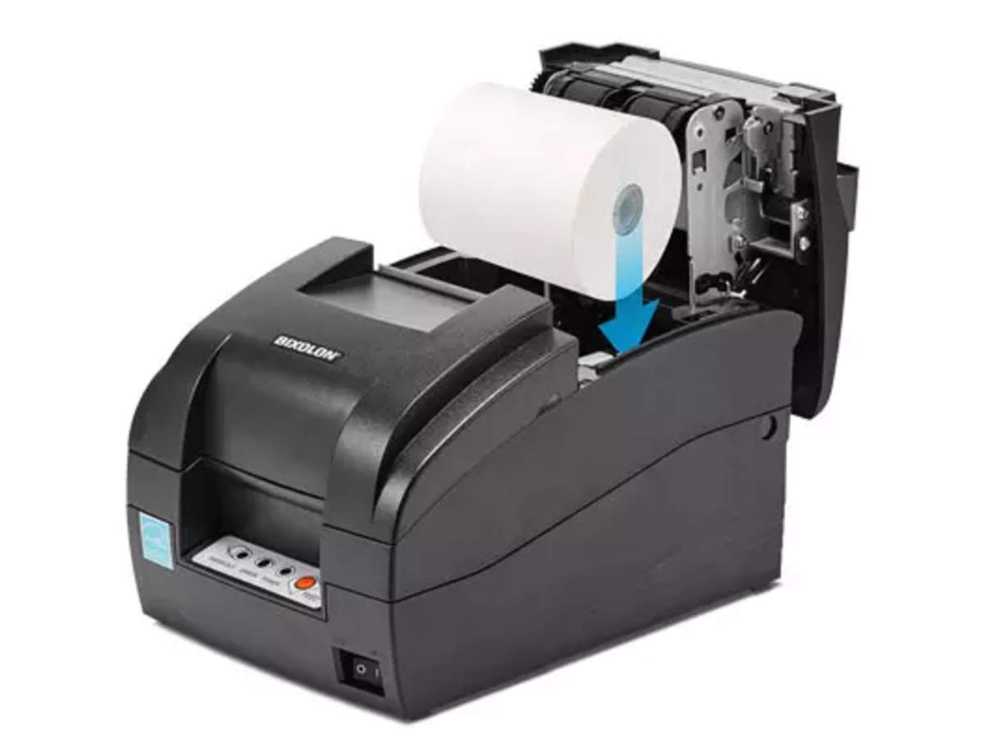
Epson dot matrix printer
Hewlett-Packard 9862A calculator plotter
POS receipt dot matrix printer

Slide 34
Can you remember what these initialisms stand for?
DTP
POS
ZINK
CRT
VGA
DVI
HDMI
cd/m2
TFT
LCD
OLED
AMOLED

Slide 35
Check your answers
DTP - desktop publishing
POS - Point of Sale
ZINK – zero ink
CRT - Cathode Ray Tube
VGA – video graphics adapter
DVI – digital video interface
HDMI - High-Definition Multimedia Interface
cd/m2 - candela per square meter
TFT - thin film transistor
LCD - liquid crystal display
OLED - organic light-emitting diode
AMOLED – active-matrix organic light-emitting diode

Slide 36
Resources
Remacha, Infotech – Units 5, 6, 7, 8
Marks, Vocabulary Book
https://data-flair.training/blogs/input-output-devices-of-computer/
https://www.techtarget.com/whatis/definition/printer
https://www.techopedia.com/definition/1268/imagesetter
https://www.91mobiles.com/hub/lcd-vs-amoled/
https://data-flair.training/blogs/input-output-devices-of-computer/

Slide 37

Further practice on VOCABULARY
Marks, Vocabulary Book – 1.4, 1.5, 1.6, 1.8 https://www.scribd.com/document/266312924/Check-Your-English-Vocabulary-for-Computers-and-Information-Technology

Slide 38
#neverstoplearning

