Slide 1
Homework
- CV and cover letter -
Learning outcome 3

Slide 2
Assignment
Study this presentation carefully
Check all the links
Choose a job opening you want to apply for
Choose the templates you like the most
Prepare your CV and Cover letter in English
Upload it to Teams
Do it before the final deadline
Earn MAXIMUM 5 points
Pass a learning outcome

Slide 3
What is a CV?
A CV—short for the Latin phrase “curriculum vitae” meaning “course of life”—is a detailed document highlighting your professional and academic history.
CVs typically include information like work experience, achievements and awards, scholarships or grants you’ve earned, coursework, research projects and publications of your work.

Slide 4
Are CV and resume the same thing?
NO!
A resume is typically a one-page document that provides a concise overview of your previous roles, skills and details about your education.
A CV is typically a longer, more detailed document focused largely on academic coursework and research.
BUT!
A CV and resume are similar in that they’re both documents that summarize your professional history, education, skills and achievements. They’re also both documents you might provide an employer for consideration for an open position.
*In India, South Africa and Australia, the terms CV and resume are interchangeable.

Slide 5
What should I put into it?
Your CV should be:
clear, concise, complete,
and up-to-date with current
employment and
educational information.
Contact information
Academic history
Professional experience
Qualifications and skills
Awards and honors
Publications
Professional associations
Grants and fellowships
Licenses and certificates
Volunteer work
Personal information (optional)
Hobbies and interests (optional)

Slide 6
What should I leave out?
There is no need to include your photo, your salary history, the reason you left your previous position, or references in a CV submitted for jobs in the United States. References should be listed separately and given to employers upon request.
In other countries, private information like your date of birth, nationality, marital status, how many children you have, and a photograph may be required.
**The requirements for international CVs differ, and depend upon
the country to which you are applying.

Slide 7
So, how do I write it then? (1)
Personal details and contact information → This includes your full name, phone number and email address. Including your address is optional. If you do include it, only list city, state and ZIP.
Education and qualifications →Be sure to include the names of institutions and dates attended in reverse order: Ph.D., Masters, Undergraduate.
Work experience/employment history → List the company or organization, job title and dates employed starting with your most recent job. List your job duties, experience gained and achievements. Start each bullet point with an action verb to demonstrate your responsibilities.

Slide 8
So, how do I write it then? (2)
4. Skills → Include computer skills, foreign language skills, and
any other recent training that is relevant to the role applied for.
Reread the job description to highlight the most important
skills employers are looking for.
5. List honors and awards → Use this section to outline your
achievements in the field related to your application.
6. Include relevant publications and presentations → Include
relevant citations of presentations, papers, studies, books or
other publications important to your professional history.
7. List your professional associations and affiliations → This
should include the name of the organization, geographic
location or chapter and dates of active membership.

Slide 9
Hard skills vs. soft skills
Hard skills are abilities specific to the job and/or industry. Generally, these are more technical skills that you learn in school, certification programs, training materials or experience on the job.
Soft skills are abilities that can be applied in any job. Often, soft skills may be referred to as “people skills” or “social skills”.

Slide 10
Important Programming Skills Employers Value
https://bootcamp.du.edu/blog/programming-skills/
https://www.simplilearn.com/essential-programmer-skills-article
https://www.springboard.com/blog/software-engineering/programming-skills/

Slide 11
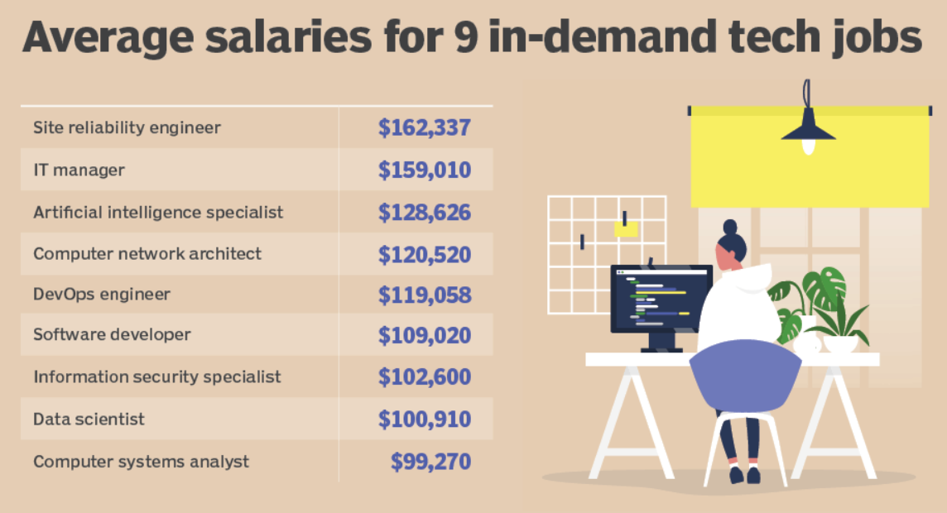
https://www.techtarget.com/whatis/feature/Top-8-most-in-demand-IT-tech-jobs

Slide 12
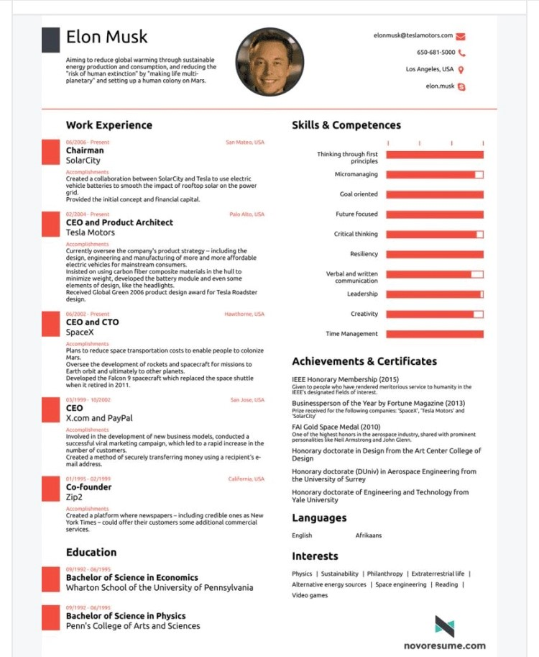
What would Elon Musk put into his CV?

Slide 13
Templates!
https://templates.office.com/en-us/modern-chronological-resume-tm16402488
https://www.totaljobs.com/advice/graduate-cv-template
https://novoresume.com/

Slide 14
What is a Cover letter?
A cover letter is a document you send with your CV, that
provides additional information about skills and experiences
related to the job you are applying to.
A cover letter is important because it explains details on your CV in more depth and is the first impression a hiring manager has of you.
Employers use cover letters to narrow down the applicant pool and choose the group of candidates they want to interview.

Slide 15
Types of cover letters
Application cover letter → The most common type of cover letter and is used to apply for a job.
Referral cover letter → Used when applying for a job but mentions the name of a current employee who referred you to the open position.
Letter of interest → A cover letter used to inquire about job openings at a company you want to work at.
Value proposition letter → A summary that explains what makes you unique, such as your skills, accomplishments and the value you can add to a company.

Slide 16
Which one do I have to write?
Application cover letter

Slide 17
How do I do that?
Don't simply repeat what's on your CV. Instead, include details on why you're a strong match for the employer's job requirements.
Think of your cover letter as a sales pitch that will market your credentials and help you get the interview.

Slide 18
Cover letter writing guidelines
Heading
Salutation
Introduction
Body of the Letter
Closing
Signature

Slide 19
What NOT to include in a Cover letter
It's not helpful to include personal information or mention how you left your last job. Stay focused on the job at hand and your qualifications for it.
Never include salary requirements unless the employer specifically requests that you do. Even then, be careful how you respond!

Slide 20
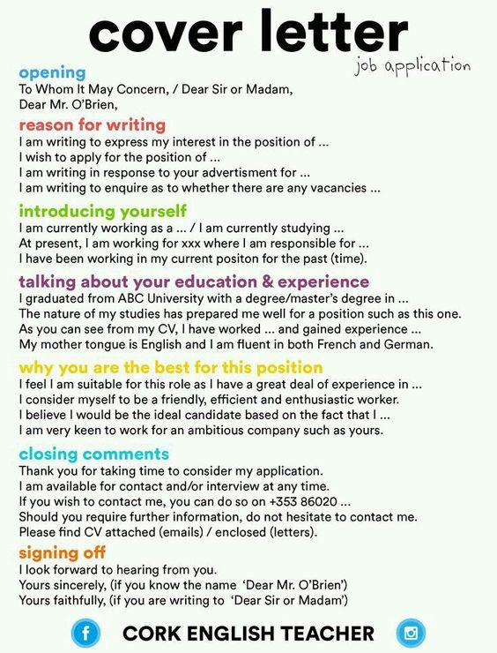
Help

Slide 21
Templates!
https://www.themuse.com/advice/how-to-write-cover-letters-for-internship-example
https://www.thebalancecareers.com/cover-letter-template-2060213
https://www.jobseeker.com/en/cover-letter

Slide 22
Do I have to do this?
Yes, if you want to pass this course☺

Slide 23
Now, choose a job opening:
CHECK CURRENT JOB OPENINGS!
Feel free to find any suitable programmer job opening, but do not forget to upolad it together with your assignment! I cannot grade your work unless I know which job opening you are applying for!
Check these sites:
https://www.glassdoor.com/Job/programmer-jobs-SRCH_KO0,10.htm
https://www.linkedin.com/jobs/programmer-jobs/?currentJobId=3749037126

Slide 24
Do I send this assignment to the teacher via email?
NO!
You UPLOAD your 3 documents to MS TEAMS – BUSINESS LETTER
Only word and pdf files are acceptable!
Minimum number of words in total (CV & Cover Letter) – 1000!
ATTENTION! → Assignments which are not uploaded in the above mentioned way or are uploaded after the deadline
WILL NOT BE TAKEN INTO CONSIDERATION!

Slide 25
What’s the deadline?
January 06th , 2024
till midnight (23:59☺).

Slide 26
Can I use AI?
Sure! However, please be aware that your work is going to be checked through an ANTI-PLAGIARISM SOFTWARE that recognizes copy-pasted content and AI- generated content.
In case the results show more than 30% of your content was copied/AI generated – your grade is 0 ☹.

Slide 27
Marking criteria
Mark | Descriptor | Marking criteria
92.01-100% | Excellent (4.51- 5pts) | The form and content of the writing is of excellent quality. The assignment has a clear structure with all sections and subsections in a predefined order. The student has demonstrated an excellent understanding of the key concepts and issues of the assignment. The writing has a highly cohesive and coherent structure. The correct use of language and subject-specific terminology is used very confidently in the whole assignment.
75.01-92% | Very Good (3.76 – 4.50pts) | The form and content of the writing is of a very good quality. The assignment has a clear structure with almost all sections and subsections in a predefined order. The student has demonstrated a very good understanding of the key concepts and issues of the assignment. The writing has a cohesive and coherent structure. The correct use of language and subject-specific terminology is consistently demonstrated in most of the written work.

Slide 28
Marking criteria
Mark | Descriptor | Marking criteria
58.01-75% | Good (3.01 – 3.75pts) | The form and content of the writing is of a good quality. The assignment has a clear structure with most of the sections and subsections in a predifined order. The student has demonstrated a good understanding of the key concepts and issues of the assignment. The writing is of a good standard. The use of language and subject-specific terminology is demonstrated in most of the written work.
50,01-58% | Pass (2.51 – 3pts) | The form and content of the writing is of a good quality. The assignment has a clear structure with some of the sections and subsections in a predifined order. The student has demonstrated some understanding of the concepts and issues of the assignment. The writing is of a good standard. The use of language and subject-specific terminology is of an adequate standard in most of the written work.
1--50% | Fail (0-2.50pts) | The work is not of a satisfactory standard in either what it sets out to express or in how it expresses it. The assignment does not have a clear structure. The student has not demonstrated any understanding of the concepts and issues of the assignment. The writing is deficient or lacking in a number of ways, i.e. key concepts not being identified and/or addressed; ideas being poorly formulated. The use of language is not satisfactory.

Slide 29
How many points do I get?
CV = maximum 2 points
Cover letter = maximum 3 points

Slide 30
How do I lose points for the CV?
-0.25 pts for the wrong chronological order for both academic history and professional
experience (if you write it from oldest to newest instead of the other way around!)
-0.50 pts for not including your high school or Algebra UC in your academic history
-0.25 pts for all untranslated names of schools/firms
-0.25 pts if no skills are specified
-0.50 pts for incorrect grammar and spelling (in the entire CV)
1 point is given for full descriptions of all jobs;
0.75 pts if they are partially described (75-99% of jobs)
0.50 pts (from 50-74% of jobs)
0.25 pts (from 0.25-49% of jobs) and
0 ptsc (0-24% of jobs decribed).

Slide 31
How do I lose points for the cover letter?
If your cover letter is AI-generated by more than 35%, it will not be graded!
If the information in the cover letter contains 50% or more of the same information as in the CV, it will not be graded!
-1 point if you do not state the reason why you want to work at the company and position you are appling for
-1 point if it is not clear which ad you are responding to
-0.25 pts for all untranslated names of schools/firms
-0.50 pts for incorrect grammar and spelling (in the entire cover letter)

Slide 32
Resources - CV
https://www.thebalancecareers.com/cv-samples-and-writing-tips-2060349
https://www.indeed.com/career-advice/resumes-cover-letters/what-is-a-cv
https://www.indeed.com/career-advice/resumes-cover-letters/how-to-write-a-cv
https://www.indeed.com/career-advice/resumes-cover-letters/best-resume-skills
https://www.indeed.com/career-advice/resumes-cover-letters/action-verbs-to-make-your-resume-stand-out

Slide 33
Resources – Cover letter
https://www.indeed.com/career-advice/resumes-cover-letters/what-is-a-cover-letter
https://www.thebalancecareers.com/get-your-cover-letter-noticed-2060153
https://www.thebalancecareers.com/cover-letter-salutation-2060313
https://www.thebalancecareers.com/cover-letter-opening-sentences-examples-2061030
https://www.thebalancecareers.com/what-to-include-in-the-body-section-of-a-cover-letter-2060306
https://www.thebalancecareers.com/formal-letter-closing-examples-2062307

Slide 34
#neverstoplearning

