Slide 1
ENGLISH FOR IT Week 6 VOCABULARY Basic software – the operating system

Slide 2
Today you will:
Learn about the function of the operating system
Revise some features of graphical user interface (GUI)
Learn the vocabulary related to reinstalling OS
Compare and discuss Mobile OS
Compare and discuss open source and proprietary software

Slide 3
The Operating System

Slide 4
In pairs, discuss these questions
What operating systems can you name? What versions of these operating systems do you know?
Which operating systems do you use most often?
Which is your favourite? Why?
Have you ever installed an operating system by yourself? Was it easy or difficult?

Slide 6
Check your answers
(1) software
(2) system software
(3) application software
(4) operating system

Slide 7
Notes:
B user-friendly, accessible, intuitive, graphics-based

Slide 8
Check your answers
Text-based.
The Macintosh was the first computer that used a mouse and a GUI (graphical user interface).
WIMP stands for windows, icons, menus and pointer.
By double-clicking the program icon or a document icon.
Running several programs and doing various tasks at the same time.
Unix.
Open-source software like Linux is freely distributed – i.e. you can copy, change and redistribute its code.
Windows Mobile.

Slide 9
GUI (graphical user interface)

Slide 11
Check your answers

Slide 12
Discuss in pairs or groups
Compare the Mac OS user interface with a Windows interface. What are the similarities and differences? Which features do you prefer from each interface?
Find out more here:
https://www.pcmag.com/news/macos-vs-windows-which-os-really-is-the-best

Slide 13
Reinstalling an Operating System

Slide 14
Reinstalling an OS

Slide 15
Check your answers

Slide 17
Check your answers

Slide 18
Mobile OS

Slide 19
What Is Apple iOS?
Apple iOS is the operating system for iPhone, iPad, and other Apple mobile devices. Based on Mac OS, the operating system which runs Apple’s line of Mac desktop and laptop computers, Apple iOS is designed for easy, seamless networking between a range of Apple products.
https://www.investopedia.com/terms/a/apple-ios.asp
What Is the Android Operating System?
The Android operating system is a mobile operating system that was developed by Google to be used for touchscreen devices, cell phones, tablets, smart TVs, wristwatches etc. Its design lets users manipulate the mobile devices intuitively, with finger movements that mirror common motions, such as pinching, swiping, and tapping. https://www.investopedia.com/terms/a/android-operating-system.asp

Slide 20
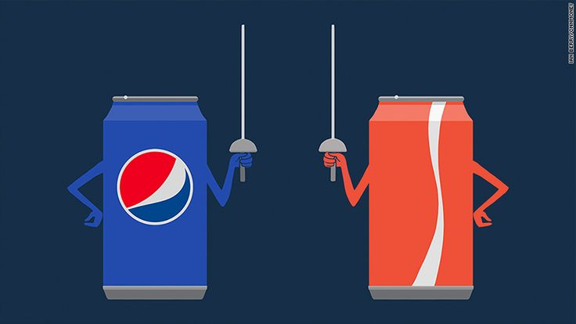
Do you know?
How is the battle between Android and Apple similar to the “Cola wars”?
Find the PDF file Mobile Operating systems on IE, read the text, discuss it as a group and answer the follow-up questions.

Slide 21
Open source vs proprietary software

Slide 22
Open source vs. proprietary software

Slide 23
Check your answers

Slide 24
Read this web article about open source software

Slide 25
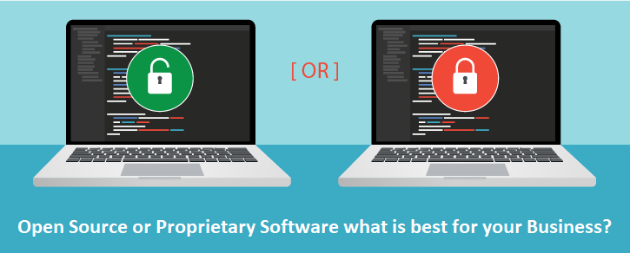

Slide 26
Check your answers The PROs of proprietary and open source software
Proprietary software | Open source software
cheaper training and free support better quality: more features, better looking, fewer bugs (because they pay their developers) more applications available | free freedom/independence from the vendor can add features have control over data
Notes:
Extra activity: Make a list of CONs for Proprietary and Open Source software in groups. Compare PROs and CONs and decide which type of software is better.

Slide 27
What do you know about Linux history?
What is the Kernel?
Read the text and find out.
Then complete it with the missing articles a/an/the or no article.

Slide 28
Resources:
Remacha, Infotech – Unit 13 (pp 63,64,65,67) https://www.academia.edu/28436822/Infotech_english_for_computer_users_Students_Book_4th_Edition
Hill, English for Information Technology 2. Pearson Education ELS - Unit 2 – IT Systems (pp 18,19), https://pdfcoffee.com/qdownload/english-for-information-technology-2-10-pdf-free.html
https://www.pcmag.com/news/macos-vs-windows-which-os-really-is-the-best
https://www.investopedia.com/terms/a/apple-ios.asp
https://www.investopedia.com/terms/a/android-operating-system.asp

Slide 29
#neverstoplearning

