Slide 1
ENGLISH FOR IT
Weeks 12 VOCABULARY
Collectives of Cyberspace

Slide 2
In this lesson, you will:
Recognize basic features of the Web
Use collocations related to the Web and the Internet
Acquire vocabulary related to the Web, e-commerce and online banking

Slide 4
Read the article on page 85 of your Infotech textbook

Slide 5
Check your answers

Slide 9
Check your answers

Slide 11
Check your answers

Slide 12


Slide 15
Check your answers

Slide 18
Check your answers

Slide 19
E-commerce
Read this magazine article about Dalya’s job. What are 3 parts of an e-commerce system? Which does Dalya find most difficult to set up?

Slide 22
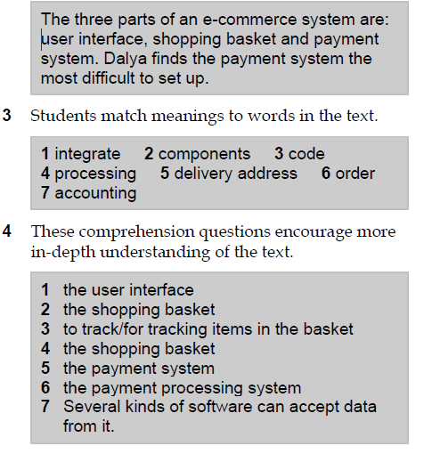
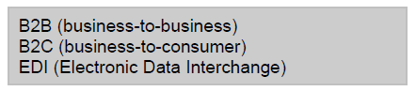
Check your answers

Slide 23
More vocabulary practice
3.4 Things on the net (p 54);
3.5 Internet terms (p 55);
3.6 e-commerce (p 56)

Slide 24
Resources:
Remacha, Infotech –Unit 17 (pp 84-88) https://www.academia.edu/28436822/Infotech_english_for_computer_users_Students_Book_4th_Edition
Pearson – Unit 6 – Interactions (pp 48-49)
Marks: Vocabulary Book –3.4 Things on the net (p 54); 3.5 Internet terms (p 55); 3.6 e-commerce (p 56)

Slide 25
#neverstoplearning

