Slide 1
ENGLISH FOR IT
Week 14 VOCABULARY
Video conferencing, chat and netiquette

Slide 2
In this lesson, you will:
Learn and use vocabulary related to video conferencing and online chatting
Practice second conditional in the context of video conferencing
Learn about netiquette
Learn and use abbreviations in online chats

Slide 5
Video call vs video conference
Videotelephony (also known as video conferencing, video teleconferencing, or simply video call) is the two-way or multipoint reception and transmission of audio and video signals by people in different locations for real-time communication.
A videophone is a telephone with a video camera and video display, capable of simultaneous video and audio communication. Video conferencing implies the use of this technology for a group or organizational meeting rather than for individuals, in a videoconference.

Slide 6
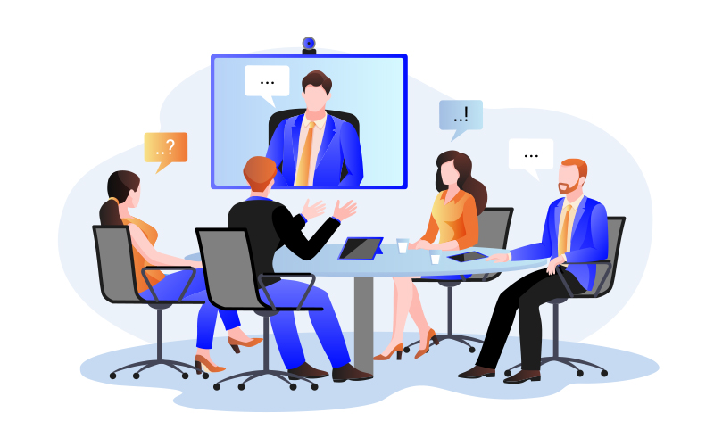

2 types of video conferencing

Slide 8
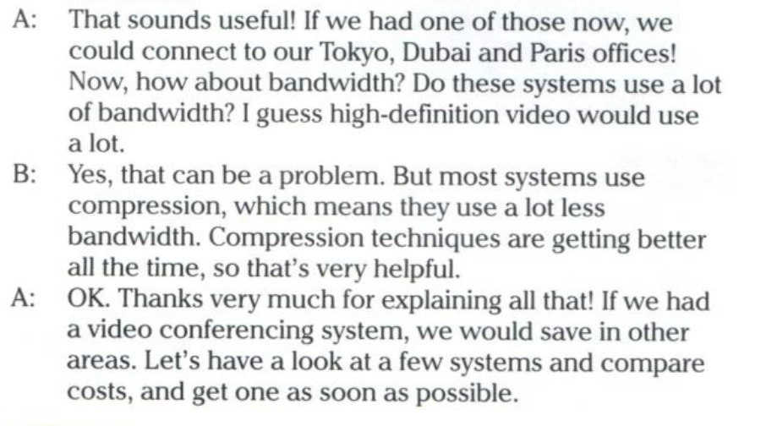

Slide 11
Answer key
Slide 6 | dedicated systems and desktop systems
Slide 7 | 1 dedicated system 2 remote control 3 MCU 4 (data) compression
Side 9 | more than two / more than one / more expensive / special room / HD monitors, video cameras, remote controls, MCU
Slide 10 | 2 maintenance would be expensive / 3 data wouldn’t transfer quickly enough; there wouldn’t be enough bandwidth; video wouldn’t transfer properly / 4 video conferencing would only work with two locations / 5 people wouldn’t know how to use the system properly / 6 there would be nowhere to go for the video conference; would have to hire a room each time/ 7 data would use too much bandwidth; bandwidth charges would be high

Slide 13
Suggested answers
1 If a deaf person used video conferencing facilities, they’ d be able to use sign language/do things that they wouldn’t be able to do by telephone.
2 If a child used video conferencing facilities, they’d be able to study from home/wouldn’t have to go to boarding school/live at school.
3 If doctors working in a small hospital a long way from the city used video conferencing facilities, they’d be able to communicate with doctors in the city more easily.
4 If a company director who doesn’t have time to visit clients overseas used video conferencing facilities, she’d be able to communicate with her clients more easily.

Slide 14
Let’s watch some videos and discuss
A Video Conference Call in Real Life
https://www.youtube.com/watch?v=JMOOG7rWTPg
Netiquette - The Dos and Don'ts of Online Meetings
https://www.youtube.com/watch?v=d-_wYdG873M

Slide 15
What is netiquette?
Study the Netiquette code here:
https://www.britannica.com/topic/netiquette

Slide 16
After reading the britannica.com entry, summarize in pairs what makes a good netiquette
Lurking
Reading the FAQs
Remember the Human
Avoid Flames
Avoid Shouting
Not a Homework Center
Composition Protocols

Slide 20
Resources:
Remacha, Infotech –Unit 18 (pp 91-92) https://www.academia.edu/28436822/Infotech_english_for_computer_users_Students_Book_4th_Edition
Pearson – Unit 6 – Interactions (pp 46-47)
https://www.youtube.com/watch?v=JMOOG7rWTPg
https://www.youtube.com/watch?v=d-_wYdG873M
https://www.britannica.com/topic/netiquette

Slide 21
#neverstoplearning

