Slide 1
Azure DevOps

Slide 2
Today's Agenda
What is DevOps Culture?
Azure DevOps Platform Overview
Git & Azure Repos Workflow
CI/CD with Azure Pipelines
Practical: Interference Tool Project

Slide 3
What is DevOps?
DevOps = Development + Operations
Culture: Developers & operators work together
Process: Automation at every step
Tools: Version control, CI/CD, monitoring

Slide 4
Links
https://dev.azure.com/IITTeam1/
https://dev.azure.com/IITTeam2
…
choose-process
devops/get-started/
learn.microsoft.com

Slide 5
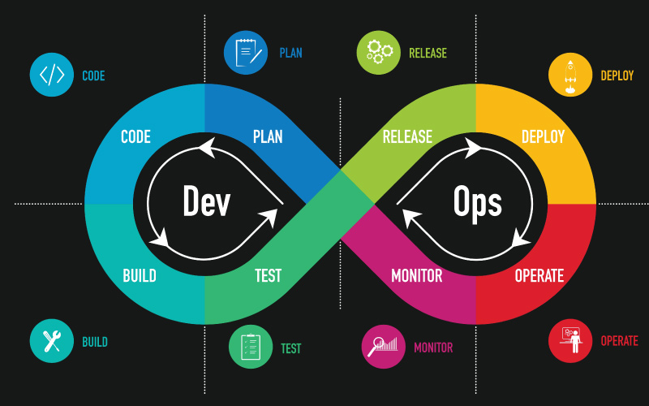
DevOps Lifecycle
The DevOps lifecycle or DevOps roadmap consists of six stages:
A. Continuous development
B. Continuous testing
C. Continuous integration
D. Continuous deployment
E. Continuous monitoring
F. Continuous feedback

Slide 6
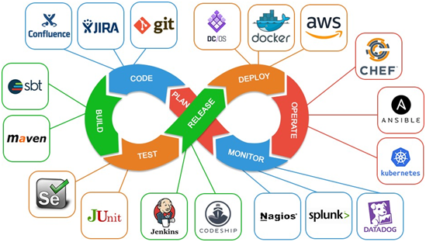
DevOps Lifecycle

Slide 7
Azure DevOps Services
Azure Repos > Git version control
Azure Pipelines > CI/CD automation
Azure Boards > Project management
Azure Test Plans > Test management

Slide 8
CI/CD: The Heart of DevOps
CI = Continuous Integration
•Every commit is automatically built
•Tests run immediately
•Problems detected early
CD = Continuous Deployment/Delivery
•Automatically deploy to production
•Or always ready for deployment

Slide 9
User Stories
US-01: Import Clean Signal
  Opis: Kao korisnik želim učitati CSV datoteku s 'clean signal' podacima kako bih vidio graf.
  Acceptance Criteria: Aplikacija mora parsirati Start/Stop frekvencije iz CSV-a.
US-02: Inject Interference
  Opis: Kao korisnik želim odabrati "Round Robin" strategiju injektiranja smetnji.
  Acceptance Criteria: Rezultirajući signal mora biti zbroj mW vrijednosti originala i smetnje.
US-03: Export Data
  Opis: Želim eksportirati modificirani signal u CSV formatu.

Slide 10
DevOps Best Practices
•Automate everything possible
•Commit code frequently (daily)
•Keep builds fast (< 10 minutes)
•Test thoroughly before production
•Document architecture decisions

Slide 11
Key Takeaways
•Automate everything possible
•Commit code frequently (daily)
•Keep builds fast (< 10 minutes)
•Test thoroughly before production
•Document architecture decisions

Slide 12
Hvala na pažnji!

