Slide 1
Satellite Communication Systems

Slide 2
About the module / internship

Slide 3

This module / internship introduces students to the basics of satellite communication systems, and their use in different areas
The main objectives of the module are:
1
Become familiar with satellite communication systems
2
Become familiar with elements and principles of satellite communication systems
3
Become familiar with standards in satellite communications
4
Become familiar with the specifics of project management in satellite communications
5
Develop basic practical skills for solving tasks related to satellite communication systems

Slide 4
After this module / internship students will be able to understand satellite communication systems and solve related problems
Learning outcomes:
1
List the areas of application of satellite communication systems
2
List the segments of satellite communication systems
3
Solve problems from satellite communication systems by applying a specific programming language.
4
List project management phases in satellite communication systems
5
State the reasons behind standardization in satellite communication systems

Slide 5


The focus is on solving task related to monitoring satellite communication systems
Module evaluation is based on solving tasks in available software packages and developing simple solutions in the development environment.
Deadline to deliver working application is by the June 12, 2026.
There is no exam, but we will have pub quizzes (with rewards).
Students will face challenge solving real world problem:
Your task is to develop a signal processing application called the Interference Injection Tool.
This tool will overlay interference over clean signal data, allowing users to visualize, modify and analyze the interfered signal.
You will manage the entire project lifecycle, from planning and development to testing, documentation, and presentation.

Slide 6

To be able to solve the problem (develop the tool) you will also need to understand some theory of satellite communication and radio frequency signals
Theoretical materials will be given and presented to students.
It is expected that certain areas are investigated by the students and help / guidance will be provided by lecturers / mentors.
1
Introduction
9
ELM waves propagation
2
Satellite basics
10
RF bands
3
Atmosphere
11
Link budget and design
4
Orbits
12
Satellite signal processing
5
Application
13
Monitoring satellite communication systems
6
Satellite communication services
14
Future trends
7
Space segment
15
Standards
8
Ground segment
16
Space project management

Slide 7
Lecturers / Mentors

Slide 8
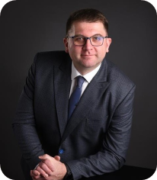

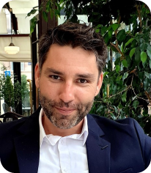
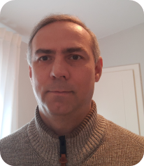
Krunoslav Franić
I am an experienced solutions manager with expertise in Program Management, Software Engineering and Project Management. I have a strong understanding of Software Development Lifecycle (SDLC) concepts and methodology .
https://www.linkedin.com/in/krunoslav-frani%C4%87-2a855251/
Igor Šarić
Igor has finished Faculty of Electrical Engineering and Computing, University of Zagreb, in 2020. In the same year he joined Eviden GDC where he is working as a software engineer on projects like eDoc and eHZZO.
Ivan Župan
Over 20 years of experience in system integration, and technical leadership with global companies like Siemens and Atos.
Expertise in systems virtualization, interoperability, and software/hardware integration.
Skilled in leading cross-functional teams, mentoring, and delivering high-quality technical solutions.
Tvrtko Pavić
Tvrtko has 20+ years of experience working with private and public sector clients on more than 50 projects. He holds multiple certifications in portfolio, program & project management, business analysis and business process management.
https://www.linkedin.com/in/tvrtko-pavic-6b0b566/

Slide 9
Thank you

