Slide 1
Satellite Communication Systems

Slide 2
01 Introduction

Slide 3
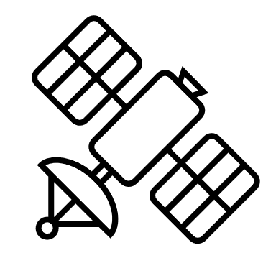

Satellite communication is the use of artificial satellites to provide communication links between various points on Earth
If the communication takes place between any two earth stations through a satellite, then it is called a satellite communication. In this communication, electromagnetic waves are used as carrier signals. These signals carry the information such as voice, audio, video or any other data between ground and space and vice-versa.
The process of satellite communication begins at an earth station. Here, an installation is designed to transmit and receive signals from a satellite in an orbit around the earth. Earth stations send the information to satellites in the form of high powered, high frequency signals.
The satellites receive and retransmit the signals back to earth where they are received by other earth stations in the coverage area of the satellite. Satellite's footprint is the area which receives a signal of useful strength from the satellite.
Diagram of a one-way communication satellite network
Satellite
Uplink
Downlink
Ground station
Ground station

Slide 4
Today, satellite communication services are used every day
Many hundreds of satellites have been launched for a wide range of different purposes including
There are three types of communication services that satellites provide
Scientific satellites
Scientific satellites provide space-based platforms to carry out fundamental research about the world we live in, our near and far space
Telecommunications
Telecommunication services include telephone calls and services provided to telephone companies, as well as wireless, mobile, and cellular network providers.
Earth observation
Earth Observation (EO) is the process of gathering information about the Earth’s surface, waters and atmosphere via ground-based, airborne and/or satellite remote sensing platforms
Broadcasting
Broadcasting services include radio and television delivered directly to the consumer and mobile broadcasting services.
Military surveillance
Military satellites are an essential component of modern warfare, providing crucial intelligence, communication, and surveillance capabilities to military forces
Data
With the growth of the Internet, a significant amount of Internet traffic goes through satellites, making ISPs one of the largest customers for satellite services.
Communications (civil and military)
Satellite communication is the use of artificial satellites to provide communication links between various points on Earth
Navigation
Global Navigation Satellite System (GNSS) refers to any satellite constellation that provides global positioning, navigation, and timing services

Slide 5
The space era started in 1957 with the launching of the first artificial satellite (Sputnik)
October 4, 1957.
USSR launched Sputnik 1
1965.
COMSAT’s EARLY BIRD: 1st commercial communications satellite
April 4, 1990.
Hubble Space Telescope launched
2003.
Eutelsat Launches e-BIRD, Designed for Internet Broadband
2024.
CroCube satellite launched
August 12, 1960.
Echo satellite launched
1969.
INTELSAT-III series provides global coverage
December 18, 1958.
USA launched SCORE – the first communication satellite
April 23, 1965.
Molniya 1 was launched. By 1967 six Molniya satellites provided coverage throughout the Soviet Union
1994.
The first global positioning system constellation becomes operational. It consists of 24 geosynchronous satellites
2004.
Private space race begins.
1962
Communications Satellite Act (U.S.)
1976.
MARISAT: 1st mobile communications satellite
* A Selective Communications Satellite Chronology

Slide 6
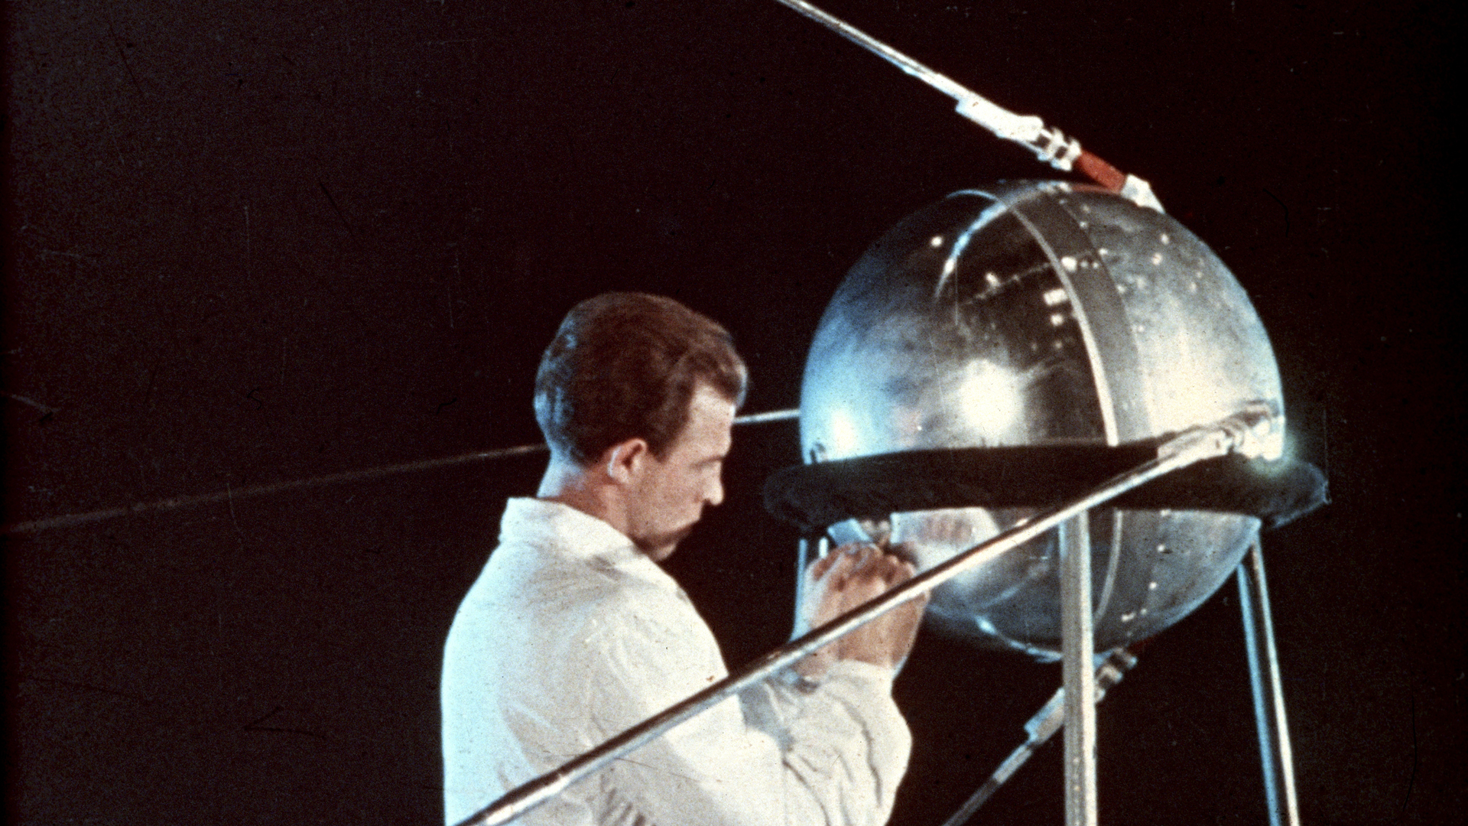
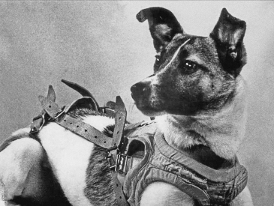
The launch of Sputnik-1 marked the start of the space age and the US - USSR space race
Name:
Russian: Спутник-1
The word 'Sputnik' originally meant 'fellow traveler,' but has become synonymous with 'satellite.'
Launching site:
Sputnik 1, launched on 4 October 1957 from the Soviet Union's rocket testing facility in the desert near Tyuratam in the Kazakh Republic (Baikonur Cosmodrome Site).
Technical characteristics:
58 cm in diameter
Weight 83.6 kg
about 98 minutes to orbit the Earth on its elliptical path
Source: https://www.esa.int/ESA_Multimedia/Images/2017/10/Sputnik-1_preparation
Sputnik-2 launched on November 3, 1957, was the second spacecraft into Earth orbit, and the first to carry an animal into orbit – dog named Laika
Source:
https://en.wikipedia.org/wiki/Laika

Slide 7
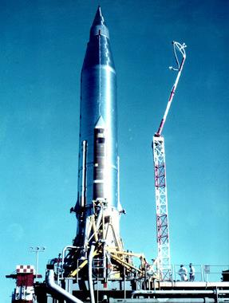
SCORE (Signal Communications by Orbiting Relay Equipment) was the world's first purpose-built communications satellite
SCORE provided:
The first broadcast of a human voice from space (recorded message):
“This is the President of the United States speaking. Through the marvels of scientific advance, my voice is coming to you from a satellite circling in outer space. My message is a simple one. Through this unique means, I convey to you and to all mankind America’s wish for peace on Earth and goodwill toward men everywhere.”
https://en.wikipedia.org/wiki/File:SCORE_Audio.ogg
Launching site:
Launch Complex 11 (LC-11) at Cape Canaveral Space Force Station
Technical characteristics:
24.3 meters long and 3.1 meters diameter Atlas missile used as a platform for the communications relay experiment
The tracking beacon operated at 108 MHz
The Atlas B on the launch pad. The SCORE communication package was housed in the rocket’s fairing pods.
Source:
https://appel.nasa.gov/2015/12/03/this-month-in-nasa-history-the-u-s-scored-in-the-race-to-space/

Slide 8
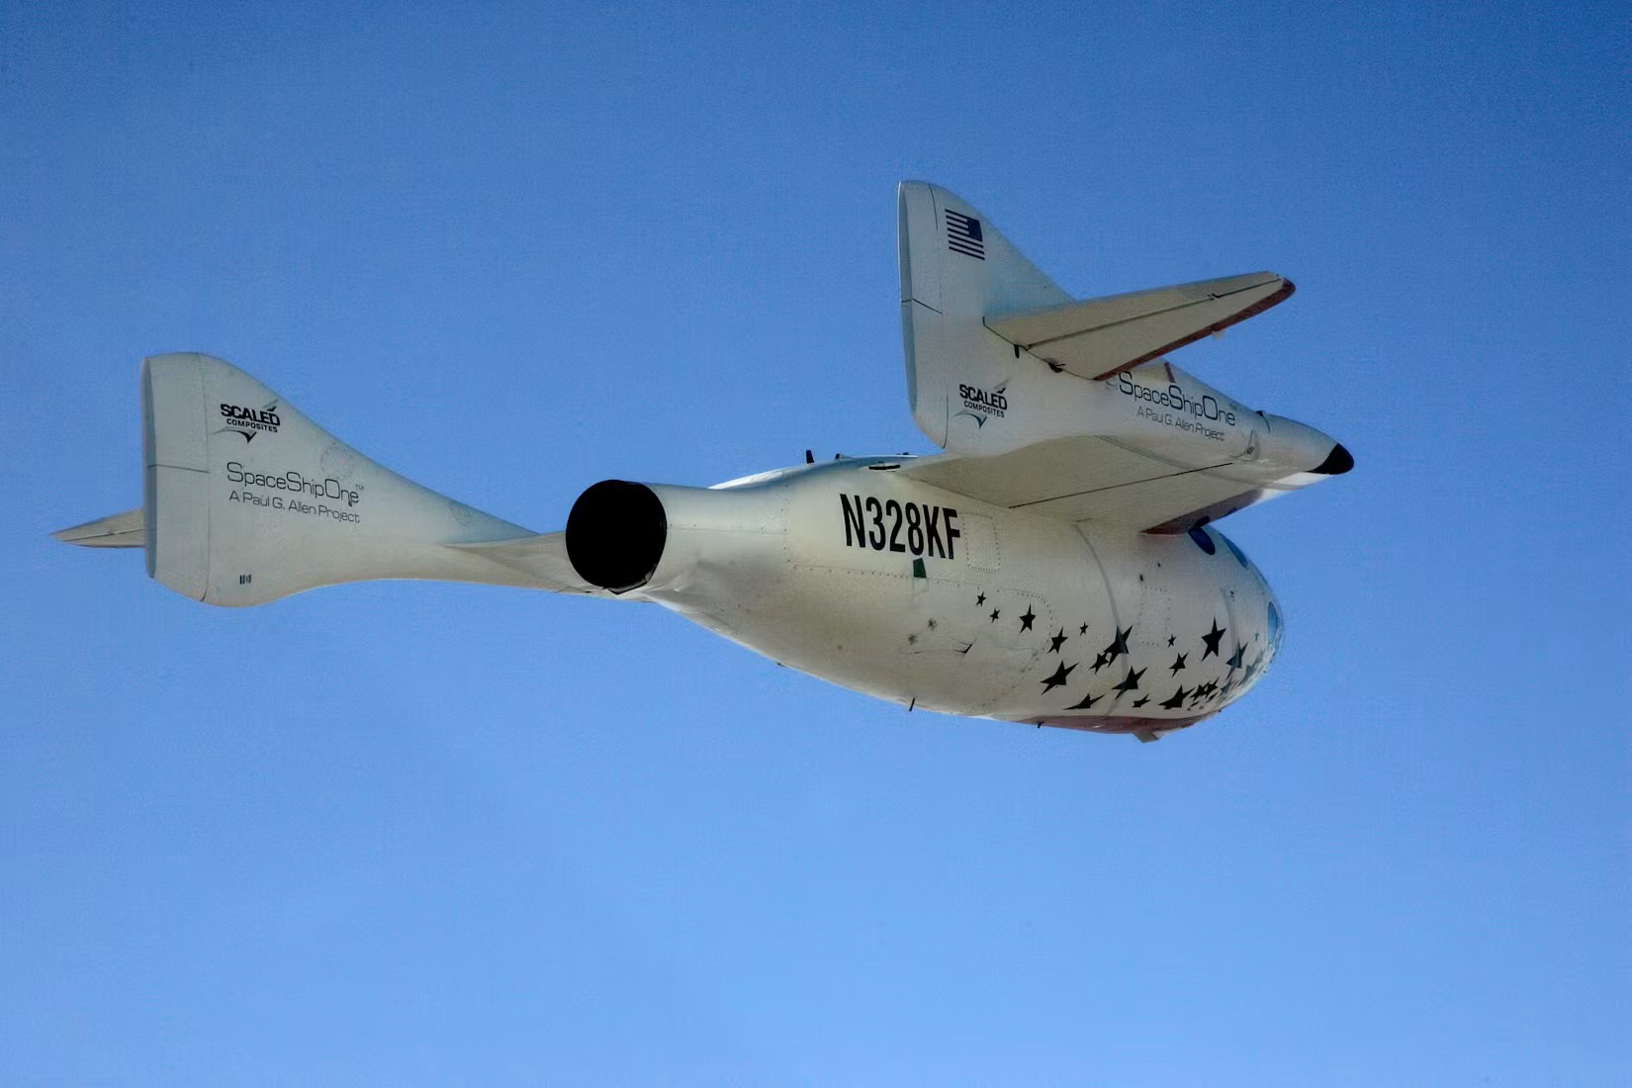
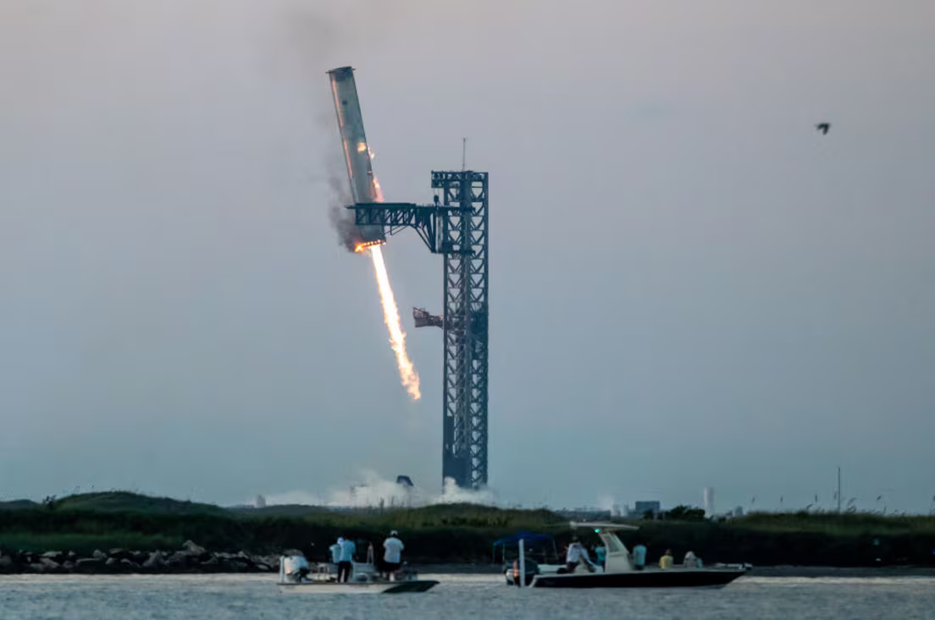
A new spaceflight era was sparked by the launch of SpaceShipOne, the first private sub-orbital spacecraft ever
Today, we can speak about the billionaire space race - is the rivalry among entrepreneurs who have entered the space industry:
Jeff Bezos's Blue Origin
Richard Branson's Virgin Group
Elon Musk's SpaceX
Video:
https://youtu.be/RYUr-5PYA7s?si=78azX6QksrELb3xN
SpaceShipOne ascending on June 21, 2004 in Mojave, California.
Source:
20 Years Ago, One Moment Changed Spaceflight Forever
SpaceX's mega rocket booster returns to the launch pad, where it was captured by metal arms during a test flight.
Source:
Launch tower's 'chopsticks' catch descending rocket booster as SpaceX launches Starship | CBC News

Slide 9
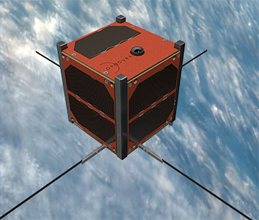
CroCube is a mission to build, test and launch the first Croatian nano satellite, from the CubeSat category of small satellites.
About:
CroCube is equipped with a camera and two radio transmitters. Its mission is to photograph the Earth's surface from an altitude of 550 km, and it will have the opportunity to photograph Croatia 3 times a day, for approximately 12 minutes.
The first message he sent to the country contained a verse by A. B. Šimić: »Čovječe, pazi da ne ideš malen ispod zvijezda. Croatia is in space!«
https://crocube.hr/
https://crocube.hr/o-misiji/crocube-satelit/
https://www.n2yo.com/satellite/?s=62394#results
Launching site:
It was launched on 21 December 2024 on the Bandwagon-2 mission on a Falcon-9 v1.2 (Block 5) rocket.
Technical characteristics:
The satellite is a 1U cube model (1U = 10 cm × 10 cm × 10 cm), with a total mass of about 1.1 kg, equipped with two cameras and an amateur radio transceiver.
CroCube.
Source:
https://space.skyrocket.de/doc_sdat/crocube.htm

Slide 10
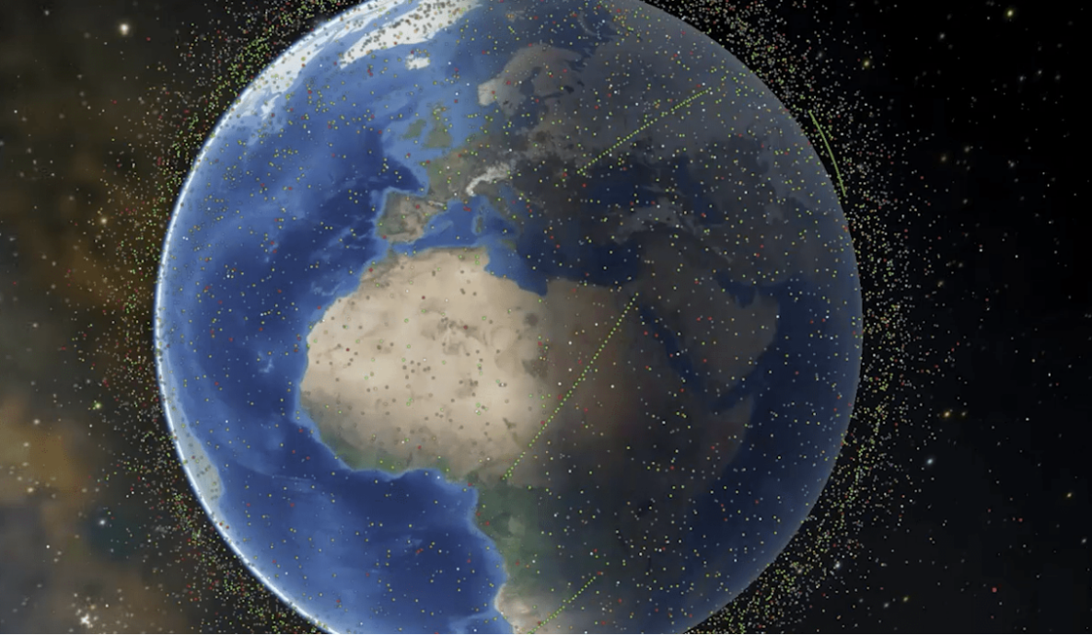
Today, there are more than 12000 active satellites in Earth’s orbit
In-orbit satellites are registered in 95 countries or multinational organizations
By orbit:
GEO 9%
MEO 2%
LEO 88%
By mission:
Mission | Number of Satellites
Communications | >8000
Earth Observation | >1000
Technology Development | >300
Navigation | >100
Space Science | >100
Source:
How Many Satellites are in Space? - NanoAvionics
For many decades, the number of satellites being launched into space remained fairly constant. Since the first ever human-made satellite, Sputnik, entered orbit in 1957, between 50 and 100 satellites were launched into space every year. This continued until the 2010s, when the emergence of private space companies like SpaceX triggered an increase in the number of launches, which have continued to rise sharply. In 2024, a rocket was launched every 34 hours on average, putting more than 2,800 satellites into orbit.

Slide 11
Operating satellites are registered in 105 countries or multinational organizations
Country/Multinational Organization | Number of Satellites
USA | >8000
Russia | >1500
China | >800
United Kingdom | >700
Japan | >200
France | >100
India | >100
Germany | >80
Canada | >70
Italy | >50
Satellite Category | Number of Satellites
Small satellite (180-500 kg) | >4600
Minisatellite (100-180 kg) | >900
Microsatellite (10-100 kg) | >1200
Nanosatellite (1-10 kg) | >500
Nearly two-thirds (>61,5%) of active satellites fall into the small satellite category.
This domination of small satellites is relatively recent. Only 34% of the satellites launched in the 1990s fell into this category. By the 2020s, small satellites comprised 94% of all satellite launches.
The ten countries with the most operational satellites
Source:
How Many Satellites are in Space? - NanoAvionics

Slide 12
Satellite communications can provide communication capabilities spanning long distances and can operate under circumstances or conditions which are inoperable for other forms of communication
Global availability
Satellites used in satellite communications are usually in geostationary orbit. Satellite communications can provide global availability. It covers land masses and maritime areas.
Amount of data
High amount of data can be transmitted with the help of satellites.
Reliability
One of the main advantages provided by satellite communication is the superior reliability unlike other forms of communication. It does not need terrestrial infrastructure for operation. It can be helpful during times of disasters as the services rarely fail.
Signal latency
Signal latency is rare but can occur where a signal may take a few milliseconds longer to be received.
Scalability
Scalability is higher in case of satellite communications.
Interference
As with any connection, interference can occur. This is usually caused by sunspots, jamming and unusually high electro-magnetic interference.
Cost
Deployment cost is higher than most forms of communications in case of satellite communications. High cost to manufacture and launch, maintenance, signal delay and signal interference.
Energy for satellites
Limited energy for satellite / Sun collectors.
Vulnerability
As it is less vulnerable than other forms of communication, it is highly used in defense departments.

Slide 13
Thank you

