Slide 1
Satellite Communication Systems

Slide 2
02 Satellite basics

Slide 3
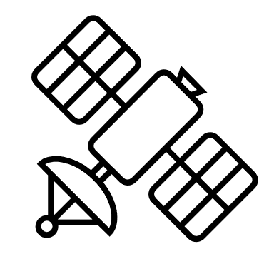

A satellite communications system can be broadly divided into two segments – a ground segment and a space segment
Space Segment
The space segment comprises the satellite or satellite constellation and the uplink and downlink satellite links
Satellite
Uplink
Downlink
Ground Segment
Ground segment refers to the collection of ground-based hardware and software components used to support the operation, communication, and control of satellites orbiting the Earth.
Ground station
Ground station

Slide 4
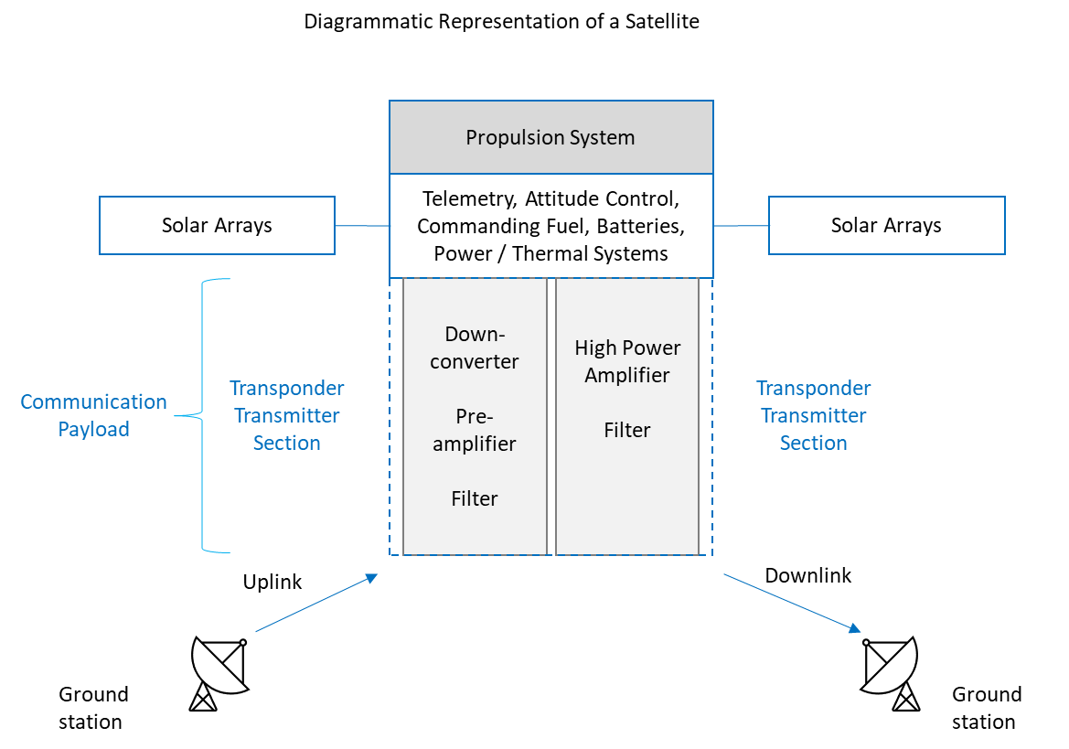
The typical satellite consists of the communications payload and the network of supporting subsystems
Payload
The payload is the reason for the satellite's existence. In a communications satellite, the payload provides the satellite with its communications capability. The payload consists of the communications antennas and several repeaters
Power
The electrical power for the satellite is generated by photovoltaic cells from sunlight and is conditioned for use by the other subsystems on the satellite.
TT&C
The Telemetry, Telecommand and Control system allows the operational staff in the satellite control center to monitor the status of the satellite and to command it into different states and configurations.
Thermal
This consists of thermal coating and insulating blankets which are used to maintain the satellite within its operating temperature range in the extreme environment of space.
AOCS
The Attitude and Orbit Control Subsystem contains sensors which monitor the satellite's orientation and which provide outputs to the Propulsion Subsystem to ensure that the satellite is pointing in the correct orientation.
Propulsion
Maintain orbital position, major attitude control corrections, orbital changes, and initial orbit deployment.
Structure
This subsystem provides mechanical support for all of the other subsystems in the satellite.

Slide 5
There are four most common types of satellites based on their application
Description
Payload
Communication
A communication satellite, usually located at GEO and equipped with a transponder — an integrated receiver and transmitter of radio signals — may receive signals from Earth and retransmit them back to the planet.
Transponder to send and receive signals; amplifiers, receivers, transmitters
Earth observation
The purpose of Earth observation type of satellites is to monitor our planet from space and report back on any changes they observe. It is possible to categorize Earth observation satellite into the following types: Weather satellites and Remote sensing satellites
Cameras, sensors, spectrometers
Navigation
The navigation system constellations are located between 20,000 and 37,000 kilometers from Earth’s surface. This type of satellite sends out signals that reveal their time, position in space
Atomic clock, signal generator
Scientific satellites
Scientific satellites are designed to conduct experiments and collect data for scientific research. These satellites are often used for astronomy, space physics, and other scientific investigations.
Telescopes, particle detectors, spectrometers, magnetometers, or other scientific instruments

Slide 6
Satellites are usually classified based on their orbital altitude which directly affects their coverage and the speed at which they travel around the planet
Orbit
Description
Low Earth orbit (LEO)
A low Earth orbit (LEO) is, as the name suggests, an orbit that is relatively close to Earth’s surface. It is normally at an altitude of less than 1000 km but could be as low as 160 km above Earth – which is low compared to other orbits, but still very far above Earth’s surface.
Medium Earth orbit (MEO)
Medium Earth orbit comprises a wide range of orbits anywhere between LEO and GEO. It is similar to LEO in that it also does not need to take specific paths around Earth, and it is used by a variety of satellites with many different applications.
Geostationary orbit (GEO);
Satellites in geostationary orbit (GEO) circle Earth above the equator from west to east following Earth’s rotation – taking 23 hours 56 minutes and 4 seconds – by travelling at exactly the same rate as Earth. This makes satellites in GEO appear to be ‘stationary’ over a fixed position.
Polar orbit and Sun-synchronous orbit (SSO)
Satellites in polar orbits usually travel past Earth from north to south rather than from west to east, passing roughly over Earth's poles. Polar orbits are a type of low Earth orbit, as they are at low altitudes between 200 to 1000 km. Sun-synchronous orbit (SSO) is a particular kind of polar orbit. Satellites in SSO, travelling over the polar regions, are synchronous with the Sun. This means they are synchronised to always be in the same ‘fixed’ position relative to the Sun. This means that the satellite always visits the same spot at the same local time – for example, passing the city of Paris every day at noon exactly.
Transfer orbits and geostationary transfer orbit (GTO)
Transfer orbits are a special kind of orbit used to get from one orbit to another. When satellites are launched from Earth and carried to space with launch vehicles such as Ariane 5, the satellites are not always placed directly on their final orbit. Often, the satellites are instead placed on a transfer orbit: an orbit where, by using relatively little energy from built-in motors, the satellite or spacecraft can move from one orbit to another.

Slide 7
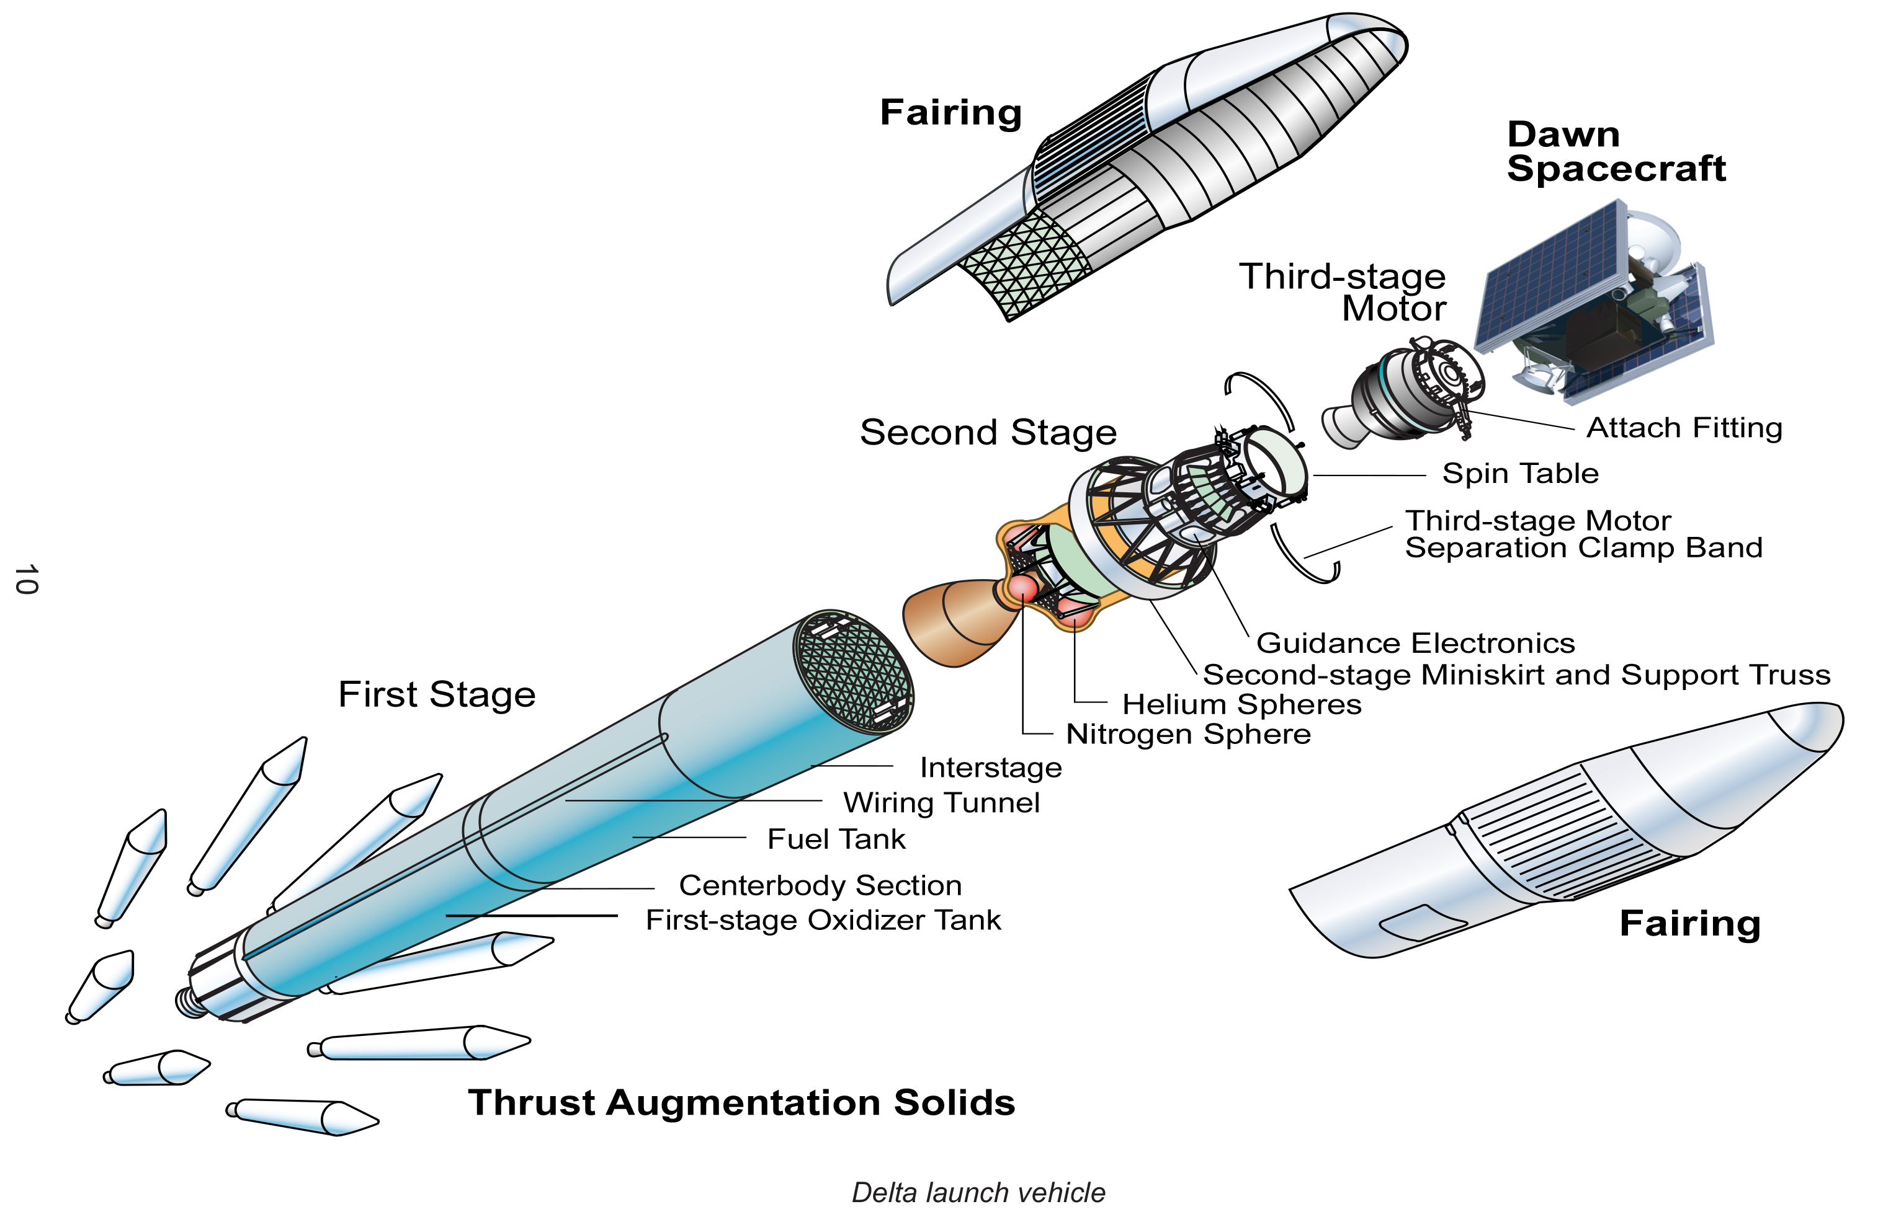
Launching a satellite into space requires a very powerful multistage rocket to propel it into the right orbit
Stage 4
Satellite gets separated from the upper stage of launch vehicle, when it has been reached to out of Earth's atmosphere. Then, the satellite will go to a “transfer orbit”. This orbit sends the satellite higher into space.
Stage 3
The third (upper) stage of the launch vehicle is connected to the satellite fairing. This fairing is a metal shield, which contains the satellite and it protects the satellite.
Stage 2
The second stage of launch vehicle contains smaller rockets. These are ignited after completion of first stage. They have their own fuel tanks in order to send the satellite into space.
Stage 1
The first stage of launch vehicle contains rockets and fuel for lifting the satellite along with launch vehicle from ground.
Source: https://science.nasa.gov/resource/dawn-launch-vehicle-diagram/

Slide 8
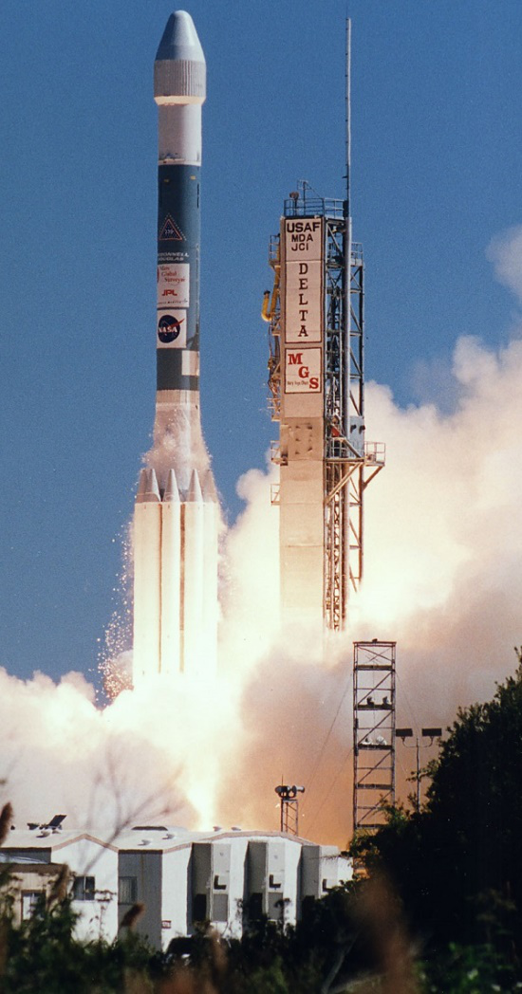
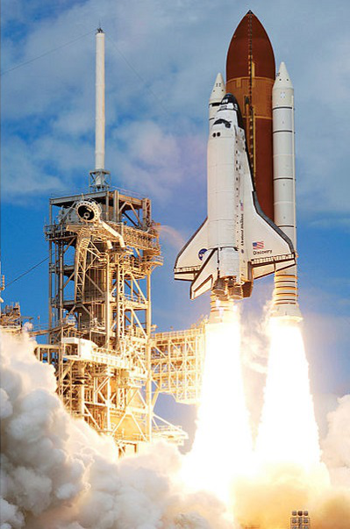
There are two types of satellite launch vehicles
Expendable Launch Vehicles (ELV)
Reusable Launch Vehicles (RLV)
Expendable launch vehicles (ELV) get destroyed after leaving the satellites in space.
The ELV contain two to three stages. First and second stages of ELV raise the satellite to an about 80 km and 160 km. Third stage of ELV places the satellite in transfer orbit. The task of ELV will be completed and its spare parts will be fallen to earth, when the satellite has reached intended orbit.
Reusable launch vehicles (RLV) can be used multiple times for launching satellites. Generally, this type of launch vehicles will return back to earth after leaving the satellite in space.
The functions of space shuttle are similar to the functions of first and second stages of ELV. Historically best known was the Space Shuttle. Satellite along with the third stage of space shuttle were mounted in the cargo bay. It was ejected from the cargo bay when the space shuttle reached to an elevation of 250 to 350 km.
Then, the third stage of space shuttle gets fired and places the satellite into a transfer orbit. After this, the space shuttle will return back to earth for reuse.
More modern examples include Space X Falcon and rockets in various stages of prototype development.

Slide 9
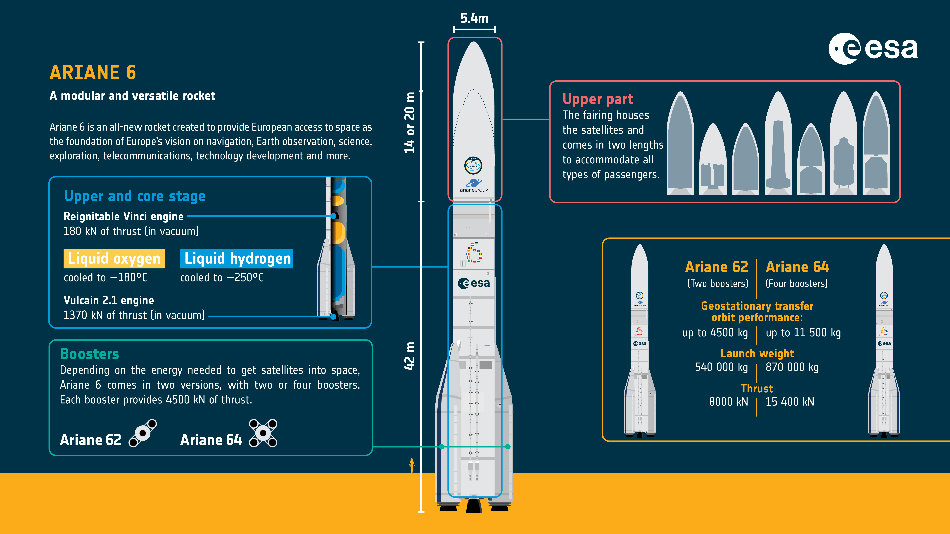
An overview of Europe's new rocket - Ariane 6
Source:
The European Space Agency - Photo: ©ESA
ESA - Ariane 6 infographic: at a glance
Notes:
An overview of Europe's new rocket Ariane 6.
Ariane 6 was designed with versatility in mind. The rocket comes in two versions and has a reignitiable upper stage to launch multiple satellites on a single flight, as well as missions that need a ‘heavy lift’ to the Moon and beyond. Payload carriers allow small satellites to piggyback on a launch providing cost-effective launch opportunities for small companies wanting to access the growing space industry.
Ariane 6 will launch several satellites, deployers and experiments from space agencies, companies, research institutes, universities and young professionals on its first flight.
Ariane 6 follows the hugely successful Ariane 5, Europe's principal rocket for more than a quarter century, flying 117 times between 1996 and 2023 from Europe's Spaceport in French Guiana.

Slide 10
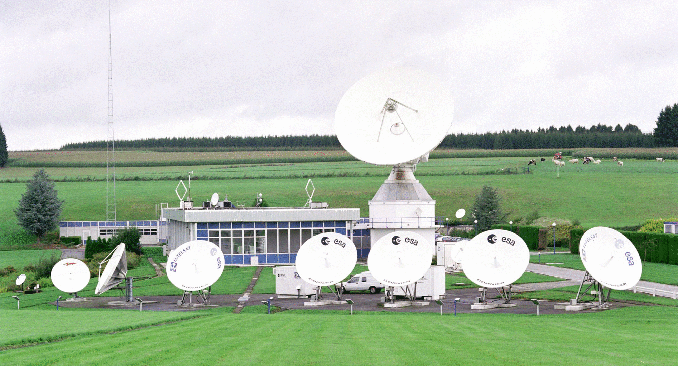
A ground segment consists of all the ground-based elements of a space system used by operators and support personnel
Ground segment refers to the collection of ground-based hardware and software components used to support the operation, communication, and control of satellites orbiting the Earth.
Key components are:
Ground Stations
They consist of antennas, transceivers, amplifiers, and other related equipment that enable the reception and transmission of signals to and from satellites.
Tracking, Telemetry, and Command
The TT&C system is responsible for monitoring and controlling the satellite’s health, position, and operational status.
Mission Control Center
The MCC is the hub of satellite operations, where personnel monitor and control all aspects of the satellite’s mission
Data Processing and Distribution Centers
These centers process, store, and distribute the data collected by the satellites to end-users or other organizations.
User Terminals
User terminals are the end-point devices that receive and transmit data from and to the satellites.
Network Operations Center
The NOC oversees the overall health and performance of the ground segment’s communication networks.
Source:
The European Space Agency - Photo: ©ESA
ESA - Redu facilities
Backup and Redundancy Systems
These systems may involve duplicated hardware, backup power sources, and alternate communication links that can be activated in case of an emergency or system failure.

Slide 11
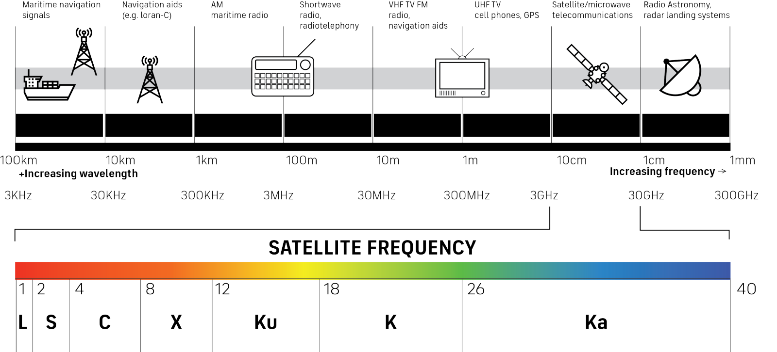
Communication satellites use multiple frequencies bands to transmit information
Source: A straightforward introduction to satellite communications (inmarsat.com)

Slide 12
The most common frequencies used in satellite communications are L-band, C-band, S-band, and Ka-band
L-BAND FREQUENCY
S-BAND FREQUENCY
C-BAND FREQUENCY
Ka-BAND FREQUENCY
L-band frequencies operate at 1-2 GHz range on the electromagnetic spectrum and are used for many radars and GPS services. With a low bandwidth and low frequency range, L-band is not suitable for streaming applications like video, voice, and high-speed broadband connectivity. But is perfect for applications such as fleet management, asset tracking, Internet of Things (IoT) and maritime and aviation safety services.
S-band frequencies operate at 2-4 GHz and are used for satellite communication and radar. S-band is of key importance to the shipping, aviation, and space industries.
C-band operates in the 4-8 GHz range of the electromagnetic spectrum.
With antennas reaching 1.8 meters – 2.4 meters long, C-band satellites relay a direct, end-to-end signal, primarily used for satellite communications, full-time satellite TV networks and raw satellite feeds, which are useful in areas impacted by heavy rain to extreme climate related weather.
Ka-band measures at 27-40 GHz on the electromagnetic spectrum and primarily offers satellite internet that requires high data transfers.
This higher frequency supports applications that need a higher bandwidth, such as video conferencing, live streaming, high-speed internet for services such as inflight Wi-Fi, and multi-media applications. This frequency also makes it easier to offer satellite internet in residential and remote regions on the planet.

Slide 13
Thank you

