Slide 1
Satellite Communication Systems

Slide 2
03 Atmosphere

Slide 3
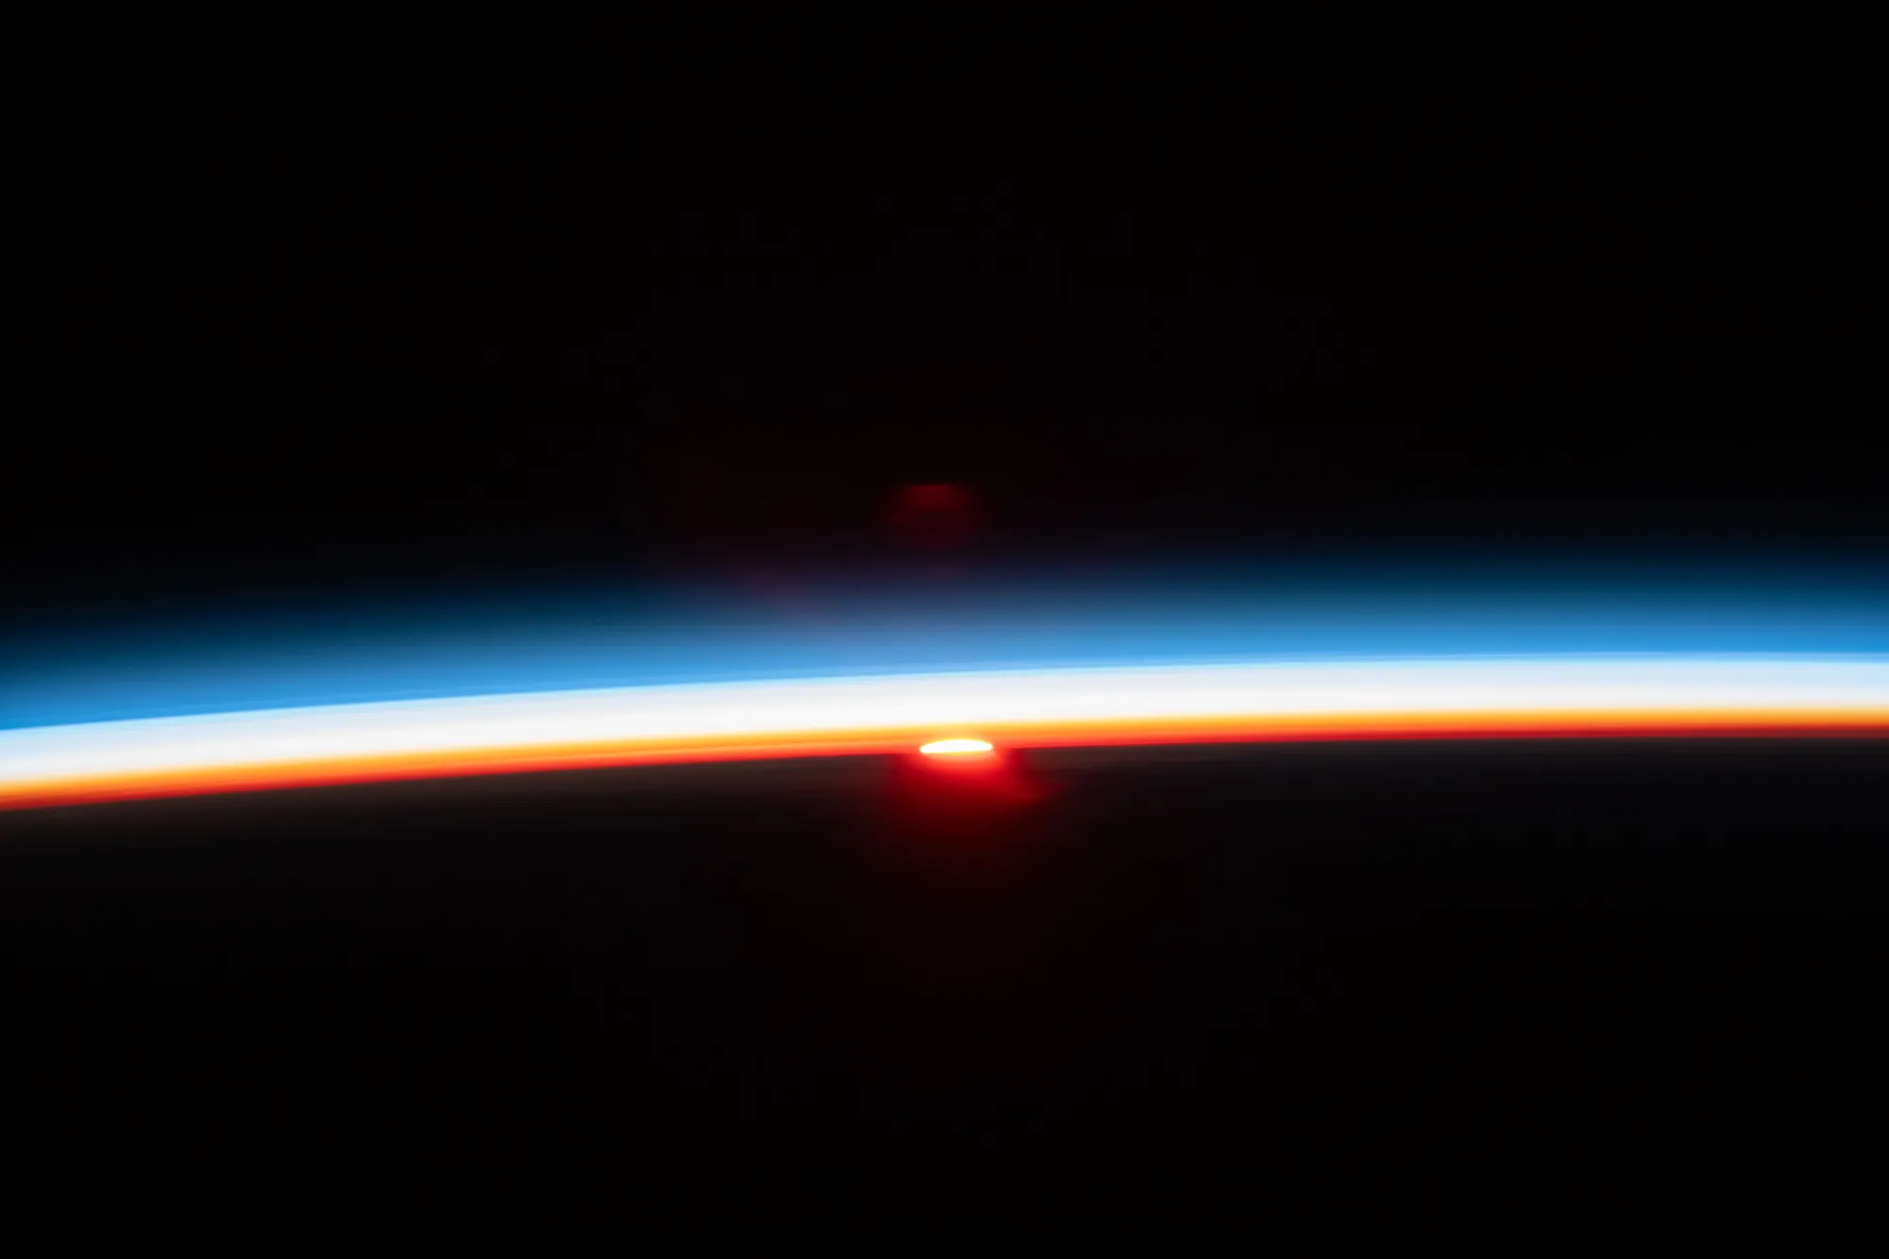
An atmosphere is made of the layers of gases surrounding a planet or other celestial body
Earth’s atmosphere is composed of about 78% nitrogen, 21% oxygen, and one percent other gases.
The atmosphere protects life on earth by shielding it from incoming ultraviolet (UV) radiation, keeping the planet warm through insulation, and preventing extremes between day and night temperatures.
Atmospheric Losses In Satellite Communications
Losses occur in the earth’s atmosphere as a result of energy absorption by the atmospheric gases. These losses are treated quite separately from those which result from adverse weather conditions, which of course are also atmospheric losses. To distinguish between these, the weather-related losses are referred to as atmospheric attenuation and the absorption losses simply as atmospheric absorption.
The atmospheric absorption loss varies with frequency.
The sun’s last rays illuminate Earth’s atmosphere and layers are visible as thin bands extending form the surface out into space.
Source:
NASA What Is... Earth's Atmosphere? - NASA

Slide 4
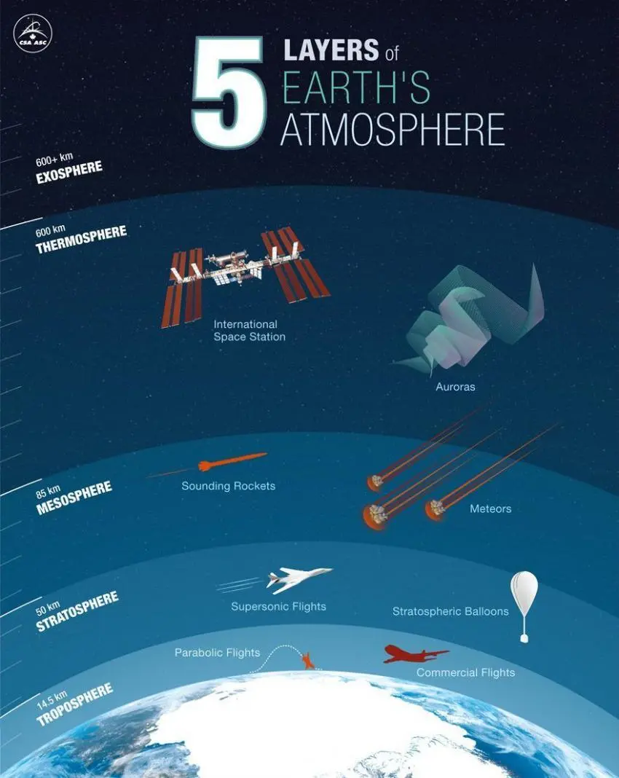
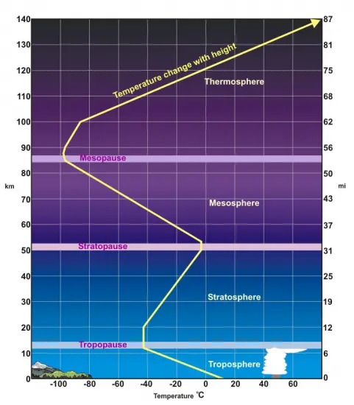
The atmosphere consists of five distinct layers, each with its own characteristics
Changes in temperatures in atmosphere
Source:
Canadian Space Agency
Source:
What Is the Troposphere? - Earth How

Slide 5
The troposphere is the innermost layer of Earth’s atmosphere
“Tropos” means change.
This layer gets its name from the weather that is constantly changing and mixing up the gases in this part of our atmosphere. The troposphere interacts with the Earth’s surface, creating gradients in temperature that drive motion in air and water.
The troposphere is between 8 and 14 kilometers thick depending on where you are on Earth. It’s thinnest at the North and South Pole.
Most dense atmosphere layer
It has most impact on communications.
Source:
Canadian Space Agency

Slide 6
The stratosphere is the layer above the troposphere
“Strat” means layer.
Compared to the troposphere, the lower stratosphere experiences less turbulent air due to reduced convection, the vertical movement of the air in the atmosphere. This region is where commercial passenger aircraft fly.
Unlike the troposphere, the temperatures begin to increase as the altitude increases within this layer, largely due to the presence of the ozone layer, which absorbs and protects the Earth from the Sun’s UV radiation.
This layer is 35 kilometers thick.
Very small influence on electromagnetic waves and communications.
Source:
Canadian Space Agency

Slide 7
The mesosphere is the middle layer between the stratosphere and the thermosphere
“Meso” means middle.
The mesosphere is 35 kilometers thick.
The air is still thin, so you wouldn’t be able to breathe up in the mesosphere. But there is more gas in this layer than there is out in the thermosphere.
The boundary between the mesosphere and the thermosphere, is the coldest part of the entire atmosphere. This is because the mesosphere receives less solar radiation (sunlight) than the layers above it, and the air is less dense than the layers below.
Meteors burn up when they enter the mesosphere, due to their speed of travel and the increased presence of gas molecules in the mesosphere compared to the outer atmospheric layers: this creates friction and heat, which incinerate the incoming meteors.
Source:
Canadian Space Agency

Slide 8
The thermosphere resides above the mesosphere and this layer is very active, swelling and shrinking in response to varying levels of solar radiation from the Sun
“Thermo” means heat.
The thermosphere can reach temperatures up to 2000°C or higher..
This layer of Earth’s atmosphere is about 513 kilometers thick.
This layer is notable for being home to the International Space Station and other Low Earth Orbit satellites.
Source:
Canadian Space Agency

Slide 9
The exosphere is the outermost layer of our atmosphere
“Exo” means outside.
The exosphere is the outermost layer of the Earth’s atmosphere, where most satellites orbit. The exosphere denotes the end of our atmosphere and the beginning of outer space, though there is not a definitive top altitude where the exosphere ends.
The exosphere has gases like hydrogen and helium, but they are very spread out. There is a lot of empty space in between. There is no air to breathe, and it’s very cold.
Source:
Canadian Space Agency

Slide 10
The ionosphere is the ionized part of the upper atmosphere of Earth
Earth's atmosphere contains a series of regions that have a relatively large number of electrically charged atoms and molecules. As a group, these regions are collectively called the ionosphere.
There are three main regions of the ionosphere, called:
D layer
E layer
F layer
These regions do not have sharp boundaries, and the altitudes at which they occur vary during the course of a day and from season to season.
The regions of the ionosphere are not considered separate layers, such as the more familiar troposphere and stratosphere. Instead, they are ionized regions embedded within the standard atmospheric layers.
The D region usually forms in the upper part of the mesosphere, while the E region typically appears in the lower thermosphere and the F region is found in the upper reaches of the thermosphere.
The ionosphere of the Earth constantly varies, depending on time of day, season, geographical position, level of solar activity.
Changes in the ionosphere's density and composition can disrupt signals.
D layer
starting about 60 or 70 km above the ground and extending upward to about 90 km
Totally disappear during the night, because they recombine with oxygen ions to form electrically neutral oxygen molecules
E layer
starting at about 90 or 100 km up and extending to 120 or 150 km
the ionization of the E region remains at night
F layer
starts about 150 km and extends far upward, sometimes as high as 500 km above the surface
This region has the greatest concentration of free electrons
During the day, two layers can be distinguished: a small layer known as F1 and above it a more highly ionized dominant layer called F2. At night they merge at about the level of the F2 layer, which is also called the Appleton layer.

Slide 11
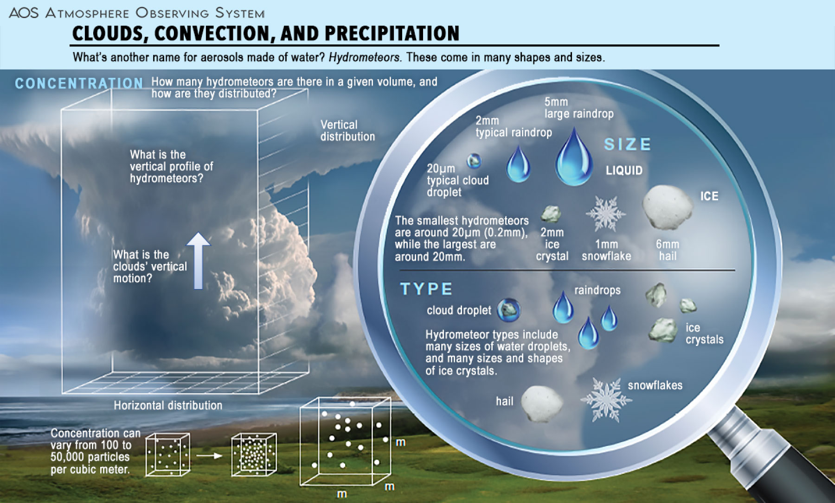
The presence of hydrometeors in the signal path can produce major impairments to space communications
A hydrometeor is a product of condensation or deposition of atmospheric water vapor, whether formed in the free atmosphere or at the earth's surface; also, any water particle blown by the wind from the earth's surface.
Rain attenuation
Rain droplets absorb and scatter the signal energy and cause its power level to attenuate to a value depending on the size, amount, and shape of the droplets that the signal passes through as well as the rain rate
The influence of fog, ice and snow is based on the same principles as rain, but their influence is one order of magnitude smaller.
Cloud attenuation
The cloud content of liquid water also causes absorption and scattering of electromagnetic energy especially for frequencies above 10 GHz, but with less intensity than that of rain. Cloud attenuation, in addition to the transmission parameters such as the signal frequency and the elevation angle, depends on the cloud parameters such as average height and thickness, as well as the total columnar content of liquid water in Kg/m2 and temperature.
Water vapor and oxygen attenuations
Water particles absorb and scatter the wave energy more than oxygen. Water vapor attenuation depends on the weather parameters such as temperature, water vapor content, and altitude above sea level. The attenuation increases proportionally once the temperature and relative humidity (RH) increase. However, oxygen has the paramount effect among all other gases because the dry atmosphere contains 20.946% oxygen, thus resulting in a significant effect on satellite wave frequencies above 50 GHz
Source:
NASA AOS NASA AOS - What is a Hydrometeor?

Slide 12
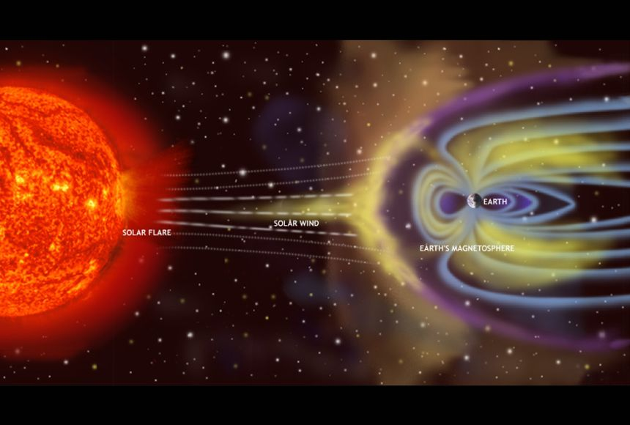
The Sun is a dynamic star, constantly in flux, sending energy out into space causing potential disruptions to satellite communication
The solar wind
The solar wind is a continuous flow of charged particles that we observe emanating from the Sun’s corona. This stream is primarily composed of electrons and protons, with energies sufficient to escape the Sun’s gravity.
Key solar wind characteristics:
Origin: The Sun’s corona
Composition: Electrons, protons (plasma)
Temperature: Millions of degrees
Speed Variations: 400-800 kilometers per second
Interactions: Magnetospheres, causing phenomena like auroras
Associated Events: Solar flares, Coronal Mass Ejections (CMEs)
Effects on Earth’s magnetosphere and Ionosphere, and Satellite communication
Magnetic Field Disturbances - shifts in the magnetospheric structure, leading to a variety of phenomena that affect satellite communications by altering the trajectory and velocity of electrons and ions in orbit
Geomagnetic Storms and Auroras - These storms happen when there is an enhanced flow of solar wind and a significant rearrangement of Earth’s magnetic fields, leading to increased currents that can potentially disrupt satellite operations
Ionospheric Variability – ionosphere ionized by solar radiation affects satellite-to-ground communication. During periods of increased solar activity, the ionosphere can become more dense with free electrons, leading to stronger signal reflections and signal delays.
Source:
NASA

Slide 13
Thank you

