Slide 1
Satellite Communication Systems

Slide 2
04 Orbits

Slide 3
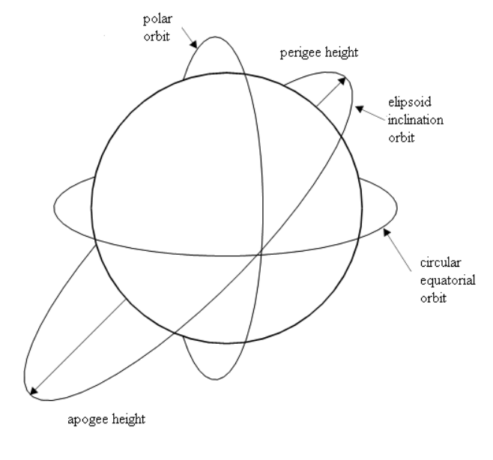
The orbit is the trajectory that an object in space takes around another object due to gravity
When rockets launch satellites, they put them into orbit in space. There, gravity keeps the satellite on its required orbit – in the same way that gravity keeps the Moon in orbit around Earth.
Satellite orbits vary depending on:
Altitude
Inclination
Orbital period

Slide 4
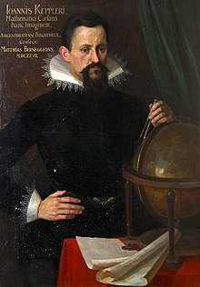
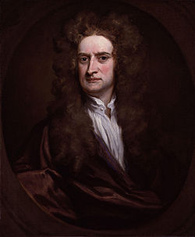
Kepler and Newton's laws mathematically describe the orbits of satellites
Kepler’s laws describe how:
planets move in elliptical orbits with the Sun as a focus,
a planet covers the same area of space in the same amount of time no matter where it is in its orbit,
a planet’s orbital period is proportional to the size of its orbit.
Newton’s laws of motion describe the relations between the forces acting on a body and the motion of the body:
if a body is at rest or moving at a constant speed in a straight line, it will remain at rest or keep moving in a straight line at constant speed unless it is acted upon by a force,
It states that the time rate of change of the momentum of a body is equal in both magnitude and direction to the force imposed on it,
when two bodies interact, they apply forces to one another that are equal in magnitude and opposite in direction.
Newton’s law of gravitation:
any particle of matter in the universe attracts any other with a force varying directly as the product of the masses and inversely as the square of the distance between them
Johannes Kepler was a German astronomer who discovered three major laws of planetary motion
Isaac Newton was an English physicist and mathematician. In the Philosophiæ Naturalis Principia Mathematica, Newton formulated the laws of motion and universal gravitation

Slide 5
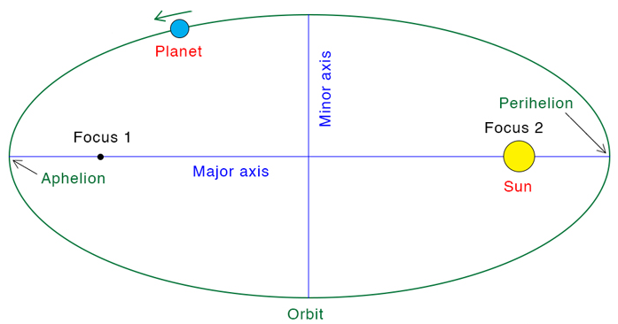
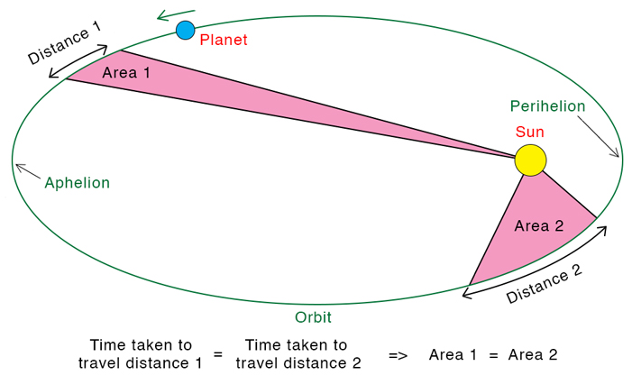

Kepler's three laws describe how planets orbit the Sun
(1) planets move in elliptical orbits with the Sun as a focus,
(2) a planet covers the same area of space in the same amount of time no matter where it is in its orbit,
(3) a planet’s orbital period is proportional to the size of its orbit.
Each planet's orbit about the Sun is an ellipse. The Sun's center is always located at one focus of the ellipse. The planet follows the ellipse in its orbit, meaning that the planet-to-Sun distance is constantly changing as the planet goes around its orbit.
The imaginary line joining a planet and the Sun sweeps out – or covers – equal areas of space during equal time intervals as the planet orbits. Basically, the planets do not move with constant speed along their orbits. Instead, their speed varies so that the line joining the centers of the Sun and the planet covers an equal area in equal amounts of time.
The orbital period of a planet, squared, is directly proportional to the semi-major axes of its orbit, cubed. This is written in equation form as T²=a³. Kepler's third law implies that the period for a planet to orbit the Sun increases rapidly with the radius of its orbit.

Slide 6
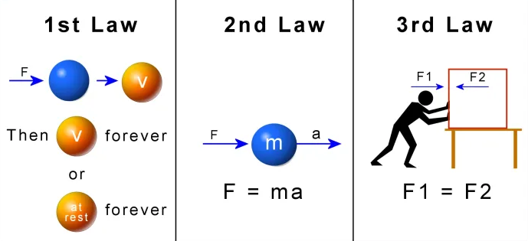
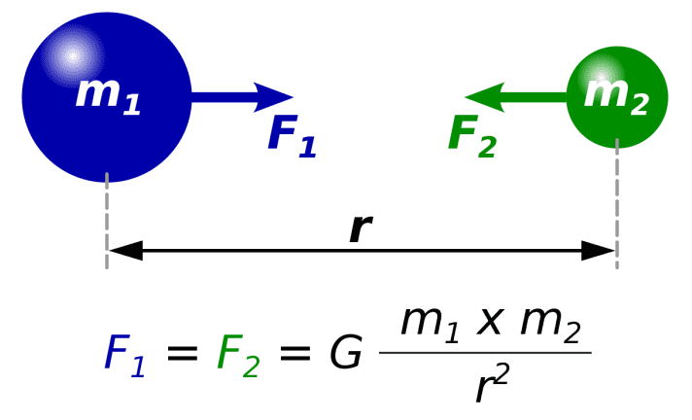
Newton’s laws of motion and gravitation helps us understand motion and how every object in space attracts every other object
Newton’s laws of motion
Newton’s law of gravitation
(1) if a body is at rest or moving at a constant speed in a straight line, it will remain at rest or keep moving in a straight line at constant speed unless it is acted upon by a force,
(2) It states that the time rate of change of the momentum of a body is equal in both magnitude and direction to the force imposed on it,
(3) when two bodies interact, they apply forces to one another that are equal in magnitude and opposite in direction.
Any particle of matter in the universe attracts any other with a force varying directly as the product of the masses and inversely as the square of the distance between them

Slide 7
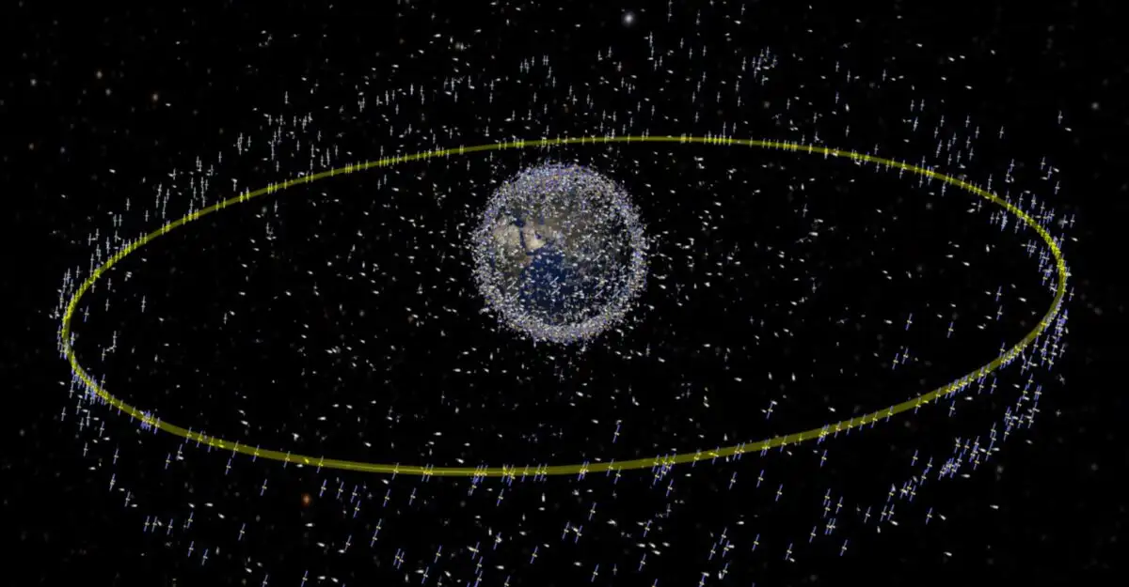
The choice of orbit depends on the nature of the mission, the acceptable interference, and the performance of the launchers
Orbit
Description
Low Earth orbit (LEO)
A low Earth orbit (LEO) is, as the name suggests, an orbit that is relatively close to Earth’s surface. It is normally at an altitude of less than 1000 km but could be as low as 160 km above Earth – which is low compared to other orbits, but still very far above Earth’s surface.
Medium Earth orbit (MEO)
Medium Earth orbit comprises a wide range of orbits anywhere between LEO and GEO. It is similar to LEO in that it also does not need to take specific paths around Earth, and it is used by a variety of satellites with many different applications.
Geostationary orbit (GEO);
Satellites in geostationary orbit (GEO) circle Earth 35786km above the equator from west to east following Earth’s rotation – taking 23 hours 56 minutes and 4 seconds – by travelling at exactly the same rate as Earth. This makes satellites in GEO appear to be ‘stationary’ over a fixed position.
Polar orbit and Sun-synchronous orbit (SSO)
Satellites in polar orbits usually travel past Earth from north to south rather than from west to east, passing roughly over Earth's poles. Polar orbits are a type of low Earth orbit, as they are at low altitudes between 200 to 1000 km. Sun-synchronous orbit (SSO) is a particular kind of polar orbit. Satellites in SSO, travelling over the polar regions, are synchronous with the Sun. This means they are synchronised to always be in the same ‘fixed’ position relative to the Sun. This means that the satellite always visits the same spot at the same local time – for example, passing the city of Paris every day at noon exactly.
Transfer orbits and geostationary transfer orbit (GTO)
Transfer orbits are a special kind of orbit used to get from one orbit to another. When satellites are launched from Earth and carried to space with launch vehicles such as Ariane 5, the satellites are not always placed directly on their final orbit. Often, the satellites are instead placed on a transfer orbit: an orbit where, by using relatively little energy from built-in motors, the satellite or spacecraft can move from one orbit to another.

Slide 8
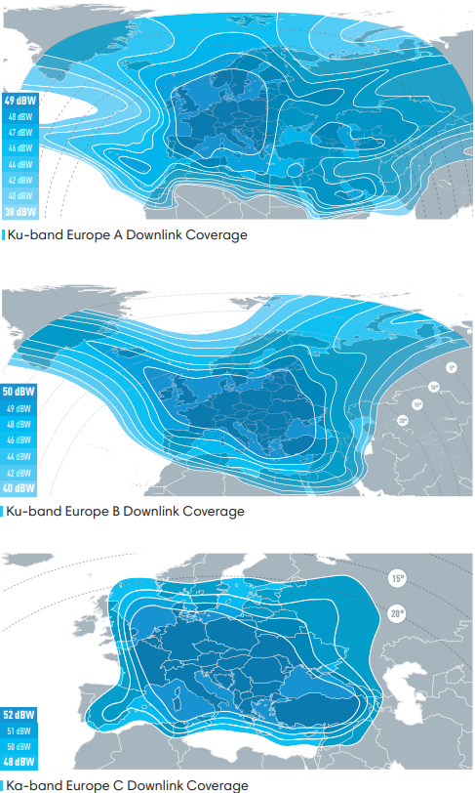
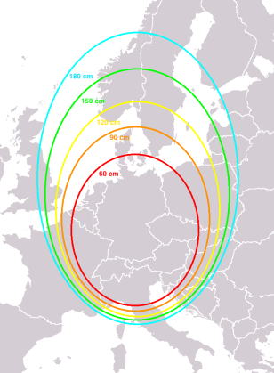
Communications satellites must be designed to offer the best possible service between intended geographical areas, without causing disturbance to other regions
The purpose of many satellites is to observe or communicate with points on Earth’s surface. Such functions require a line of sight that is neither too long nor too oblique, so only a certain segment of Earth will be covered by a satellite at any given time. Here the term “covered” is meant to include “can communicate with” if the purpose of the satellite is communications
Receive antenna size necessary depending on the geographical position
Source:
EUTELSAT 16A | Eutelsat Satellites | Eutelsat

Slide 9
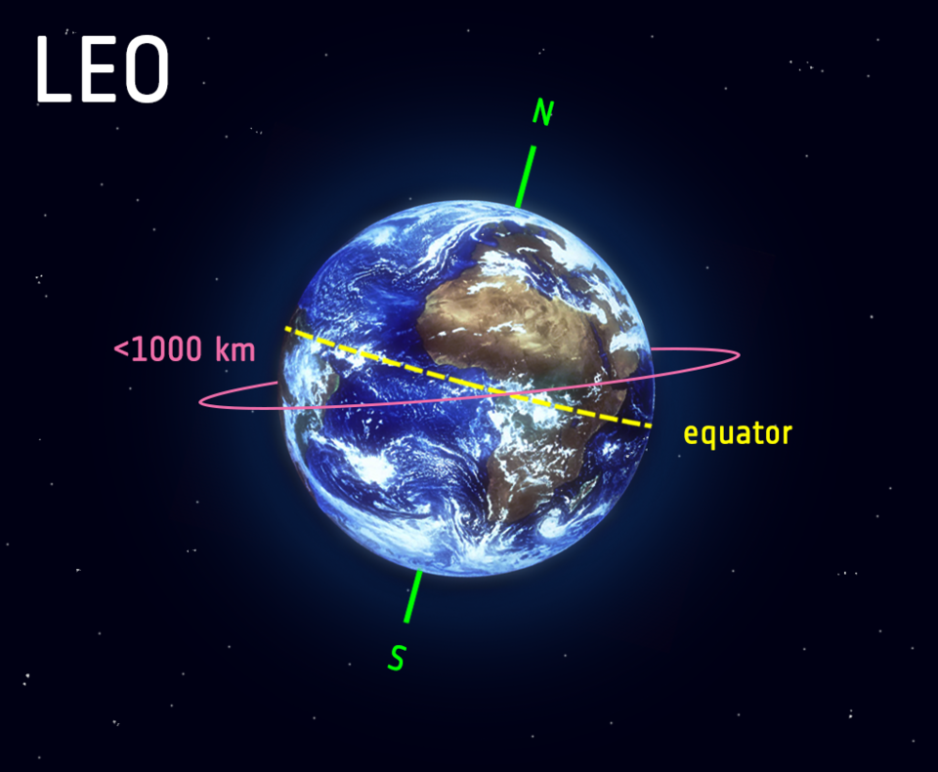
A low Earth orbit (LEO) is, as the name suggests, an orbit that is relatively close to Earth’s surface
Altitude:
Up to 2,000 km
Application
Remote sensing satellites
Altimeter satellites
Satellite characteristics:
Orbit period ranges from 1.5 to 2 hours
Diameter of coverage is about 8000 km
Round-trip signal propagation delay less than 20 ms
Maximum satellite visible time up to 20 min
System must cope with large Doppler shifts
Atmospheric drag results in orbital deterioration
LEO’s close proximity to Earth makes it useful for several reasons. It is the orbit most commonly used for satellite imaging, as being near the surface allows it to take images of higher resolution. It is also the orbit used for the International Space Station (ISS), as it is easier for astronauts to travel to and from it at a shorter distance. Satellites in this orbit travel at a speed of around 7.8 km per second; at this speed, a satellite takes approximately 90 minutes to circle Earth, meaning the ISS travels around Earth about 16 times a day.
However, individual LEO satellites are less useful for tasks such as telecommunication, because they move so fast across the sky and therefore require a lot of effort to track from ground stations.
Instead, communications satellites in LEO often work as part of a large combination or constellation, of multiple satellites to give constant coverage. In order to increase coverage, sometimes constellations like this, consisting of several of the same or similar satellites, are launched together to create a ‘net’ around Earth. This lets them cover large areas of Earth simultaneously by working together.
Source:
ESA
ESA - Types of orbits

Slide 10

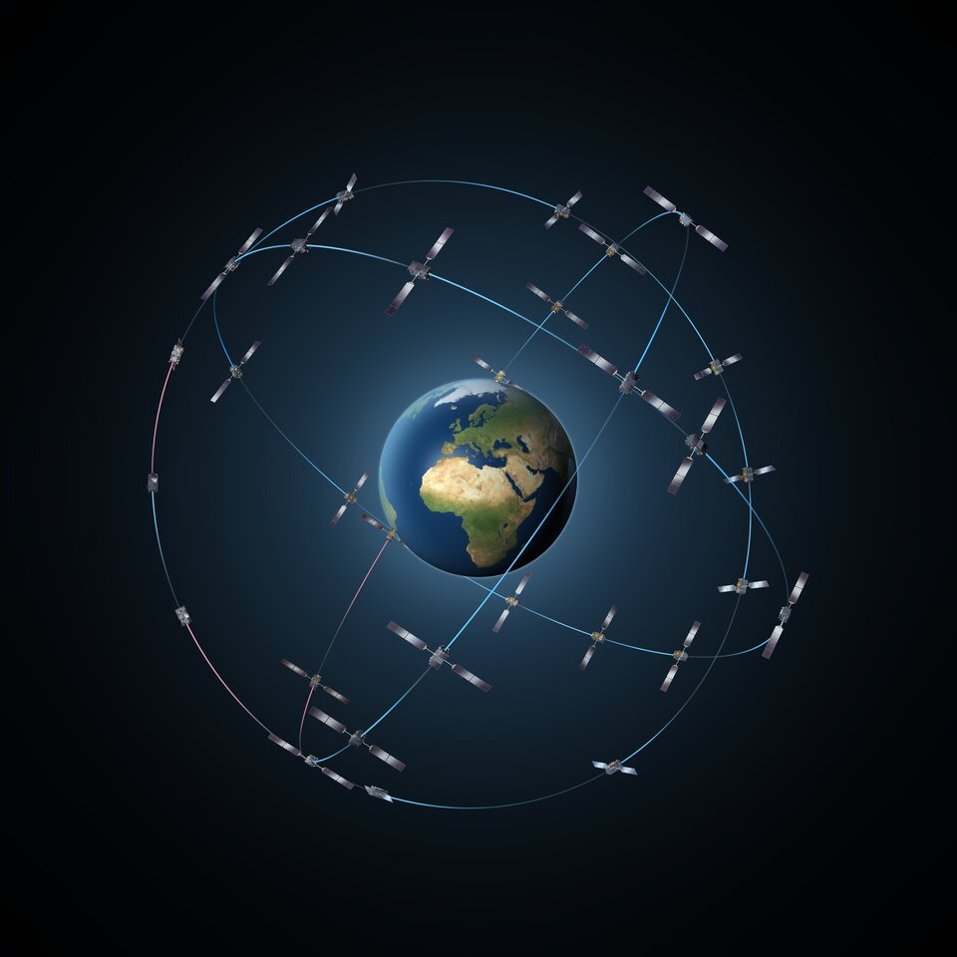
Medium Earth orbit comprises a wide range of orbits anywhere between LEO and GEO
Altitude:
Between 5,000 km – 20,000 km
Application:
GPS satellites
Satellite characteristics:
Orbit period of 6 hours
Diameter of coverage is 10,000 to 15,000 km
Round trip signal propagation delay less than 50 ms
Maximum satellite visible time is a few hours
Medium Earth orbit comprises a wide range of orbits anywhere between LEO and GEO. It is similar to LEO in that it also does not need to take specific paths around Earth, and it is used by a variety of satellites with many different applications.
It is very commonly used by navigation satellites, like the European Galileo system (pictured). Galileo powers navigation communications across Europe, and is used for many types of navigation, from tracking large jumbo jets to getting directions to your smartphone. Galileo uses a constellation of multiple satellites to provide coverage across large parts of the world all at once.
Galileo constellation
Source:
ESA
ESA - Types of orbits

Slide 11
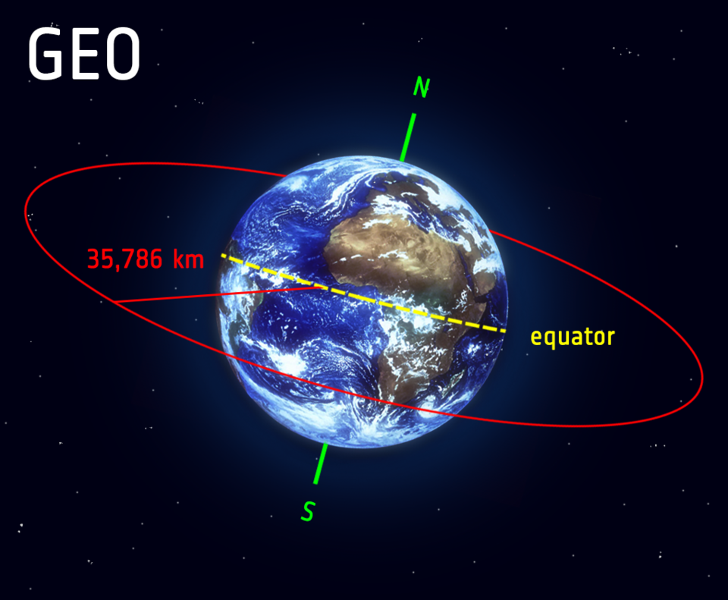
Satellites in geostationary orbit (GEO) circle Earth above the equator from west to east following Earth’s rotation
Altitude:
36,000 km
Application:
Communication satellites
Satellite characteristics:
The satellite needs 1 day to complete an orbit
Since the earth turns once per day, the satellite moves with the surface of the earth
Advantages of the GEO orbit
No problem with frequency changes
Tracking of the satellite is simplified
High coverage area
Disadvantages of the GEO orbit
Weak signal after traveling over 35,000 km
Polar regions are poorly served
Signal sending delay is substantial
Satellites in geostationary orbit (GEO) circle Earth above the equator from west to east following Earth’s rotation – taking 23 hours 56 minutes and 4 seconds – by travelling at exactly the same rate as Earth. This makes satellites in GEO appear to be ‘stationary’ over a fixed position.
GEO is used by satellites that need to stay constantly above one particular place over Earth, such as telecommunication satellites. This way, an antenna on Earth can be fixed to always stay pointed towards that satellite without moving. It can also be used by weather monitoring satellites, because they can continually observe specific areas to see how weather trends emerge there.
Satellites in GEO cover a large range of Earth so as few as three equally-spaced satellites can provide near global coverage. This is because when a satellite is this far from Earth, it can cover large sections at once. This is akin to being able to see more of a map from a metre away compared with if you were a centimetre from it. So to see all of Earth at once from GEO far fewer satellites are needed than at a lower altitude.
Source:
ESA
ESA - Types of orbits

Slide 12
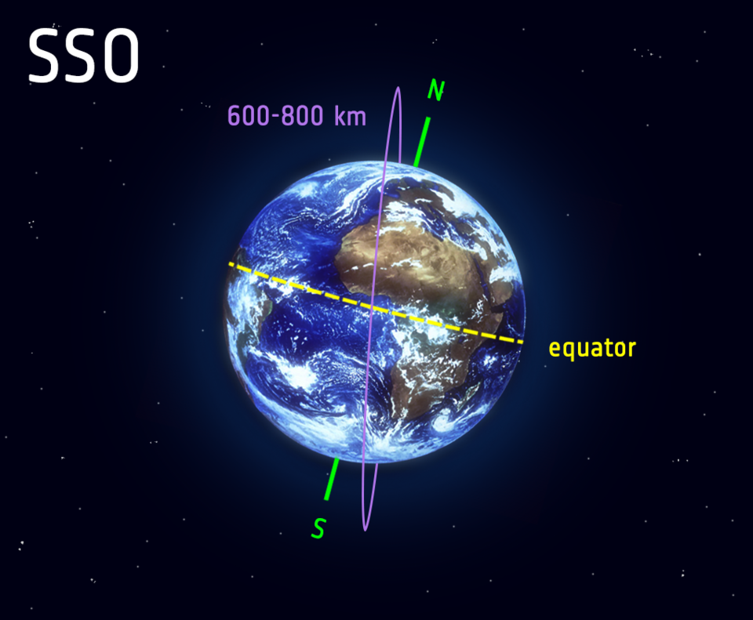
Satellites in polar orbits usually travel past Earth from north to south rather than from west to east, passing roughly over Earth's poles
Satellites in polar orbits usually travel past Earth from north to south rather than from west to east, passing roughly over Earth's poles.
Satellites in a polar orbit do not have to pass the North and South Pole precisely; even a deviation within 20 to 30 degrees is still classed as a polar orbit. Polar orbits are a type of low Earth orbit, as they are at low altitudes between 200 to 1000 km.
Sun-synchronous orbit (SSO) is a particular kind of polar orbit. Satellites in SSO, travelling over the polar regions, are synchronous with the Sun. This means they are synchronised to always be in the same ‘fixed’ position relative to the Sun. This means that the satellite always visits the same spot at the same local time – for example, passing the city of Paris every day at noon exactly.
This means that the satellite will always observe a point on the Earth as if constantly at the same time of the day, which serves a number of applications; for example, it means that scientists and those who use the satellite images can compare how somewhere changes over time.
Often, satellites in SSO are synchronised so that they are in constant dawn or dusk – this is because by constantly riding a sunset or sunrise, they will never have the Sun at an angle where the Earth shadows them. A satellite in a Sun-synchronous orbit would usually be at an altitude of between 600 to 800 km. At 800 km, it will be travelling at a speed of approximately 7.5 km per second.
Source:
ESA
ESA - Types of orbits

Slide 13
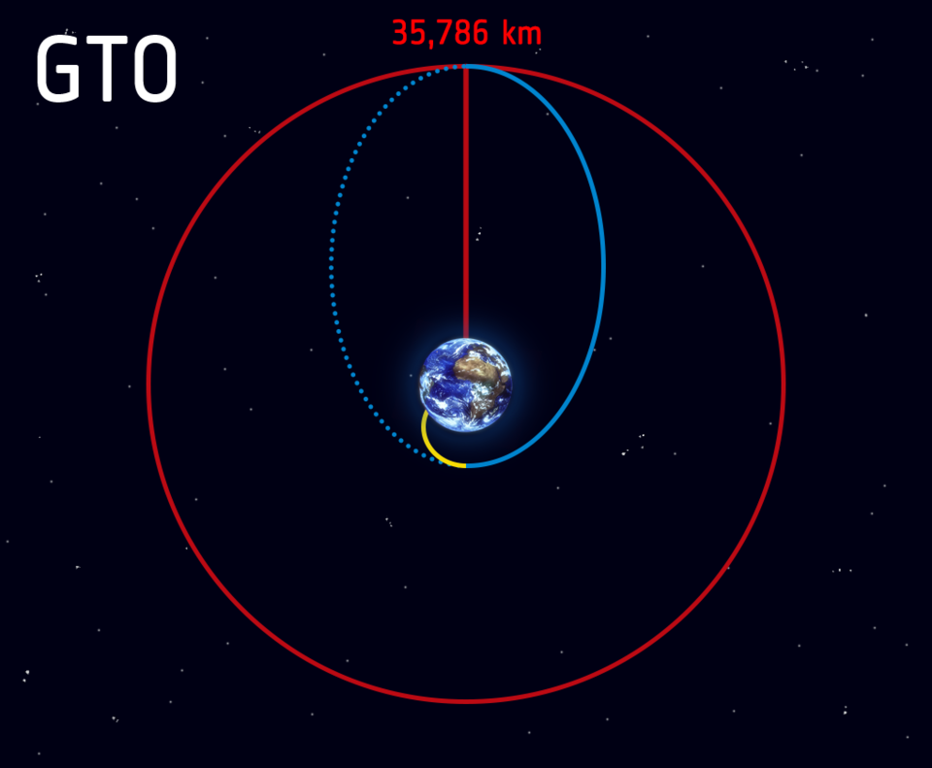
Transfer orbits are a special kind of orbit used to get from one orbit to another
Launch and ascent to space (yellow line) becomes the geostationary transfer orbit (blue line) when the rocket releases the satellite in space on a path to geostationary orbit (red line).
When satellites are launched from Earth and carried to space with launch vehicles, the satellites are not always placed directly on their final orbit. Often, the satellites are instead placed on a transfer orbit: an orbit where, by using relatively little energy from built-in motors, the satellite or spacecraft can move from one orbit to another.
This allows a satellite to reach, for example, a high-altitude orbit like GEO without actually needing the launch vehicle to go all the way to this altitude, which would require more effort – this is like taking a shortcut. Reaching GEO in this way is an example of one of the most common transfer orbits, called the geostationary transfer orbit (GTO).
Source:
ESA
ESA - Types of orbits

Slide 14
Comparison of LEO, MEO and GEO
Low Earth Orbit (LEO)
Medium Earth orbit (MEO)
Geostationary Earth orbit (GEO)
Altitude:
Up to 2,000 km
Application
Remote sensing satellites
Altimeter satellites
Satellite characteristics:
Orbit period ranges from 1.5 to 2 hours
Diameter of coverage is about 8000 km
Round-trip signal propagation delay less than 20 ms
Maximum satellite visible time up to 20 min
System must cope with large Doppler shifts
Atmospheric drag results in orbital deterioration
Altitude:
Between 5,000 km – 20,000 km
Application:
GPS satellites
Satellite characteristics:
Orbit period of 6 hours
Diameter of coverage is 10,000 to 15,000 km
Round trip signal propagation delay less than 50 ms
Maximum satellite visible time is a few hours
Altitude:
36,000 km
Application:
Communication satellites
Satellite characteristics:
The satellite needs 1 day to complete an orbit
Since the earth turns once per day, the satellite moves with the surface of the earth
Advantages of the GEO orbit
No problem with frequency changes
Tracking of the satellite is simplified
High coverage area
Disadvantages of the GEO orbit
Weak signal after traveling over 35,000 km
Polar regions are poorly served
Signal sending delay is substantial

Slide 15
Thank you

