Slide 1
Satellite Communication Systems

Slide 2
06 Satellite Communication Services

Slide 3
Satellite communications enables voice and data communication services across the globe
Satellites have fundamentally transformed global connectivity by extending communication infrastructure to remote and underserved regions, bridging the digital divide and enabling access to critical services.
Satellites enable global communication in remote areas efficiently.
Advanced satellite systems optimize data transmission for reliable connectivity.
Satellite technology bridges digital gaps, enhancing global connectivity.
Satellite networks ensure seamless, high-quality broadcasting for diverse audiences.
There are three types of communication services that satellites provide
Telecommunications
Telecommunication services include telephone calls and services provided to telephone companies, as well as wireless, mobile, and cellular network providers.
Broadcasting
Broadcasting services include radio and television delivered directly to the consumer and mobile broadcasting services
Data
Data communications involve the transfer of data from one point to another.

Slide 4
Mobile communications provide a user with two-way voice or data communications services by using some form of portable wireless technology
Typically, providers of satellite mobile communications use Geostationary Orbit (GEO), Medium Earth Orbit (MEO) satellites or Low Earth Orbit (LEO) satellites to relay signals up from a handset or terminal and back down to a ground station where the signal interfaces with the public telephone system or the internet.
Because satellites operate in Earth orbit, mobile satellite providers have the unique ability to offer virtually ubiquitous coverage for mobile voice and data communications, especially for customers who operate in areas far beyond the coverage offered by terrestrial mobile networks.
Mobile satellite communications and mobile satellite services (MSS) voice terminals or handsets can range in size from handheld to laptop-sized units and can be fully portable of mounted in vehicles for on the move communications. Mobile satellite data devices can provide simple one-way or simplex tracking as well as two-way duplex data and broadband internet communications.
Satellite telephones can provide users with the ability to make and receive phone calls and text messages from virtually anywhere. Satellite data modems provide users with connectivity, without having to rely on terrestrial mobile networks. Satellite providers may also offer machine to machine (M2M) data for various applications including monitoring or tracking services.
One of the most recent and innovative developments in the satellite industry is Direct-to-Device (D2D) services. D2D service allows cellular smartphone users to communicate using satellite networks—even when cellular or Wi-Fi terrestrial coverage is unavailable. Depending on the type of D2D service, select smartphone users would be able to text or use voice and connectivity services, even when operating far outside the coverage area of terrestrial mobile services.
MSS operates at L-band—low enough in the frequency spectrum to avoid the rain fade associated with higher bandwidth Ku- and Ka-band fixed satellite systems

Slide 5
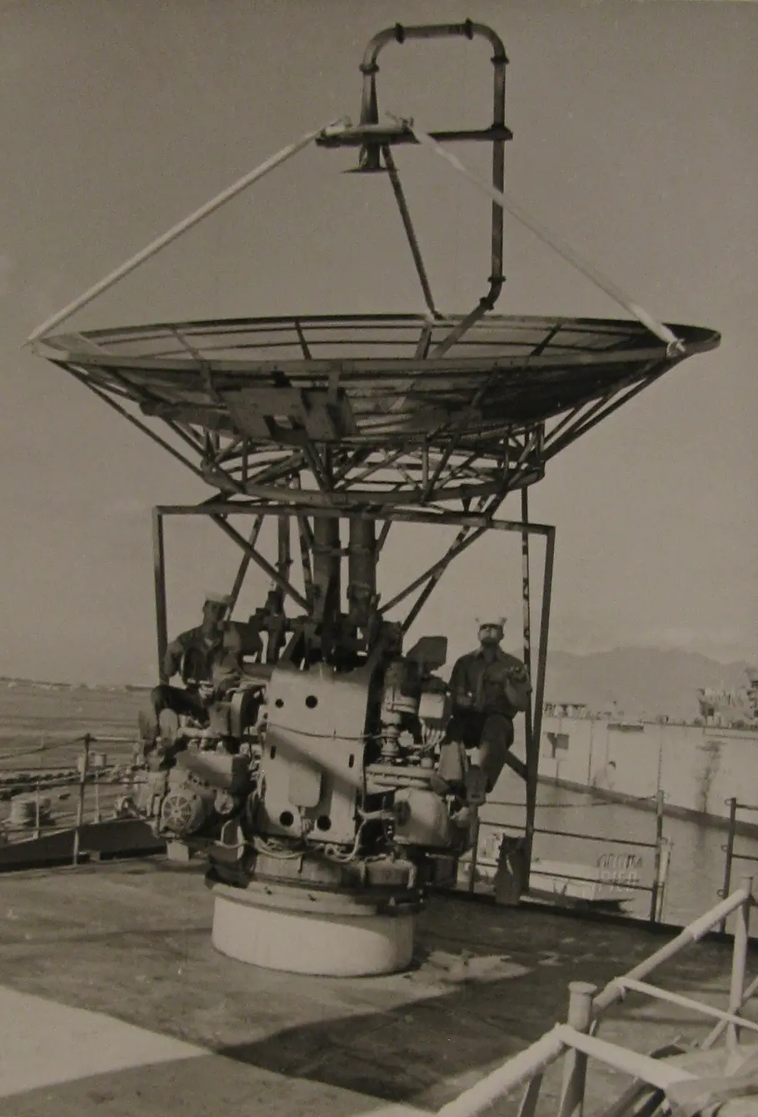
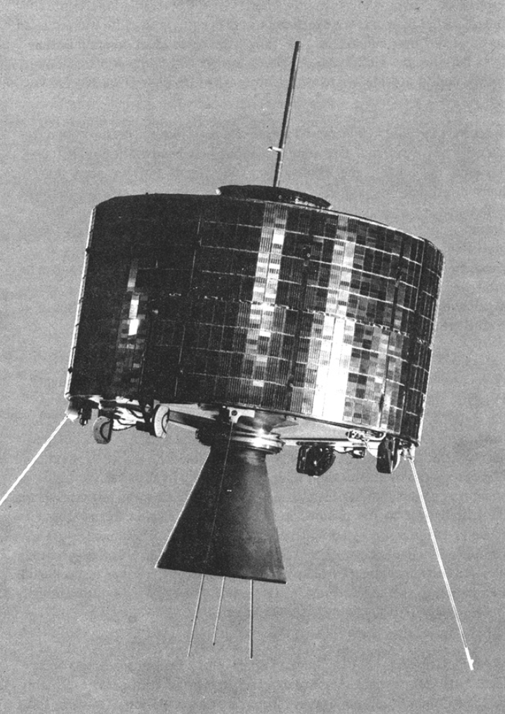
10 years from bouncing signals from the moon to broadcasting Olympic games through satellite
On July 24, 1954, the Naval Research Laboratory (NRL) at Stump Neck, Maryland (now the Naval Surface Warfare Center in Indian Head, Maryland) sent and received the first human voice transmission to be bounced back to Earth from the Moon.
On August 19, 1964 Syncom 3, the first GSO communication satellite was launched.
The satellite, in orbit near the International Date Line, was used to telecast the 1964 Summer Olympics in Tokyo to the United States. It was the first television program to cross the Pacific ocean.

Slide 6
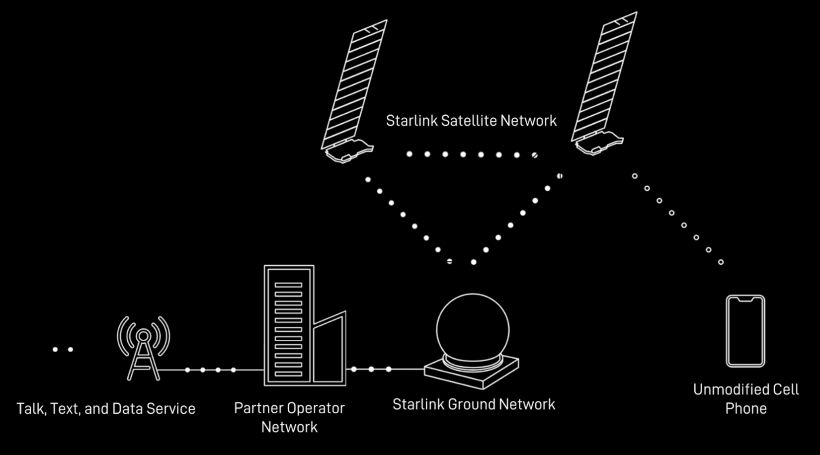
On January 2, 2024, Starlink launched to orbit first six satellites with Direct to Cell capabilities
Starlink satellites with Direct to Cell capability have an advanced eNodeB modem onboard that acts like a cellphone tower in space, allowing network integration similar to a standard roaming partner.
Starlink satellites with the Direct to Cell payload are equipped with innovative new custom silicon, phased array antennas, and advanced software algorithms that overcome these challenges and provide standard LTE service to cell phones on the ground.
Direct to Cell satellites act like cell towers in space, sending traffic to partner operator’s cores using Starlink's space and ground systems.
Source: Starlink Business | Direct To Cell

Slide 7
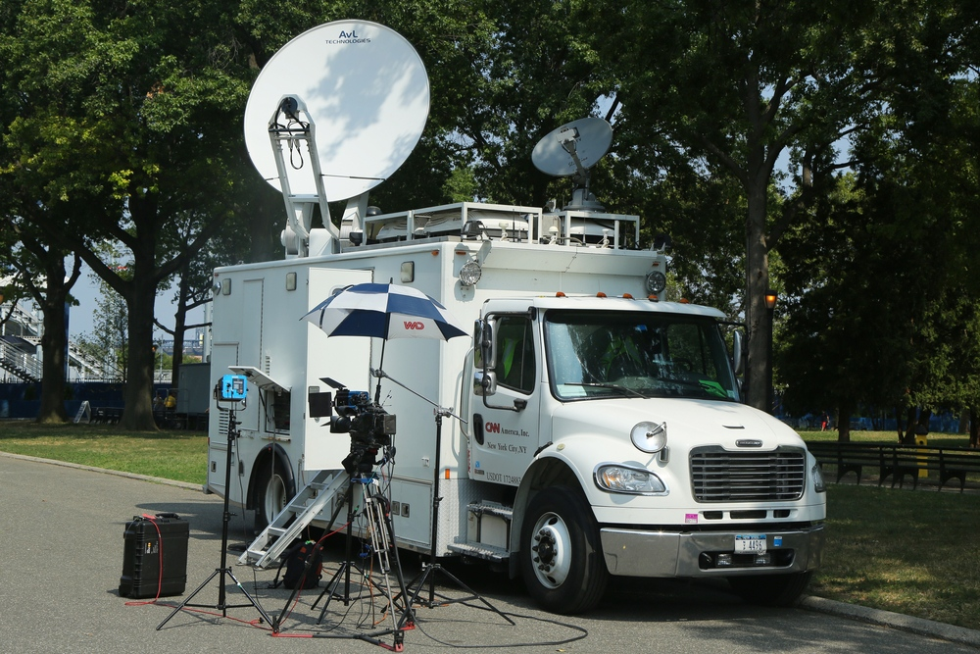
Communications satellites are used to broadcast news, sports, concerts and other programming live as events happened
Onsite Live News Reports
Satellite news gathering trucks have allowed reporters the ability send live news reports from remote locations. The satellite truck is equipped with a satellite dish antenna which is pointed at a communications satellite. The truck takes the video feed from the remote reporter and sends the signal back to the television studio or production facility via satellite where the video and audio is prepared for broadcast.
Satellite Television
Video channels broadcast by satellite are also received by Direct Broadcast Satellite (DBS) or Direct-to-Home (DTH) companies which use satellites to deliver TV channels directly to the homes of service provider subscribers that are equipped with a satellite dish and home receiver.
Satellite Radio
Satellites may also be used by a satellite radio provider to broadcast audio channels with news, sports and entertainment programming to customers at home, work or in vehicle in both rural and urban centers.
Source: Broadcast: Satellite TV & Radio – Satellite Industry Association (sia.org)

Slide 8
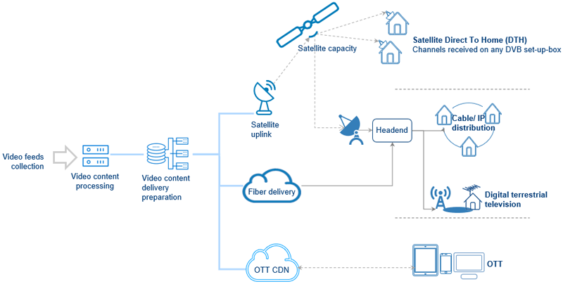
Satellite Direct-to-Home achieves video delivery via radio waves received through a satellite dish
TV distribution itself can come in many different shapes and sizes, but there are three main types of delivery models:
Satellite Direct-to-Home
Terrestrial networks (e.g. Cable, IP and DTT distribution)
OTT (Over-the-Top)
Satellite Direct-to-Home enables broadcasters to directly beam their channels to the viewer’s TV set. This means that viewers have no need for a separate cable connection to access the TV channels.
The biggest advantage of satellite television for broadcasters is its unique reach.
Cost is another important element for broadcasters. While some infrastructure transmission costs increase based on the number of users, with satellite transmission, costs remain the same no matter how many viewers you reach.
Another concern that potentially faces broadcasters is the maturity of DTH technology, yet DTH viewing is growing in every region and it can distribute any format, including 4k.
Among the advantages for DTH viewers are the superior quality of content, since the signal is not split through a cable, and there is no cable operator who curates and curbs channel choice.
The disadvantages for viewers largely depend on the region and prevailing business models. In some regions, viewers can access thousands of free TV channels with just a low-cost satellite dish and set-top box, and no monthly fees, while elsewhere, setting up the receiving apparatus can be more costly and require time and effort.
Main types of TV distribution models.
Source: A Guide to TV Distribution Models (DTH vs Terrestrial vs OTT) | Eutelsat

Slide 9


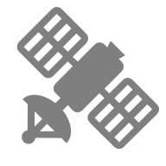
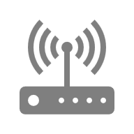
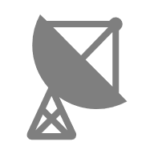


Satellite internet is wireless internet beamed down from satellites orbiting the Earth
Satellite internet uses a five-part relay system:
Internet-ready device
Modem/router
Satellite dish
Satellite in space
Network Operations Center (NOC)
Satellite internet works by using radio waves to communicate with satellites orbiting the Earth. Data is sent and retrieved through a communication network that starts with your device and travels through your modem and satellite dish, out to a satellite in space, then back to Earth to ground stations known as network operations centers (NOC). And then, data travels back through this network—out to space and then back to your satellite dish on Earth—to deliver data on your device.
Network operations center (NOC)
Whenever you request information from the internet, the data from that request is uploaded through the above relay. The satellite then beams that request to the NOC.
Using a much larger satellite dish than the one you have at home, the NOC receives your request. The NOC then taps into the internet backbone, gathers the information you requested, and sends it back through the relay to you.
All of this process, including beaming information into space and back twice, happens in fractions of a second.
Satellite internet provides web access through satellites orbiting Earth, enabling connectivity in remote regions. Initially reliant on large, geostationary satellites positioned about 35,800 km above the equator, this technology has seen significant evolution. These satellites suffered from high latency issues, impacting the speed and efficiency of data transmission. Recent years have seen a shift toward Low Earth Orbit (LEO) satellites, which orbit much closer to the surface at approximately 500 km to 2,000 km. This advancement has reduced latency and improved the overall speed and reliability of satellite internet services.

Slide 10
Satellites can often be used to connect IoT devices so they may transmit data, even when they are operating far beyond the coverage of terrestrial data networks
IoT devices can range in complexity, providing simple identification or location data to complex machine to machine (M2M) communication. When connected, the IoT devices can provide sensor data indicating information such as location and operating conditions. Such automated monitoring can be invaluable for increased efficiency and production for a wide variety of applications including the following:
Asset Tracking
is a prime application for IoT. Tracking the location of assets and inventory is critical for both businesses and government and managing the assets is easier when using IoT remote asset tracking solutions.
Maritime Applications
are often ideally suited for satellite IoT solutions thanks to the ability of satellites to offer coverage and service offshore and far from land-based data coverage. Such applications include the following:
Vessel Monitoring Systems (VMS) and VMS Compliance
Enhanced Maritime Location and Safety
Monitoring of Maritime Vessel Conditions such as Engine Performance
Remote Buoy Location and Monitoring of Maritime Environmental Conditions
Remote Industrial Assets
are often times located in areas underserved or completely unserved by terrestrial mobile data companies. Coverage offered by satellites is often times the only way remote industrial equipment can remain connected to the internet. Many applications rely on IoT connected devices to monitor equipment, change equipment settings and manage assets.
The Connected Car
Most new vehicles today have the option available to connect to the internet via terrestrial mobile networks to power such things as on-board Wi-Fi or streaming music. Yes, cars do connect to satellites for GPS navigation but connecting to the internet is done primarily through terrestrial networks.
The possibility of one day accessing the ubiquitous coverage offered by satellites is an attractive feature for designers of future connected cars because there are many vehicles that operate in areas underserved or unserved by mobile internet services.
Smart grid management
With utilities companies increasingly moving towards smart grids, where electricity distribution and consumption can be effectively managed, companies are looking to monitor and automate reclosers, manage advanced metering infrastructure and address other aspects of the smart grid. Satellite connectivity can power this as well as aid workforce safety.

Slide 11
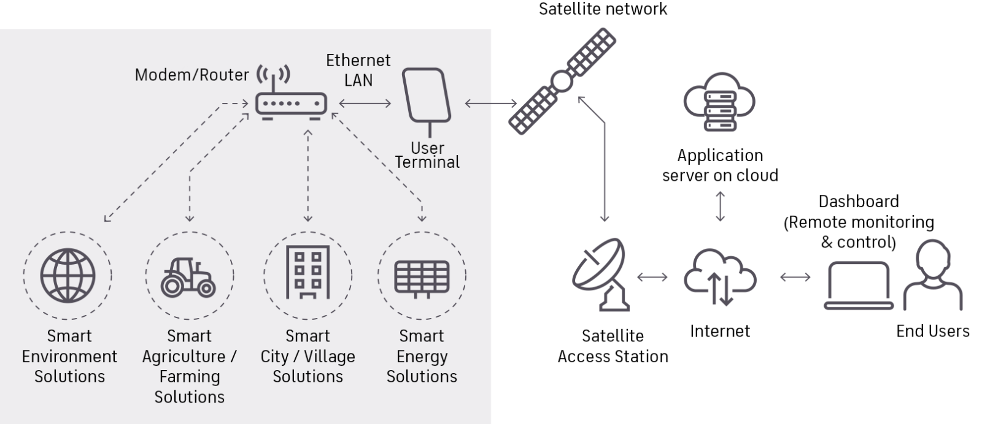
A simplified diagram of how satellite communications operates with IoT technologies for various industrial applications
Firstly, IoT enabled devices such as sensors, trackers and monitoring devices need to be equipped with satellite communication terminals. This allows the given device to be directly connected with a satellite in space, bypassing the need for a complete terrestrial infrastructure.
The IoT device then collects data from their surroundings, such as environmental conditions, equipment performance, or asset tracking. This is then processed and packaged for transmission.
Using selected frequencies and protocols, the device transmits the packaged data to the satellites above. Once received by the satellite, this data is then relayed back down to ground stations located on Earth and then forwarded to the intended recipient such as farmers, energy operators or fleet managers to be processed, analysed and visualised through cloud-based or local systems.
Source: Satellite IoT: the future of networking (inmarsat.com)

Slide 12
Thank you

