Slide 1
Satellite Communication Systems

Slide 2
07 Space Segment

Slide 3
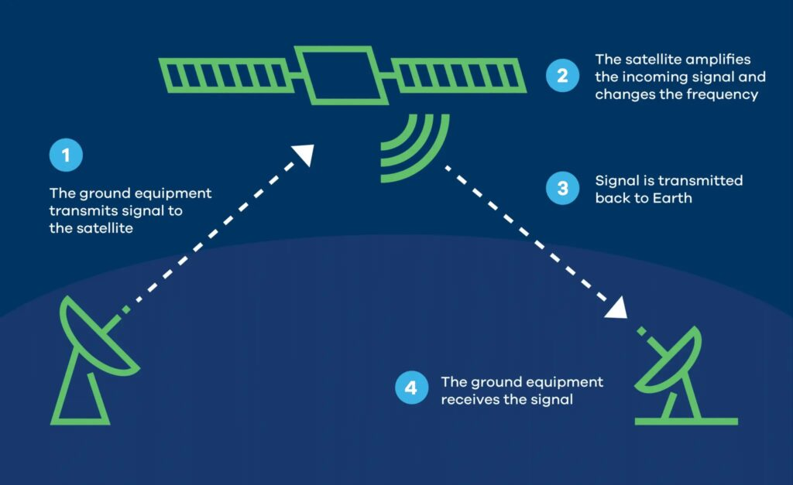
Satellite Communications
Satellite: the main component hosting all hardware and software systems as the central components, orbiting the Earth to facilitate communication over long distances.
Ground Station: Ground stations are terrestrial facilities equipped with antennas and transceivers that communicate with satellites.
They manage the uplink (transmitting signals to the satellite) and downlink (receiving signals from the satellite) transmissions.

Slide 4
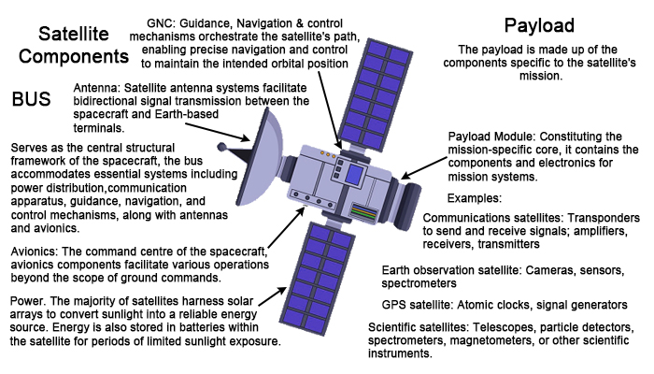
Satellite Components
Communication modules: antenna and repeater are called payload.
Modules that support the payload such as electric power, propulsion, telemetry, tracking, etc. are called platform.

Slide 5
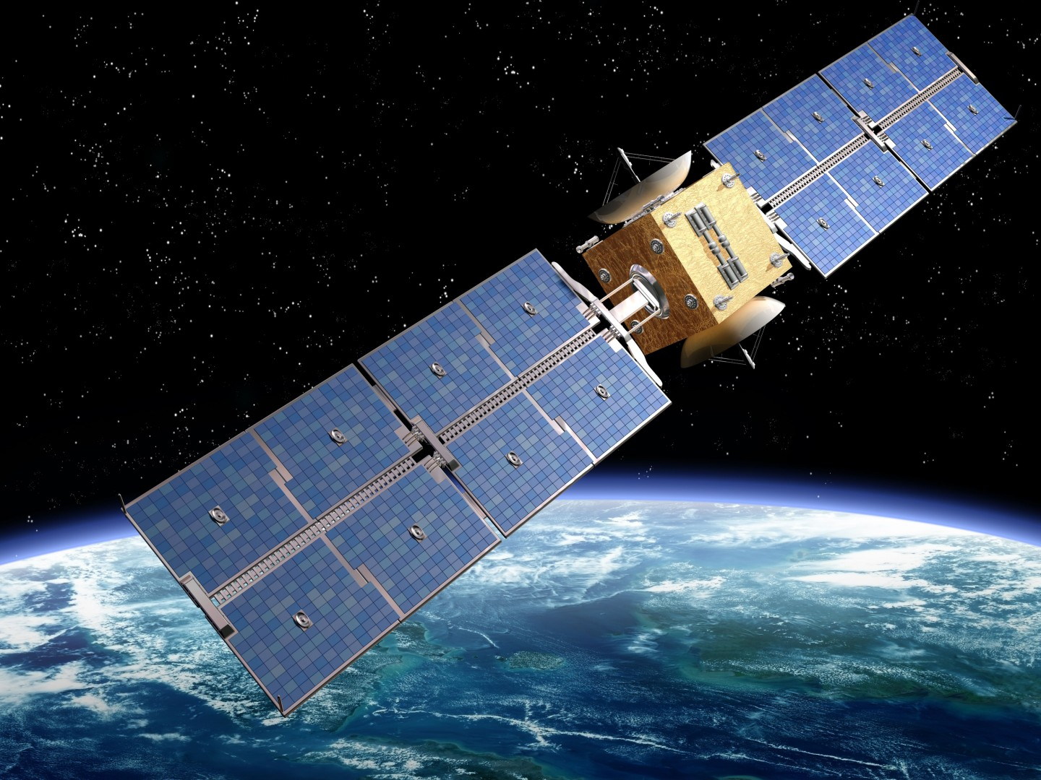
Radiation Influences
Objects in space receive light (and heat) from the sun, but they also radiate heat into the blackness of space. Thermal equilibrium must be obtained.
There are 3 ways to transfer heat, conduction, convection, and radiation. In the vacuum of space, there is no air or other material to conduct or convect heat away from the satellite. Instead, satellites lose heat by emitting infrared radiation.
Satellite temperature highly depends on the payload and can be achieved through passive means (i.e. by radiation) or in case very low temperatures are needed (e.g. radio telescope), coolant (such as liquid helium) is present on-board.
Notes:
Kondukcija (vođenje topline) - dvaju tijela u dodiru.
Konvekcija (strujanje topline) strujanje fluida (tekućina i plinova).
Radijacija (toplinsko zračenje) putem elektromagnetskog zračenja.

Slide 6
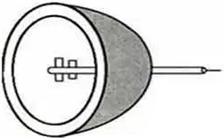
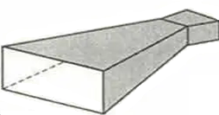

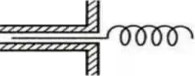
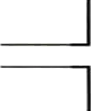
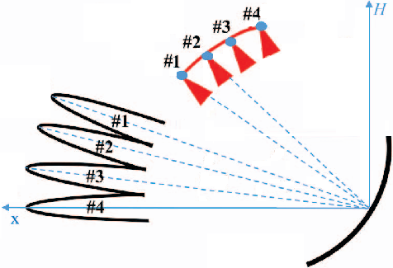
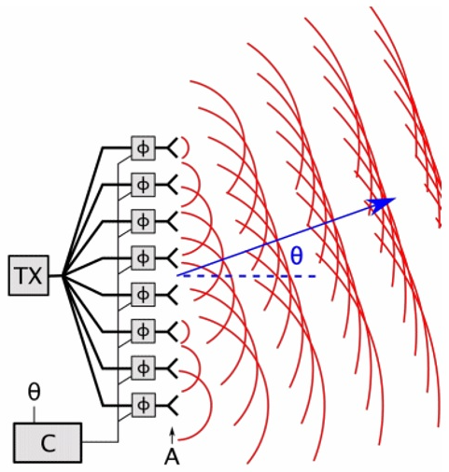
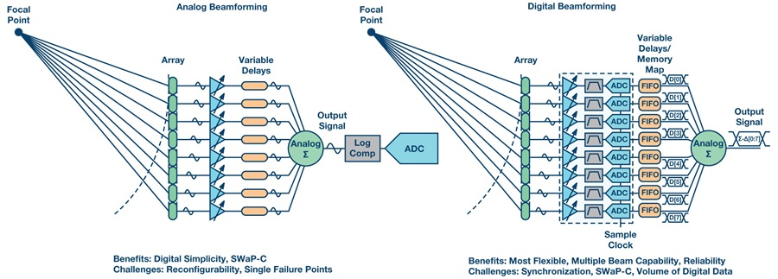
Antennas
Satellite antenna – light and shock-resistant
It must operate in a vacuum and under the Sun radiation
Materials for antenna: Magnesium, Titan, Invar, Beryllium, Copper alloys, Carbon Fiber
Many types:
  Parabolic reflector, Horn, Phased Array, Patch/Microstrip, Helical, Wire, Multibeam

Slide 7
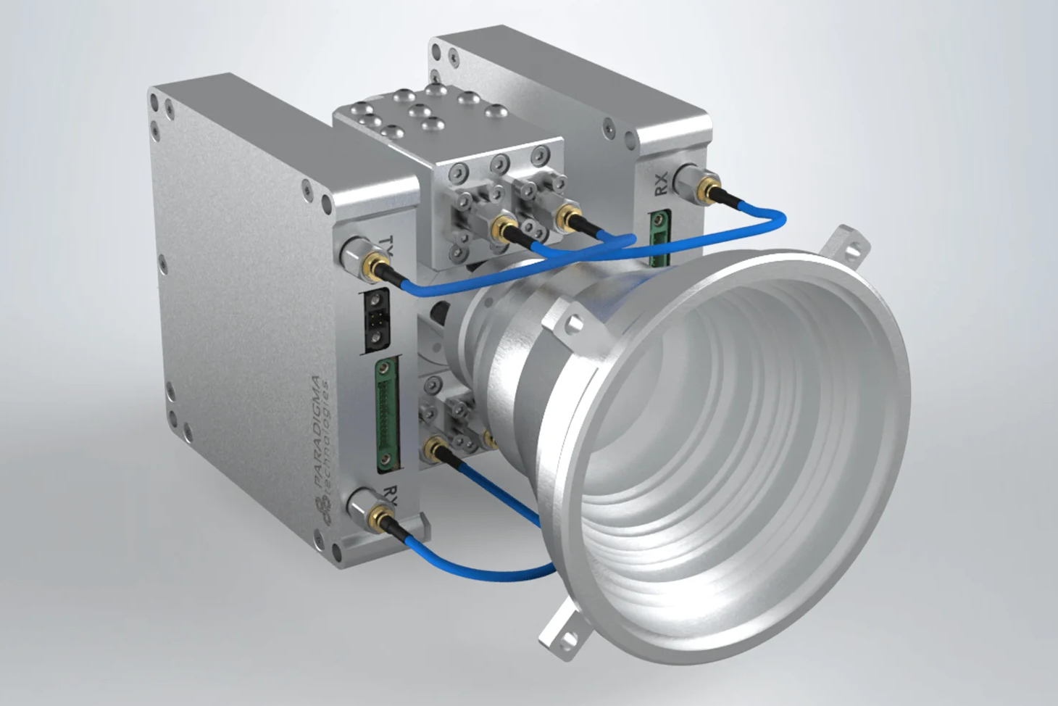
Transponder
Electronic device for receiving and transmitting signals
It is used to receive signal from one or more earth satellite stations and send the signals back to one or more receiving satellite earth stations.
Most common Heterodyne transponder.
Historically, only RF operations were performed usually using bent-pipe transponders and are still popular due to cost and simplicity. Recently regenerative transponders are being more frequently used.
Satellite antenna
Duplexer
LNA
Carrier processor
HPA
Notes:
https://paradigma-tech.com/ka-band-transponder/

Slide 8
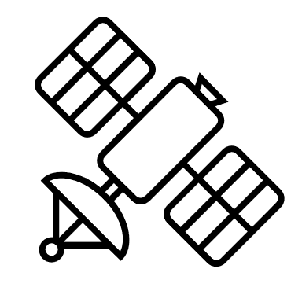
Transponder structure
RF Frequency Mixer
Satellite Repeater
LNA
Band Pass Filter
Demodulator
High Power
Amplifiers
Down Converter
Amplifier
Input Filter
LNA
∿
High Gain Receiving Antenna on Satellite
Local oscillator
Processing
∿
Regenerative
Local oscillator
Input Multiplexer
Output
Multiplexer
High Gain Transmitting Antenna on Satellite
Local oscillator
Modulator
∿
Bent pipe
High Power Amplifier (HPA)
Amplifier
Band Pass Filter
Transmitting Earth station
Receiving
Earth station
RF Frequency Mixer
Duplexer is a two-way microwave gate. It receives uplink signal from the satellite antenna and transmits downlink signal to the satellite antenna.
Low Noise Amplifier (LNA) amplifies the weak received signal.
Carrier Processor performs the frequency down conversion of received signal (uplink). This block determines the type of transponder.
Power Amplifier amplifies the signal power to the required level.

Slide 9
Transponder
Main part of transmitter is the power amplifier.
Amplifiers work with signals from 0.3GHz to 300GHz (1m-1mm wavelength)
RF power amplifiers can be manufactured using a solid-state device like LDMOS, GaN, etc. or using vacuum tubes.
Types of amplifiers: Klystron, Magnetron, Traveling Wave Tubes, Crossed Field Amplifiers, Maser, Klystrons, Velocity modulations, Two cavity KlystronsT…
For usage where comparatively lower power amplification is required, Solid State Power Amplifiers are generally considered. They are further sub-divided into several classes, each with specific characteristics.
SSP amplifiers are commonly seen in the LNAs.
For applications were considerably higher amplification is required, vacuum tubes are considered, for example Travelling wave tube
TWT (Traveling Wave Tube) amplifiers are generally very commonly used in RF communication space due to high amplification, low noise, wide bandwidth and high operating frequencies.

Slide 10
Transponder
Functions | TWTA |  | SSPA
All units have the same linearity, intermodulation, and spectral regrowth performance
 | Advantages | Disadvantages | Advantages | Disadvantages
Linearity and Intermodulation Distortion | TWTA and GaN SSPA are equal |  | GaN SSPA and TWTA are equal
Available Output Power | Higher available output power and at higher frequencies
Efficiency of Operation, i.e. AC Power Consumption | More efficient in the back-off state | High Voltage = 10.000+V |  | High Currents = 100+A
Size and Weight | TWTA packages including power supplies are smaller and weigh less |  | Basic RF modules are but the power supply and required heat sinks make the overall package larger
Heat Dissipation | TWTA power distributed over a relatively large area, making heat sinking a less challenging task |  |  | Power FETs dissipate large amounts of power at a concentrated point. Heat dissipation is currently one of the most challenging problems in SSPA design
Reliability | Many years of reliable operation on spacecrafts/satellites | Limited life from 40,000 to 100,000 hours of continuous operation | Theoretically could have MTBFs greater than 1,000,000 hours | Power Supply reliability is a known SSPA problem
Temperature Stability | TWTs are very stable over temperature | Solid state driver amplifiers need to be temperature compensated |  | SSPAs and driver amplifiers need to be temperature compensated
Noise Power |  |  | 10 dBm better than TWT
Harmonics |  |  | 10 dBc better than TWT
Reliability vs. Temperature | Operate up to 85 degrees C |  |  | Operate up to 65 degrees C

Slide 11
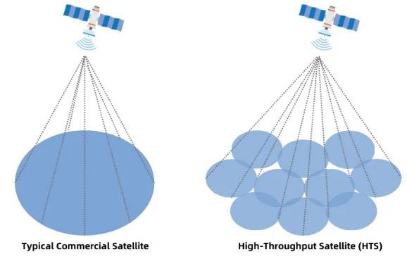
High Throughput Satellites
Challenges of HTS
Spectrum Availability: Securing sufficient spectrum for high data rates and capacity can be challenging due to spectrum congestion and regulatory constraints.
Interference: Coordinating with other satellite systems to avoid interference is crucial, especially in densely populated satellite orbits.
Ground Infrastructure: Establishing a robust ground infrastructure to support HTS operations, including gateway stations and beam hopping support, requires significant investment and coordination.
Cost: HTS development and maintenance can be expensive, including satellite construction, launch, and ground infrastructure costs.
HTS operate in Ka-band or Ku-band frequencies and offer significantly higher amount of data compared to traditional satellites (Tbps vs Gbps).

Slide 12
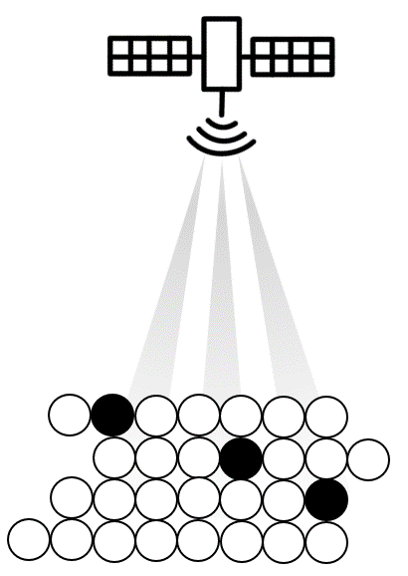
Very High Throughput Satellites (VHTS)
Under development
They are connected to the ground segment by optical technologies (optical feeder links).
Inter-satellite links (ISL) are used to efficiently route data streams over the satellite network.
Beam Hopping
  Adapts to the varying demand in the course of the day
  Facilitates the adaptation of a satellite to new services with a different workload
  Supports coverage for locally fluctuating data traffic from mobile users

Slide 13

NG Satellites - Flexible Payloads
Digital Transparent Processor (DTP) is currently a key technology for telecommunications payload: The ability to sample and digitally onboard process data flows with increasing data rates.
DTP Key performances:
Very wide digitalized bandwidth (many hundreds of MHz)
Many tens of GHz of full capacity
Cost decreases in Mass/consumption/volume per GHz

Slide 14
Single beam coverage
Single beam coverage
Multi-beam coverage
Flexible channelization
Flexible frequency positioning between (sub-) channels
Gain control
Beam forming capability

Slide 15
Thank you

