Slide 1
Satellite Communication Systems

Slide 2
08 Ground Segment

Slide 3
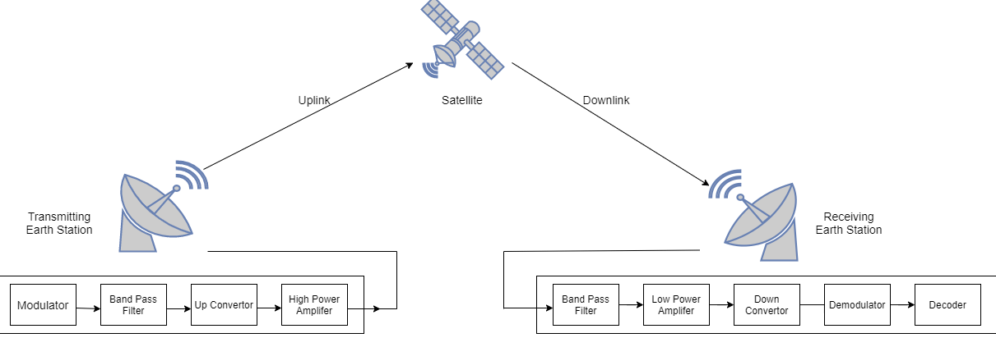
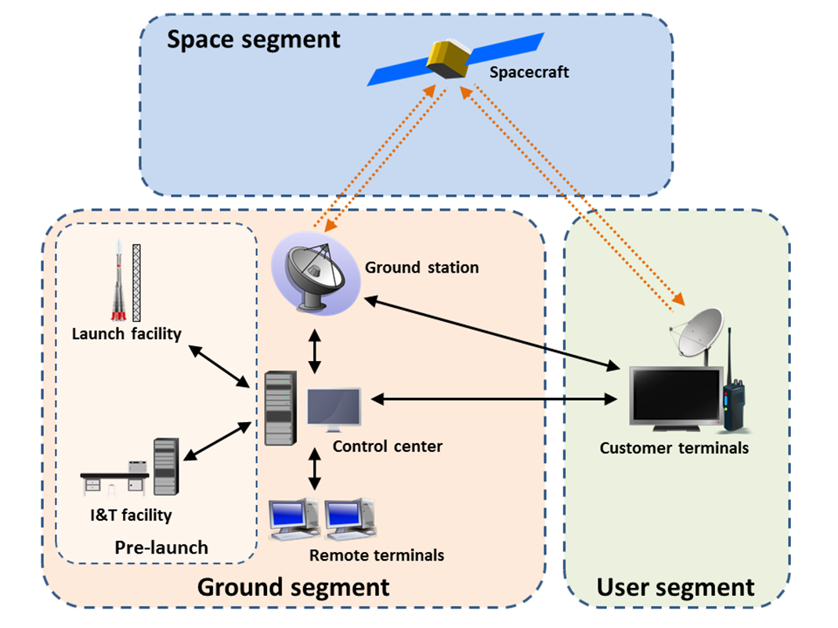
Ground Segment
Simplified, data must be modulated for transmission. Then only intended frequency range must be transmitted. Upconverter converts the intermediate frequency to transmission frequency which is then amplified and transmitted through the antenna.
On receiving sited, the process is reversed.

Slide 4
Earth station scheme

Slide 5
Position Selection
Earth satellite station should not have direct visibility with stations which might interfere transmission.
20 – 50 km is minimal distance from the interfering transmitters
The station should be best placed in a valley.
As far as possible from Sea
In rural area
.

Slide 6
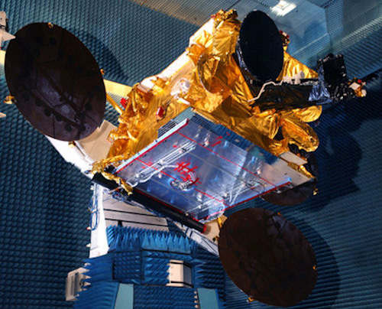
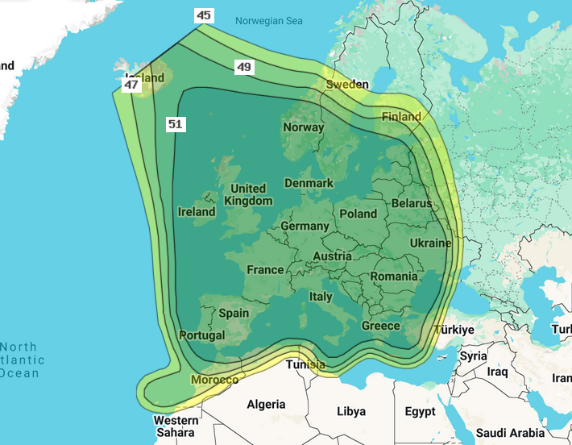
ASTRA 1N example – Satellite
Astra 1N is part of Astra 1 constellation of four high-powered satellites at 19.2°E inclination which are owned and operated by SES. Constellation consists of Astra 1L, Astra 1KR, Astra 1M and Astra 1N, all providing services to Europe and North Africa.
Weight of an Astra 1N satellite is about 5.3 tons.
Satellite is launched in 2011 and designed for mission lifespan of ~16 years (enough fuel for orbit raising, station keeping, end-of-life disposal maneuvers)
Power amplifier used is travelling wave tube (13 kW). EIRP is >50 dBW for Pan-European coverage, falling to ~45dBW at the edges.
It has 52 transponders in Ku band
Channel bandwidth is between 26MHz and 33MHz.
Downlink frequencies are around 10.7-12.75 GHz (both standard Ku-band and extended Ku-band) and uplink frequency is around from 12.7-18.1 GHz.
Notes:
http://frequencyplansatellites.altervista.org/Astra/Astra_1N.pdf
https://sms-teleport.com/astra-1-at-19-2-east/

Slide 7
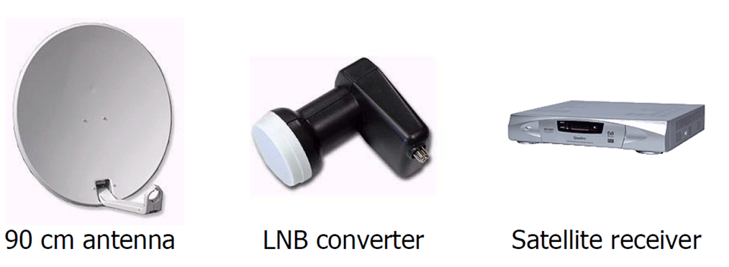
ASTRA 1N example – Components on the receiving side
Satellite
Receiver / IDU
(Indoor Unit)
LNB
converter
Antenna
Antenna characteristics are determined by type of signal received
For Astra 1N, we have Ku band with EIRP of anywhere between 45dBW to 51dBW which would equate to need for parabolic antenna size from 90 to 55cm
~Dish size (with noise figure of 0.7dB)
On the receiving side there is a LNB – Low-Noise Block Down converter connected to the parabolic antenna.
LNB converts the Ku band to a frequency range from 950 MHZ to 2150 MHz (L-Band).
LNB is further characterized by
Gain – for this application, usual is from 50 dB to 70 dB
Filters – usually LTE filters are applied
Cross Pol. Isolation – usually between 22 dB and 25 dB (the higher the better)
Noise figure – usually below 0.5dB (the lower the better)
Return loss, L/O, required power supply…
Called by few names, Receiver, IDU or Satellite Modem
It is the core processing component of the complete system, it performs
Conversion of modulated signals back into baseband digital signals (Demodulation function).
Recovery of the original transmitted data by decoding the modulated signal (Decoder function).
Some other functions, such as providing power for LNB, performing Error Correction, User interface,.
EIRP [dBW] | Dish diameter [cm]
51 | 55
50 | 60
49 | 60
48 | 60
47 | 75
46 | 80
45 | 90

Slide 8
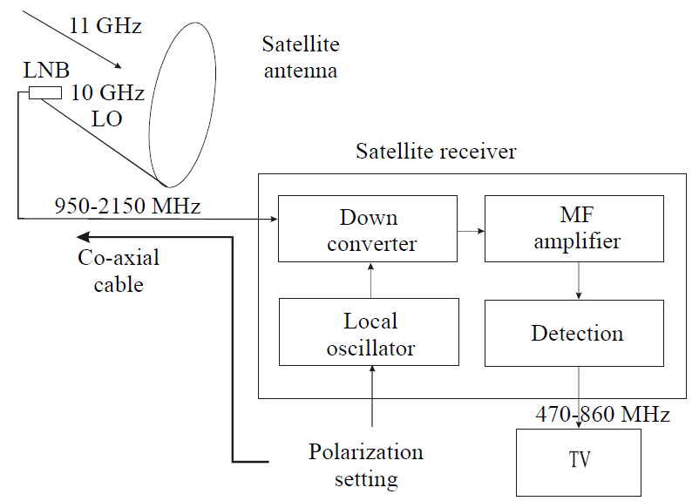
ASTRA 1N example – Architecture

Slide 9
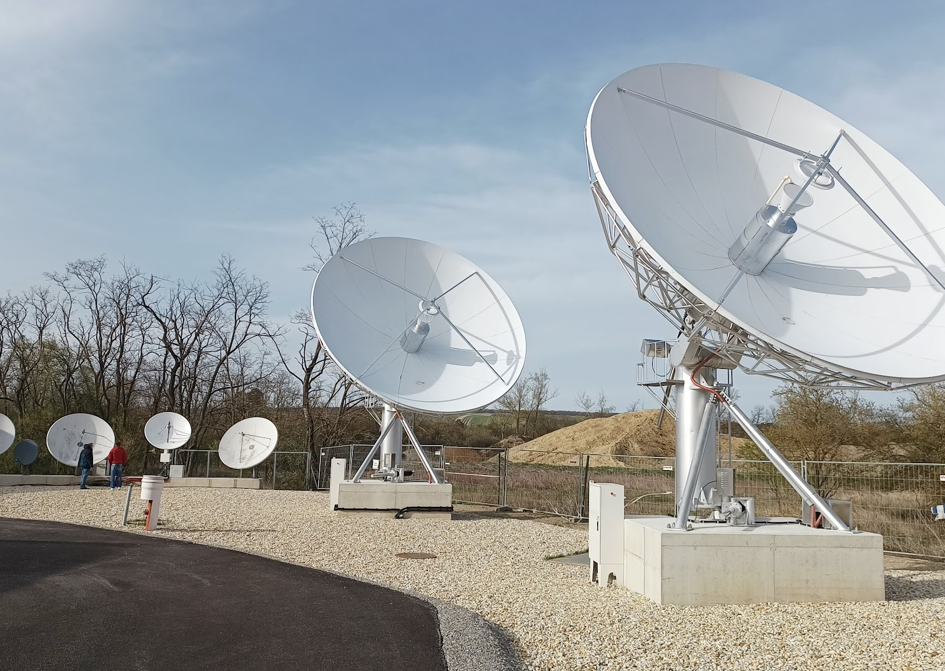
Antennas
Antennas are crucial for both ground stations and satellites.
Ground station antennas transmit signals to satellites and receive signals from them.
General Figure of merit of Antenna is G/T
The G/T (Gain-to-Noise Temperature ratio) of an antenna is a critical figure of merit that measures its performance in receiving weak signals.
It is expressed in decibels per Kelvin (dB/K) and provides insight into the antenna's ability to amplify desired signals while minimizing noise.
G is the antenna gain in decibels at the receive frequency.
T is the system noise temperature in Kelvin (K)
Higher the G/T means better performance in detecting week signals, which is crucial for satellite communication
Satellite antennas in Prottes, Eviden Lab.

Slide 10
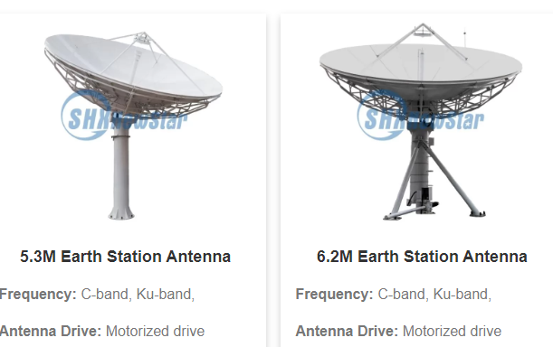
Parabolic antenna geometry
Parabolic antennas have high gain

Slide 11
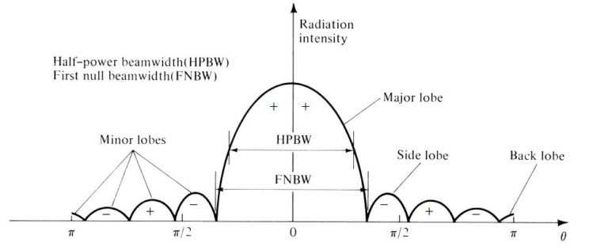
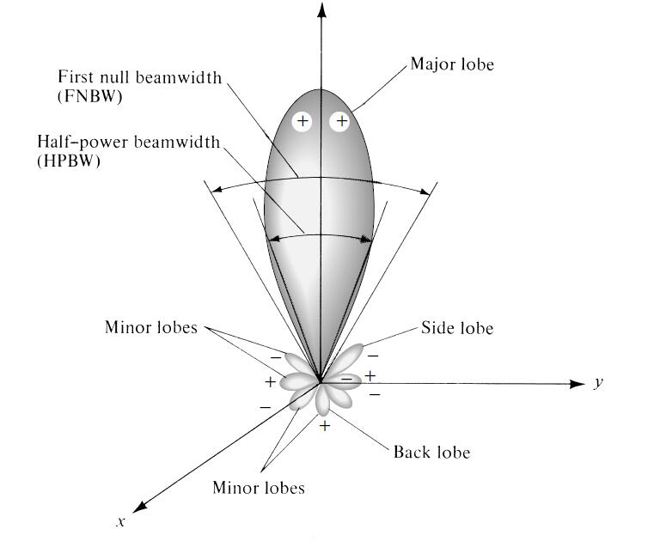
Antenna radiation pattern

Slide 12
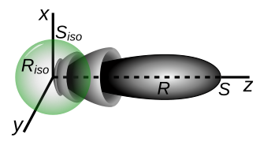
Antenna Gain
For transmitting antenna, the gain describes how well the antenna converts input power into radio waves headed in a specified direction.
For receiving antenna, the gain describes how well the antenna converts radio waves arriving from a specified direction into electrical power.
xyz are power density axes in watts per square meter.
R is the radiation pattern of a directive antenna, which radiates a maximum power density of S watts per square meter at some given distance from the antenna.
R_{iso} is the radiation pattern of an isotropic antenna which radiates the same total power, and S_{iso} is the power density it radiates.
Visualization of gain

Slide 13
Antenna noise temperature
Noise temperature is one way of expressing the level of available noise power introduced by a component or source.
Noise is everywhere, all attributing to the Antenna noise temperature, for example contributing factors are
Sky noise is one of the contributing factors, especially in bands such as Ka or Ku due to atmospheric absorption
Elevation (at lower elevations, antenna collects more noise due to the longer path signal takes through the atmosphere)
Cosmic background radiation (~2.7K)
Ground noise
Weather
Design – Feed, LNA…
Frequency band – Higher frequencies suffer from attenuation due to atmospheric loss, lower frequencies (<3GHz) due to galactic sources
Human made – vehicles, buildings, reflection, scattering..

Slide 14
Antenna maintenance
De-icing & De-hydrating
Ice on the antenna is the main reason for a weak signal during winter.
The antenna is heated with heaters from the rear side.
Temperature sensors determine when heating is needed
Waveguides must be de-hydrated in order to prevent moisture and thus degradation of the signal quality
and then electric current starts to flow through heaters.

Slide 15
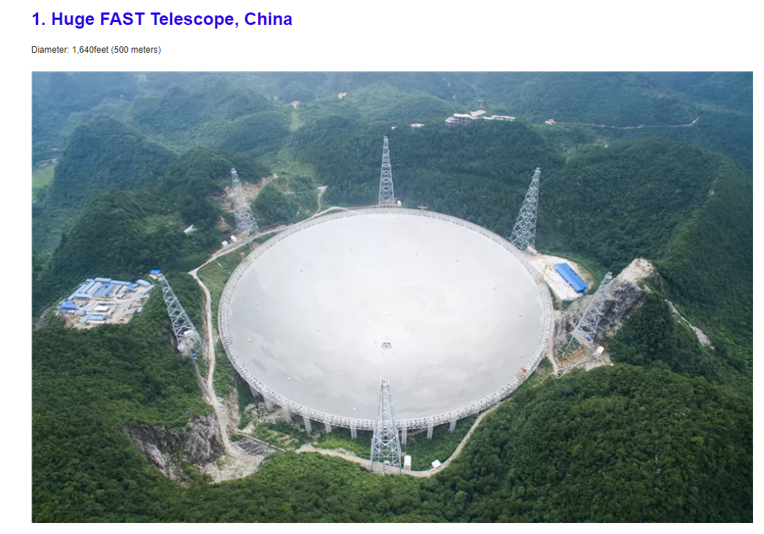
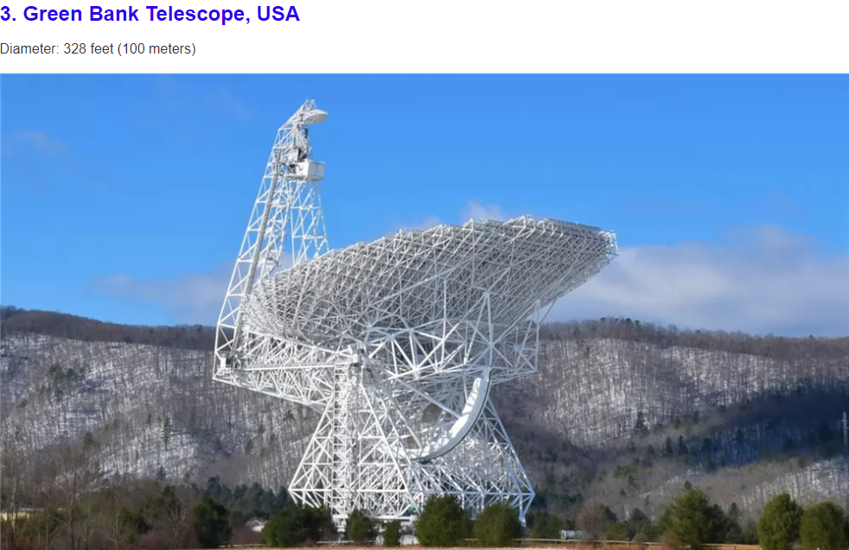
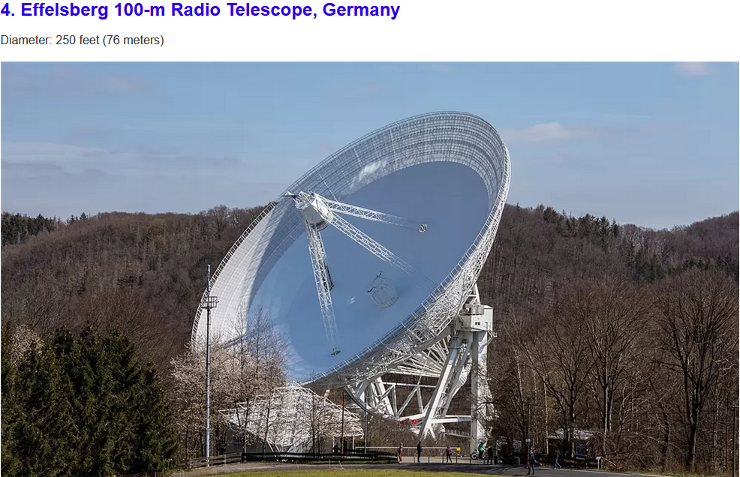
The Largest Antennas
Antenna size usually is derived from its intended use and frequency at which it operates. VSAT antennas usually have diameter from 0.75 m to below 4m and are generally considered for general consumer use. HUBs usually have larger antennas with maximum diameter below 20m. Higher diameter antennas are usually for specialized use.
Notes:
Arecibo, Puerto Rico

Slide 16
VSAT - Very Small Aperture Terminal
Small intelligent earth satellite stations working in a system with one larger HUB earth station and a satellite in GEO orbit.
Usable for broadcasters, banks, airplane companies, oil and gas industry, news gathering, telemedicine, etc...
Terminals can just receive signal, just send signal or both.
Users are arranged in star, mesh or point to point network.
VSAT networks can operate in any band, but are usually mostly used in Ku for consumer broadband and enterprises and in Ka band for high capacity broadband.

Slide 17
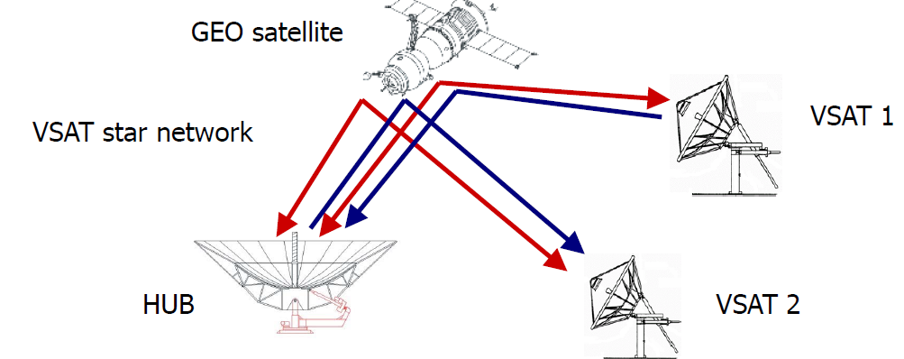
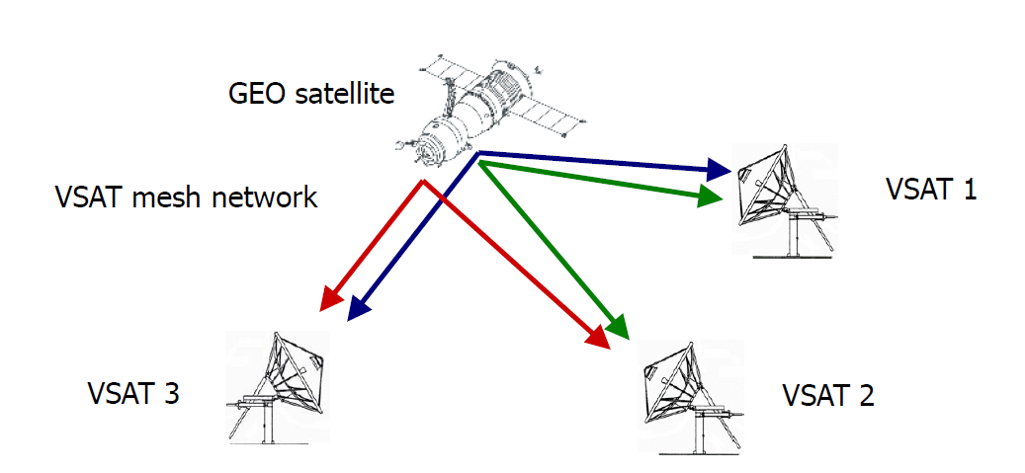
VSAT - Very Small Aperture Terminal
Star and mesh Network.

Slide 18
Thank you

