Slide 1
Satellite Communication Systems

Slide 2
08 Ground Segment

Slide 3
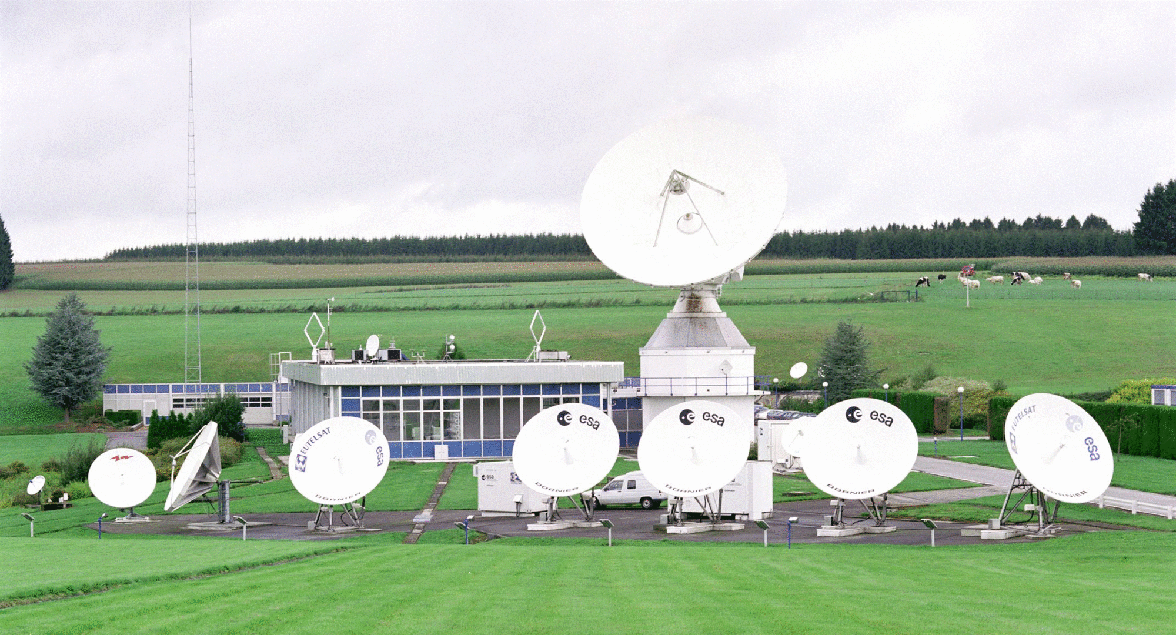
A ground segment consists of all the ground-based elements of a space system used by operators and support personnel
Ground segment refers to the collection of ground-based hardware and software components used to support the operation, communication, and control of satellites orbiting the Earth.
Key components are:
Ground Stations
They consist of antennas, transceivers, amplifiers, and other related equipment that enable the reception and transmission of signals to and from satellites.
Tracking, Telemetry, and Command
The TT&C system is responsible for monitoring and controlling the satellite’s health, position, and operational status.
Mission Control Center
The MCC is the hub of satellite operations, where personnel monitor and control all aspects of the satellite’s mission
Data Processing and Distribution Centers
These centers process, store, and distribute the data collected by the satellites to end-users or other organizations.
User Terminals
User terminals are the end-point devices that receive and transmit data from and to the satellites.
Network Operations Center
The NOC oversees the overall health and performance of the ground segment’s communication networks.
Source:
The European Space Agency - Photo: ©ESA
ESA - Redu facilities
Backup and Redundancy Systems
These systems may involve duplicated hardware, backup power sources, and alternate communication links that can be activated in case of an emergency or system failure.

Slide 4
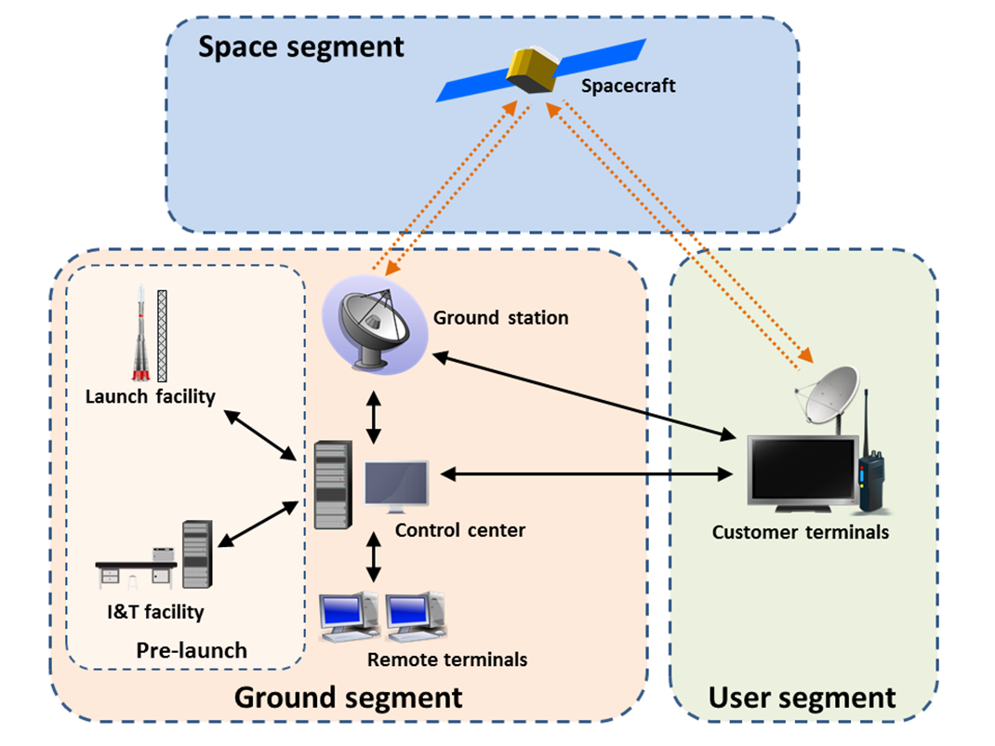
The backbone of satellite networks is the ground segment
Ground stations are vital for satellite operational success and data integrity.
Mission control centers oversee spacecraft telemetry and performance monitoring.
Integration and testing facilities ensure satellite system reliability and functionality.
Ground networks optimize connectivity and enable seamless data exchange in satellite networks.
Source: Ground segment - Wikipedia

Slide 5
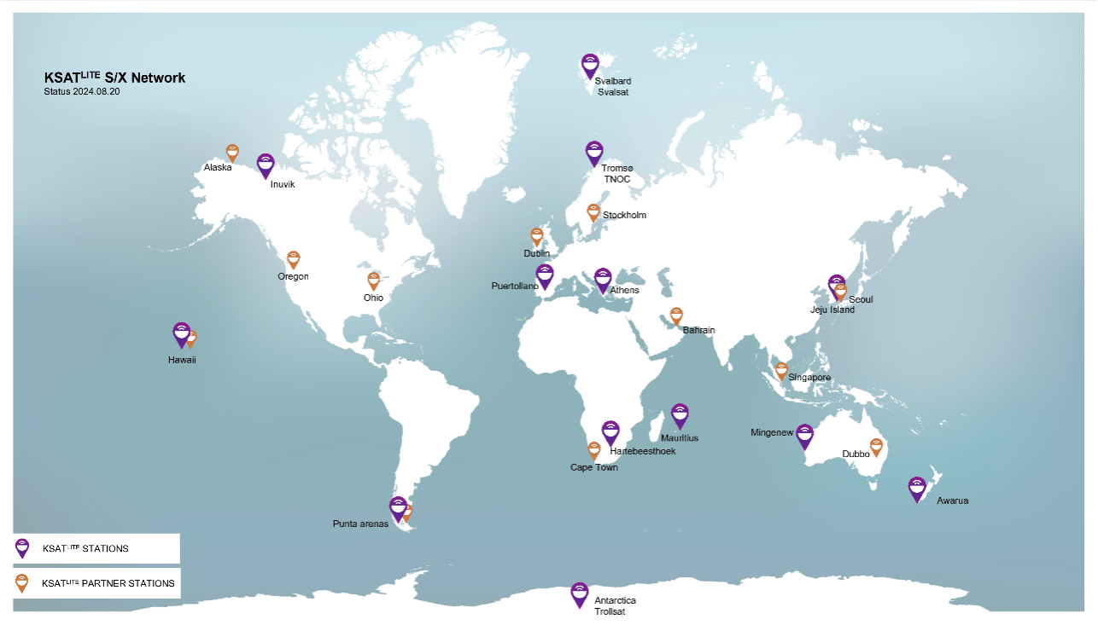
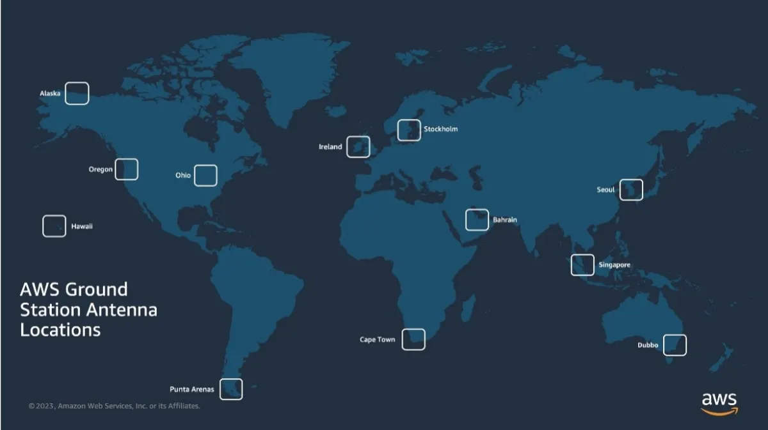
Ground stations are strategically located around the globe to provide continuous coverage and support to orbiting satellites
The baseline of Kongsberg Satellite Services AS (KSAT)’s 3.7-meter KSATLITE antennas provide X-band and S-band for downlink and S-band for uplink. KSAT operates over 100 KSATLITE antennas at 15+ ground station sites across the globe, supporting over 1.5 million passes in 2023 alone.
AWS Ground Station is a managed service that lets customers build ground segment architectures in the cloud to control their satellites, process satellite data, and scale satellite operations without having to worry about building or managing their own antenna infrastructure. Customers can stream satellite data from any of the AWS antennas to the Amazon Elastic Compute Cloud (EC2) for real-time processing or to directly store data in the Amazon Simple Storage Service (S3).
Source: 11.0 Ground Data Systems and Mission Operations - NASA

Slide 6




When selecting a position for a ground station in a satellite communication system, several factors should be considered to ensure optimal functionality and communication efficiency
Properly positioning antennas is essential for maximizing signal strength and quality. Factors such as elevation, obstructions, and interference must be considered to optimize performance. Neglecting antenna placement can result in poor reception and communication issues.
Elevation: Higher elevations provide better line of sight with satellites and reduce the likelihood of signal obstructions from surrounding structures or terrain.
Terrain and Obstacles: The site should have a clear view of the sky to minimize signal interference caused by buildings, trees, or geographical features.
Accessibility: Easy access to the site is crucial for maintenance and repairs. Additionally, good accessibility facilitates the installation of equipment and the delivery of supplies.
.
Environmental Factors: Local weather conditions, potential sources of electromagnetic interference, and adherence to zoning regulations play a significant role in determining the suitability of a site location for a ground station.

Slide 7
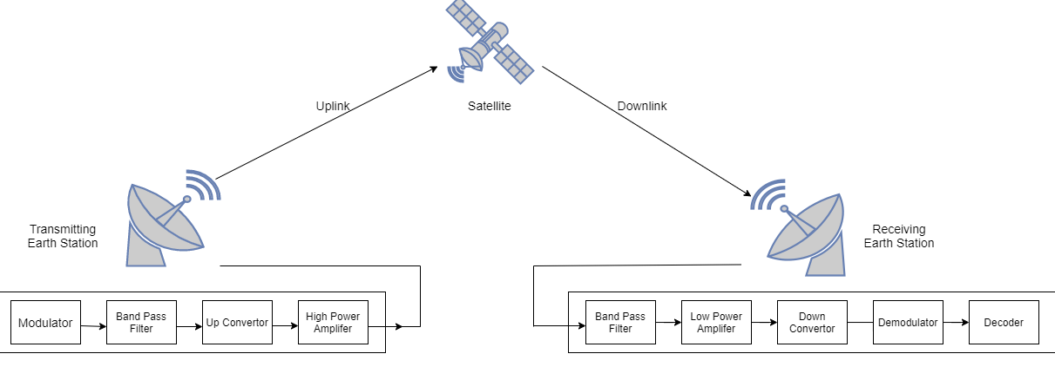
An example transmit and receive block diagram
Simplified, data must be modulated for transmission. Then only intended frequency range must be transmitted. Upconverter converts the intermediate frequency to transmission frequency which is then amplified and transmitted through the antenna.
On receiving sited, the process is reversed.

Slide 8
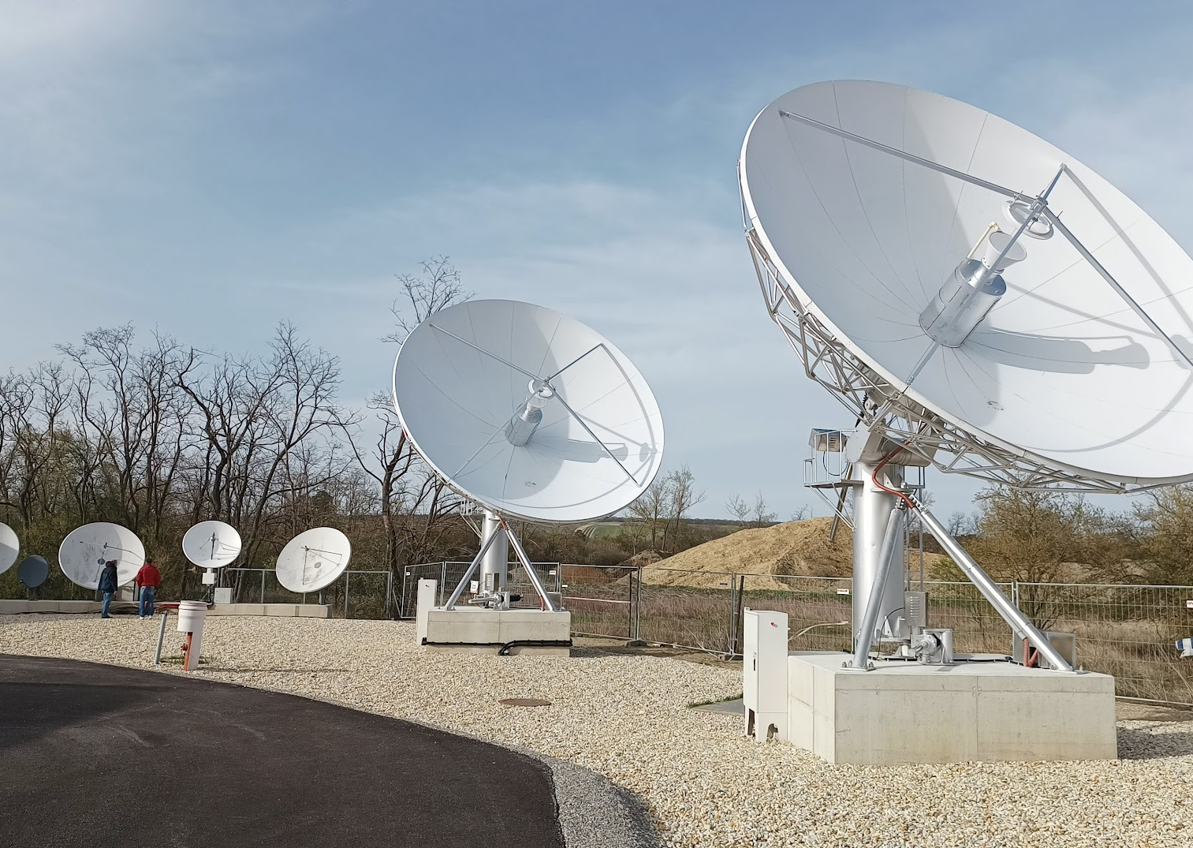
Satellite antennas are essential for satellite communications as they play a crucial role in the transmission and reception of data, voice, and video signals
Antennas are crucial for both ground stations and satellites.
Ground station antennas transmit signals to satellites and receive signals from them.
General Figure of merit of Antenna is G/T
The G/T (Gain-to-Noise Temperature ratio) of an antenna is a critical figure of merit that measures its performance in receiving weak signals.
It is expressed in decibels per Kelvin (dB/K) and provides insight into the antenna's ability to amplify desired signals while minimizing noise.
G is the antenna gain in decibels at the receive frequency.
T is the system noise temperature in Kelvin (K)
Higher the G/T means better performance in detecting week signals, which is crucial for satellite communication
Antenna size usually is derived from its intended use and frequency at which it operates. VSAT antennas usually have diameter from 0.75 m to below 4m and are generally considered for general consumer use. HUBs usually have larger antennas with maximum diameter below 20m. Higher diameter antennas are usually for specialized use.
Satellite antennas in Prottes, Austria, Eviden Lab.

Slide 9
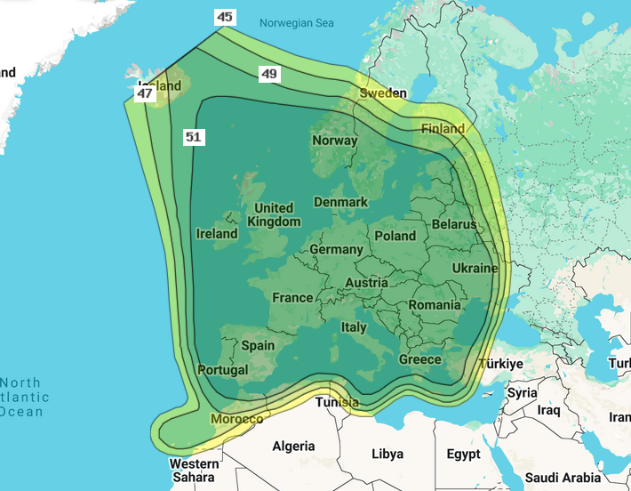
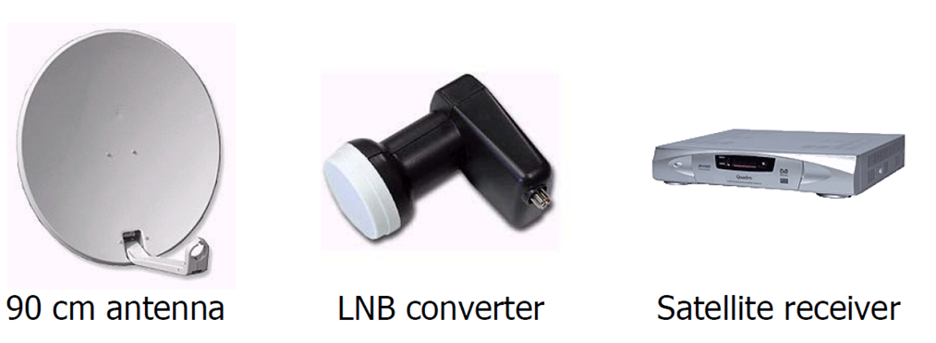
Example of ASTRA 1N
Astra 1N is part of Astra 1 constellation of four high-powered satellites at 19.2°E inclination which are owned and operated by SES. Constellation consists of Astra 1L, Astra 1KR, Astra 1M and Astra 1N, all providing services to Europe and North Africa.
Channel bandwidth is between 26MHz and 33MHz.
Downlink frequencies are around 10.7-12.75 GHz (both standard Ku-band and extended Ku-band) and uplink frequency is around from 12.7-18.1 GHz.
Antenna
Antenna characteristics are determined by type of signal received
For Astra 1N, we have Ku band with EIRP of anywhere between 45dBW to 51dBW which would equate to need for parabolic antenna size from 90 to 55cm
~Dish size (with noise figure of 0.7dB)
EIRP [dBW] | Dish diameter [cm]
51 | 55
50 | 60
49 | 60
48 | 60
47 | 75
46 | 80
45 | 90

Slide 10
ASTRA 1N example – Components on the receiving side
Antenna
LNB
converter
Satellite
Receiver / IDU
(Indoor Unit)
Antenna characteristics are determined by type of signal received
For Astra 1N, we have Ku band with EIRP of anywhere between 45dBW to 51dBW which would equate to need for parabolic antenna size from 90 to 55cm
~Dish size (with noise figure of 0.7dB)
On the receiving side there is a LNB – Low-Noise Block Down converter connected to the parabolic antenna.
LNB converts the Ku band to a frequency range from 950 MHZ to 2150 MHz (L-Band).
LNB is further characterized by
Gain – for this application, usual is from 50 dB to 70 dB
Filters – usually LTE filters are applied
Cross Pol. Isolation – usually between 22 dB and 25 dB (the higher the better)
Noise figure – usually below 0.5dB (the lower the better)
Return loss, L/O, required power supply…
Called by few names, Receiver, IDU or Satellite Modem
It is the core processing component of the complete system, it performs
Conversion of modulated signals back into baseband digital signals (Demodulation function).
Recovery of the original transmitted data by decoding the modulated signal (Decoder function).
Some other functions, such as providing power for LNB, performing Error Correction, User interface,.
EIRP [dBW] | Dish diameter [cm]
51 | 55
50 | 60
49 | 60
48 | 60
47 | 75
46 | 80
45 | 90

Slide 11
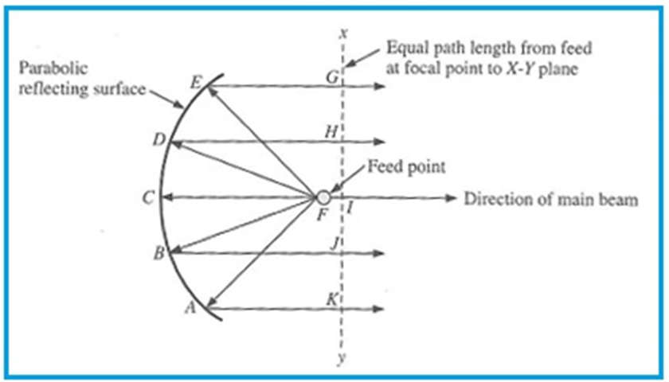
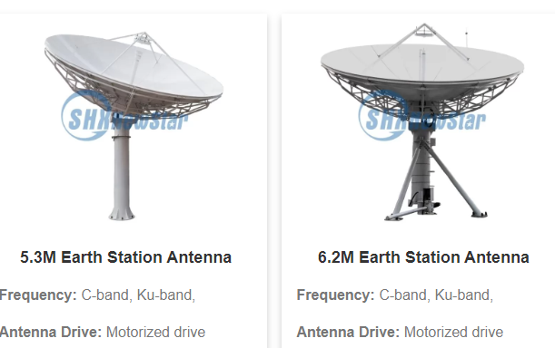
The geometry of a parabolic antenna is defined by its parabolic shape, which focuses incoming waves at a single point, maximizing gain and directivity
The parabolic shape ensures that all waves emanating from the focus reflect off the surface and travel parallel to the axis of the parabola. This property is essential for achieving high directivity and gain, as it allows the antenna to focus energy into a narrow beam.

Slide 12
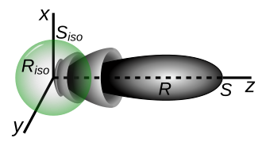
Antenna gain quantifies the ability of an antenna to focus energy in a particular direction, enhancing the signal strength in that direction
For transmitting antenna, the gain describes how well the antenna converts input power into radio waves headed in a specified direction.
For receiving antenna, the gain describes how well the antenna converts radio waves arriving from a specified direction into electrical power.
xyz are power density axes in watts per square meter.
R is the radiation pattern of a directive antenna, which radiates a maximum power density of S watts per square meter at some given distance from the antenna.
R_{iso} is the radiation pattern of an isotropic antenna which radiates the same total power, and S_{iso} is the power density it radiates.
Visualization of gain

Slide 13
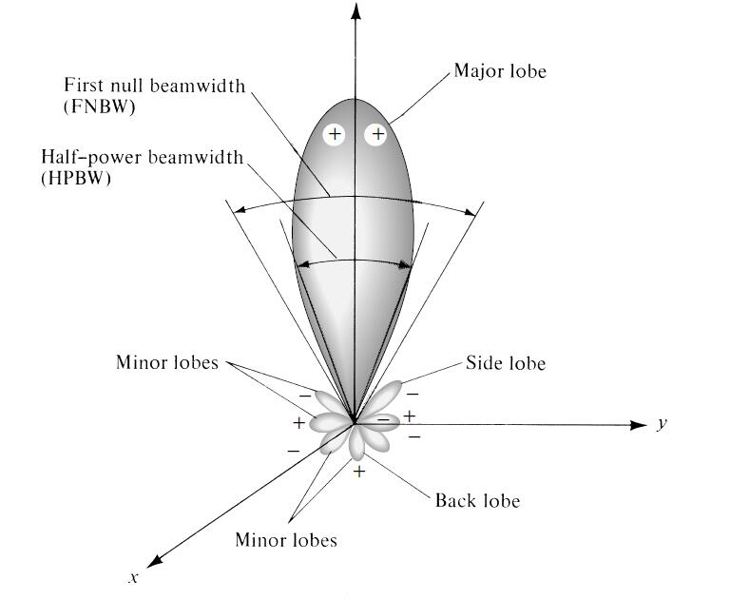
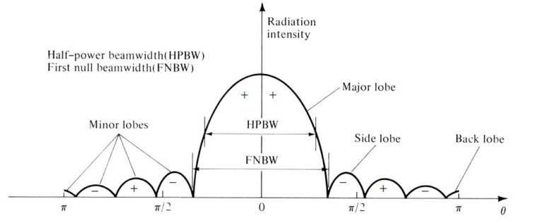
The radiation pattern of an antenna is a graphical representation that illustrates how the antenna radiates energy into space
Main Lobe: The direction in which the maximum radiation occurs. This indicates the antenna's directivity.
Side Lobes: Areas of lesser radiation that occur away from the main lobe. They can indicate unwanted radiation and affect performance.
Back Lobe: Radiation that occurs in the opposite direction of the main lobe, often minimized in well-designed antennas.

Slide 14
Low-noise antennas are essential for receiving weak signals from satellites, where antenna noise temperature plays a critical role in overall system performance
Noise temperature is one way of expressing the level of available noise power introduced by a component or source.
Noise is everywhere, all attributing to the Antenna noise temperature, for example contributing factors are
Sky noise is one of the contributing factors, especially in bands such as Ka or Ku due to atmospheric absorption
Elevation (at lower elevations, antenna collects more noise due to the longer path signal takes through the atmosphere)
Cosmic background radiation (~2.7K)
Ground noise
Weather
Design – Feed, LNA…
Frequency band – Higher frequencies suffer from attenuation due to atmospheric loss, lower frequencies (<3GHz) due to galactic sources
Human made – vehicles, buildings, reflection, scattering..

Slide 15
Regular maintenance of satellite antennas is crucial for ensuring optimal performance, preventing signal loss, and extending the lifespan of the equipment
Proper maintenance is vital to avoid disruptions caused by environmental factors, equipment wear, and misalignment. Regular checks can help identify issues before they escalate, ensuring continuous and reliable service.
Key Maintenance Practices:
Routine Inspections
Cleaning
Lubrication
Alignment Checks
Preventive Maintenance
Example: De-icing & De-hydrating
Ice on the antenna is the main reason for a weak signal during winter.
The antenna is heated with heaters from the rear side.
Temperature sensors determine when heating is needed
Waveguides must be de-hydrated in order to prevent moisture and thus degradation of the signal quality
and then electric current starts to flow through heaters.

Slide 16
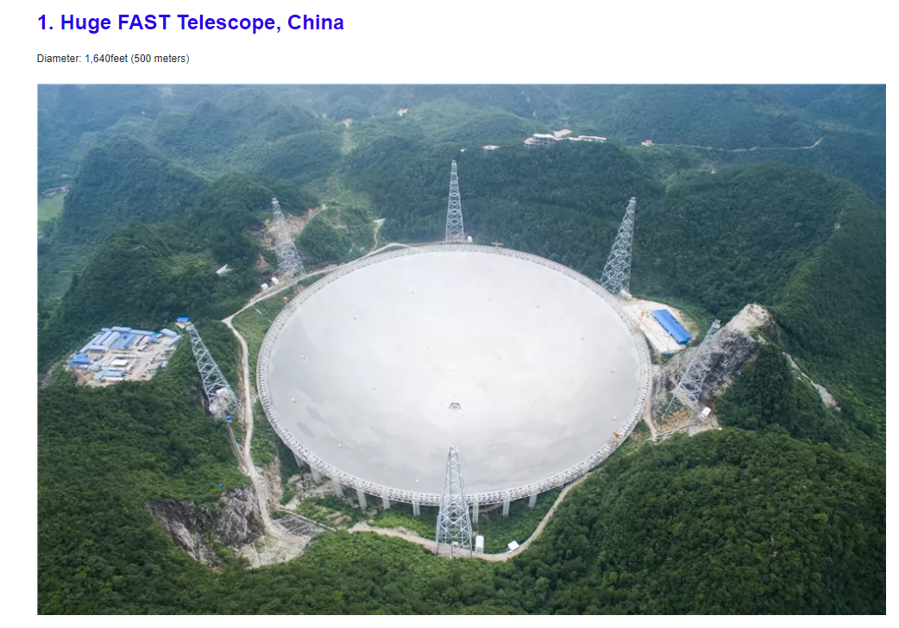
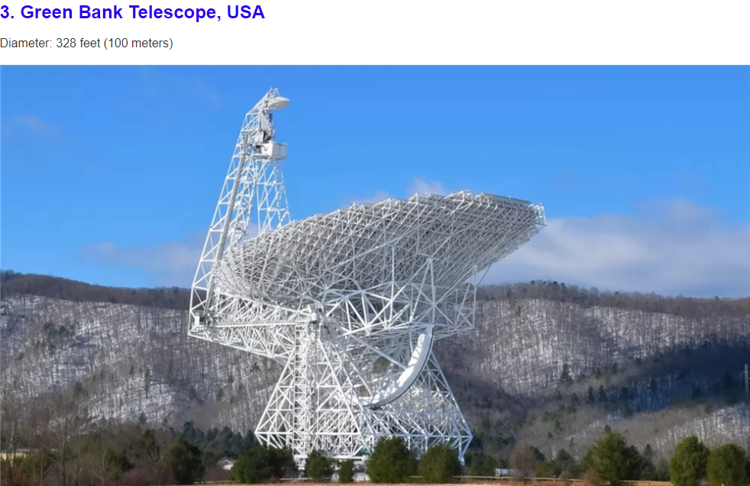
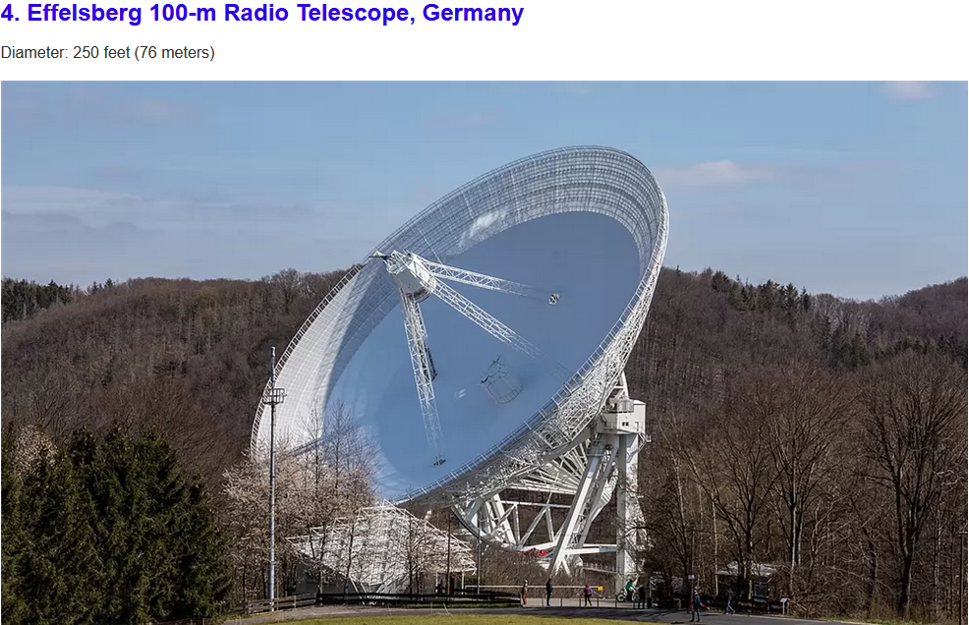
The Largest Antennas
Notes:
Arecibo, Puerto Rico

Slide 17





Utilizing a combination of Very Small Aperture Terminals (VSATs) in star or mesh configurations, ground networks employ advanced data transmission methods to facilitate seamless satellite connectivity
Very Small Aperture Terminals (VSATs)
Small intelligent earth satellite stations working in a system with one larger HUB earth station and a satellite in GEO orbit.
Usable for broadcasters, banks, airplane companies, oil and gas industry, news gathering, telemedicine, etc...
Terminals can just receive signal, just send signal or both.
Users are arranged in star, mesh or point to point network.
VSAT networks can operate in any band, but are usually mostly used in Ku for consumer broadband and enterprises and in Ka band for high capacity broadband.

Slide 18
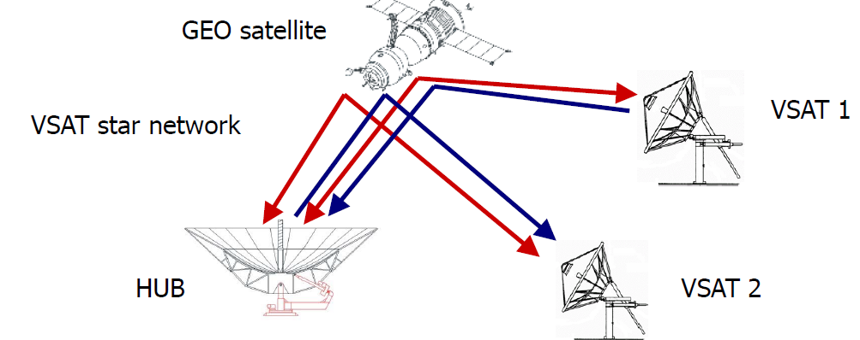
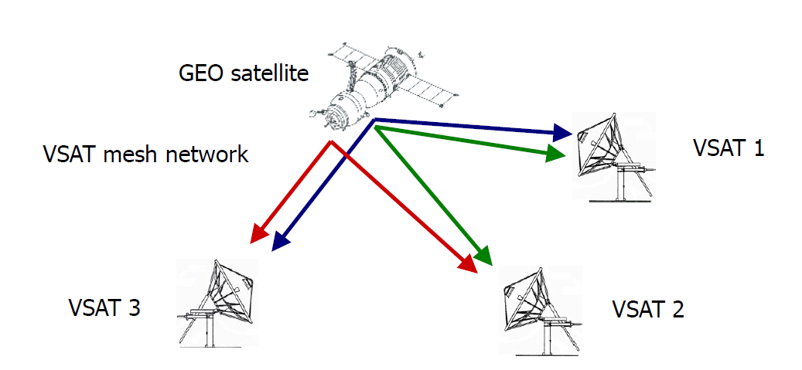
VSAT (Very Small Aperture Terminal) network architecture primarily utilizes two topologies: Star and Mesh, each designed to meet specific communication needs
Broadly, a VSAT network consists of VSAT terminals distributed across different regions on Earth and a Hub station located at one central place. Communication between the Hub station and VSAT terminals is carried out using RF frequencies in different bands (e.g., C band, Ku band) as per applications and regions of use.
In a Star-type VSAT network, all communications occur through the Hub station using multi-hop communication.
In a Mesh-type VSAT network, all communications occur directly between VSATs without the need for a central Hub station.

Slide 19
Thank you

