Slide 1
Satellite Communication Systems

Slide 2
09 ELM Waves Propagation

Slide 3
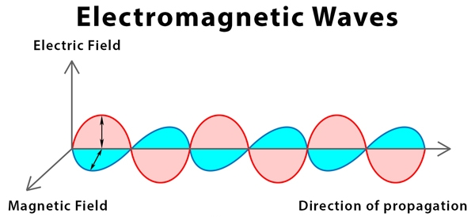
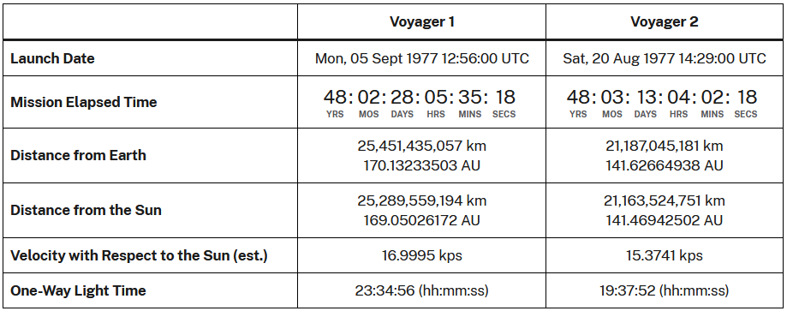
Electromagnetic waves are created as a result of vibrations produced between an electric field and the magnetic field
Characteristics of Electromagnetic Waves:
Motion is similar to transverse waves, except that it does not require any medium to travel
Consist of electric field and magnetic field perpendicular to each other and the direction of propagation
Defined by wavelength, velocity, frequency, amplitude, and time-period.
Velocity of EM waves in vacuum is a constant, c = 3 X 10^8 m/s
While going from one medium to another, EM waves change their wavelength and hence, their speed
Depending upon the type of radiation, EM waves have different sources. For example, x-rays are generated when high energy electrons impact a metal target.
Source: Electromagnetic waves: Definition, Propagation, and Types (sciencefacts.net)
Electromagnetic (EM) waves, also called electromagnetic radiation, are created by the coupling of oscillating electric and magnetic fields, whose directions are perpendicular to each other.
The direction of propagation of the EM wave is perpendicular to both the electric and magnetic field vectors. Unlike mechanical waves, electromagnetic waves do not need a medium to propagate. They can travel in a vacuum with the speed of light. The heat from a burning fire, the light from the sun, the X-rays used by a doctor, and the energy used for cooking food in a microwave are all examples of electromagnetic waves.
https://science.nasa.gov/mission/voyager/where-are-voyager-1-and-voyager-2-now/

Slide 4
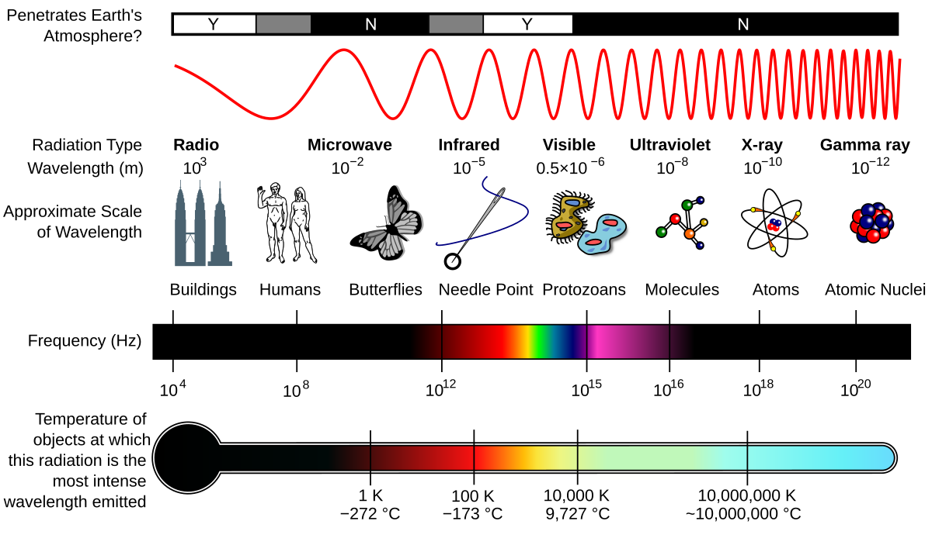
There are seven types of electromagnetic waves – radio wave, microwave, infrared, visible light, ultraviolet, x-rays, and gamma rays
1
Radio waves: radio waves are emitted by radio stations, TV stations, and cellphone towers.
2
Microwaves: Microwaves are used to broadcast information through space as they can penetrate through clouds and light rain.
1km
1cm
10µm
500nm
10nm
100pm
1pm
Infrared: Infrared radiation is thermal radiation that carries heat. They are used in many infrared devices and remote sensing for weather conditions.
3
4
Visible Light: Light is the only part of the electromagnetic spectrum that is visible to the human eye.
5
Ultraviolet: Ultraviolet light is emitted by the sun and is responsible for sunburn.
10 kHz
100 MHz
1THz
1PHz
10PHz
1EHz
100EHz
6
X-rays: X-rays are used for medical purposes. They can penetrate through the skin and tissue and reveal a detailed structure of the interior.
7
Gamma Rays: Distant astronomical bodies emit high energy gamma rays. They are also produced in the laboratory by bombarding subatomic particles with protons and neutrons and during a nuclear explosion.

Slide 5
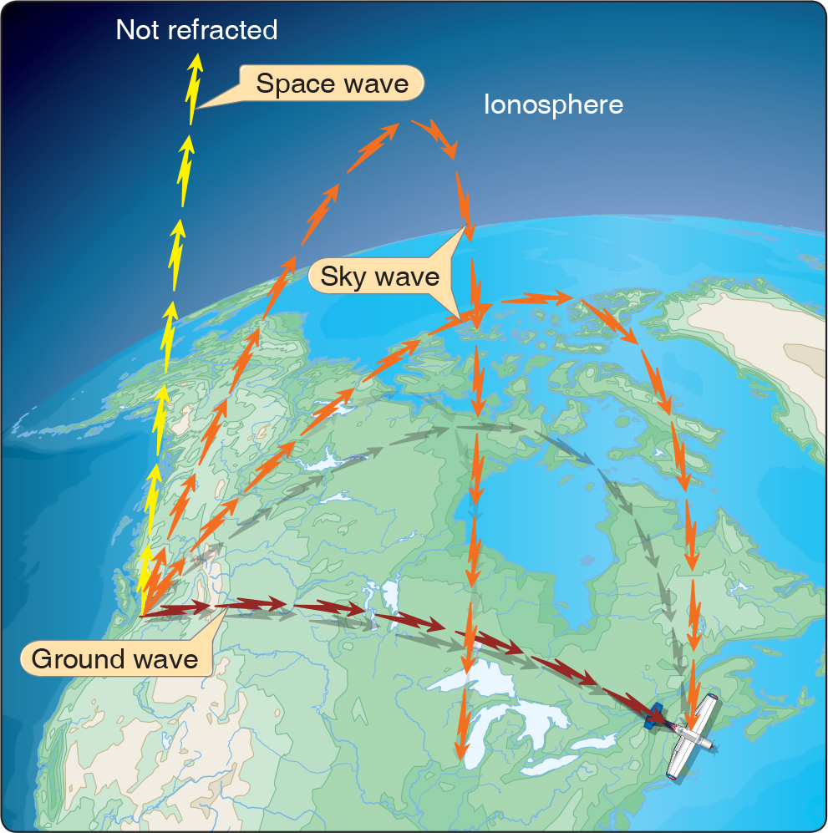
The electromagnetic waves are propagated from the transmitter antenna to the receiver antenna in the following ways
Ground waves
When the electromagnetic waves are propagated along the surface, the propagation is known as ground wave propagation.
Sky waves
When the electromagnetic waves are propagated through the sky and get reflected back to the earth from the ionosphere, the propagation is known as sky wave propagation.
Space waves
When the electromagnetic waves propagate from the transmitter antenna to the receiver antenna without any reflection or refraction, the propagation is known as space wave propagation.

Slide 6
Ground waves propagate over the earth’s surface in low and medium frequencies.
Ground waves
Ground wave propagation is a type of radio propagation which is also known as a surface wave.
These are mainly used for transmission between the surface of the earth and the ionosphere. These are made up of several constituent waves.
It is known as a ground wave because it is the sum of the waves that are reflected by the earth’s surface or any hills. The waves follow the earth’s curvature, enabling them to cover beyond the horizon. Beyond the horizon, the waves get blocked by the earth’s curvature, and the signals are produced by the diffracted surface wave.
Advantages of Ground Wave Propagation
These waves have the tendency to bend around the corners or obstructions during propagation which makes them more efficient and also, these are not affected by the change in atmospheric conditions.
Disadvantages of Ground Wave Propagation
High-frequency waves cannot be transmitted as the energy losses are more because of the energy absorption in the earth’s atmosphere.
These are used to cover short ranges and also involves attenuation of waves as they interact with the eddy currents produced by the surface of the earth.
Applications Ground Wave Propagation
These can be used for one-way communication from the military to submerged submarines as they penetrate to a significant depth into seawater.
AM broadcasting can be done with the help of ground waves.

Slide 7
Sky waves are either the reflected or refracted back waves to the earth from the ionosphere, which is an electrically charged layer of the upper atmosphere
Sky waves
Medium and shortwave frequencies can be refracted back to earth which is beyond the horizon, which makes them useful in the transcontinental transmission of the waves.
Critical frequency is defined as the maximum frequency at which the total internal reflection takes place from the ionosphere.
Skip distance is the minimum distance between the earth’s surface and the radio signal’s transmission point.
Skywave propagation applications:
Satellite communications take place with the help of skywave propagation as it is dependent on the upper atmospheric conditions
Mobile communications

Slide 8
When the electromagnetic waves propagate from the transmitter antenna to the receiver antenna without any reflection or refraction, the propagation is known as space wave propagation
Space waves
Space wave propagation is defined for the radio waves that occur within the 20km of the atmosphere ie; troposphere, comprising of a direct and reflected waves. These waves are also known as tropospheric propagation as they can travel directly from the earth’s surface to the troposphere surface of the earth. It is also known as a line of sight propagation as the signals are sent in a straight line from the transmitter to the receiver.
It is used in various communication systems like:
A line of sight communication and satellite communication
Radar communication
Microwave linking
Space wave propagation limitations:
These waves are affected by the curvature of the earth.
The propagation of these waves happens along the line of sight distance which is defined as the distance between the transmitting antenna and the receiving antenna which is also known as the range of communication.

Slide 9
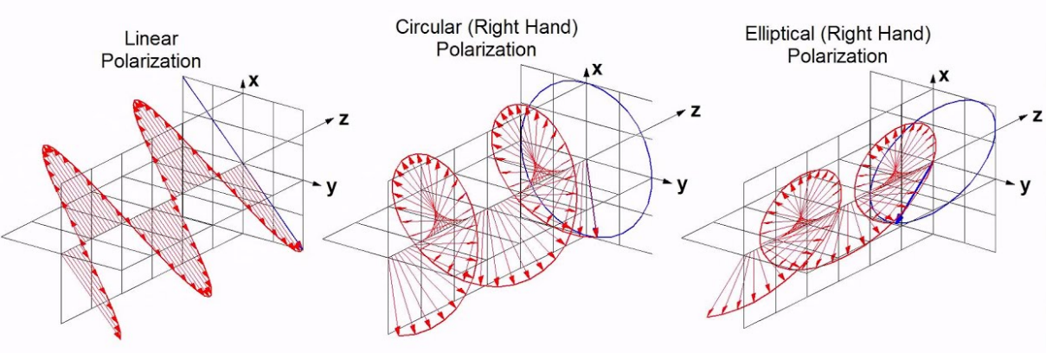
Polarization describes the way the electric field of the radio wave is oriented
In some cases, especially waves that are generated by a natural source, the fields vibrate in multiple random orientations, and are said to be unpolarized. But when waves are generated from, or passed through an intentionally polarizing device, such as an antenna, the fields are restricted in movement and are said to be “polarized.”
Linear Polarization
Vertically and horizontally mounted antennas are designed to transmit or receive vertically and horizontally polarized waves, respectively. Therefore, changes in polarization cause changes in the magnitude of the received signal due to the inability of the antenna to receive polarization changes.
Circular polarization
Circular polarization has the electric lines of force rotating through 360 degrees with every cycle of rf energy. Circular polarization arises by two 90° phase shift income signals and also by plane polarized antennas moving 90° simultaneously.
Elliptical polarization
Elliptical polarization is such that the tip of the electric field vector describes an ellipse in any fixed plane intersecting, and normal to, the direction of propagation

Slide 10
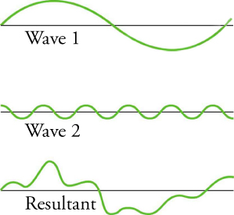
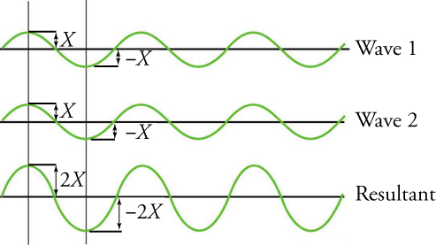
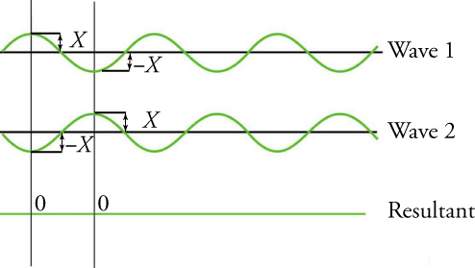
Wave interference is the phenomenon that occurs when two waves meet while traveling along the same medium
Constructive interference
Pure constructive interference occurs when two identical waves arrive at the same point exactly in phase.
When waves are exactly in phase, the crests of the two waves are precisely aligned, as are the troughs. Because the disturbances add, the pure constructive interference of two waves with the same amplitude produces a wave that has twice the amplitude of the two individual waves, but has the same wavelength.
Destructive interference
Because the disturbances are in opposite directions for this superposition, the resulting amplitude is zero for pure destructive interference; that is, the waves completely cancel out each other.
Superposition
While pure constructive interference and pure destructive interference can occur, they are not very common because they require precisely aligned identical waves. The superposition of most waves that we see in nature produces a combination of constructive and destructive interferences.
Source: 13.3 Wave Interaction: Superposition and Interference - Physics | OpenStax

Slide 11
The task of determining the shape of the resultant demands that the principle of superposition is applied
The principle of superposition is sometimes stated as follows:
When two waves interfere, the resulting displacement of the medium at any location is the algebraic sum of the displacements of the individual waves at that same location.
The summing the individual displacements for locations of complete overlap was made out to be an easy task - as easy as simple arithmetic:
Displacement of Pulse 1 | Displacement of Pulse 2 | = | Resulting Displacement
+1 | +1 | = | +2
-1 | -1 | = | -2
+1 | -1 | = | 0
+1 | -2 | = | -1
In actuality, the task of determining the complete shape of the entire medium during interference demands that the principle of superposition be applied for every point (or nearly every point) along the medium

Slide 12

Electromagnetic interference (EMI), also called radio-frequency interference (RFI) when in the radio frequency spectrum, is a disturbance generated by an external source
Both human-made and natural sources generate changing electrical currents and voltages that can cause Electromagnetic interference
Recording of US House of Representatives debate on October 8, 2002, interrupted and distorted by electromagnetic interference from a solar flare
Source: Electromagnetic interference - Wikipedia

Slide 13
Electromagnetic interference divides into several categories according to the source and signal characteristics
The origin of interference, often called "noise" in this context, can be human-made (artificial) or natural.
Continuous, or continuous wave (CW), interference arises where the source continuously emits at a given range of frequencies. This type is naturally divided into sub-categories according to frequency range, and as a whole is sometimes referred to as "DC to daylight". One common classification is into narrowband and broadband, according to the spread of the frequency range.
Audio frequency
Audio frequency, from very low frequencies up to around 20 kHz. Frequencies up to 100 kHz may sometimes be classified as audio. Sources include:
Mains hum from: power supply units, nearby power supply wiring, transmission lines and substations.
Audio processing equipment, such as audio power amplifiers and loudspeakers.
Demodulation of a high-frequency carrier wave such as an FM radio transmission.
Radio frequency interference (RFI)
Radio frequency interference (RFI), from typically 20 kHz to an upper limit which constantly increases as technology pushes it higher. Sources include:
Wireless and radio frequency transmissions
Television and radio receivers
Industrial, scientific and medical equipment (ISM)
Digital processing circuitry such as microcontrollers
Switched-mode power supplies (SMPS)
Broadband noise
Broadband noise may be spread across parts of either or both frequency ranges, with no particular frequency accentuated. Sources include:
Solar activity
Continuously operating spark gaps such as arc welders
CDMA (spread-spectrum) mobile telephony

Slide 14
Noise is the random variation in the signal resulting from natural effects and the physical properties of the receiving system
If the noise level increases, the signal gets progressively harder to understand. When the noise reaches a certain level, the signal becomes unintelligible. This point, in a receiver system, is called the threshold. The receiver threshold determines the minimum signal that must be received to ensure an intelligible signal.
The noise level of the receiver system is determined by a number of factors which vary with the frequency, receiver design and geometry. The principal sources of noise are:
Receiver noise, generated by the electronics in the receiver itself;
Antenna noise, which is noise received from a number of sources by the antenna. The noise can be received by the main beam of the antenna or can be received by the sidelobes, in addition, the noise can be received directly from the radiating source or can be reflected from the ground, buildings or large structures. The main constituents of antenna noise are:
Solar noise - the sun is a major source of radio noise because of its high temperature;
Sky noise - several cosmic sources and the atmosphere itself generate noise;
Ground noise - the Earth itself radiates microwave energy which, if the Earth is in the antenna beam, is received as noise.
One of the fundamental metrics used to express the signal quality is SNR, or signal to noise ratio.
Generally, a higher SNR is better, as it indicates a clearer signal. There is no single number for SNR, as it depends on many factors, but roughly speaking:
SNR | Interpretation | Practical Implication
< 0 dB | Very Poor | Noise dominates; signal is unusable.
0 dB to <10 dB | Poor/Marginal | Signal barely detectable; high error rates; connection may be unreliable.
10 dB to 20 dB | Low/Acceptable | Understandable but with noticeable noise/errors. Often the minimum for a basic data connection.
20 dB to 30 dB | Good | Adequate for most voice and data communications; noise is faint.
> 30 dB | Excellent | Excellent clarity and high data rates with negligible noise.
$${SNR}_{dB}={Signal Power}_{dB}− {Noise Power}_{dB}$$
Descriptive example: https://en.wikipedia.org/wiki/Signal-to-noise_ratio

Slide 15
Several different terms are used to describe the various manifestations of interference
Intermodulation
Whenever two or more carriers are present in the bandwidth of a nonlinear device such as an amplifier, additional spurious signals called intermodulation products are generated.
Often, these intermodulation products will fall in adjacent channels and will cause interference.
Co-Channel Interference
This general term is used to describe any interference which results from a transmission at the same frequency as the wanted signal. It can come from another earth station, satellite or, in some cases, from another repeater on the same satellite.
Adjacent Channel Interference
This is used to describe interference in one channel caused by the sidebands of the adjacent channel, generally being transmitted by the same earth station or satellite.
Cross Polar Interference
This interference results from signals being transmitted on the opposite polarisation to the wanted signal leaking across to the intended received polarisation. This can occur because rain, for example, can cause the polarisation of a signal to rotate slightly resulting in a component in the opposite polarisation. It can also result from non-infinite isolation between opposite polarisations in an antenna, for example.

Slide 16
Thank you

