Slide 1
Satellite Communication Systems

Slide 2
10 Radio frequency bands

Slide 3
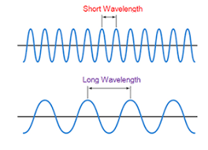
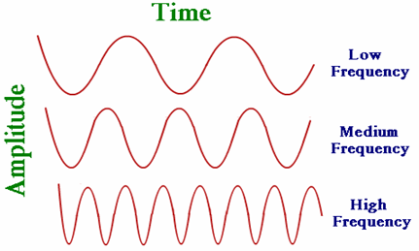
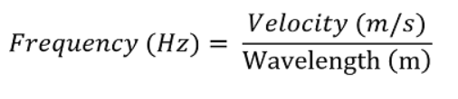
Radio frequency (RF) is a measurement representing the oscillation rate of electromagnetic radiation spectrum, or electromagnetic radio waves
Radio frequency is measured in units called hertz (Hz), which represent the number of cycles per second when a radio wave is transmitted. One hertz equals one cycle per second; radio waves range from thousands (kilohertz) to millions (megahertz) to billions (gigahertz) of cycles per second.
In a radio wave, the wavelength is inversely proportional to the frequency. Radio frequencies are not visible to the human eye. As the frequency is increased beyond that of the RF spectrum, electromagnetic energy takes the form of microwaves, infrared radiation (IR), visible, ultraviolet, X-rays and gamma rays.
Relationship between frequency and wavelength

Slide 4
The radio frequencies spectrum is the part of the electromagnetic spectrum with frequencies in the range between 300 Hz and 300 GHz
Name
Frequency range
Wavelength
Application
Extremely low frequency (ELF)
300 – 3000 Hz
100 – 1000 km
This frequency band is used for underwater communication
Very low frequency (VLF)
3 – 30 kHz
10 – 100 km
Navigation, communication on large distances
Low frequency (LF)
30 – 300 kHz
1 – 10 km
Navigation, ship communication
Medium frequency (MF)
300 – 3000 kHz
100 – 1000 m
AM radio, navigation
High frequency (HF)
3 – 30 MHz
10 – 100 m
Broadcasting, point to point around Earth
Very high frequency (VHF)
30 – 300 MHz
1 – 10 m
Radio and TV broadcasting, mobile services
Ultra high frequency (UHF)
300 – 3000 MHz
10 – 100 cm
Mobile telephony, satellites, radar
Super high frequency (SHF)
3 – 30 GHz
1 – 10 cm
Microwave links, satellite communications
Extremely high frequency (EHF)
30 – 300 GHz
1 – 10 mm
Radio astronomy, satellite broadcasting, communication satellites, weather satellites

Slide 5
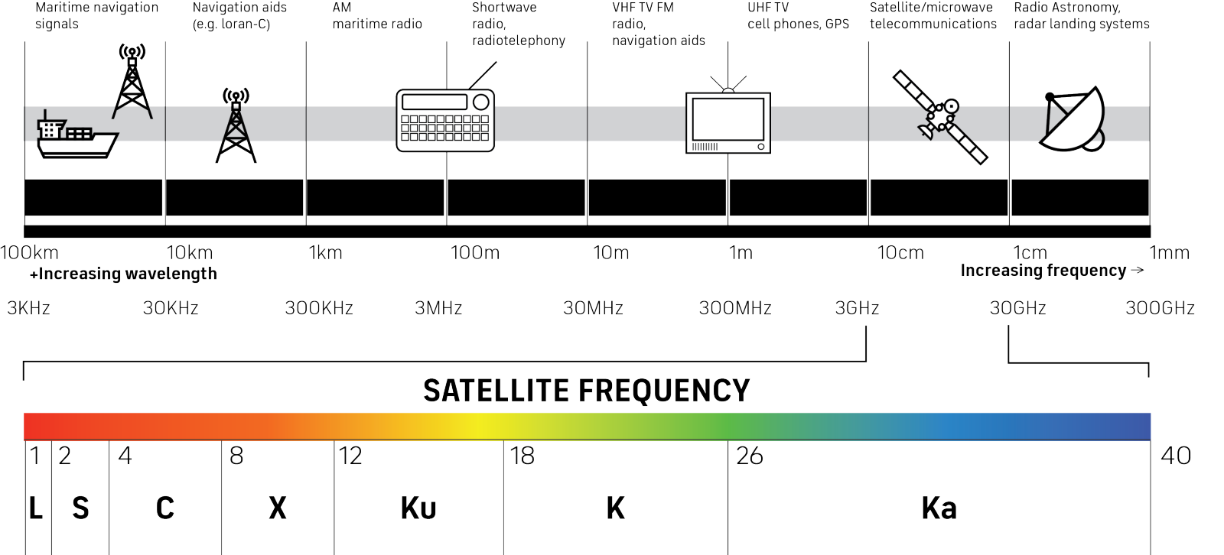
Communication satellites use multiple frequencies bands to transmit information
Source: A straightforward introduction to satellite communications (inmarsat.com)

Slide 6
The most common frequencies used in satellite communications are L-band, C-band, S-band, and Ka-band
L-BAND FREQUENCY
S-BAND FREQUENCY
C-BAND FREQUENCY
Ka-BAND FREQUENCY
L-band frequencies operate at 1-2 GHz range on the electromagnetic spectrum and are used for many radars and GPS services. With a low bandwidth and low frequency range, L-band is not suitable for streaming applications like video, voice, and high-speed broadband connectivity. But is perfect for applications such as fleet management, asset tracking, Internet of Things (IoT) and maritime and aviation safety services.
S-band frequencies operate at 2-4 GHz and are used for satellite communication and radar. S-band is of key importance to the shipping, aviation, and space industries.
C-band operates in the 4-8 GHz range of the electromagnetic spectrum.
With antennas reaching 1.8 meters – 2.4 meters long, C-band satellites relay a direct, end-to-end signal, primarily used for satellite communications, full-time satellite TV networks and raw satellite feeds, which are useful in areas impacted by heavy rain to extreme climate related weather.
Ka-band measures at 27-40 GHz on the electromagnetic spectrum and primarily offers satellite internet that requires high data transfers.
This higher power frequency supports applications that need a higher bandwidth, such as video conferencing, live streaming, high-speed internet for services such as inflight Wi-Fi, and multi-media applications. This frequency also makes it easier to offer satellite internet in residential and remote regions on the planet.

Slide 7
L-band frequencies operate at 1-2 GHz range on the electromagnetic spectrum and are used for many radars and GPS services
Frequency Band Designation | Frequency Range | Wavelength
L Band | 1 to 2 GHz | 30 to 15 cm
Following are the advantages of L Band over other frequency bands.
L-band signals have good penetration capabilities which is used in NLOS conditions for communication.
L band signals are less susceptible to atmospheric interference which makes them more reliable for communication and sensing in challenging environmental conditions.
Shorter wavelength of L band can make use of relatively compact antennas, which is practical for mobile and portable communication devices.
Many L band systems such as GPS and satellite phones offer global coverage which ensures connectivity in remote and inaccessible areas.
L-band signals are less prone to multipath interference.
Following are the disadvantages of L Band.
L band frequencies have limited bandwidth which can restrict data rates achievable in communication systems compared to high frequency bands.
In radar applications, L band frequencies offer lower resolutions compared to higher band frequencies. This can limit its suitability for some surveillance and imaging tasks.

Slide 8
S-band frequencies operate at 2-4 GHz and are used for satellite communication and radar
Frequency Band Designation | Frequency Range | Wavelength
S Band | 2 to 4 GHz | 15 to 7.5 cm
Following are the advantages of S Band :
S band offers good balance between resolution and range in radar systems which make them versatile for various surveillance and detection applications.
S band systems are known for their reliability and resistance to signal interference which makes them suitable for critical applications in aviation and maritime industries.
S band radar provides more accurate data due to their relatively smaller wavelengths which is used for weather forecasting and air traffic control (ATC).
Satellite communication systems operating in S band offer global coverage which ensure connectivity in remote and other underserved areas.
Following are the disadvantages of S Band :
S-band frequencies can be affected by rain attenuation particularly in heavy rainfall areas. This may require additional mitigation measures for reliable communication.
S band systems often require larger antennas compared to L band systems. This may be a limitation in certain applications where antenna size and weight is a major concern.

Slide 9
C-band operates in the 4-8 GHz range of the electromagnetic spectrum
Frequency Band Designation | Frequency Range | Wavelength
C Band | 4 to 8 GHz | 7.5–3.75 cm
Following are the advantages of C Band:
Less interference from heavy rain fading
Cheaper bandwidth compared to other bands
It has wider and global coverage.
It has lower propagation delay.
It has less attenuation compared to other bands.
Following are the disadvantages of C Band:
Antenna size is large.
Throughput is less compared to other bands.

Slide 10
Ka-band measures at 27-40 GHz on the electromagnetic spectrum and primarily offers satellite internet that requires high data transfers
Frequency Band Designation | Frequency Range | Wavelength
Ka Band | 27 to 40 GHz | 1.1 to 0.75 cm
Following are the advantages of Ka Band Frequency over other frequency bands.
It allows high speed data communication.
It allows use of smaller dish antennas with diameters (0.9 meters).
Due to small antenna sizes, installation is cheaper and easier.
The disadvantages of Ka band are as follows.
It has significant signal attenuation due to rain fading.

Slide 11

Management of the RF spectrum is a complicated policy issue, with various entities at the national and international level providing oversight and coordination
The radio frequency (RF) spectrum is a critical component of space activities. Nearly every satellite uses some portion of the RF spectrum to communicate with the ground or other satellites. As the RF spectrum is a limited natural resource, the increase in the number of terrestrial and space users leads to RF congestion that could result in unintentional radio frequency interference (RFI). Natural events such as space weather can also create RFI, as can intentional activities such as jamming. Management of the RF spectrum is a complicated policy issue, with various entities at the national and international level providing oversight and coordination. With a growing number of space actors and reliance on space, RFI is a significant challenge for ensuring space sustainability and security.
Radio regulations are necessary to ensure an efficient and economical use of the radio-frequency spectrum by all communications systems, both terrestrial and satellite. While so doing, the sovereign right of each state to regulate its
telecommunications must be preserved. It is the role of the ITU to promote, coordinate, and harmonize the efforts of its members to fulfil these possibly conflicting objectives.
ITU is the United Nations specialized agency for information and communication technologies (ICTs). The Organization is made up of a membership of 193 Member States and more than 1000 companies, universities and international and regional organizations. Headquartered in Geneva, Switzerland, and with regional offices on every continent, ITU is the oldest agency in the UN family – connecting the world since the dawn of the telegraph in 1865.​
ITU facilitates international connectivity in communication networks. ITU allocates global radio spectrum and satellite orbits, develops the technical standards that ensure networks and technologies connect seamlessly, and works to improve access to digital technologies in underserved communities worldwide. ITU works to bring digital connectivity to everyone, providing a trusted, multilateral platform to broker international agreements and standards, share knowledge, build capacity, and work with members and partners to spread access to technology around the world.​​
https://www.itu.int/

Slide 12
Thank you

