Slide 1
Satellite Communication Systems

Slide 2
11 Link Budget and Design

Slide 3
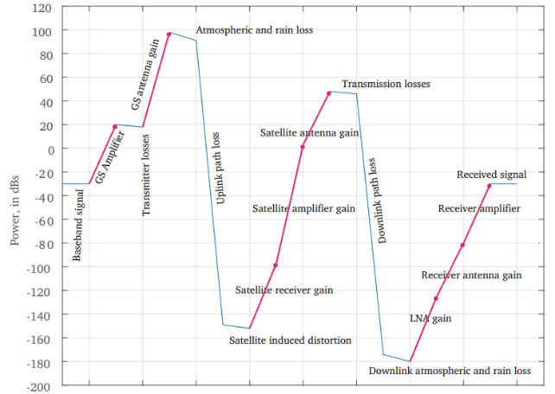
A typical satellite signal is gaining and losing power, finally arriving at the destination with just enough power to be decoded
The red lines show the injection of power by the amplifiers and the antennas, and the blue lines show the attenuation at various points in a line of sight satellite uplink and downlink. We need to have the signal arrive at a given threshold of power. Any less and, the receiver will not be able to decode it. Any more would be wasted. This process of arriving at the threshold required power, while considering all intermediate losses and gains, is called doing the link budget.
Source: Langton C.: Doing Link Budgets

Slide 4


In a Satellite communication system, a link budget analysis is the detailed investigation of signal gains and losses moving through a channel from a sender to receiver
Satellite link budget analysis accounts for all the power gains and losses that an RF signal experiences, from a transmitter, through the communication medium, to the receiver
A link budget analysis is required to determine the maximum efficiency.
A link budget is a comprehensive calculation to predict the performance of a radio communication link.
Effective Isotropic Radiated Power (EIRP): The power radiated by the transmitter into a given direction.
Path Loss: The attenuation of signal strength as it travels through free space.
Receiver Sensitivity: The minimum signal power level at which the receiver can detect a signal with an acceptable error rate.
Satellite
Transmitted signal
Receiving signal
Downlink
Uplink
Transmitting antenna
Receiving antenna

Slide 5
The basic block diagram
Transponder
Uplink
RX
Demodulator
Switch
Modulator
High power amplifier
Downlink
Demodulator
Modulator
High power amplifier
Satellite
Uplink
Downlink
Transmitting antenna
Receiving antenna
Baseband signal input
Encoder
Modulator
Up converter
High power amplifier
Low noise amplifier
Down converter
Demodulator
Encoder
Baseband signal

Slide 6


There are two types of link budget calculations since there are two links namely, uplink and downlink
Uplink
Downlink
It is the process in which earth is transmitting the signal to the satellite and satellite is receiving it. Its mathematical equation can be written as:
In this process, satellite sends the signal and the earth station receives it. The equation is same as the satellite uplink with a difference that we use the abbreviation “D” everywhere instead of “U” to denote the downlink phenomena. Its mathematical equation can be written as;
is the carrier to noise density ratio
is the satellite receiver G/T ratio and units are dB/K. G/T represent noise performance.
Boltzmann's Constant = -228.6 (dBK)
is the carrier to noise density ratio
is the earth station receiver G/T ratio and units are dB/K
Boltzmann's Constant = -228.6 (dBK)
Equivalent isotropic radiated power (EIRP)
Losses represent the satellite receiver feeder losses. The losses which depend upon the frequency are all taken into the consideration.
Equivalent isotropic radiated power (EIRP)
All the losses that are present around earth stations
The difference between the power sent at one end and received at the receiving station is known as Transmission losses. The losses can be categorized into 2 types: Constant losses and Variable losses. The losses which are constant such as feeder losses are known as constant losses. No matter what precautions we might have taken, still these losses are bound to occur. Another type of loses are variable loss. The sky and weather condition is an example of this type of loss. Means if the sky is not clear signal will not reach effectively to the satellite or vice versa.

Slide 7

The link budget is generally written out in a standard format
Link Budget
EIRP Transmission Loss G/T K | 37.0 dBW 121.3 dB -4.0 dB/K -228.6 dBK
C/N₀ | 140.3 dBW/Hz
C/I₀ (interference) | 150.7 dBW/Hz
C/(N₀ + I₀) overall | 139.9 dBW/Hz
Interference can be treated as an additional source of noise and is often included in link budgets. The interference in 1 Hz is calculated and this is combined with the calculated C/N₀ to form a composite C/(N₀+I₀):

Slide 8
The performance of the total satellite link from the transmit earth station, through the satellite and down to the receive earth station can be calculated by combining the performance of the uplink and downlink
THE EARTH TO SPACE LINK (UPLINK)
THE SPACE TO EARTH LINK (DOWNLINK)
For a given satellite, uplink performance is limited primarily by the satellite G/T. Satellite antenna gains tend to be lower than ideal for two reasons. Firstly, because a wide coverage area is required and secondly, because satellite antennas are generally relatively small because of mechanical constraints. Satellite receiver noise figures are also not as low as can be achieved terrestrially.
For a given satellite, downlink performance is limited primarily by satellite EIRP. As noted above, satellite antenna gains tend to be lower than ideal. Satellites are also generally severely power limited, which imposes constraints on the High Power Amplifier output powers which can be used.
Satellite G/T
Satellite EIRP
Space loss Ls
Interference C/Io
Space loss Ls
Earth station EIRP
Earth station G/T
Interference C/Io

Slide 9

Effective (Equivalent) Isotropic Radiated Power (EIRP) is a measurement of radiated output power from an ideal isotropic antenna in a single direction
An isotropic antenna is meant to distribute power equally in all directions – When we channel that power into a single direction and calculate the power it is known as EIRP. It will be the maximum power emitted by the antenna in the direction with highest antenna gain. When calculating EIRP we must take in to account the losses in the transmission line and the loss of power due to the connectors.
Typically, for an antenna radiation pattern measurement, if a single value of EIRP is given, this will be the maximum value of the EIRP over all measured angles.
Equivalent isotropic radiated power (EIRP) is the main parameter that is used in measurement of link budget.
EIRP – output power of a signal when it is concentrated into a smaller area by the antenna
Output power of the transmitter
Cable loss
Often the cable losses L can be neglected, as they are generally a small fraction of a dB.
Antenna gain

Slide 10
Bit Error Rate (BER) is a measure of the number of erroneous bits received compared to the total number of bits transmitted in a data transmission system
It quantifies the accuracy of data transfer and provides insights into the quality of a communication channel or a digital link.
To determine the BER, a sender transmits a known pattern or sequence of bits to the receiver. The receiver then compares the received bits with the original transmitted pattern and identifies any discrepancies. The bit error ratio (also BER) is the number of bit errors divided by the total number of transferred bits during a studied time interval. BER is typically expressed as a ratio or percentage, representing the probability of bit errors occurring during transmission.
The interpretation of BER values depends on the specific application and the desired level of performance. In general, lower BER values indicate better transmission accuracy and higher data integrity. For instance, a BER of 10^-6 means that, on average, one bit error occurs every one million bits transmitted. In contrast, a BER of 10^-9 signifies an error occurrence of one bit in every billion transmitted bits, indicating a significantly more reliable system.
Achieving a lower BER often comes at the cost of increased complexity, bandwidth utilization, or power consumption. Engineers and designers need to strike a balance between BER, system requirements, and available resources.

Slide 11
Link design is a process of determining specification of communication architectures to establish link between satellites and ground stations or satellites each other
A wireless link budget is drafted prior to data transmission to anticipate the possible losses that could occur during transmission of data through the channel
A link budget takes into account all forms of possible losses including path loss, atmospheric absorption loss and channel noise.
Transmission power
The transmission power is a vital parameter in the link budget design. The signal transmitted from the earth station (ES) travels hundreds to thousands of kilometers to reach the receiving satellite. To ensure that the SNR of the signal at the receiver is above the threshold SNR, proper signal power must be allocated.
A satellite link budget will take into consideration several factors such as −
Transmission power (PT)
Antenna Gain (G)
Frequency of operation (f)
Feeder loss (or connector loss)
Atmospheric absorption loss (including rain attenuation if it demands)
C/N ratio (Carrier to Noise ratio)
Gr/Ts ratio
The above mentioned factors or parameters are of prime importance. Along with these parameters, depending on the requirements of the applications, miscellaneous factors are also included in the link budget.
Antenna gain
High gain antennas are used in long distance communications. Using high gain antennas reduces the path loss. For long distance communications, parabolic reflector antennas are preferred. This is because, antennas with high diameter offer high gains.

Slide 12
Thank you

