Slide 1
Satellite Communication Systems

Slide 2
12 Satellite Signal Processing

Slide 3
Analogni prijenos podataka je način prenošenja informacija putem električnih ili elektromagnetskih signala koji variraju kontinuirano. Na slici je žutim valom prikazan analogni signal. Umjesto da koristi diskretne (odvojene) vrijednosti, kao što to čini digitalni prijenos podataka, analogni prijenos koristi beskrajno različite vrijednosti između minimalne i maksimalne razine.
Analogni prijenos podataka šalje informaciju putem neprekidnih električnih ili elektromagnetskih signala tako da mijenja napon, struju ili neku drugu fizičku veličinu.
Zbog toga analogni signal može biti podložan smetnjama, šumovima i gubicima kvalitete signala tijekom prijenosa. To znači da udaljeni kraj može doživjeti promjene u signalu koje mogu izobličiti originalnu informaciju.
Osim toga, analogni signali imaju ograničen kapacitet u prijenosu informacija što također može dovesti do gubitka kvalitete prijenosa kod većih udaljenosti.

Slide 4
Digitalni prijenos podataka koristi diskretne vrijednosti kako bi prenio informacije. Podaci se kodiraju u obliku nula (0) i jedinica (1) što se zove digitalni signal.
Glavna prednost digitalnog prijenosa je preciznost. Za razliku od analognog prijenosa, gdje se informacija kontinuirano mijenja, digitalni signal koristi jasne korake što ga čini otpornijim na smetnje i gubitke. Time omogućuje brzu i preciznu razmjenu informacija te omogućuje bolju kontrolu nad kvalitetom signala. Kako se podaci predstavljaju kao binarni brojevi, digitalni prijenos podataka omogućuje jednostavno kodiranje, dekodiranje i obradu informacija
Digitalni prijenos podataka nudi prednosti poput robusnosti, tj. otpornosti na manja odstupanja jer su digitalni signali manje osjetljivi na smetnje i oštećenja te mogu biti obnovljeni i ispravljeni putem specijaliziranih algoritama. Također, digitalni podaci mogu se komprimirati bez gubitka kvalitete što omogućuje efikasniji prijenos velike količine informacija.

Slide 5
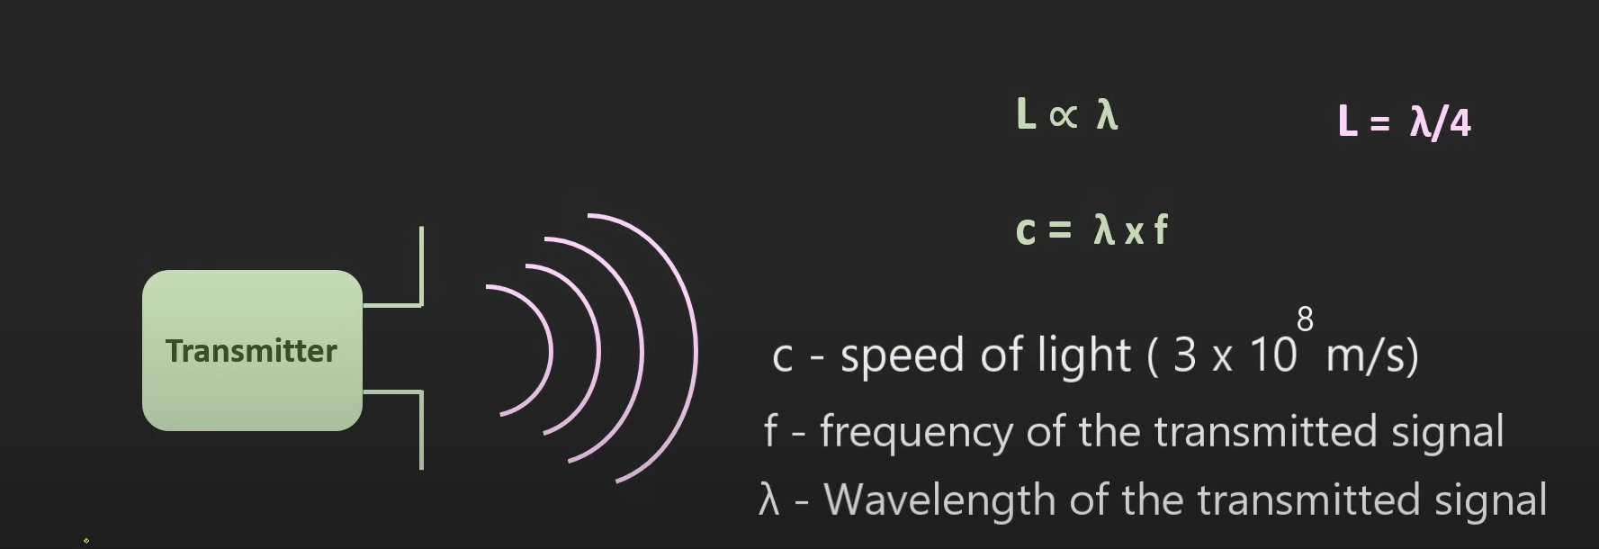

Slide 6
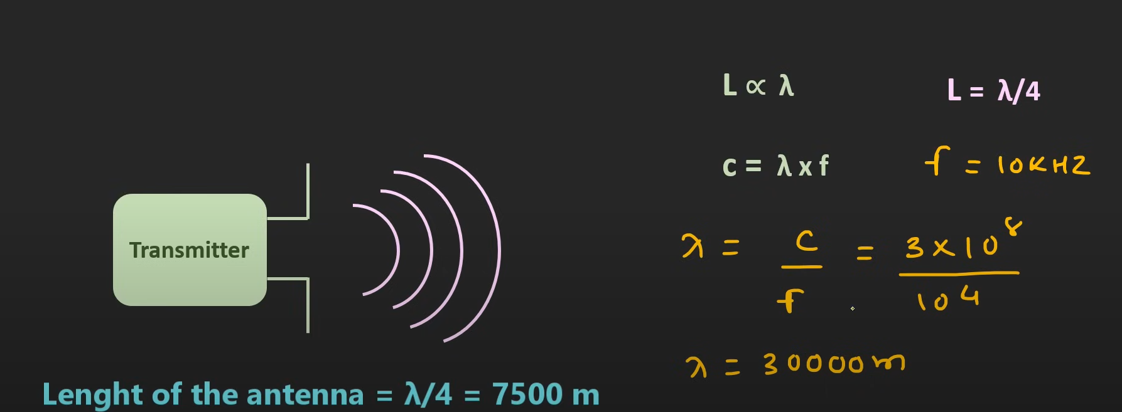

Slide 7
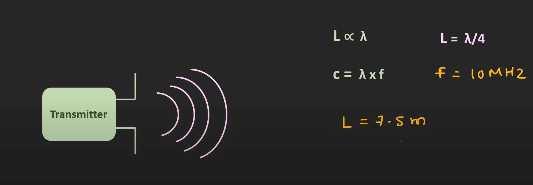

Slide 8
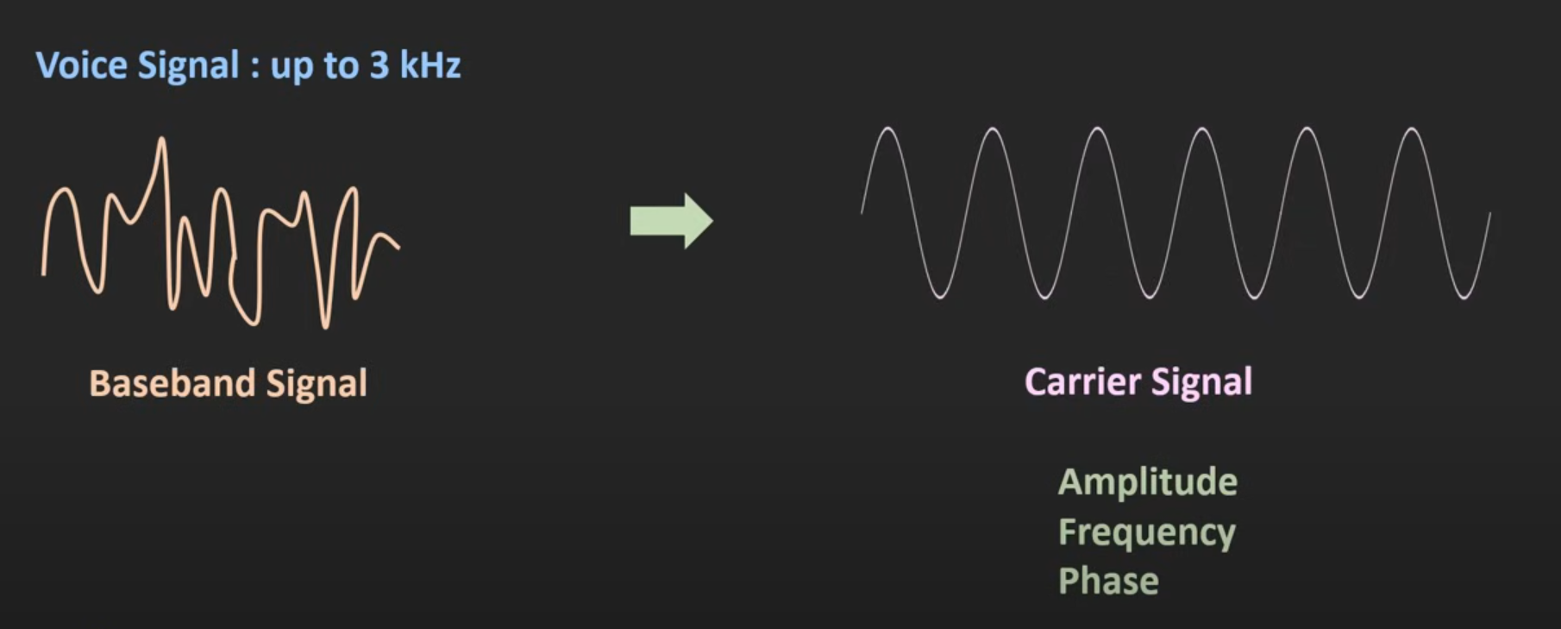
Modulacija je postupak prilagođavanja informacije u oblik pogodan za prijenos komunikacijskim kanalom
Modulacijski postupci koji se koriste u digitalnim komunikacijskim sustavima ovise o parametru koji se modulira. To može biti amplituda, faza ili frekvencija, ali i dva ili sva tri parametra istodobno.
U procesu modulacije razlikujemo prijenosni signal, modulacijski signal, odnosno signal informacije te modulirani signal. Modulirani signal nastaje tako da se u ritmu promjene modulacijskog signala mijenja jedan od parametara prijenosnog signala.
Proces vraćanja signala u izvorni oblik naziva se demodulacija i odvija se na prijemnoj strani. Za prijenosni signal najčešće se uzima sinusni signal.

Slide 9
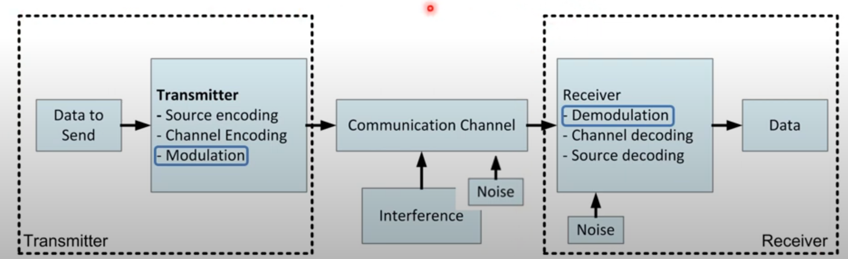

Slide 10
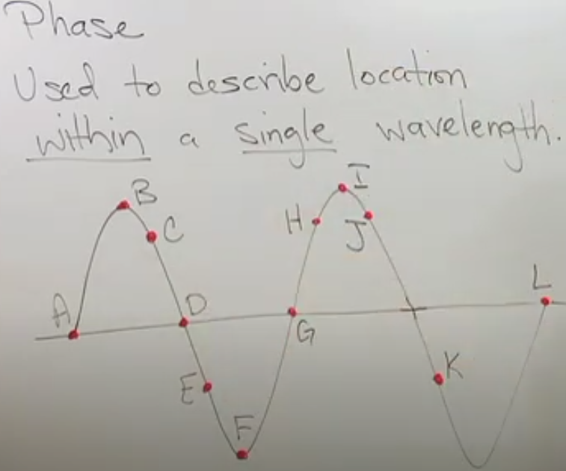
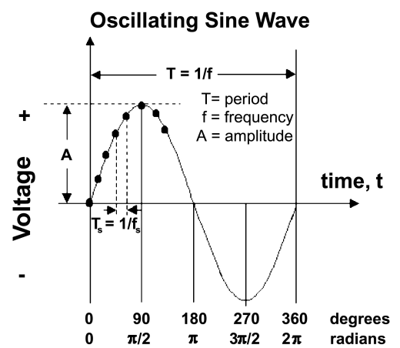

Slide 11
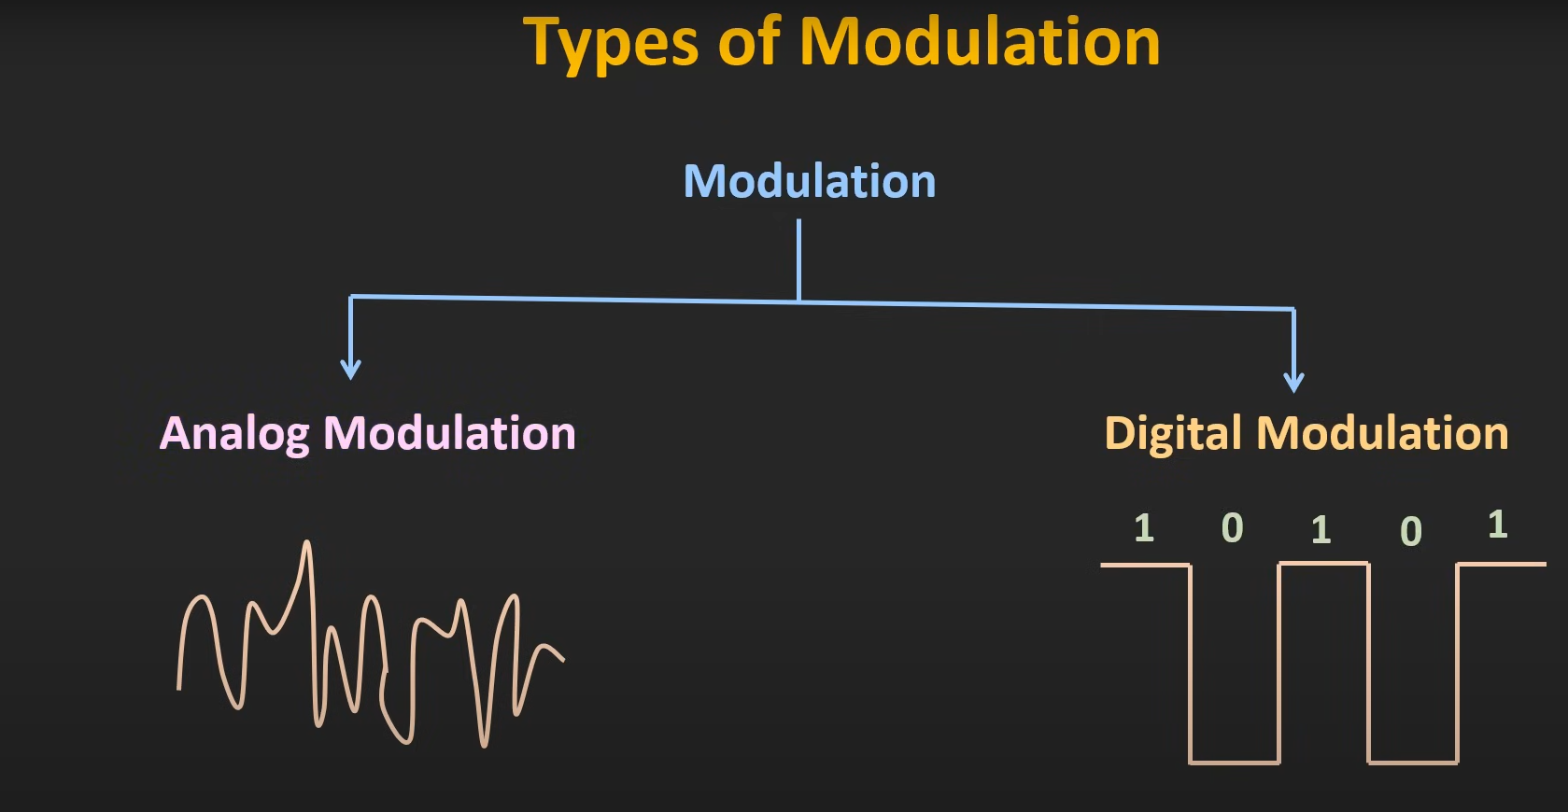

Slide 12
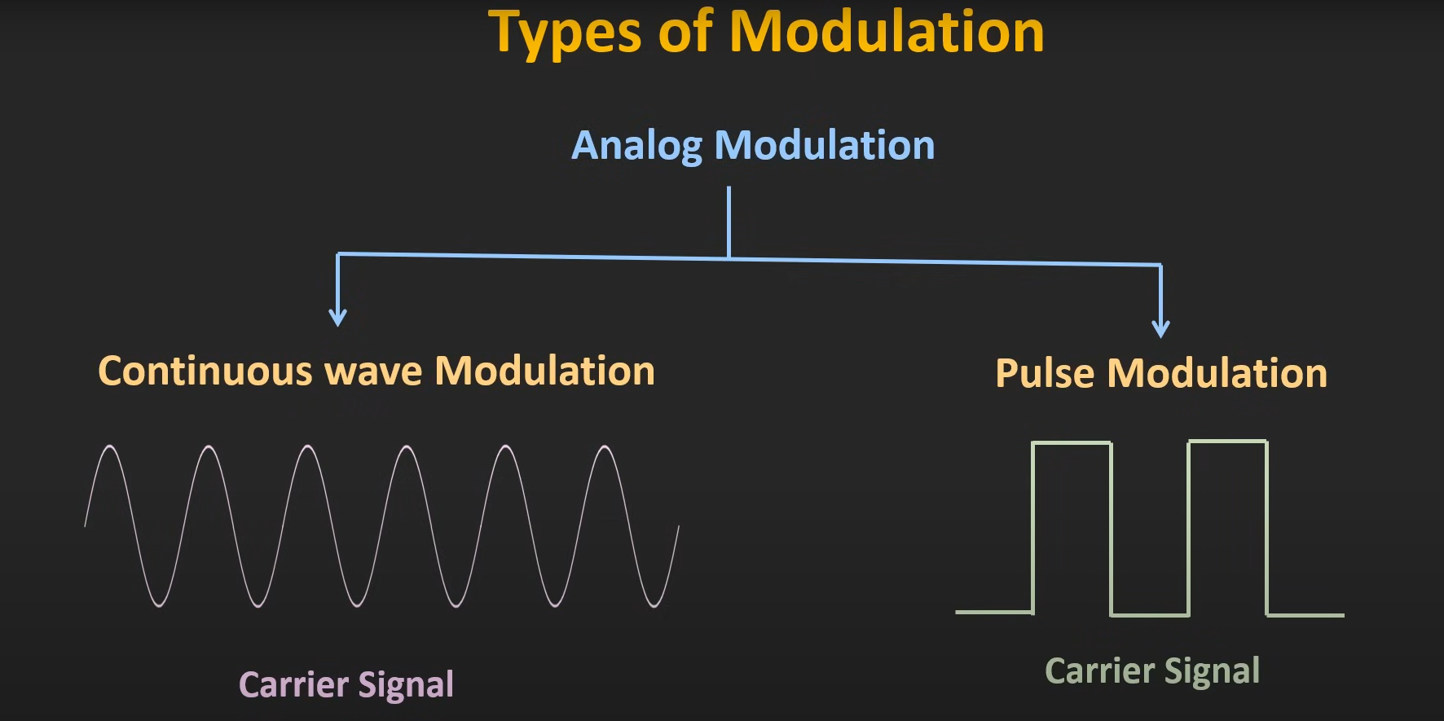

Slide 13
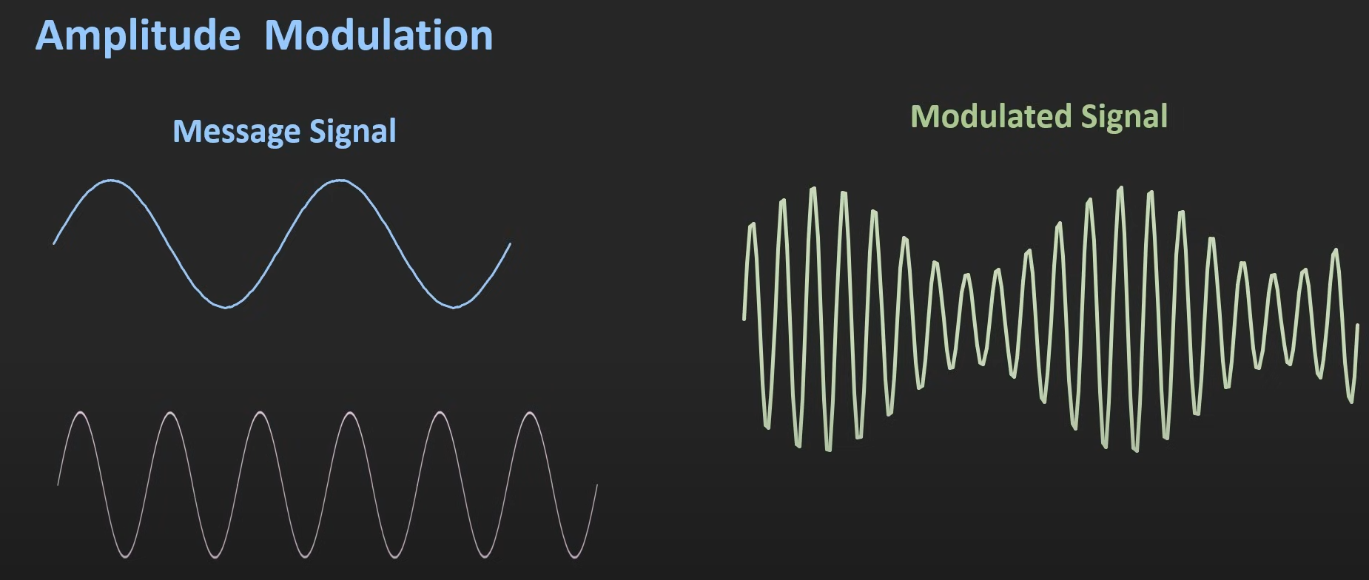
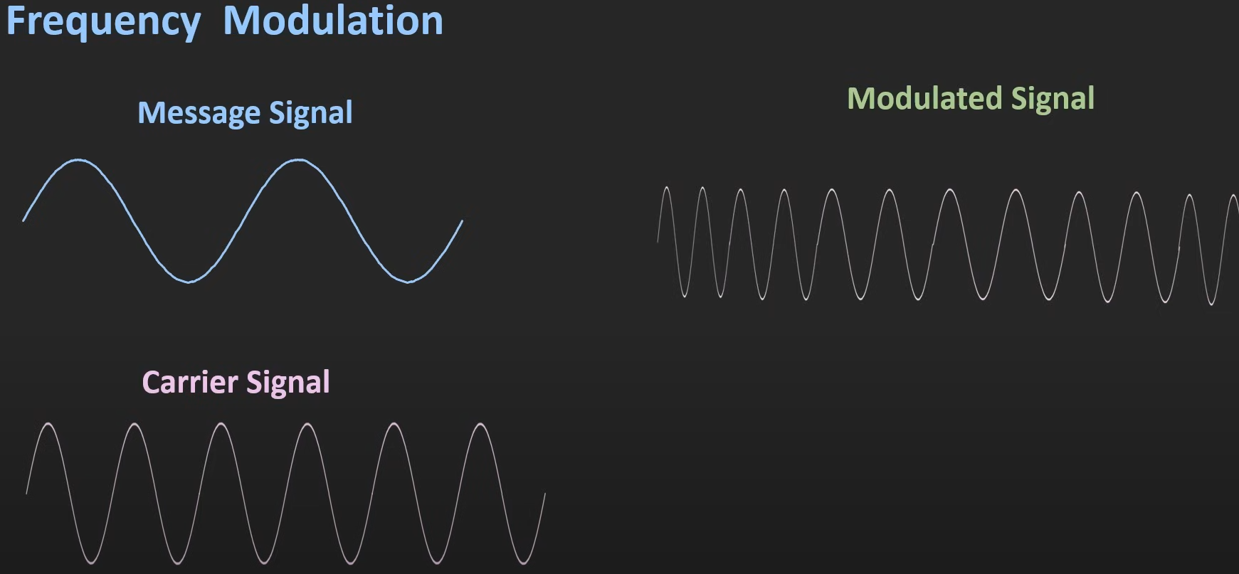
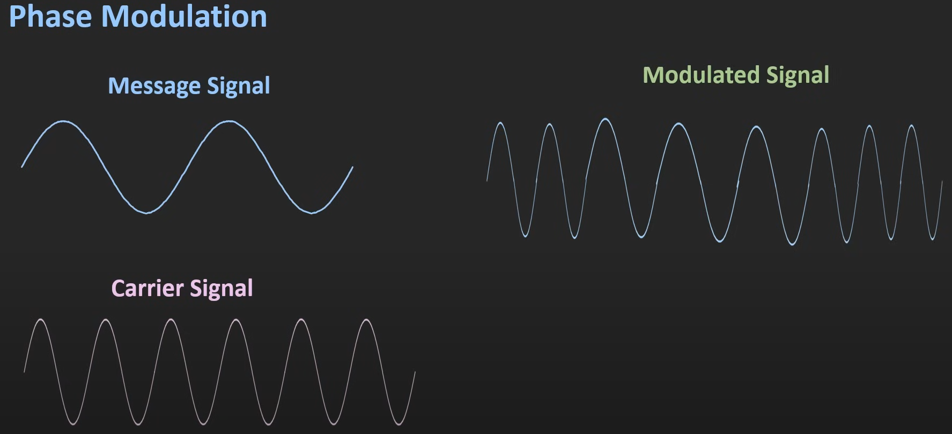
Amplitudna modulacija koristi varijacije u amplitudi nosivog signala kako bi se kodirale informacije. Viša amplituda predstavlja jednu vrijednost, a niža amplituda predstavlja drugu vrijednost. Amplitudna demodulacija se koristi na prijemnoj strani kako bi se izdvojile promjene u amplitudi moduliranog signala i dobile originalne informacije.
Frekvencijska modulacija koristi varijacije u frekvenciji nosivog signala kako bi se informacije kodirale. Viša frekvencija predstavlja jednu vrijednost, a niža frekvencija predstavlja drugu vrijednost. Frekvencijska demodulacija se koristi na prijemnoj strani kako bi se izdvojile promjene u frekvenciji moduliranog signala i dobile originalne informacije.
Fazna modulacija koristi varijacije u fazi nosivog signala kako bi se kodirale informacije. Različite faze odgovaraju različitim vrijednostima podataka. Fazna demodulacija se koristi na prijemnoj strani kako bi se izdvojile promjene u fazi moduliranog signala i dobile originalne informacije.

Slide 14
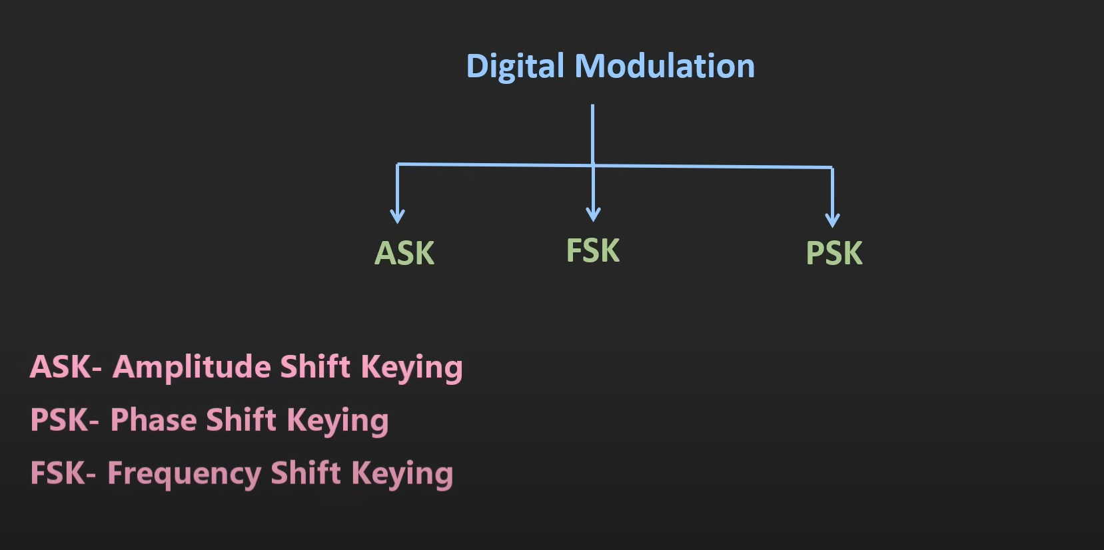

Slide 15
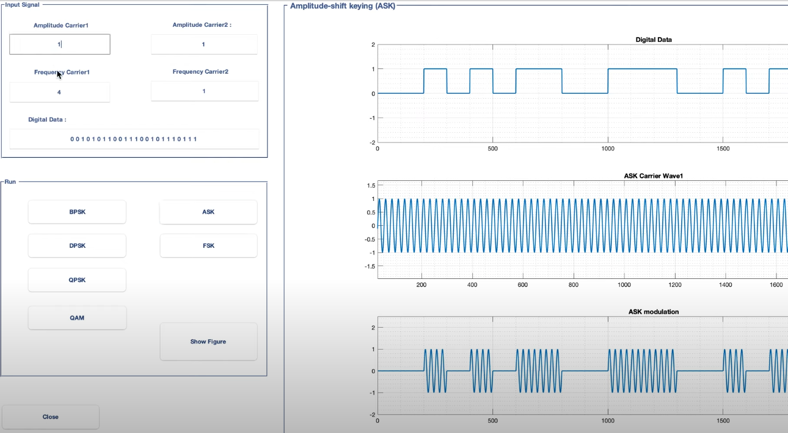

Slide 16
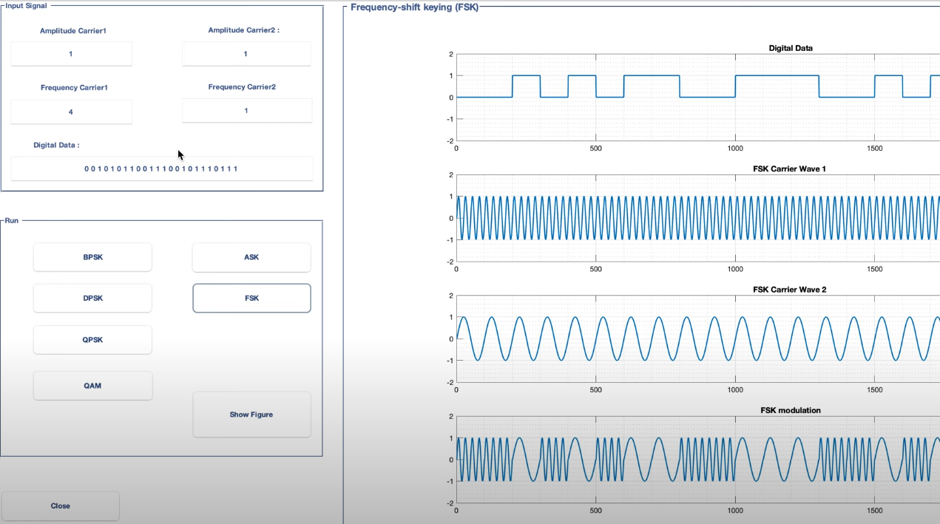

Slide 17
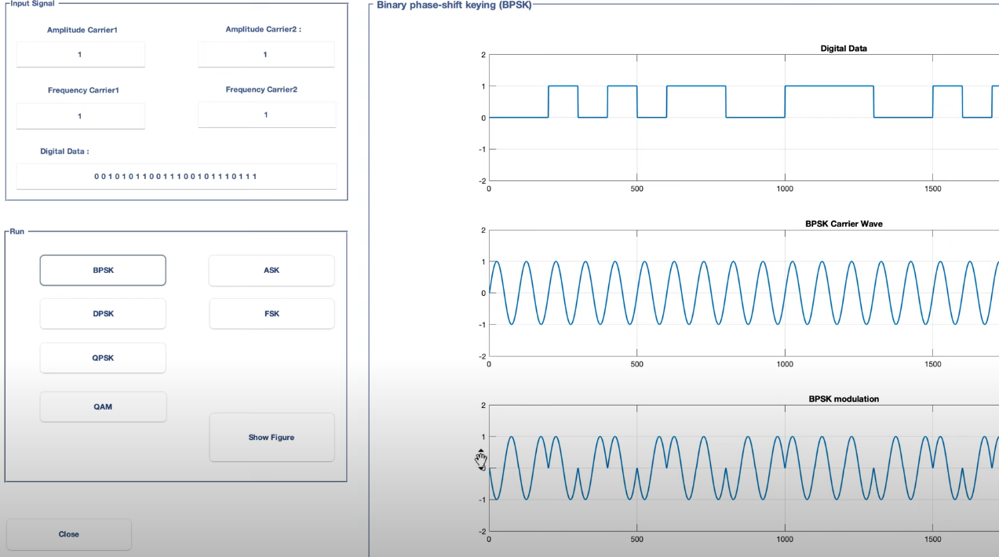

Slide 18
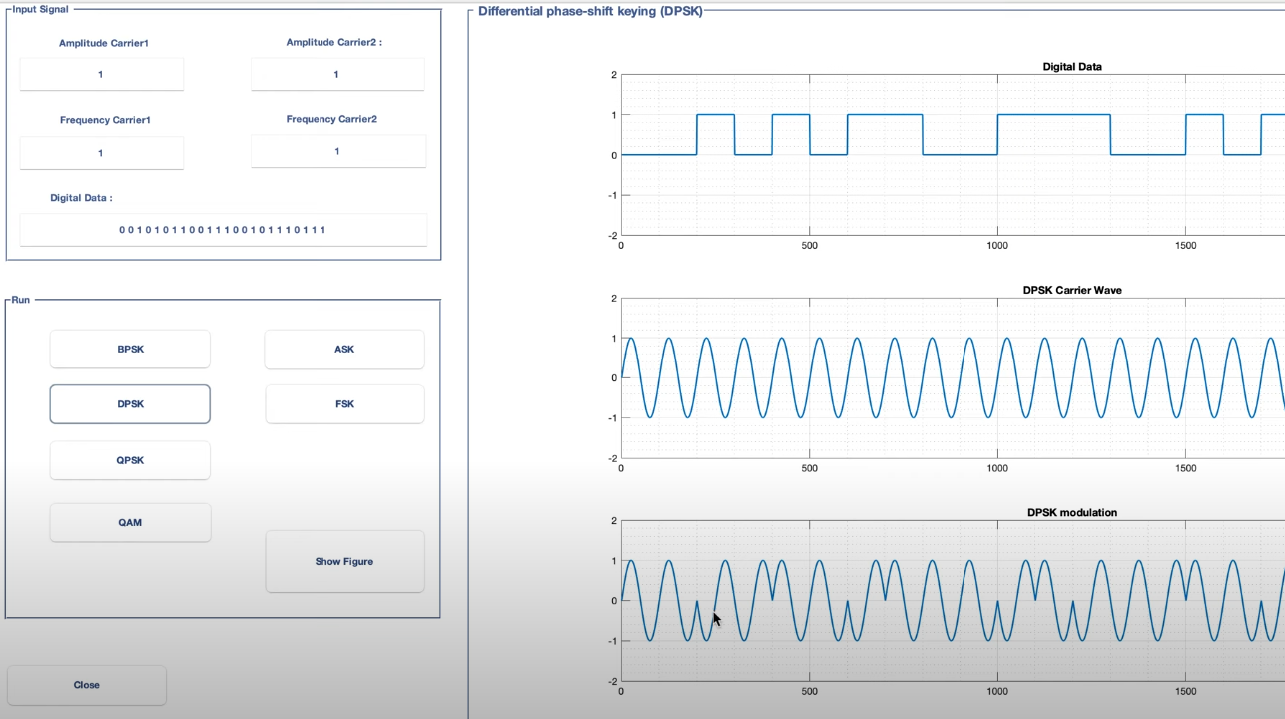

Slide 19
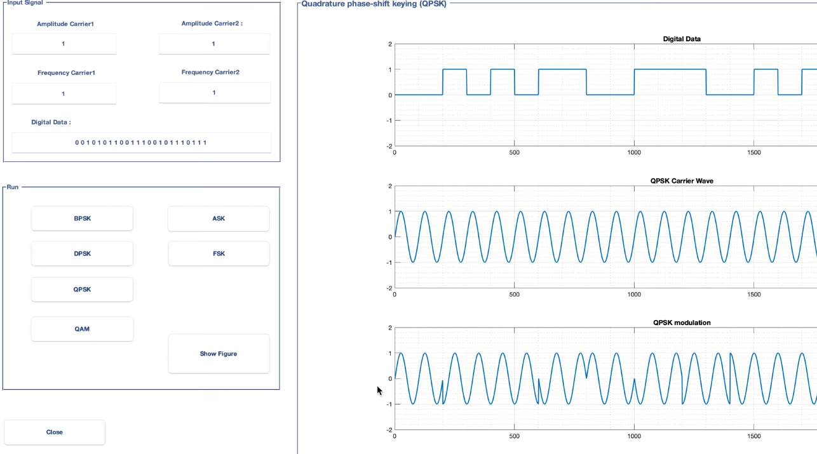

Slide 20
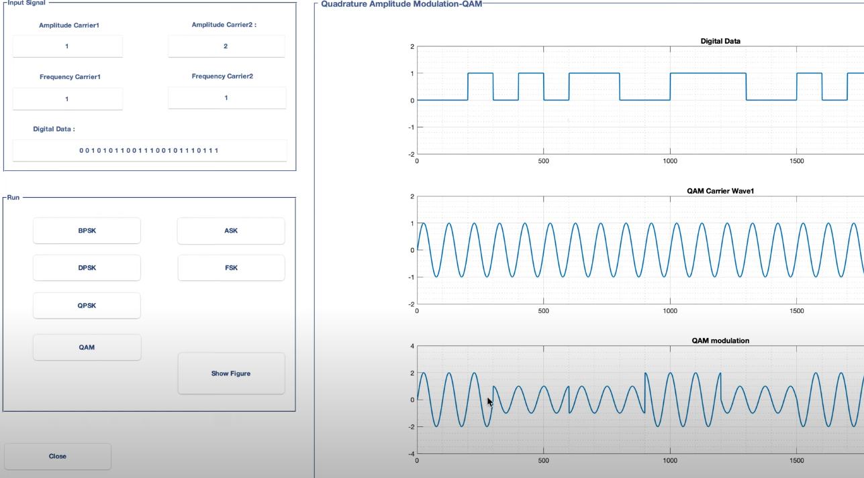

Slide 21
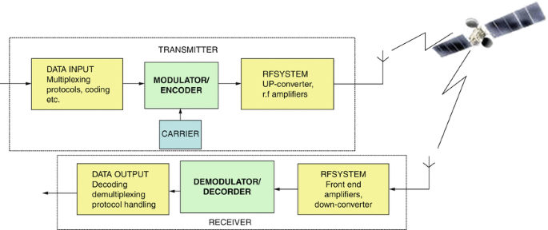
Modulation and Coding
Modulation is impressing the wanted data on a Radio Frequency (RF) carrier which is then conveyed over the satellite link and demodulated at the receiving terminal.
Modulation translates a baseband spectrum (in a lower frequency range) to a carrier spectrum (at a much higher frequency range).
In the modulation process, one or more parameters of the auxiliary signal is changed. The auxiliary signal is called the carrier.
The signal which contains the information is called the modulation signal

Slide 22
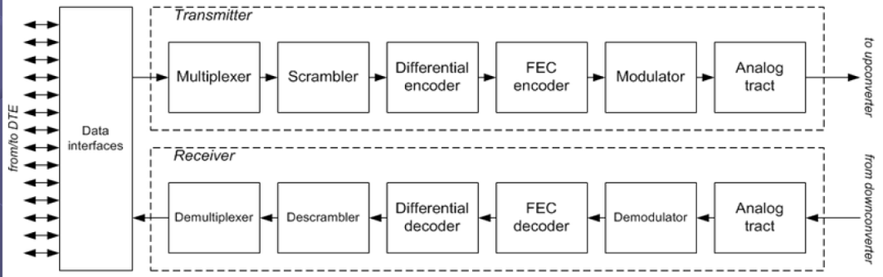
Modulation
Most communications systems optimize efficiencies in system designs, including spectral, power, and cost.
The selection of modulation schemes for satellite communications depends on the communication channels, hardware limitations, and data throughput requirements.

Slide 23
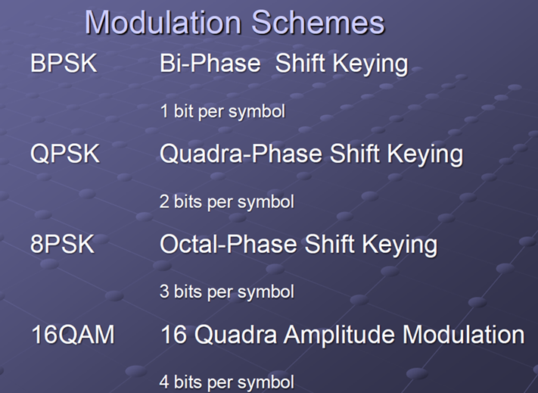
Modulation
The main function of modulation is transforming the ‘information’ into a radio signal for transmission and, together with the coding, determining the bandwidth (BW) to be occupied in the satellite.

Slide 24
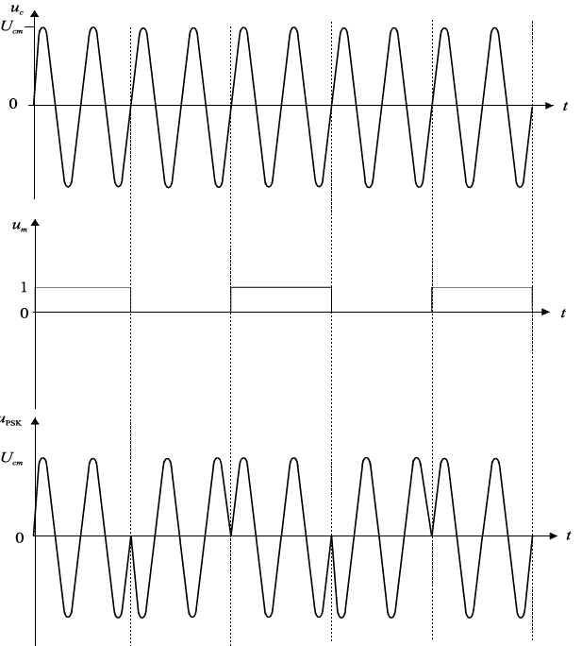
Digital Modulation Types
The difference between analog and digital modulations is in the modulation signal.
With digital modulations, the modulation signal is either “0” or “1”.
PSK – Phase Shift Keying

Slide 25
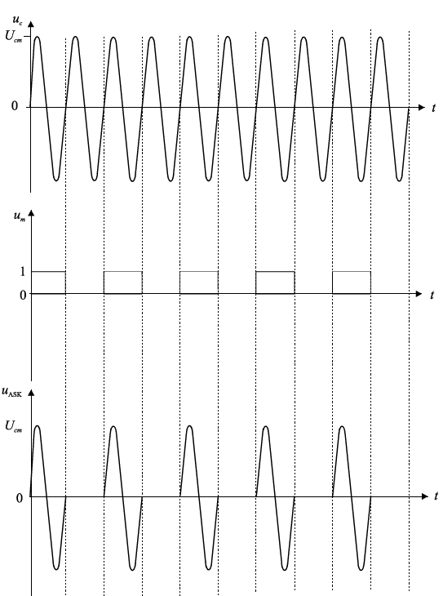
Digital Modulation
ASK–Amplitude Shift Keying
Ideal ASK has an infinitive spectrum. It is therefore necessary to shape pulses to narrow the frequency bandwidth.
Disadvantage of ASK modulation is that S/N ratio is not same for “1” and for “0”. It also needs different powers for those two states.
A break in communication is read as “0”.

Slide 26
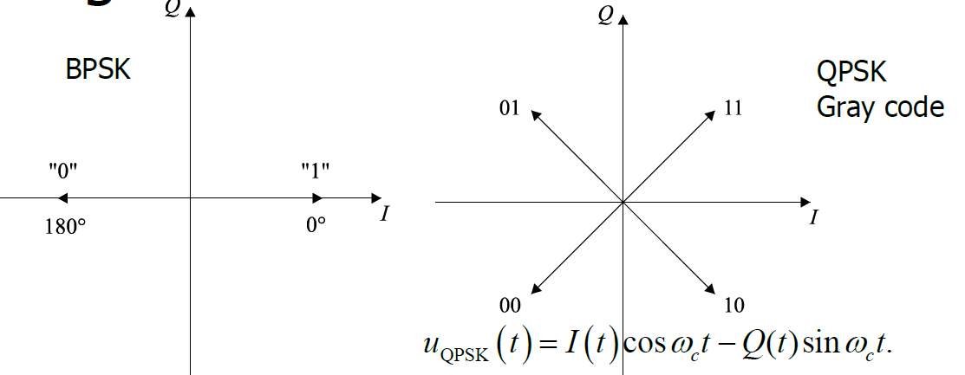
Digital Modulation
BPSK is resilient to interference but has a small spectral efficiency.
Each state of QPSK requires two bits while BPSK requires one bit.
QPSK demands more memory, and the possibility of error is higher. Spectral efficiency is higher, that is, it is possible to transmit two times more information in a communication channel.

Slide 27
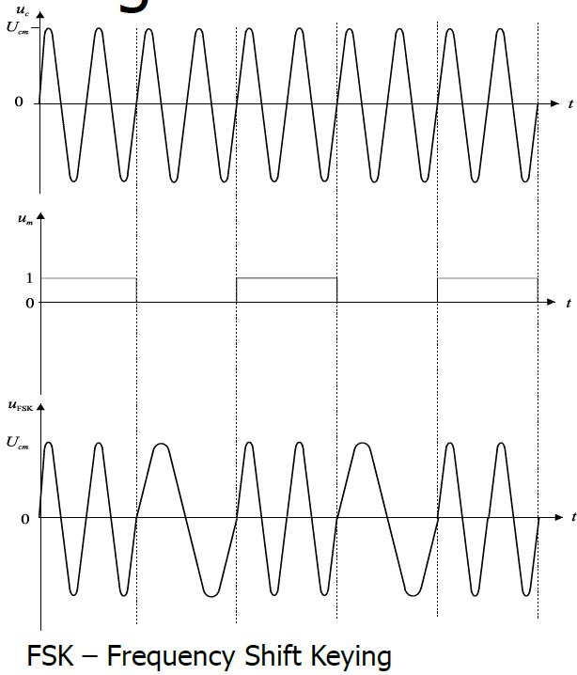
Digital Modulation
FSK – Frequency Shift Keying
With FSK, the frequency of carrier is changed discretely according to the modulation signal.
The simplest FSK is the BPSK or binary FSK with two carrier frequencies.
Demodulation of ASK is much easier than demodulation of FSK.

Slide 28
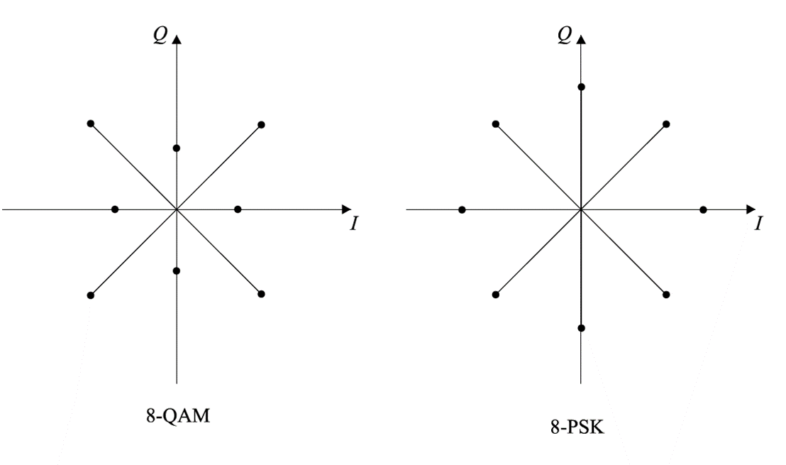
QAM – Quadrature amplitude modulation
QAM can be both analog and digital.
Digital QAM is used more often than analog QAM.
It has two modulation signals I(t) and Q(t) which are in relation
QPSK is a special case of QAM.
The difference is that QPSK has no amplitude modulation while QAM has.
Depending on the quantization level, there could be 4-QAM, 16-QAM, and 64-QAM.
More states mean more possibility of error.

Slide 29
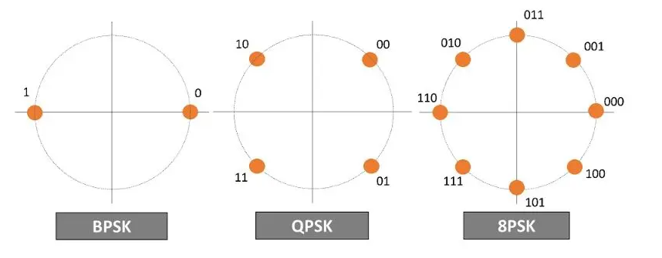
Constant Envelope Digital Modulation Schemes
The constant envelope modulation schemes such as FSK and PSK are the most suitable for satellite communications because they minimize the effect of nonlinear amplification in the high-power amplifier.
For higher-order PSK, the constellation points are closer to each other, and the system is more sensitive to channel impairments. For FSK, 4FSK (2 bits per symbol) has higher spectral efficiency than 2FSK’s but the smaller frequency deviation will cause a bad sensitivity in the receiver.

Slide 30
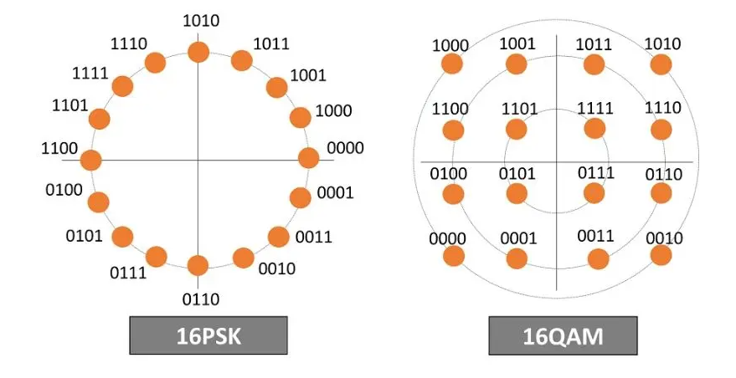
Nonconstant Envelope Digital Modulation Schemes
16QAM increases the distance between the constellation points and has better resistance to signal impairments.
However, 16QAM also increases the amplitude levels to three (rings) compared with 16PSK. RF power amplifiers require a wider linear range for nonconstant modulation schemes.
Satellite equipment must be capable of transmitting at a high power level while maintaining high output linearity. Also, the higher modulation schemes enable higher data throughput but are sensitive to signal impairments.

Slide 31
ISI – Interymbol interference
When rectangular pulses pass through the frequency band-limited channel, they spread in time, and the pulse from each symbol will be spread into the time interval of the adjacent (next) pulse.
This leads to intersymbol interference. ISI can also appear from multipath propagation.
The obvious solution for lowering ISI is increasing the frequency bandwidth.

Slide 32
ISI – Intersymbol interference
The figure shows frequency response (above) and impulse response (below) of raised-cosine filter with various roll-off factors.
Unwanted emission outside bandwidth should be 40 dB to 80 dB lower than in its own channel.

Slide 33
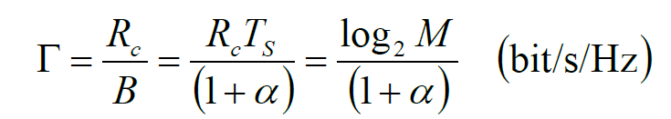
Modulation spectral efficiency
Modulation spectral efficiency is the ratio of the transmitted bit rate Rc and bandwidth occupied by the carrier.
The bandwidth occupied by the carrier depends on the spectrum of the modulated carrier and filtering. Filtering is used for lowering the interference to adjacent carriers.
ISI-free transmissions can be achieved with a raised cosine filter.
Roll-off factor α will determine the bandwidth.
For roll-off factor α = 0.35, the required bandwidth is 1.35/TS, and spectral efficiencies (bit/s/Hz) are: 0.7 for BPSK, 1.5 for QPSK and 2.2 for 8PSK

Slide 34
Coding
Coding is directly associated to error correction techniques which are fundamental in satellite communications due to limited power of satellite transponders and to the low level of C/N ratio arriving to the receiving station.
Coders are part of transmitter systems and decoders are part of receiver systems.
There are error detecting and correcting codes.
Parity (redundant) bits are introduced into the known information bits. This reduces the data speed.
The number of parity bits necessary depends on interference in the communication channel and interference.
Adequate decoder must exist on receiver side.

Slide 35
Convolutional Coding
Code has three main characteristics:
Code length – number of bits in a code word
Code dimension – number of information bits in a code word
Code distance – number of bits necessary to move from one to another code word
Convolutional coding can correct error bits which gives coding gain to the system.
Codes have three parameters:
n – number of output bits
k – number of input bits
m – number of memory registers
Ratio k/n = R is a code rate

Slide 36
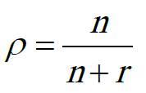
FEC – Forward Error Correction
FEC is a digital signal processing that increases the reliability of data by introducing known structures into the data stream before transmission.
The known structure enables the receiving system detection and possible correction of errors in the channel or receiver.
Correction of data means that it is not necessary to send the information again (useful with real-time information).
Original data consists of n bits. The encoder introduces redundant (parity) bits r, increasing the total number of bits to n + r of a code word.
On the receiving end, the decoder extracts the original data.
The code rate is defined as
where r is the number of redundant bits added to n information bits.

Slide 37
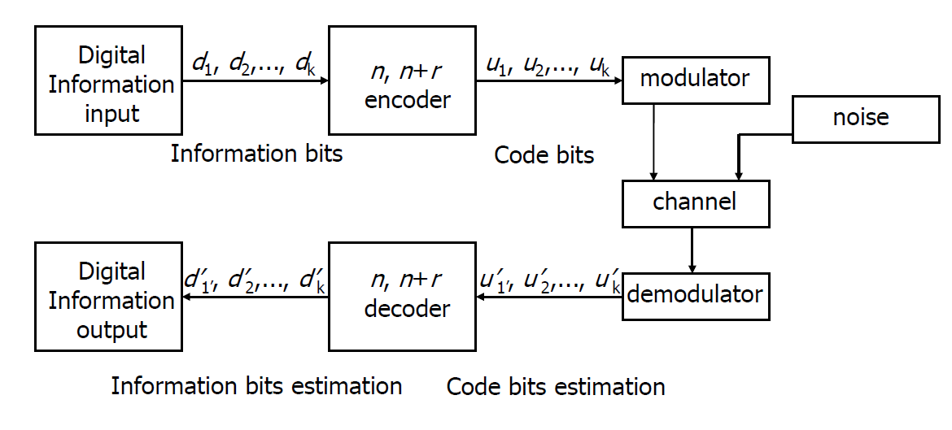
FEC – Forward Error Correction

Slide 38
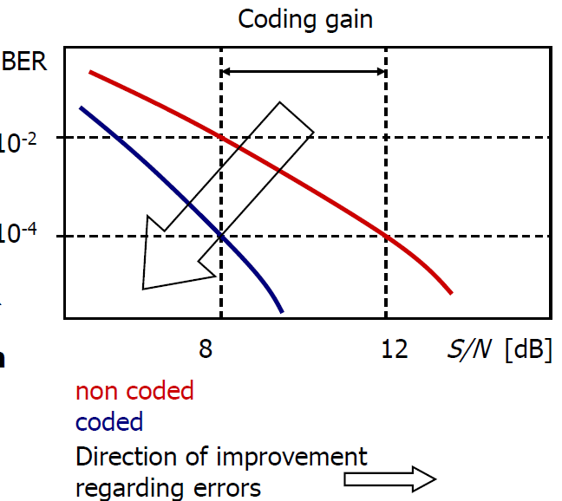
FEC – Forward Error Correction
Quality parameter – BER (bit error rate) vs ratio of S/N – “waterfall”.
When S/N increases, BER decreases – system performs better
Coded system (on figure) has 100 times smaller BER in comparison to the non coded system for same S/N.
Or, coded system has same BER as non coded for lower S/N. The difference is called coding gain (4 dB in figure).
Smaller necessary S/N needs smaller antennas, lower transmitting power, cheaper receivers, ...

Slide 39
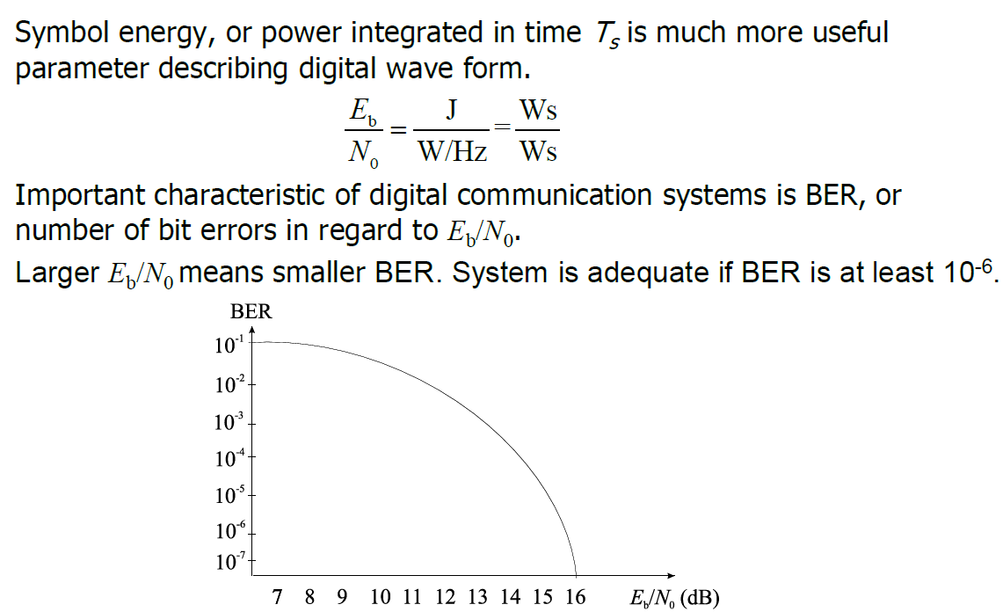
BER – Bit Error Rate

Slide 40
BER – Bit Error Rate
The figure shows theoretical bit error probabilities (BEP) for different modulations.
Bit error rate (BER) measures the performance of the demodulator by counting the number of bits in error, n in a stream of N received bits: BER = n/N

Slide 41
Multiple Access

Slide 42
Multiple Transmission and access
For better use of the frequency spectrum, multiple transmission and multiple access is used.
If allocation of time or frequency segments is fixed then multiple transmission is at hand (Division Multiplex Transmission).
Examples of multiple transmissions are FDM i TDM.
If the allocation of time or frequency segments is variable, then multiple access is at hand (Division Multiple Access).
Examples of multiple access are FDMA i TDMA

Slide 43
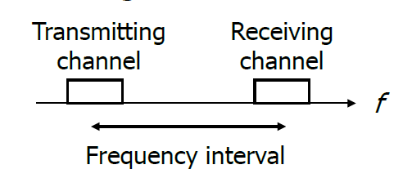
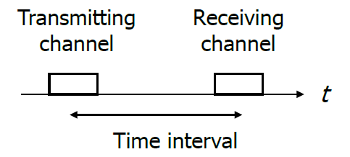
Multiple Transmission
FDD – Frequency Division Duplex Communication with 2 different communication channels; one for receiving and the other for transmitting signals
Two simplex channels at the same time
The frequency interval between channels is fixed.
TDD – Time Division Duplex Communication on same frequency; half time for transmitting and have time for receiving signal

Slide 44
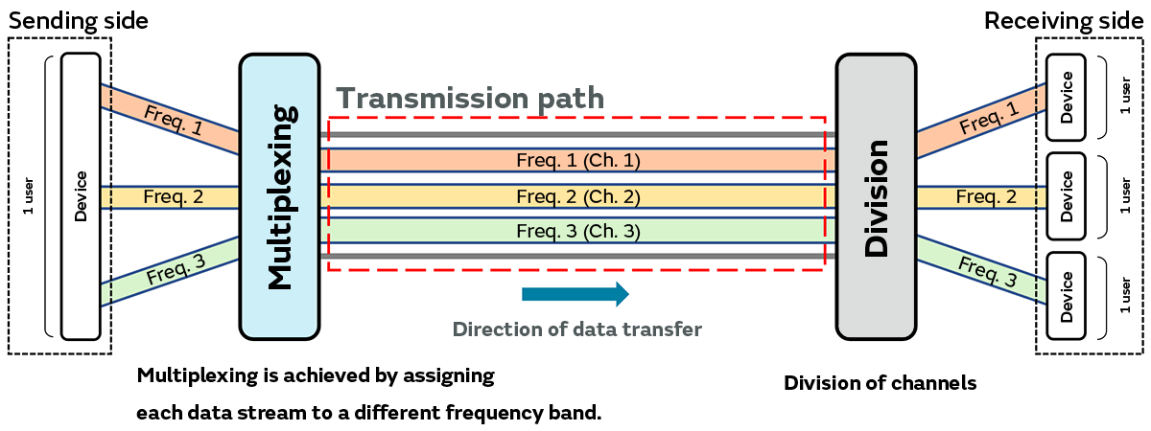
Frequency-division multiplexing (FDM)

Slide 45
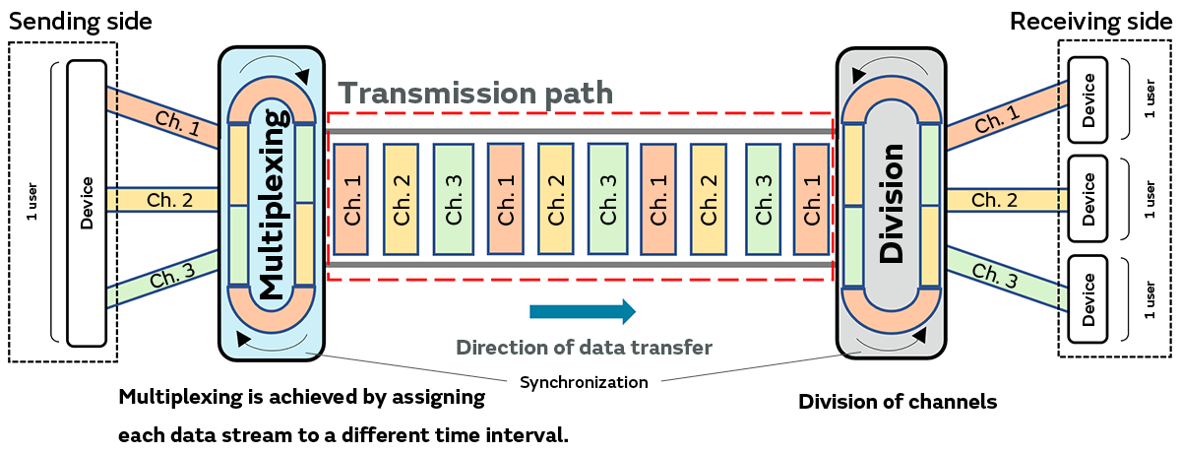
Time-division multiplexing (TDM)

Slide 46
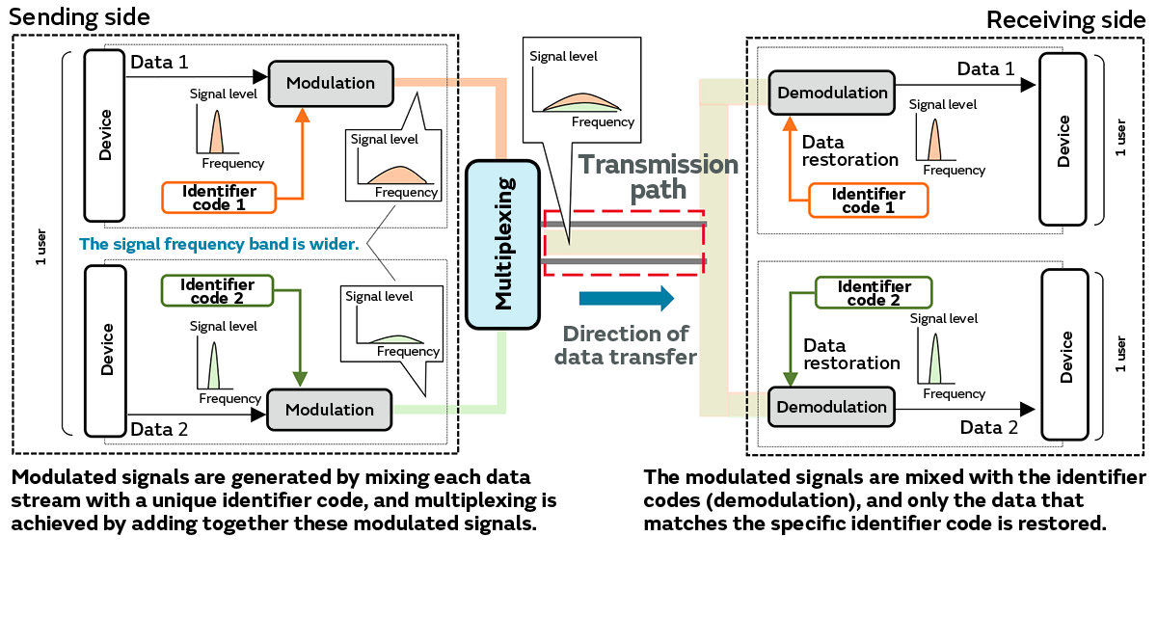
Code-division multiplexing (CDM)

Slide 47
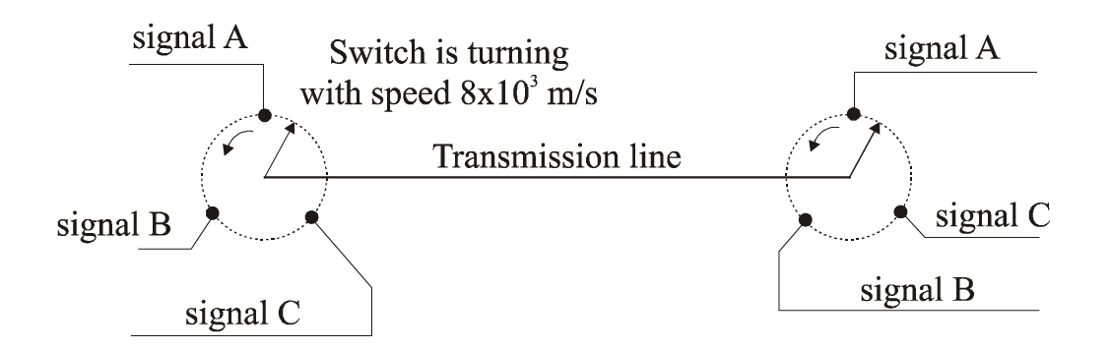
Multiple Transmission
TDM - Time Division Multiplex
When signal is sampled with narrow pulses, there are intervals in which other signals can be sampled.

Slide 48
https://www.hakom.hr/hr/hakom-dodijelio-spektar-za-mreze-pokretnih-komunikacija/10500
http://tablice.hakom.hr:8080/vis?lang=hr
https://gssc.esa.int/navipedia/index.php?title=About_navipedia
https://gssc.esa.int/navipedia/index.php?title=GNSS_signal
https://gssc.esa.int/navipedia/index.php?title=GLONASS_Signal_Plan
https://gssc.esa.int/navipedia/index.php?title=CDMA_FDMA_Techniques

Slide 49
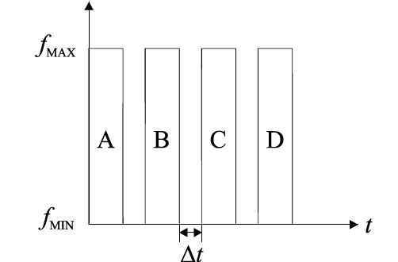
Multiple Transmission
In order to avoid overlapping of neighboring samples, safety intervals Δt are introduced between the samples.
Every signal occupies the entire frequency band f part of the time.

Slide 50
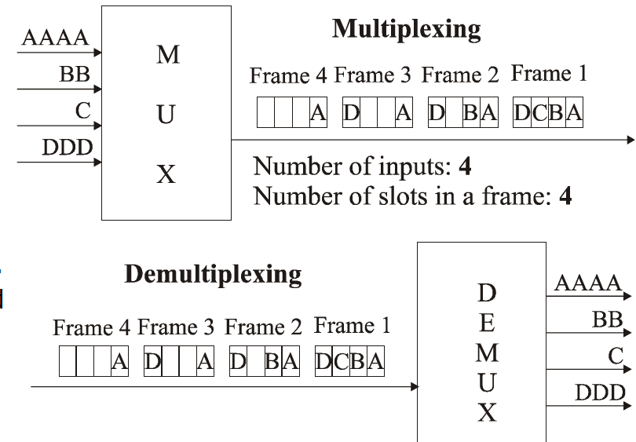
Multiple Transmission

Slide 51
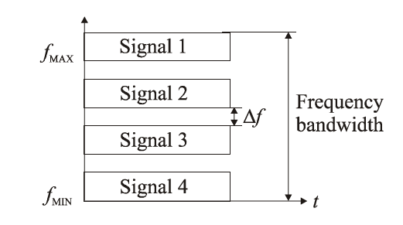
Multiple Transmission
FDM - Frequency Division Multiplex
Signals created by every transmitter modulate different transmission frequencies. These modulated signals are then merged into one complex signal which is transmitted.
Transmitting frequencies must be sufficiently placed apart to enable modulation and demodulation.
It is used in telephony where 30 kHz voice channels are combined into one broadband 4 MHz channel.

Slide 52
Multiple access
Allocation of frequency or time segments is variable (Division Multiple Access).
Multiple access can be by frequency, time, code, space and packet.
By the domain:
FDMA (Frequency Division Multiple Access)
TDMA (Time Division Multiple Access)
CDMA (Code Division Multiple Access)
By the assignment:
PAMA (Permanent Assignment Multiple Access)
DAMA (Demand Assignment Multiple Access))

Slide 53
FDMA
Frequency division multiplex access
Multiple access by frequency division
Each channel is allocated to one user at a time.
Narrowband channels (30 kHz) for voice communications
Speed rate is 25 kb/s
On the receiving side there are bandpass filters.

Slide 54
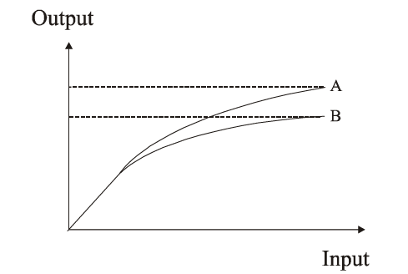
FDMA
Oldest method (analogous systems)
Channels share antenna and amplifier at the same time.
There could be inter-channel interference.
A – single carrier per channel (SCPC)
B – multiple carrier per channel (MCPC)
Output power decreases with the number of channels transmitted.

Slide 55
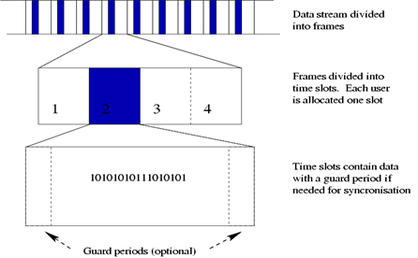
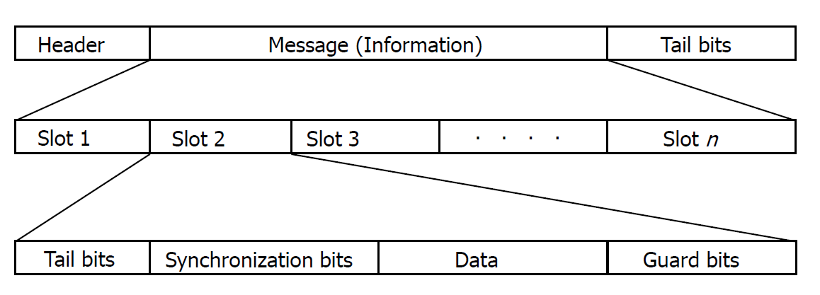
TDMA
Time division multiple access
Multiple access by time division
Each carrier is divided into several individual channels. The division is made by time.
Frame is divided into several time slots.
Frequency bandwidth can be narrow (20-30 kHz) or wide (200-300 kHz).
Transmission is not continuous but in bursts.
Synchronization is necessary to separate one burst from another.
Synchronization requires 20 -30% more bits altogether.

Slide 56
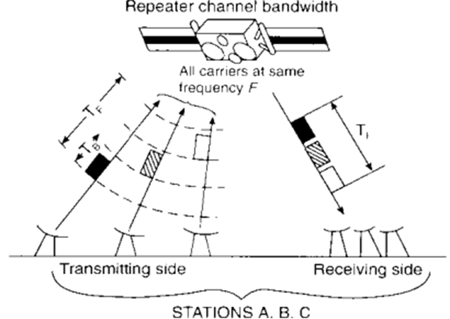
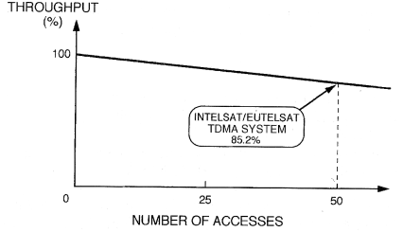
TDMA
Characteristics
More users use single frequency.
Variable data rate is possible – frequency bandwidth can be allocated on request.
Transmission is not continuous – energy (battery) saving
Inter symbol interference (ISI) larger than with FDMA.
Signal processing adds delay.
Switching from one station to another station can be performed in the moments when there is no signal transmission.
On uplink TDMA demands high power which can be a problem with mobile devices.
On downlink TDMA requires less power than FDMA

Slide 57
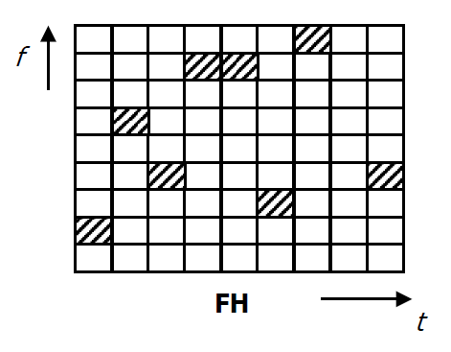
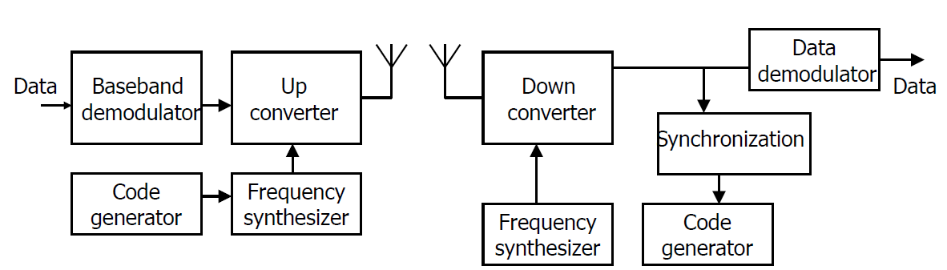
FH – Frequency Hopping
Data is modulated in baseband.
Frequency synthesizer, controlled by coded signal, helps in up conversion.
At receiver, information is obtained by demodulation in baseband.
Synchronization is necessary for harmonizing hopping scheme of local code generator and receive signal, in order to narrow the signal properly.
For smooth frequency hopping, it is desirable to lower the transmitting power before hop and to increase it again after the hop.
Only part of the spectrum is used, but the band changes in time.

Slide 58


TH - Time Hopping
With time hopping, data is being sent in fast bursts determined by code allocated to the user.
Time axis is divided into frames, with every frame divided into M time slots.
During every frame, user transmits in one of time slots. Code signal determines which of the M slots will transmit.
TH-CDMA uses whole frequency spectrum part of the time, while FH-CDMA uses part of the spectrum all the time.

Slide 59

Space Division Multiple Access
SDMA is method which optimizes frequency spectrum use and lowers the expenses by using antenna directivity.
There is a possibility of using same frequency in more than one direction

Slide 60



New technologies for HTS systems

Slide 61
Thank you

