Slide 1
Satellite Communication Systems

Slide 2
12 Satellite Signal Processing

Slide 3
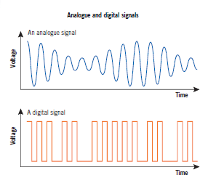
Analogue and digital signals are used in satellite communication for transmitting information
Analogue
An analogue signal changes in frequency and/or amplitude continually. Analog uses infinitely varying values ​​between minimum and maximum levels.
Analog data transmission sends information via continuous electrical or electromagnetic signals by varying voltage, current, or some other physical quantity.
As a result, an analog signal can be subject to interference, noise, and loss of signal quality during transmission. This means that the remote end may experience changes in the signal that can distort the original information.
In addition, analog signals have a limited capacity to transmit information, which can also lead to loss of transmission quality over longer distances.
Digital
A digital signal has just two values – represented as 0 and 1 (or on and off). The signal is converted into a code of 0s and 1s. It becomes a stream of 0 and 1 values. These pulses are added to the carrier wave and transmitted. After the signal is received, it is decoded to recover the original signal.
The main advantage of digital transmission is precision. Unlike analog transmission, where information is continuously changing, a digital signal uses clear steps that make it more resistant to interference and loss. This enables a quick and precise exchange of information and enables better control over signal quality. As data is represented as binary numbers, digital data transmission allows easy encoding, decoding and processing of information

Slide 4
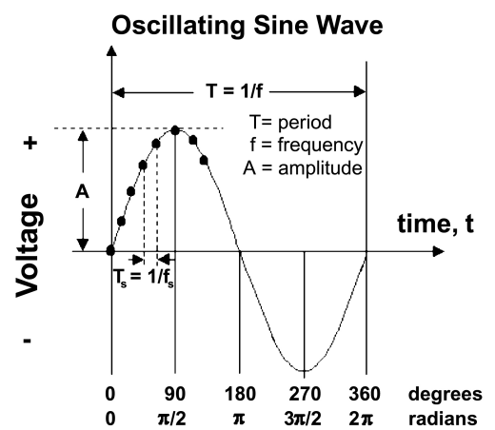
A phase is the position of a wave at a point in time (instant) on a waveform cycle
The curving line represents the waveform, which is measured in terms of both amplitude and frequency.
Amplitude indicates how far the wave deviates from its rest position as it alternates between positive peak amplitude and negative peak amplitude.
Frequency is the number of cycles per second, with each cycle representing a unit of time.
Frequency is measured in hertz (Hz) or one of its derivatives, such as kilohertz (kHz) or megahertz (MHz).
Any point on the wave cycle can be identified by its phase

Slide 5



Satellite signal processing involves the manipulation and transformation of signals to ensure they are transmitted and received accurately
The process includes:
Filtering:
Filtering removes unwanted noise and interference
Amplification:
Amplification boosts the signal strength
Frequency conversion:
Frequency conversion changes the signal frequency to match the transmission medium
Effective signal processing is essential for maintaining the integrity and quality of the data transmitted via satellites.

Slide 6
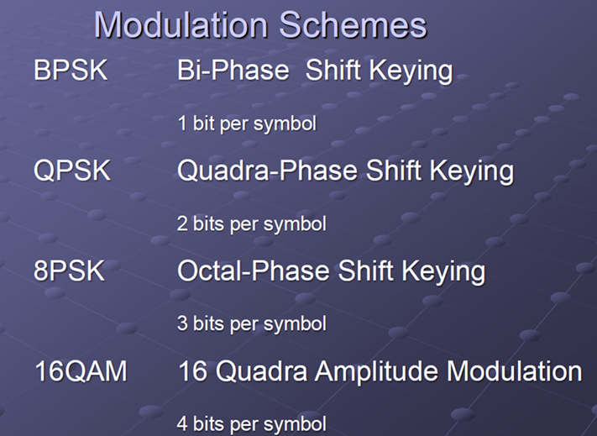
Modulation is the process of varying a carrier signal's properties to encode information for transmission over communication channels
Process of modulation
Modulation involves converting data into a form suitable for transmission by altering one or more characteristics of a carrier signal.
This process allows the transmission of information, such as audio, video, or data, over various media, including radio waves, optical fibers, and more.
The primary purposes of modulation include:
Efficient Transmission: Modulation enables signals to be transmitted over long distances without significant loss of quality.
Multiple Signal Transmission: It allows multiple signals to be transmitted simultaneously over a single communication channel, reducing interference and maximizing bandwidth usage.
Antenna Size Reduction: Higher frequency signals require smaller antennas, making them more practical for various applications.
INFORMATION BEARING SIGNAL
MODULATOR
MODULATED SIGNAL
CARRIER SIGNAL
Modulation is impressing the wanted data on a Radio Frequency (RF) carrier which is then conveyed over the satellite link and demodulated at the receiving terminal.
Modulation translates a baseband spectrum (in a lower frequency range) to a carrier spectrum (at a much higher frequency range).
In the modulation process, one or more parameters of the auxiliary signal is changed. The auxiliary signal is called the carrier.
The signal which contains the information is called the modulation signal

Slide 7
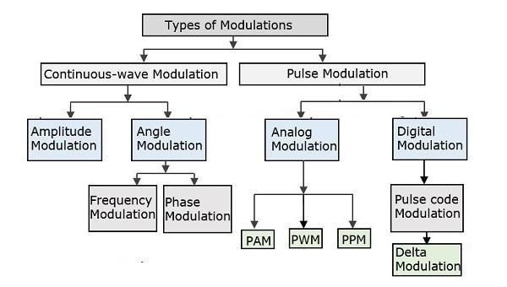
Satellite communication employs various modulation techniques to optimize data transmission
Types of modulation:
Analog
Amplitude modulation
Frequency modulation
Phase modulation
Digital
Amplitude shift keying (ASK)
Frequency shift keying (FSK)
Phase shift keying or (PSK)
Digital communication supports higher noise immunity than analog communication. But at the same time, digital data requires more bandwidth as compared to an analog signal.
In Digital communication, error detection and correction can be implemented easily. Digital modulation provides much more efficient results when compared to analog communication.

Slide 8
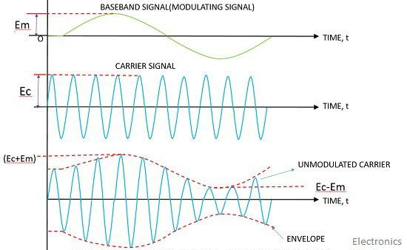
Amplitude Modulation
Amplitude Modulation is the process in which the amplitude of carrier signal is varied according to the amplitude of the message signal. This mode of modulation is very simple and straightway to modulate any baseband signal. It is the most effective and easiest way of modulation.

Slide 9
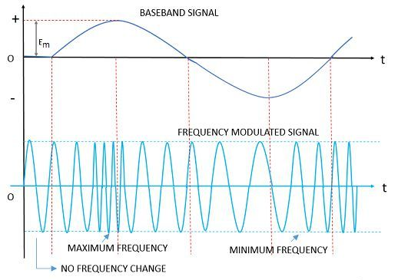
Frequency Modulation
Frequency Modulation: This type of modulation has mainly its application during radio communication. When the frequency of the carrier is varied according to the amplitude of information bearing signal then this modulation is known as frequency modulation. Here, carrier’s amplitude remains constant. In this, the information is carried by frequency variation. The most important factor is the amount of variation of signal frequency. Better SNR can be achieved through FM as compared to AM in case of wider bandwidth.

Slide 10
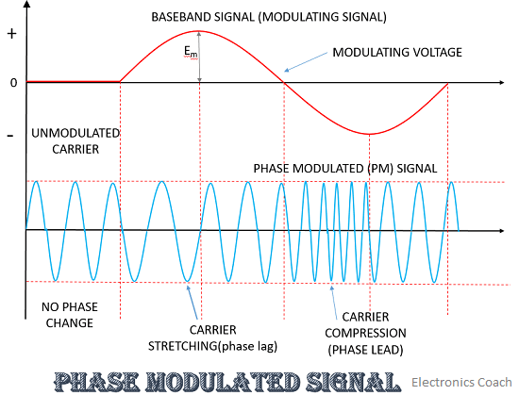
Phase modulation
Phase Modulation: Here, the phase shift of the carrier is varied according to the amplitude of carrier wave. When we apply phase modulation it leads to change in frequency too.

Slide 11
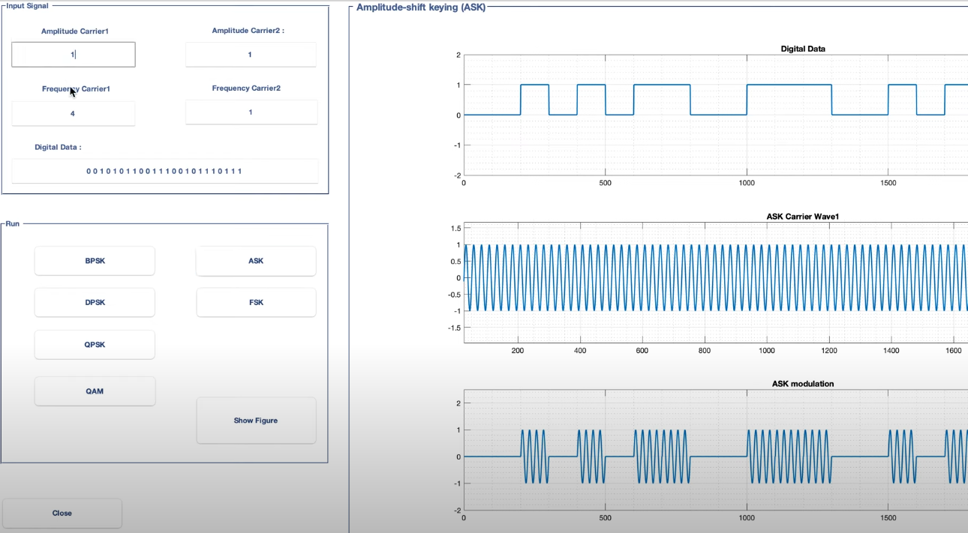
Amplitude shift keying (ASK) is a digital modulation technique that represents digital data by varying the amplitude of a carrier wave

Slide 12
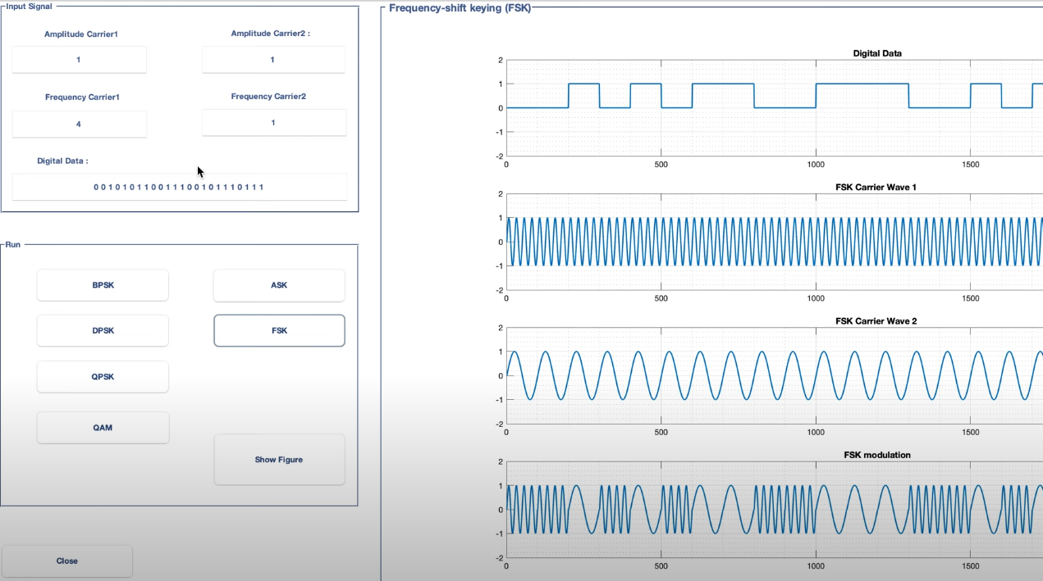
Frequency shift keying (FSK) is a digital modulation technique that encodes data by varying the frequency of a carrier signal

Slide 13
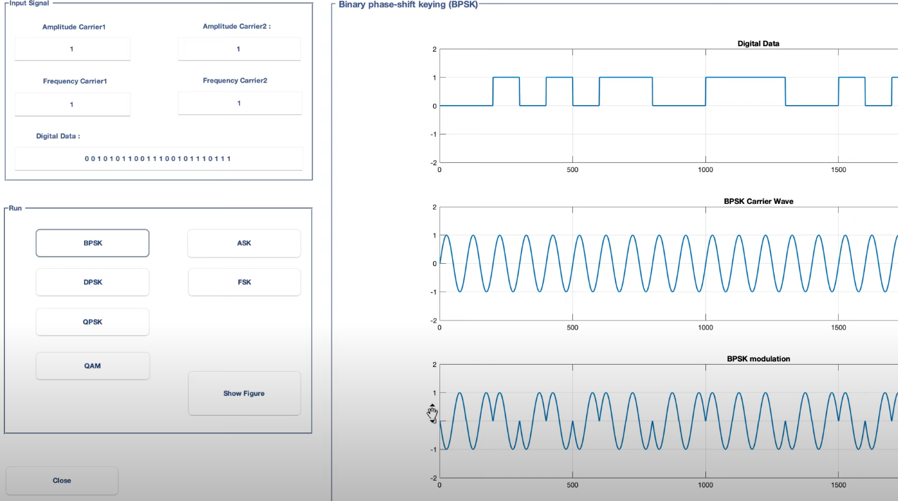
In Binary phase-shift keying, the carrier signal undergoes a 180-degree phase shift to represent a binary 0, while no phase shift represents a binary 1

Slide 14
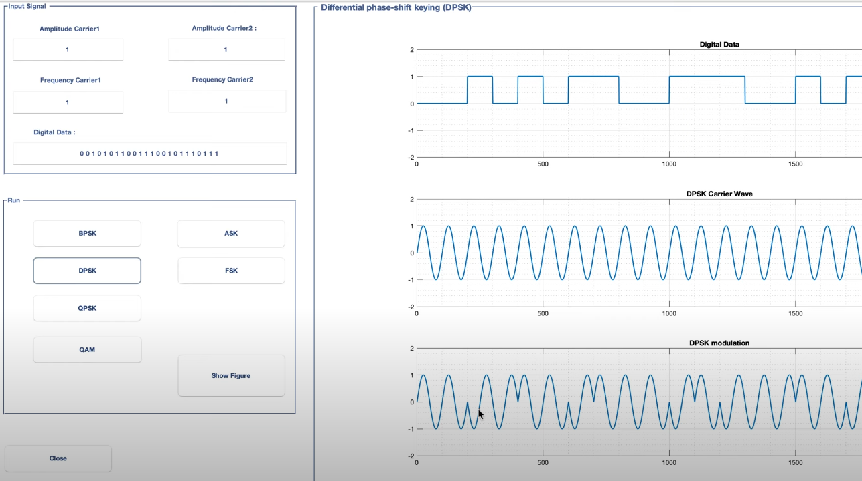
In Differential phase-shift keying, the phase of the modulated signal is shifted relative to the previous signal element

Slide 15
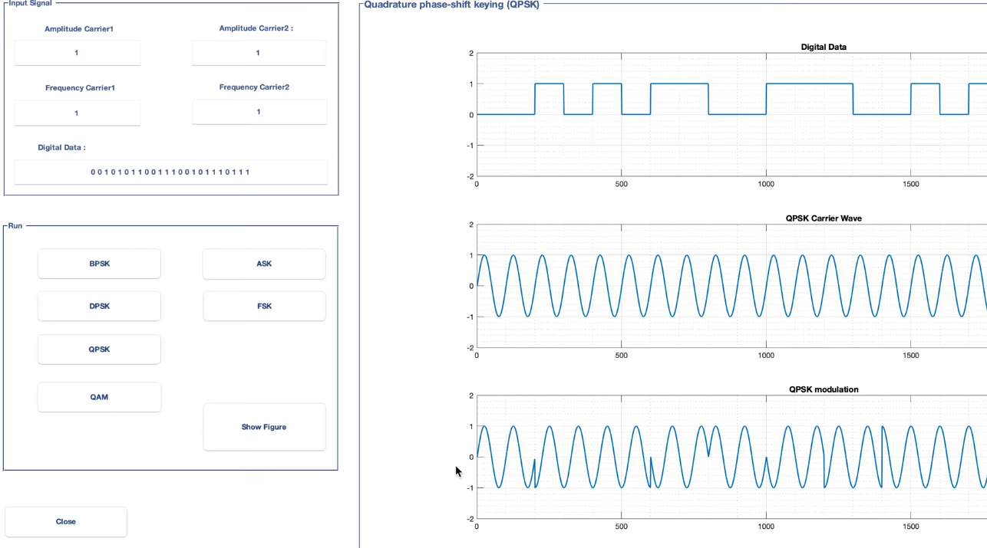
Quadrature phase-shift keyingis a digital modulation technique that encodes data by shifting the phase of a carrier wave among four distinct values, allowing two bits to be transmitted per symbol

Slide 16
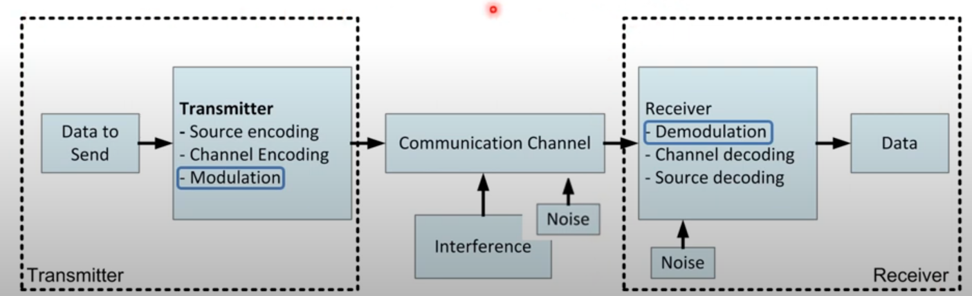
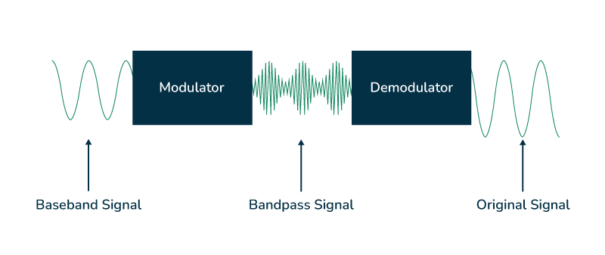
The Demodulation is the process of extracting the original information from a modulated carrier wave
It is an important function used in the communication systems which allows the recovery of transmitted data at the receiver end.
Demodulation is the technique to recover the original signal from the modulated signal. The demodulation is done with the help of a demodulator. A demodulator will convert the carrier variation of amplitude, frequency, or phase back to the message signal. There are three different types of demodulators for converting the AM (amplitude modulation), FM (frequency modulation), and PM (phase modulation) modulation schemes.
The Demodulation is important as the it ensure that the transmitted audio signals can be correctly received and processed. Demodulation is the process of recovering the original signal from the modulated signal. It allows the separation of the audio frequency from the higher frequency carrier which makes the signal audible and usable to the human listener and compatible with standard audio playback devices. Without using the demodulation the information carried by the high-frequency carrier waves would remain inaccessible.
Source What is Demodulation ? - GeeksforGeeks

Slide 17
Difference Between Modulation and Demodulation
Modulation | Demodulation
It is the process where properties of the carrier signal like amplitude, frequency, or phase change according to the baseband or message signal. | Demodulation is the technique to recover the original signal from the modulated signal
Modulation of the signal is done at the transmitter side. | Demodulation of the signal is done at the receiver side.
It is performed to transmit the signal over the long distance. | It is performed to extract the original information from the modulated signal.
It is a simple process as compared to demodulation. | It is a complex process.
It converts low-frequency signals into high-frequency signals. | It converts high-frequency signal into low-frequency signal.
To perform modulation, modulator (electronic circuit) is required. | To perform demodulation, demodulator or detector (electronic circuit) is required.
It is the mixing of two signals of different parameters. | It is the process of recovery of original signal from the mixed signal.

Slide 18
Multiple Access

Slide 19
To maximize the efficiency and effectiveness of satellite communications, various multiple access techniques are employed
Given the demand for simultaneous access by potentially hundreds of users, multiple access techniques are essential for efficiently allocating the satellite’s fixed communication resources. These techniques must handle a variety of bit and message rates, and diverse traffic requirements, making the challenge of accessing the satellite more complex.
Multiple access is a technique that enables multiple users to communicate without interference by sharing multiplexed channels.
The basic types of multiple access, from the least to the most advanced, are as follows: • Frequency-division multiple access (FDMA) • Time-division multiple access (TDMA) • Code-division multiple access (CDMA)
For better use of the frequency spectrum, multiple transmission and multiple access is used.
If allocation of time or frequency segments is fixed, then multiple transmission is at hand (Division Multiplex Transmission).
Examples of multiple transmissions are FDM i TDM.
If allocation of time or frequency segments is variable, then multiple access is at hand (Division Multiple Access).
Examples of multiple access are FDMA i TDMA

Slide 20
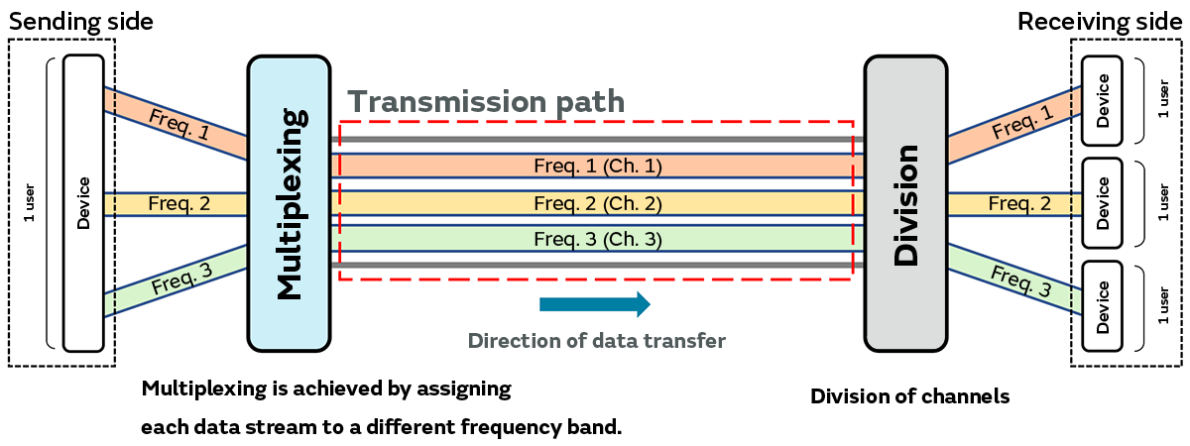
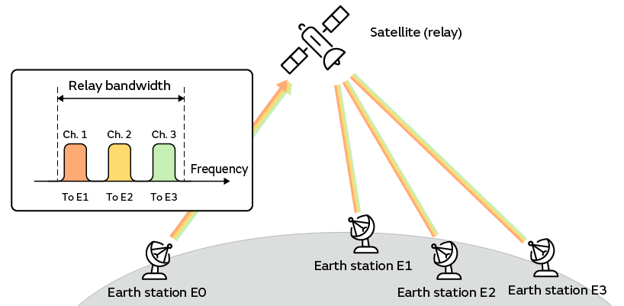
Frequency-Division Multiple Access (FDMA)
Conceptual diagram of FDMA
Source: FDMA, TDMA, and CDMA Multiple Access: Effective Utilization of Bandwidth (1) | Murata Manufacturing Articles
FDMA divides up data streams from multiple users and assigns them to channels using different frequency bands, all of which share a single transmission path. Adoption of FDMA began in the 1980s, and it was used to carry cellphone and car phone calls under the analog 1st generation mobile communication system (1G).
The data signal from earth station E0, consisting of data streams targeted at earth stations E1 to E3, modulated and assigned to different frequencies arranged at equally spaced intervals within the bandwidth supported by the satellite relay, is sent in a manner that ensures that the adjacent signal frequency bands do not overlap (to prevent interference).

Slide 21
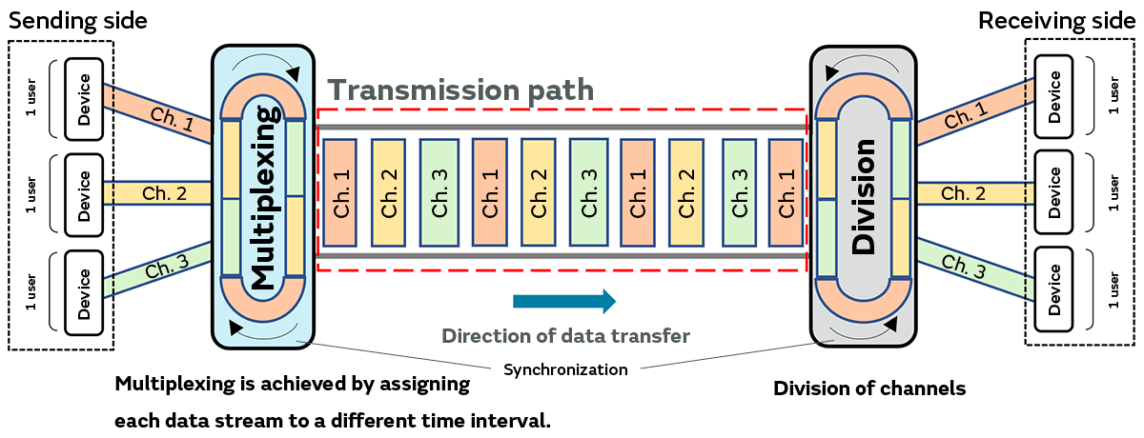
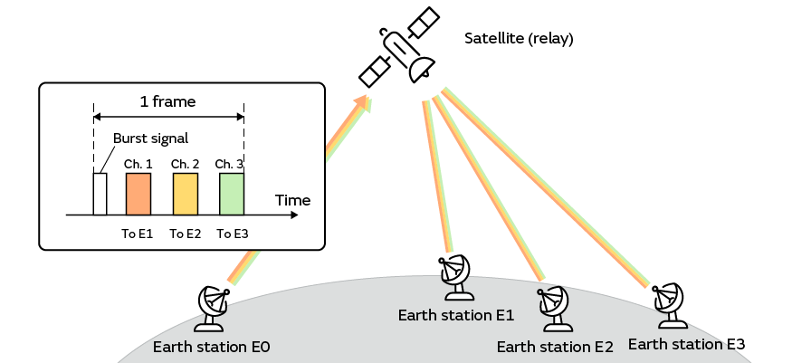
Time-Division Multiple Access (TDMA)
Conceptual diagram of TDMA
Source: FDMA, TDMA, and CDMA Multiple Access: Effective Utilization of Bandwidth (1) | Murata Manufacturing Articles
TDMA divides up data streams from multiple users into uniform time intervals and assigns them to channels, all of which share a single transmission path. Adoption of TDMA began in the 1990s, and it was used to carry mobile phone calls (GSM, PDC, PHS, etc.) under the digital 2nd generation mobile communication system (2G).
The data signal is sent from earth station E0, delimited by time frames and consisting of “slots” used as channels, excluding the standard burst signal embedded in each frame, and each channel is assigned one of the data streams targeted at earth stations E1 to E3. Then, at each earth station from E1 to E3 the signal is divided up in a manner synchronized with the transmission timing of earth station E0, and the data streams are extracted.

Slide 22
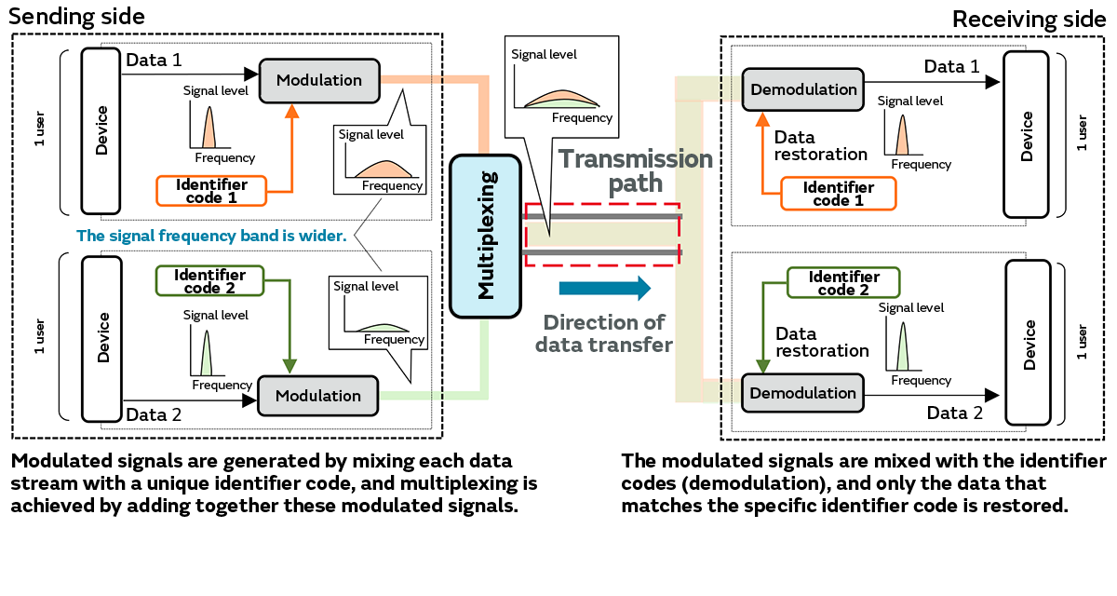
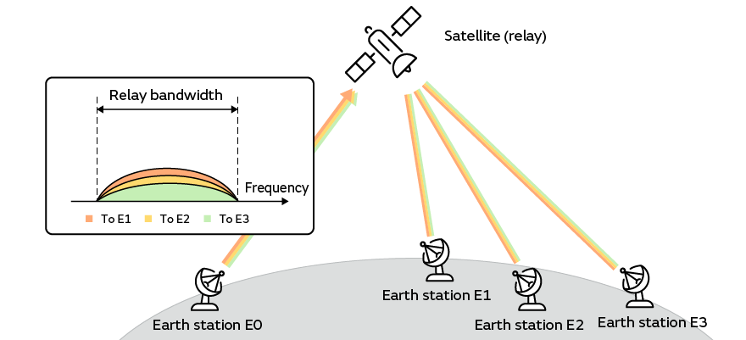
Code-Division Multiple Access (CDMA)
CDMA generates signals in which the data streams of users are mixed with unique identifier codes, and the signals of all the users are overlaid within the same frequency band and conveyed via a single transmission path. CDMA is used to carry mobile phone calls under the 3rd generation mobile communication system (3G) introduced in the 2000s.
Earth station E0 mixes the identifier codes assigned to earth stations E1 to E3 on the receiving side with the data signals targeted at each earth station, generating signals with frequency bands wider than that of the original data signals, and adds them together to create a multiplexed signal that it sends to the satellite relay.
Earth stations E1 to E3 each receive the multiplexed signals from the satellite relay, mix in the earth station identifier codes to divide up the signals, and extract data only from the signal that matches their own identifier code.
Conceptual diagram of CDMA
Source: FDMA, TDMA, and CDMA Multiple Access: Effective Utilization of Bandwidth (1) | Murata Manufacturing Articles

Slide 23
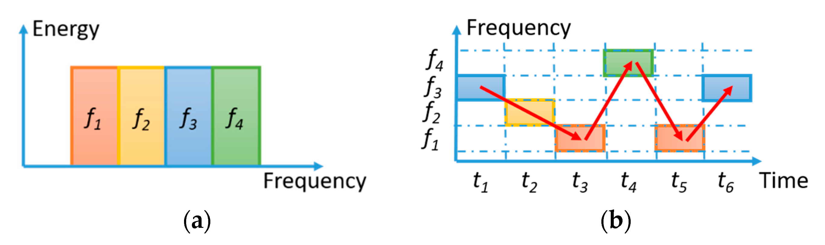
Frequency hopping is a method of transmitting radio signals by rapidly changing the carrier frequency among many frequencies
Principle of frequency-hopping communication systems. (a) Frequency channel assignment for a single user; (b) Time-varying spectral usage of the allocated frequency for a particular user.
Source: Ultrafast and Wideband Microwave Photonic Frequency-Hopping Systems: A Review
Carrier Frequency Changes: The carrier frequency of the transmitted signal is switched rapidly among various frequency channels. This switching occurs based on a predefined hopping pattern, which is synchronized between the transmitter and receiver.
Interference Resistance: By hopping between frequencies, the signal is less likely to be affected by interference at any single frequency. If interference occurs, it only impacts the signal during a brief interval, allowing the communication to continue on other frequencies.
Security Enhancement: Frequency hopping makes it challenging for potential eavesdroppers to intercept the communication, as they would need to know the hopping pattern to follow the signal effectively. This technique is often used in military communications to enhance security.

Slide 24
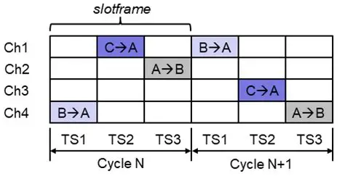
Time hopping in satellite communication is a resource allocation technique where satellite beams switch coverage areas in scheduled time slots to optimize bandwidth and meet varying user demands
In satellite systems, especially high-throughput satellites, traffic demand is not uniform across regions, so time hopping allows beams to dynamically serve different areas at different times. This means a satellite does not continuously illuminate one region but instead cycles through multiple regions, allocating time slots based on demand. By doing so, it improves spectral efficiency and reduces wasted capacity, since resources are directed where they are most needed. Time hopping is closely related to beam hopping, but it emphasizes the temporal scheduling of signals rather than just spatial switching. It is particularly useful in LEO and GEO satellite networks, where user traffic fluctuates due to mobility, weather conditions, or peak-hour usage

Slide 25
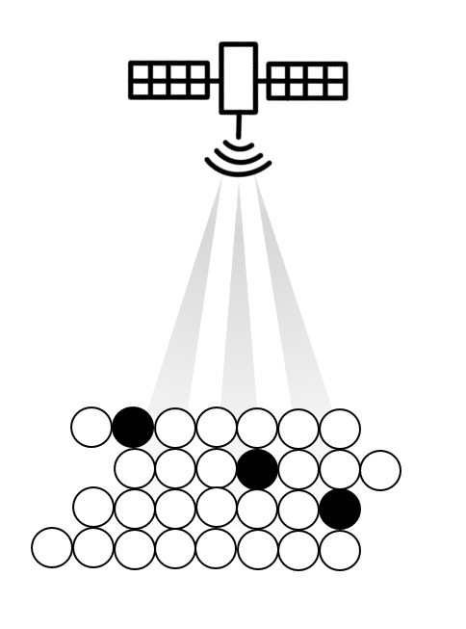
Beam hopping involves switching between different Beams that cover specific areas on the ground
In basic terms, a beam is a focused area where a satellite sends its signal. Each beam can serve users located in its area of coverage. The main goal of beam hopping is to allow a satellite to adjust its signal strength based on the number of users in each beam area. By switching which beams are active at different times, satellites can provide more efficient service to users.
The Challenges of Beam Hopping
The main challenge in beam hopping lies in creating a plan that optimally manages the time each beam is active. This is known as a beam hopping time plan (BHTP). If too many beams are active at once or if they are not active long enough, it can lead to problems with the quality of service.
There are also technical limitations, like interference between adjacent beams. Effective planning must take these issues into account to deliver the best performance.
Beam hopping
Source: Beam Hopping

Slide 26
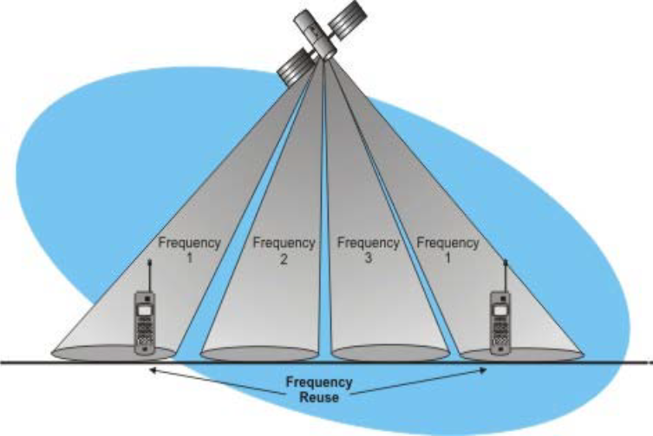
Space Division Multiple Access (SDMA) is a form of multiple access technology that enables simultaneous transmission and reception of data by multiple users over the same frequency band
SDMA is method which optimizes frequency spectrum use and lowers the expenses by using antenna directivity.
There is a possibility of using same frequency in more than one direction

Slide 27
Thank you

