Slide 1
Satellite Communication Systems

Slide 2
13 Monitoring Satellite Communication Systems

Slide 3
The goal of spectrum management is to maximize spectrum efficiency, minimize interference and eliminate unauthorized and improper use of the spectrum
Spectrum monitoring supports the spectrum management process
Monitoring is closely associated with inspection and compliance in that it enables the identification and measurement of spectrum usage, interference sources, the verification of proper technical and operational characteristics of radiated signals, and detection and identification of illegal transmitters, producing data on the effectiveness of spectrum management policies.
Monitoring further supports the overall spectrum management effort by providing general measurement of channel and band usage, including channel availability statistics of a technical and operational nature, thereby giving a measure of spectrum occupancy. Monitoring is also useful for planning, in that it can assist spectrum managers in understanding the level of spectrum use as compared to the assignments that are registered on paper or in data files.
Satellite monitoring has two primary goals
1
Goal 1: Evaluation of satellite resource utilization:
Carrier and transponder level;
Orbit position occupancy;
Frequency occupancy;
Orbit position and frequency assignment (over long-term usage);
Power flux-density (pfd) and other technical parameters compliance;
Beam coverage.
y
2
Goal 2: Detection and resolution of interference:
Geolocation of interfering transmitters on the surface of the earth;
Determination if the interfering transmitters are mobile or fixed;
Detection and technical analysis of interfering satellite communication networks;
Determination of the exact position of terrestrial interferers;
Investigation and verification of emission parameters with license conditions;
Elimination of the interference

Slide 4
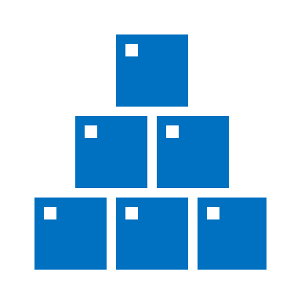

Modern receiving systems should have the ability to perform real-time, non-real-time (data is analysed later, known as post processing), and fixed time measurements
The system should have:
a measurement bandwidth wider than the typical satellite carriers being evaluated.
as a minimum, however, the system should support measurement bandwidths greater than 100 MHz.
should also be able to record IQ data at the full bandwidth of the signal.
the IQ recordings support post processing and analysis of the signal.
The following RF parameters should be measured in real time by the receiving system:
Centre frequency;
Doppler frequency;
Power flux-density (pfd) in reference bandwidth and total pfd;
Equivalent Isotropic Radiated Power (EIRP);
Carrier-to-noise ratio, C/N0;
Transponder bandwidth and carrier bandwidth;
Out-of-band spectrum;
Received signal to noise ratio.

Slide 5
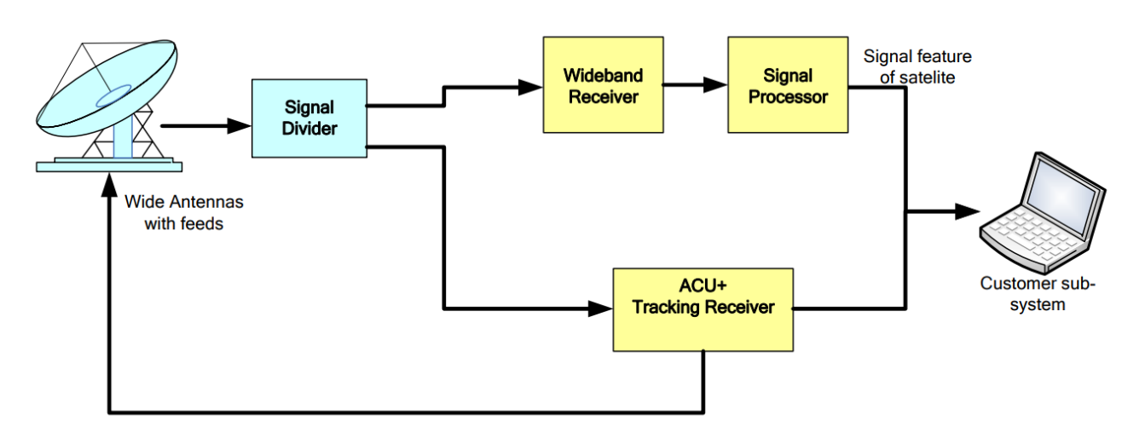
A block diagram for a typical satellite monitoring system
Source: Measurement techniques and new technologies for satellite monitoring (itu.int)

Slide 6

With the proper triggering, the receiving system can record a signal once it is detected so that the characteristics of the signal can be preserved for future analysis
The receiving system should have the ability to determine the following signal properties:
Code rate and symbol rate.
Modulation type, i.e. QPSK, 8PSK, BPSK, 16QAM.
Source coding and channel coding type (i.e. RS, Turbo, LDPC).
Multiplex Access, i.e. TDMA, FDMA, SDMA, CDMA.
DVB Carrier-Identification (DVB-CID). DVB-CID is a unique identifier to identify the owner of a satellite signal according to ETSI TS 103 129.
Additional parameters show below could be used to identify the communication system:
Communication protocol type, i.e. IP, DCME.
Communication system, i.e. SNG, DVB-S, DVB-S2, COMTECH.
Communication network type, i.e. SkyWAN, iDirect, LinkWay/LinkStar.

Slide 7
The deviation between the measured and the nominal (expected) parameters should be continuously compared
The monitoring system may generate an alarm to notify the operator when a given threshold is exceeded
Modern satellite monitoring systems are capable of setting high and low power level thresholds. When a level violation occurs, the software can automatically take an action to provide useful information to satellite
operations.
The following parameters can be used to detect an anomaly or unauthorized transmission and set an alarm:
Centre frequency
Bandwidth
EIRP
S/N ratio
Guard band noise level changes
Modulation characteristics (symbol rate, EVM).
Spectrograms can be used by the operator to visualize short duration interference, fast time slot drift, and sweeping signals.

Slide 8

To build an understanding of the performance of a satellite system over time, the monitoring database can be visualized
To build an understanding of the performance of a satellite system over time, the monitoring database can be visualized by displaying data in different formats including traditional spectrum analysis, spectrograms, waterfall plots, constellation diagrams (for demodulated signals), as well as digital maps for location referenced data. Periodic measurements show parametric changes over short or long time periods and provide insight into trends and the impact of other factors associated with system performance (such as weather, local events, equipment changes, etc.)
The monitoring data could be observed in the following formats:
¸
Audio and video display (for previously decoded data).
Graphic display of signal data in spatial domain, time domain, frequency domain and modulation domain, i.e. spectrogram, waterfall plot, and constellation diagram.
Map display on geolocation result.
Driving route display of monitoring vehicle.

Slide 9

To manage the spectrum usage of satellites and earth stations, a highly integrated database is used to compare the measurement data
To manage the spectrum usage of satellites and earth stations, a highly integrated database is used to compare the measurement data as listed in with historical data for the purpose of both understanding normal operations and identifying the origin of anomalous transmissions
The data allow for example the following analyses:
Identification of unauthorised emissions and anomalies
Deployment of interferences and unauthorised satellite communication network (i.e. VSAT) including interference frequencies, modulation types, the number of interferences, geographical distribution of the interference sources
Satellite orbit position
Frequency occupancy.

Slide 10
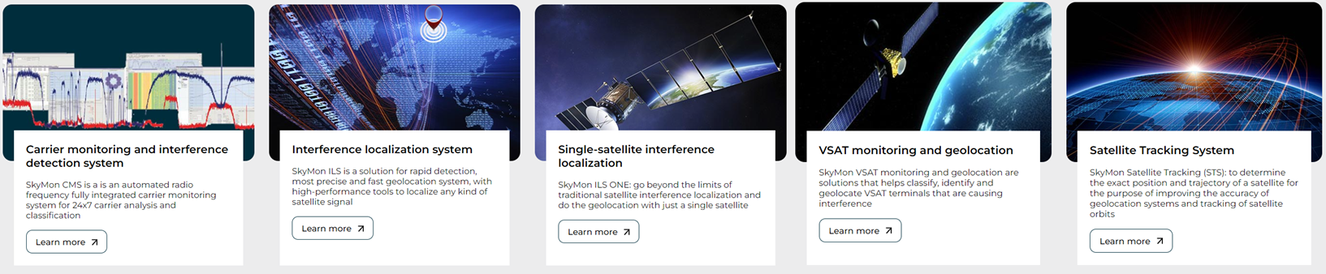
SkyMon is the satellite payload monitoring and interference localization solution that lets you identify interference and manage payloads

Slide 11




SkyMon Carrier Monitoring System (CMS) is an automated radio frequency traffic monitoring system that provides satellite operators with all the necessary tools to continually monitor the satellite links
Automatic background mode
Monitors the traffic in a round-robin fashion – 24 hours a day, 7 days a week – without any operator interaction. Background monitoring is automatically distributed to all monitoring sites and rescheduled if one site fails.
Active foreground mode
Different measurement modes (foreground modes) are available, which provide different levels of control of the selected device and different levels of measurement data output. Foreground mode is always initiated by a user request.
Blind-scanning high-performance DSP demodulation is used to scan and detect individual carriers. The system provides user-friendly point-and-click operations to add identified carriers to the frequency plan database for automatic monitoring.
Hidden carrier detection
The system evaluates the error vector signal, which enables detection of interfering in-band spurious signals without deteriorating ongoing transmissions. The underlying carrier noise and interference spectra are presented in the same display plot that also shows the measured carrier spectra, separated by different colors.
Interference localization
In order to geographically localize the source of interfering signals, the system comes with an integrated interference localization function.
SkyMon is the only system that provides detection and localization of interference sources fully integrated in one system.

Slide 12
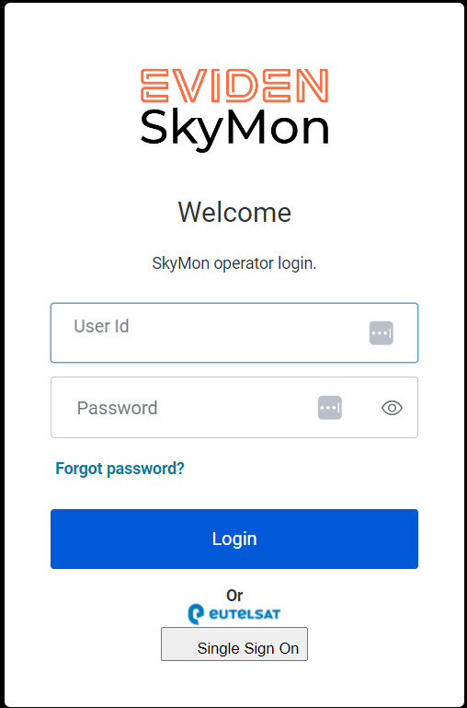
SkyMon Live Demonstration

Slide 13
Thank you

