Slide 1
Satellite Communication Systems

Slide 2
14 Future trends

Slide 3
The space value chain refers to the various stages (upstream, midstream, and downstream) and activities involved in the design, development, production, and use of space-related products and services
Upstream products and services
Midstream products and services
Downstream products and services
Satellite hardware
Smart manufacturing
Other space assets
Launch vehicles
Ground products and services
Postlaunch operations
Data products and analytics
Payloads and components
Robotics
Lunar assets
Heavy and small launch vehicles
Gateway and ground architecture
Satellite communications and navigation
Space situational awareness
Subsegment
Satellite control and computers
Additive manufacturing
Orbital vehicles
Launch operations and maintenance
Terminals and platform equipment
In-orbit services
Geospatial data
Power and propulsion
Upstream products and services include the design and manufacture of satellites, launch systems, space systems, components, ground equipment, and other space-related hardware. They also include the development of new technologies such as advanced propulsion systems, robotics, and additive manufacturing.
Midstream products and services include the operation, maintenance, and servicing of space systems. These include launching and operating satellites, as well as providing ground-based services.
Downstream products and services include the use of satellite-based navigation, satellite communication, earth observation data, space situational awareness, and geospatial data.
Source: Deloitte

Slide 4
The four major categories of players in the space ecosystem
(i)
Space companies whose primary business or a major segment of their business is Space. These companies build products such as launch vehicles and satellites and/or provide services to consumers from Space. Customers can include both government and nongovernment segments.
(ii)
Government agencies, who build, launch, and manage space-based capabilities for national security and scientific research and development. This also includes policy and standards development.
(iii)
Non-space companies that are impacted by space commercialization and services. They may be exploring an entry into the space market and could need assistance to get there.
(iv)
Academia contributes to innovation through research and development of science and space technologies for the future space missions, and also plays crucial role in educating and supplying talent for the industry.
Source: Deloitte

Slide 5
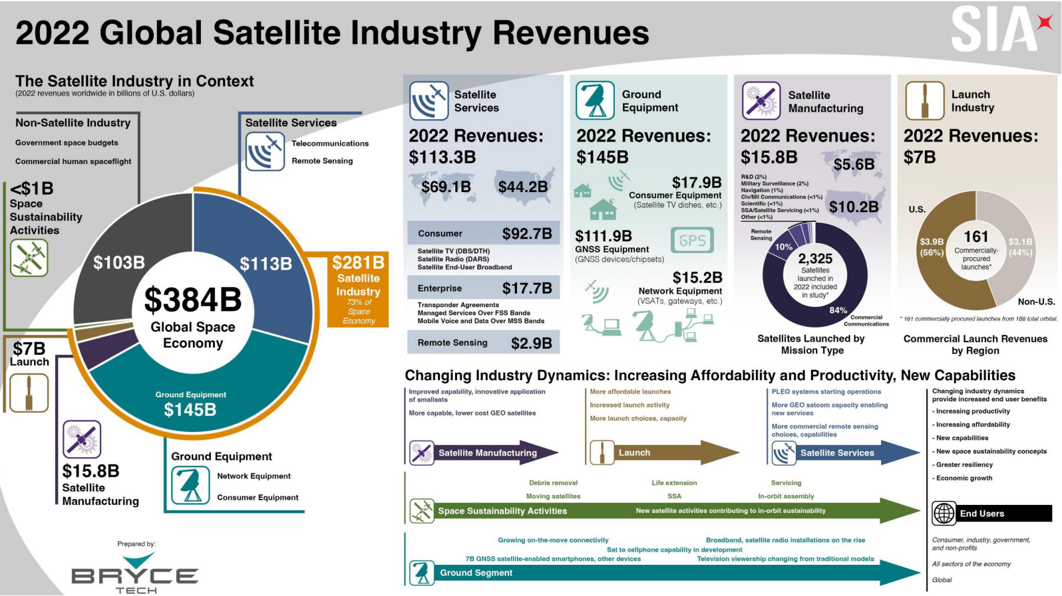
Source: Bryce Tech

Slide 6
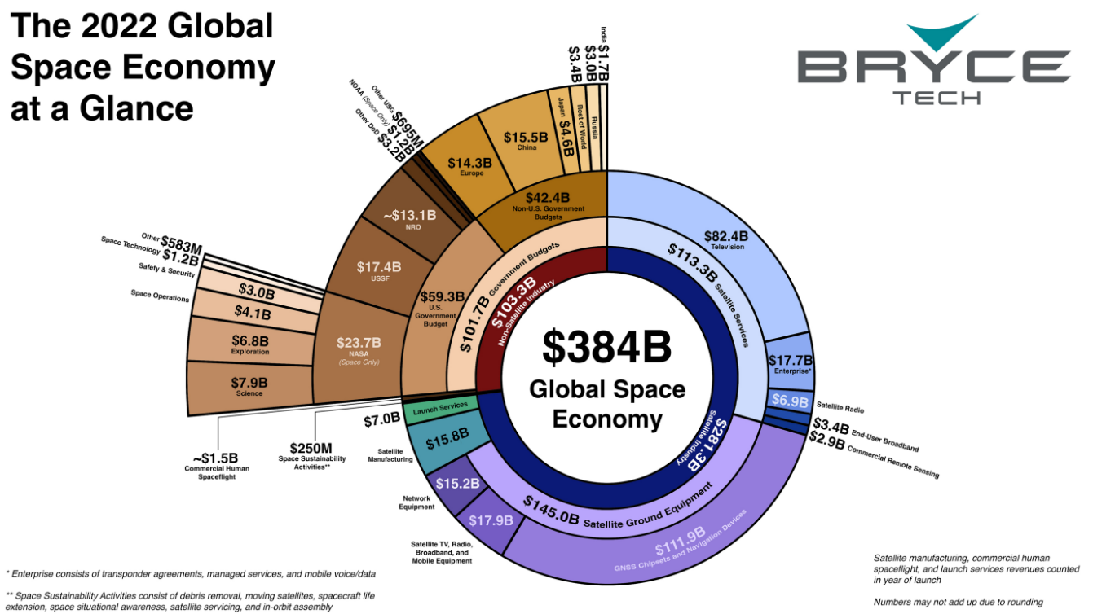
Source: Bryce Tech

Slide 7
Companies operating in the space value chain can unlock true growth by focusing on six major areas that have the potential for disruptive growth
1
2
3
4
5
6
Space data-as-a-service
Data-as-a-service will likely be the key driver of growth for companies in the space ecosystem
In-space manufacturing (ISM)
Involves using the unique environment of outer space for industrial production
Additive manufacturing
Additive manufacturing has the potential to revolutionize the way space-related hardware and components are produced
Robotics in space
Robotics technology could be used for advanced applications such as in-situ resource utilization, and for the construction of habitats and structures on other celestial bodies
Space sustainability
The mitigation and remediation of space debris, including fragments and massive derelict objects, present a unique opportunity
National security space
With increasing geopolitical uncertainty and space being a shared global resource, the use of space by militaries will offer companies strong growth avenues in supporting national security
Source: Deloitte

Slide 8
Data gathered from space, i.e., the vast amount of information collected by a wide variety of space-based instruments and platforms, can be increasingly used for a variety of purposes
Including:
military communications,
open ocean surveillance,
environmental and climate change monitoring,
and emergency response.
Space data has the potential to support new technologies and industries, such as autonomous vehicles and the Internet of Things (IoT). As the cost of access to space is reduced and advances in technology continue, the amount and variety of data gathered from space will likely continue to grow and could provide valuable insights and benefits to several industries and end-users. For example, the amount of data being sent to and from space will likely grow to more than 500 exabytes of information from 2020 to 2030 (a 14x increase). Ninety-eight percent of senior executives surveyed said that demand for space data is increasing as it has broader use and significance across end-markets. One potential use case could include using space-based technologies, such as Earth observation and remote sensing, to monitor and manage natural resources, support agriculture, and assist with disaster response and management.
In addition, emerging breakthrough technologies such as edge computing and AI could transform space data services. Edge computing in space is an emerging technology that can open a new domain for software applications, probably similar in scale to mobile apps. As edge computing is all about processing data closer to where it's being generated and enabling processing at greater speeds and volumes leading to greater action-led results in real-time, edge devices on spacecraft could process sensor data (e.g., images) to produce actionable information on the spot.
Source: Deloitte

Slide 9
AI, too, could be increasingly used in processing space data in these ways
1
Spacecraft navigation: Analyze data from a variety of sensors, such as cameras and LIDAR (Light Detection and Ranging) to create a detailed map of the spacecraft’s environment. This information could then be used to navigate the spacecraft to avoid obstacles and optimize its trajectory.
2
Image and signal processing: Analyze images taken by spacecraft to identify specific features, such as craters or mountains on a planet’s surface. Similarly, AI could be used to analyze signals from space-based instruments, such as radio telescopes, to detect patterns or anomalies in the data.
3
Scientific data analysis: Process large amounts of data collected by spacecraft and telescopes, identifying patterns and trends that would be difficult for humans to detect.
4
Control and monitor satellite systems: Make decisions on board the satellite, such as adjusting its position or power usage. AI could also be used to monitor the health of the satellite, identifying potential problems before they occur and taking action to prevent them.
Source: Deloitte

Slide 10
Space data could enable digital reality technologies (e.g., augmented and virtual reality, and digital twins) for geospatial intelligence and space domain awareness
1
Enhancing local intelligence (using 3D geospatial data for dynamic and precision targeting) and mapping by integrating geospatial information and digital reality technologies
2
Developing new 3D/metaverse applications that require 3D georegistered data in areas such as social media
3
Leveraging space situational awareness data to create immersive environments for understanding and managing space traffic and threats
Source: Deloitte

Slide 11
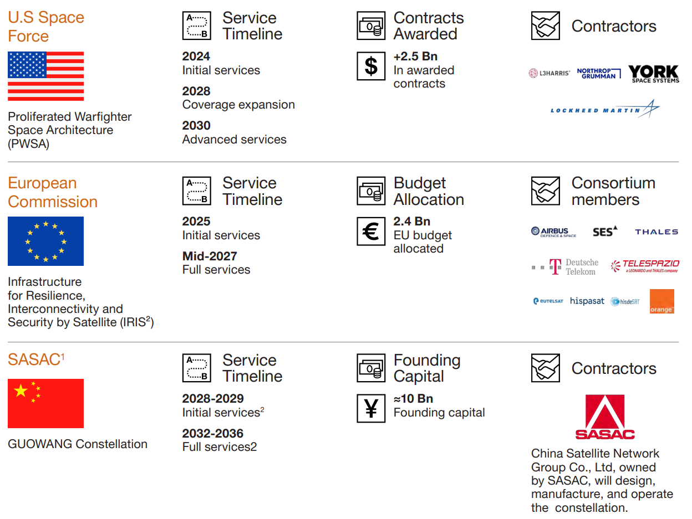
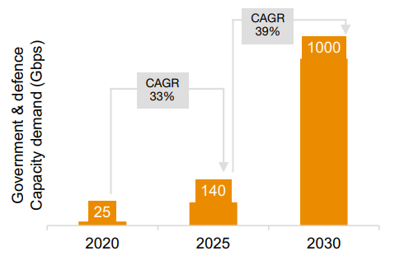
Sovereign LEO capacity is becoming a strategic dimension for major space fairing nations
Recent geopolitical conflict in Europe highlighted the dependency of many countries on commercial providers, particularly those in LEO, who maintain control over critical communications infrastructure.
This has prompted both the EU & US to strongly push for sovereign capabilities that address the growing demand for civil government and defence capacity
China too has recognized the importance of strategic assets in LEO and identifies space-based connectivity as its core priority of focus.
Source: PwC

Slide 12
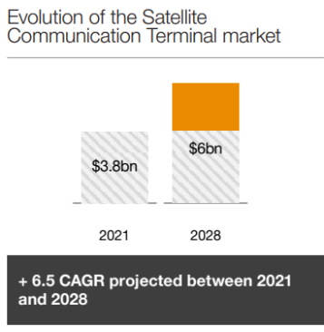
The development of mega-constellations is impacting the user terminal and antenna market
Multi-frequency terminals
Multi-beam and multi-frequency terminals allow access to both Ku and Ka-band, and GEO, MEO and LEO satellites are being developed to comply with emerging user needs and requirements.
A growing flat panel antenna market
Flat panel antennas appeal to users supported by mega-constellations as they are smaller and more discreet than traditional antennas, and thanks to the phased array, they offer the possibility to electronically follow satellites while
remaining stationary.
Mobility features for marine and military
Both marine and military domains include a mobility requirement that implies the need for uninterrupted communications. Satellite Communication on The Move (COTM) enables users to sustain communications in vehicles reaching a speed of 130 km/h
Increased demand for anti-jamming features
A few days prior to the beginning of the conflict in Ukraine, Russia launched a cyberattack jamming the UHF and VHF of terminals in Eastern Ukraine. Both military and commercial demand are expressing more and more the need for anti-jamming features.
Source: PwC

Slide 13
Thank you

