Slide 1
Satellite Communication Systems

Slide 2
15 Standards

Slide 3
Simplified, standards are documents that establish an agreed upon way of doing something
Standards are published documents that establish technical specifications and procedures designed to maximize the reliability of the materials, products, methods, and/or services people use every day.
From accepted best practices to technical specifications or requirements, standards help ensure a common approach and repeatable outcome in the design and development of products, services and technologies.
A standard can be thought of as an agreed-upon norm used by people, industry, and government that outlines the best way to complete a task – whether it’s about developing a product, providing a service, controlling a process, or interacting with the world.
Standards are important because they:
Increase efficiency
Standards contribute to making the development, manufacturing and supply of products and services more efficient, reliable, safer, and cleaner.
Fuel compatibility and interoperability
Standards form the fundamental building blocks for product development by establishing consistent protocols that can be universally understood and adopted.
Increase competitiveness
Standards have an important economic and social role for enabling our industry to remain competitive on the market and to conquer new markets. By adopting a standard, manufacturers are both joining and leveraging an ecosystem of like-minded companies and other organizations.
Facilitate trade
Standards allow trading between organizations to progress easier and fairer.
Transfer knowledge
Standards aid in transferring knowledge and enhancing engineering capabilities to smaller or developing organizations.
Provides goal for education
Standards participate to the education of todays and future engineers when conforming to standards is secured, thus, for instance, avoiding designers reinventing the wheel.

Slide 4

The European Cooperation for Space Standardization is an initiative established to develop a coherent, single set of user-friendly standards for use in all European space activities.
In the early 1990s:
Each customer had its own set of standards (eg NASA, US MIL, industry best practices)
European space industry had to meet different requirements for each customer
Very expensive…
Need to develop a common
standardization system.
The ultimate goal of building such a standardization system, at European level, is to minimize life-cycle cost, while continually improving the quality, functional integrity, and compatibility of all elements of a space project. This goal is achieved by applying common standards for project management, quality, engineering and sustainability for the design, development, testing and qualification of hardware and software.
The European Cooperation for Space Standardization (ECSS):
Is a collaboration between the European Space Agency (ESA), the European space industry represented by Eurospace, and several space agencies, to develop and maintain a coherent, single set of user-friendly standards for use in all European space activities. Established in 1993 following a call by Eurospace to unify space products assurance standardization on a European level, it was officially adopted by the ESA on 23 June 1994 through the resolution ESA/C/CXIII/Res.1, to replace its own Procedures, Specifications and Standards (PSS) system.
ECSS purpose:
develop and maintain a single set of consistent space standards
recognized and applied for use by the entire European Space Community
the European way of procuring space systems
standards made applicable by the project contract
The European Cooperation for Space Standardization website: https://ecss.nl/

Slide 5
ECSS system is fully operational
ECSS in numbers (status as of 2023, source ESA materials):
More than 29000 ECSS requirements
> 18000 engineering requirements
> 500 project management requirements
> 9000 product assurance requirements
> 83 sustainability requirements
136 active standards
7 Requests to translate ECSS
standards:
Japan
Belarus
China
Ukraine
Kazakhstan
Poland
Russia
134 ECSS standards adopted as European Norms by CEN
More than 20 Working groups (WG)
Active WG for new standards, including:
machine learning qualification for space projects
management branch simplification
magnetic cleanliness
software security
COTS
57 active handbooks
> 50 ESA space projects using ECSS standards
57 ECSS handbooks adopted as Technical Reports by CEN
> 300 Working Groups since 1994

Slide 6
ECSS has two high level bodies: the Steering Board and the
Technical Authority
Steering Board
Steering Board:
Sets policy and strategy
1 representative per agency
4 representatives for Eurospace
Executive Secretariat:
secretariat support to SB & TA
support WGs in drafting documents in
accordance with ECSS rules and procedures
custody ECSS docs: collect and analyse CRs,
NWIPs and Feedback
administrate the ECSS Website
Executive Secretariat (ESA)
Technical Authority
Technical Authority:
Day-to-day running
1 representative per agency
4 representatives for Eurospace
WG
Network of Experts
WG
WG

Slide 7
ECSS members are committed to use the ECSS standards for their Space projects and programmes
Members
Agencies & companies actively supporting ECSS
Agenzia Spaziale Italiana (ASI)
UK Space Agency
Centre National d’Etudes Spatiales (CNES)
Deutsches Zentrum für Luft- und Raumfahrt (DLR)
European Space Agency (ESA)
Netherlands Space Office (NSO)
Norwegian Space Centre
The European industry is represented by
Eurospace
Associated member
Canadian Space Agency (CSA)
Observers
CEN-CENELEC
EUMETSAT
European Commission (EC)
European Defense Agency (EDA)
Source: Members | European Cooperation for Space Standardization (ecss.nl)
Contribute to the development of ECSS documents by:
Participating in the ECSS governing bodies
Contributing to the development of docs by appointing experts to WGs
Providing comments to the docs under development, during their review
Providing CRs as needed, and contributing to the feedback process

Slide 8
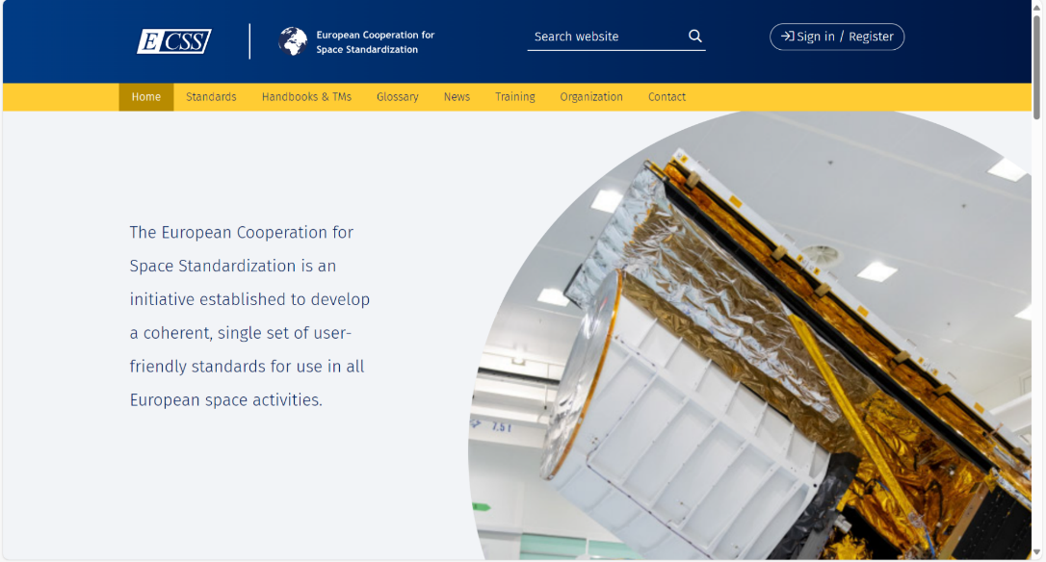
The ECSS website is one of a mechanism to promote, disseminate the information, and involve the space community in the development of standards is vital for ECSS success and evolution
The European Cooperation for Space Standardization website: https://ecss.nl/
The ECSS web site has the objective to:
Make all the information freely available to stakeholders and worldwide: The most recent versions of the standards, handbooks, procedures, and policies are easily accessible and downloadable, making these documents publicly available in real time.
Sharing and promoting ideas among the space community: the ECSS Technical Authority meets 4 times a year, to discuss and prioritize the needs for new standards, and the update of the existing ones. Discussions help to promote and sustain a common understanding and interpretation of the standards. All these aspects are key in building a common ECSS culture across the space community in Europe.
Integrate the initiatives of the different key players in the boards, panels, or working groups: When developing ECSS standards, such key players perform their task on a voluntary and non-permanent basis. They are provided with a password-protected environment as a central place to share information, decisions, and documents created during the development of their document.

Slide 9
ECSS interfaces with other Standards Development Organizations (SDOs)
ECSS avoids the developing documents, if an existing or planned document on the subject from other SDOs is considered suitable for ECSS use:
document suitable as is - No additional action needed (it will be cross-referenced By ECSS docs)
usable, but needs some modifications for full suitability - adopted via an Adoption Note, which lists one by one all the clauses/paragraphs/requirements:
  To be deleted
  To be modified (and then including the modified text)
  To be added (and then including the added text)
3 options for ECSS participation in development activities in other SDOs:
1. ECSS decides not to participate at all in the development, and when the document is published.
The risk is that if the final product is not suitable, ECSS will have to generate its own document.
2. ECSS does not contribute directly to the drafting, but it comments the document during the Public Review and monitor the dispositions and implementation.
This permits certain control on the final product, but it does not ensure that it will meet the ECSS needs.
3. ECSS decides to fully cooperate with the other SDO in the complete development of the document, by providing experts to the WG and producing comments during the PR.
ECSS has agreements in place with other SDOs:
Liaison
ad-hoc cooperation
formal agreement
Examples of SDOs:
International Organization for Standardization (ISO)
European Committee for Standardisation (CEN)
Consultative Committee for Space Data Systems (CCSDS)
European Space Components Coordination (ESCC)

Slide 10
The documents released by the ECSS are classified under three document types
Standards
are normative documents defining verifiable requirements and providing the minimum necessary description.
content limited to verifiable requirements – state what to do, not how to do it
express what to do in terms of regulatory provisions
provisions focused on a contractual relationship for direct use in invitations to tender and business agreements
each requirement contained within a standard has a unique identification, allowing full traceability and easy verification of compliance.
Handbooks
are non-normative documents providing background information, orientation, advice or recommendations related to one specific discipline or to a specific technique, technology, process or activity.
Technical memoranda
are information documents that cannot be used as normative documents
provide useful information to the space community
content not yet mature for a standard or handbook

Slide 11
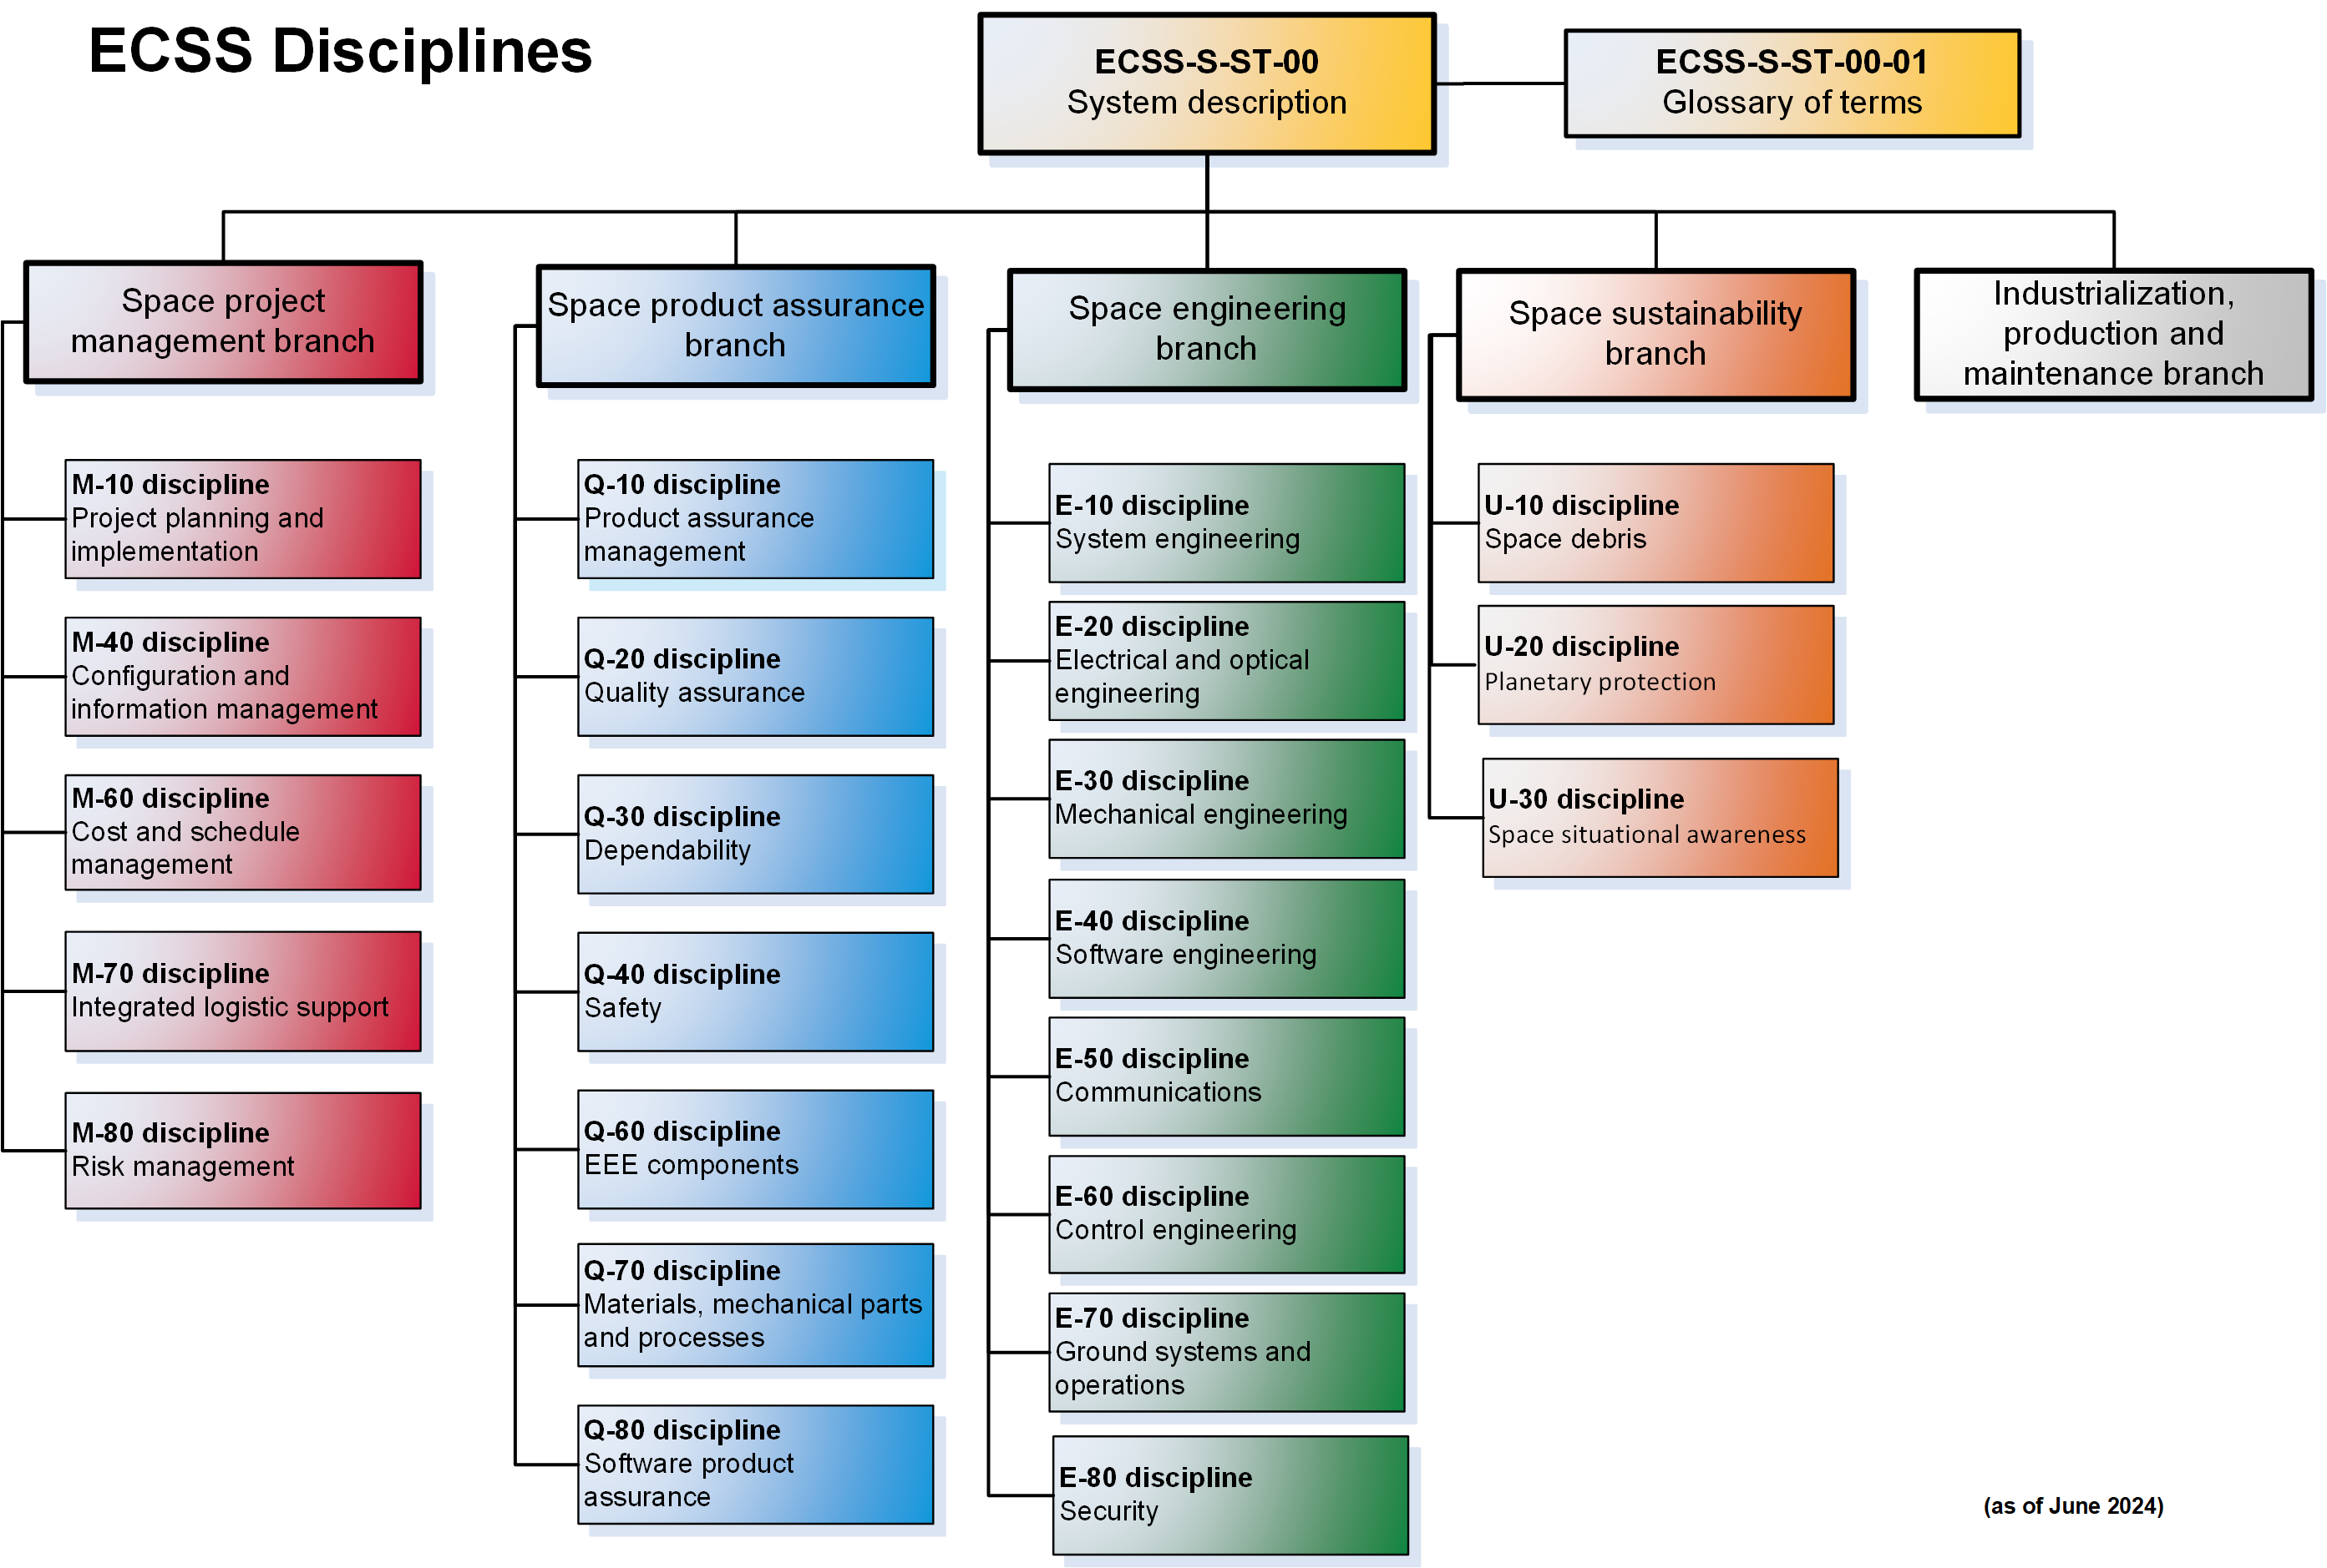
Structure and architecture of ECSS Standard System (I)
Source: Document Tree | European Cooperation for Space Standardization (ecss.nl) (as of June 2024)

Slide 12
Structure and architecture of ECSS Standard System (II)
Management branch
(M-branch)
Engineering branch
(E-branch)
Product Assurance
(Q-branch)
Space Sustainability
(U-branch)
The overall objective of project management is to implement a process to achieve successful completion of the project in terms of cost, schedule and technical performance. Project management is performed following a structured approach throughout all stages of its life cycle and at all levels of the customer-supplier chain.
It integrates all management, engineering and product assurance functions required to execute the project.
It covers the engineering aspects of space systems and products, including:
The engineering process as applied to space systems and their elements or functions
Technical aspects of product used to accomplish, or associated with, space missions
The prime objective of Product Assurance is to assure that the Space Products accomplish their defined mission objectives and more specifically that they are safe, available and reliable. In support of project Risk Management, PA assures an adequate identification, appraisal, prevention and control of technical risks within project constraints.
The prime objective of Space Sustainability is to ensure the long term sustainability of space activities, including orbital debris mitigation, space situation awareness, and planetary protection.
Space sustainability refers to the ability for all countries to continue to use space for peaceful purpose and socio-economic or scientific benefit over the long term.

Slide 13
Denomination of ECSS documents
ECSS-<Branch>-<Document type>-<number><version>
Branches:
S – ECSS system
M – Management
E - Engineering
Q – Product Assurance
U - Sustainability
Document type:
ST – Standard
AS – Adopted Standard
HB – Handbook
AH – Adopted Handbook
TM – Technical Memorandum
Number is one or two groups of two digits.
Version is a letter from “A” onwards.
May include also a Rev index, from 1 onwards
Example:
ECSS-S-ST-00C Rev.1

Slide 14
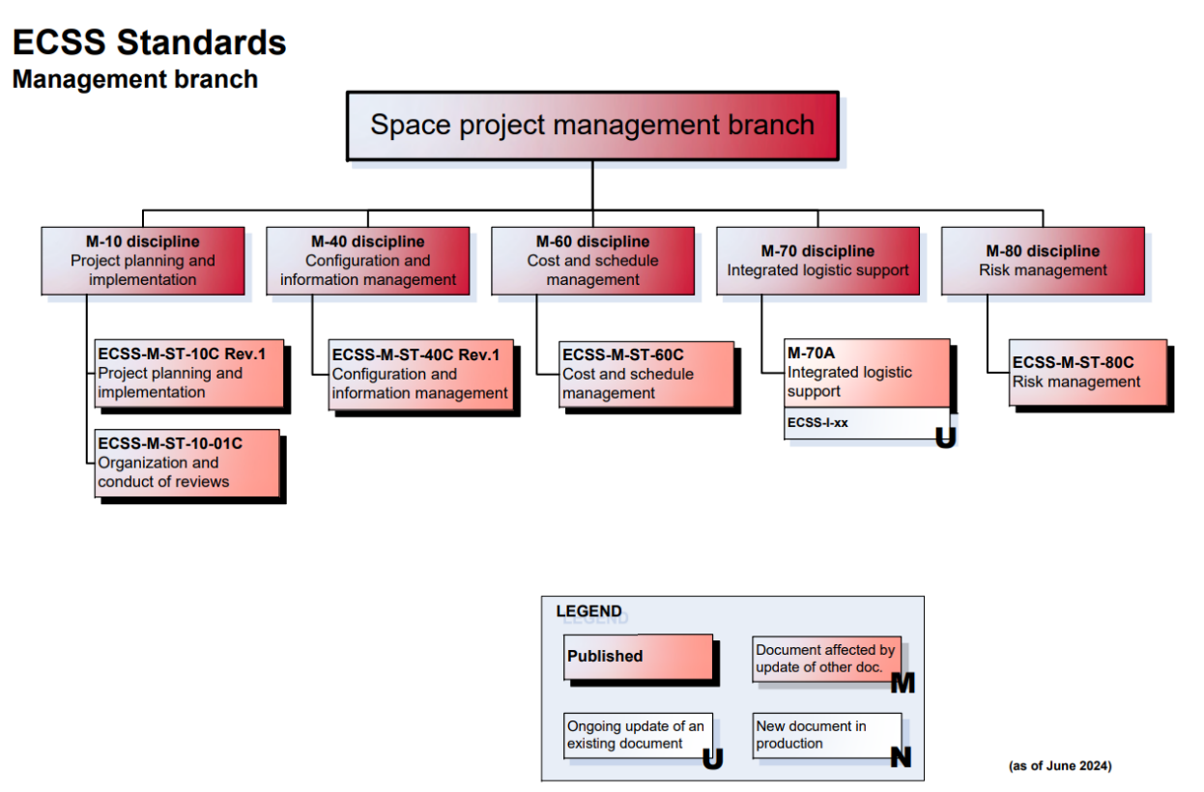
Example of ECSS standards’ denomination
Source: Document Tree | European Cooperation for Space Standardization (ecss.nl) (as of June 2024)

Slide 15
ECSS standards shall NOT be used in isolation
ECSS is a consistent and coherent set of standards:
ECSS was started with the aims to develop a single coherent set of space standards, either adopted from other SDOs or developed by ECSS itself, for the use of the entire Space community.
This implies that repetition and overlapping among standards should be avoided. If an existing part of a document needs to be addressed in a second one, it is not repeated but a reference to the first one should be done.
Example: standards applicable to a software project
Software is specifically covered by the following two ECSS standards:
ECSS-E-ST-40C Software
ECSS-Q-ST-80C Rev.1 Software product assurance
These two standards are not enough to run a space contract, even if the project only includes
software.
Other documents may need to be included:
ECSS M-ST-10 Project planning and implementation (for e.g. the definition of the project phases)
ECSS-M-ST-10-01 Organization and conduct of reviews
ECSS-M-ST-40 Documentation and configuration management (for e.g. the SW configuration control)
ECSS-E-ST-10 System Engineering (for e.g. DDF, DJF, Technical Specification)
ECSS-E-ST-10-02 Verification
ECSS-Q-ST-10-09 Non-conformance control system
ECSS-Q-ST-30 Dependability (for e.g. criticality definition)
ECSS-Q-ST-40 Safety

Slide 16
The style and presentation are identical for all ECSS standards
❑ change log, ToC, [introduction]
1. Scope
clear and concise identification of the coverage and applicability of the standard
2. Normative reference
listing only documents referenced from requirements
3. Terms, definitions, and abbreviations
4. [Principles and/or background]
containing only informative/guidance material
5. Requirements
containing the normative provisions
it may contain some NOTES and a few guidance sub-clauses with only guidance material
6. [More requirements]
n. [Pre-tailoring (per product type and project phase)]
only mandatory if the standard is subject to pre-tailoring
❑ [Annexes]
Normative annexes (DRDs) – always first
Informative annexes
❑ Bibliography
lists documents references from informative/guidance text

Slide 17
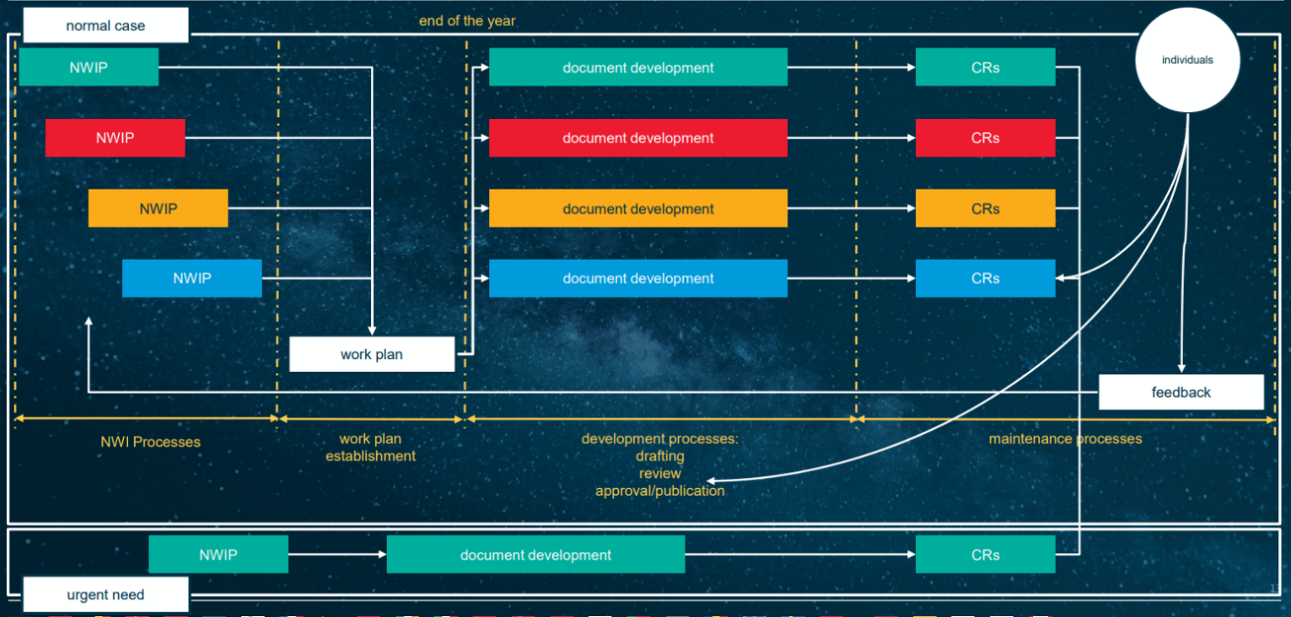
ECSS document lifecycle
Source: ESA Copyright

Slide 18
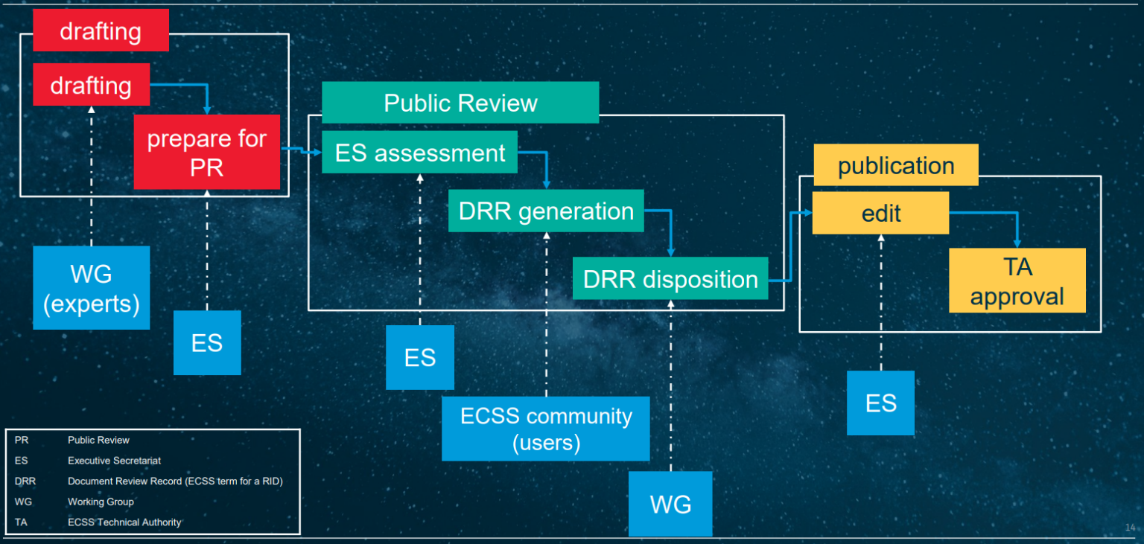
ECSS documents production lifecycle
Source: ESA Copyright

Slide 19
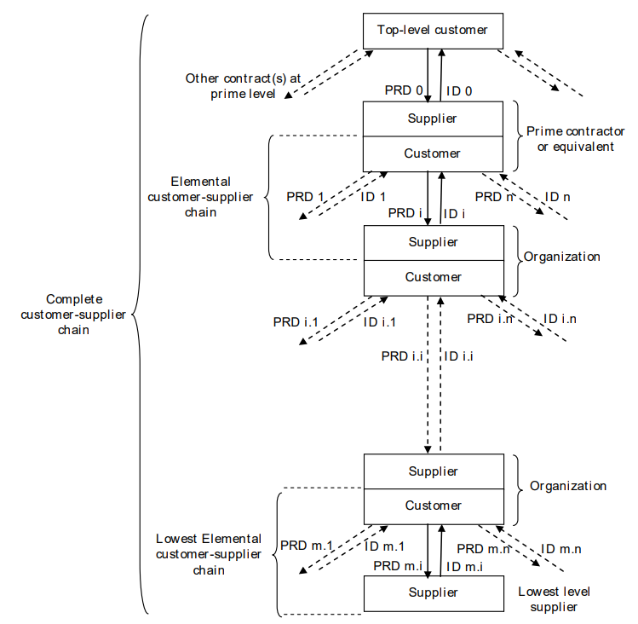
ECSS documents are made applicable by invoking them in business agreements
The ECSS documents themselves do not have legal standing and they do not constitute business agreements.
The applicability of standards and requirements is specified in the project requirements documents (PRDs), which are included in business agreements, which are agreed by the parties and binding them.
Most space projects comprise a number of hierarchical levels, where:
The actor at the top level of the hierarchy is the top level customer
The actors at the intermediate levels of the hierarchy are the both supplier and customer
The actors at the lowest level of the hierarchy are suppliers only
Characteristics of ECSS standards and requirements:
specific legal langue not used
language used aims to avoid variations in interpretation
clearly state the obligations of each actor (customer/supplier)
Business agreements can come in various types, such as:
Contracts
Memoranda of understanding
Inter-governmental agreements
Inter-agency agreements
Partnerships
Bartering agreements
Purchase orders
Source: ECSS-S-ST-00C Rev.1

Slide 20
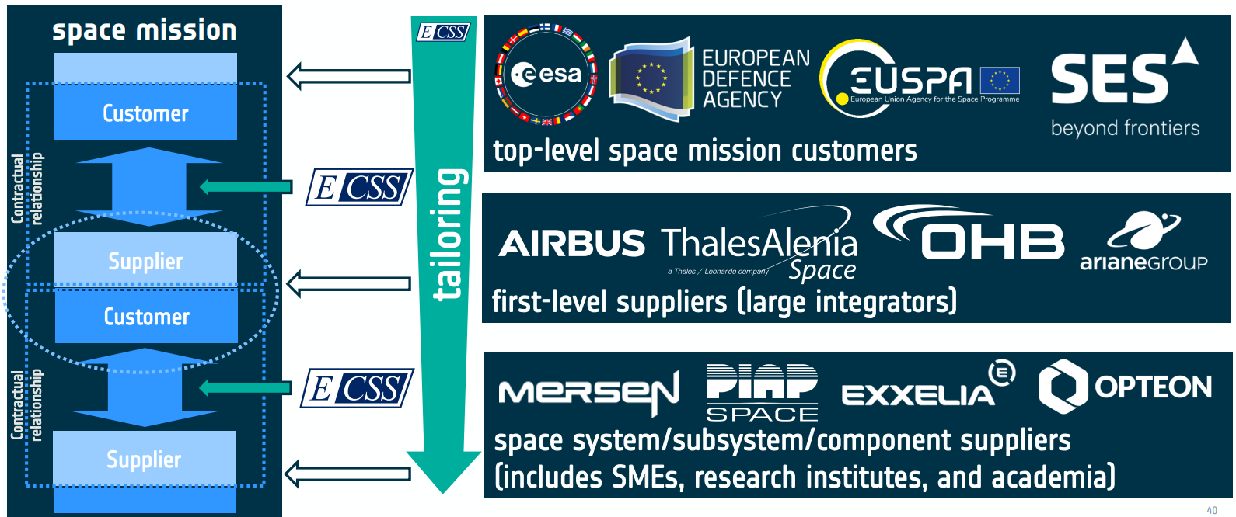
ECSS is the cornerstone of space project procurement in Europe
Source: ESA materials (ESA Copyright)

Slide 21
The process of adapting the requirements to the project specificities is called tailoring
The tailoring process of ECSS requirements for a given project / mission consist of the preparatory and the actual tailoring activities in the following 7 steps:
Preparatory activities:
Core tailoring activities
Core tailoring activities
1
Identification of project characteristics
3
Selection of applicable ECSS Standards
5
Completion of requirements
2
Analysis of project characteristics and identification of risks
4
Selection of requirements from applicable standards
6
Harmonization of requirements
7
Documenting of requirements applicability
The tailoring process is described in detail in ECSS-S-ST-00-02

Slide 22
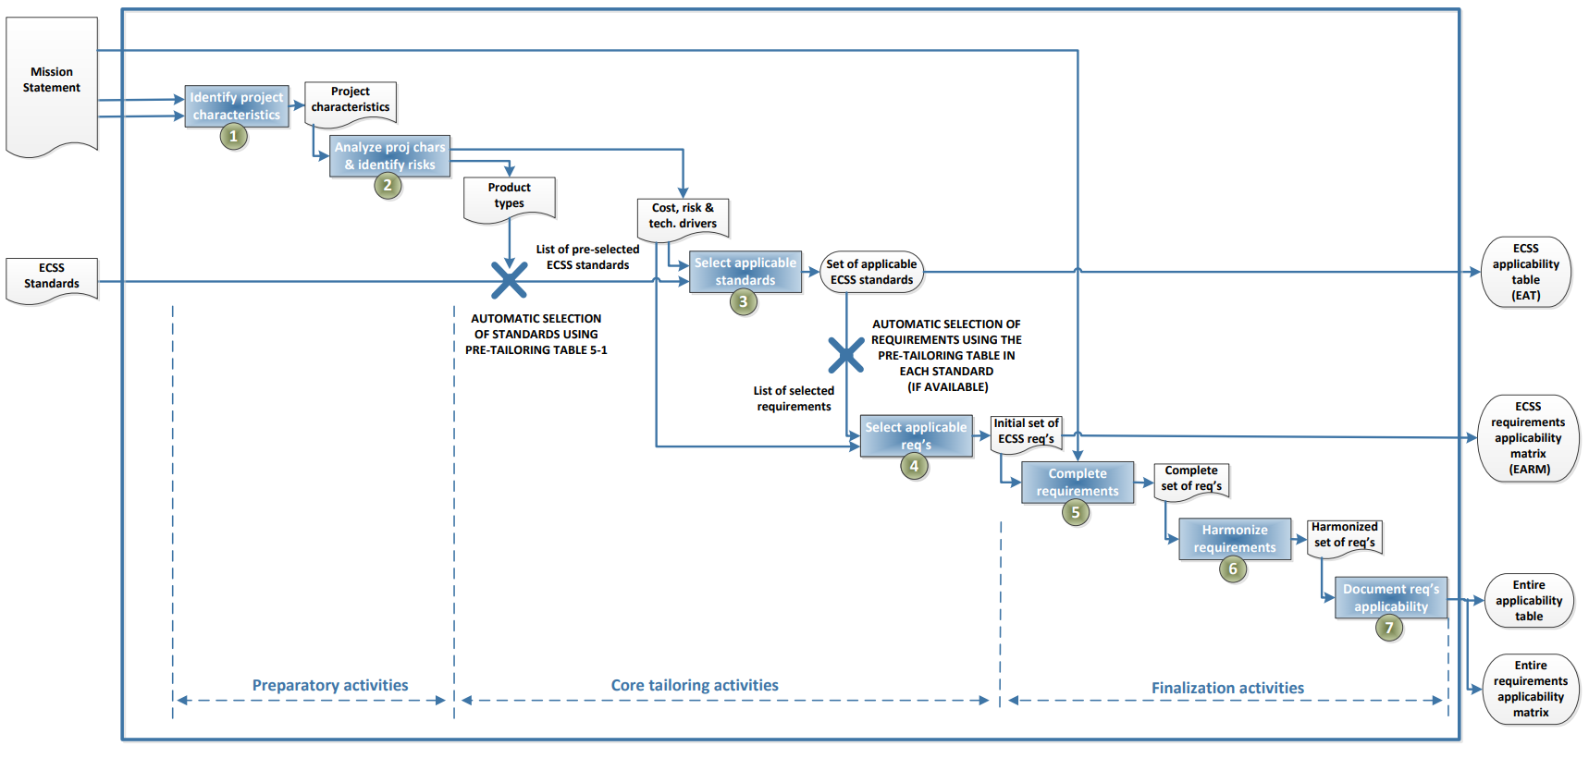
7-step tailoring process at the top level of the customer/supplier chain
Source: ECSS-S-ST-00-02C Draft 1

Slide 23
ECSS-E-ST-40C Space engineering
Software

Slide 24
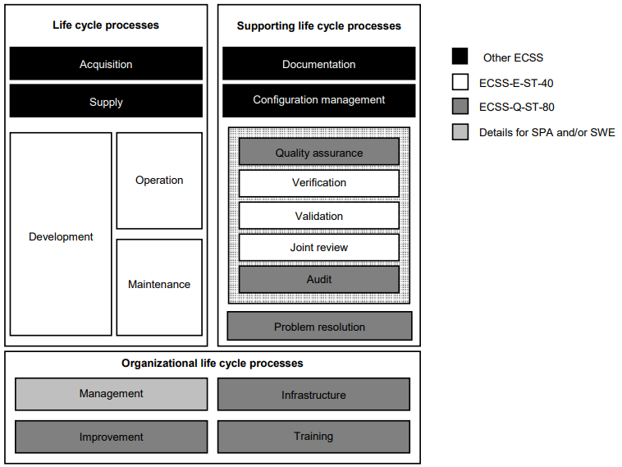
This Standard defines the principles and requirements applicable to space software engineering
This software engineering Standard concerns the “product software”, i.e. software that is part of a space system product tree and developed as part of a space project.
This Standard is applicable, to the extent defined by the tailoring process, to all the elements of a space system, including the space segment, the launch service segment and the ground segment.
This Standard covers all aspects of space software engineering including requirements definition, design, production, verification and validation, transfer, operations and maintenance.
It defines the scope of the space software engineering processes and its
interfaces with management and product assurance, which are addressed in the Management (–M) and Product assurance (–Q) branches of the ECSS System, and explains how they apply in the software engineering processes.
Software related processes in ECSS Standards
Source: ECSS-E-ST-40C

Slide 25
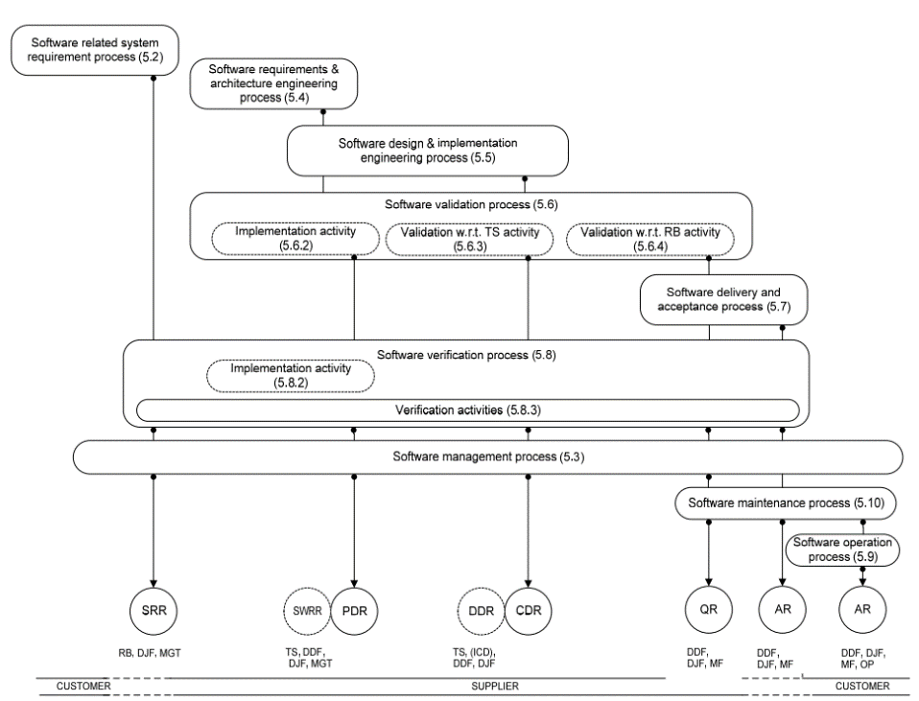
Overview of the software life cycle process
Source: ECSS-E-ST-40C

Slide 26
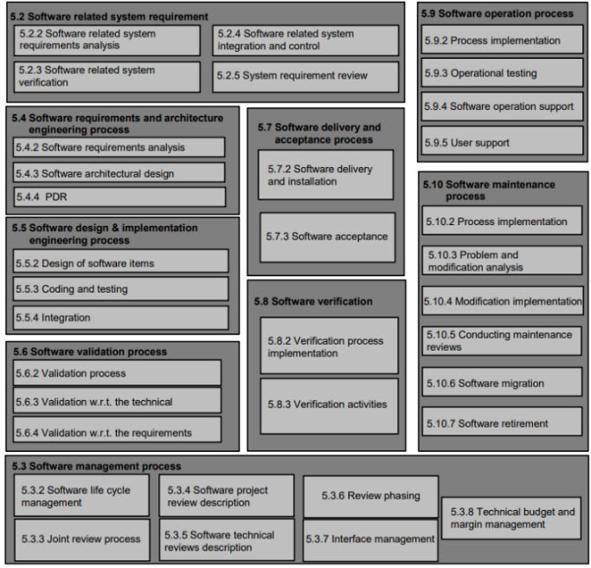
Structure of this ECSS-E-ST-40C

Slide 27
Thank you

