Slide 1
Satellite Communication Systems

Slide 2
16 Space project management standards

Slide 3
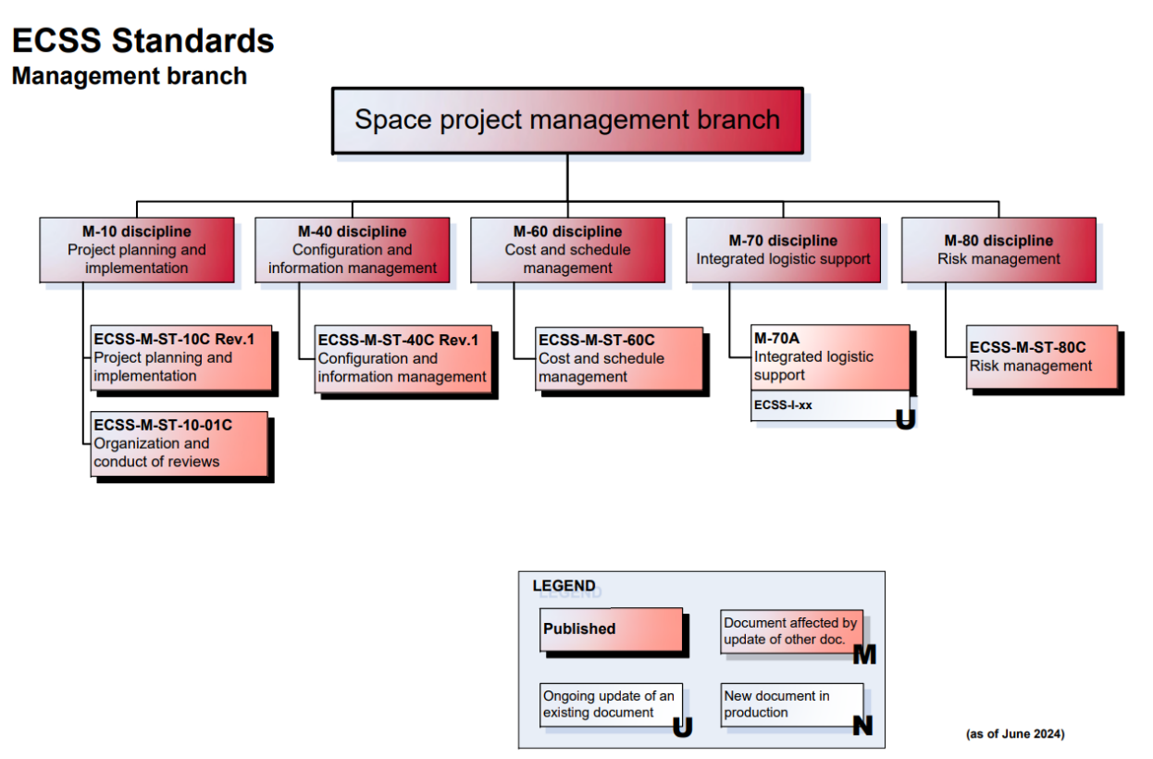
ECSS Standards in Space project management branch
M-70 is a version A (old standard, and update is ongoing – it will not be covered in this presentation)
Source: Document Tree | European Cooperation for Space Standardization (ecss.nl) (as of June 2024)

Slide 4
ECSS-M-ST-10C Project planning and implementation

Slide 5
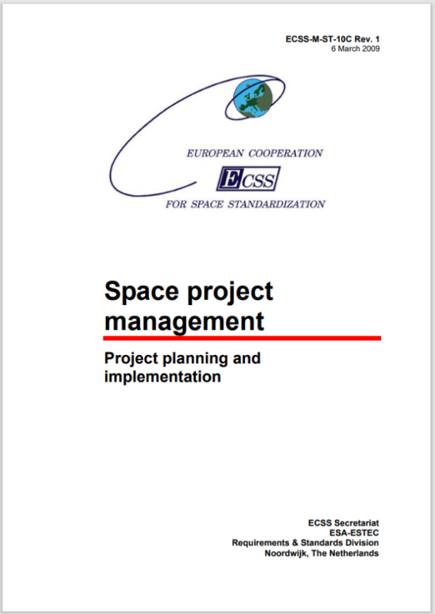
Project planning and implementation is the project function, encompassing a coherent set of processes for all aspects of project management and control
This is done by:
1
establishing the project requirements and constraints derived from the mission statement.
2
defining phases and formal milestones enabling the progress of the project to be controlled with respect to cost, schedule and technical objectives (i.e. project control function).
3
defining project breakdown structures, which constitute the common and unique reference system for the project management to:
identify the tasks and responsibilities of each actor;
facilitate the coherence between all activities of the whole project;
perform scheduling and costing activities
4
setting up a project organization to perform all necessary activities on the project.
The scope of this ECSS Standard is limited to describing the key elements of project planning and implementation and identifying the top level requirements and products that together provide a coherent and integrated project planning across the 3 ECSS branches

Slide 6
Project breakdown structures provide the basis for creating a common understanding between all actors
Function tree
The function tree is the breakdown of the system performances into functions. Each function is decomposed into sub–functions independent of the type of products involved.
Specification tree
The specification tree defines the hierarchical relationship of all technical requirements specifications for the different elements of a system or product
Product tree
The product tree is the breakdown of the project into successive levels of hardware and software products or elements, articulated to perform the functions identified in the function tree. However, the function and the product tree do not necessarily mirror each other.
Work breakdown structure (WBS)
It divides the project into manageable work packages, organized according to the nature of the work by breaking down the total work to be performed into increasing levels of detail. The WBS is derived from the product tree, selected elements of which are extended to include support functions (i.e. management, engineering, product assurance) and associated services (e.g. test facilities).
Work package (WP)
A WP can be any element of the WBS down to the lowest level that can be measured and managed for planning, monitoring, and control.
Organization breakdown structure (OBS)
The OBS depicts the proposed project organization, including the interface and contractual responsibilities

Slide 7
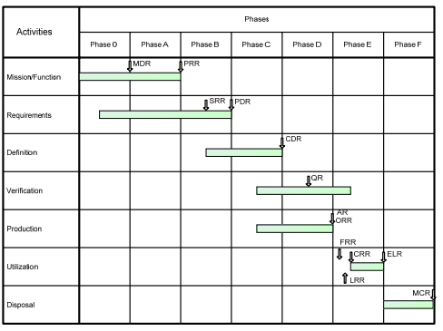
The life cycle of space projects is typically divided into 7 phases
Phase 0
Mission analysis/needs identification
Phase A
Feasibility
Phase B
Preliminary Definition
Phase C
Detailed Definition
Phase D
Qualification and Production
Phase E
Utilization
Phase F
Disposal
Typical project life cycle (Source ECSS-M-ST-10C Rev. 1)

Slide 8
Project management plan defines the project management approach and methodology to be used, together with an overview of all elements of project management disciplines
Scope and content
1
Introduction
7
Cost and schedule management
2
Applicable and reference documents
8
Integrated logistic support
3
Objectives and constraints of the project
9
Risk management
4
Project organization
10
Product assurance management
5
Project breakdown structures
11
Engineering management
6
Configuration, information and documentation management

Slide 9
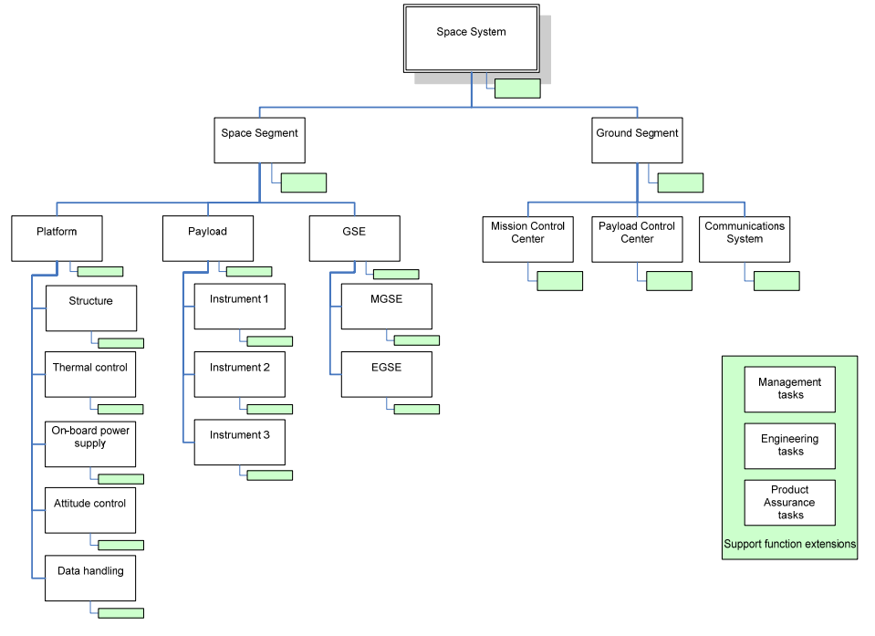
The main challenge associated with developing the WBS is to determine the balancing between the project definition aspects of the WBS and the requirements for data collecting and reporting
One has to keep in mind that the WBS is a tool designed to assist the project manager when decomposing the project only to the levels necessary to meet the needs of the project, the nature of the work, and the confidence of the team.
An excessive WBS levels can lead to unrealistic levels of maintenance and reporting, and consequently to an inefficient and over costly project. The theory that more management data equates to better management control has been proven false many times over in the last decades when assessing systems performance. On the other hand, if not detailed enough it makes the element difficult to manage or the risk unacceptable
Should the WBS be decomposed further?
Example of the list of questions:
Is there a need to improve the assessment of the cost estimates or progress measuring of the WBS element?
Is there more than one individual responsible for the WBS element? Does the WBS element content include more than one type of work process or produces more than one deliverable at completion?
Is there a need to assess the timing of work processes that are internal to the WBS element?
Is there a need to assess the cost of work processes or deliverables that are internal to the WBS element?
Are there interactions between deliverables within a WBS element to another WBS element?
Source: ECSS-M-ST-10C Rev. 1

Slide 10
ECSS-M-ST-40C Configuration and information management

Slide 11
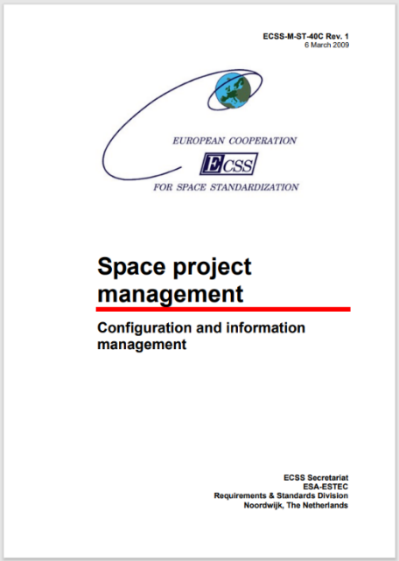
The scope of this standard is to describe the processes and provide the requirements for managing the information/documentation and configuration of products within a space programme or project
Configuration management is the process for establishing and maintaining a consistent record of a product’s functional and physical characteristics compared to its design and operational requirements. Configuration management is applied throughout the entire life cycle of the product.
Configuration management allows one to:
know at any time the technical description of a product using approved documentation;
record and control the evolution in the technical description of a product (e.g. system and its products);
provide traceability of the evolution of the product’s technical description;
ensure the consistency of the internal interfaces;
verify and demonstrate to all actors that documentation is and remains the exact image of the products it describes;
identify the current configuration baseline and the as‐built configuration of a product, to record discrepancies detected during production, delivery or operation and dispositioned for further use;
enable any actor to know the operational possibilities and limitations of each product item and, in case of nonconformance, to know which items are affected
Information/documentation management is the process for ensuring timely and effective creation, collection, review, delivery, storage, and archiving of project information.
Information/documentation management allows someone to:
ensure the correctness, accessibility, rapid availability, reliability and security of information provided to all the actors both internal and external to the project;
ensure the coherence of the overall project information, thus facilitating effective and efficient use of the information;
ensure that all the actors who need access to information are aware of its availability, the means of access, and related methods and procedures;
support the programme / project reporting.

Slide 12
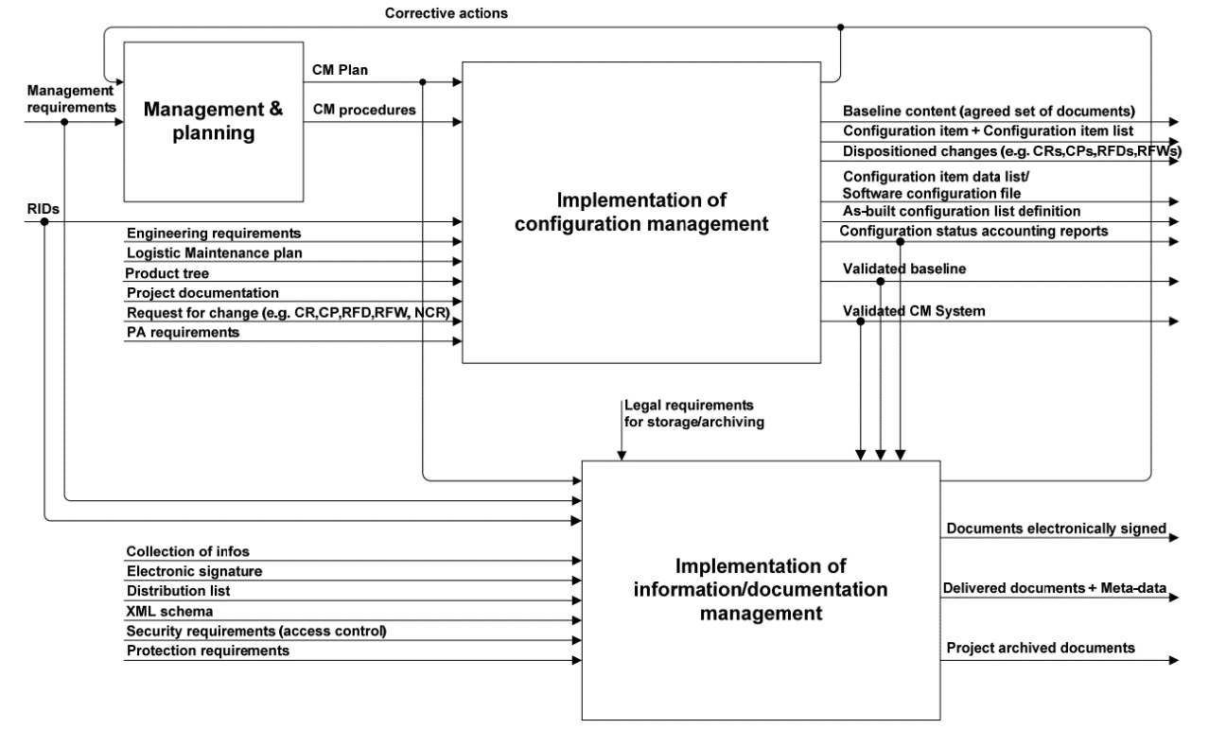
Configuration and information/documentation activities
Source: ECSS-M-ST-40C

Slide 13
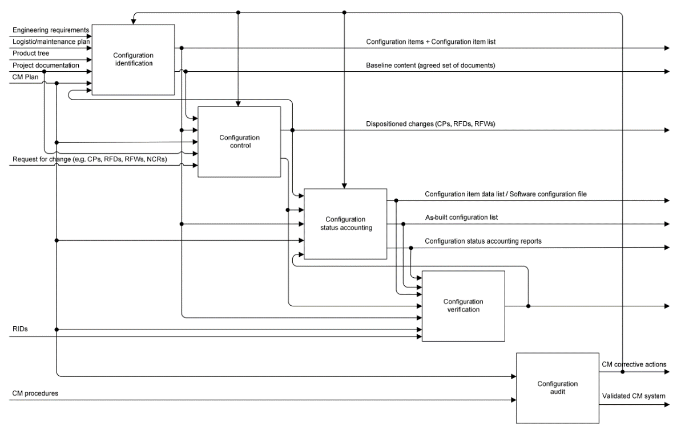
Implementation of configuration management comprises definition, organization, execution and supervision of the following activities
Source: ECSS-M-ST-40C

Slide 14
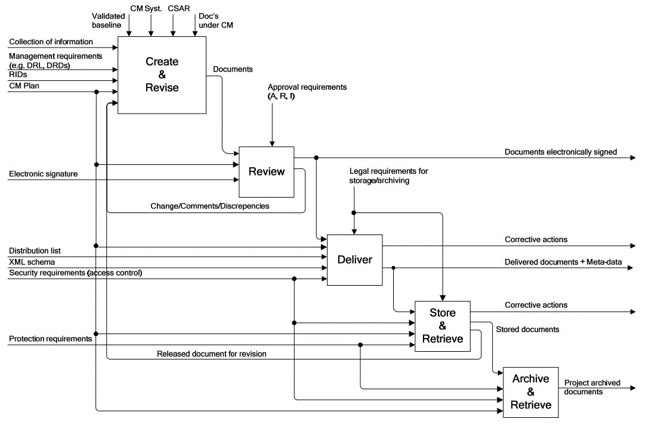
Implementation of information/documentation management comprises of the following activities
Source: ECSS-M-ST-40C

Slide 15
ECSS-M-ST-60 Cost and schedule management

Slide 16
Cost and schedule management is a major factor in the effective, responsible and proactive controlling of projects.
The main objectives of Cost and Schedule management are to:
plan accurately the phasing of procurements, expenses and resources for the project;
highlight any deviations and hence propose remedial actions, with the aim of completing the project within the given time and financial constraints
Cost management includes the activities to complete the project within the approved budget, i.e.
Cost estimating and planning;
Cost control;
Cost reporting.
Schedule management includes the activities to accomplish timely completion
of the project, i.e.:
Schedule definition, including activity definition and sequencing, activity duration estimating and schedule baseline establishment;
Schedule control, including the comparison between the current working schedule and the baseline schedule;
Schedule reporting.
The main structures to perform these activities are the:
Work breakdown structure;
Cost breakdown structure;
Business agreement structure;
Country/company structure

Slide 17
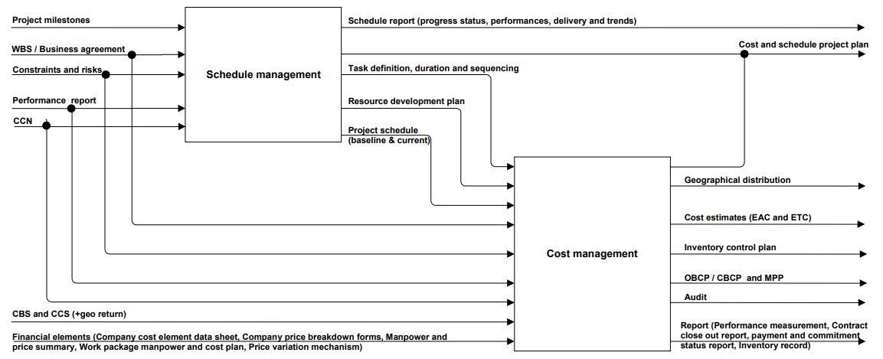
An overall functional analysis of cost and schedule management
Source: ECSS-M-ST-60C

Slide 18
The WBS is the principal structure used in managing a project and provides a framework for managing cost, schedule and technical content
An estimate based on WBS elements helps to plan, coordinate, and control the various project activities that both the customer and the suppliers are conducting. The WBS also provides a common framework for tracking the evolution of estimates, hence forecasting the total cost of the project more accurately.
Proper use of the WBS for technical, schedule, and cost management allows the defining of work and related resources, ensuring that all work is included without duplication of effort. In addition, the WBS is used to accumulate performance data and associated variances to evaluate progress in terms of performance.
Source: ECSS-M-ST-10C Rev. 1

Slide 19
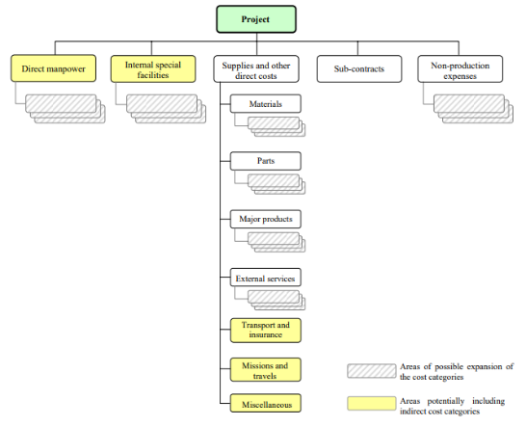
The Cost Breakdown Structure (CBS) defines the breakdown of all the costs of the project into agreed cost categories to be used for all Cost management activities
Source: ECSS-M-ST-60C

Slide 20
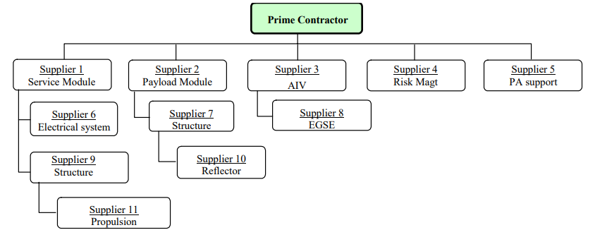
Business agreement structure shows which suppliers are responsible for which work package
By relating work packages in the WBS to business agreements in the Business Agreement Structure, contractual responsibilities can be traced. It facilitates the cost management process by providing the means to ensure that all impacts (e.g. liability, financial, technical or schedule) of a change in the business agreement are properly assessed at all levels of the contractual hierarchy.
Source: ECSS-M-ST-60C

Slide 21
The Country/Company Structure (CCS) shows the relationships between each companyʹs business agreement for a project and the countries in which the corresponding work is performed
By identifying the relationships between work packages in the WBS and business agreements in the CCS, reports can be generated to illustrate how each supplier’s work is distributed per country, e.g. for geographical return purposes.
In the case of projects where it is simple to identify the countries in which the works are performed, the CCS is combined with the Business Agreement Structure.

Slide 22
ECSS-M-ST-80C Risk management

Slide 23
Risk management is a systematic and iterative process for optimizing resources in accordance with the project’s risk management policy
According to ECSS risks are a threat to project success because they have negative effects on the project cost, schedule and technical performance, but appropriate practices of controlling risks can also present new opportunities with positive impact.
The overall risk management in a project is an iterative process throughout the project life cycle, with iterations being determined by the project progress through the different project phases, and by changes to a given project baseline influencing project resources.
The objective of project risk management is to identify, assess, reduce, accept, and control space project risks in a systematic, proactive, comprehensive and cost effective manner, taking into account the project’s technical and programmatic constraints.
The risk management process requires information exchange among all project domains, and provides visibility over risks, with a ranking according to their criticality for the project; these risks are monitored and controlled according to the rules defined for the domains to which they belong

Slide 24
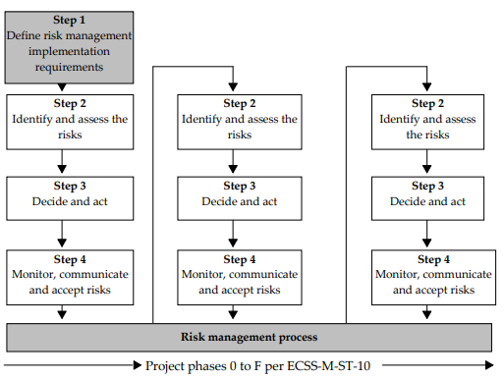
The steps and cycles in the risk management process
Source: ECSS-M-ST-80C

Slide 25
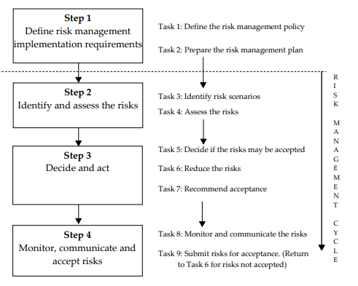
The tasks associated with the steps of the risk management process within the risk management cycle
Source: ECSS-M-ST-80C

Slide 26
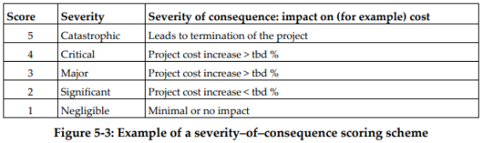
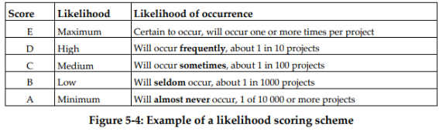
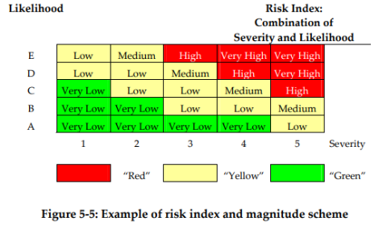
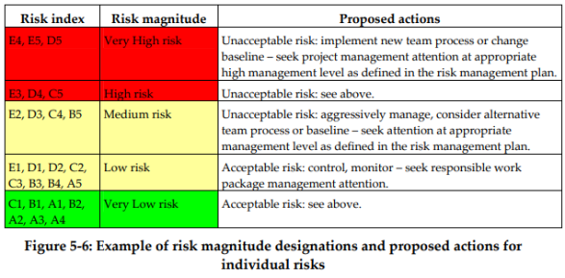
Risk policy contains scoring schemes used in risk management

Slide 27
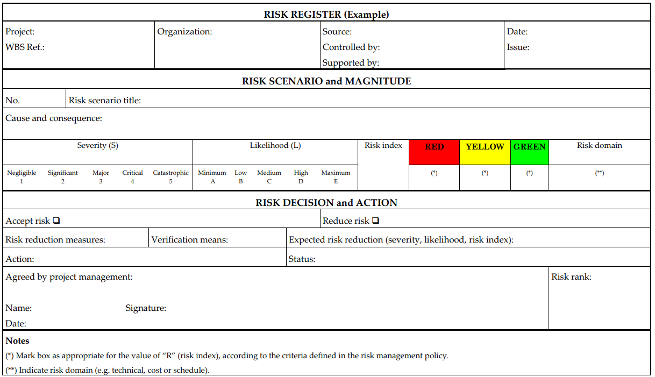
Risk register example
Source: ECSS-M-ST-80C

Slide 28
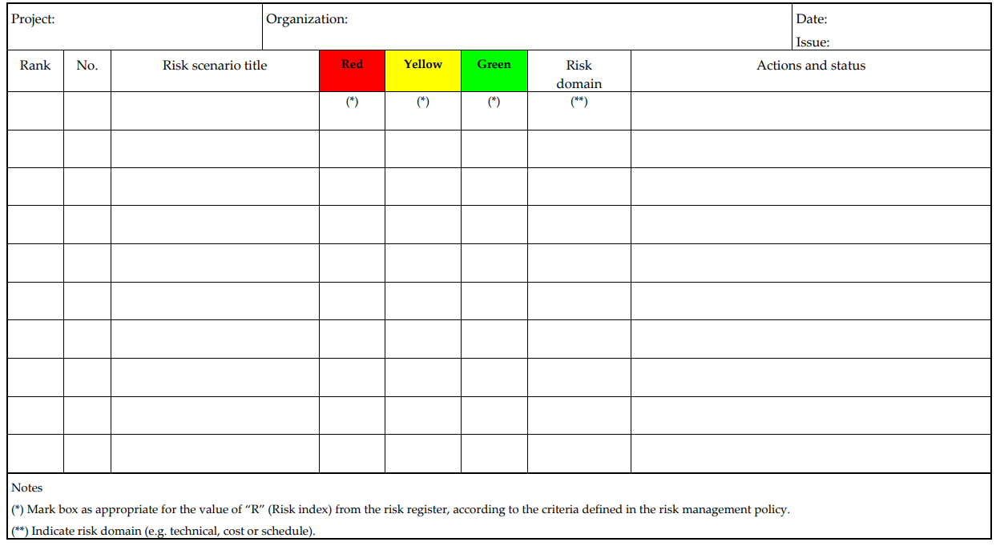
Risk log example
Source: ECSS-M-ST-80C

Slide 29
Thank you

