Slide 1
Sigurnost informacijskih sustava
mr.sc. Dražen Pranić

Slide 2
Agenda
Uvod
Vrste malicioznog softvera

Slide 3
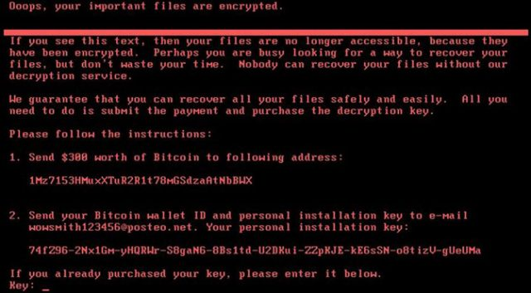
Wannacry
Svibanj 2017.
Više od 230.000 zaraženih računala u jednom danu
“WannaCry je bio prekretnica. Svjedočili smo prvom globalnom, multivektorskom napadu koji se temeljio na državno potpomognutim alatima.”
Ovaj napad prouzročio je povećanje broja napada zlonamjernim ransomware sadržajem te su mnogi napadi kasnije koristili iste ranjivosti koje su se koristile u ovom napadu.

Slide 4
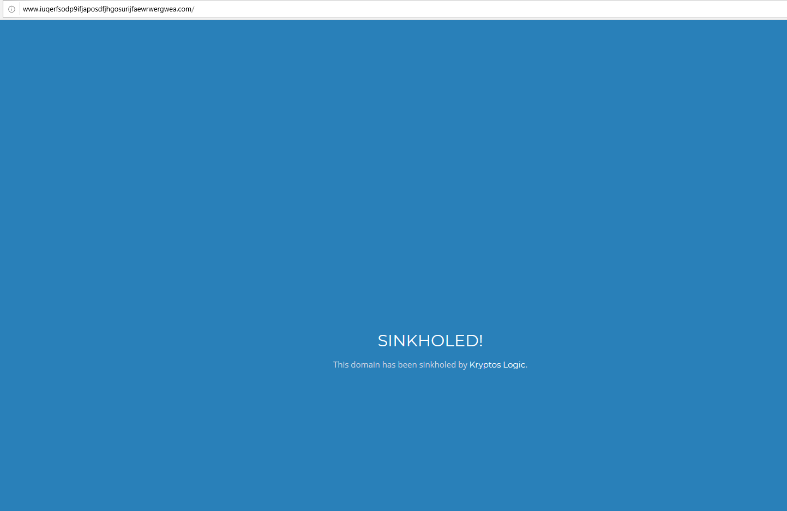
WannaCry
Znate li možda čemu su služili ovi URLovi?
http://www.iuqerfsodp9ifjaposdfjhgosurijfaewrwergwea.com
http://ifferfsodp9ifjaposdfjhgosurijfaewrwergwea.com

Slide 5
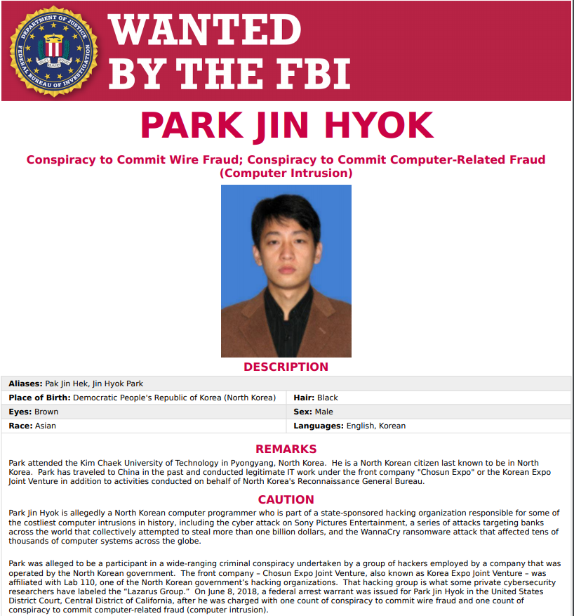
WannaCry akteri
Znate li tko stoji iza Wannacry kampanje?
Rusija
Kina
Iran
Sjeverna Koreja

Slide 6
NotPetya (mjesec dana kasnije)
Lipanj 2017 – Ukrajina
The original infection vector appears to be via a backdoor planted in M.E.Doc, an accounting software package that's used by almost every company Ukraine.
Worm komponenta
  Širenje putem SMB protokola (Koristi Eternal Blue ranjivost)
  Krađa kredencijala (Mimikatz funkcionalnost) → WMI
“You can infect computers that aren’t patched, and then you can grab the passwords from those computers to infect other computers that are patched”
Destroyer ne ransomware

Slide 7
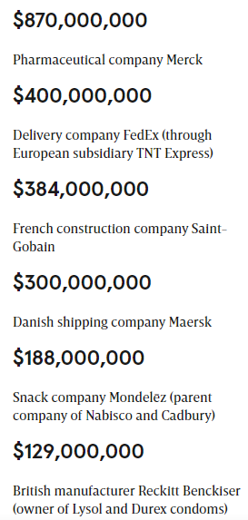
NotPetya
https://www.wired.com/story/notpetya-cyberattack-ukraine-russia-code-crashed-the-world/
“To date, it was simply the fastest-propagating piece of malware we’ve ever seen,” says Craig Williams, director of outreach at Cisco’s Talos division
at least 300 Ukrainian companies were hit, and one senior Ukrainian government official estimated that 10 percent of all computers in the country were wiped

Slide 8
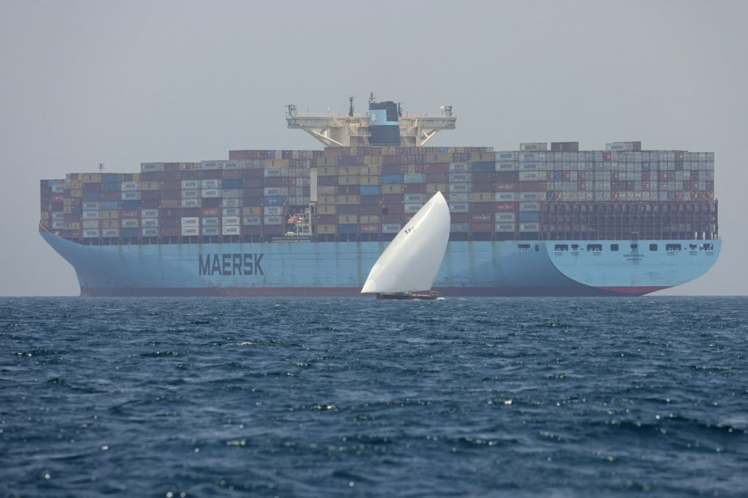
NotPetya and Maersk
Maersk’s 150 or so domain controllers were programmed to sync their data with one another, so that, in theory, any of them could function as a backup for all the others. But that decentralized backup strategy hadn’t accounted for one scenario: where every domain controller is wiped simultaneously. “If we can’t recover our domain controllers,” a Maersk IT staffer remembers thinking, “we can’t recover anything.”
After a frantic search that entailed calling hundreds of IT admins in data centers around the world, Maersk’s desperate administrators finally found one lone surviving domain controller in a remote office—in Ghana.
It took just 10 days for the company to rebuild its entire network of 4,000 servers and 45,000 PCs. (Full recovery had taken far longer: Some staffers at the Maidenhead operation continued to work day and night for close to two months to rebuild Maersk’s software setup.) “We overcame the problem with human resilience,” Snabe told the crowd.

Slide 9
Chinese Hackers Were Using NSA Hacking Tool a Year Before it was Leaked by Shadow Brokers
Research from Symantec shows that a Chinese hacking group were using NSA hacking tools a year before Shadow Brokers leaked the cache of tools to the Internet.
The Chinese hackers appear to have captured and reverse-engineered the tools, illustrating a lesson of cyberwarfare: hacking an adversary gives them access to the cyber tools used.
Created by the NSA, intercepted by China, later stolen and leaked by another mysterious hacker group known as the Shadow Brokers, and ultimately used by North Korea and Russia in two of the most damaging and costly cyberattacks in history.
https://www.wired.com/story/nsa-zero-day-symantec-buckeye-china/

Slide 10
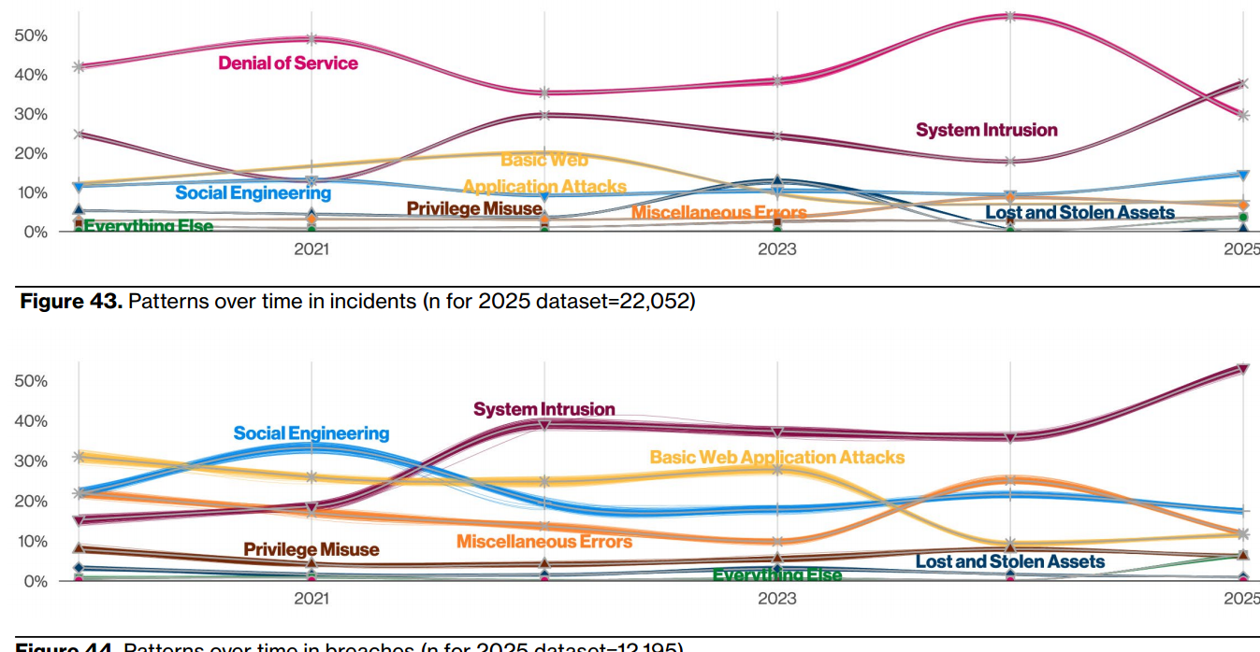
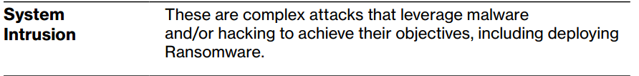

Slide 11
Vrste malicioznih programa
Definicije prihvaćene od AV industrije
Vrsta malicioznog programa ovisi o dvije karakteristike
  metoda širenja i/ili
  aktivnosti na inficiranom računalu
Četiri glavne vrste malicioznih programa
  Virusi
  Crvi
  Trojanski konji
  Potencijalno neželjene aplikacije (engl. PUA)
Spyware, ransomware, fileless malware

Slide 12
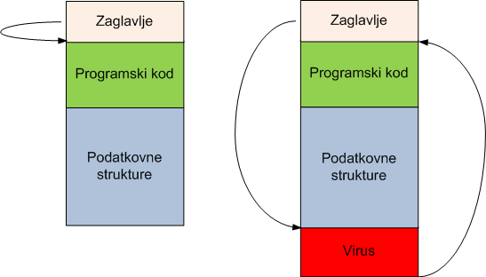
Virusi
Najstarija vrsta malicioznih programa
Virus se “priljepljuje” na legitiman program i izvršuje prilikom pokretanja
Izvorni program
Inficirani program

Slide 13
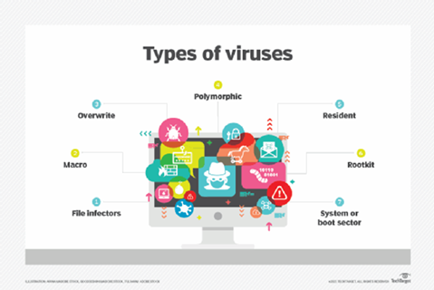
Virusi
Prema načinu inficiranja :
  Virusi koji inficiraju datoteke (eng. file infectors)
    Batch datoteke i shell skripte
  Boot sector virusi
    Inficiraju sektor na mediju koji se prvi čita
  Macro virusi
    Koriste macro jezik aplikacije
    Microsoft Office (Word, Excel)
Kombinirane kategorije (eng. multipartite)
  Npr. boot sector i file infector u jednom
  Otežavaju uklanjanje virusa (nije dovoljno ukloniti samo jedan izvor zaraze)

Slide 14
Crvi
Glavna karakteristike:
  Šire se putem računalnih mreža
  NE inficiraju druge datoteke
Kako se crvi šire putem mreže:
  Iskorištavaju protokole za udaljeno spajanje/administraciju (npr. RDP, SSH)
  Iskorištavaju slabosti u lozinkama (npr. Stuxnet koristio defaultne zaporke za Siemens PLC, pogađaju lozinke)
  Iskorištavaju sigurnosne ranjivosti u mrežnim servisima (npr. SQL Slammer, Blaster, Code Red, Nimda,…)
  Iskorištavaju sigurnosne ranjivosti u aplikacijama

Slide 15
Trojanski konji
Glavna karakteristika:
  Nisu se u stanju sami širiti
  Ne inficiraju druge datoteke
Ponekad trebaju drugi maliciozni program za samu instalaciju i/ili socijalni inženjering
Napadaču omogućavaju kontrolu preko Interneta
  Danas najčešći maliciozni programi
  Kradu osjetljive informacije ili koriste lokalne resurse
  Omogućuju potpunu kontrolu računala od strane napadača

Slide 16
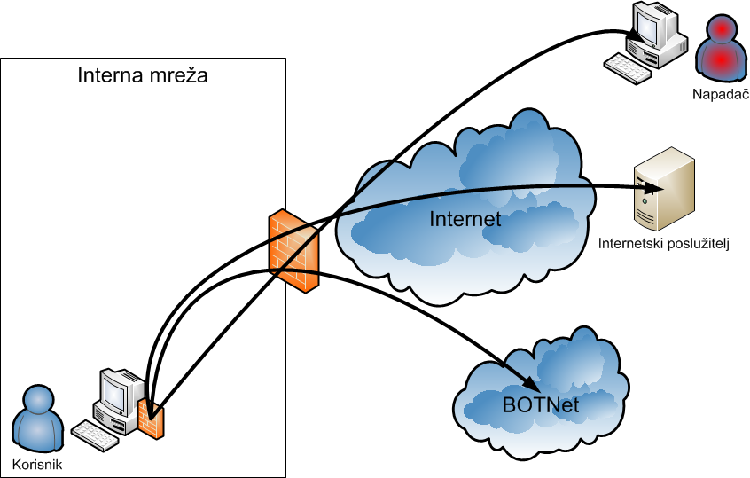
Trojanski konj - klijent
Povratna veza (reverse connection) – standardni portovi (80, 443)

Slide 17
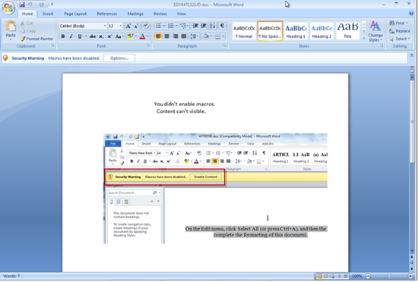
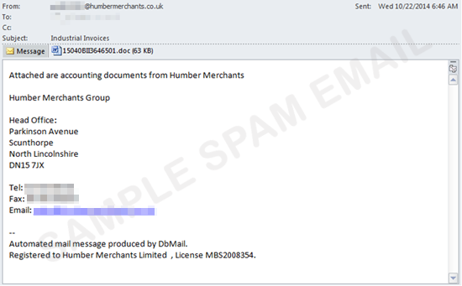
Dridex

Slide 18
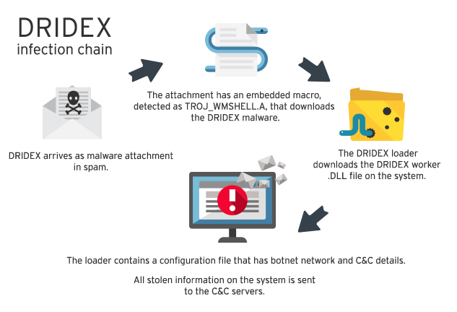
Dridex

Slide 19
Dridex
Upload files
Download files
Execute files
Monitor network traffic
Browser screenshot taking
Add the compromised computer to a botnet
Communicate with other peer nodes through the peer-to-peer (P2P) protocol to retrieve configuration details
Download and execute additional modules
Download and execute additional files
Inject itself into browser processes for Internet Explorer, Chrome, and Firefox in order to monitor communications and steal information.

Slide 20
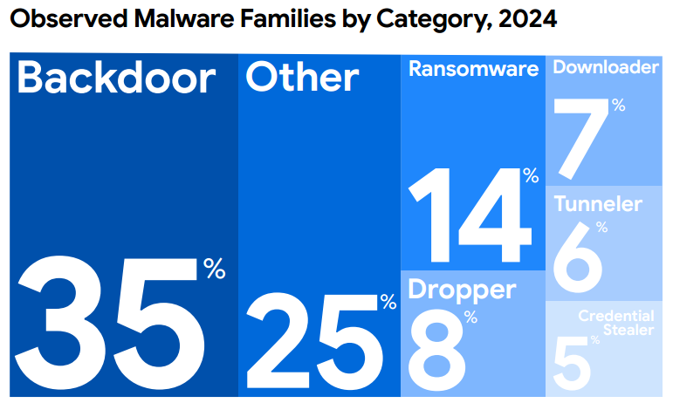

Slide 21
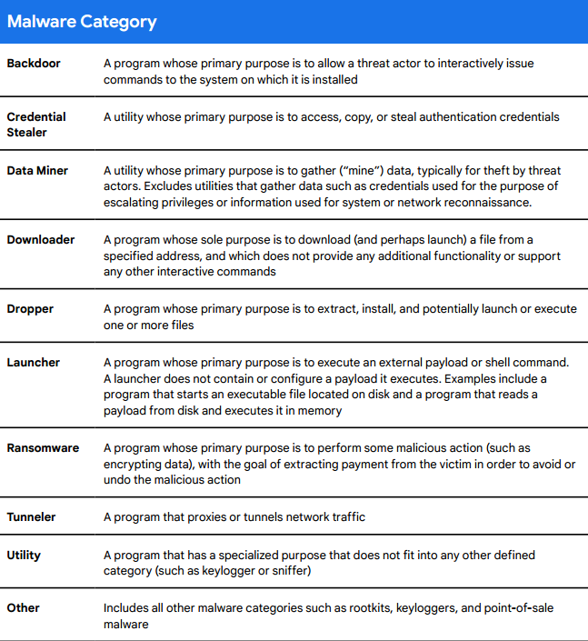

Slide 22
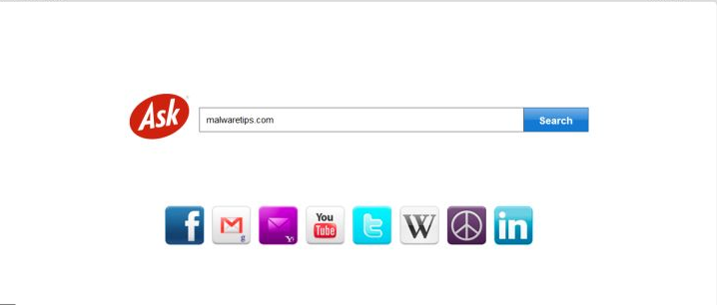
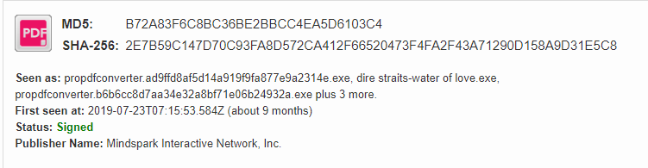
Potencijalno neželjene aplikacije
Aplikacije koje mogu imati neželjeni utjecaj na sigurnost i privatnost korisnika (engl. grayware)
Aplikacije koje instaliraju druge tijekom instalacije
  Toolbar u Web pregledniku, mijenja postavke (npr. tražilica)
Adware – neželjene reklame
Spyware – preveliko prikupljanje podataka

Slide 23
Mreže malicioznih programa (Botneti)
Autori malicioznih programa žele kontrolirati inficirana računala
  Mreže inficiranih računala nazivaju se botneti
Trojanski programi s komponentom udaljene kontrole
Centralni poslužitelji nazivaju se Command & Control (C&C)
Jednostavno davanje naredbi velikom broju inficiranih računala
DDOS napadi, slanje spam poruka i sl.

Slide 24
Napredne mogućnosti malicioznih programa
Cilj napadača: otežati detekciju i/ili analizu malicioznog programa
Napredne mogućnosti:
  Polimorfizam
  Rootkit tehnologije
  Kriptiranje koda
  Emulacija korištenjem virtualnih strojeva
  Fileless

Slide 25
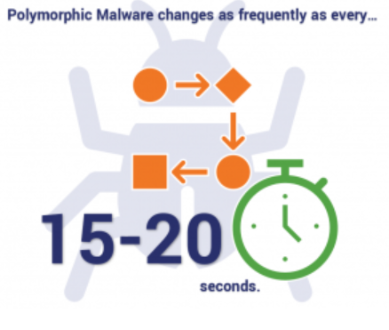
Polimorfizam
Promjena tijela programa uz zadržavanje iste funkcionalnosti
Detekcija temeljena na potpisima promatra tijelo programa → promjena tijela → potpis neučinkovit
Kriptiranje ili komprimiranje tijela pomoću specijalnih programa (engl. packer) → njihov kod jedino vidljiv → u memoriji računala dekriptiraju/dekomprimiraju izvorni maliciozni program
Promjena enkripcijskog ključa → promjena tijela programa

Slide 26
Rootkit tehnologije
Integriranje malicioznog programa s ključnim funkcijama i strukturama jezgre OS-a
  Postalo popularno u 2007.
Presreće pozive jezgri (eng. function hooking)
  Npr. kada se želi otvoriti neku datoteku ili direktorij
    Provjerava se ime željene datoteke te ako je na popisu vraća se lažni ili modificirani rezultat → javlja AV softveru da ne postoji
    U protivnom izvršava se legitimni dio koda

Slide 27
Rootkit tehnologije
Primjer Stuxneta
  Worm dio – odgovoran za širenje malvera
  Izvršni dio – izvođenje malvera
  Rotkit dio – skrivanje malvera

Slide 28
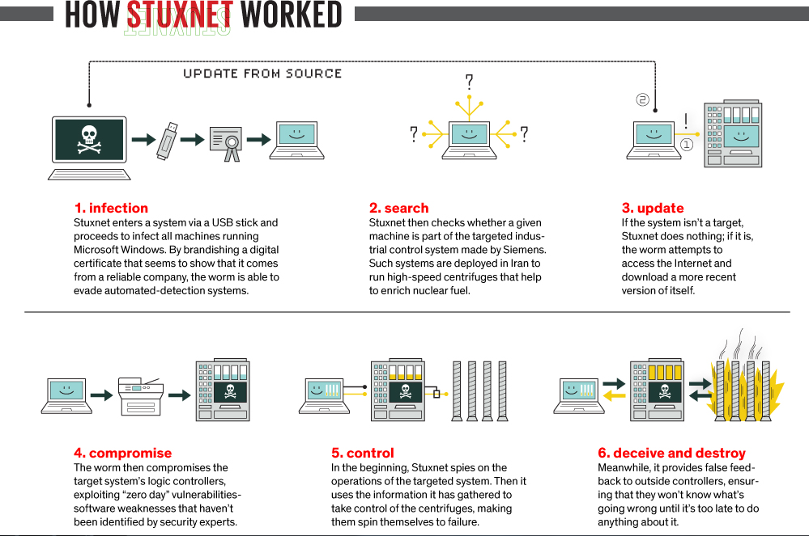

Slide 29
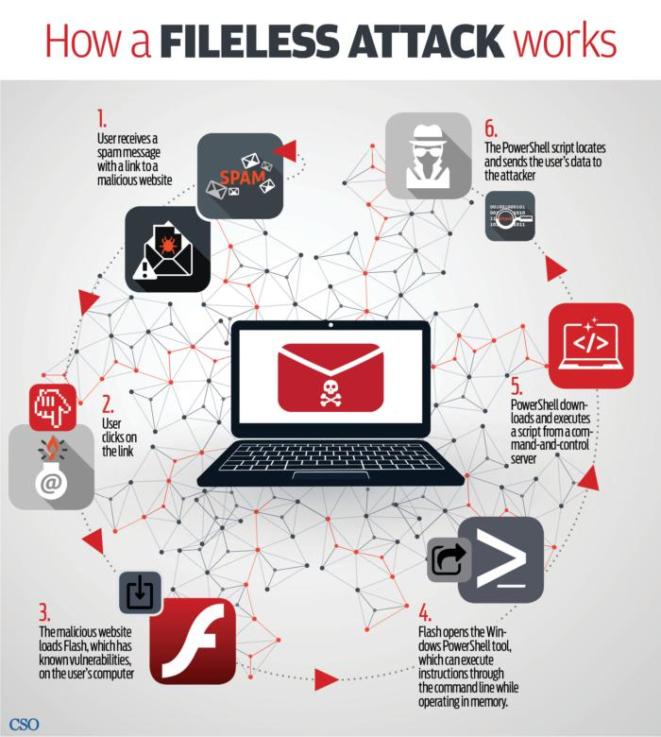

Slide 30
Fileless malware persistence
https://www.comparitech.com/blog/information-security/fileless-malware-attacks/
When you turn off a computer, all active processes shut down. Processes that are services of the operating system are started up again when you turn the computer on.
Fileless malware writes its script into the Registry of Windows. This is a function of the operating system that launches programs either at system startup or on a schedule. The code that runs the fileless malware is actually a script. A script is a plain text list of commands, rather than a compiled executable file.
Short lists of instructions don’t have to be stored in a file. However, longer and more complicated scripts do get stored for relaunch at system start up. In these case, although the program is classified as “fileless,” there is actually a file involved.

Slide 31
Fileless Malware
Ostaje rezistentan na računalu temeljem promjena registry postavki
Nemoguće detektirati s tradicionalnim AV rješenjima
Analiza anomalija → Strojno učenje
EDR funkcionalnosti u antivirusnom softveru

Slide 32
Defense evasion
The adversary is trying to avoid being detected.
Defense Evasion consists of techniques that adversaries use to avoid detection throughout their compromise.
Techniques used for defense evasion include uninstalling/disabling security software or obfuscating/encrypting data and scripts.
Adversaries also leverage and abuse trusted processes to hide and masquerade their malware. Other tactics’ techniques are cross-listed here when those techniques include the added benefit of subverting defenses.

Slide 33
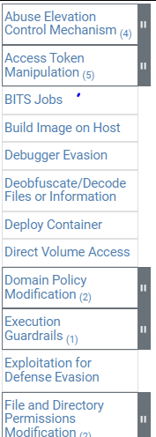
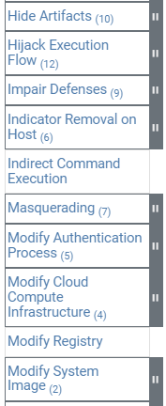
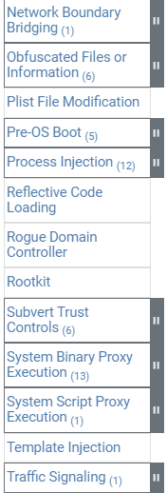
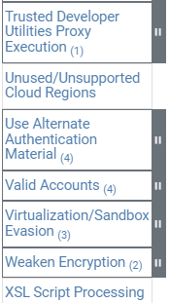
Defense evasion

Slide 34
Anti-virusni programi
Osnovna zaštita od malicioznih programa
Korištenje AV programa propisuju razni standardi
  CIS Top 18, ISO 27001, PCI DSS,…
Integriraju se s operacijskim sustavom kako bi presreli rizične operacije
  Pokretanje programa
  Otvaranje datoteka
  Komunikacija preko Interneta

Slide 35
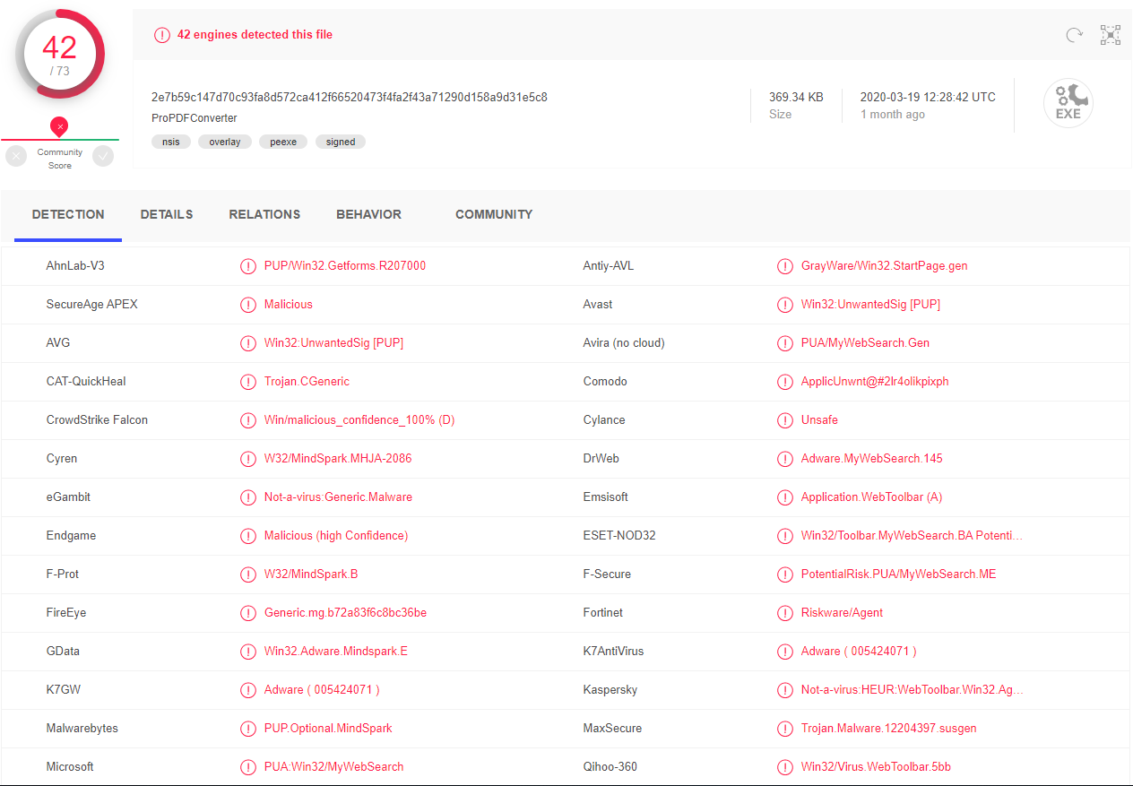
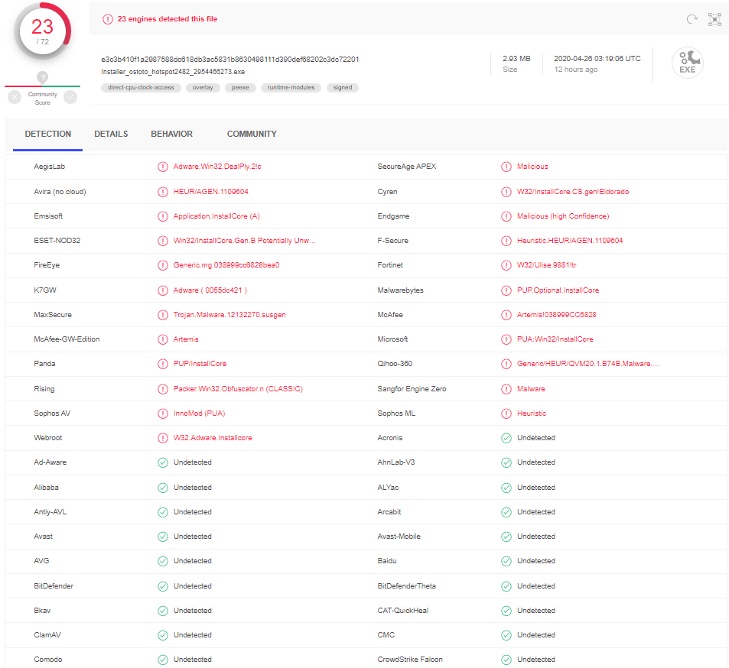
Detekcija potpisima
Klasičan način rada anti-virusnih programa
  Korištena od samih početaka
Maliciozni programi detektiraju se prema potpisu
  Potpis se može smatrati jedinstvenim uzorkom
  Obično jedinstveni dio programskog koda
    Omogućava detekciju porodica malicioznih programa
    “Generički potpisi”
Neučinkoviti za 0-day malware, polimorfizam, fileless malware,…
Zapravo samo neučinkoviti☺

Slide 36

Platforme za analizu malicioznog softvera
ReversingLabs analyzes 5x more files weekly and finds over 2x more new malware samples weekly than VirusTotal.

Slide 37
Antivirusna rješenja nove generacije
Leaderi koji su kupili, dodali nove funkcionalnosti
Izazivači koji su promijenili koncept zaštite na klijentu
AV rješenja nove generacije moraju biti u stanju osigurati primjerenu:
  Prevenciju
  Detekciju
  Forenziku

Slide 38
EPP Funkcionalnosti
Must-Have Capabilities
  Prevention of, and protection against, security threats, including malware that uses file-based and fileless attack techniques.
  The ability to detect and prevent threats using behavioral analysis of endpoint, application and end-user activity.
Standard Capabilities
  Management and reporting of operating system security controls, such as host firewall, device control and endpoint encryption.
  Assessment of endpoints for vulnerabilities and risk reporting based on inventory, configuration, patch and policy of endpoint devices.
  Integrated endpoint detection and response (EDR) functionality enabling raw telemetry collection, detection customization, postincident investigation and remediation.
  Partner- and vendor-delivered service wrappers, such as managed detection and response (MDR) and co-managed security monitoring.

Slide 39
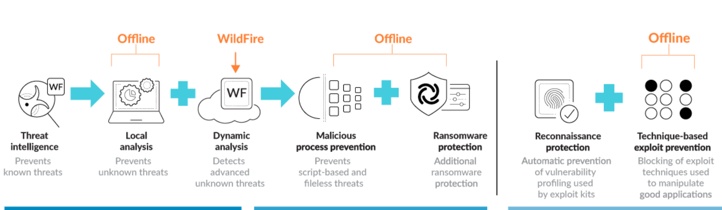
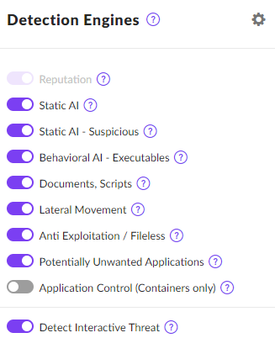
Primjer

Slide 40
Sandbox tehnike
Dynamic analysis – observes files as they detonate in a purpose-built, evasion-resistant virtual environment,
Static analysis – effective detection of malware and exploits that compliments dynamic analysis
Machine learning – extracts thousands of unique features from each file, training apredictive machine learning model to identify new malware, which is not possible with static or dynamic analysis alone
Bare metal analysis – evasive threats are automatically sent to a real hardware environment for detonation, entirely removing an adversary’s ability to deploy anti-VM analysis techniques.

Slide 41
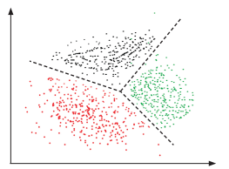
Strojno učenje
Danas svi proizvođači tvrde da imaju implementirano strojno učenje☺
  nadzirano učenje
  nenadzirano učenje
Prevladava nadzirano učenje jer se temelji na analizi ogromne količine strukturiranih podataka
Izazov lažne pozitivne detekcije

Slide 42
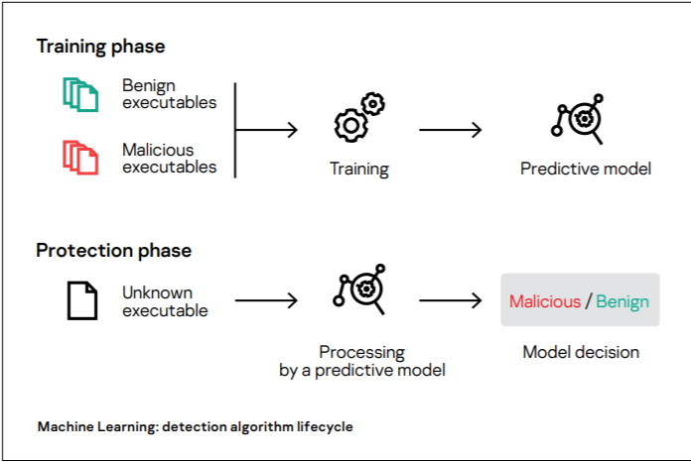
Nadzirano strojno učenje

Slide 43
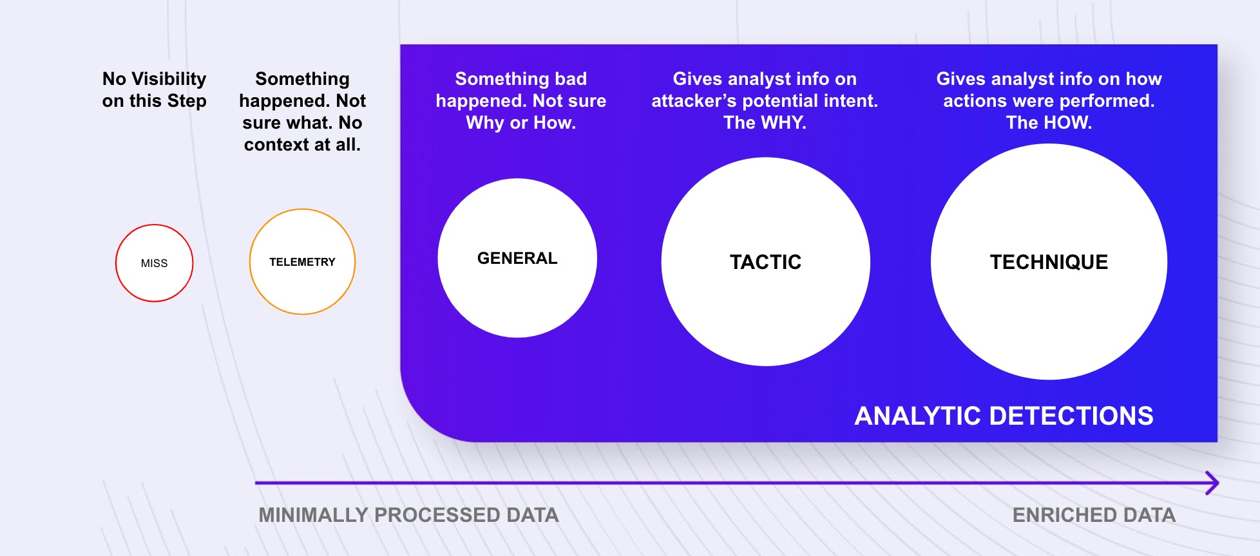
MITRE evaluacija
https://attackevals.mitre-engenuity.org/enterprise/turla/

Slide 44
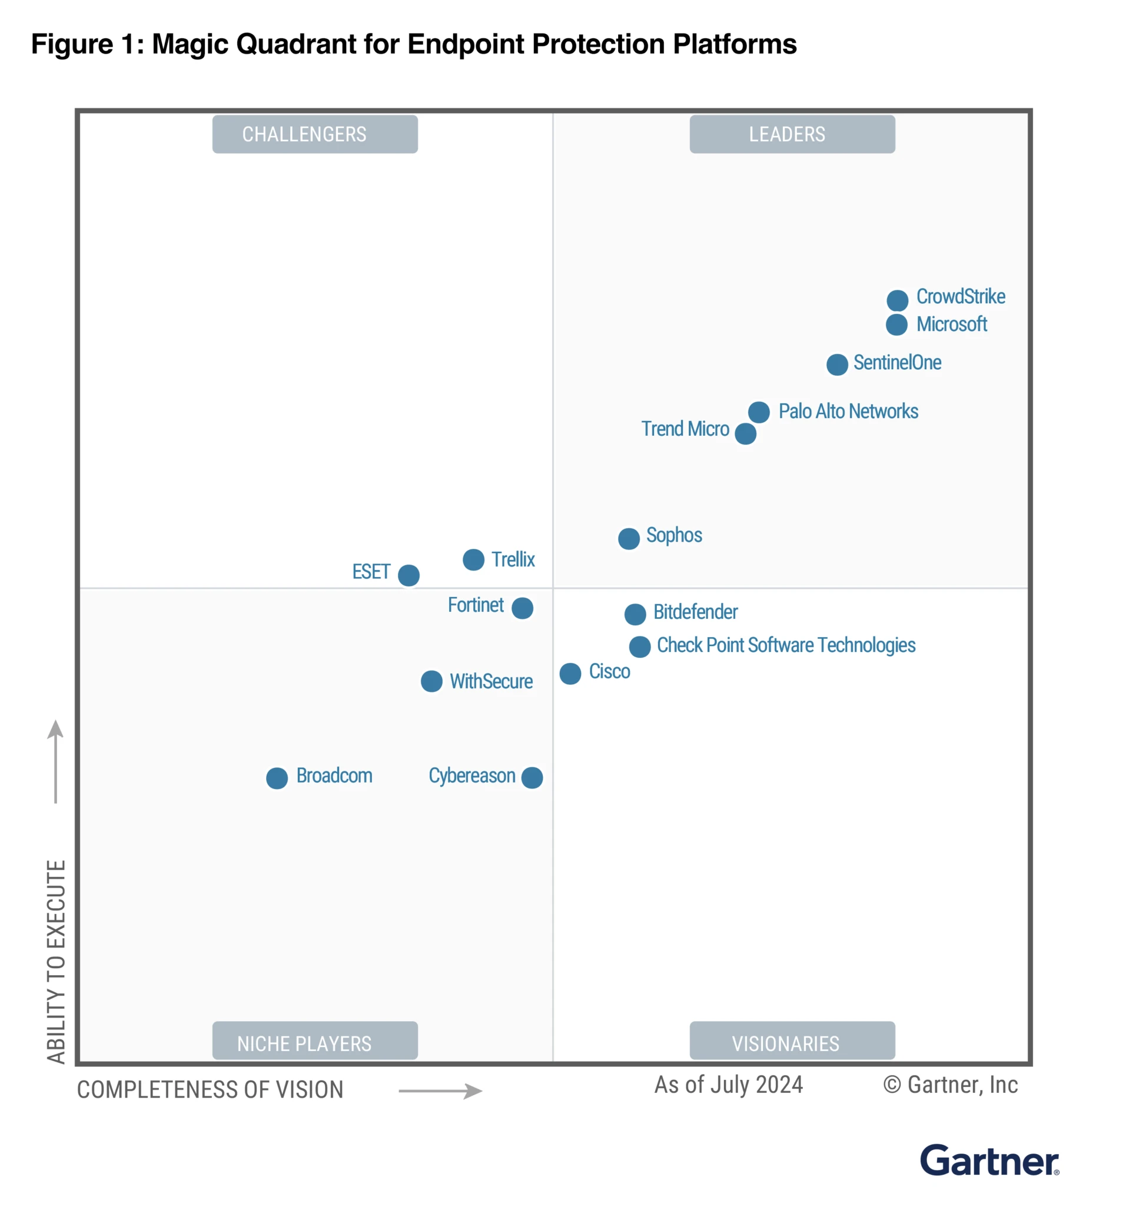

Slide 45
Zaključak
Malware je bio, je i biti će ozbiljna prijetnja
Tvrtke moraju ulagati u prevenciju, detekciju i forenziku
Nova i stara rješenja → nova generacija antivirusnih rješenja
MITRE evaluacija izvrstan okvir za testiranje
Napredne funkcionalnosti
  Strojno učenje
  Automatska analiza malwera u sandbox okruženju

