Slide 1
Sigurnost informacijskih sustava
mr.sc. Dražen Pranić

Slide 2
Agenda
Uvod
APT napadi
Nedostaci postojećih mehanizama zaštite
MITRE ATT&CK
Lov/traženje prijetnji (engl. Threat hunting)

Slide 3
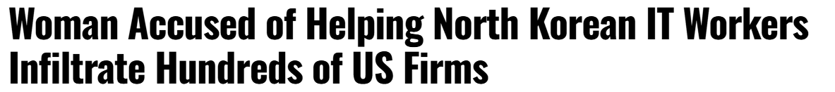
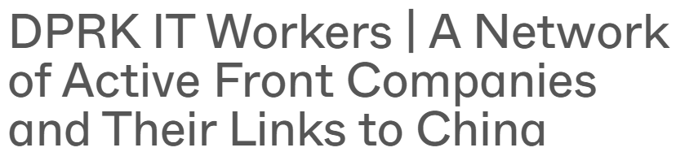
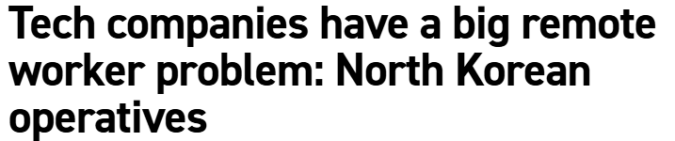
Fake IT workers

Slide 4
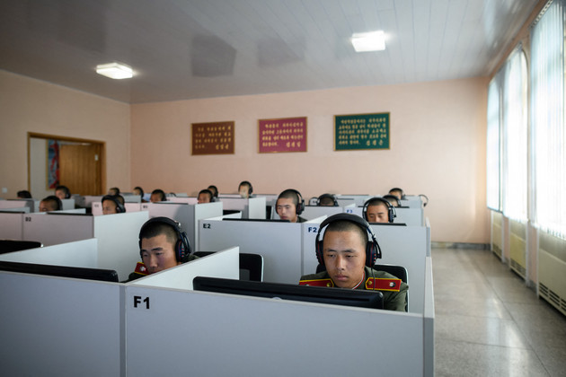
Fake IT Workers
North Korean operatives will use stolen credentials during the onboarding process and ask employers to send their work laptops to front addresses in the U.S. — which are often laptop “farms” with dozens of devices kept running by a few American individuals who are paid to join the scheme.

Slide 5
Fake IT Workers
KnowBe4 said its security team detected suspicious activities coming from a newly hired Principal Software Engineer’s workstation and quickly determined the malicious insider was using a Raspberry Pi to download malware, manipulate session history files, and execute unauthorized software.
“We sent them their Mac workstation, and the moment it was received, it immediately started to load malware

Slide 6
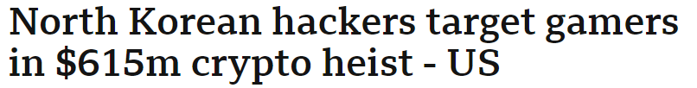

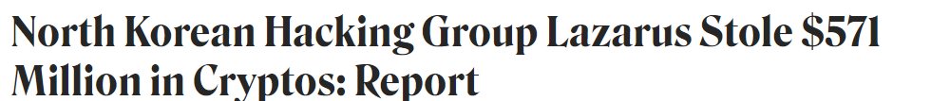
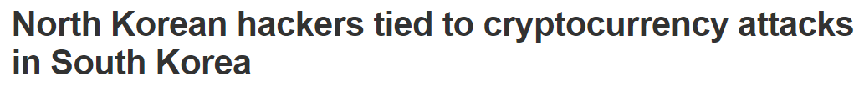
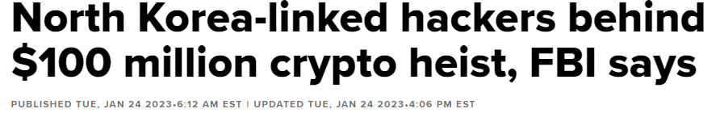
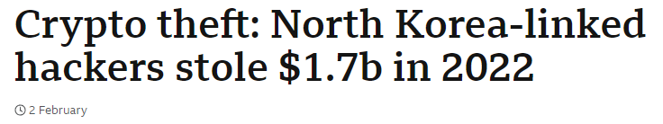

Slide 7
Recorded Future report
https://go.recordedfuture.com/hubfs/reports/cta-2023-1130.pdf
Since 2017, North Korea has greatly expanded its targeting of the cryptocurrency industry, stealing over an estimated $3 billion worth of cryptocurrency
North Korean threat actors were accused of stealing an estimated $1.7 billion worth of cryptocurrency in 2022 alone, a sum equivalent to approximately 5% of North Korea’s economy or 45% of its military budget.
the regime has a long history of illicit activity, building up its networks over decades, and it steers its whole society to support these operations, grooming promising youth for future careers conducting cybercriminal operations

Slide 8
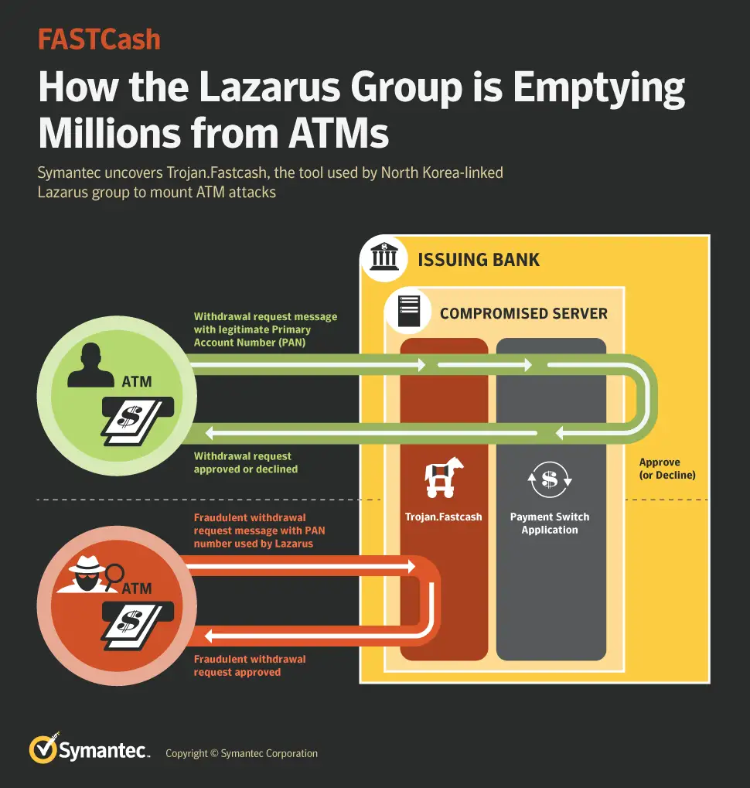

Slide 9
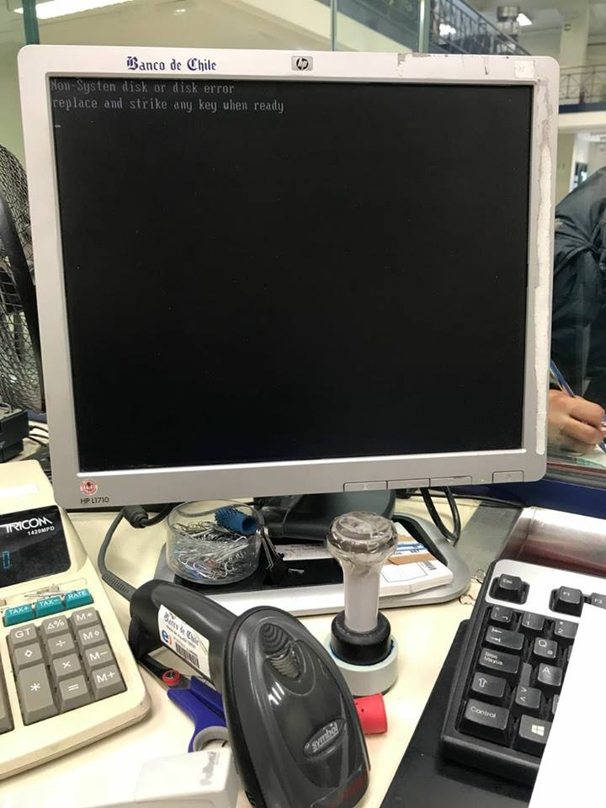
Banco de Chile
https://www.theregister.co.uk/2018/06/11/chile_bank_wiper_prelude_cyberheaist/
9.000 računala zaraženo ransomwareom (KillDisk wiper malware )
it just damages the MBR and reboots the computer. It was allegedly deployed via an antivirus update mechanism.

Slide 10
Zašto?
https://badcyber.com/banco-de-chile-victim-of-a-devastating-wiper-attack-money-allegedly-stolen/
11 mil. $ ukradeno kroz sumnjive SWIFT transkacije
allegedly some artefacts of a well know Lazarus toolset were identified in bank system

Slide 11
Bangladeš napad
https://www.bbc.com/news/stories-57520169
Veljača 2016 pokušali isprazniti financijske rezerve centralne banke u Bangladešu u iznosu od milijarde $
Godinu dana neprimijećeni na internoj mreži
Kompromitirali SWIFT, onemogućili rad ključnog printera☺
planirali napad tako da su imali 4 dana za prebacivanje sredstava
  The hack started at around 20:00 Bangladesh time on Thursday 4 February. But in New York it was Thursday morning, giving the Fed plenty of time to (unwittingly) carry out the hackers' wishes while Bangladesh was asleep.
  The next day, Friday, was the start of the Bangladeshi weekend, which runs from Friday to Saturday. So the bank's HQ in Dhaka was beginning two days off. And when the Bangladeshis began to uncover the theft on Saturday, it was already the weekend in New York.

Slide 12
Bangladeš napad
Pokušali prebaciti sredstva na banku u Filipinima
35 transfera na RCBC banku u Jupiter ulici Manila
"The transactions… were held up at the Fed because the address used in one of the orders included the word 'Jupiter', which is also the name of a sanctioned Iranian shipping vessel," says Carolyn Maloney.
Just the mention of the word "Jupiter" was enough to set alarm bells ringing in the Fed's automated computer systems. The payments were reviewed, and most were stopped. But not all. Five transactions, worth $101m, crossed this hurdle.
Of that, $20m was transferred to a Sri Lankan charity called the Shalika Foundation, which had been lined up by the hackers' accomplices as one conduit for the stolen money. (Its founder, Shalika Perera, says she believed the money was a legitimate donation.) But here again, a tiny detail derailed the hackers' plans. The transfer was made to the "Shalika Fundation". An eagle-eyed bank employee spotted the spelling mistake and the transaction was reversed.

Slide 13
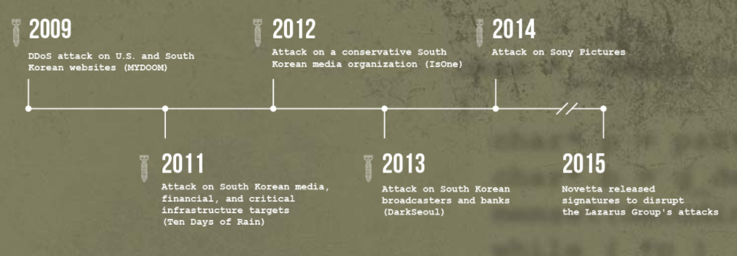
Lazarus grupa
Koriste različite tehnike i malware familije https://www.operationblockbuster.com/wp-content/uploads/2016/02/Operation-Blockbuster-Report.pdf
Povezuju se s Sjevernom Korejom
Symantec reported that it was "highly likely" that Lazarus was behind the WannaCry attack

Slide 14
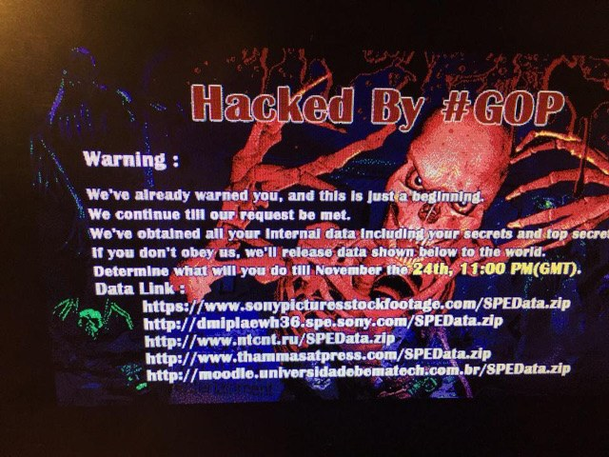

Slide 15
Sony Pictures
Studeni 24, 2014
data included personal information about Sony Pictures employees and their families, e-mails between employees, information about executive salaries at the company, copies of then-unreleased Sony films
Obrisana infrastruktura
http://www.nacional.hr/hakirana-posta-mocnih-filmasa-otkrila-tastinu-rasizam-i-seksizam-u-hollywoodu/
Prijetnja terorističkim napadima na kina koja se odluče na prikazivanje "Intervju", komedije o ubojstvu sjevernokorejskog predsjednika Kim Jong-una
Film pušten na mala vrata

Slide 16
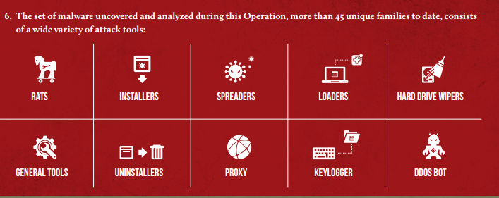
Sony pictures

Slide 17
APT
advanced persistent threat - termin su 2006. skovale Američke zračne snage (US Air Force) kako bi olakšale komunikaciju s medijima u slučaju napada kojeg nisu smjele klasificirati. Kasnije je preuzet od strane stručnjaka za računalnu sigurnost.
zahtijevaju izrazito velike ljudske i novčane resurse
mogu ga izvesti vlade ili velike organizacije
https://attack.mitre.org/groups/

Slide 18
APT
napredan - široki spektar tehnologija, tehnika i metodologija upada u računalne sustave
perzistentan - neprestano praćenje i interakcija s metom
prijetnja - koordinirana skupina ljudi, a ne automatizirani programski kod

Slide 19
APT
APT napadi često koriste dotad nepoznate propuste u računalnim sustavima, programima ili operacijskim sustavima (eng. zero-day exploits).
Upotreba zero-day exploit programa svojstvena je za APT napade pošto je razvoj takvih programa skup, složen i dugotrajan, a rijetki imaju dovoljno resursa za razvoj.

Slide 20
Napredne kontrole za umanjenje rizika od APT-a
CIS Top 18 IG3
Threat Hunting
Deception
Simulacija napada

Slide 21
CIS Top 18 IG3
IG3 is comprised of an additional 23 Safeguards
https://www.cisecurity.org/controls/implementation-groups/ig3

Slide 22
Threat hunting definicija
Aktivna potraga za anomalijama na poslužiteljima, osobnim računalima… koje mogu biti znakovi kompromitacije, neovlaštenih upada i sl.
Nije reakcija na alerte u sustavima za detekciju već aktivna potraga:
  Procesi
  Izvršne datoteke
  Mrežne postavke
  Izmjene sistemskih postavki (npr. Windows registry)

Slide 23
Što se traži?
Processes: Hunters are looking for processes with certain names, file paths, checksums, and network activity. They want to find processes that make changes to registry entries, have specific child processes, access certain software libraries, have specific MD5 hashes, make specific registry key modifications, and include known bad files.
Binaries: Here hunters look for binaries with certain checksums, file names, paths, metadata, specific registry modifications, and many other characteristics.
Network activity: This threat attribute includes network activity to specific domain names and IP addresses.
Registry key modifications: Hunters can look for specific registry key additions and modifications.

Slide 24
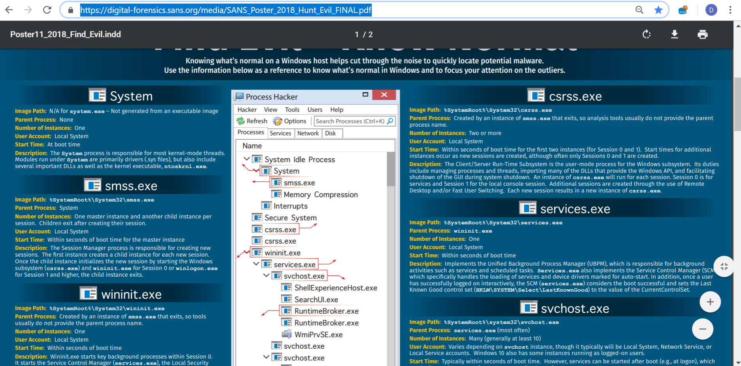
SANS Hunt Evil

Slide 25
Threat Hunting
Known Bad
File Hash
File Size
CnC IP Address
Threat Intel – Malware Reports - CIRT

Slide 26
Threat Hunting
Known Bad
Windows Executables in Strange Directories
Non-Browser Applications Connecting to Internet
Suspicious Behavior

Slide 27
Threat Hunting
Known Bad
Know Normal to Find Evil
Baselining
Machine learning
Persistence
Suspicious Behavior
Unknown Bad

Slide 28
Vještine huntera
Hunters are curious. They are passionate. They are skilled at leveraging multiple tools and understanding and pushing the limits of those tools.
Most important, hunters are innovative analysts who understand their threat landscape and their organization well enough to ask the right questions and find the answers.

Slide 29
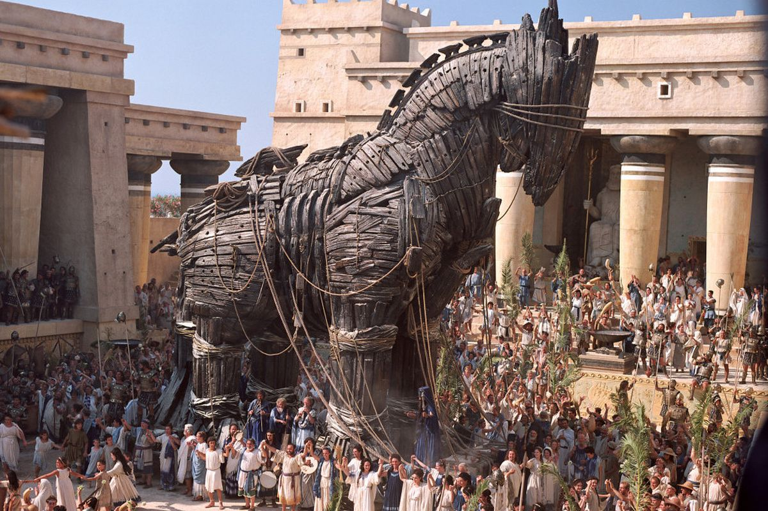
Prijevara (engl. Deception)

Slide 30
Svrha
Judicious use of networks, pocket litter, and honeytokens can waste the adversary’s time and resources, expose their pedigree, and create false knowledge on their part.
Deception can also add randomness and unpredictability to an architecture, network trafﬁc, service, or mission activity, making an adversary’s understanding of the environment more challenging and at best inaccurate”

Slide 31
Svrha
Confuse and mislead adversaries
Impact adversary's decision-making process
Degrade adversary's ability to move laterally
Divert the adversary away from HVAs
Increase the observability by the defender

Slide 32


Deception, A Page Out of an Attacker’s Playbook
Exploit Their Trust, Create Uncertainty, Slow the Attack, Change The Game!
Can’t Tell Real From Fake
Make Mistakes
Threat Deception
Increase Attacker Costs
Spend More Time/ Start Over
Deception
Make Economics Undesirable
Seeks an Easier Target

Slide 33
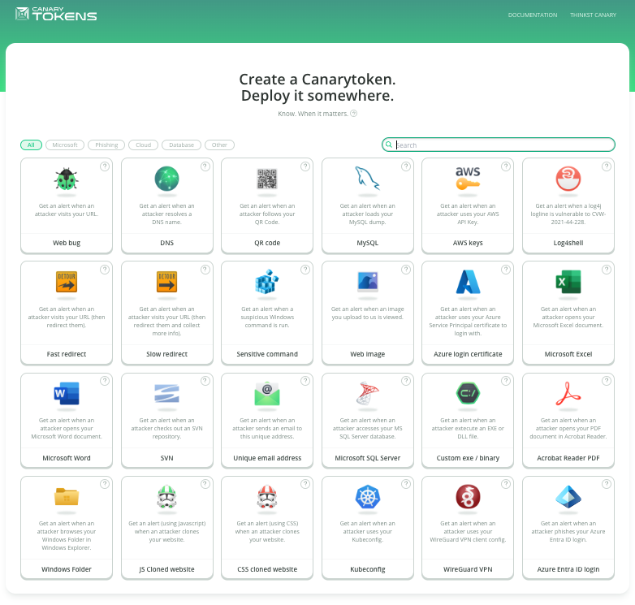

Slide 34
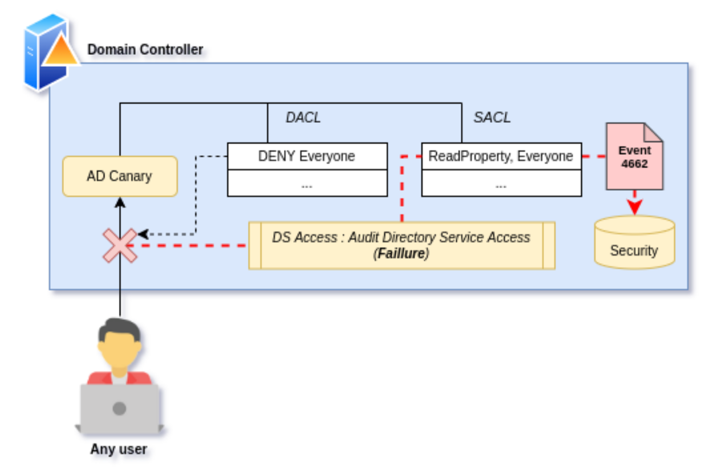
Active Directory deception
https://github.com/AirbusProtect/AD-Canaries?tab=readme-ov-file

Slide 35
Simulacija napada
Simuliranje „pravih” napada u stvarnom okruženju
Red Teams
  internal or external entities dedicated to testing the effectiveness of a security program by emulating the tools and techniques of likely attackers in the most realistic way possible
Blue Teams
  internal security team that defends against both real attackers and Red Teams.
Purple teams
  ensure and maximize the effectiveness of the Red and Blue teams. They do this by integrating the defensive tactics and controls from the Blue Team with the threats and vulnerabilities found by the Red Team into a single narrative that maximizes both. Ideally Purple shouldn’t be a team at all, but rather a permanent dynamic between Red and Blue.

Slide 36
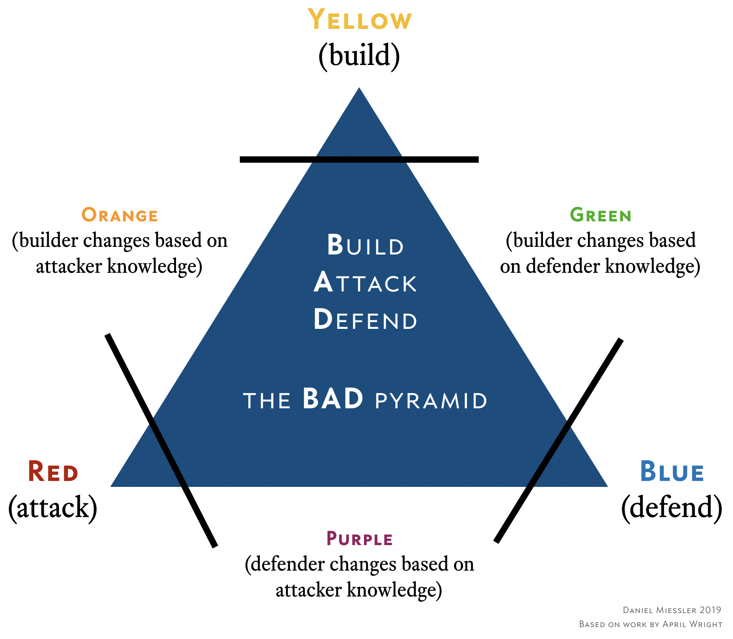
Simulacija napada
https://danielmiessler.com/study/red-blue-purple-teams/

Slide 37
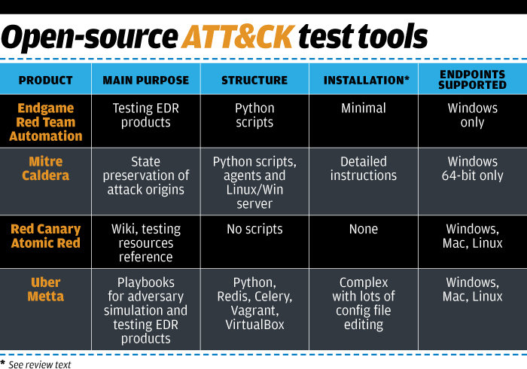

Slide 38
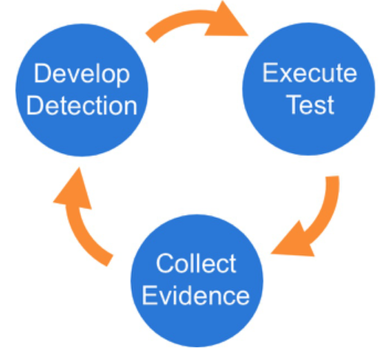
Red Canary Atomics
https://atomicredteam.io/testing
Our Atomic Red Team tests are small, highly portable detection tests mapped to the MITRE ATT&CK Framework
Teams need to be able to test everything from specific technical controls to outcomes.
We should be able to run a test in less than five minutes.
We need to keep learning how adversaries are operating

Slide 39
MITRE ATT&CK
MITRE ATT&CK™ je javno dostupna baza taktika i tehnika napadača temeljena na analizama napada
ATT&CK baza znanja iznimno korisna u detekciji napada
Radi poduzimanja primjerenog sigurnosnog odgovora važno je identificirati u kojoj smo fazi napada
Sigurnosni alati integrirani s MITRE ATT&CK
https://attack.mitre.org/

Slide 40
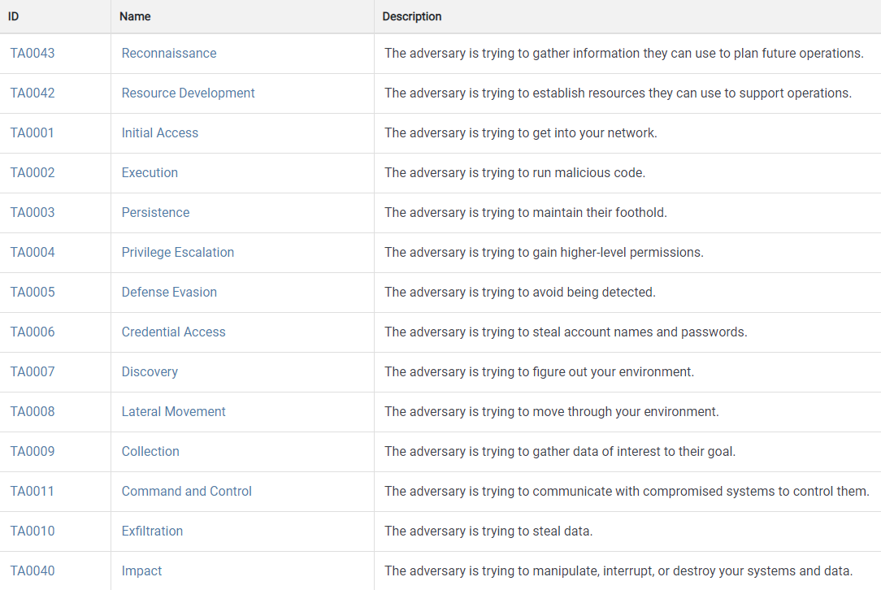
MITRE ATT&CK

Slide 41
Zaključak
APT napadi su rijetki ali iznimno moćni
Povrh standardnih sigurnosnih kontrola potrebno implementirati dodatne kontrole koje su fokusirane na detekciju
Istaknute su: Deception, Threat hunting i simulacija napada

