Slide 1
Sigurnost informacijskih sustava
mr.sc. Dražen Pranić

Slide 2
Agenda
OWASP Top 10 u detalje
DevSecOps

Slide 3
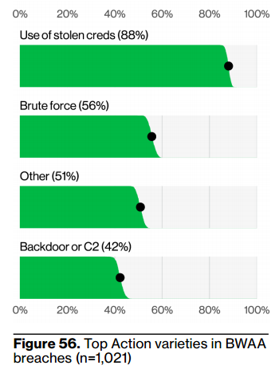
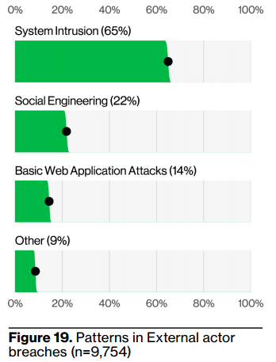
Verizon statistics
Basic Web Application Attacks
These attacks are against a Web application, and after the initial compromise, they do not have a large number of additional Actions. It is the “get in, get the data and get out” pattern.

Slide 4
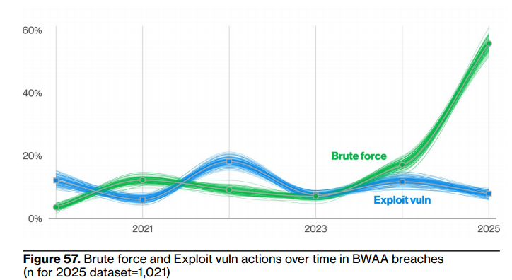

Slide 5
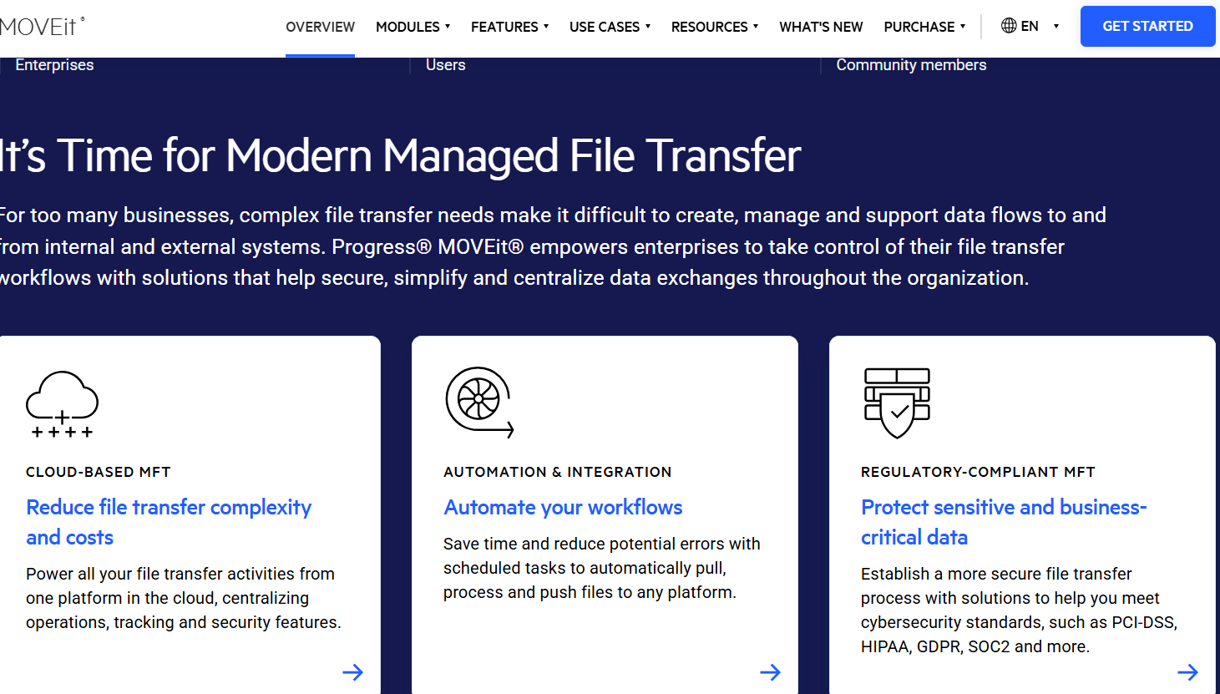

Slide 6
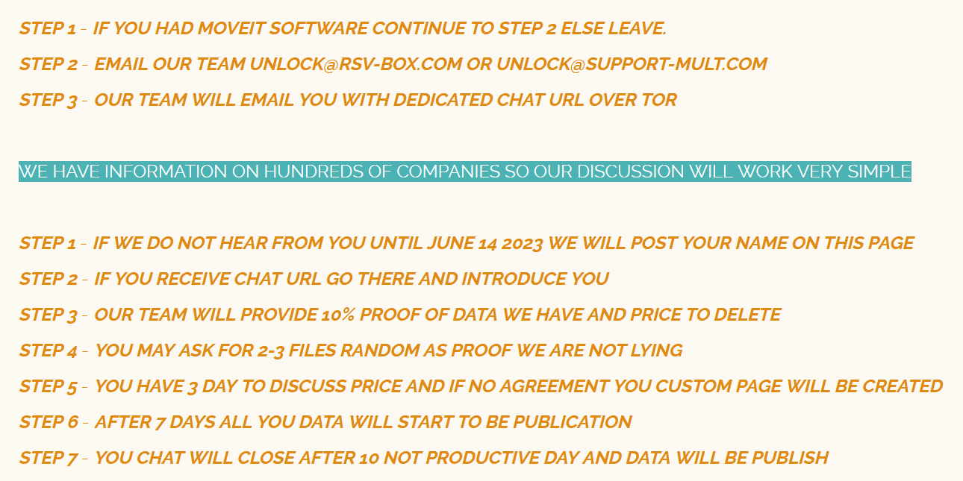

Slide 7
MOVEit napadi
https://www.progress.com/moveit
https://news.risky.biz/risky-biz-news-clop-linked-to-moveit/
https://www.emsisoft.com/en/blog/44123/unpacking-the-moveit-breach-statistics-and-analysis/
https://www.infosecurity-magazine.com/news/clop-could-make-100m-moveit/

Slide 8
MOVEit napadi
a zero-day vulnerability in the MOVEit server (CVE-2023-34362, an SQL injection) → Cloud and On-Premise
According to GreyNoise, the company says it saw public scans for MOVEit servers as far back as March 3.
The attacks were swift and coordinated. They appear to have started on May 27, over the US Memorial Day extended weekend, when most companies would have been running with skeleton security teams.
The attack chain leverages this vulnerability to conduct an arbitrary file upload (drop a webshell) via the moveitsvc service account to the server’s \MOVEitTransfer\wwwroot\ directory.
  Connect to specified SQL databases
  Exfiltrate the contents of files hosted by MOVEit Transfer
  When MOVEit Transfer is connected to Azure blob storage, exfiltrate contents of specific files in Azure’s blob storage service

Slide 9
MOVEit napadi
Organizations: 2,771
Individuals: 95,788,491
U.S.-based organizations account for 78.9 percent of known victims, Canada-based 13.5 percent, Germany-based 1.3 percent, and U.K.-based 0.7 percent.

Slide 10
Napadi na web aplikacije
Web aplikacije predstavljaju osnovu elektroničkog poslovanja
  Jednostavno dostupne velikom broju korisnika
Web aplikacije – pogled iz perspektive sigurnosti
  Najizloženiji dio informacijskog sustava
  Vrlo zahtjevne za monitoring
Rezultat
  Iznimno velik broj napada

Slide 11
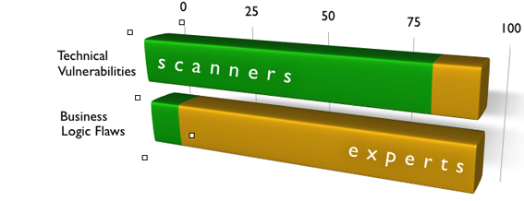
Tehničke i logičke ranjivosti
Tehničke ranjivosti
  Relativno jednostavno ih je moguće otkriti automatiziranim alatima za provjeru ranjivosti
  Problemi u konfiguraciji, loše filtriranje korisničkog unosa i prikaza itd.
Logičke ranjivosti
  Ranjivosti u logici poslovne aplikacije
  Praktički nemoguće otkriti automatiziranim alatima

Slide 12
OWASP project
OWASP project = Open Web Application Security Project https://www.owasp.org/
https://www.owasp.org/index.php/OWASP_Project_Inventory#Flagship_Projects
Projekti → skup dokumenta i alata koji imaju za cilj:
  Spriječiti propuste
  Detektirati propuste
  Integrirati sigurnost u SDLC

Slide 13
Najpoznatiji projekti
Tools
  OWASP Zed Attack Proxy
  OWASP Web Testing Environment Project
  OWASP OWTF
  OWASP Dependency Check
Code
  OWASP ModSecurity Core Rule Set Project
  OWASP CSRFGuard Project
  OWASP AppSensor Project
Documentation
  OWASP Application Security Verification Standard Project
  OWASP Software Assurance Maturity Model
  OWASP AppSensor Project
  OWASP Top Ten Project
  OWASP Testing Guide Project

Slide 14
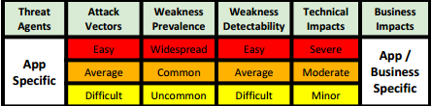
OWASP top 10 web aplikacijskih rizika
Najvažniji projekt vezano za sigurnost Web aplikacija
Rizici su određeni prema njihovoj metodologiji
Rizik = Vjerojatnost * Utjecaj
  Vjerojatnost
    Znanje potrebno za iskorištavanje
    Motivacija
  Lakoća otkrivanja i iskorištavanja propusta
Tehnički i poslovni utjecaj

Slide 15
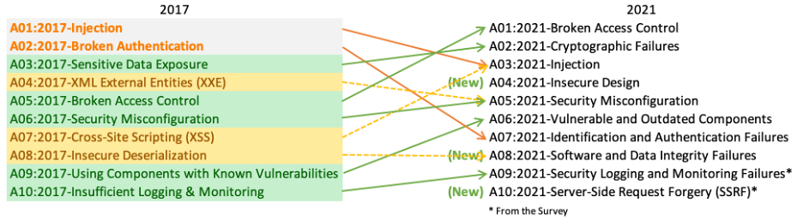
OWASP Top 10 2017 → 2021

Slide 16
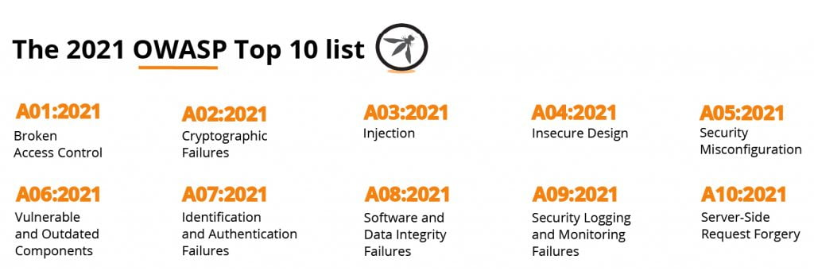
OWASP Top 10 - 2021

Slide 17
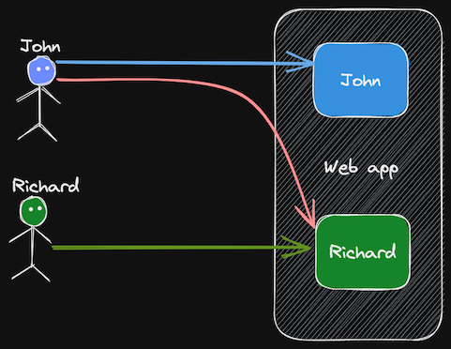
A1 – Broken Access Control
Access control enforces policy such that users cannot act outside of their intended permissions.
Failures typically lead to unauthorized information disclosure, modification, or destruction of all data or performing a business function outside the user's limits.

Slide 18
A1 – Broken Access Control
Violation of the principle of least privilege or deny by default, where access should only be granted for particular capabilities, roles, or users, but is available to anyone.
Bypassing access control checks by modifying the URL (parameter tampering or force browsing), internal application state, or the HTML page, or by using an attack tool modifying API requests.
Permitting viewing or editing someone else's account, by providing its unique identifier (insecure direct object references)
Accessing API with missing access controls for POST, PUT and DELETE.

Slide 19
A1 – Broken Access Control
Elevation of privilege. Acting as a user without being logged in or acting as an admin when logged in as a user.
Metadata manipulation, such as replaying or tampering with a JSON Web Token (JWT) access control token, or a cookie or hidden field manipulated to elevate privileges or abusing JWT invalidation.
CORS misconfiguration allows API access from unauthorized/untrusted origins.
Force browsing to authenticated pages as an unauthenticated user or to privileged pages as a standard user.

Slide 20
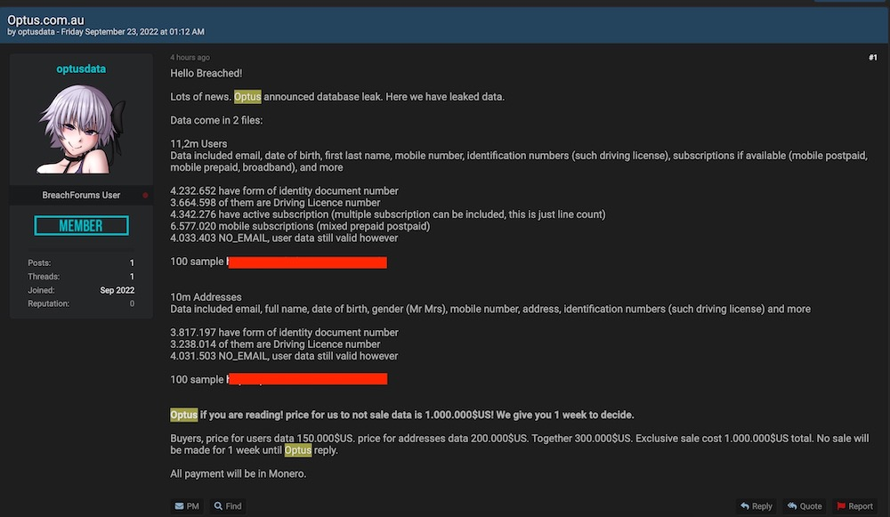
Optus data breach
https://nakedsecurity.sophos.com/2022/09/28/optus-breach-aussie-telco-told-it-will-have-to-pay-to-replace-ids/
https://www.upguard.com/blog/how-did-the-optus-data-breach-happen
Australia's second-largest telecoms provider
Curenje 11.2 mil. Korisničkih podataka

Slide 21

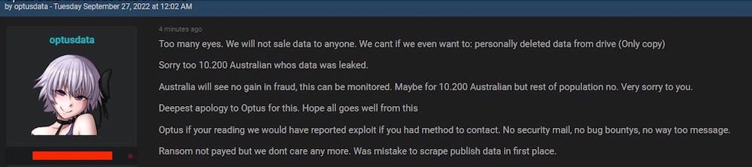
Optus data breach
The seller wrote, “Optus if you are reading! Price for us to not sale [sic] data is 1,000,000$US! We give you 1 week to decide.”
Regular buyers, the seller said, could have the databases for $300,000 as a job lot, if Optus didn’t take up its $1m “exclusive access” offer within the week.
The seller said they expected payment in the form of Monero, a popular cryptocurrency that’s harder to trace than Bitcoin.

Slide 22
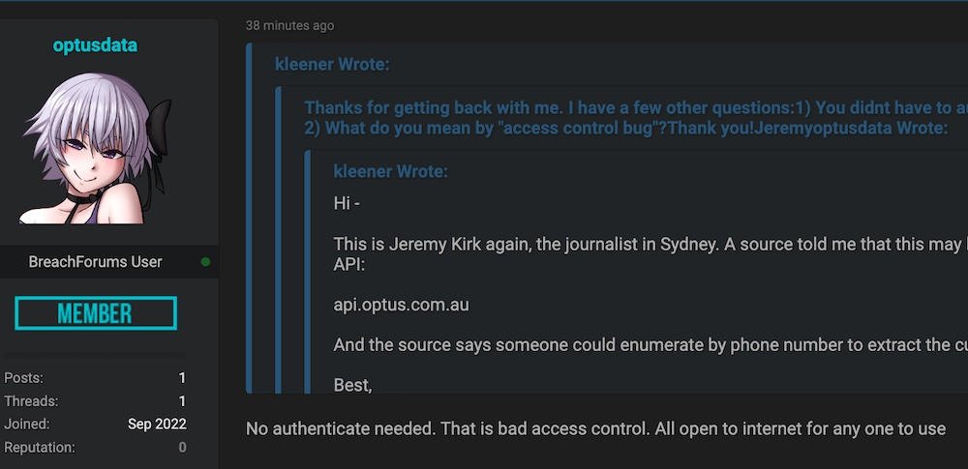
Optus data breach

Slide 23
Optus data breach
In an emotional apology, Optus chief executive Kelly Bayer Rosmarin called it a "sophisticated attack", saying the company has very strong cybersecurity.
The API endpoint was "api.www.optus.com.au.”
When Optusdata started frequently accessing that API, it triggered a security alert. A suspiciously high volume of data was coming from that API, which was a signal to Optus of malicious behavior.
Customer records were indeed stored with incrementing identifiers. This allowed them to write a script that requested every customer record in the database by simply incrementing each contactID index by one.
Nije implementirana nikakva zaštita za API pristup
  Autentikacija
  Teško pogodivi ID
  Rate limiting

Slide 24
Optus data breach
https://www.abc.net.au/news/2023-04-21/optus-hack-class-action-customer-privacy-breach-data-leaked/102247638
Optus apologised for the breach and set aside $140 million to help customers renew ID documents and commission an independent report into the breach.
It has also promised to invest more in protecting its systems and rebuilding customer trust.

Slide 25
A1 Yahoo
The attackers in this case apparently found a way to forge these authentication cookies, which would have granted them to access targeted accounts without needing to supply the account’s password.
In addition, a forged cookie could have allowed the attackers to remain logged into the hacked accounts for weeks or indefinitely.

Slide 26
A1 – Broken Access Control
Deny access by default to all private resource
Minimize Cross-Origin Resource Sharing ( CORS )
Implement access control mechanism and use it on each request which handles private data
Disable web server directory listing and ensure file metadata (e.g., .git) and backup files are not present within web roots.
Log all unauthorized access attempts and add alerts so you get notified when some abnormal traffic occurs
Add rate-limiting to your API so you prevent scanning tools which can be used by attackers.
Stateful session identifiers should be invalidated on the server after logout. Stateless JWT tokens should rather be short-lived so that the window of opportunity for an attacker is minimized. For longer lived JWTs it’s highly recommended to follow the OAuth standards to revoke access.

Slide 27
A2: Cryptographic Failures
Osjetljive podatke potrebno je prvo identificirati
Ne pohranjivati osjetljive podatke nepotrebno
Primjena kriptografije u gibanju i mirovanju
Identificirati sva mjesta na koja se isti pohranjuju
  Računalnu resursi u oblaku
  Baze podataka, datoteke, direktoriji, log datoteke itd.
  Backup datoteke
Korištenje jakih kriptografskih algoritama (npr. salting)
Primjereno upravljanje ključevima

Slide 28
A2: Cryptographic Failures
Kako se zaštititi?
  Detaljna provjera arhitekture
  Identificiranje mjesta gdje se pohranjuju osjetljivi podaci
  Osiguravanje pohranjenih podataka
    Enkripcija podataka
  Koristiti odgovarajuće mehanizme zaštite
    Enkripcija datoteka, baze podataka, stupaca u bazi podataka
    Korištenje poznatih, snažnih algoritama za enkripciju
      Posebnu pažnju posvetiti rukovanju ključevima

Slide 29
Zaboravljeni Web server
The University’s Computing and Maths School (CMS) had held a training conference and one of the academics involved asked a student to build a web microsite. The site included a facility for conference academics to upload documents anonymously via URL, something that attackers would eventually use to their advantage.
Nobody remembered (or had the job of) shutting this down once the conference had finished and so it sat there for years as new vulnerabilities were discovered, patches were applied, skills were improved on all sides and attacks on web servers became everyday occurrences.

Slide 30
Zaboravljeni Web server
A web server set up by an enterprising student for a conference in 2004 and then forgotten about has left the University of Greenwich nursing a £120,000 ($160,000) fine from Britain’s Information Commissioner (ICO).

Slide 31
Zaboravljeni Web server
… a database containing the personal data of 19,500 University staff, students, alumni, and conference attendees.
The data also included more intimate personal data of 3,500 people covering learning difficulties, staff sickness, food allergies, …

Slide 32
Zaboravljeni Web server
Whilst the microsite was developed in one of the University’s departments without IT knowledge, as a data controller it is responsible for the security of data throughout the institution.

Slide 33
Zaboravljeni Web server
The initial breach is thought to have occurred in 2013, before it was broken into several times during 2016 with the help of an SQL flaw and some uploaded PHP exploits that opened the way to the databases holding the good stuff.
Eventually, one of the attackers posted the data to Pastebin in January 2016, at which point the breach became public knowledge.

Slide 34
A3 –Injection
Injection ranjivosti nastaju kada aplikacija pošalje korisnikov unos interpreteru
  Korisnikovom unosu ne možemo vjerovati
  Sukladno tome ga treba i tretirati!
Što je interpreter?
  Bilo koji dio aplikacije koji prima ulazni niz znakova i interpretira ih kao naredbe
    Klasično SQL, ali može biti i ljuska sustava, LDAP, Xpath …
Najčešći primjer je SQL injection
  Veliki broj ranjivih aplikacija
  Obično kritične ranjivosti

Slide 35
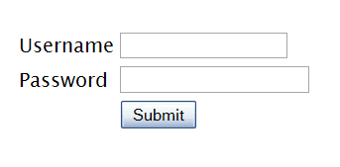
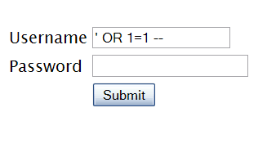

SQL Injection – Illustrated
"SELECT * FROM accounts WHERE acct=‘’ OR 1=1--’"
Account Summary
Acct:5424-6066-2134-4334
Acct:4128-7574-3921-0192
Acct:5424-9383-2039-4029
Acct:4128-0004-1234-0293
Account:
Account:
SKU:
DB Table 

SKU:
HTTP response 

HTTP request
Finance
SQL query
Transactions
Accounts
Administration
Communication
Knowledge Mgmt
E-Commerce
Bus. Functions
Databases
Legacy Systems
Web Services
Directories
Billing
Application Layer
Human Resrcs
APPLICATION
ATTACK
Custom Code
1. Application presents a form to the attacker
2. Attacker sends an attack in the form data
App Server
3. Application forwards attack to the database in a SQL query
Web Server
Hardened OS
4. Database runs query containing attack and sends encrypted results back to application
Network Layer
Firewall
Firewall
5. Application decrypts data as normal and sends results to the user

Slide 36
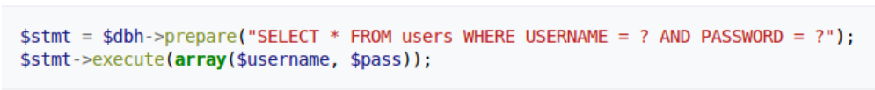
A3 – SQL Injection Kako se obraniti?
The root of the SQL injection problem is mixing of the code and the data.
the query and the data should be sent to the SQL server separately:
Prepared statements (with Parameterized Queries)
  In a prepared statement, the values that will be inserted into a SQL query are sent to the SQL server after the actual query is sent to the server
  data input by a hacker can’t be interpreted as SQL

Slide 37
A3 – SQL Injection Kako se obraniti?
2. Stored procedures
  The difference between prepared statements and stored procedures is that the SQL code for a stored procedure is defined and stored in the database itself, and then called from the application.
Both of these techniques have the same effectiveness in preventing SQL injection so your organization should choose which approach makes the most sense for you.

Slide 38
A3 - Cross Site Scripting (XSS)
XSS je script injection
Uzroci: Nedovoljno filtriranje podataka (ulaznih/izlaznih podataka)
Izvršavanje malicioznog koda unutar Web preglednika korisnika koji posjećuje ranjivu Web stranicu
  JavaScript (AJAX), VBScript, ActiveX, HTML, Flash
Vrlo česta i podcijenjena ranjivost
Napad uključuje tri strane:
  Napadač, ranjiva web aplikacija, Klijent (web browser)
  Meta napada je korisnik, ne web aplikacija

Slide 39
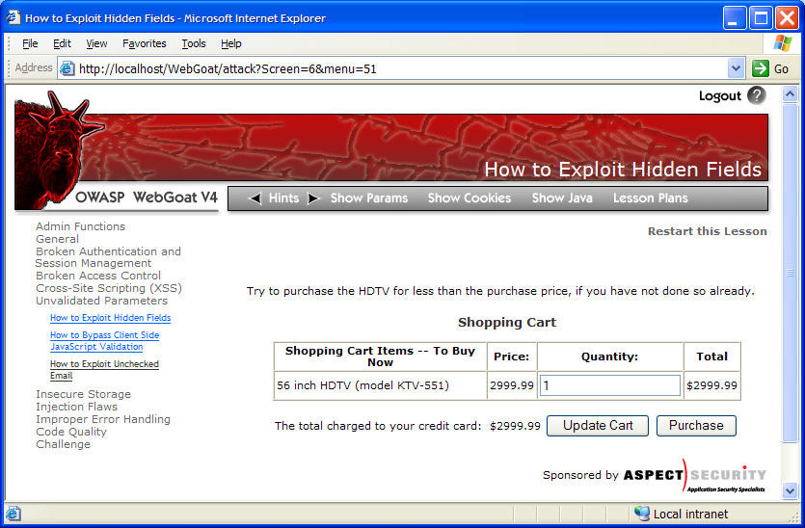

A3 - Cross Site Scripting (XSS)
1
Attacker sets the trap – update my profile
Application with stored XSS vulnerability
Attacker enters a malicious script into a web page that stores the data on the server
2
Victim views page – sees attacker profile
Finance
Transactions
Accounts
Administration
Communication
Knowledge Mgmt
E-Commerce
Bus. Functions
Custom Code
Script runs inside victim’s browser with full access to the DOM and cookies
3
Script silently sends attacker Victim’s session cookie

Slide 40
A3 - Cross Site Scripting (XSS) (posljedice napada)
Krađa cookiea / Preuzimanje sjednice
Lažiranje sadržaja web stranica
  Prikaz lažnih informacija
  Web defacement
  Phishing
Krađa identiteta
Napadi na internu računalnu mrežu

Slide 41
A4 – Nesigurni dizajn
Novi rizik koji se odnosi na loš dizajn i arhitekturu
Razlika između nesigurnog dizajna i nesigurne implementacije
Implementirati najbolju praksu za siguran razvoj softvera

Slide 42
A5: Nesigurna konfiguracija
Web aplikacije baziraju se na sigurnoj infrastrukturi
  Web poslužitelj
  Framework (ASP, PHP …)
  Operacijski sustav
Vrlo često framework „štiti” programera od grešaka
  Moderni framework štiti od SQL injectiona, XSS-a i slično
  No i dalje trebamo biti upoznati s ovim ranjivostima
Defaultne postavke
  Administratorska sučelja dostupna svima
  Defaultni korisnički računi …

Slide 43
A5: Nesigurna konfiguracija
Finance
Database
Transactions
Accounts
Administration
Communication
Knowledge Mgmt
E-Commerce
Bus. Functions
Custom Code
App Configuration
Framework
App Server
Web Server
Insider
Hardened OS

Slide 44
A5: Nesigurna konfiguracija (Kako se zaštititi?
Standardne preporuke za hardening
Potrebno zaštititi cijelu platformu
  OS, web poslužitelj, framework
  Ne ignorirati lokalne ranjivosti
Redovito instalirati zakrpe
Provjera sa automatiziranim alatima
  Dobri u pronalaženju problema u konfiguraciji

Slide 45
A6: Ranjive i zastarjele komponente
Korištenje ranjivih/zastarjelih komponenti (operacijski sustav, baza, web poslužitelj, aplikacije, programski okvir, …)
Neprimjereno/neučinkovito upravljanje ranjivostima
Ne testiranje kompatibilnost ažuriranih komponenti
https://www.sonatype.com/resources/log4j-vulnerability-resource-center

Slide 46
A7 – Identifikacijske/autenfikacijske pogreške
Automatski autentifikacijski napadi
Korištenje slabih i/ili inicijalnih lozinki
NIST preporuke se ne slijede
Nezaštićena pohrana lozinki
Nekorištenje multifaktor autentifikacije

Slide 47
A8 – Software and Data Integrity Failures
Software and data integrity failures relate to code and infrastructure that does not protect against integrity violations
An example of this is where an application relies upon plugins, libraries, or modules from untrusted sources, repositories, and content delivery networ
An insecure CI/CD pipeline can introduce the potential for unauthorized access, malicious code, or system compromise.
Many applications now include auto-update functionality, where updates are downloaded without sufficient integrity verification and applied to the previously trusted application.
Potrebno uspostaviti procesne i softverske kontrole (korištenje specijaliziranih alata) nad vanjskim komponentama

Slide 48
A9:Nedovoljno logiranje i nadziranje
Exploitation of insufficient logging and monitoring is the bedrock of nearly every major incident.
Attackers rely on the lack of monitoring and timely response to achieve their goals without being detected.

Slide 49
A10 - Server-Side Request Forgery (SSRF)
SSRF flaws occur whenever a web application is fetching a remote resource without validating the user-supplied URL.
It allows an attacker to coerce the application to send a crafted request to an unexpected destination, even when protected by a firewall, VPN, or another type of network access control list (ACL).

Slide 50
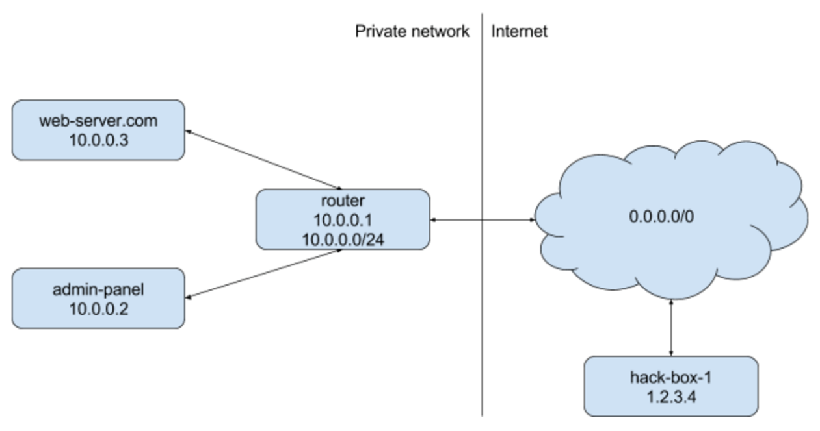
Server Side Request Forgery
Server Side Request Forgery is an attack where a server can be tricked into connecting to a server it did not intend
hack-box-01 $ curl http://web-server.com:4567/\?url\=http://10.0.0.2/
RESPONSE: <html><head><title>Internal admin panel</title></head>...</html>

Slide 51
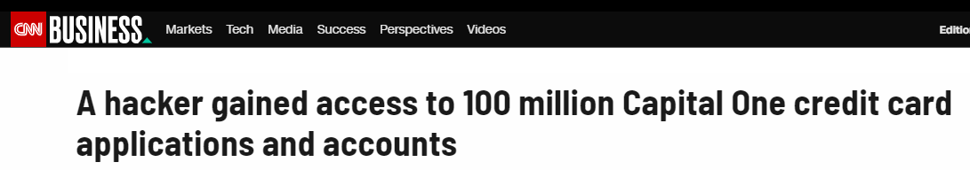
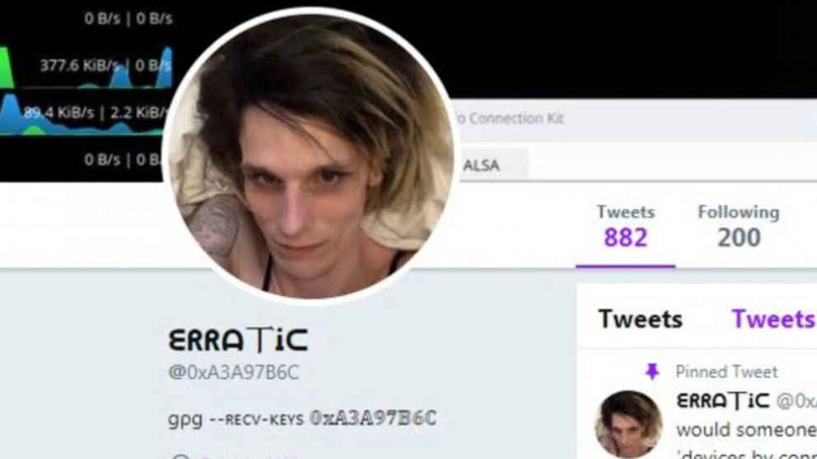

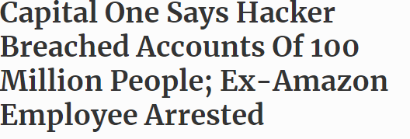

Slide 52
Capital One detalji
According to a source with direct knowledge of the breach investigation, the problem stemmed in part from a misconfigured open-source Web Application Firewall (WAF) (ModSecurity)
The misconfiguration of the WAF allowed the intruder to trick the firewall into relaying requests to a key back-end resource on the AWS platform.
Every indication is that the attacker exploited a type of vulnerability known as Server Side Request Forgery (SSRF) in order to perform the attack.
https://www.hackerone.com/blog-How-To-Server-Side-Request-Forgery-SSRF

Slide 53
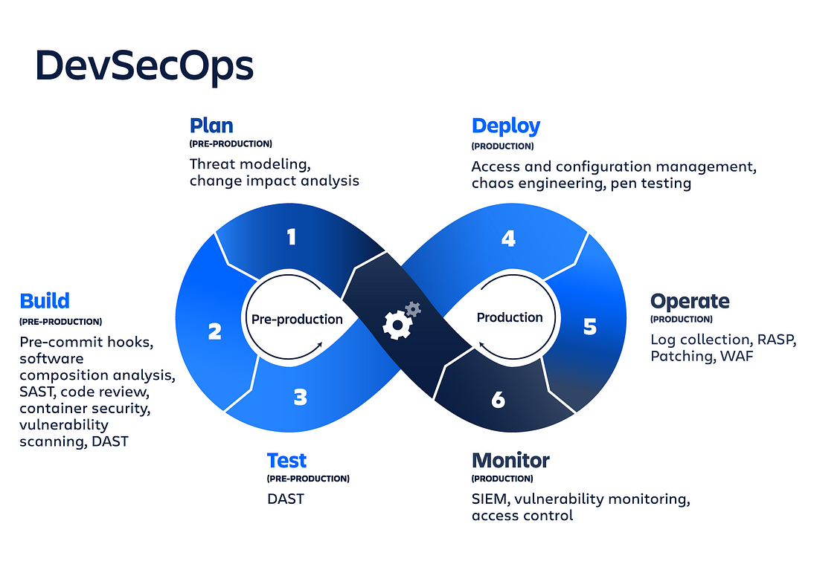
DevSecOps

Slide 54
DevSecOps
DevSecOps, which stands for development, security, and operations, is a framework that integrates security into all phases of the software development lifecycle.
It is a way of automating the process of development, testing, deployment and maintenance of applications, while ensuring that security and compliance requirements are met.
DevSecOps Principles:
  Automate All the Thing: Automating routine tasks and processes helps to speed up the delivery process
  Shift Security Left: Process of integrating security practices earlier in the development process.
  Continuous Integration and Continuous Delivery: CI and CD ensure that code is tested, reviewed, and deployed quickly and consistently
  …

Slide 55
Alati za provjeru sigurnosti web aplikacija
Static AST (SAST): This technology analyzes an application's source and binary code for security vulnerabilities, typically at the programming or testing phases of the software lifecycle.
Dynamic AST (DAST): This testing method analyzes applications while they're running. It simulates attacks against an application, analyzes the application's reactions to the attack, and then determines whether it's vulnerable or not.

Slide 56
Zaključak
Sigurnost Web aplikacija uvijek aktualna tema
OWASP top 10 predstavlja izvrstan okvir
DevSecOps

