Slide 1
Sigurnost informacijskih sustava
mr.sc. Dražen Pranić

Slide 2
Agenda
Verizon Data Breach i Google M-Trends Izvještaj
Statistika ranjivosti za prošlu godinu
Životni ciklus ranjivosti
Upravljanje ranjivostima
Penetracijsko testiranje

Slide 3
18-ti Verizon Data Breach Izvještaj
https://www.verizon.com/business/resources/T5bb/reports/2025-dbir-data-breach-investigations-report.pdf
Verizon DBIR team analyzed 22,052 real-world security incidents, of which 12,195 were confirmed data breaches that occurred inside organizations of all sizes and types
Together, these attacks represent victims from 139 countries around the world.

Slide 4
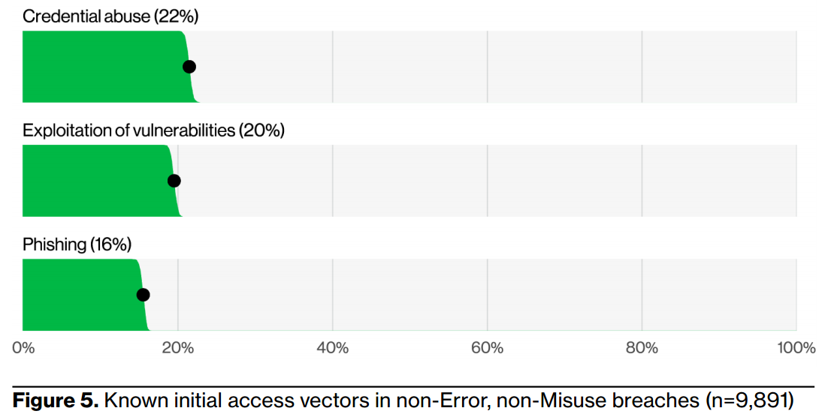

Slide 5
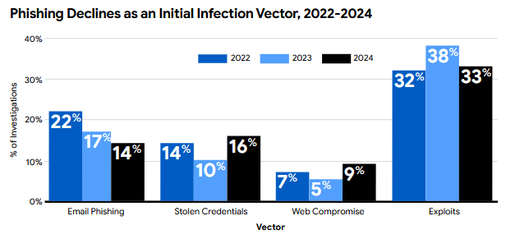
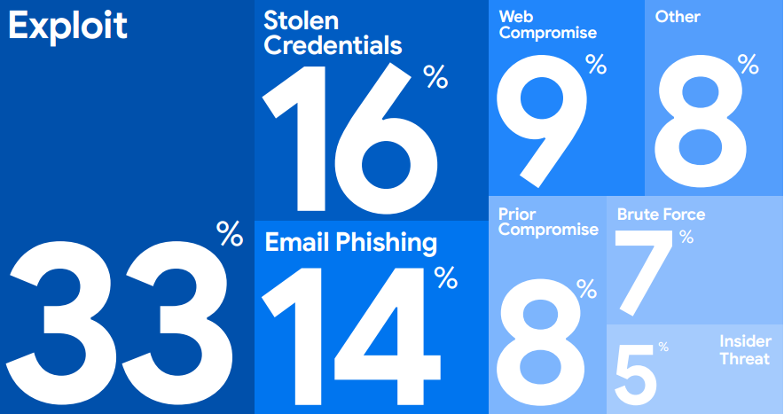

Slide 6
Vulnerabilities
The exploitation of vulnerabilities has seen another year of growth as an initial access vector for breaches, reaching 20%.
This value approaches that of credential abuse, which is still the most common vector. This was an increase of 34% in relation to last year’s report and was supported, in part, by zero day exploits targeting edge devices and virtual private networks (VPNs).
The percentage of edge devices and VPNs as a target on our exploitation of vulnerabilities action was 22%, and it grew almost eight-fold from the 3% found in last year’s report.
Organizations worked very hard to patch those edge device vulnerabilities, but our analysis showed only about 54% of those were fully remediated throughout the year, and it took a median of 32 days to accomplish.

Slide 7
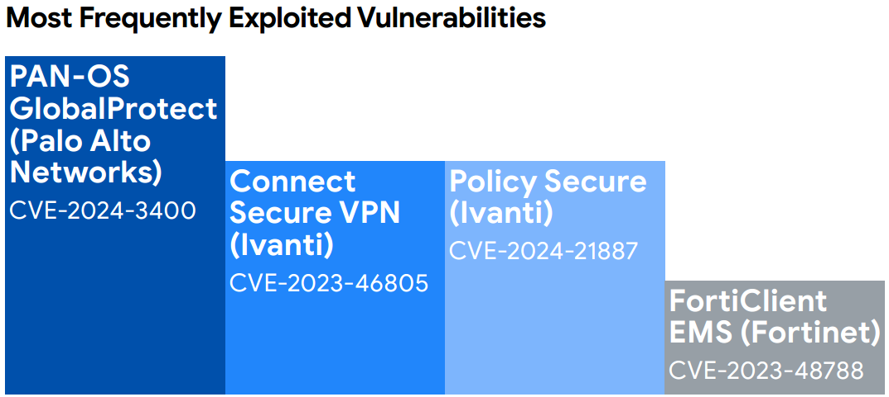

Slide 8
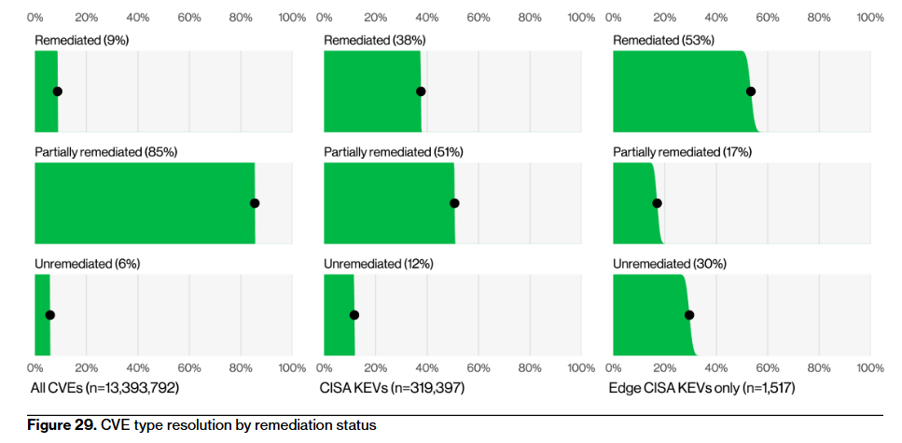

Slide 9
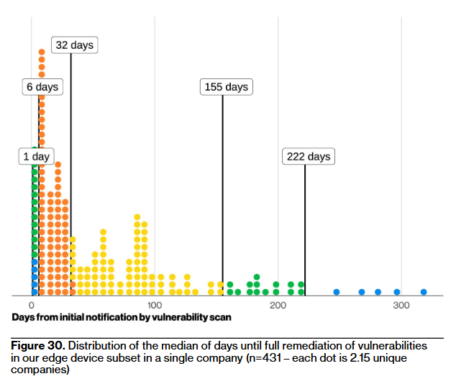

Slide 10
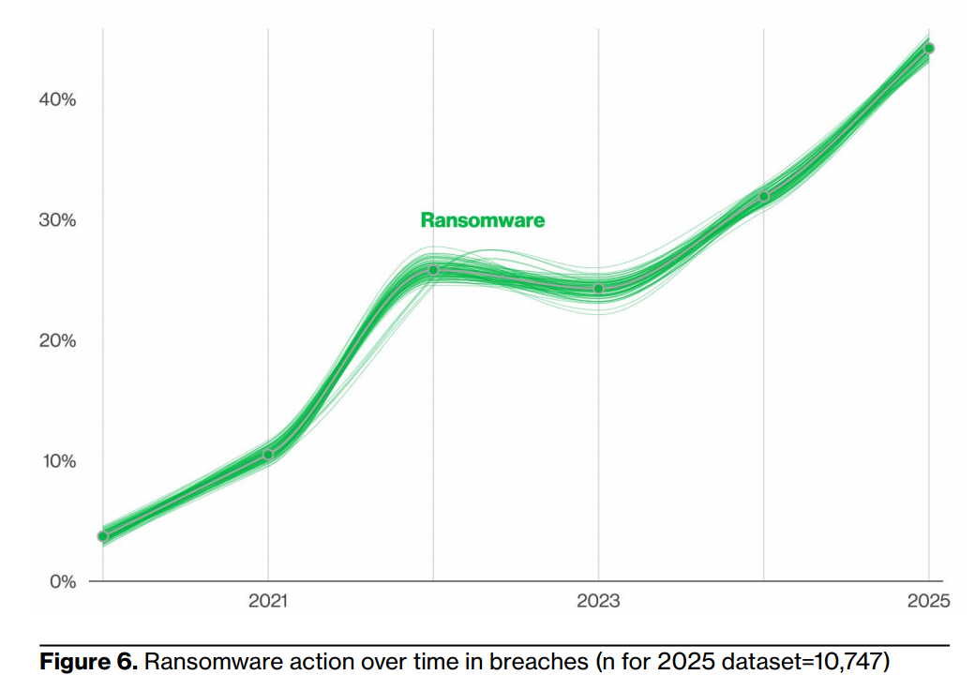

Slide 11
Credentials and ransomware
By correlating infostealer logs and marketplace postings with the
internet domains of victims that were disclosed by ransomware actors in 2024, we saw that 54% of those victims had their domains show up in the credential dumps (for instance, as URLs the credentials allegedly gave access to), and 40% of the victims had corporate email addresses as part of the compromised credentials.
This suggests these credentials could have been leveraged for those ransomware breaches, pointing to potential access broker involvement as a source of initial access vectors.

Slide 12
CVSS Statistics
https://www.cvedetails.com/cvss-score-distribution.php

Slide 14
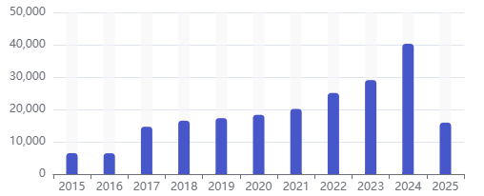
Za razmišljanje
Brinu li tvrtke koje razvijaju softver o ranjivostima?
Ulažu li više u sigurnost 2025. nego 2015.?
Zašto se broj ranjivosti u tom periodu značajno povećao?

Slide 15
Ranjivost
Ranjivost je svojstvo resursa
  Slabost u sustavu, sigurnosnim procedurama, dizajnu ili implementaciji resursa
Ranjivosti nisu samo u tehničkim mjerama zaštite!
  Iako su takve najčešće vidljive
  Propusti u konfiguraciji
  Brojne ranjivosti proizlaze npr. iz loše definiranih procedura ili sigurnosnih politika
Npr. admin/admin, javno dostupna baza, izgubljeni USB…

Slide 16
Common Vulnerabilities and Exposures (CVE)
https://www.cve.org/
Common Vulnerabilities and Exposures (CVE) by MITRE
The mission of the CVE® Program is to identify, define, and catalog publicly disclosed cybersecurity vulnerabilities. There is one CVE Record for each vulnerability in the catalog.

Slide 17
Common Vulnerability Scoring System (CVSS)
https://www.sans.org/blog/what-is-cvss/
CVSS stands for the Common Vulnerability Scoring System.
It's a way to evaluate and rank reported vulnerabilities in a standardized and repeatable way.
CVSS generates a score from 0 to 10 based on the severity of the vulnerability. A score of 0 means the vulnerability is less significant than the highest vulnerability with a score of 10
The CVSS score combines a lot of factors to be able to generate a score:
  Attack Vector
  Attack Complexity
  Privileges Required
  User Interaction …

Slide 18
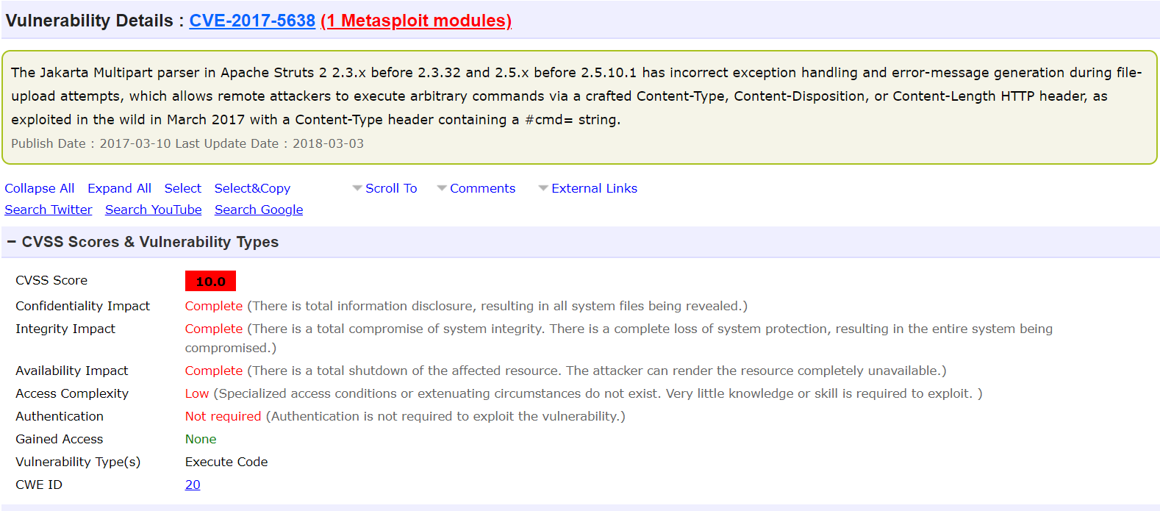
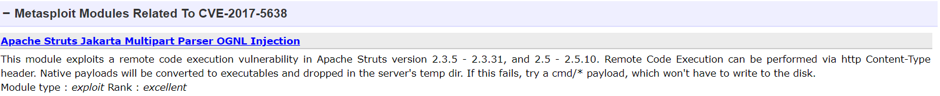

Slide 19
Životni ciklus ranjivosti
Period kritične izloženosti = Vremensko razdoblje od trenutka kada je ranjivost otkrivena do trenutka kada je objavljena sigurnosna zakrpa
Zero day ranjivost je sigurnosni propust u računalnoj aplikaciji koji je otkriven i poznat je napadačima prije nego što za njega zna proizvođač i javnost
Životni ciklus izravno je povezan sa sigurnosnim rizikom

Slide 20
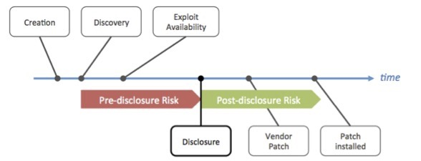
Životni ciklus ranjivosti

Slide 21
Životni ciklus ranjivosti
Otkrivanje ranjivosti
  Trenutak u kojem je ranjivost otkrivena
  Slijedi razdoblje u kojem razina rizika ovisi o dinamici širenja informacije
Trenutak pojave exploit programa
  Exploit je specijalizirani program koji iskorištava ranjivost
  0-day exploit → iskorištava 0-day ranjivost
  Vrijeme potrebno za izradu exploita ovisi o složenosti i tipu ranjivosti
  Pojavljivanje exploit programa značajno povećava sigurnosni rizik
  Pogotovo ako je exploit javno dostupan

Slide 22
Životni ciklus ranjivosti
Trenutak javne objave informacija o ranjivosti
  Trenutak u kojem informacije postaju dostupne široj javnosti
  Službeno se smatra objava proizvođača ranjivog softvera/hardvera
  CVE – common vulnerabilities and exposures
    baza javno poznatih ranjivosti i izloženosti
Trenutak izdavanja sigurnosne zakrpe
  Proizvođač službeno objavljuje zakrpu
    Uklanjanje ranjivosti može se temeljiti i na konfiguracijskim promjenama
Instalacija sigurnosne zakrpe

Slide 23
Upravljanje ranjivostima
0-day napadi→ puno pozornosti, vrlo rijetki
Iskorištavanje poznatih ranjivost predstavlja daleko realniji scenarij
SANS → preko 80% sigurnosnih incidenata odnosi se na iskorištavanje poznatih ranjivosti

Slide 24
Proces upravljanja ranjivostima
Jedan od temeljnih procesa upravljanja informacijskom sigurnošću
  Eng. vulnerability management
Sistematizirani proces identifikacije i uklanjanja sigurnosnih ranjivosti
  Minimiziranje tj. spuštanje na prihvatljive razine
  Cilj je proaktivna zaštita informacijskog sustava
Sve aktivnosti moraju biti formalno definirane
  S pripadajućim ulogama i odgovornostima
  Omogućava konzistentno i jednoznačno provođenje svih aktivnosti

Slide 25
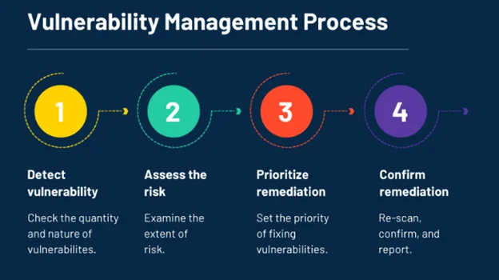
Proces upravljanja ranjivostima

Slide 26
Otkrivanje i analiza ranjivosti
Korištenje alata za redovito automatsko skeniranje ranjivosti
Skeniranje s admin pravima (agent ili eksterno skeniranje)
Tenable Nessus, Nexpose Rapid 7, Qualys najpoznatiji alati
Alati su u principu bazirani na potpisima
Definiranje prioriteta za uklanjanje ranjivosti (izazov)
Inovativni pristupi (korištenje threat intelligence)

Slide 27
Otkrivanje i analiza ranjivosti
Omogućuju i automatizaciju nekih drugih postupaka
  Identifikacija aktivnih sustava
  Pregledavanje TCP i UDP portova
  Identifikacija operacijskih sustava
  Enumeracija korisničkih računa i grupa
  Provjera instaliranih sigurnosnih zakrpi
  Pregledavanje web poslužitelja
  Provjera sigurnosnih postavki

Slide 28
Procjena rizika
Svaka organizacija treba znati koji su to najvažniji resursi
Izloženost resursa jako važna
  Sustav javno dostupni
  Interni sustavi
  Sustavi u izoliranom okruženju

Slide 29
Evaluacija otkrivenih ranjivosti
Nema svaka ranjivost jednaku težinu
Najvažnije su one za koje postoji gotovi exploit koji se koriste
Ranjivosti bez exploita ne predstavljaju ozbiljnu prijetnju
Međutim, exploit se može pojaviti naknadno
Navedeno znači da se ranjivosti moraju kontinuirano evaluirati

Slide 30
Evaluacija /što patchirati?
Roughly two out of every three CVEs used in attacks already had associated exploit code published.
When exploit code has been published, the chance of seeing the vulnerability targeted in the wild is seven times higher than without published exploit code
“Successful vulnerability management, then, balances the two opposing goals of coverage (fix everything that matters) and efficiency (delay/deprioritize what doesn't matter),„

Slide 31
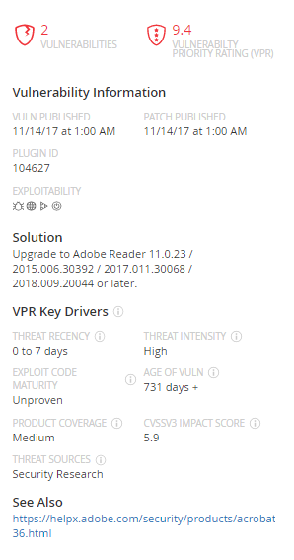
Evaluacija /što patchirati?
A strategy that prioritizes only "really bad" CVEs, such as those with a CVSS score of 10, would be considered highly efficient, but have low coverage since many easy-to-exploit vulnerabilities with lower CVSS scores would be missed.
A strategy that increases coverage, by remediating all vulnerabilities with a CVSS score of 6 or higher, would have lower efficiency because time is being spent addressing vulnerabilities that would never be exploited.

Slide 32
Vulnerability Prioritization Technology
streamlines the vulnerability analysis and remediation/mitigation process by focusing efforts on identifying and prioritizing the vulnerabilities that pose the greatest risks to the organization.
Exploitability of a vulnerability
Asset or business criticality
Severity of a vulnerability
Compensating controls in place

Slide 33
Exploit Prediction Scoring System (EPSS)
https://www.first.org/epss/data_stats
EPSS is a daily estimate of the probability of exploitation activity being observed over the next 30 days.
It is designed from the ground up to make the best use of all of the information available and it does this in five steps:
  Collect as much vulnerability information as we can from a variety of sources
  Collect evidence of daily exploitation activity
  Train a model: discover/learn the relationship between the vulnerability information and the exploitation activity
  Measure the performance of the model, tweak and repeat step 3 to optimize the model
  On a daily basis: refresh the vulnerability information (step 1) and use the model (step 3) to produce daily estimates of the probability of exploitation in the next 30 days for each published CVE.

Slide 34
Exploit Prediction Scoring System (EPSS)
https://www.cve.org/CVERecord?id=CVE-2024-3400
https://www.cisa.gov/known-exploited-vulnerabilities-catalog
https://www.cert.hr/ranjivost-nultog-dana-palo-alto-vatrozida-omogucuje-udaljeno-izvrsavanje-koda/
https://www.bleepingcomputer.com/news/security/palo-alto-networks-zero-day-exploited-since-march-to-backdoor-firewalls/

Slide 35
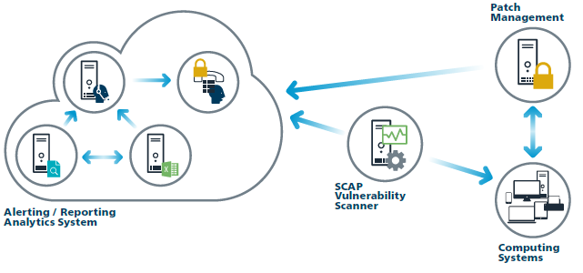
Uklanjanje ranjivosti
Korištenje specijaliziranih alata za automatiziranu instalaciju
Vrlo rijetko manualna instalacija (npr. DMZ)

Slide 36

Dobri hakeri i ranjivosti
https://www.forbes.com/sites/daveywinder/2019/08/29/how-to-make-1-million-from-hacking-six-hacker-millionaires-tell-their-story/#74a02d7f5332
“Bug Bounty is a deal offered by many websites and software developers by which individuals can receive recognition and compensation for reporting bugs, especially those pertaining to exploits and vulnerabilities.”

Slide 37
Google Project Zero
Formed in 2014, Project Zero is a team of security researchers at Google who study zero-day vulnerabilities in the hardware and software systems that are depended upon by users around the world.
Our mission is to make the discovery and exploitation of security vulnerabilities more difficult, and to significantly improve the safety and security of the Internet for everyone.
We perform vulnerability research on popular software like mobile operating systems, web browsers, and open source libraries.
We use the results from this research to patch serious security vulnerabilities, to improve our understanding of how exploit-based attacks work, and to drive long-term structural improvements to security.

Slide 38
Google Project Zero
Elite Hackers
https://googleprojectzero.blogspot.com/
https://bugs.chromium.org/p/project-zero/issues/list?q=&can=1
When Project Zero's hacker-hunters find a bug, they say they'll alert the company responsible for a fix and give it between 60 and 90 days to issue a patch before publicly revealing the flaw on the Google Project Zero blog.
In cases where the bug is being actively exploited by hackers, Google says it will move much faster, pressuring the vulnerable software's creator to fix the problem or find a workaround in as little as seven days.

Slide 39
Penetracijsko testiranje
Najsofisticiraniji i najtemeljitiji postupak ispitivanja sigurnosti
Sustav se u kontroliranim uvjetima podvrgava stvarnim pokušajima napada korištenjem svih onih tehnika i alata koje napadači inače koriste prilikom provođenja neovlaštenih aktivnosti
Svrha → pronaći ozbiljne slabosti u informacijskom sustavu
Ugovara se s vanjskim partnerima

Slide 40
Comparing Security Audit, Vulnerability Assessment, and Penetration Testing
Security Audit
Vulnerability Assessment
Penetration Testing
A security audit checks whether an organization follows a set of standard security policies and procedures
A vulnerability assessment focuses on discovering the vulnerabilities in an information system but provides no indication of whether the vulnerabilities can be exploited or of the amount of damage that may result from the successful exploitation of the vulnerabilities
Penetration testing is a methodological approach to security assessment that encompasses a security audit and vulnerability assessment, and it demonstrates whether the vulnerabilities in a system can be successfully exploited by attackers
Security Audit

Slide 41
Types of Penetration Assessment: Goal-oriented vs. Compliance-oriented vs. Red-team-oriented
Goal-oriented/Objective-oriented Penetration Testing
This type of assessments is driven by goals. The objectives of the penetration test are defined, rather than defining the scope of targets
The goal of penetration assessment is defined before it begins
The job of the pen tester to check whether he/she can achieve the goal and to determine the different ways to achieve the goal
Gain remote access to an internal network
Gain domain administrator access
Examples
Gain access to credit-card information
Create a denial of service (DoS) condition against a website
Deface a website

Slide 42
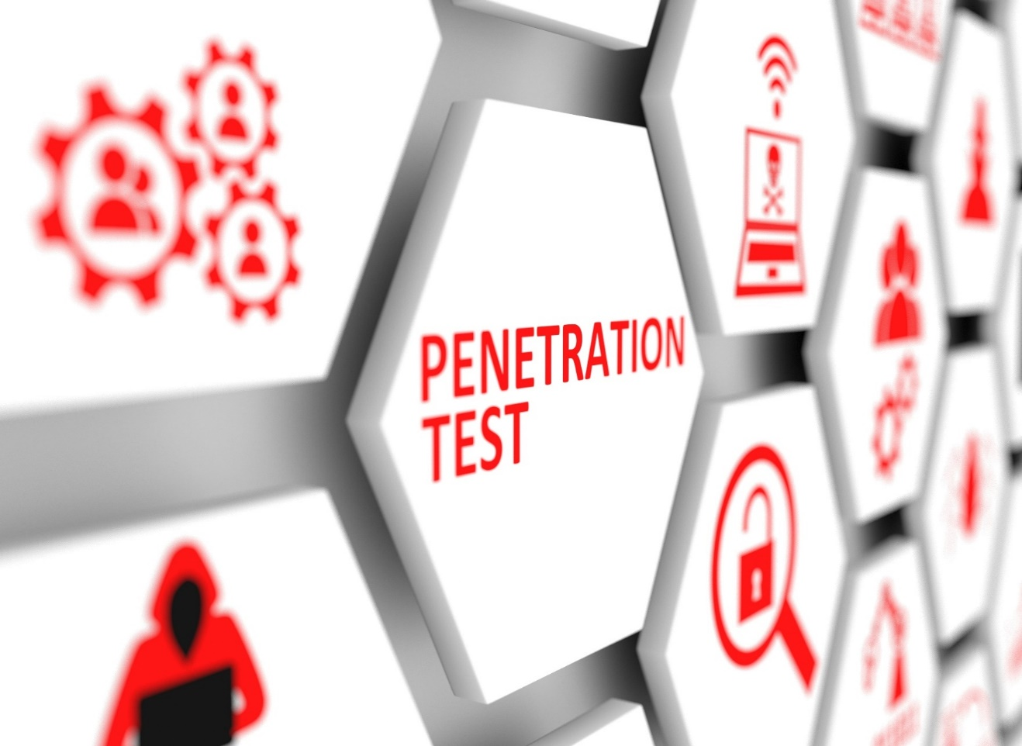
Types of Penetration Assessment: Goal-oriented vs. Compliance-oriented vs. Red-team-oriented
Compliance-oriented Penetration Testing
This type of assessments is driven by compliance requirements. It is testing against adherence to compliance requirements
It entails conducting an assessment against the compliance requirements of cyber security standards, frameworks, laws, acts, etc.
For example, an organization may ask to perform a security assessment against PCI-DSS requirements

Slide 43

Types of Penetration Assessment: Goal-oriented vs. Compliance-oriented vs. Red-team-oriented
Red-team-based Penetration Testing
  Red-team-based penetration testing is an adversarial goal-based assessment in which the pen tester must mimic the behavior of a real attacker and target the environment
  This type of assessment has no specific driver
  For example, an organization may ask to conduct a security assessment for evaluating its overall security. It may include assessing people, networks, applications, physical security, etc.

Slide 44
Penetracijsko testiranje - Podjela prema načinu provođenja
Bez prethodnog poznavanja testiranog sustava
  Eng. black box, zero knowledge
  Jedine informacije koje može imati su javno dostupne informacije
S prethodnim poznavanjem testiranog sustava
  Eng. white box
  Provoditelju se ustupaju sve potrebne informacije o ciljnom sustavu
S djelomičnim poznavanjem testiranog sustava
  Eng. gray box
Što mislite koji način testiranja je najučinkovitiji?

Slide 45
Postupak provođenja penetracijskog testiranja
Budući da simulira stvarni pokušaj napada na tehničkoj razini je praktički jednak stvarnom napadu
  Koriste se tehnike i alati koji su dostupni i napadačima
Razlika u cilju
  Napadač želi ukrasti podatke ili nanijeti štetu
  Provoditelj želi identificirati i ukloniti ranjivosti
Razlika u cijeni☺
Postupak potrebno sistematizirati i kontrolirati
Pravno-formalni aspekt
  penetracijski test je ugovorom definirana radnja koja obvezuje pravnu ili fizičku osobu zaduženu za njezino obavljanje na visoku razinu tajnosti prikupljenih podataka o slabostima testiranog sustava

Slide 46
BAS
Breach and Attack Simulation (BAS) Tools enable organizations to gain a deeper understanding of security posture vulnerabilities by automating testing of threat vectors such as external and insider, lateral movement, and data exfiltration.
BAS complements red teaming and penetration testing but cannot completely replace them
BAS validates an organization's security posture by testing its ability to detect a portfolio of simulated attacks performed by SaaS platforms, software agents, and virtual machines.

Slide 47
Zaključak
0-day ranjivosti privlače pozornost
Pravovremeno patchiranje izazov
Prioritizacija ranjivosti
Penetracijsko testiranje
BAS

