Slide 1
Sigurnost informacijskih sustava
mr.sc. Dražen Pranić

Slide 2
Agenda
CISO rola
Organizacijska struktura
Odgovornosti
Eksternalizacija

Slide 3
Istraživanja
https://www.heidrick.com/en/insights/compensation-trends/2022-global-chief-information-security-officer-ciso-survey?__source=newsletter%7Ccouncils%7Ctec
https://home.kpmg/xx/en/home/campaigns/2019/07/the-seven-ways-of-the-agile-ciso.html
https://interact.f5.com/rs/653-SMC-783/images/RPRT-SEC-1167223548-global-ciso-benchmarkUPDATED.pdf
https://www2.deloitte.com/content/dam/Deloitte/de/Documents/risk/DR19_TheNewCISO.pdf

Slide 4
CISO Burnout
https://www.heidrick.com/en/insights/compensation-trends/2022-global-chief-information-security-officer-ciso-survey?__source=newsletter%7Ccouncils%7Ctec
stress and burnout. When asked to state the most significant personal risks CISOs are facing relating to their role, stress (59%) and burnout (48%) were the top responses.
“We can’t do everything, so it is about how we make sure we are focusing on the right priorities in the right order so that we are enabling the business but at the same time striking the fine balance in securing the organisation.”
https://www.csoonline.com/article/3640718/deloitte-uk-ciso-addresses-stress-and-burnout-in-cybersecurity.html

Slide 5
CISO Burnout
https://www.forbes.com/sites/tonybradley/2024/10/15/the-cybersecurity-burnout-crisis-is-reaching-the-breaking-point/
early 98% of respondents reported working beyond their contracted hours, with the average CISO clocking an additional nine hours per week.
42% of respondents are most concerned about the rise of AI-enabled cyberattacks​.
Ransomware remains a major concern, with 37% of security leaders identifying it as a top source of stress.

Slide 6
CISO Constraints
The fallout from budget and staffing constraints is more serious and stressful for cybersecurity leaders even if similar limitations apply to every department,
In security, if you don’t handle your constraints well, what you’re potentially looking at is your brand is significantly damaged, your customers are at risk

Slide 7
Personal liability
Sixty-two percent of cyber leaders said they are concerned about personal liability related to a cyberattack on their company as legal and regulatory pressures grow.
The recent legal case against former Uber Chief Security Officer Joe Sullivan, charged with obstruction of justice, has heightened awareness among CISOs about their own accountability. A federal judge sentenced Sullivan on May 4 to three years of probation and ordered him to pay a fine of $50,000 for failing to report a 2016 data breach to the Federal Trade Commission.
Current and former security chiefs wrote letters of support for Sullivan to the court, expressing concern that his conviction might cause CISOs to fear regulatory scrutiny and go overboard in disclosing cyber incidents.
three years of probation, 200 hours of community service, and a $50,000 fine.

Slide 8
Uber case
https://www.justice.gov/usao-ndca/pr/former-chief-security-officer-uber-sentenced-three-years-probation-covering-data
Hackers breached 57 million Uber users' and drivers' accounts and demanded $100,000 to delete their copy of the stolen data. This includes names, phone numbers, email addresses and more than 600,000 US drivers' licence numbers.
Uber’s CSO at the time, disguised the “ransom money” as payment to a bug bounty program.
The payment was made in bitcoin, and hackers were asked to sign non-disclosure agreements, falsely stating that no data was lost.
Sullivan participated in a presentation to the FTC in March 2016 regarding Uber’s cybersecurity program, and he testified under oath in November 2016.
The incident was not disclosed to the FTC or the public until their new CEO, Dara Khosrowshahi, joined the company in 2017.

Slide 9
Uber case (2014 and 2016)
12.5.2014 - Threat actors access personal data of Uber customers and drivers contained in an AWS S3 bucket. The attackers used an AWS access key that was publicly posted to GitHub and obtained information that included 100,000 drivers' names, driver's license numbers, physical addresses, email addresses and other data.
Nov. 14, 2016: Sullivan receives an email from anonymous threat actors claiming they exploited a "major vulnerability" and obtained access to an Uber database. Uber's security team investigates the claim and discovers attackers used stolen GitHub credentials to access Uber's private code repository, where they found AWS credentials and accessed an S3 bucket with the database.
As established at trial, ten days after his sworn FTC testimony, Sullivan learned that Uber had been hacked again. Furthermore, the hackers had exploited the same vulnerability that had led to the 2014 breach. Unlike the 2014 breach, however, the data stolen in 2016 was massive in scale and included records associated with approximately 57 million Uber users and drivers.
...Uber’s confessed that it didn’t use multifactor authentication on its GitHub account

Slide 10
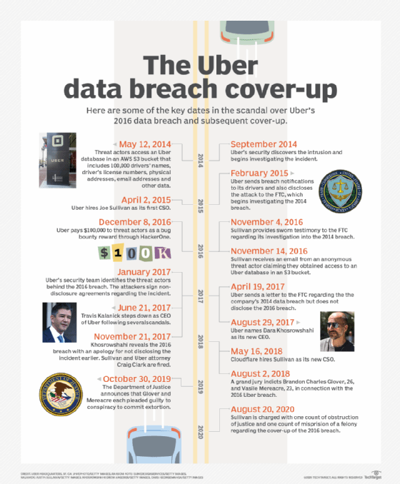

Slide 11
Organizacija informacijske sigurnosti
Upravljanje informacijskom sigurnošću zahtijeva definiranje osnovnih uloga i odgovornosti
Konačna odgovornost počinje i završava na upravi
Definira okvir, strategiju, organizacijsku strukturu
Određuje odgovorne osobe
Omogućuje resurse
„…upravljačka tijela ključnih i važnih subjekata trebala odobravati mjere upravljanja kibersigurnosnim rizicima i nadzirati njihovu provedbu…”
„… članovi upravljačkih tijela ključnih i važnih subjekata moraju pohađati osposobljavanja”

Slide 12
CISO odgovornosti
Steve Katz, prvi CISO, 1994 Citigroup
Usklađivanje sigurnosnih ciljeva sa strategijom organizacije
Izrada i implementacija politika i procedura
Upravljanje rizikom
Upravljanje sigurnosnim incidentima
Uskladivost sa standardima i zakonskom regulativom
Edukacija zaposlenika

Slide 13
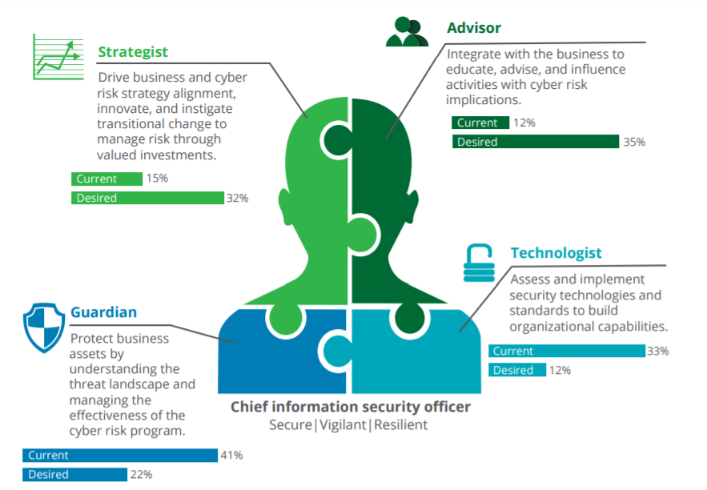

Slide 14
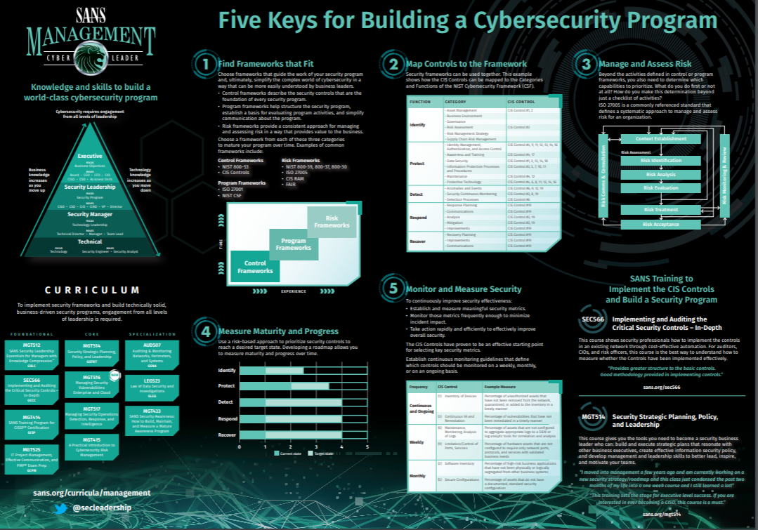

Slide 15
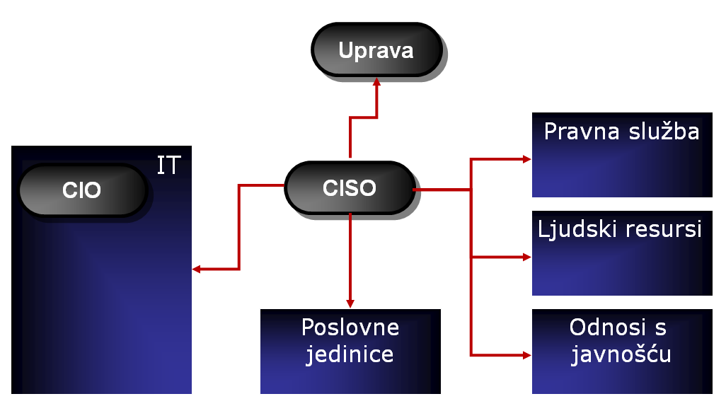
Pozicija CISO
Zašto CISO mora biti izvan IT-a?

Slide 16
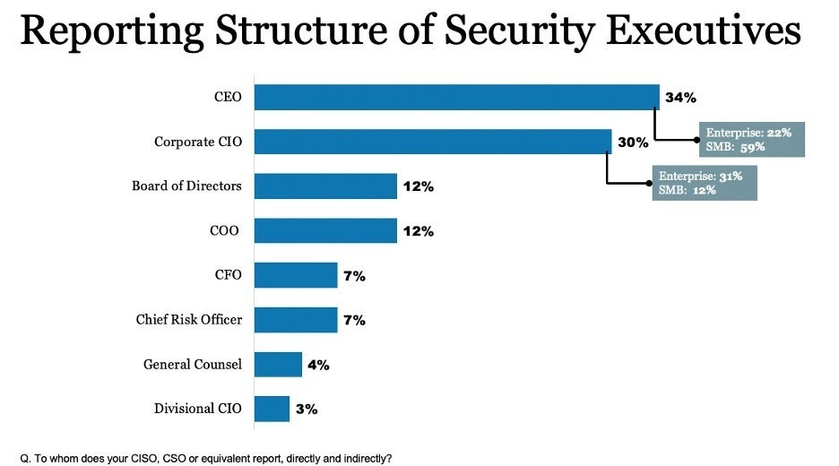

Slide 17
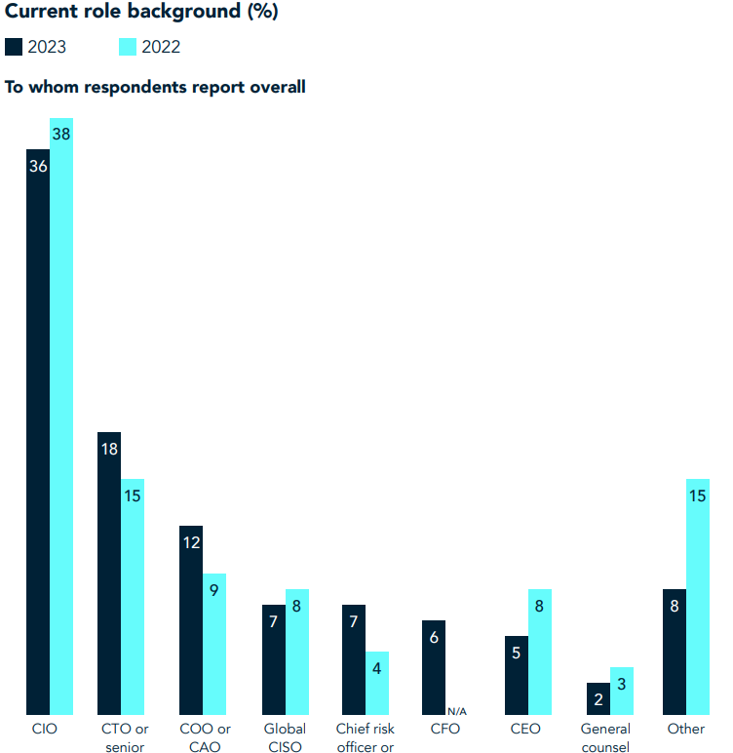

Slide 18
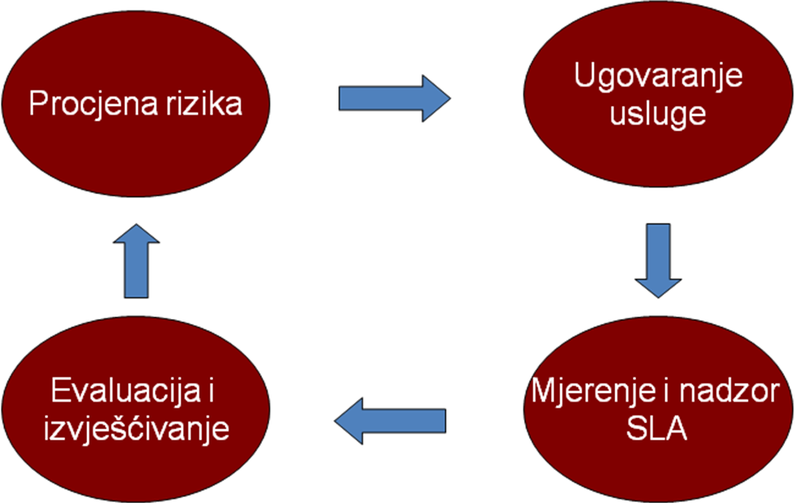
Eksternalizacija

Slide 19
Eksternalizacija (sigurnost trećih strana)
Procjena rizika
Analiza sposobnosti vanjskog partnera
Ne samo tehnička već i financijska, reputacijska itd.
Ugovaranje usluge
Formalno definiranje parametara usluge
Uključiti izjavu o povjerljivosti
Mjerenje i nadzor SLA
Kontinuirano mjerenje razine usluge
Evaluacija i izvješćivanje
Na temelju rezultata, za određeno vremensko razdoblje
Ulazni parametar za sljedeći ciklus procjene rizika

Slide 20
Definiranje i provjera sigurnosnih zahtjeva
Ovisno o vrsti/važnosti usluge potrebno definirati sigurnosne zahtjeve za pružatelje usluga
GDPR – definirati tehničke i organizacijske mjere za izvršitelje obrade (vrlo široka definicija)
Razvoj Web aplikacija – zahtijevati uskladivost s OWASP Top 10 rizicima
Revizija u svrhu utvrđivanja poštuju li vanjski partneri zahtjeve koje su prihvatili

Slide 21
Target primjer
27.11.2013 – 15.12.2013
Gubitak kreditnih kartica i osobnih podataka za više od 110 milijuna korisnika
Istraga pokazala da je ulaz u informacijski sustav omogućen putem mrežnih kredencijala od strane Fazio Mechanical (klima uređaji, …)
Ukradeni dva mjeseca prije nego što je napad započeo → koristili besplatnu verziju antivirusnog progama (Malwarebytes Anti-Malware)
Besplatna verzija nema real time protection
Pristupali eksternom sustava plaćanja partnera

Slide 22
Target primjer
Uspjeli se logirati na server koji je u internoj mreži
Nije se koristila dvo-faktorska autentikacija → zahtjev PCI DSS
“in rare cases” would Target have required a vendor to use a one-time token or other two-factor authentication approach.
Target would have paid very little attention to vendors like Fazio, and I would be surprised if there was ever even a basic security assessment done of those types of vendors by Target.”

Slide 23
Target primjer
Ukupan trošak oko 300 mil. $
Ostavke čelnih ljudi (CIO, CISO, CCO)
https://www.google.lv/webhp?sourceid=chrome-instant&ion=1&espv=2&ie=UTF-8#q=target+finance+stock&*

Slide 24
Zaključak
Odgovornost uprave
Organizacijska struktura i odgovornost CISO
Sigurnosti trećih strana
Target primjer

