Slide 1
Managing information systems
Mr.sc Dražen Pranić
Notes:
Ažurirati naziv kolegija.

Slide 2
Agenda
AI

Slide 3
AI will be everywhere
https://www.youtube.com/shorts/874RnJA9BmI

Slide 4

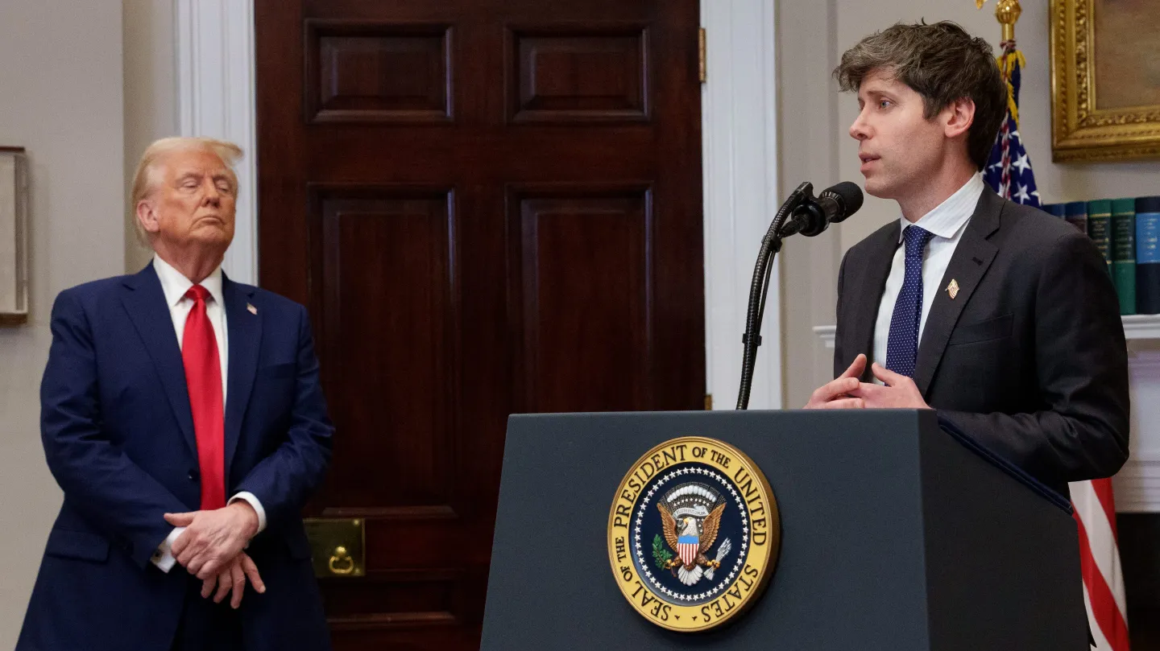


Slide 5
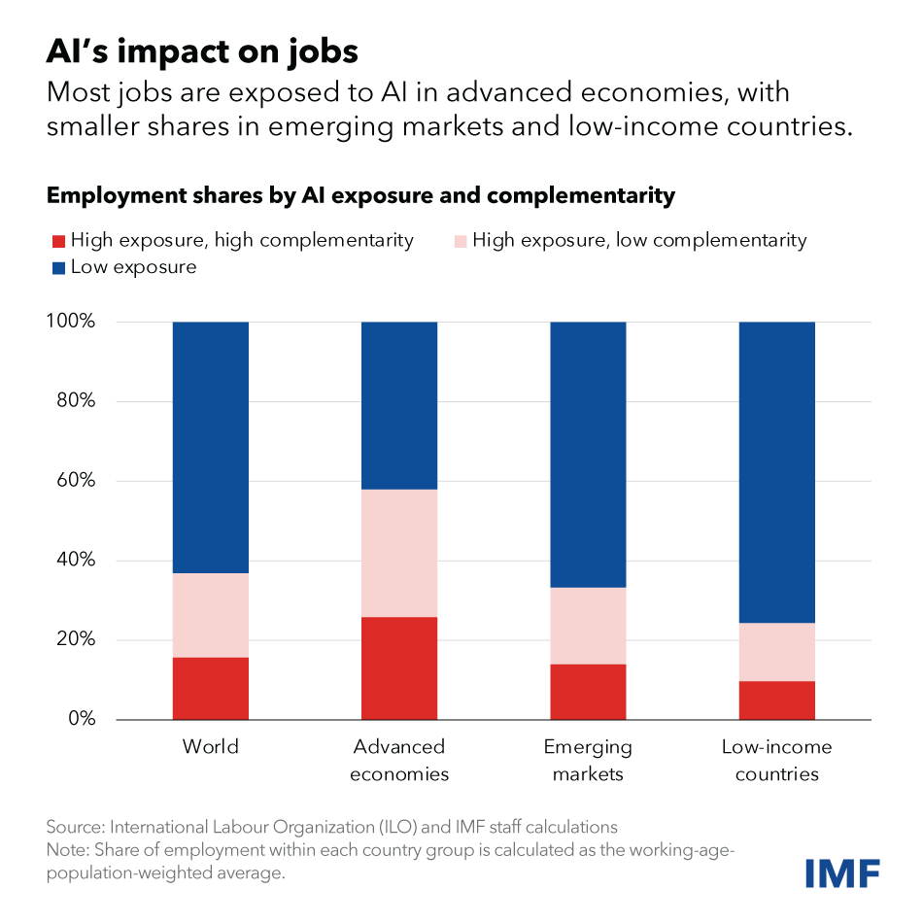

Slide 6
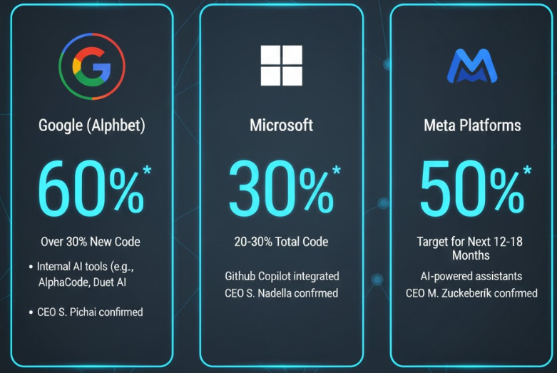

Slide 7
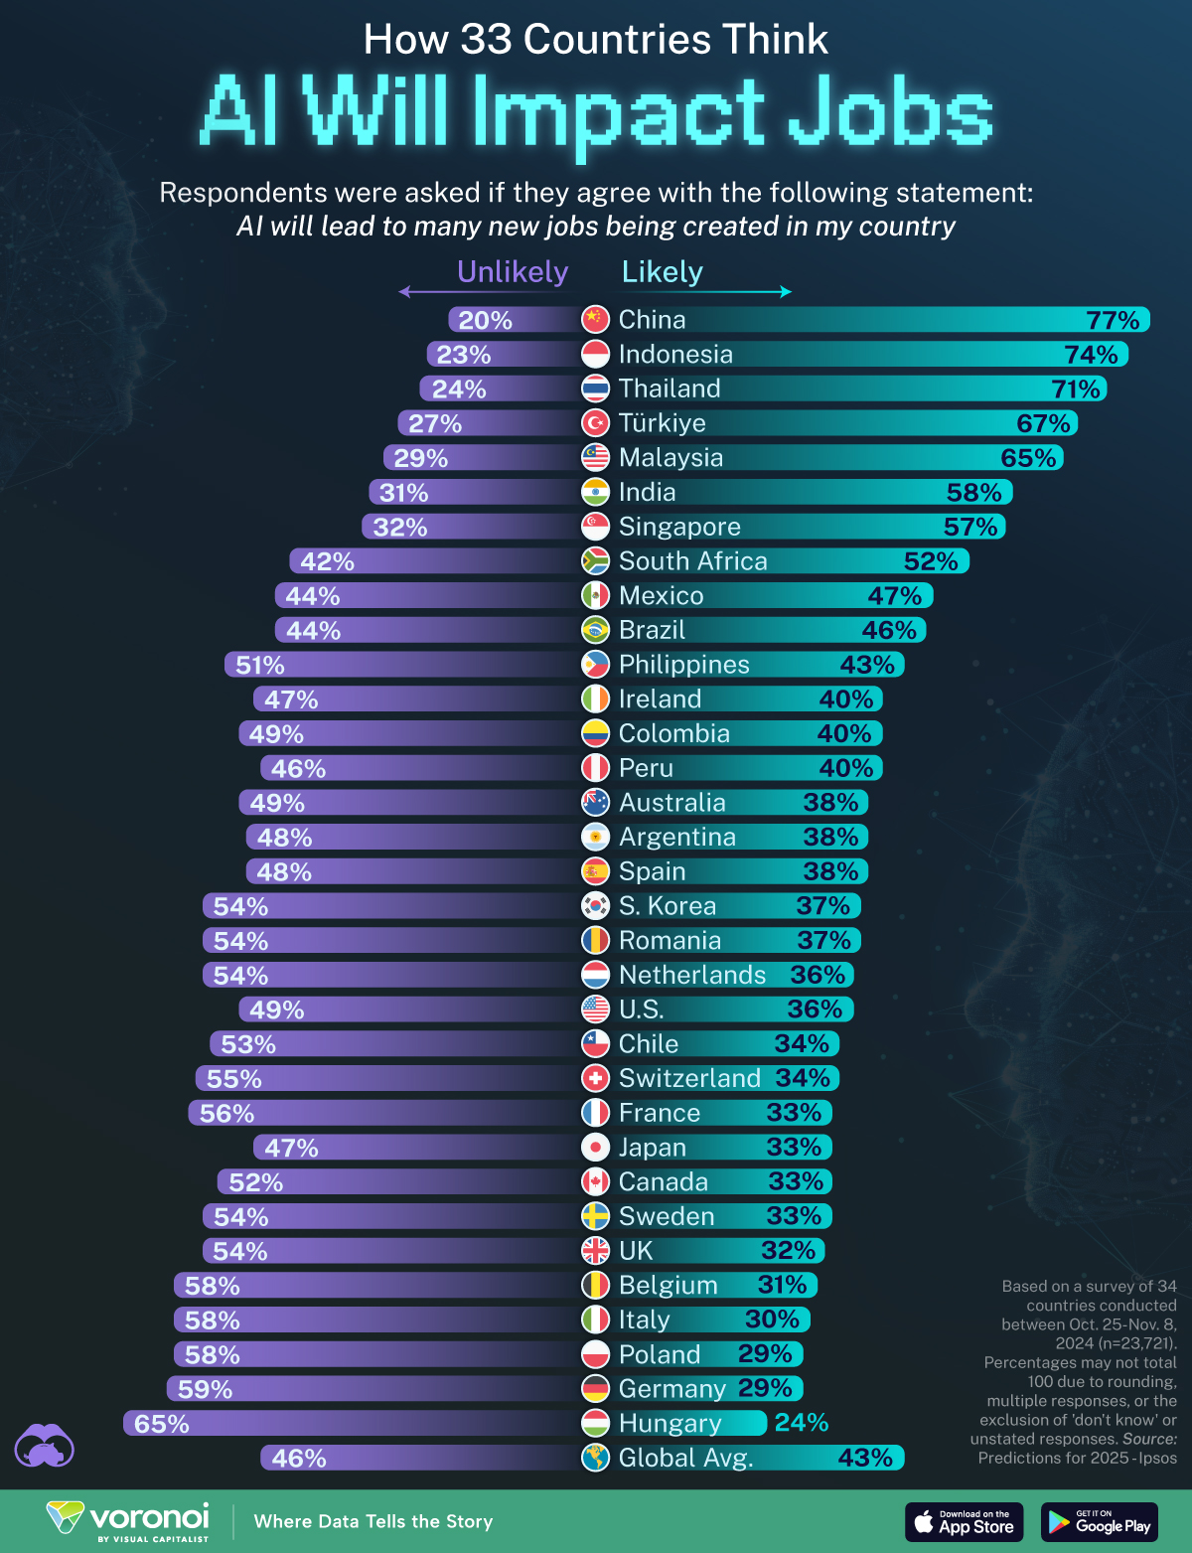

Slide 8
AI impact on workforce
In the next five years, 170 million jobs are projected to be created and 92 million jobs to be displaced, constituting a structural labour market churn of 22% of the 1.2 billion formal jobs in the dataset being studied.
This amounts to a net employment increase of 7%, or 78million jobs.

Slide 9
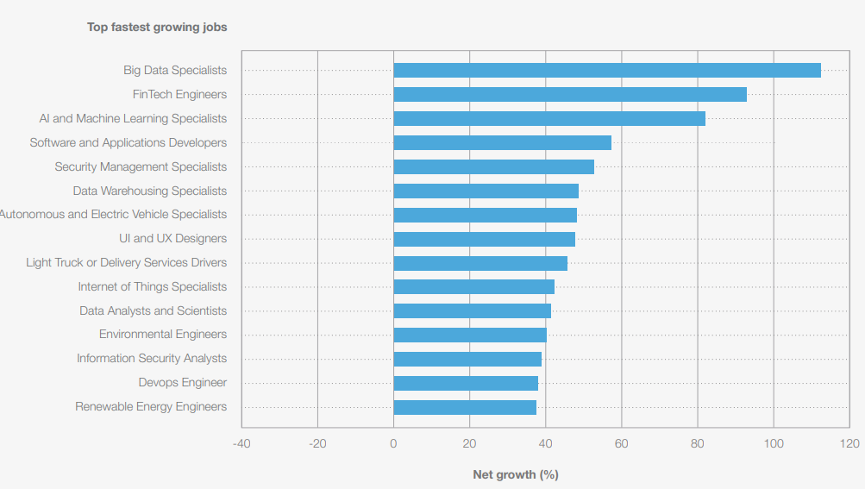
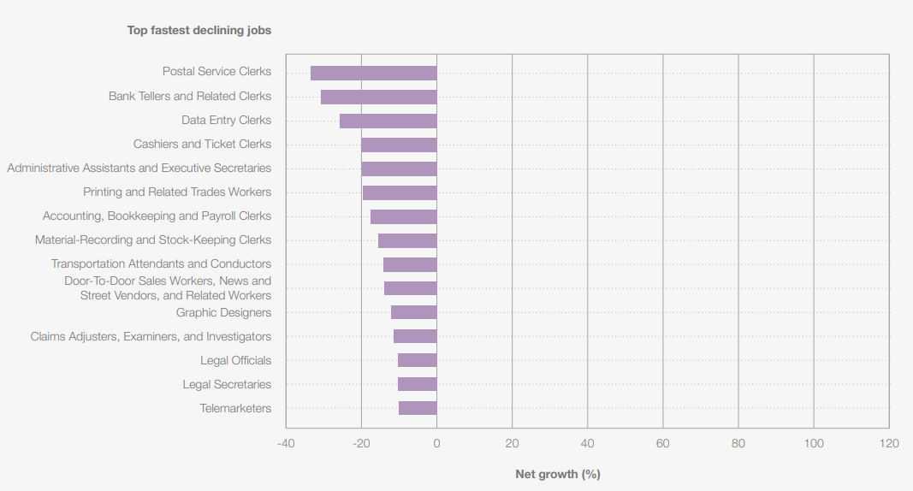
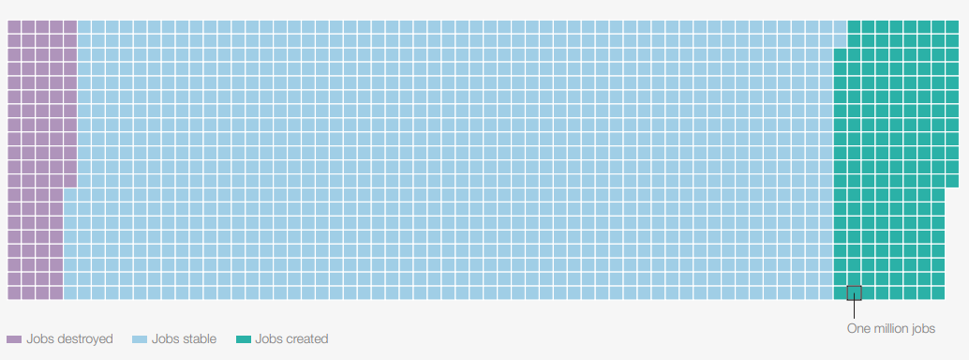

Slide 10
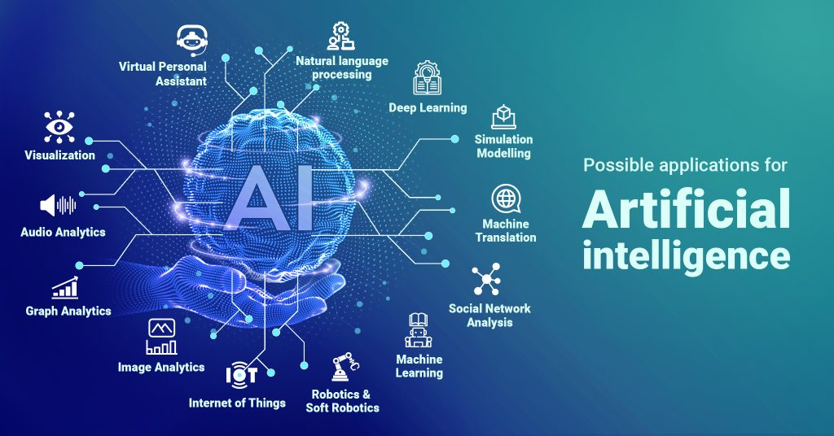

Slide 11
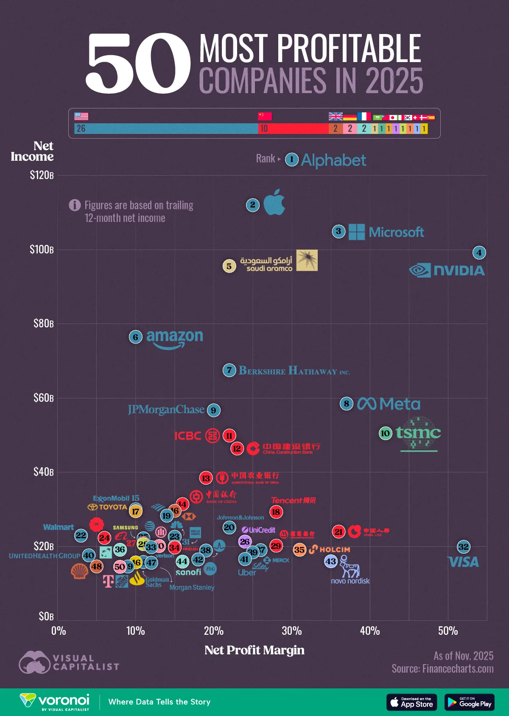
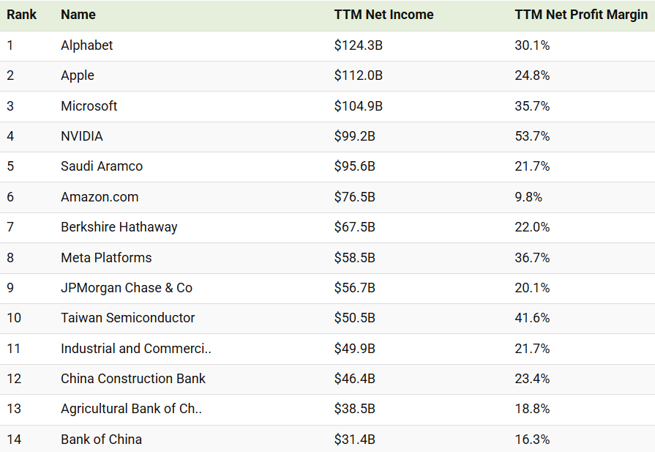

Slide 12
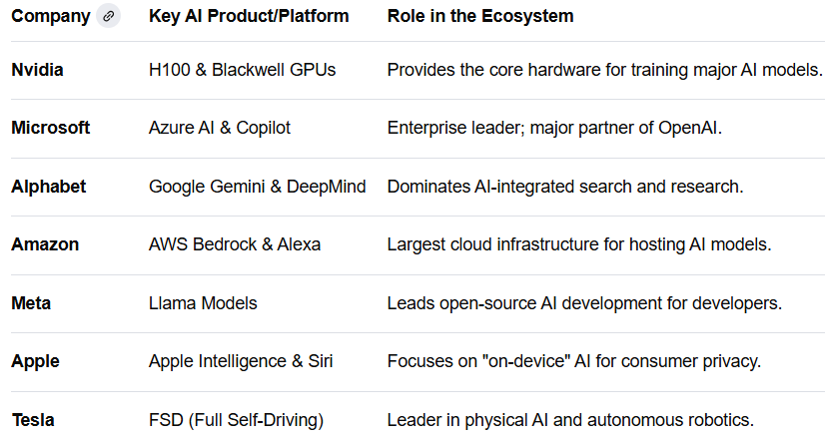
The „Big Seven”

Slide 13
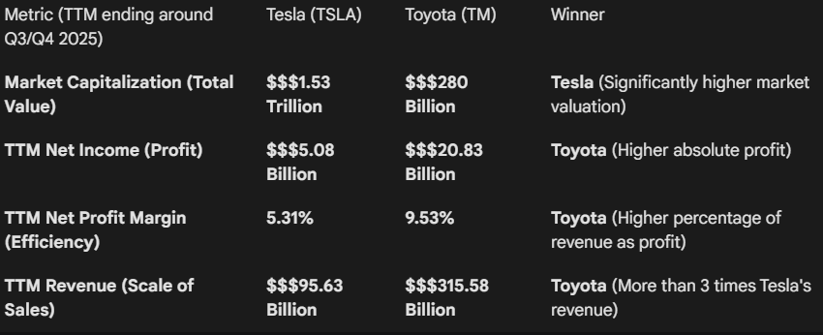
Tesla vs Toyota

Slide 14
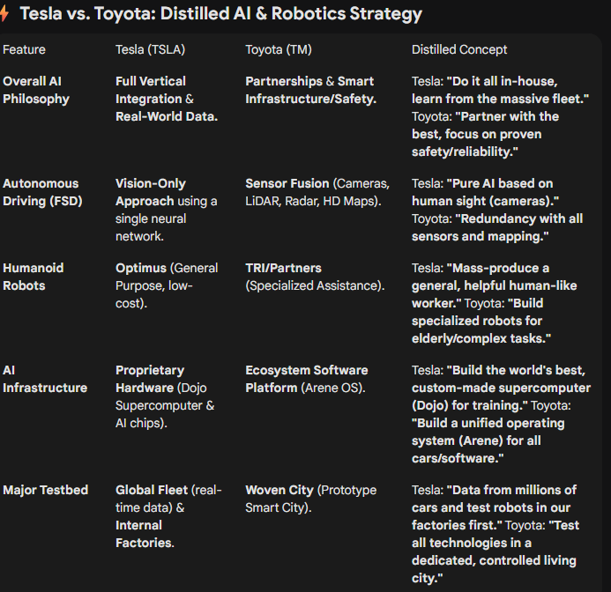
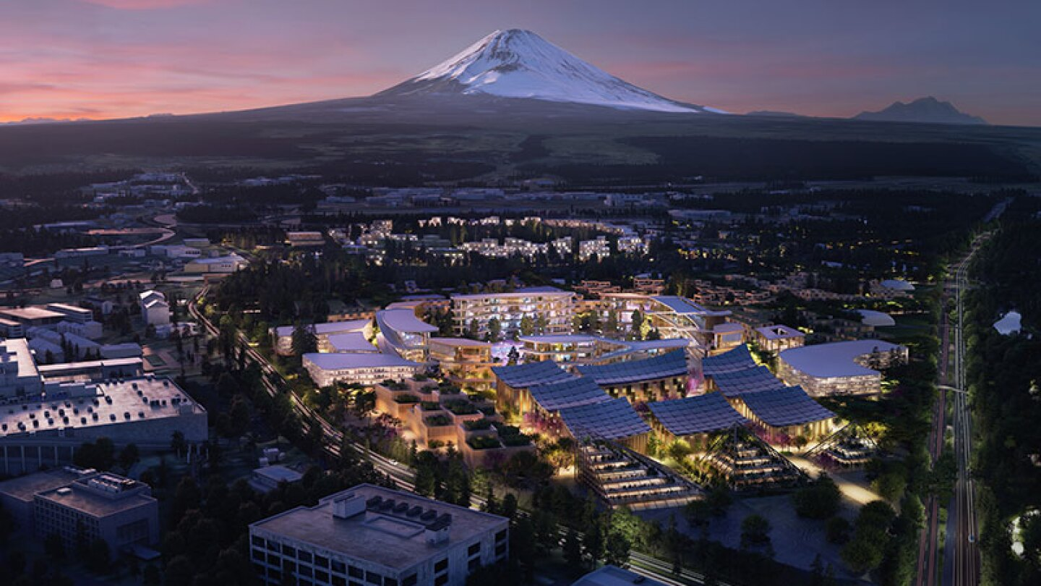

Slide 15
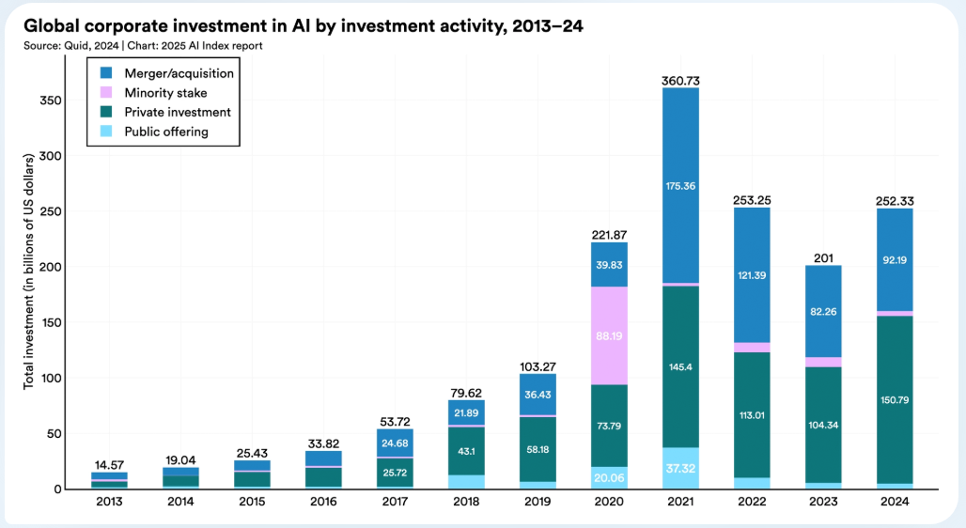
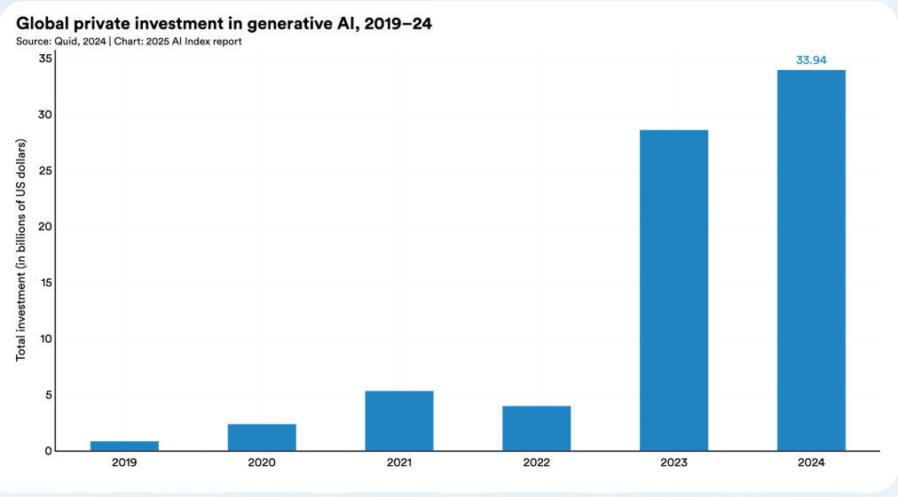
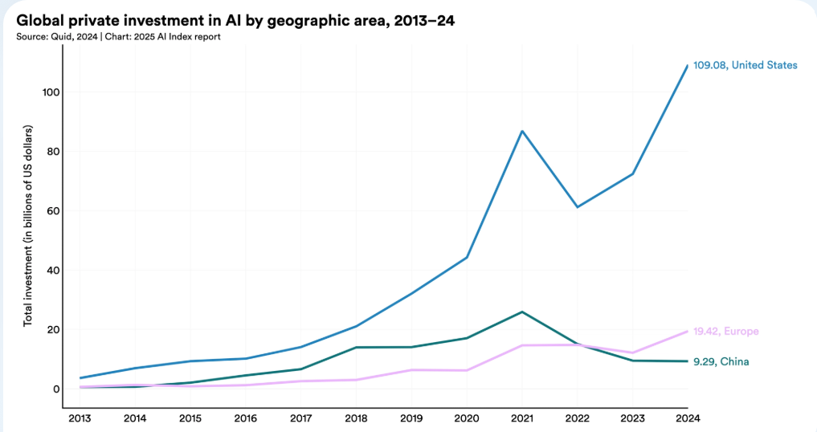
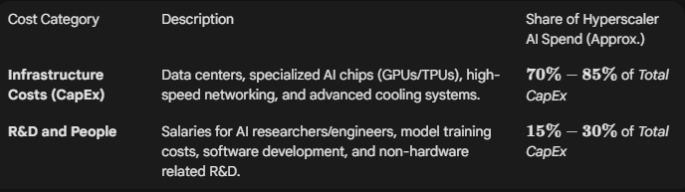

Slide 16
The Immense Economic Upside
Productivity Revolution: AI is projected to increase global GDP by trillions of dollars over the next decade, primarily by significantly boosting labor productivity (automating routine tasks and augmenting human work).
McKinsey estimates AI could deliver an additional $13 trillion in economic output by 2030.
Operational Efficiency: AI automates complex processes, streamlines logistics (like Amazon's warehouses), reduces human error, and provides deep predictive analytics. This translates directly to cost reduction and higher profit margins.

Slide 17
The "Winner-Take-All" Competitive Race
The Tech Arms Race: Major U.S. Hyperscalers (Google, Microsoft, Amazon, Meta) view AI as the next foundational technology shift. They believe that whoever dominates the best foundational models and the largest computing power will control the future of the internet, cloud computing, and enterprise software.
Fear of Being Left Behind (FOMO): No major corporation can afford to fall behind its competitors in AI adoption. If one company builds a superior AI model or platform, it could attract all the major clients, making it an existential threat to rivals. This forces aggressive CapEx (Capital Expenditure) spending, often ahead of proven revenue.
Securing the Supply Chain: The bottleneck is the physical infrastructure. Companies are racing to secure scarce resources like advanced chips (GPUs), power contracts, and data center land years in advance to ensure they have the "compute" required for future models.

Slide 18
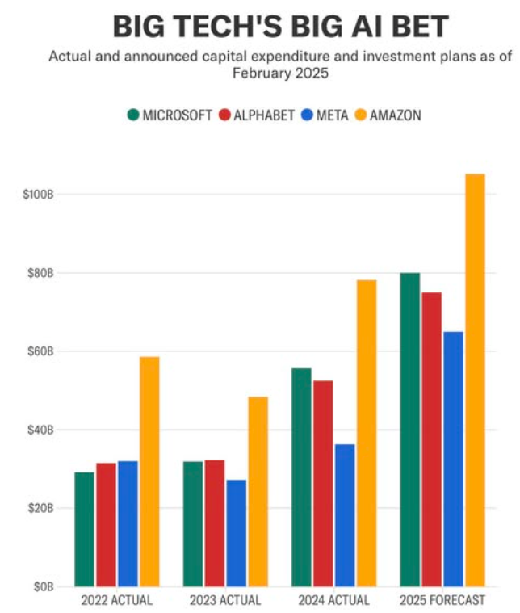
AI War
The Compute Race
The Power Struggle
Open vs. Closed Data
The Talent Drain

Slide 19
The Compute Race
"We are no longer building data centers; we are building AI factories. The input is electricity, and the output is intelligence." — Jensen Huang, NVIDIA CEO.

Slide 20
The Compute Race
NVIDIA Corporation holds a dominant share of the AI chip market, estimated at 85% to 90% for data center GPUs,
Google's Tensor Processing Units (TPUs) power services like Search and Gemini AI models.
AWS developed Inferentia chips for AI inference and Trainium for AI model training.
Microsoft introduced its custom Azure Maia AI Accelerator and Cobalt CPU in late 2023 for internal cloud-based AI workloads, such as Microsoft Copilot.
The in-house chip initiatives of Google, Amazon, and Microsoft reduce the hyperscalers' dependency on external purchases

Slide 21
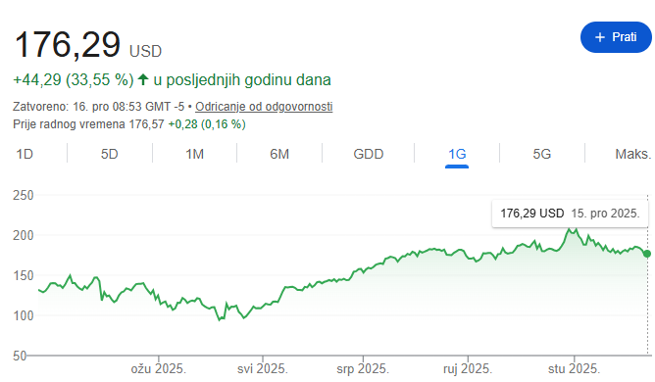
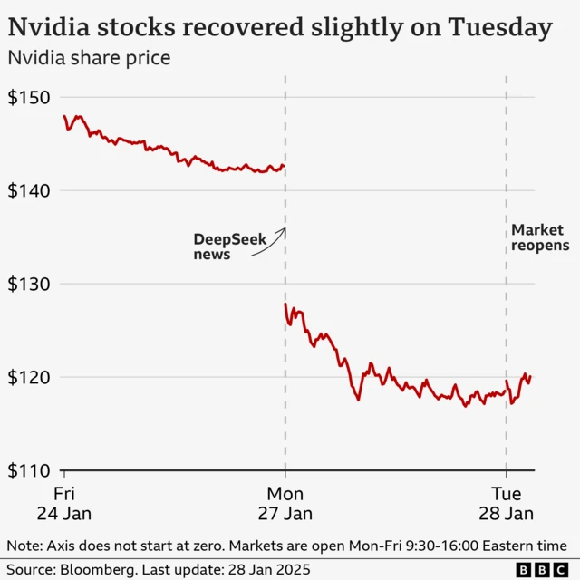

Slide 22
Is DeepSeek Still Relevant?
The 2024 View (Brute Force) | The late 2025 Reality (Efficiency)
"Spend to Win": Meta and Microsoft planned to buy millions more GPUs. | "Think to Win": Companies now prioritize algorithmic efficiency over just adding more chips.
NVIDIA Monopoly: NVIDIA was the only game in town for training. | The "Silicon Hedge": Big Tech is racing to build custom chips (Maia, TPU v6) to run DeepSeek-style "efficient" models.
Closed Source: Powerful AI was a secret held by OpenAI. | Open Source Pressure: Meta (Llama 4) and DeepSeek have forced OpenAI to release cheaper "Mini" models.

Slide 23
Interference
If AI were a human employee, Training is their years of schooling, and Inference is every single day they spend at the office doing work.
Training: You feed a model trillions of words so it can learn patterns (this happens once and costs billions).
Inference: A user asks a question, and the model "infers" the answer based on what it learned. This happens every time you hit "Enter" on ChatGPT.

Slide 24
Why Inference is the Real "AI War"
Feature | Training | Inference
Frequency | Once every few months. | Billions of times per day.
Cost Type | "CapEx" (One-time investment). | "OpEx" (The monthly utility bill).
Hardware | High-end NVIDIA GPUs (H100/B200). | Custom "Inference Chips" (Maia, TPU, Trainium).
Goal | Intelligence & Accuracy. | Speed (Latency) & Cost-per-Token.

Slide 25
The Power Strugle
Traditional servers draw 6-12 kW per rack, AI-optimized facilities demand 50-100 kW per rack, with cutting-edge configurations exceeding 200 kW.
MIT research demonstrates that running a single large AI model consumes equivalent energy to 120 U.S. homes annually.
Model training amplifies this challenge because it’s non-linear and unpredictable, requiring infrastructure capable of sustained peak loads without performance degradation.
McKinsey analysis reveals the fundamental tension: data center construction requires 18-24 months while power infrastructure development demands 3-7 years for generation and up to 10 years for transmission.

Slide 26
The Power Strugle
Cooling represents ~30–40% of data center energy use and is significantly higher in AI facilities.
Liquid cooling can cut cooling energy consumption by up to 30% versus air cooling.
AI training relies on thousands of synchronized GPUs, where outages cause major computational and financial losses.
This drives the need for fully redundant power, large-scale UPS, and instant multi-MW backup generation.
Solar plus battery storage is emerging as a viable primary power source for always-on AI facilities.

Slide 27
The Power Strugle
Strategy | Key Move | Strategic Goal
The Nuclear Pivot | Microsoft + Three Mile Island | Microsoft is footing the bill to restart the Three Mile Island nuclear plant (now Crane Clean Energy Center) to secure 100% of its power for 20 years.
SMR Innovation | Google + Kairos Power | Google signed a deal for a fleet of Small Modular Reactors (SMRs). These are "mini-nuclear" plants built on-site to keep data centers independent of the public grid.
Direct Co-location | Amazon + Talen Energy | Amazon bought a data center directly connected to the Susquehanna nuclear plant. They are "plugging in" directly to the source to bypass grid congestion.
The Grid Buyout | Meta + Constellation | Meta signed a massive deal to save a nuclear plant in Illinois from closing, essentially "buying" the plant's future output to guarantee their AI training never stops.

Slide 28
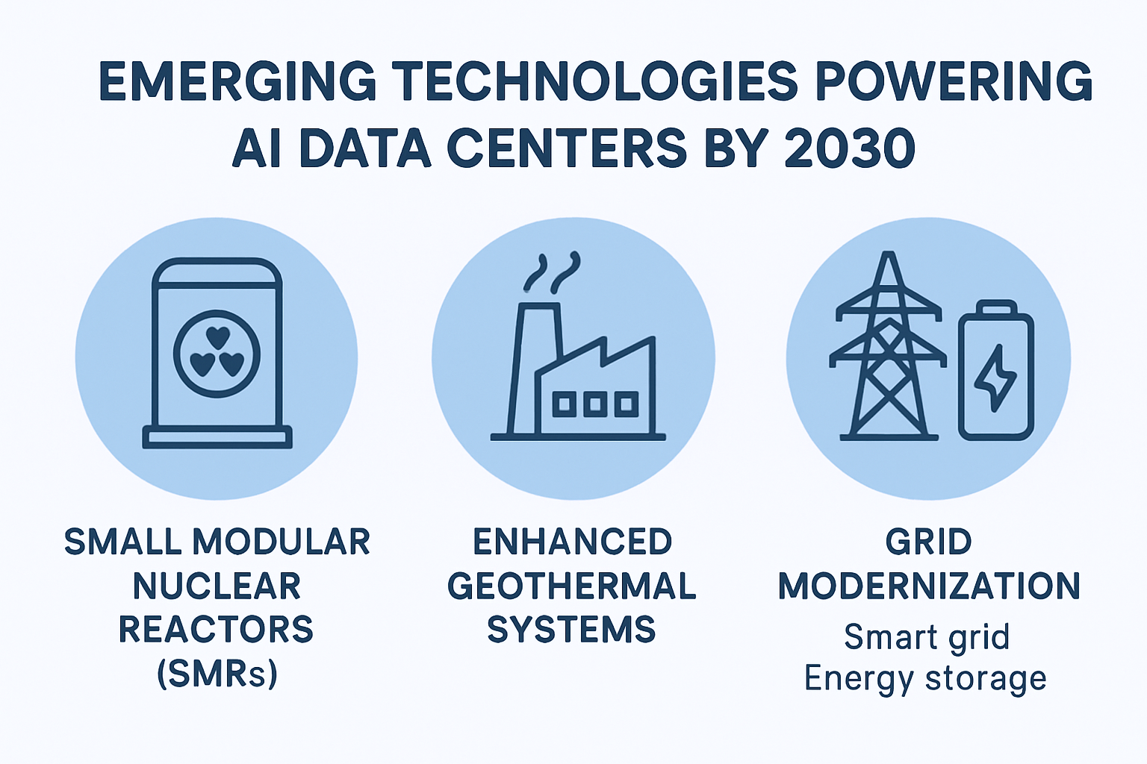

Slide 29
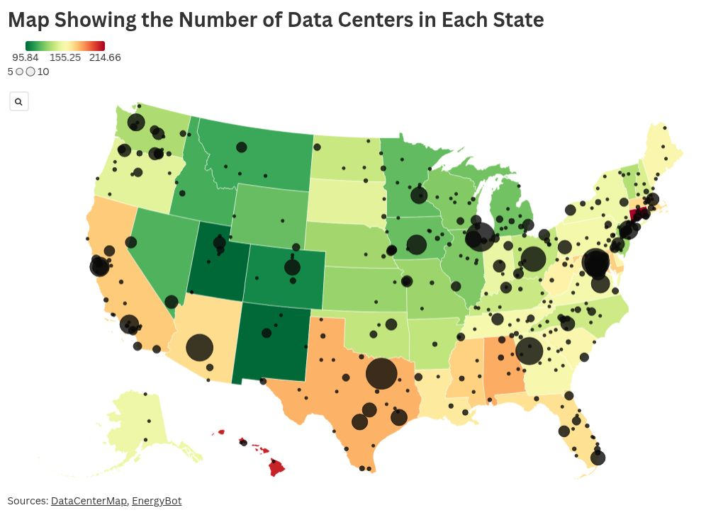
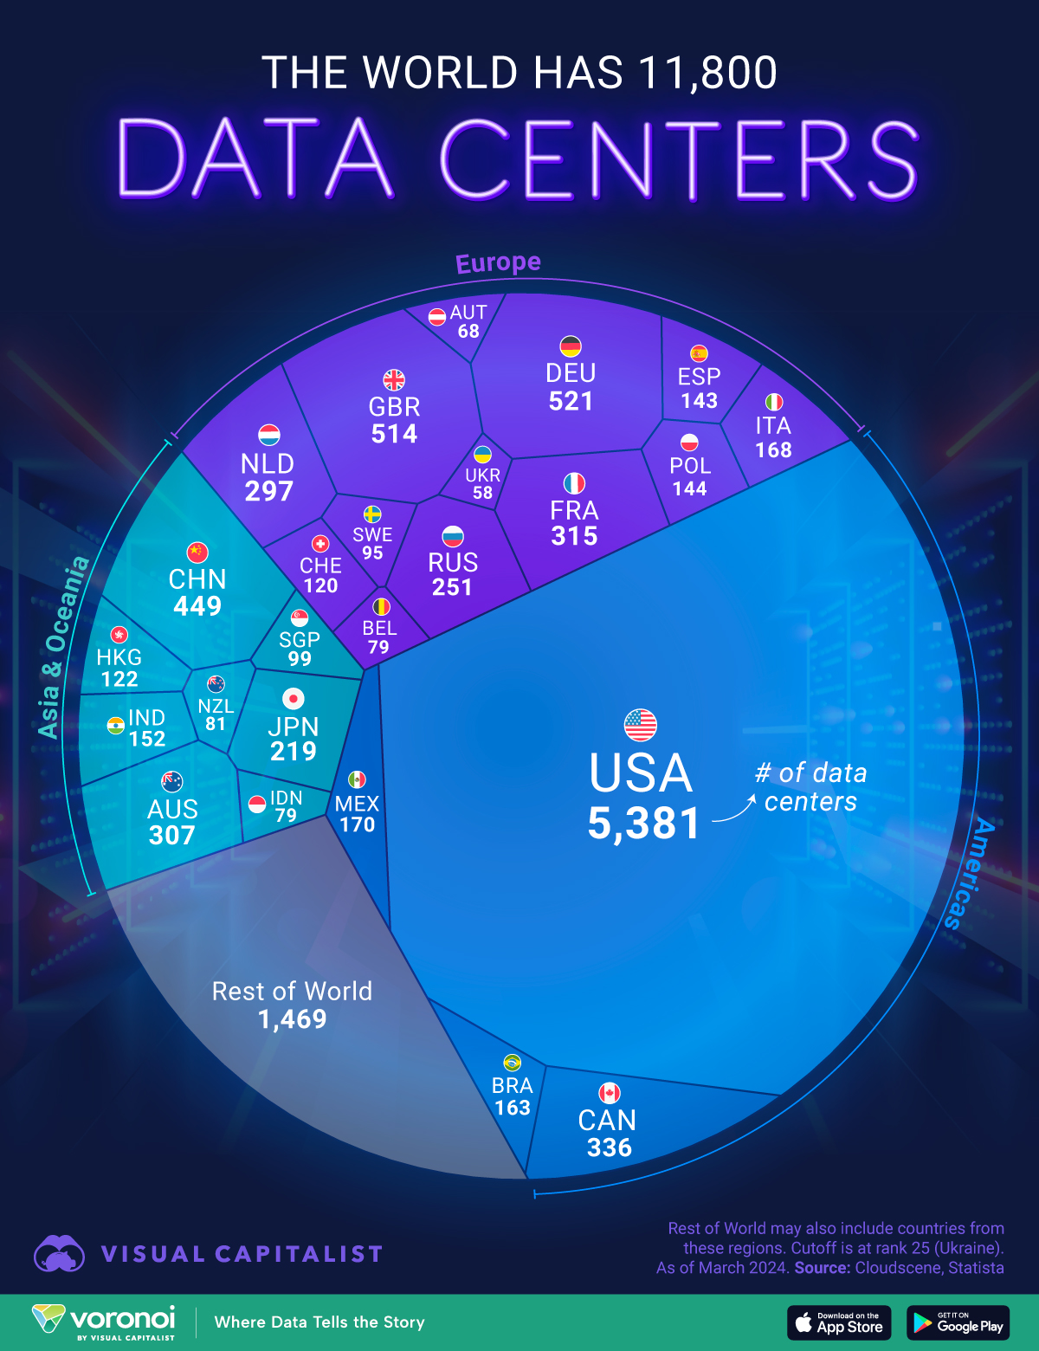

Slide 30
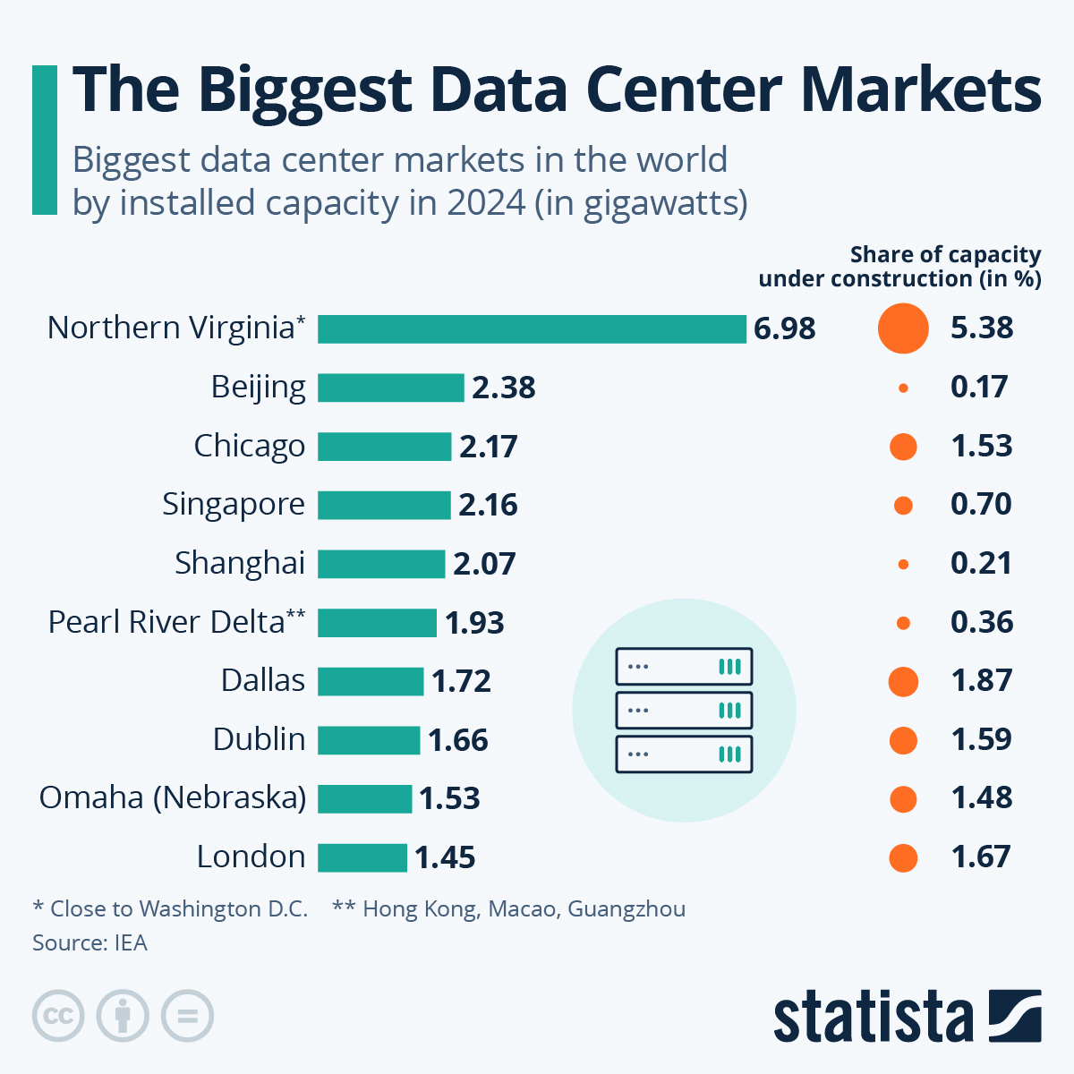
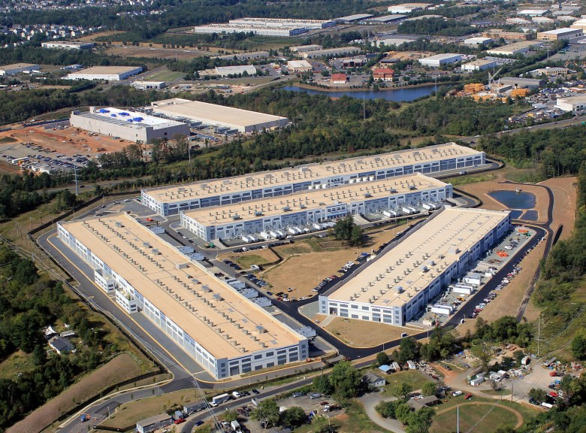
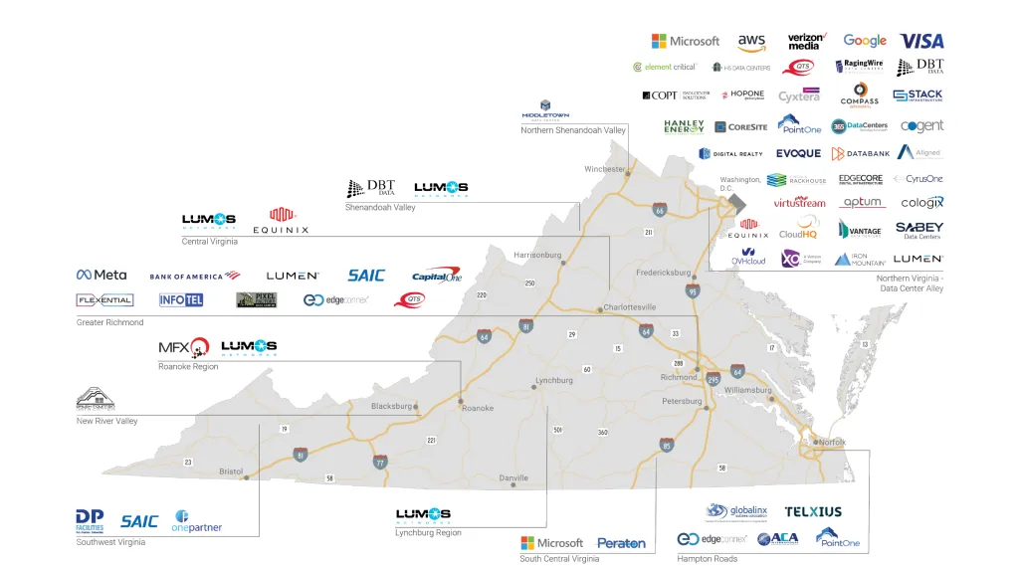

Slide 31
Stargate Project
Goal: To build the physical and digital infrastructure, including supercomputers with millions of GPUs, necessary to power next-generation artificial intelligence and position the U.S. as a leader in the global AI race.
Key Partners: A joint venture (Stargate LLC) between OpenAI, SoftBank, Oracle, and the Emirati investment firm MGX. Key technology partners include Microsoft, NVIDIA, and Arm. SoftBank is responsible for financing, and OpenAI for operations.
Investment: The project plans to invest up to $500 billion over four years, starting with an initial $100 billion.

Slide 32
Stargate project
OpenAI,40%,"Strategic Architect: Oversees operations, model alignment, and site selection. Ensures the hardware is built specifically for ""Reasoning"" models (o1/o3)."
SoftBank Group,40%,"Lead Financier: Handles the $100B+ initial fundraising, debt syndication, and global supply chain logistics."
Oracle,12%,"Infrastructure Backbone: Provides the OCI (Oracle Cloud Infrastructure) virtualization layer and database systems. Acts as the primary landlord for the ""Stargate campuses.""
MGX (UAE),8%,"Strategic Capital: Provides sovereign liquidity and international expansion support. Facilitates the ""Stargate UAE"" node in Abu Dhabi."

Slide 33
Element | The "Playbook" | Key Players | Strategic Goal
1. The Walled Garden (Closed) | Utilizing exclusive, massive user-generated content from their own ecosystems that competitors cannot access. | Meta, Google, Apple | To use "private" human interactions (Instagram posts, YouTube videos, iMessage context) to create models with unique personality and context.
2. The Licensed Feed (Paid) | Establishing multi-million dollar "tollbooth" agreements to legally ingest the most recent human thoughts and news. | OpenAI, Reddit, News Corp | To avoid legal "scraping" battles and ensure the AI remains current by training on high-quality, real-time data from publishers.
3. The Open Frontier (Public) | Leveraging ultra-efficient training techniques to squeeze maximum intelligence out of the remaining free, public web data. | DeepSeek, Mistral | To prove that "Shoestring AI"—training models at a fraction of the cost—can match the giants by using better math rather than more data.
4. The Synthetic Solution (AI-Generated) | Using current AI models to generate billions of "clean" data points to train the next generation of models. | NVIDIA, Anthropic | To solve the "Data Drought" by creating simulated worlds (for robotics) or perfectly logical reasoning chains that humans haven't written yet.

Slide 34
Open vs. Closed Data
Data Scarcity: Because the public internet is "exhausted" (everything useful has already been scraped), the value of Element 1 (Closed) and Element 2 (Paid) has skyrocketed.
Model Collapse: The danger in Element 4 (Synthetic) is "AI Inbreeding." If models only learn from other AI, they risk losing the nuance and "soul" of human logic, which is why Project Stargate is investing so heavily in massive compute to process the most complex data possible.

Slide 35
The Talent Drain
In August 2025, Elon Musk’s AI company, xAI, filed a federal lawsuit in California against Xuechen Li, a former star engineer who left to join OpenAI. This case has become the "standard" for how Big Tech now handles talent poaching
Xuechen Li, a Stanford PhD and one of xAI's first 20 hires.
xAI claims Li "willfully and maliciously" stole confidential data, including Grok’s source code, before leaving.
Li had received $7 Million in stock options at xAI; the lawsuit seeks to claw back these funds and block his employment at OpenAI.

Slide 36
The Talent Drain
The $10M Offer: By late 2025, the industry "signing bonus" for top-tier AI researchers has reached $5M to $10M. Musk is using this lawsuit to send a message to other employees: If you leave for a rival, you will face a million-dollar legal battle
Source Code is the new Nuclear Secret. Companies are no longer just competing on features; they are using the legal system to "lock-in" talent and prevent the migration of technical breakthroughs.

Slide 37
Apple & Google
Apple pays Google to use its 1.2 Trillion parameter Gemini model to power Siri's advanced planning
Gemini will handle complex queries, summaries, and scheduling that Apple’s in-house models still can't perform.
Unlike Google phones, Gemini on iPhone runs on Apple’s own servers. Google never sees the user data.
Apple avoids using the ""Gemini"" name in marketing to maintain the illusion that ""Apple Intelligence"" is entirely in-house."
Apple plans to offer Gemini alongside ChatGPT and Claude, letting users choose their ""brain"" to avoid antitrust lawsuits."

Slide 38
Apple & Google
Apple realized in mid-2025 that their 150B parameter models were getting "schooled" by Gemini and GPT-5. By "renting" Google's brain for $1B, they stay competitive while they race to build their own 1T parameter model for 2027
For Google, this isn't about the $1B (which is a fraction of what they pay Apple for Search). It’s about data and dominance. If Gemini is the default "brain" for 1.5 billion iPhone users, it becomes the global standard over OpenAI.
Apple has "sandboxed" Google. Gemini provides the logic, but Apple holds the keys to the personal data. This prevents Google from using iPhone users to train their own future models.

Slide 39
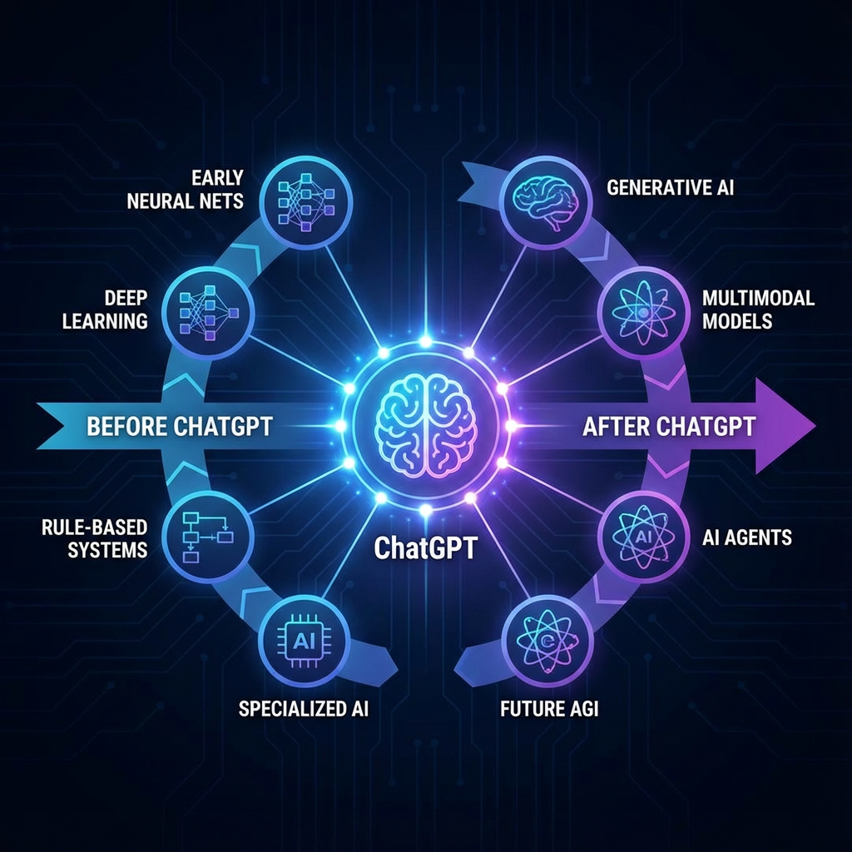
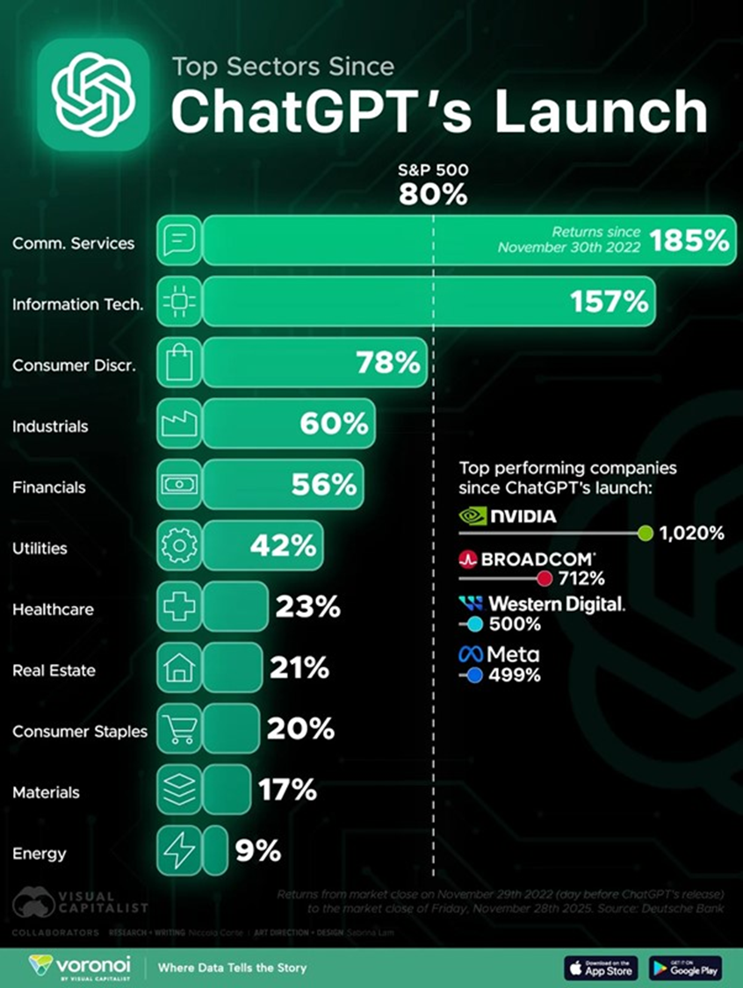

Slide 40
What Is Intelligence?
Lat. intelligere - understand, comprehend
Intelligence is a descriptive concept - it describes certain properties of an individual or a group of individuals
There is no consensus on the definition of intelligence
Most definitions include concepts such as abstract reasoning, understanding, self-consciousness, communication, learning, planning, and problem solving
Notes:
.

Slide 41
What is Artificial Intelligence
"the science and engineering of making intelligent machines"
"The study of the computations that make it possible to perceive, reason, and act."
"AI is the science of making machines do things that require intelligence if done by men."
"A branch of the computer science concerned with the study and creation of computer systems that exhibit some form of intelligence: systems that learn new concepts and tasks, systems that can reason and also draw useful conclusions about the world around us, systems that can understand the various natural languages and perceive and comprehend a visual scene and systems that perform other types of feats that essentially require human types of intelligence."

Slide 42
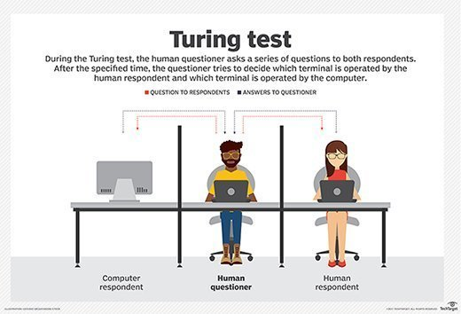

Slide 43
1956: “Artificial Intelligence”
The term was invented in (John McCarthy, Marvin Minsky, Nathaniel Rochester, and Claude Shannon, “A Proposal for the Dartmouth Summer Research Project on Artificial Intelligence,” August 1955):
“We propose that a 2-month, 10-man study of artificial intelligence be carried out during the summer … An attempt will be made to find how to make machines
use language,
form abstractions and concepts,
solve kinds of problems now reserved for humans
improve themselves.”

Slide 44
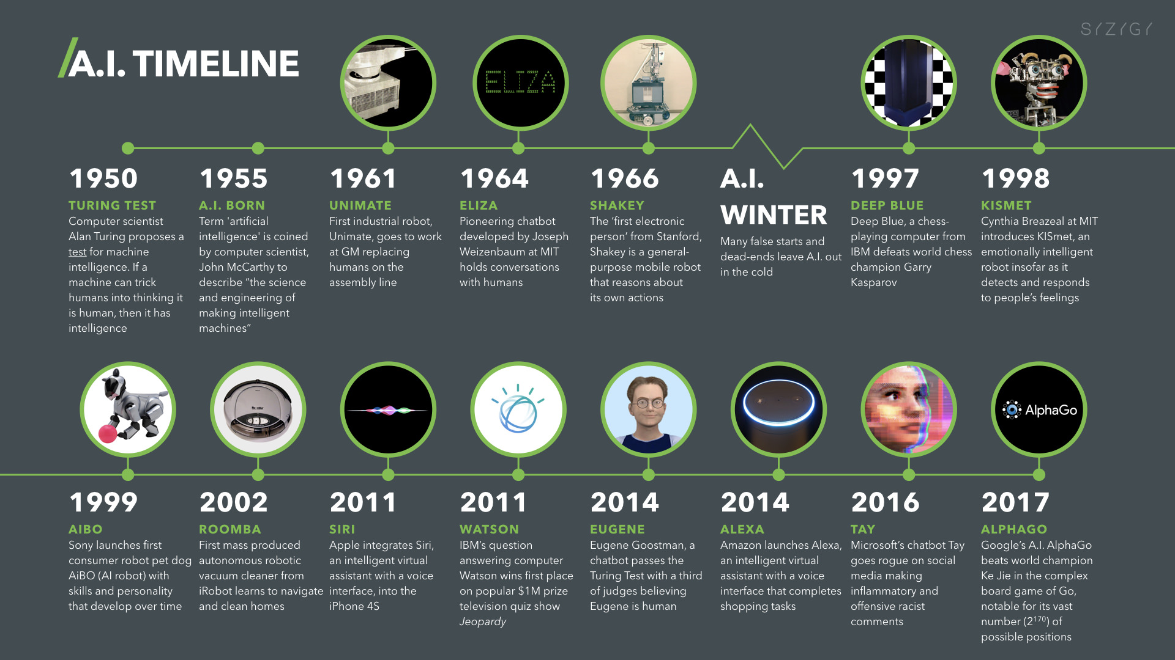

Slide 45
So, can machines think?
We don't know, but we know we can build machines that perform tasks that require intelligence: control complex processes, solve complex problems, make decisions, reason, use natural language, recognize visual objects . . .

Slide 46
Major Types of AI
Expert systems
Machine learning
Neural networks and deep learning networks
Genetic algorithms
Natural language processing
Computer vision
Robotics

Slide 47
Expert Systems
The premise of expert systems was straightforward — aim to capture all the domain-specific knowledge in a particular field, encode it into a computer program, add an interface to query the system, and you have a computer-brained ‘expert’ readily available.
Capture tacit knowledge in very specific and limited domain of human expertise
Capture knowledge as set of rules
Typically perform limited tasks
Diagnosing malfunctioning machine
Determining whether to grant credit for loan
Used for discrete, highly structured decision making
Knowledge base: Set of hundreds or thousands of rules

Slide 48
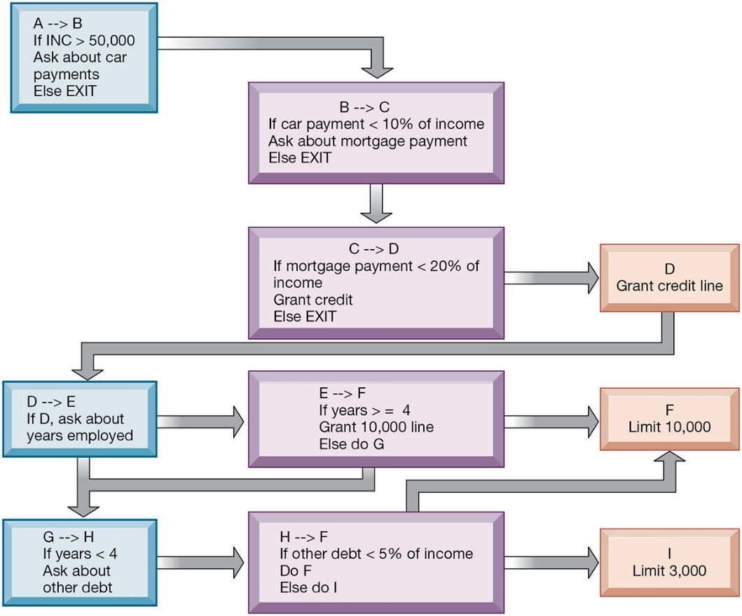
Rules in an Expert System

Slide 49
Expert Systems trends
Integration with Other AI Technologies: Modern expert systems often integrate with other AI technologies like machine learning and natural language processing to enhance their capabilities.
Transition from Rule-Based to Data-Driven: Traditional expert systems were heavily rule-based, relying on a set of hardcoded rules. Contemporary systems often incorporate data-driven AI techniques to adapt and learn from new data.
User Interface Improvements: Modern expert systems feature more user-friendly interfaces, making them accessible to a wider range of users.
Cloud Computing and Big Data: The rise of cloud computing and big data analytics has expanded the capabilities and applications of expert systems.

Slide 50
ES Challenges
Keeping Knowledge Current: One challenge of expert systems is ensuring that their knowledge base remains up-to-date with the latest information and trends in their respective fields.
Complexity and Maintenance: Developing and maintaining an expert system can be complex and resource-intensive.

Slide 51
Machine Learning
Machine learning is programming computers to optimize a performance criterion using example data or past experience.
We have a model defined up to some parameter, and learning is the execution of a computer algorithm to optimize the parameters of the model using the training data or past experience.

Slide 52
Prediction
Based on seen data, the model should be able to predict properties of new, unseen data
Otherwise said, the model should be able to generalize
From a logical perspective, what the model does is induction: based on a limited sample of data, the model infers a general rule how the data behave
Aim of machine learning: build models that generalize well!

Slide 53
Why ML?
Problems that are too hard to be solved algorithmically - we have no idea how to solve them, because we don't really know how we do it ourselves (e.g., speech recognition)
Dynamically adaptable systems - e.g., robots, adaptable user interfaces
Vast amounts of data - vast data is out there, can we tap on the knowledge that it contains?
data science, big data, data mining
Not all problems deserve an ML solution. Do not use a cannon to kill a fly?

Slide 54
Machine Learning
Supervised learning
Data is labeled and comes in pairs (input, output)=(x; y). We need to find a mapping f(x) = y
Classification (example: Security software (Email, AV), regression (house prices)
Unsupervised learning
Data comes without labels. We need to find regularities in the data.
Clustering, novelty/outlier detection
Reinforcement learning
Learning an optimal strategy based on trials with a delayed reward

Slide 55
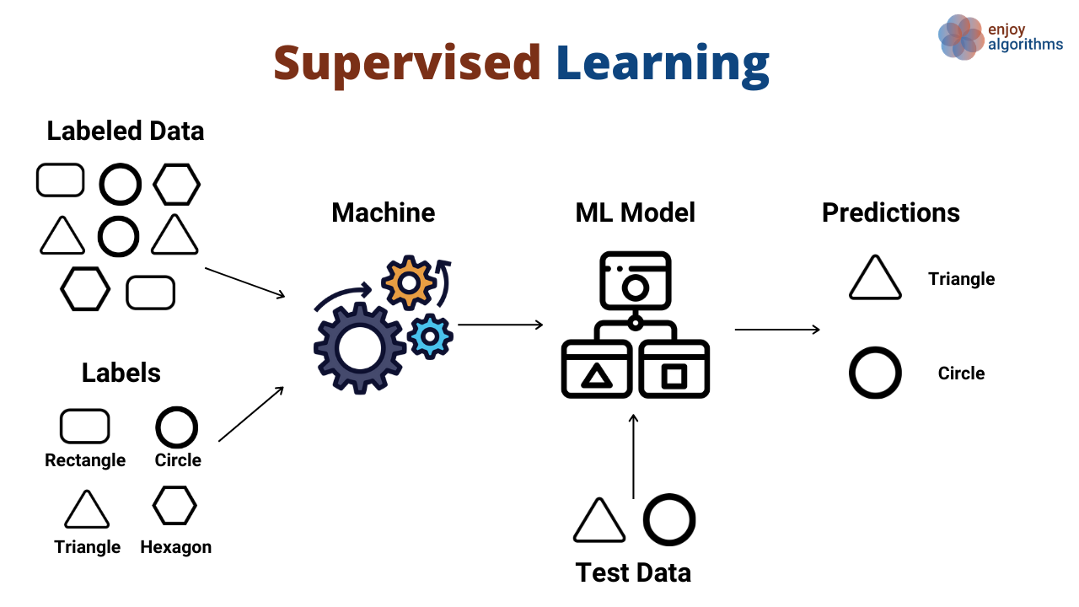

Slide 56
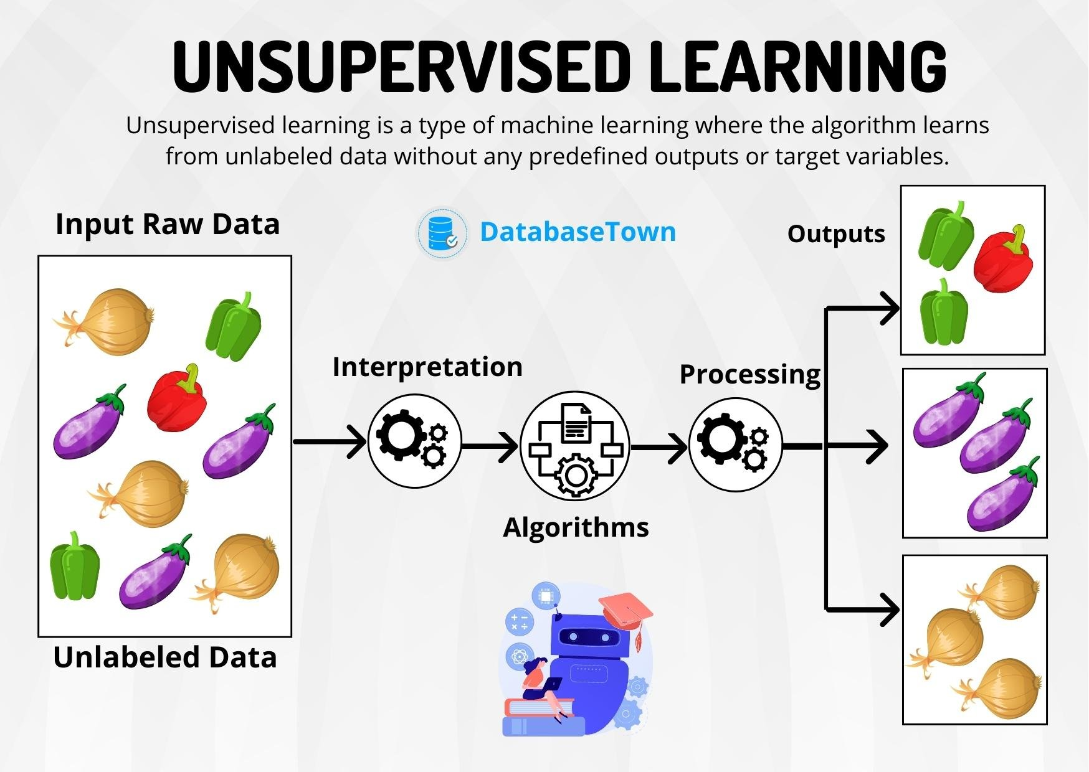

Slide 57
Reinforcement learning
A way of training an AI by using a system of rewards and punishments—much like how you might train a dog or how a human learns to play a video game.
Exploitation: Doing what it already knows works to get a guaranteed reward.
Exploration: Trying something totally new to see if there is an even bigger reward hidden somewhere else.
Self-Driving Cars: They get "rewards" for staying in the lane and "penalties" for getting too close to other cars.
Reinforcement Learning from Human Feedback (RLHF)

Slide 58
Why Humans are Essential
Subjectivity: Computers can't define "politeness" or "humor" with math.
The Feedback Loop:
Action: AI provides a response.
Environment (Human): Evaluates based on intent, safety, and tone.
Reward: A high score for helpfulness; a low score for being harmful or robotic.
Safety: Prevents the AI from giving dangerous instructions (e.g., how to build a bomb,…).
Factuality: Reduces "hallucinations" (making things up).

Slide 59
Negative aspects
Safety Training (RLHF): To teach an AI to refuse to generate a deepfake or a violent image, a human teacher must first look at examples of that content to label it as "harmful."
The AI cannot learn what is "bad" unless a human defines it first.
Massive amount of this work is outsourced to countries like Kenya, the Philippines, and India
In many of these regions, there are fewer legal protections or mental health requirements. This allows companies to process massive amounts of "toxic" data quickly

Slide 60
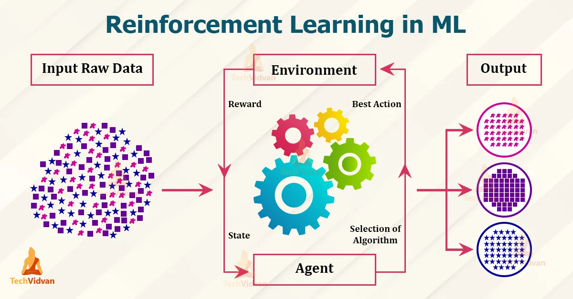

Slide 61
Neural Networks
Find patterns and relationships in massive amounts of data too complicated for humans to analyze
“Learn” patterns by searching for relationships, building models, and correcting over and over again
Humans “train” network by feeding it data inputs for which outputs are known, to help neural network learn solution by example from human experts
Used in medicine, science, and business for problems in pattern classification, prediction, financial analysis, and control and optimization

Slide 62
Deep learning: The current big thing in ML
Combines cleverly engineered artifcial neural networks and large amounts of data
We have had neural networks before, but today we also have:
Much faster computer architectures (GPU SIMD)
Much more data
Reaches state-of-the-art results on a broad range of machine learning tasks
Example: Autonomous vehicles

Slide 63
ChatGPT
ChatGPT (Chat Generative Pre-trained Transformer) is a large language model-based chatbot developed by OpenAI and launched on November 30, 2022, that enables users to refine and steer a conversation towards
Model is fine-tuned to target conversational usage.
The fine-tuning process leveraged both supervised learning as well as reinforcement learning in a process called reinforcement learning from human feedback
Both approaches employed human trainers to improve model performance. In the case of supervised learning, the trainers played both sides: the user and the AI assistant.

Slide 64
ChatGPT Statistics 2025
ChatGPT reached 1 million users in just five days after its launch.
Weekly Active Users: 800 million+ (as of December 2025).
Monthly Traffic: The platform recorded approximately 5.24 billion monthly visits globally.
Global Adoption: Nearly 10% of the world's adult population uses ChatGPT at least weekly.
Geography: The United States and India lead the world in visitor share, each accounting for roughly 16% of total traffic

Slide 65
Common Use Cases
Category Usage Percentage
Asking (Seeking advice/information) 49%
Practical Guidance 29%
Learning 26%
Entertainment 22%

Slide 66
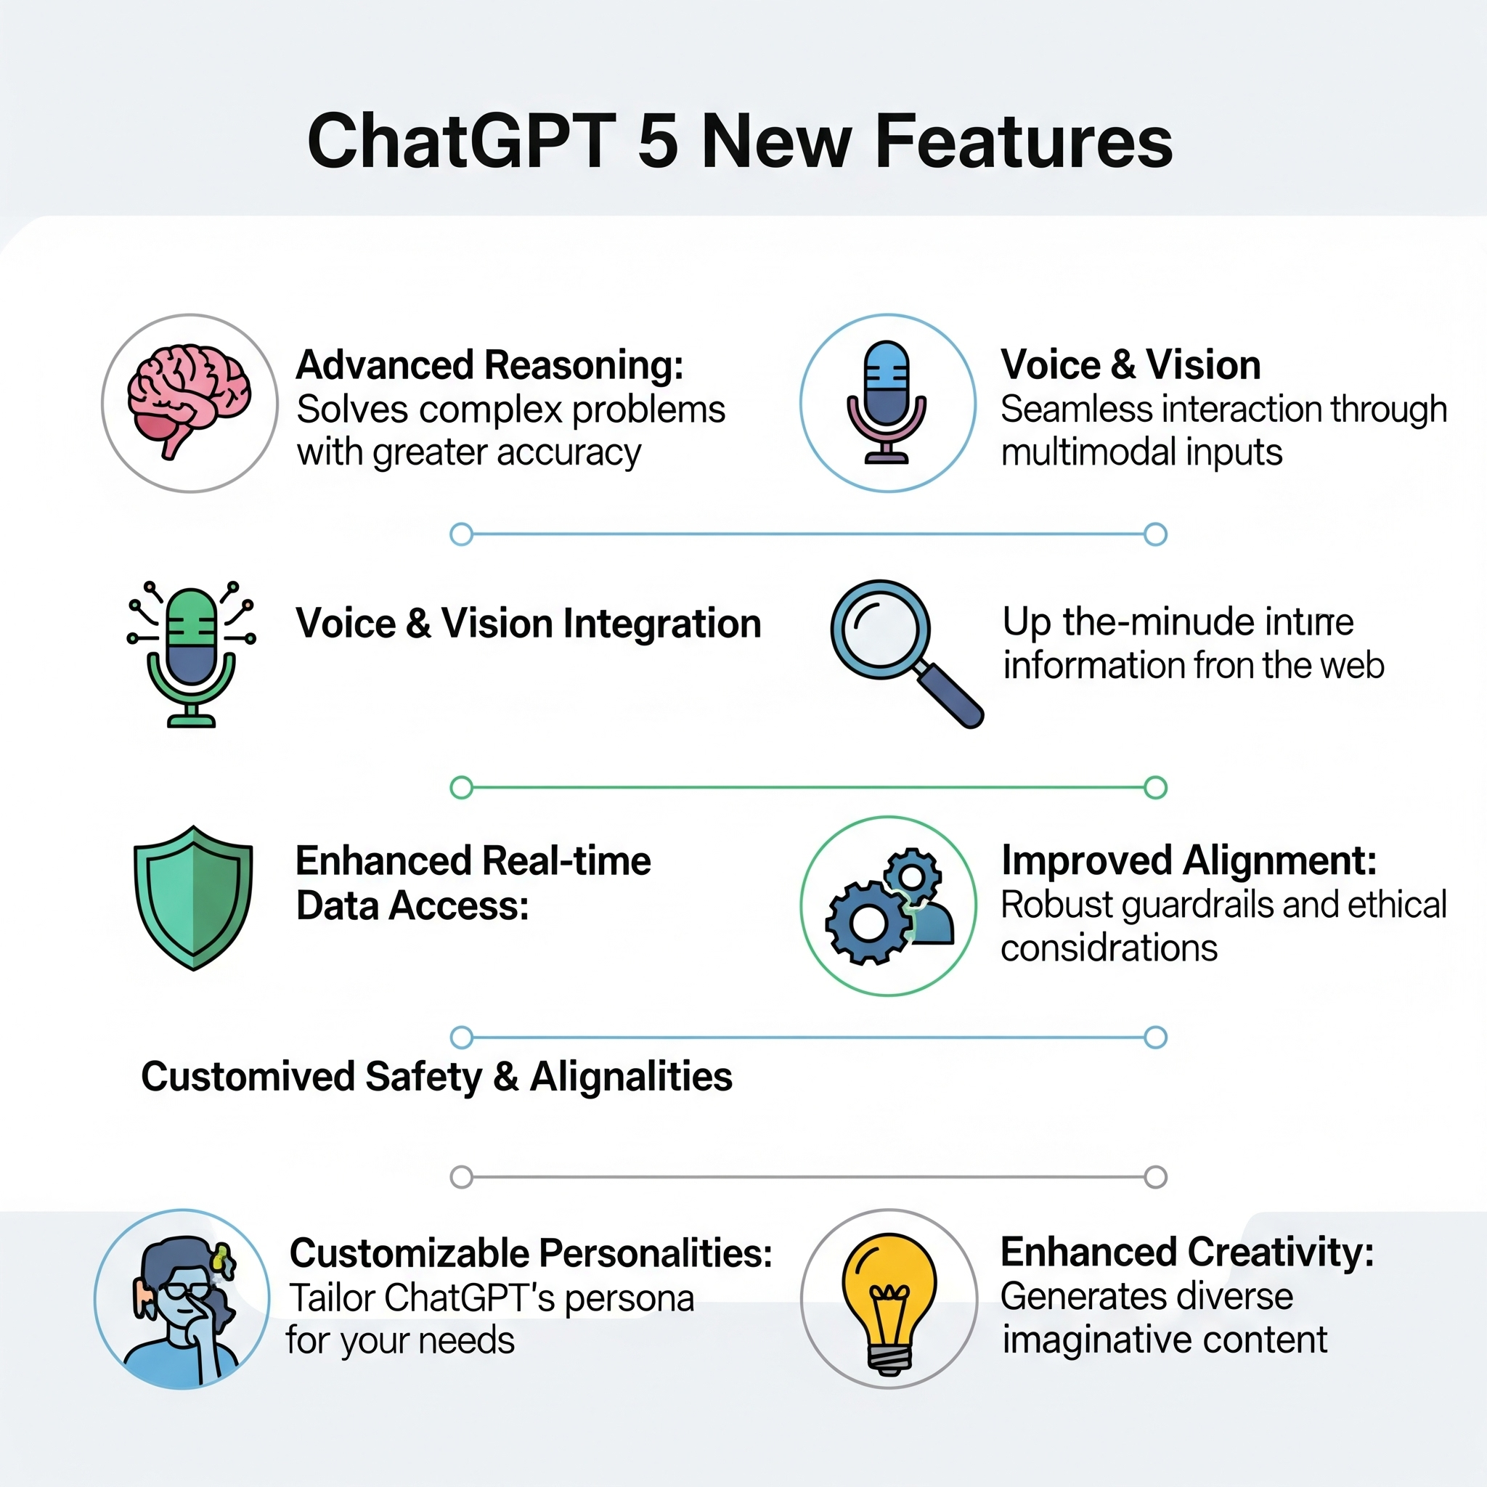

Slide 67
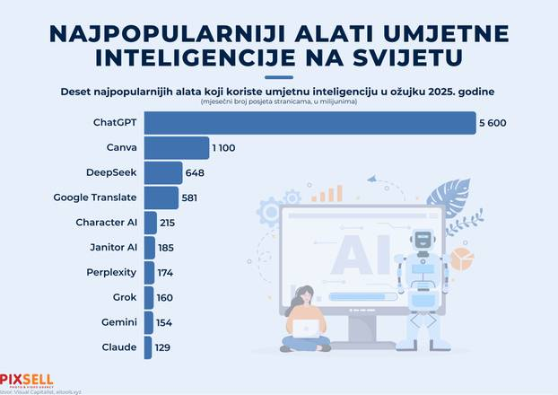
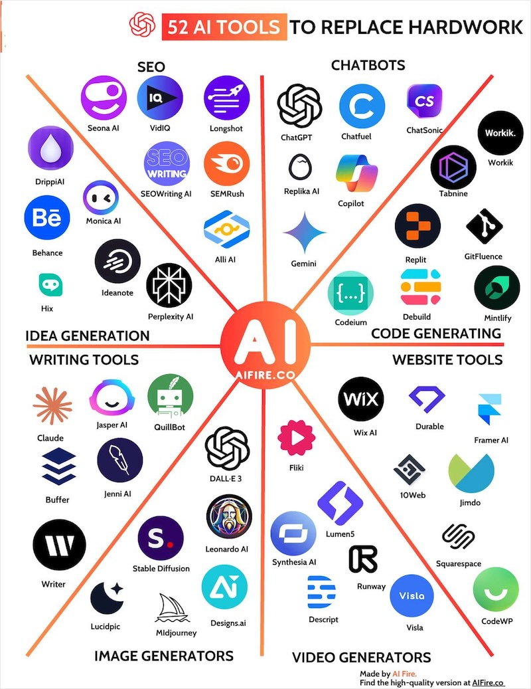

Slide 68
Category | Benchmark Example | What is Measured?
1. Language Understanding (NLP) | MMLU, SuperGLUE, HellaSwag | General knowledge, factual knowledge, reasoning capability, and common-sense logic.
2. Coding and Agentic Reasoning | HumanEval, SWE-Bench | The model's ability to solve programming problems, generate functional code, and fix bugs.
3. Hardware Performance | MLPerf | The speed of training (Time-to-Train) and the speed of inference (prediction) on various chips and systems. Measures hardware efficiency.
4. Visual Reasoning | ARC (AI2 Reasoning Challenge) | The model's ability to logically infer based on visual patterns and diagrams (abstract reasoning).

Slide 69
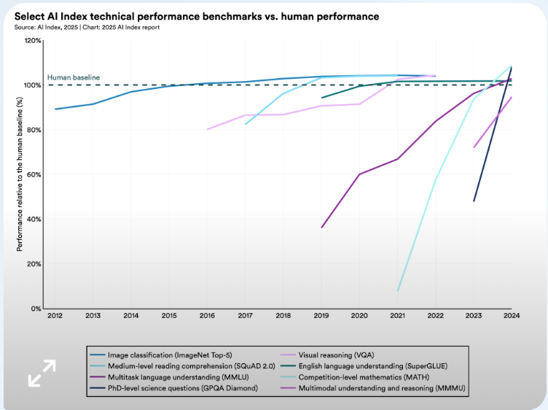

Slide 70
Humanity’s Last Exam (HLE)
HLE is one of the hardest AI benchmarks, designed to test deep reasoning and expert-level problem solving across multiple disciplines.
Top AI models score only ~25–40%, reflecting the extreme difficulty of the test, not poor model performance.
HLE highlights current limits of AI, clearly distinguishing advanced pattern recognition from true human-level reasoning.

Slide 71
Humanity’s Last Exam (HLE)
Gemini 3 Pro Preview: ~37.5 % accuracy
GPT-5 Pro: ~31.6 %
Claude Opus 4.5: ~25 %
AI is highly capable but still significantly below expert human reasoning on the most complex intellectual problems.
Progress is fast but incremental — gains are measured in single-digit percentage points

Slide 72
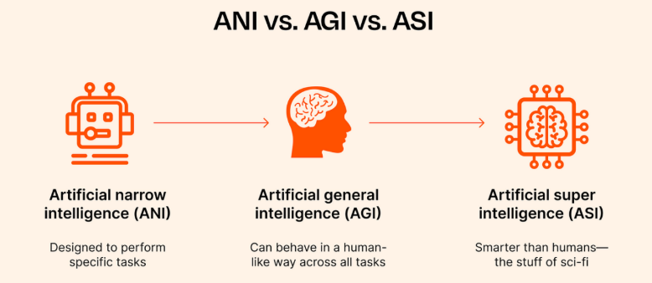

Slide 73
Acronym | Full Name | Capability | Analogy
ANI | Artificial Narrow Intelligence | Specialized: Excels at a single task or a narrow set of tasks, operating within pre-defined parameters. It lacks generalization and consciousness. | The Line Cook—excellent at one recipe, but cannot run the whole restaurant.
AGI | Artificial General Intelligence | Human-Level: A hypothetical AI capable of performing any intellectual task a human can do. It can reason, learn, adapt, and apply knowledge across different domains. | The Michelin-Starred Chef—can cook any cuisine, manage staff, and run the business.
ASI | Artificial Superintelligence | Superhuman: A hypothetical AI that is significantly more intelligent than the smartest human in every conceivable domain, including creativity, general wisdom, and problem-solving. | A Super-Intelligent Alien Chef—can optimize the entire global food supply chain, solve world hunger, and create unimaginable dishes.

Slide 74
Conclusion
The AI revolution is no longer a future possibility but an unavoidable industrial reality;
To thrive in this new era, we must transition from viewing AI as a competitor to embracing it as an essential partner that amplifies human potential.

Slide 75
Hvala na pažnji!

