Slide 1
Managing information systems
Mr.sc Dražen Pranić
Notes:
Ažurirati naziv kolegija.

Slide 2
Agenda
Decision Making process
Business Intelligence
Business Intelligence Infrastructure

Slide 3
What Are the Different Types of Decisions, and How Does the Decision-Making Process Work?
Business value of improved decision making
Improving hundreds of thousands of “small” decisions adds up to large annual value for the business
Types of decisions
Unstructured: Decision maker must provide judgment, evaluation, and insight to solve problem
Structured: Repetitive and routine; involve definite procedure for handling so they do not have to be treated each time as new
Semistructured: Only part of problem has clear-cut answer provided by accepted procedure

Slide 4
What Are the Different Types of Decisions, and How Does the Decision-Making Process Work? (2 of 2)
Senior managers
Make many unstructured decisions
Middle managers
Make more structured decisions but these may include unstructured components
Operational managers and rank and file employees
Make more structured decisions

Slide 5
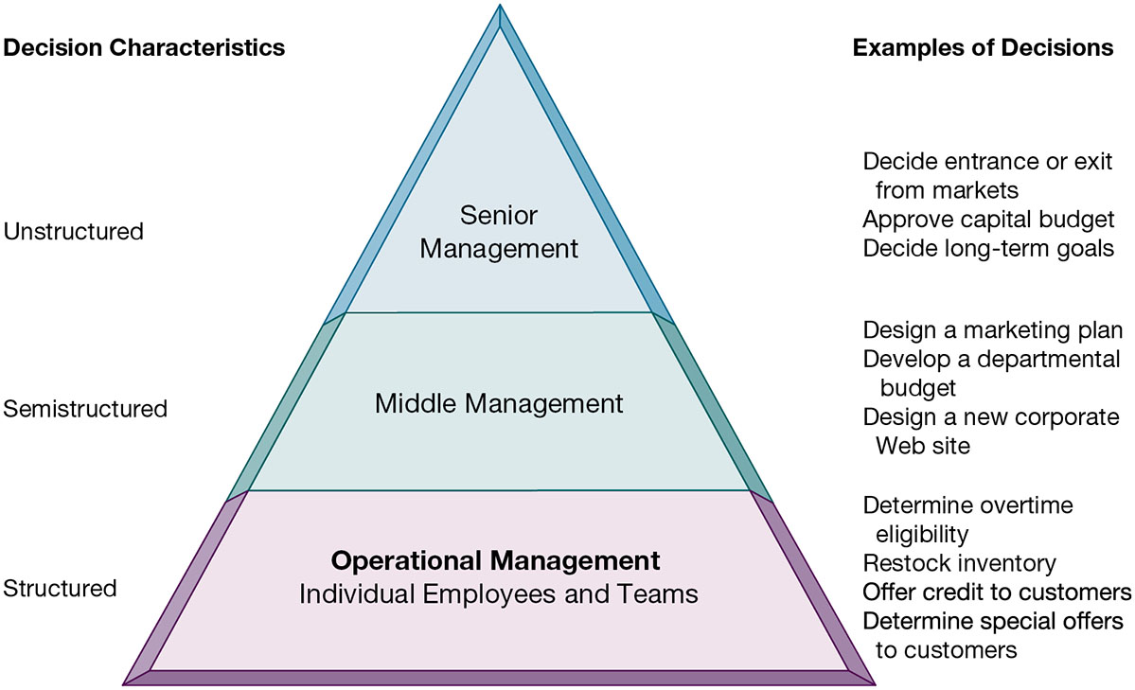
Information Requirements of Key Decision-Making Groups in a Firm

Slide 6
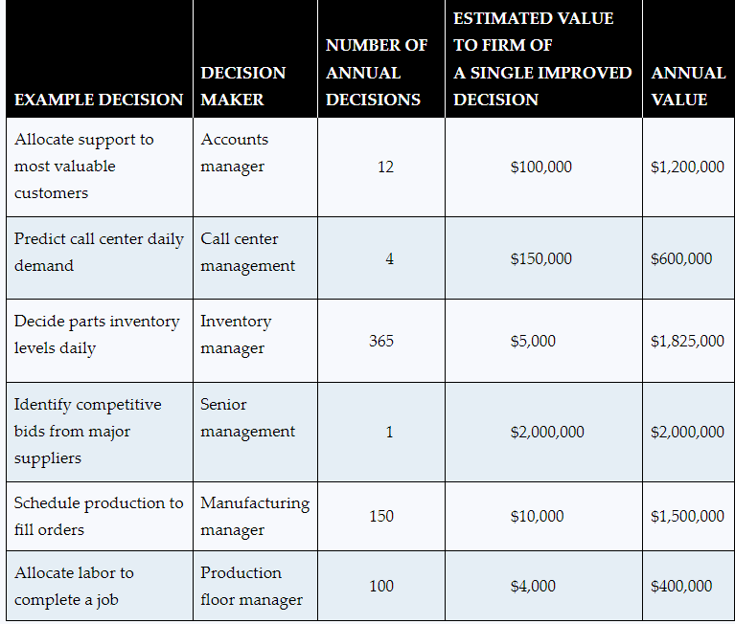

Slide 7
The Decision-Making Process
Intelligence
Discovering, identifying, and understanding the problems occurring in the organization
Design
Identifying and exploring solutions to the problem
Choice
Choosing among solution alternatives
Implementation
Making chosen alternative work and continuing to monitor how well solution is working

Slide 8
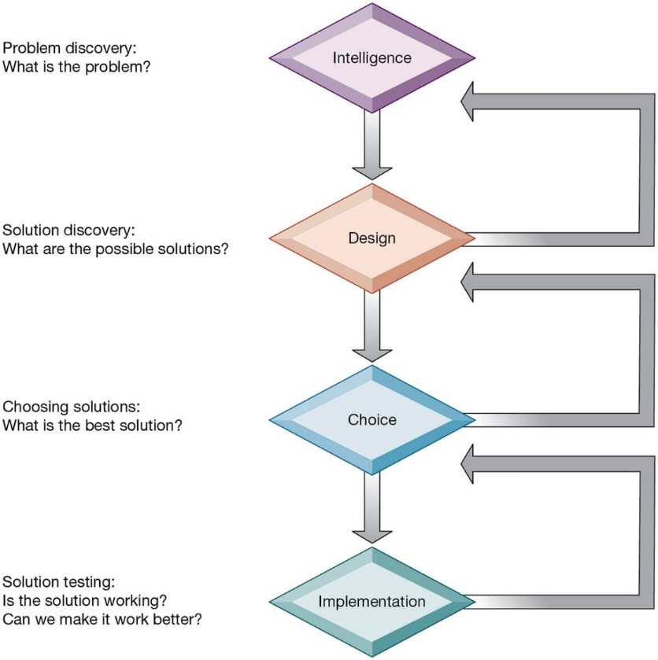
Stages in Decision Making

Slide 9
Real-World Decision Making
Three main reasons why investments in I T do not always produce positive results
Information quality
High-quality decisions require high-quality information
Management filters
Managers have selective attention and have variety of biases that reject information that does not conform to prior conceptions
Intiution, feelings
Organizational inertia and politics
Strong forces within organizations resist making decisions calling for major change

Slide 10
High-Velocity Automated Decision Making
Made possible through computer algorithms precisely defining steps for a highly structured decision
Humans taken out of decision
For example: High-speed computer trading programs
Trades executed in nanoseconds
Require safeguards to ensure proper operation and regulation

Slide 11
Amazon's dynamic pricing
Data-Driven Approach: Amazon's system constantly gathers and analyzes a massive amount of data, including competitor pricing, supply and demand, customer browsing and purchase history, inventory levels, and other market trends.
Algorithmic Pricing: Using sophisticated algorithms, Amazon's dynamic pricing system can adjust the prices of millions of products throughout the day. These algorithms are designed to determine the optimal price point for each product at any given time, aiming to maximize sales and profits.
Customer Behavior and Preferences: The system takes into account customer behavior patterns, such as how price-sensitive customers are to certain products, their purchasing habits, and how likely they are to buy at different price points.
Competitor Pricing: Amazon's pricing algorithms also monitor the prices of the same or similar products offered by competitors. If a competitor lowers their price on a product, Amazon's system can automatically respond by adjusting its own price for the same item.

Slide 12
Amazon's dynamic pricing
Supply and Demand Dynamics: The pricing strategy considers the demand for products and the available inventory. For items in high demand or with limited stock, prices might be higher. Conversely, prices might be lowered to move excess inventory or less popular items.
Event-Driven Pricing: During special events, like holiday seasons, Black Friday, or Prime Day, Amazon’s dynamic pricing system may make more frequent adjustments to take advantage of increased shopping activity.
Personalization: In some cases, Amazon may use customer-specific data to offer personalized prices, although this is a more complex and less transparent aspect of dynamic pricing.
Real-Time Adjustments: The key to Amazon's dynamic pricing is its ability to make these adjustments in real-time, responding quickly to any changes in the market, competitor actions, or customer behavior.

Slide 13
Complaints
In September 2023, the Federal Trade Commission (FTC) filed a complaint against Amazon, alleging that it created a monopoly by exploiting customers and businesses to maintain control over the ecommerce market. Recently, online retailers, Target and Amazon, each hosted summer sales events which demonstrated some of the coercive tactics alleged in the complaint.
“Amazon recognizes that sellers find ‘that it has become more difficult over time to be profitable on Amazon’ due to Amazon’s ‘increasing fees and costs.’ But as one seller explains, ‘we have nowhere else to go and Amazon knows it.’”

Slide 14
What is Business Intelligence?
Business intelligence
Infrastructure for collecting, storing, analyzing data produced by business
Databases, data warehouses, data marts, Hadoop, analytic platforms
Business analytics
Tools and techniques for analyzing data
Online Analytical Processing (OLAP), statistics, models, data mining
Business intelligence vendors
Create business intelligence and analytics purchased by firms

Slide 15
The Business Intelligence Environment
Six elements in the business intelligence environment
Data from the business environment
Business intelligence infrastructure
Business analytics toolset
Managerial users and methods
Delivery platform—M I S, D S S, E S S
User interface

Slide 16
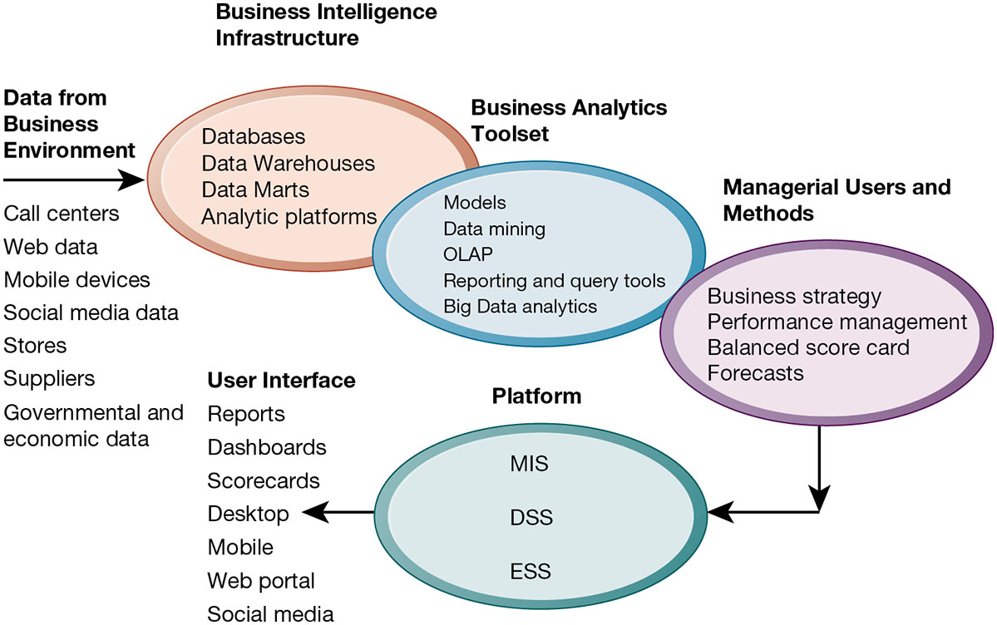
Business Intelligence and Analytics for Decision Support

Slide 17
Business Intelligence infrastructure
Databases
Data Warehouse
ETL
Analytics

Slide 18
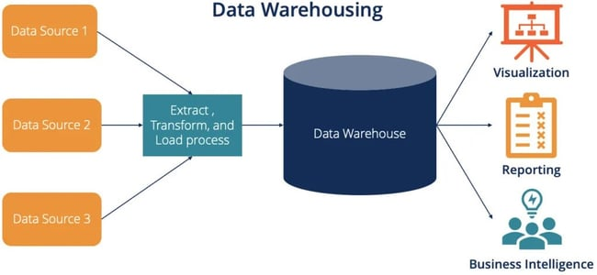

Slide 19
Data Warehouse
https://blog.hubspot.com/website/data-warehouse-concepts
central repository of integrated data from one or more disparate sources, primarily used for reporting and analysis as part of business intelligence.
It plays a key role in corporate decision-making by providing a consolidated view of enterprise data.

Slide 20
Data Warehouse purpose
Centralized Storage: A data warehouse stores large amounts of historical data so you can analyze different aspects of your business over time.
Data Consolidation: It integrates data from multiple sources, often different departments or entities, into a cohesive, single database.
Analysis and Reporting: Primarily used for generating reports, conducting analysis, and supporting decision-making processes.

Slide 21
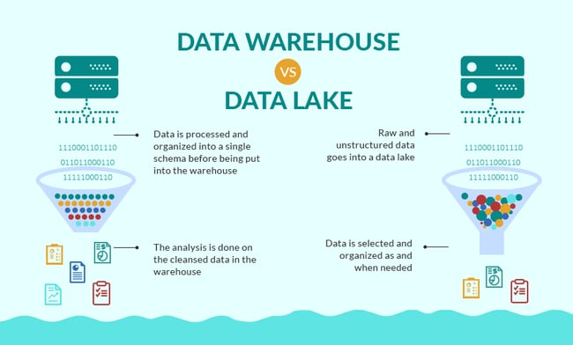

Slide 22
Feature | 🏛️ Data Warehouse | 🌊 Data Lake
Data Type | Structured (Relational tables, operational DBs). | All Types: Structured, Semi-structured (JSON, XML), Unstructured (logs, images, video).
Data State | Processed, Cleaned, & Curated. | Raw, Native Format.
Schema | Schema-on-Write: Structure defined before data storage (using ETL). | Schema-on-Read: Structure applied when data is read/analyzed (using ELT).
Purpose/Use | Business Intelligence (BI), Reporting, Historical Analysis, Pre-defined questions. | Advanced Analytics, Machine Learning (ML), Data Science, Exploratory Analysis, Future-use questions.
Users | Business Analysts, BI Professionals. | Data Scientists, Data Engineers, Developers.
Performance | Optimized for fast query performance on structured data. | Prioritizes storage volume and flexibility; query performance can vary on raw data.
Cost | Typically higher per GB (optimized and indexed storage). | Typically lower per GB (uses inexpensive object storage).
Data Quality | High: Highly reliable, governed, "single source of truth." | Variable: Can contain unverified or raw data; requires governance to avoid becoming a "data swamp."

Slide 23
ETL
Extraction, Transformation, and Loading (ETL) is a fundamental process in data warehousing that involves three distinct steps to move data from various sources to a centralized data repository, typically a data warehouse.
It is enabling organizations to efficiently gather, clean, and store data for analysis and decision-making.

Slide 24
Extraction
Purpose: This is the first step where data is collected or extracted from various source systems. These sources could be databases, CRM systems, ERP systems, flat files, web services, and more.
Process: During extraction, the goal is to retrieve all the necessary data without impacting the performance of the source systems. This process often involves querying databases or interacting with APIs.
Challenges: The main challenge in this step is dealing with different data formats and structures, ensuring consistency and accuracy during data retrieval.

Slide 25
Transformation
Once the data is extracted, it needs to be transformed into a format suitable for analysis. This step is crucial because data from different sources often comes in various formats and structures.
Processes Involved:
Cleaning: Removing inaccuracies, inconsistencies, or duplications from the data.
Standardizing: Converting data to a common format or unit.
Enriching: Enhancing data by adding relevant information.
Aggregating/Summarizing: Compiling detailed data into summary format.
Sorting: Arranging data in a certain order for easier analysis.
Joining: Combining data from different sources.
Splitting: Dividing a single column into multiple columns.
Outcome: The result is a set of data that is clean, consistent, and structured in a unified format.

Slide 26
Loading
The final step is to load the transformed data into a target repository, such as a data warehouse or data mart.
Types of Loading:
Full Load: The entire dataset is loaded at once. This is common during initial setup.
Incremental Load: Only new or updated data is added to the warehouse, saving time and resources.
Challenges: Ensuring data integrity during the load process and optimizing the performance of the load operation are key considerations.

Slide 27
User interface
Dashboards and Reporting Tools: User-friendly interfaces for accessing BI insights.
Mobile BI: Accessibility of BI tools on smartphones and tablets for on-the-go decision making.

Slide 28
Business Intelligence and Analytics Capabilities
Goal is to deliver accurate real-time information to decision makers
Main analytic functionalities of B I systems
Production reports
Parameterized reports
Dashboards/scorecards
Ad hoc query/search/report creation
Drill down
Forecasts, scenarios, models

Slide 29
Examples of Business Intelligence Predefined Production Reports
Business Functional Area | Production Reports
Sales | Forecast sales; sales team performance; cross-selling; sales cycle times
Service/call center | Customer satisfaction; service cost; resolution rates; churn rates
Marketing | Campaign effectiveness; loyalty and attrition; market basket analysis
Procurement and support | Direct and indirect spending; off-contract purchases; supplier performance
Supply chain | Backlog; fulfillment status; order cycle time; bill of materials analysis
Financials | General ledger; accounts receivable and payable; cash flow; profitability
Human resources | Employee productivity; compensation; workforce demographics; retention
Notes:
Table 12.4, page 466

Slide 30
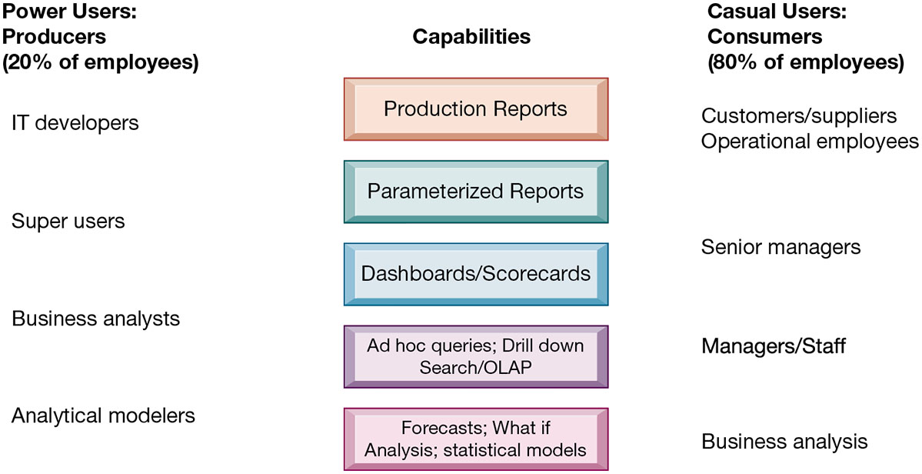
Business Intelligence Users

Slide 31
Predictive Analytics
Uses variety of data, techniques to predict future trends and behavior patterns
Statistical analysis
Data mining
Historical data
Assumptions
Incorporated into numerous B I applications for sales, marketing, finance, fraud detection, health care, sport,...
Credit scoring
Predicting responses to direct marketing campaigns

Slide 32
Moneyball
The Oakland Athletics (often referred to as the A's) are a Major League Baseball (MLB) team that gained widespread recognition for their innovative use of predictive analytics, particularly in the field of player recruitment and team composition
This approach was popularized by the book "Moneyball: The Art of Winning an Unfair Game" by Michael Lewis, and later by the film "Moneyball."

Slide 33
Moneyball
In the early 2000s, the A's, led by General Manager Billy Beane, faced a significant financial disadvantage compared to wealthier MLB teams. With limited resources, they had to find a cost-effective way to build a competitive team.
The A's embraced sabermetrics, the empirical analysis of baseball statistics. This approach contrasted with traditional methods that relied heavily on the subjective evaluation of players by scouts.
The A's assembled a team of undervalued players. This strategy allowed them to compete effectively against teams with much larger payrolls.

Slide 34
Big Data Analytics
Big data: Massive datasets collected from social media, online and in-store customer data, and so on
Help create real-time, personalized shopping experiences for major online retailers
Smart cities
Public records
Sensors, location data from smartphones
Ability to evaluate effect of one service change on system
Notes:
Ask students if they have ideas about how the cities they live in, towns or villages, could use big data analytics to improve the lives of citizens.

Slide 35
Operational Intelligence and Analytics
Operational intelligence: Business activity monitoring
Collection and use of data generated by sensors
Internet of Things (IoT)
Creating huge streams of data from web activities, sensors, and other monitoring devices
Software for operational intelligence and analytics enable companies to analyze their big data
Predictive maintenance (Oil&Gas companies)

Slide 36
Location Analytics and Geographic Information Systems
Location analytics
Ability to gain business insight from the location (geographic) component of data
Mobile phones
Sensors, scanning devices
Map data
Geographic information systems (G I S)
Ties location-related data to maps

Slide 37

Starbucks and GIS
Geographic Information System (GIS): Starbucks uses GIS technology to analyze various geographic and demographic factors. This system helps them visualize data on a map, making it easier to identify patterns and relationships that might not be apparent in traditional data formats.
Location-Based Data: This includes data on existing store locations, traffic patterns, pedestrian flows, and the proximity of potential sites to popular landmarks or centers of activity (like office buildings, shopping centers, or universities).
Demographic Data: Starbucks analyzes demographic information such as population density, age groups, income levels, and consumer behaviors in different areas. This helps them assess the potential market size and the purchasing power of customers in various locations.
Competitor Analysis: The system also considers the location of competitors. Understanding where competitors are located helps Starbucks identify market gaps or areas where they can capitalize on a strong demand for coffee shops.

Slide 38
Starbucks and GIS
Real Estate and Market Trends: Data on real estate trends, rental prices, and property values are also considered, as they significantly impact the profitability of a new store.
Historical Sales Data: Analysis of sales data from existing stores helps in understanding what store formats and product offerings are most successful in specific types of locations.
Cannibalization Analysis: To avoid harming sales at other Starbucks locations, the system analyzes how a new store might impact nearby Starbucks stores, estimating the degree of sales overlap or cannibalization.
Customer Feedback and Preferences: Starbucks also considers customer feedback and preferences, which can be region-specific, to tailor the store to local tastes and demands.

Slide 39
Category | GIS Component Supported | Supporting Statistics & Numbers
Global Scale & Expansion | 🗺️ Geographic & Location Data | * Total Global Stores: Over 40,000 stores worldwide. * Expansion Rate: Opened 722 net new stores in Q4 FY24 alone. * Leading Market Focus: U.S. (16,941 stores) and China (7,596 stores) accounted for 61% of the global portfolio (Q4 FY24).
High-Density Strategy | 📍 Location-Based Data & Competitor Analysis | * Leading State: California leads with 3,039 stores, demonstrating targeted market saturation. * High Density Example (US): Cities like Las Vegas, NV, have 25.0 stores per 100K residents, showing clustering driven by traffic flow/demand models.
Targeted Demographics | 🧑‍🤝‍🧑 Demographic Data | * Income Focus: Most stores are located in areas with a Median Household Income of $60,000 or more. * Commercial Proximity: Many sites are chosen within a 5-minute walking distance of major commercial centers, optimizing for pedestrian flow and centers of activity.

Slide 40
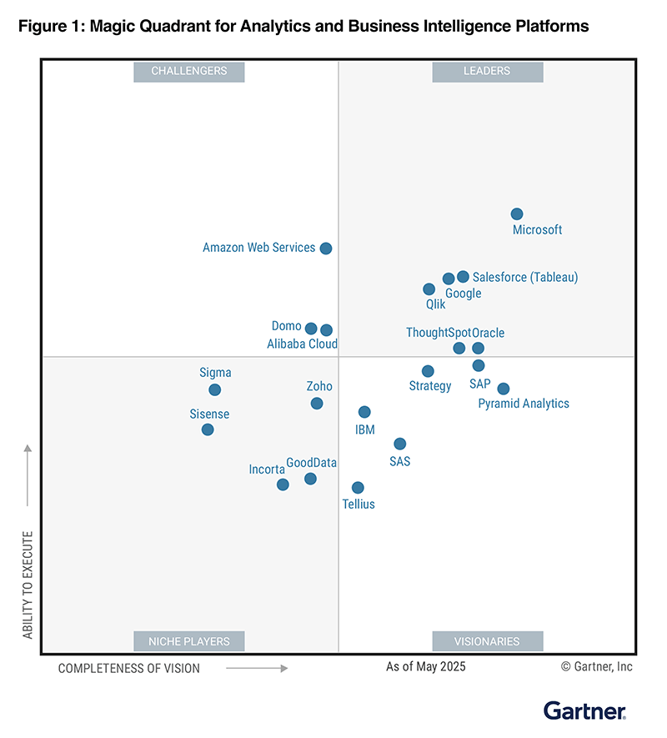

Slide 41
Gartner criteria
Automated insights — A core attribute of augmented analytics, this is the ability to apply machine learning (ML) techniques to automatically generate insights for end users (for example, by identifying the most important attributes in a dataset).
Analytics catalog — This refers to the product’s ability to display analytic content to make it easy to find and consume. The catalog is searchable and makes recommendations to users.
Data preparation — Data preparation includes support for drag-and-drop, user-driven combination of data from different sources, and the creation of analytic models (such as user-defined measures, sets, groups and hierarchies).
Data source connectivity — Data source connectivity capabilities enable users to connect to and ingest structured data contained in various types of storage platforms, both on-premises and in the cloud.
Data storytelling — Data storytelling is the ability to combine interactive data visualization with narrative techniques to package and deliver insights in a compelling, easily understood form for presentation to decision makers.
Data visualization — Data visualization involves support for highly interactive dashboards and exploration of data through the manipulation of chart images. Included is an array of visualization options that go beyond those of pie, bar and line charts, such as heat and tree maps, geographic maps, scatter plots and other special-purpose visuals.

Slide 42
Gartner criteria
Visualization: Supports custom visualizations, allows users to visualize and analyze graphs and integrates with charting libraries, supports geographic mapping, and recommends which visualization type to use for different data types.
Content management: This capability allows administrators and D&A stewards to manage the security, certification and life cycle of analytics content.
Reporting: This capability provides pixel-perfect, paginated reports that can be scheduled and shared with a large user community.​
Data preparation: Supports drag-and-drop, user-driven combination of data from different sources and the creation of analytic models, such as user-defined measures, data pipelines, sets, groups and hierarchies.
Automated insights: The ability to apply machine learning (ML) techniques to automatically generate insights for end users; for example, identifying the most important attributes in a dataset, conducting time series forecasting and identifying clusters within datasets. These features also enable the incorporation of usage and feedback data from users to display content that is most relevant for their role and use case.
Natural language query (NLQ): This capability enables users to ask questions of the data using terms that are either typed into a search box or spoken aloud.
Data source connectivity: Capabilities that enable users to connect to and ingest data contained in various types of storage platforms, both on-premises and in the cloud. ​
Analytics catalog: Portal-like curation and collaboration of ABI content, enabling users to share, find, search, comment and certify dashboards, reports and datasets from a diverse range of platforms in one place.

Slide 43
Market Overview
This year, the analytics and business intelligence (ABI) platforms market experienced significant changes driven by generative AI (GenAI) disruptions.
Vendors focused on innovations in AI agents and agentic capabilities, such as natural language query (NLQ) and natural language generation (NLG).
These advancements allow users to generate reports, insights and technical outputs like data models and dashboards using natural language prompts through AI assistants.

Slide 44
Conlusion
Data-Driven Decisions
AI-Enhanced Analytic
Competitive Advantage

Slide 45
Hvala na pažnji!

