Slide 1
Managing information systems
Mr.sc Dražen Pranić
Notes:
Ažurirati naziv kolegija.

Slide 2
Agenda
ERP
SCM
CRM

Slide 3
What Are Enterprise Systems
https://www.youtube.com/watch?v=WlfYKgOtWIU&ab_channel=SAPTV
Also known as enterprise resource planning (ERP) systems
Based on a suite of integrated software modules and a common central database
Collects data from many divisions of firm for use in nearly all of firm’s internal business activities
Information entered in one process is immediately available for other processes
Notes:
.

Slide 4
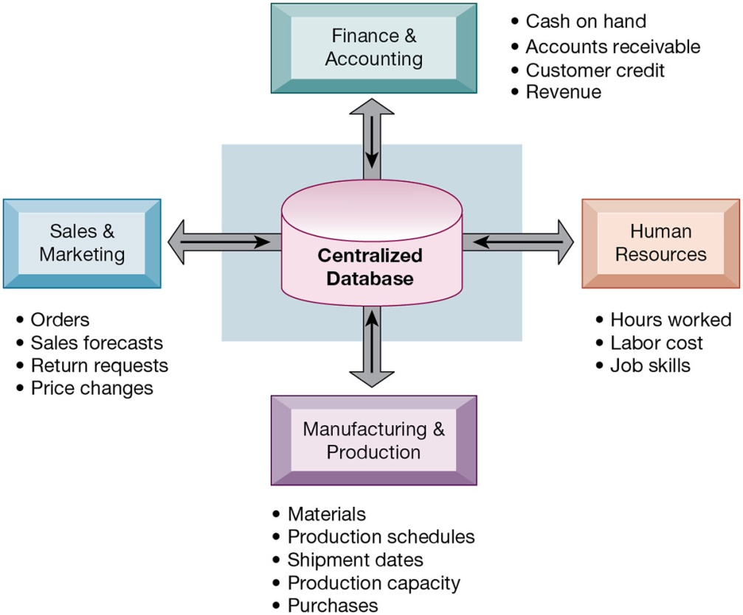
How Enterprise Systems Work

Slide 5
Enterprise Software
Built around thousands of predefined business processes that reflect best practices
Finance and accounting
Human resources
Manufacturing and production
Sales and marketing
To implement, firms:
Select functions of system they wish to use
Map business processes to software processes

Slide 6
Enterprise Software
Why it is typically best to perform only minimal changes to enterprise software, and instead, change the way the firm works in order to conform to the software’s business processes?

Slide 7
Business Value of Enterprise Systems
Increase operational efficiency
Provide firm-wide information to support decision making
Enable rapid responses to customer requests for information or products
Include analytical tools to evaluate overall organizational performance and improve decision-making

Slide 8
ERP trends
The ERP market continues to represent a significant portion of the enterprise applications market. According to Gartner’s analysis, worldwide ERP software revenue grew by 8% to a market value of $44 billion in total software revenue.
The SaaS ERP market share is close to $26 billion, and grew at the market average of 16.9%, driven primarily by the rapid adoption of financial management solutions and human capital management among businesses of all sizes.

Slide 9
Cloud ERP for Service-Centric Enterprises
Financial management system (FMS) functionality
Order-to-cash (O2C) functionality
Source-to-pay (S2P) functionality
Human capital management (HCM) functionality,
Other administrative ERP functionality

Slide 10
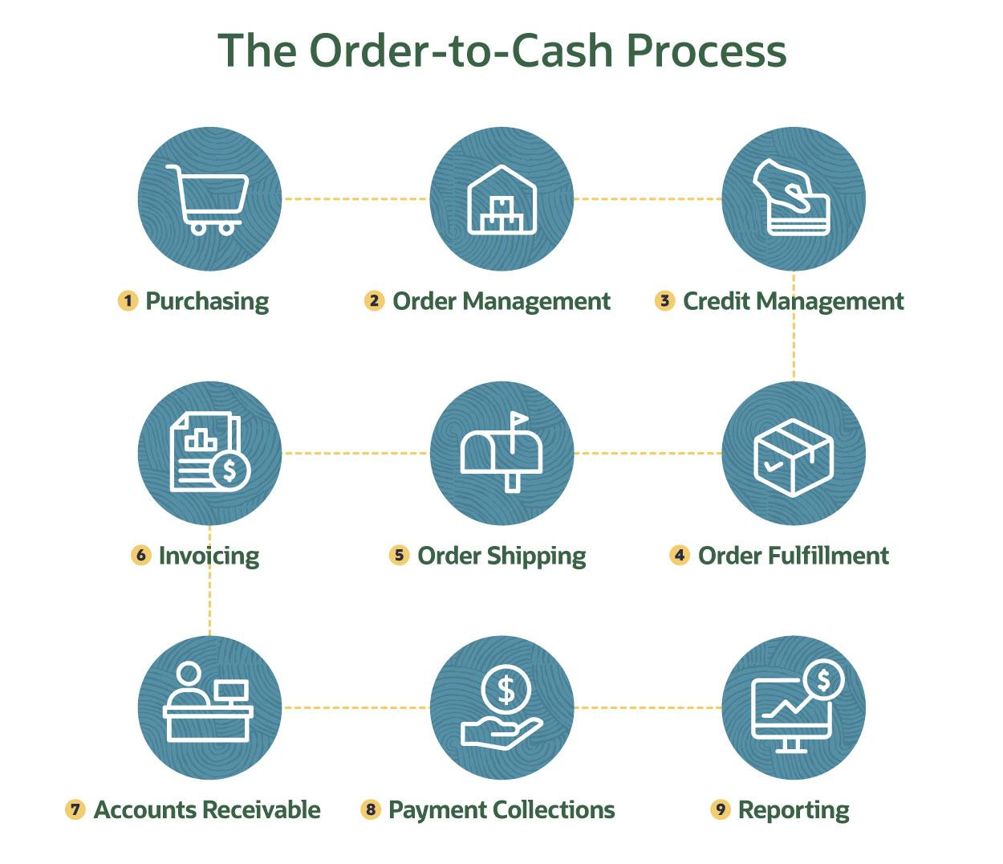

Slide 11
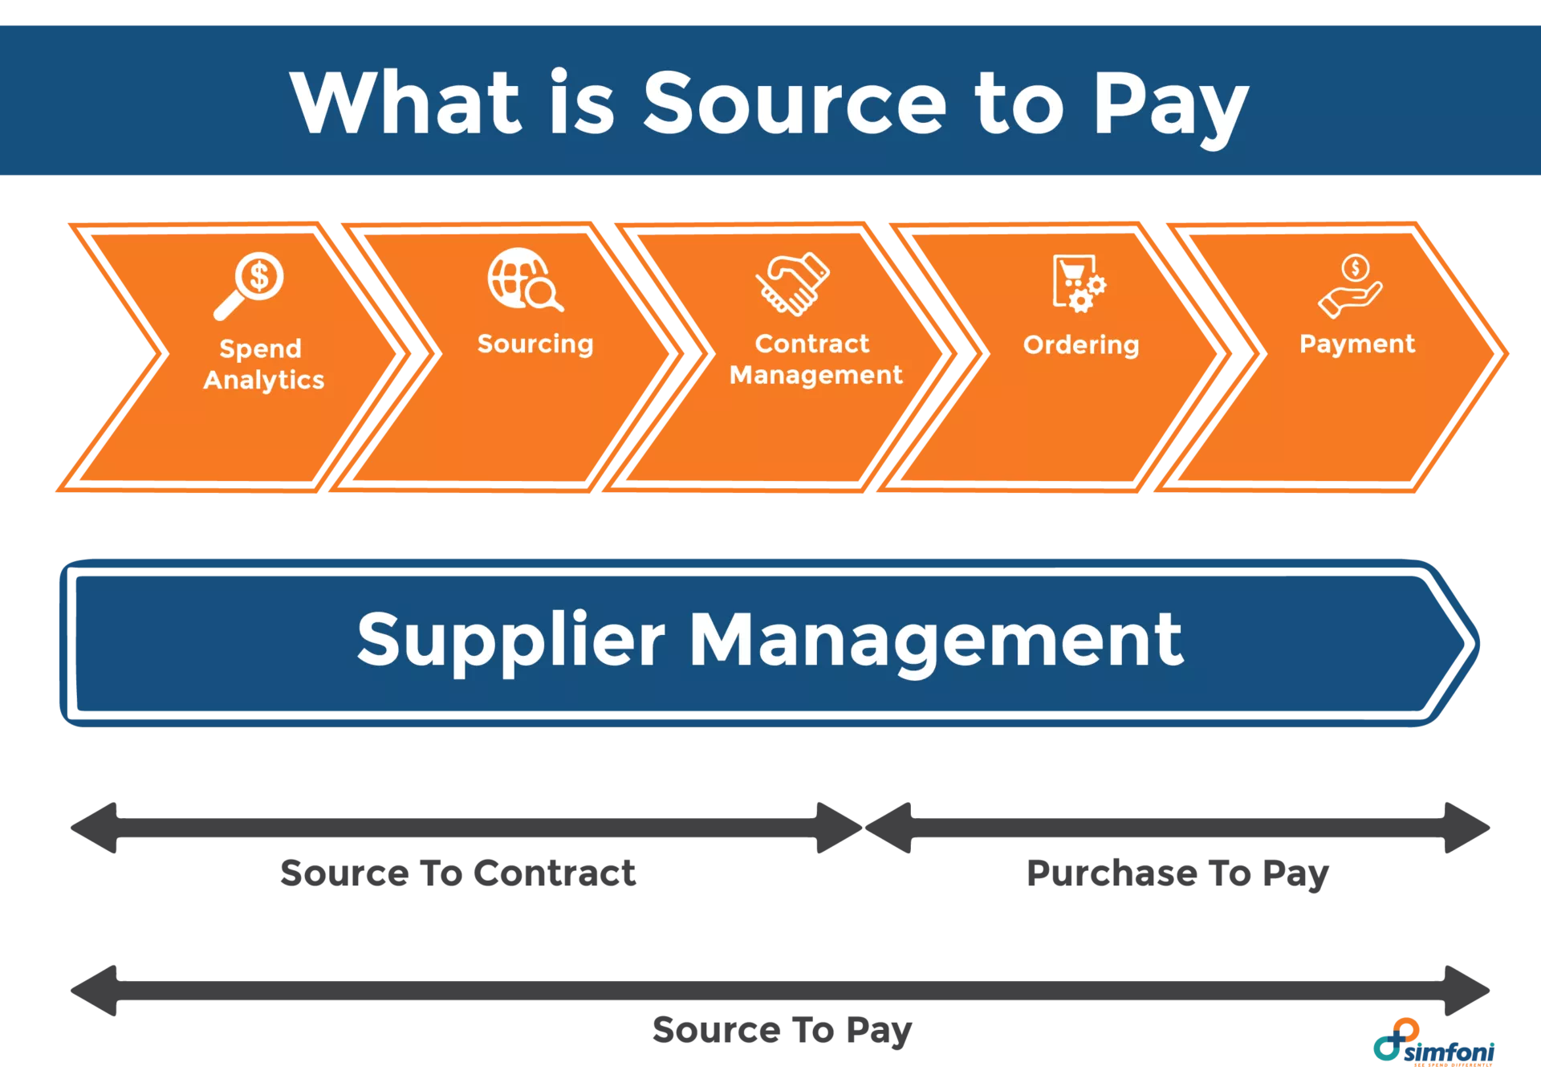

Slide 12
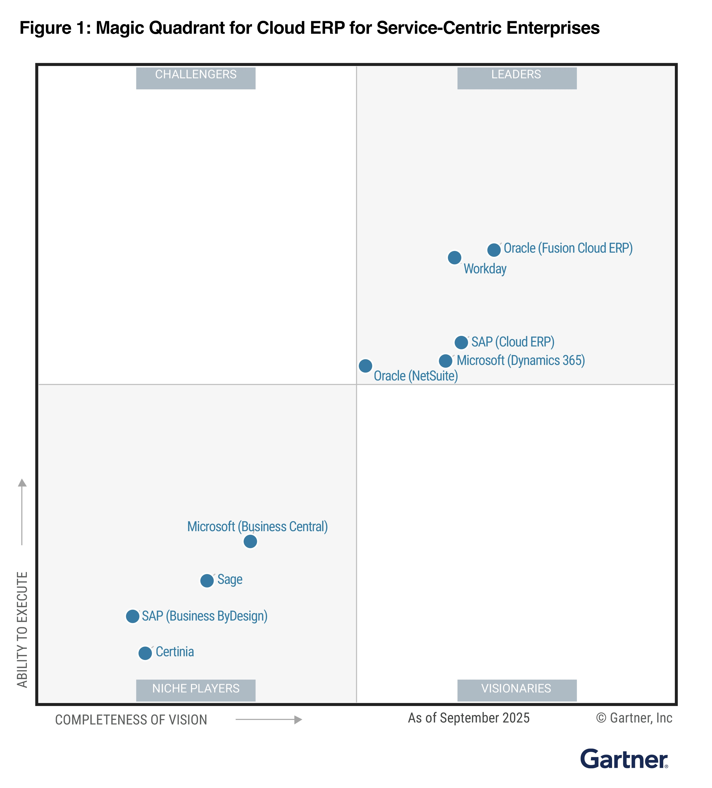

Slide 13
The Supply Chain
Network of organizations and processes for:
Procuring materials
Transforming materials into products
Distributing the products
Upstream supply chain
Downstream supply chain
Internal supply chain

Slide 14
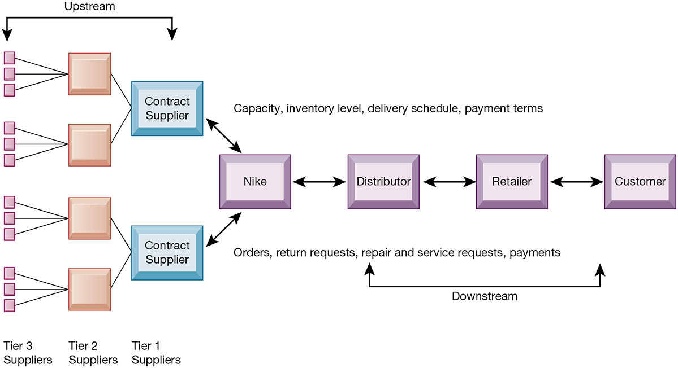
Nike’s Supply Chain

Slide 15
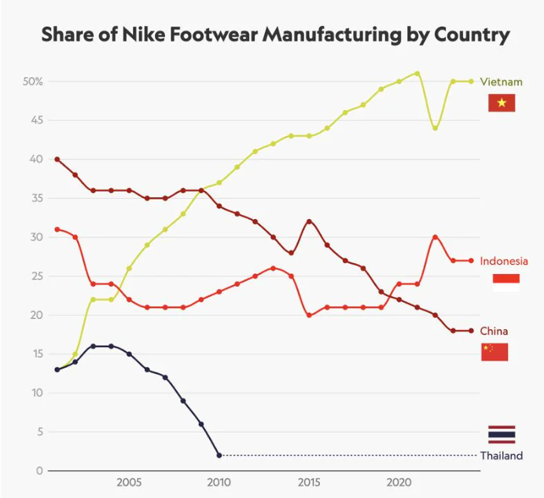

Slide 16
Supply Chain Management
Inefficiencies cut into a company’s operating costs
Inefficiencies in the supply chain, such as parts shortages, underused plant capacity, excessive finished goods inventory, or high transportation costs, are caused by inaccurate or untimely information
Just-in-time strategy
Components arrive as they are needed
Finished goods shipped after leaving assembly line
Safety stock: buffer for lack of flexibility in supply chain

Slide 17
Supply Chain Management Software
Supply chain planning systems
Model existing supply chain
Enable demand planning
Optimize sourcing, manufacturing plans
Establish inventory levels
Identify transportation modes
Supply chain execution systems
Manage flow of products through distribution centers and warehouses

Slide 18
Global Supply Chains and the Internet
Global supply chain issues
Greater geographical distances, time differences
Participants from different countries
Different performance standards
Different legal requirements
Internet helps manage global complexities
Warehouse management
Transportation management
Logistics
Outsourcing

Slide 19
Demand-Driven Supply Chains: From Push to Pull Manufacturing and Efficient Customer Response
Push-based model (build-to-stock)
Earlier S C M systems
Schedules based on best guesses of demand
Pull-based model (demand-driven)
Web-based
Customer orders trigger events in supply chain
Internet enables move from sequential supply chains to concurrent supply chains
Complex networks of suppliers can adjust immediately

Slide 20
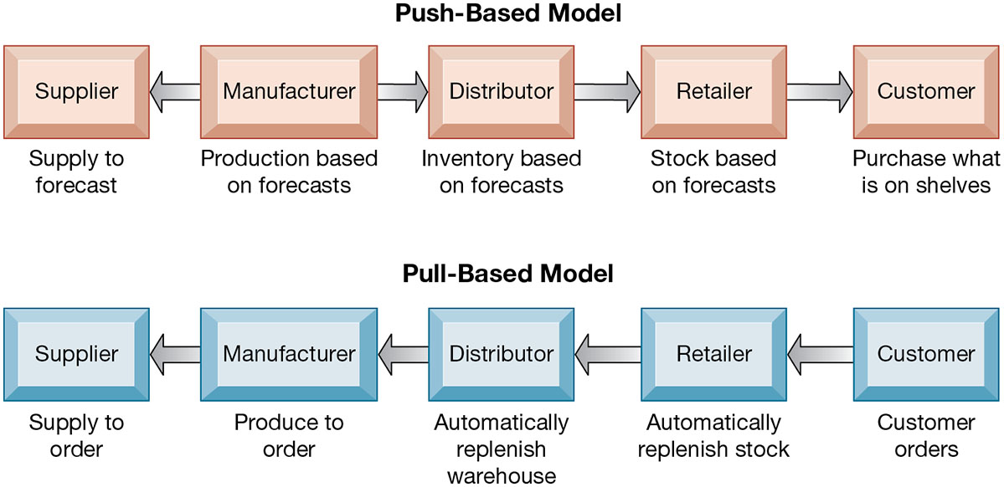
Push- Versus Pull-Based Supply Chain Models

Slide 21
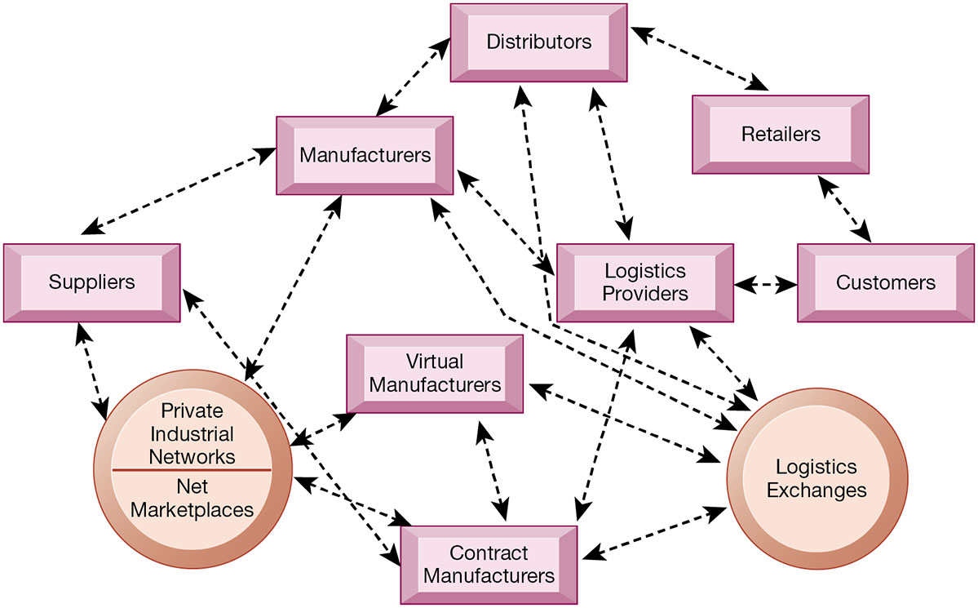
The Emerging Internet-Driven Supply Chain

Slide 22
Business Value of Supply Chain Management Systems
Match supply to demand
Reduce inventory levels
Improve delivery service
Speed product time to market
Use assets more effectively
Increase sales

Slide 23
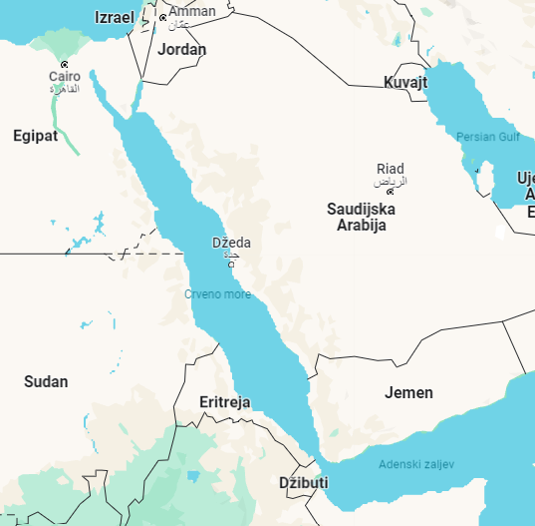
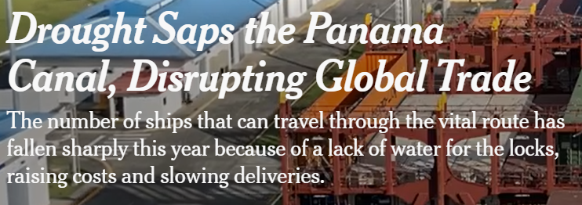

Slide 24
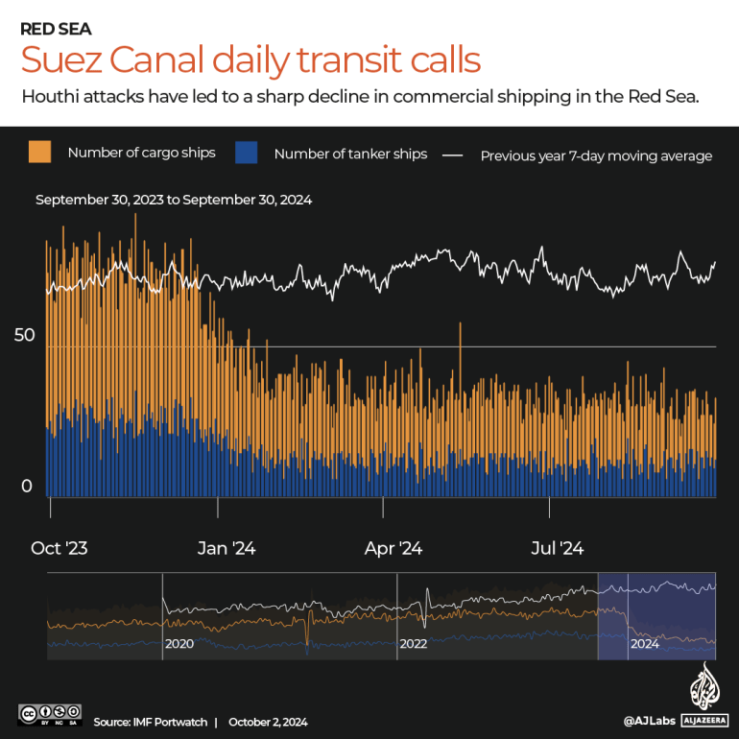

Slide 25

Maersk
our fleet of around 740 ships
343 ports and terminals in 121 countries;
on average, a Maersk container ship call a port every six minutes – somewhere in the world.
4 mlrd. $ profit
Around 100.000 employees

Slide 26
Customer Relationship Management
Knowing the customer
In large businesses, too many customers and too many ways customers interact with firm
C R M systems
Capture and integrate customer data from all over the organization
Consolidate and analyze customer data
Distribute customer information to various systems and customer touch points across enterprise
Provide single enterprise view of customers

Slide 27
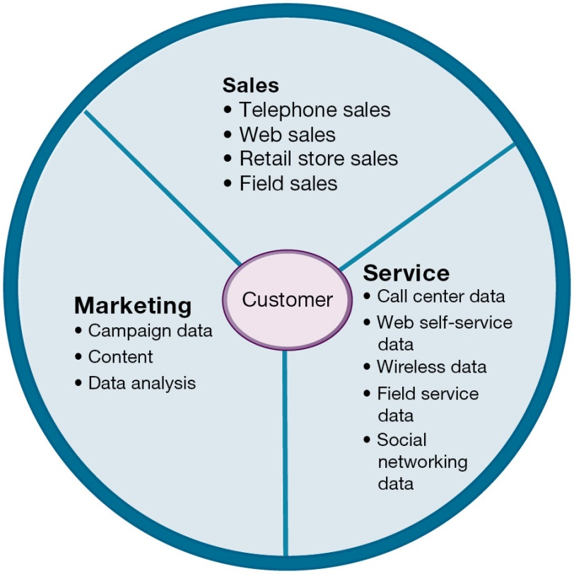
Customer Relationship Management (C R M)

Slide 28
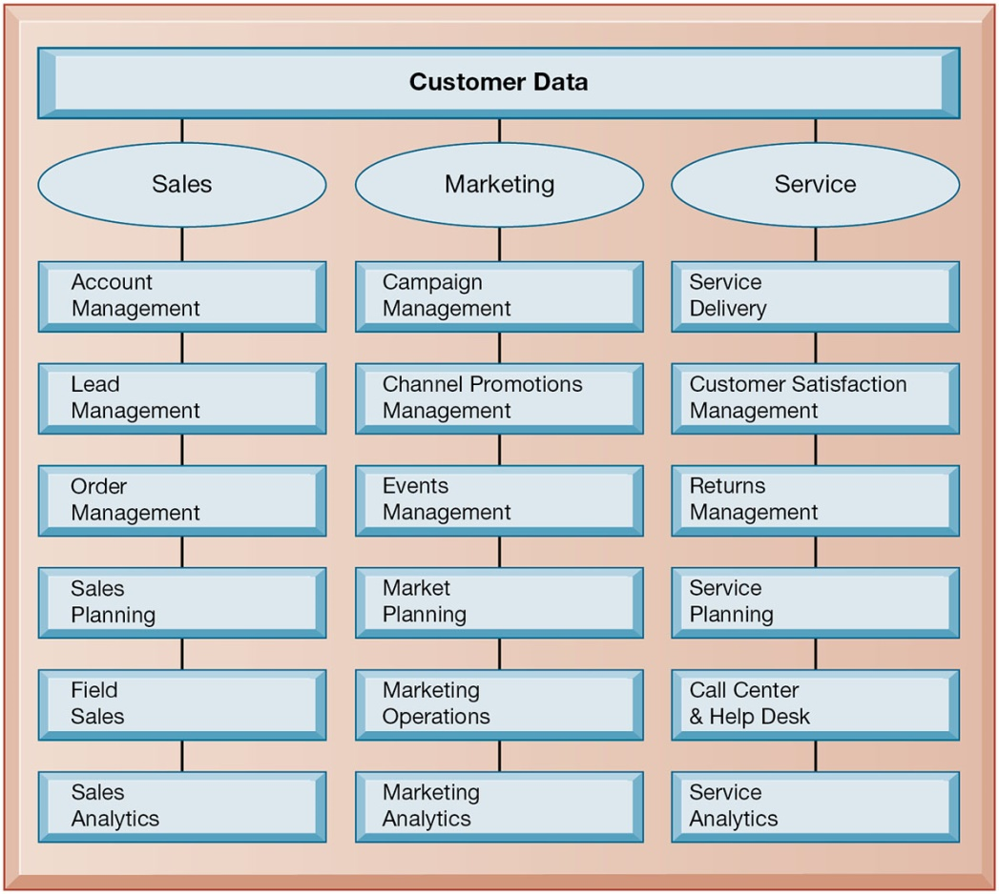
C R M Software Capabilities

Slide 29
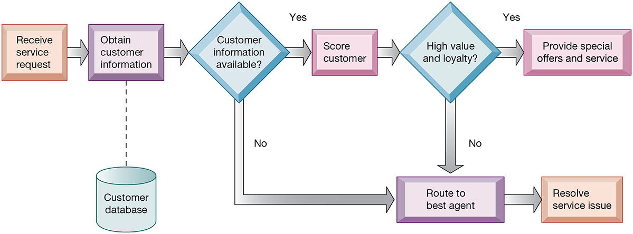
Customer Loyalty Management Process Map

Slide 30
Operational and Analytical C R M
https://www.youtube.com/watch?v=KW5lO34uOsM&ab_channel=Salesforce
Operational C R M
Customer-facing applications
Sales force automation call center and customer service support
Marketing automation
Analytical C R M
Based on data warehouses populated by operational C R M systems and customer touch points
Analyzes customer data (O L A P, data mining, etc.)
Customer lifetime value (C L T V)

Slide 31
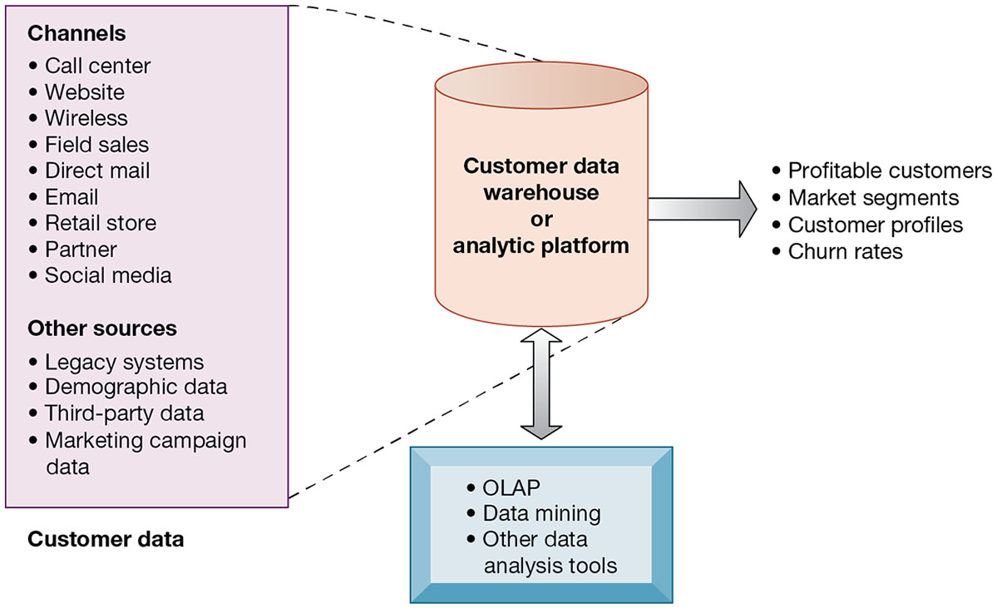
Analytical C R M Data Warehouse

Slide 32
Business Value of Customer Relationship Management Systems
Business value of C R M systems
Increased customer satisfaction
Reduced direct-marketing costs
More effective marketing
Lower costs for customer acquisition/retention
Increased sales revenue
Churn rate
Number of customers who stop using or purchasing products or services from a company
Indicator of growth or decline of firm’s customer base

Slide 33
Cost of Acquiring vs. Cost of Losing a User
“Acquiring a new customer can be 5–25× more expensive than retaining an existing one.”(industry-wide CRM/SaaS benchmark range)
Acquisition cost includes marketing, incentives, onboarding, identity checks and conversion funnels — usually a one-time expense.
Losing a user means losing long-term revenue (LTV), future upsell potential, referrals and brand trust — a compounded loss over time.
Replacement of a churned user requires new CAC spend, increasing total cost and lowering profitability.
High retention reduces churn, protects lifetime value and is financially far more impactful than purely maximizing acquisition volume.

Slide 34
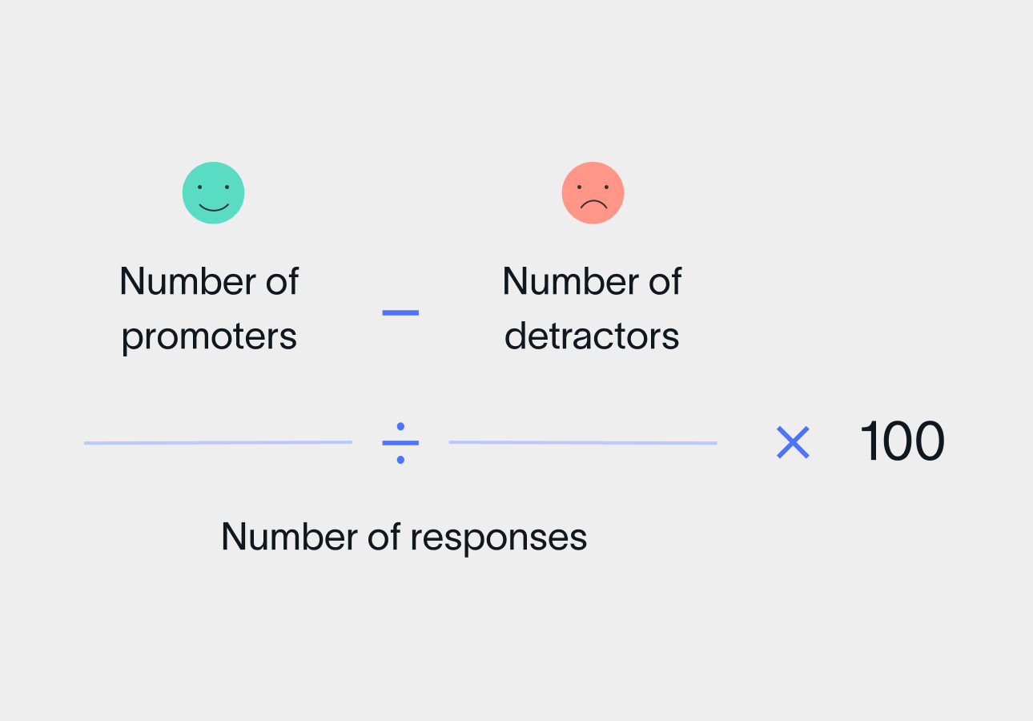
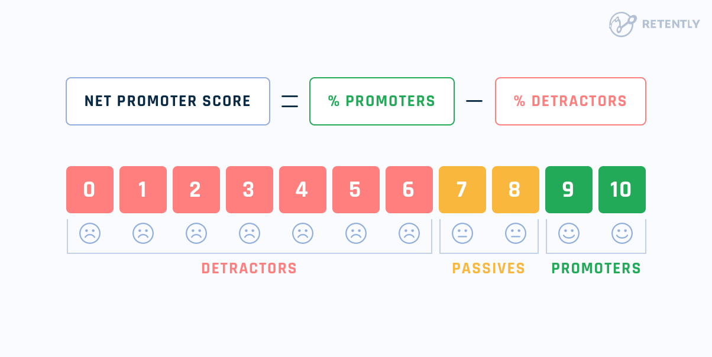
Net Promoter Score (NPS)
NPS is a core loyalty metric that reflects how likely users are to recommend your service (0–10 scale), directly correlating with churn risk and lifetime value.
CRM platforms can measure and track NPS by collecting post-interaction or periodic surveys and linking results to individual customers and behavioural data.
Users with high NPS (Promoters) show higher retention, stronger engagement and lower service costs — improving LTV and reducing acquisition replacement spend.
Low NPS (Detractors) signal increased churn risk and lost revenue potential, making NPS one of the earliest and most cost-efficient indicators of future losses.
Improving NPS typically reduces the long-term cost of losing users, enables targeted retention actions, and strengthens overall profitability more than increasing acquisition volume alone

Slide 35
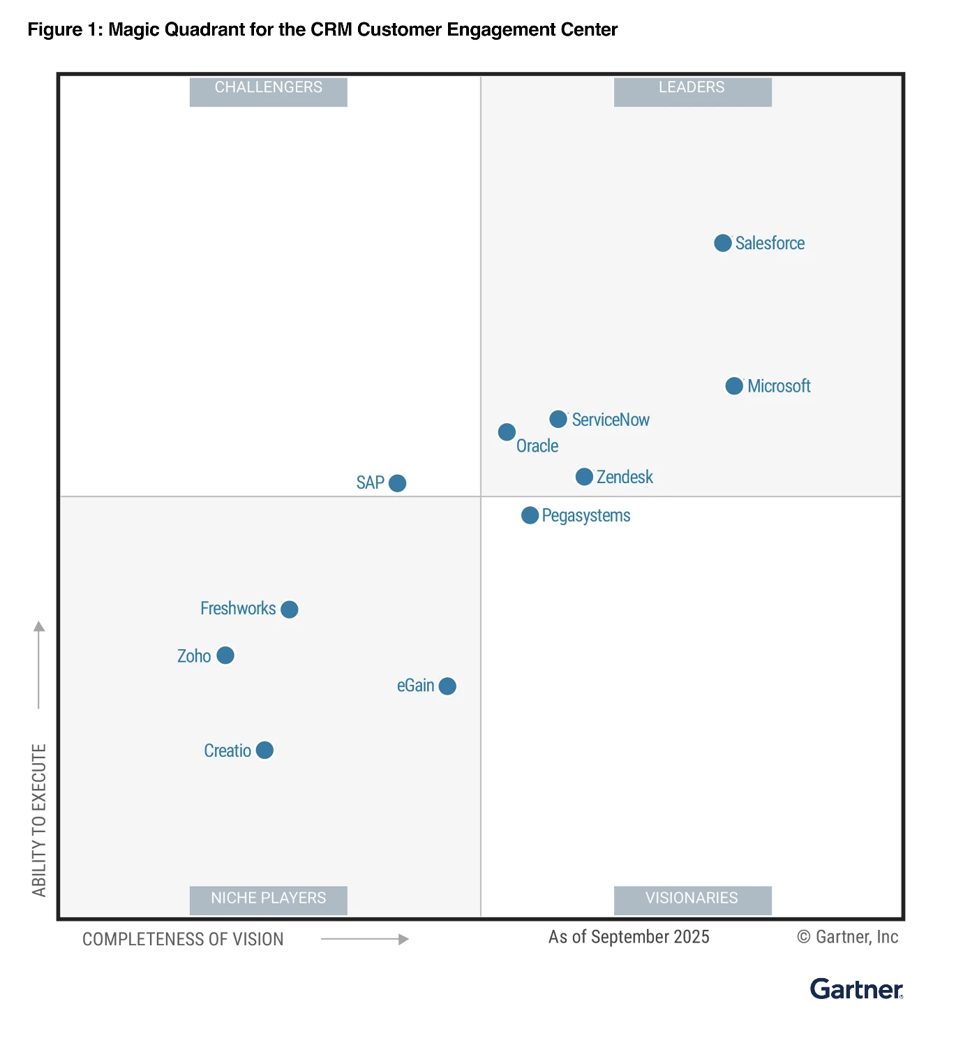

Slide 36
Spotify business model
It uses a freemium revenue model that offers a basic, limited, ad-supported service for free and an unlimited premium service for a subscription fee
Total users: over 713 million Spotify users worldwide as of 2025
Paying Subscribers: 281 million users
Ad-Supported Listeners: 432 million users
Revenue:
Subscription € 11,337 M
Advertisement € 899 M

Slide 37
Spotify and Salesforce
It previously took months for Spotify Advertising to gather and act on campaign data. Now, Salesforce acts as a single source of truth for Spotify’s ad inventory. Executives and ad reps have full visibility of the sales pipeline with dashboards and AI-powered insights from Sales Cloud Einstein.
Opportunity Scoring helps reps sell fast with AI by prioritizing leads based on those most likely to close.

Slide 38
Spotify and Salesforce
In less than seven days, data flows into Spotify’s marketing environment for follow-up. Spotify Advertising has also increased the number of marketing campaigns it runs each year fivefold simply by automating customer journeys like registration.
Spotify Advertising uses a third party tool to track website visits. With Personalization, visitors see customized buttons and banners based on their previous activity, leading to a 53% increase in click-through rates.

Slide 39
Spotify and Salesforce
With CRM Analytics, Spotify knows which customers are in danger of leaving or decreasing spend. Dashboards help teams monitor and understand account health, revenue performance, and product adoption, among other fields.
This way, sales can follow up with customers who need additional help or attention.

Slide 40
Enterprise Application Challenges
Expensive to purchase and implement
Many projects experience cost overruns
Long development times
Technology changes
Business process changes
Organizational learning changes
Switching costs, dependence on software vendors
Data standardization, management, cleansing

Slide 41
Next-Generation Enterprise Applications
Enterprise solutions/suites
Make applications more flexible, web-enabled, integrated with other systems
Cloud-based versions
Functionality for mobile platform
Versions also available for small and medium-sized businesses

Slide 42
Next-Generation Enterprise Applications
Social C R M
Incorporating social networking technologies
Company social networks
Monitor social media activity; social media analytics
Manage social and web-based campaigns
Business intelligence
Inclusion of B I with enterprise applications
Flexible reporting, ad hoc analysis, “what-if” scenarios, digital dashboards, data visualization, AI machine learning

Slide 43
Conclusion
Enterprise Applications are key part of information system
Avoid silos effect
Advanced features

Slide 44
Hvala na pažnji!

