Slide 1
Managing information systems
Mr.sc Dražen Pranić
Notes:
Ažurirati naziv kolegija.

Slide 2
Agenda
IT infrastructure
Tehnological trends
Cloud
IoT

Slide 3
Neflix example
https://aws.amazon.com/solutions/case-studies/innovators/netflix/
Netflix uses AWS for nearly all its computing and storage needs, including databases, analytics, recommendation engines, video transcoding, and more—hundreds of functions that in total use more than 100,000 server instances on AWS

Slide 4
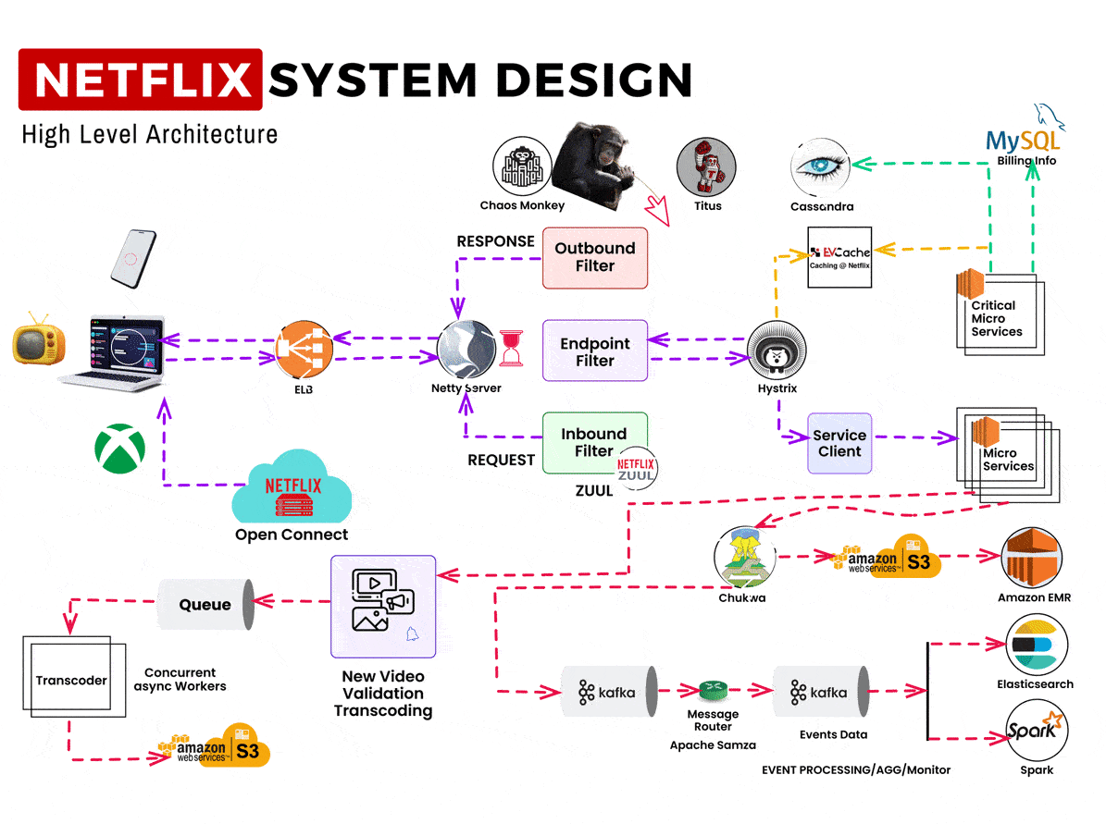

Slide 5
Netflix infrastructure
1. The User Access Layer
Netflix serves users across devices — from smart TVs and laptops to mobile phones and gaming consoles.
When you open Netflix and hit “Play,” your request first goes through Amazon’s Elastic Load Balancer (ELB).
Purpose of ELB:
Distributes incoming user requests across multiple Netflix servers.
Prevents overload or downtime on any single instance.

Slide 6
Netflix infrastructure
2. API Gateway — Netflix Zuul
Once requests pass through the load balancer, they hit Netflix Zuul, the powerful API Gateway that acts as a traffic controller for all requests.
Zuul performs multiple critical functions using filters:
Inbound Filter: Validates and authenticates incoming requests.
Endpoint Filter: Routes requests to the right backend microservice.
Outbound Filter: Modifies and formats the outgoing response before sending it to the user.
All of this happens on top of the Netty Server, an asynchronous network framework that helps handle massive numbers of concurrent HTTP requests efficiently.

Slide 7
Netflix infrastructure
3. Microservices Architecture
Netflix operates on a microservices architecture, where each service handles a specific function:
User profiles
Search and recommendations
Payments and billing
Content metadata
To maintain reliability, Netflix uses:
Hystrix → a circuit breaker library that isolates failures and prevents cascading breakdowns.
Service Client → facilitates communication between multiple microservices securely and efficiently.
This design ensures that even if one service fails (e.g., recommendations), others (like playback) continue to function seamlessly.

Slide 8
Netflix infrastructure
4. Data Storage and Caching
At Netflix’s scale, data management is crucial. They use a combination of SQL, NoSQL, and in-memory caching:
Cassandra → A NoSQL distributed database that stores huge volumes of user activity and metadata.
MySQL → Used for structured data such as billing and subscription details.
EVCache → Netflix’s in-house caching system (based on Memcached) that speeds up data retrieval.
This hybrid setup ensures low latency and high availability for millions of concurrent data requests.

Slide 9
Netflix infrastructure
5. Infrastructure Resilience and Deployment
Netflix runs its services on Amazon Web Services (AWS) — but it also uses in-house tools to ensure fault tolerance and scalability:
Chaos Monkey: Part of the “Simian Army,” it randomly shuts down production instances to test how well the system handles unexpected failures.
Titus: Netflix’s container management platform that automates microservice deployment, scaling, and monitoring.
Together, these tools make Netflix’s architecture resilient, self-healing, and cloud-native.

Slide 10
Netflix infrastructure
6. Open Connect — Netflix’s CDN
When you finally hit “Play,” the video isn’t streamed directly from AWS. Instead, Netflix uses Open Connect, its own Content Delivery Network (CDN).
Open Connect caches video content closer to users around the world — minimizing latency and ensuring HD and 4K streaming without buffering.

Slide 11
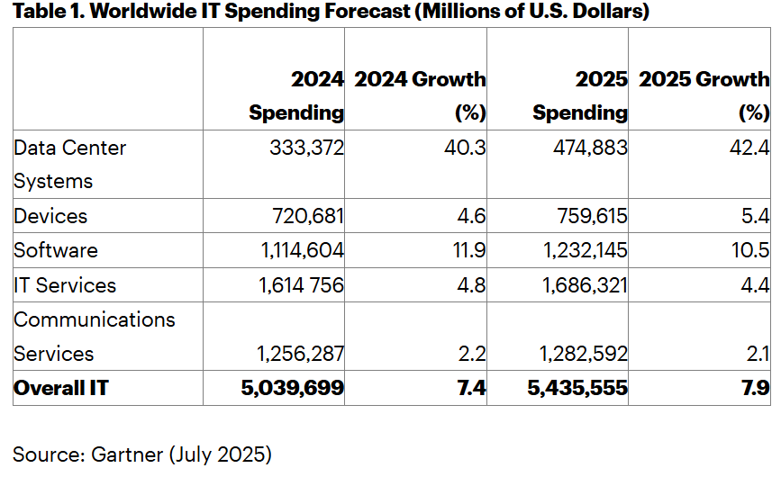

Slide 12
IT spending analysis
Data centers are experiencing a surge driven by GenAI, with spending on AI optimized servers, which was virtually nonexistent in 2021, expected to triple that of traditional servers by 2027,”

Slide 13
Defining I T Infrastructure
Set of physical devices and software required to operate an enterprise
Set of firm-wide services including:
Computing platforms providing computing services
Physical facilities management services
I T management, education, and other services
“Service platform” perspective
More accurate view of value of investments

Slide 14
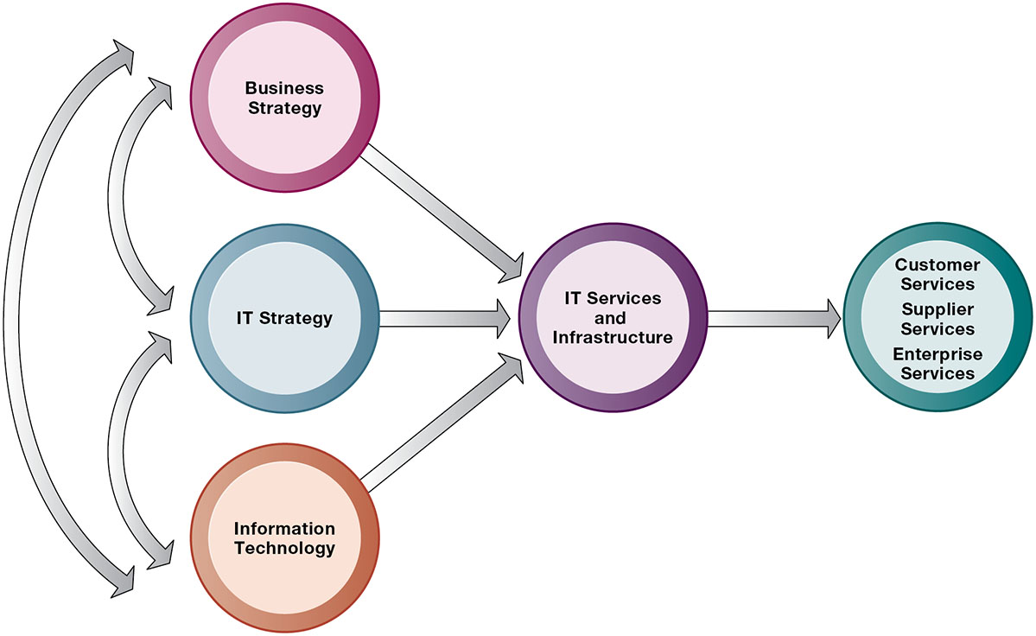
Connection Between the Firm, I T Infrastructure, and Business Capabilities

Slide 15
Evolution of I T Infrastructure
General-purpose mainframe and minicomputer era: 1959 to present
IBM 360, AS 400
support thousands of online remote terminals connected to the centralized mainframe using proprietary communication protocols and proprietary data lines.
Personal computer era: 1981 to present
Client/server era: 1983 to present
Enterprise computing era: 1992 to present
Network/Internet/OSI
Cloud and mobile computing: 2000 to present

Slide 16
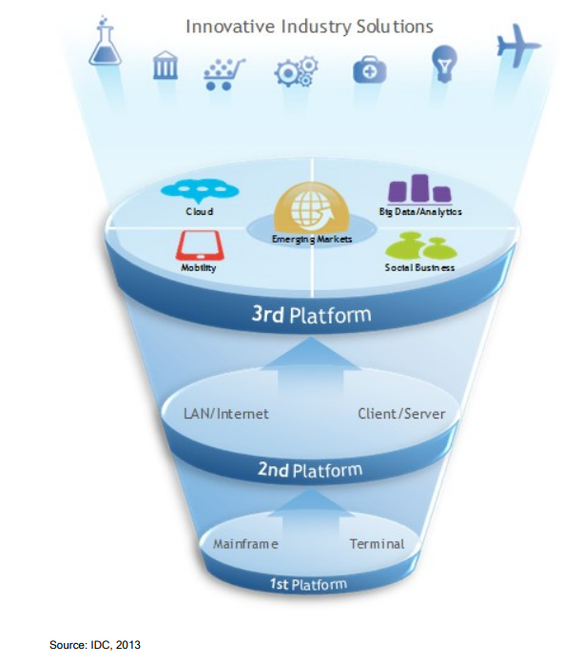

Slide 17
Technology Drivers of Infrastructure Evolution
Moore’s law and microprocessing power
Computing power doubles every 2 years
Nanotechnology
Law of Mass Digital Storage
The amount of data being stored each year doubles
Metcalfe’s Law and network economics
Value or power of a network grows exponentially as a function of the number of network members

Slide 18
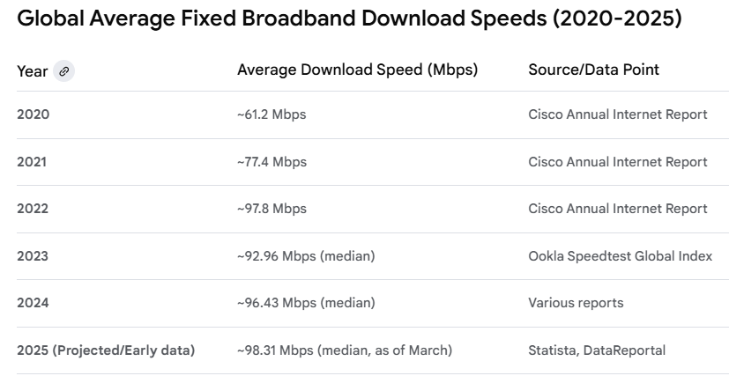

Slide 19
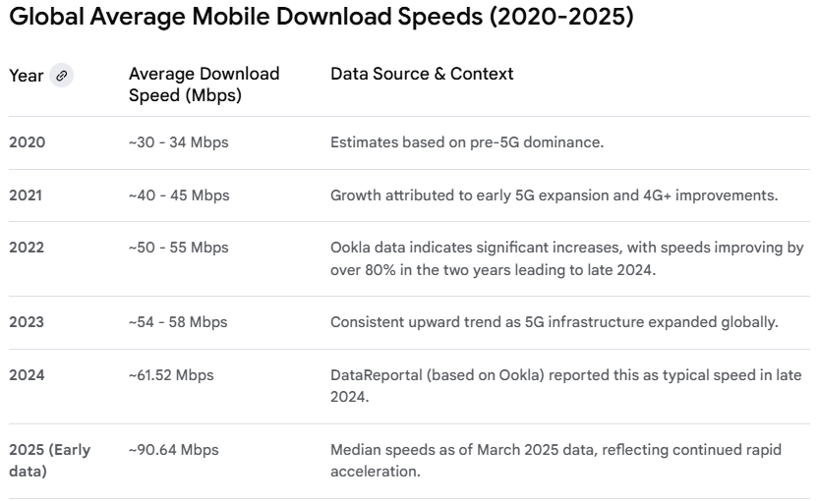

Slide 20
What Are the Components of I T Infrastructure?
Computer hardware platforms
Operating system platforms
Enterprise software applications
Data management and storage
Networking/telecommunications platforms
Internet platforms
Consulting system integration services

Slide 21
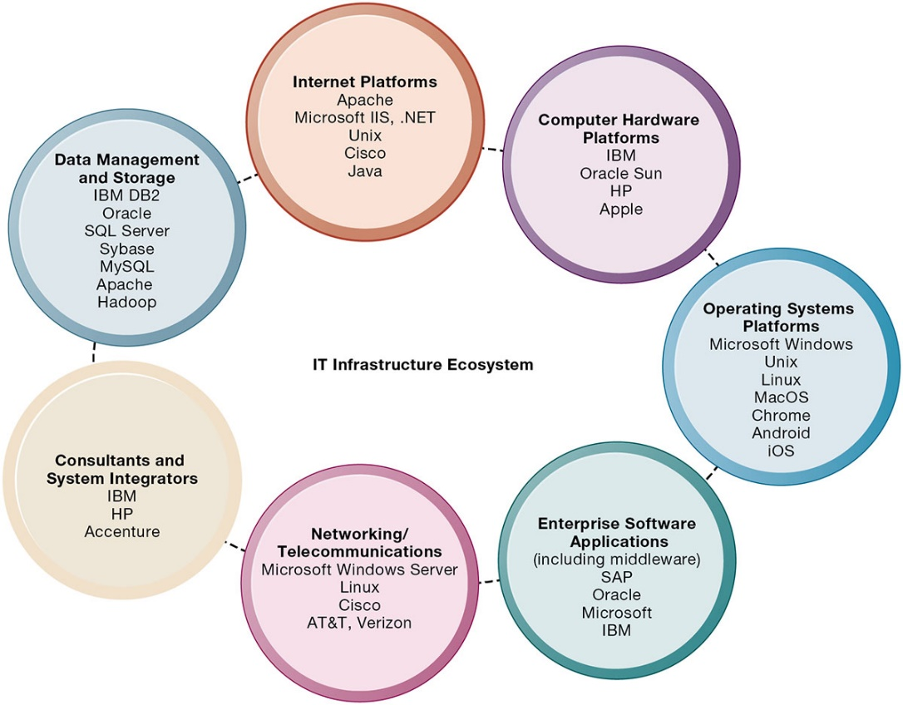
The I T Infrastructure Ecosystem

Slide 22
Computer Hardware Platforms
Client machines
Desktop P C s, laptops
Mobile computing: smartphones, tablets
Desktop chips vs. mobile chips
Servers
Mainframes
I B M mainframe
Digital workhorse for banking and telecommunications networks

Slide 23
Operating System Platforms
Corporate servers
Windows Server
Unix
Linux
Client level
Microsoft Windows, macOS, Linux
Android, i O S
…

Slide 24
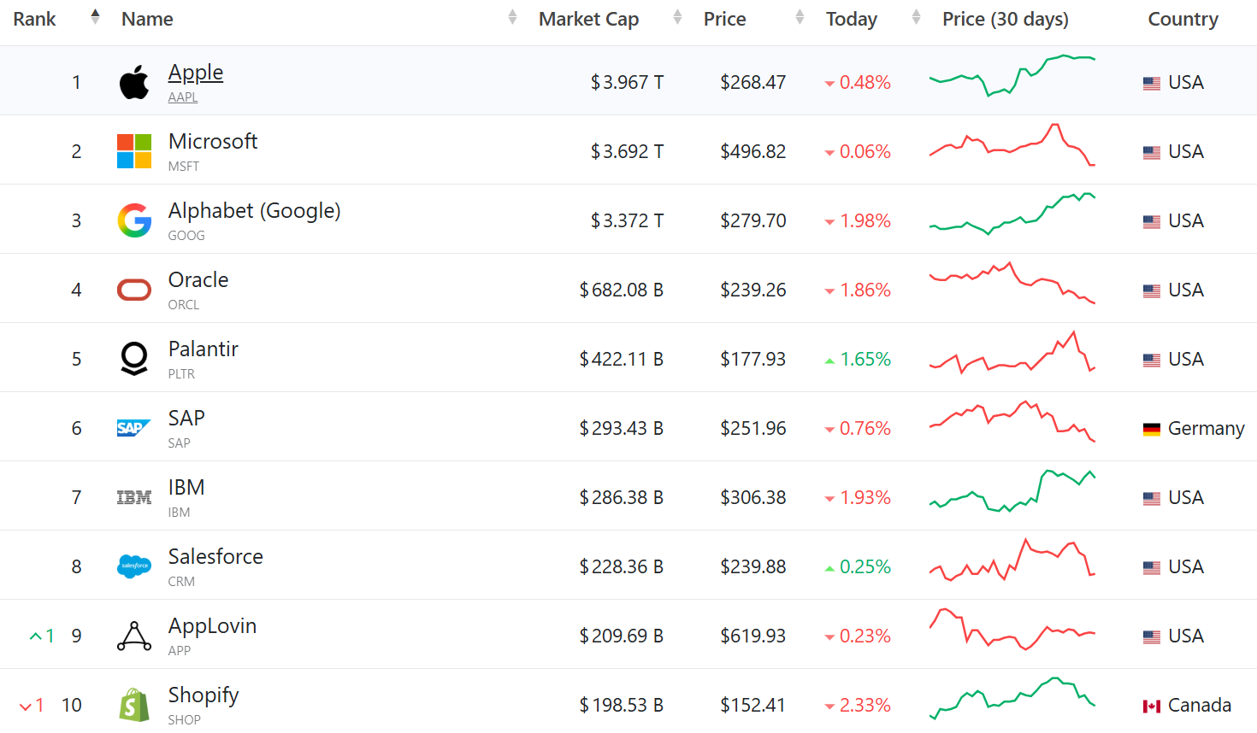
Enterprise Software Applications
Salesforce, Sap, Oracle, ServiceNow ...
https://companiesmarketcap.com/software/largest-software-companies-by-market-cap/

Slide 25
Data Management and Storage
SQL (relational)
I B M (D B 2)
Oracle
Microsoft (S Q L Server)
SAP Sybase (Adaptive Server Enterprise),
MyS Q L (Oracle)
NoSQL (nonrelational)
MongoDB
Couchbase
Cassandra
DynamoDB

Slide 26
Networking/Telecommunications Platforms
Network operating systems
Windows Server, Linux, Unix
Network hardware providers
Cisco, Checkpoint, Palo Alto, Fortinet
Telecommunication services
Telecommunications, cable, telephone company charges for voice lines and Internet access
A T&T, Verizon

Slide 27
What Are the Current Trends in Computer Hardware Platforms?
The mobile digital platform
Smartphones
Tablet computers
Digital e-book readers and apps (Kindle)
Wearable devices

Slide 28
What Are the Current Trends in Computer Hardware Platforms?
Virtualization
Allows single physical resource to act as multiple resources (i.e., run multiple instances of O S); also enables multiple physical resources (such as storage devices) to appear as a single logical resource (such as in software-defined storage (SDS))
Reduces hardware and power expenditures
Facilitates hardware centralization
Microservices and containers

Slide 29


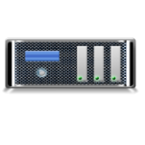

Containers Vs. Virtual Machines
Virtualization is the ability to run multiple operating systems on a single physical system and share the underlying resources such as a server, storage device, or network
Containers are placed on the top of one physical server and host operating system, and share the operating system’s kernel binaries and libraries, thereby reducing the need for reproducing the OS
App1
App2
App3
Bins/Libs
Bins/Libs
Bins/Libs
App1
App2
App3
Guest OS
Guest OS
Guest OS
Bins/Libs
Bins/Libs
Bins/Libs
Hypervisor
Container Engine
Host Operating System
Host Operating System
Infrastructure
Infrastructure
Virtual Machines
Containers

Slide 30
Containers
lightweight, standalone, and executable package that includes everything needed to run a piece of software, including the code, runtime, libraries, and system tools

Slide 31
Containers (key features)
Isolation: Containers encapsulate an application and its dependencies, isolating it from the underlying system and other containers. This isolation ensures that applications run consistently regardless of the environment.
Portability: Containers can run on any system that supports containerization, providing portability across different environments, from development to testing to production.
Efficiency: Containers share the host operating system's kernel, making them more lightweight compared to traditional virtual machines. They start up quickly and consume fewer resources.
Orchestration: Container orchestration tools, such as Kubernetes and Docker Swarm, help manage and automate the deployment, scaling, and operation of containerized applications.
Microservices: Containers are often used in a microservices architecture, where an application is composed of small, independently deployable services. Each microservice can run in its own container.

Slide 32

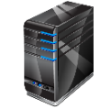
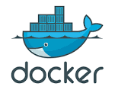






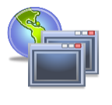




What is Docker?
Docker is an open source technology used for developing, packaging, and running applications and all its dependencies in the form of containers, to ensure that the application works in a seamless environment
Docker provides a Platform-as-a-Service (PaaS) through OS-level virtualization and delivers containerized software packages
Docker Engine
Docker Architecture
Client
Docker Host
Registry
Client Docker CLI
Manages
Manages
DAEMON
Containers
Docker Build
Rest API
Images
Docker Pull
Server Docker daemon
Manages
Manages
Docker Run
Network
Data Volumes
Build
Pull
Containers
Images
Run

Slide 33
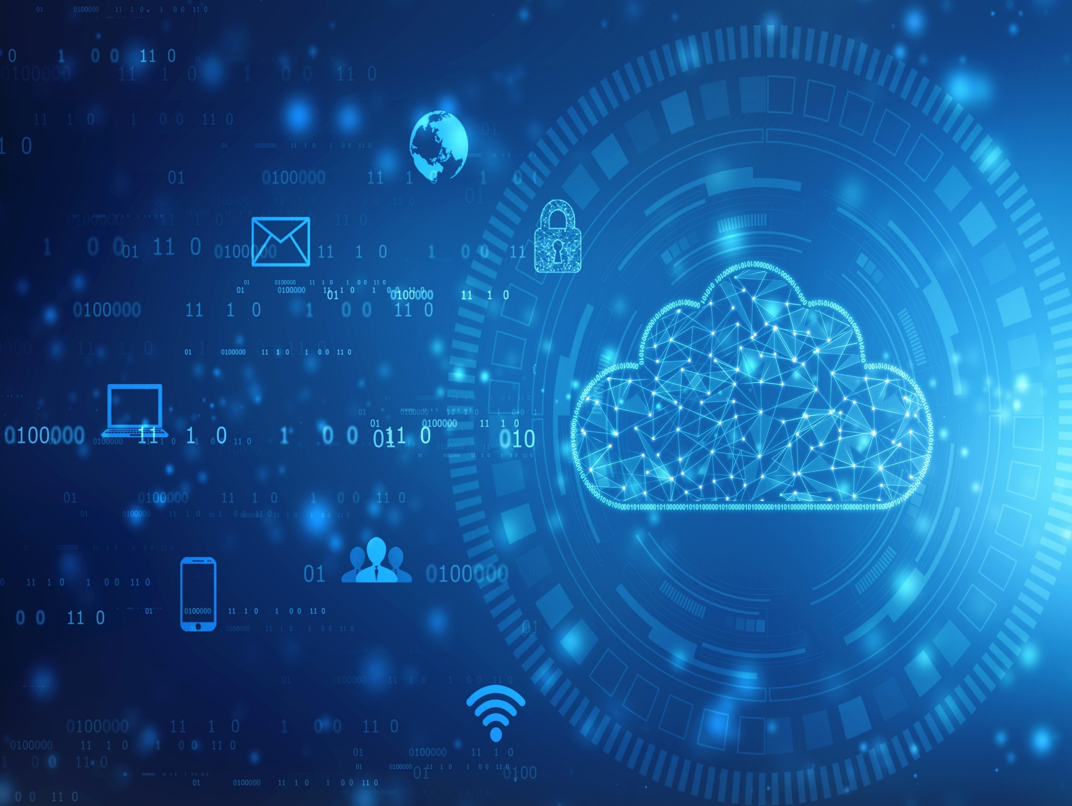
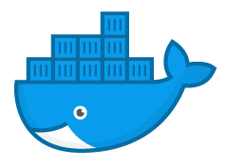






Container Orchestration
An automated process of managing the lifecycles of software containers and their dynamic environments
It is used for scheduling and distributing the work of individual containers for microservices-based applications spread across multiple clusters
Container Orchestration Software
Automate Tasks
Application environment with multiple containers
Scaling
Provisioning
Deployment
Configuration
Availability
Security
Health monitoring
Load balancing
Resource allocation
Docker Swarm
Kubernetes

Slide 34






Microservices Vs. Monolithic
Monolithic applications are broken down into cloud-hosted sub-applications called microservices that work together, each performing a unique task
As each microservice is packaged into the Docker container along with the required libraries, frameworks, and configuration files, microservices belonging to a single application can be developed and managed using multiple platforms
Monolithic Application
Microservices Application
User Interface
App 1
App 2
Business Logic
Data Access Layer
Microservice
Microservice
Microservice
Microservice

Slide 35
Cloud Computing
Cloud computing is an on-demand delivery of IT capabilities where IT infrastructure and applications are provided to subscribers as a metered service over a network
Characteristics of Cloud Computing
1
On-demand self-service
5
Broad network access
2
Distributed storage
6
Resource pooling
3
Rapid elasticity
7
Measured service
4
Automated management
8
Virtualization technology

Slide 36
Types of Cloud Computing Services
Infrastructure-as-a-Service (IaaS)
SYS ADMINS
Provides virtual machines and other abstracted hardware and operating systems which may be controlled through a service API
E.g., Amazon EC2, Microsoft Azure, or Google
Platform-as-a-Service (PaaS)
DEVELOPERS
Offers development tools, configuration management, and deployment platforms on-demand that can be used by subscribers to develop custom applications
E.g., Google App Engine, Microsoft Azure
Software-as-a-Service (SaaS)
END
CUSTOMERS
Offers software to subscribers on-demand over the Internet
E.g., web-based office applications like Google Workspace, Salesforce CRM, or Microsoft Office

Slide 37
Types of Cloud Computing Services (Cont’d)
Identity-as-a-Service (IDaaS)
Container-as-a-Service (CaaS)
Offers IAM services including SSO, MFA, IGA, and intelligence collection
E.g., OneLogin, Centrify Identity Service, Microsoft Azure Active Directory, or Okta
END CUSTOMERS
Offers virtualization of container engines, and management of containers, applications, and clusters, through a web portal or API
E.g., Amazon AWS EC2, or Google Kubernetes Engine (GKE)
SYS ADMINS
Security-as-a-Service (SECaaS)
Function-as-a-Service (FaaS)
Provides penetration testing, authentication, intrusion detection, anti-malware, security incident, and event management services
E.g., eSentire MDR, Switchfast Technologies, OneNeck IT Solutions, or McAfee Managed Security Services
Provides a platform for developing, running, and managing application functionalities for microservices
E.g., AWS Lambda, Google Cloud Functions, Microsoft Azure Functions, or Oracle Cloud Fn
END CUSTOMERS
END CUSTOMERS

Slide 38




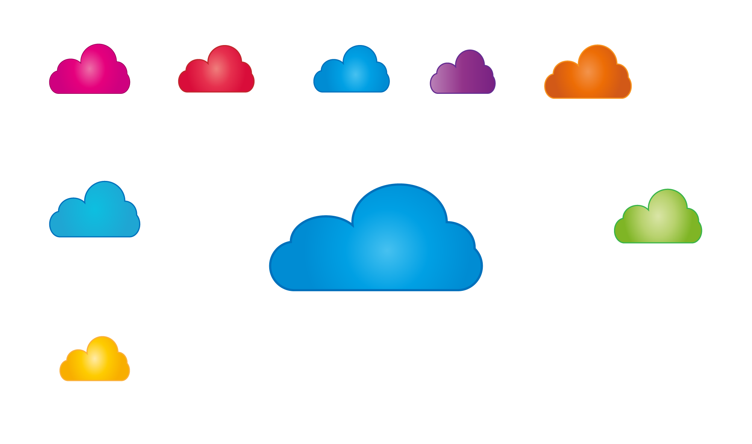


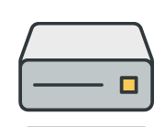
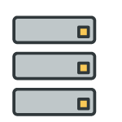



Cloud Deployment Models
Public Cloud
Services are rendered over a network that is open for public use
Users terminating the access
Users initiating access
Public users accessing the cloud via network
Computers in a network providing access
Cloud provider
Boundary Controller
Optional subscriber-controlled security perimeter
New
hardware
Users that access the cloud within the security perimeter
Old
hardware
Outside subscriber’s facility

Slide 39
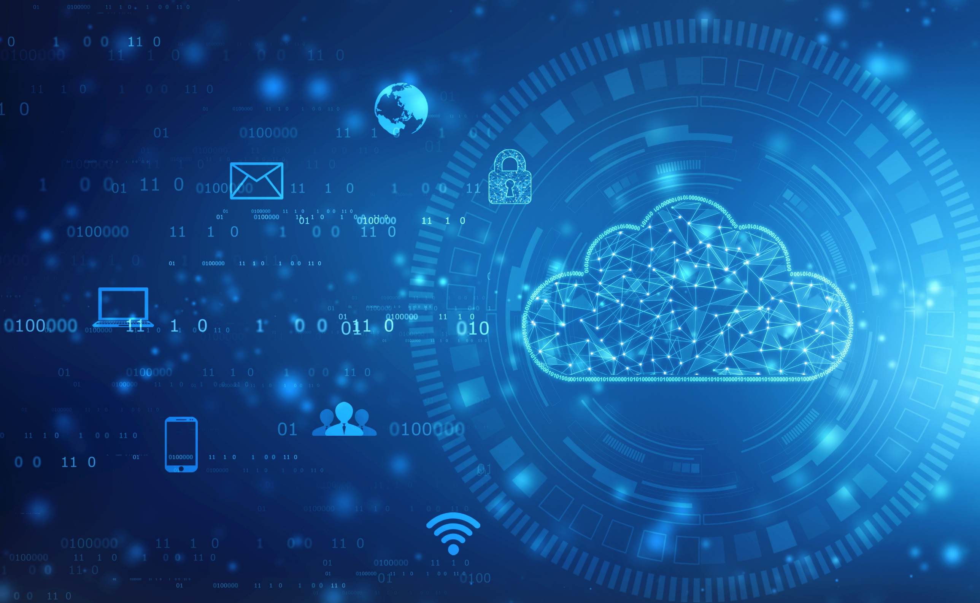






Cloud Deployment Models (Cont’d)
Private Cloud
Cloud infrastructure is operated for a single organization only
Legitimate access path
Boundary Controller
Subscriber controlled security perimeter
Inside
Private cloud
Outside
Blocked
access
Users accessing cloud from within the perimeter

Slide 40
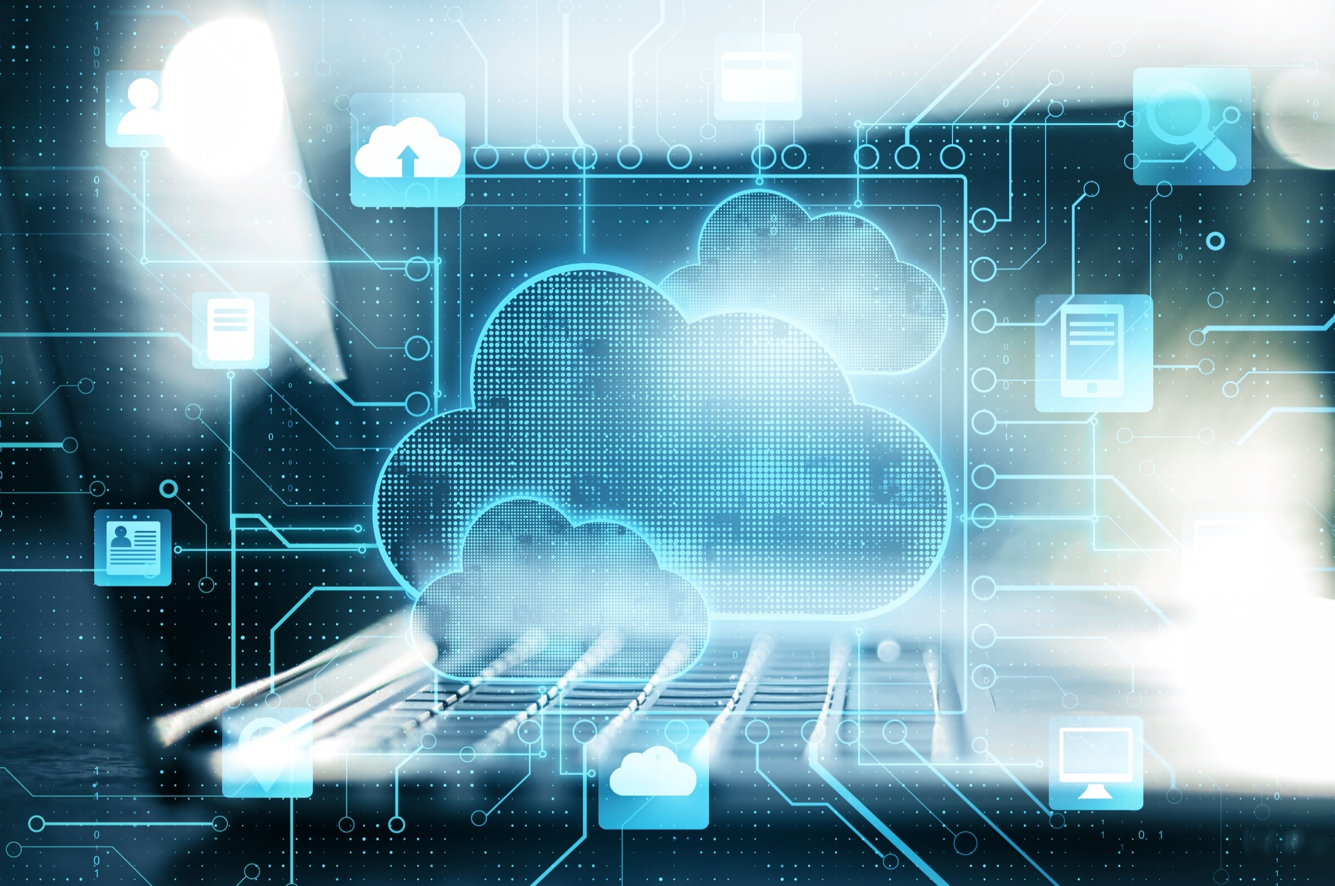
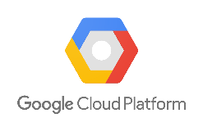
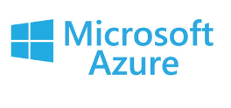
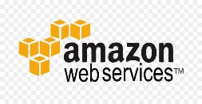
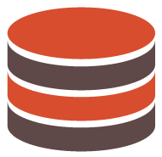

Cloud Deployment Models (Cont’d)
Dynamic heterogeneous environment that combines workloads across multiple cloud vendors, managed via one proprietary interface to achieve long term business goals
Multi Cloud
Application Data
Application Data
Public cloud
Public cloud
Application Data
Application Data
Public cloud
Private cloud
Companies/users consuming cloud resources

Slide 41



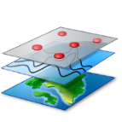




NIST Cloud Deployment Reference Architecture
NIST cloud computing reference architecture defines five major actors:
Cloud Consumer
A person or organization that uses cloud computing services
Cloud Provider
Cloud Provider
Service Layer
Cloud Service Management
A person or organization providing services to interested parties
Cloud Consumer
SaaS
Cloud Broker
Cloud Auditor
PaaS
Business Support
Service Intermediation
Cloud Carrier
Security audit
IaaS
An intermediary for providing connectivity and transport services between cloud consumers and providers
Provisioning/ Configuration
Privacy
Security
Service Aggregation
Privacy Impact Audit
Resource Abstraction and Control Layer
Performance Audit
Physical Resource Layer
Portability/ Interoperability
Service Arbitrage
Cloud Auditor
A party for making independent assessments of cloud service controls and taking an opinion thereon
Hardware
Facility
Cloud Broker
An entity that manages cloud services in terms of use, performance, and delivery, and maintains the relationship between cloud providers and consumers
Cloud Carrier

Slide 42
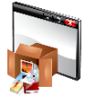
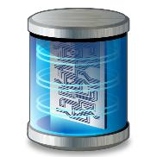
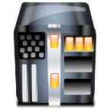
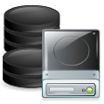
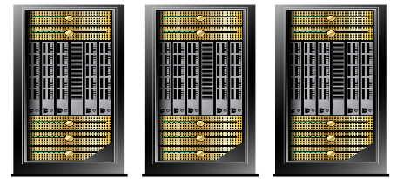
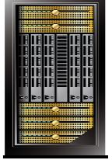
Cloud Storage Architecture
High Level Cloud Storage Architecture
Cloud storage is a data storage medium used to store digital data in logical pools using a network
Front-End
Public APIs for Data and Management
The cloud storage architecture consists of three main layers namely, front-end, middleware, and back-end
Virtual Computer Servers
Virtual Computer Servers
The Front-end layer is accessed by the end user where it provides APIs for the management of data storage
Object Storage
Block, File or Object Storage
Middleware
The Middleware layer performs several functions such as data de-duplication and replication of data
Logical Storage Pools
Physical Storage Servers
Physical Storage Servers
Back-End
The Back-end layer is where the hardware is implemented
Cloud Service Location 1
Location n

Slide 43
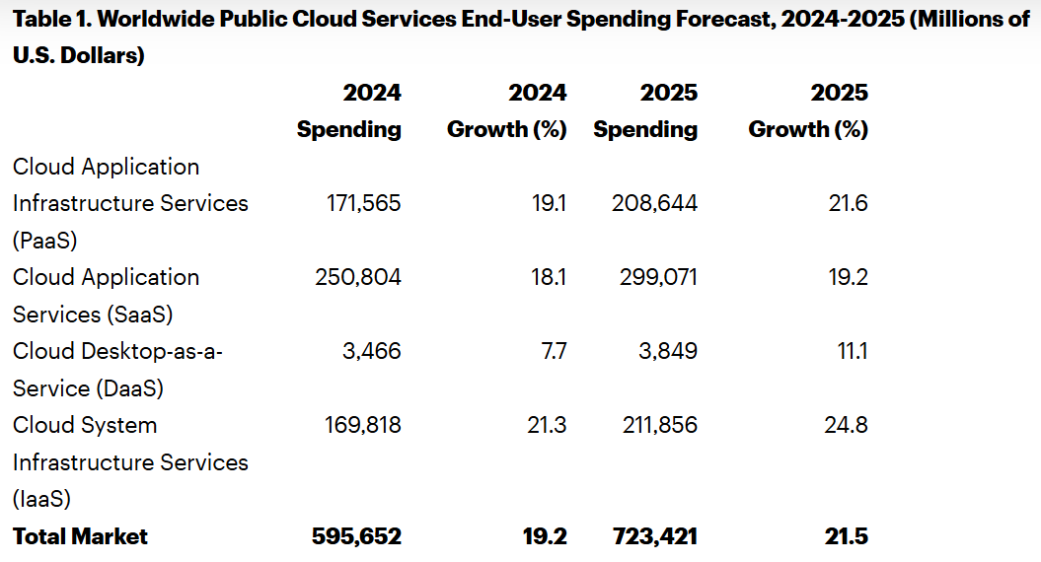

Slide 44
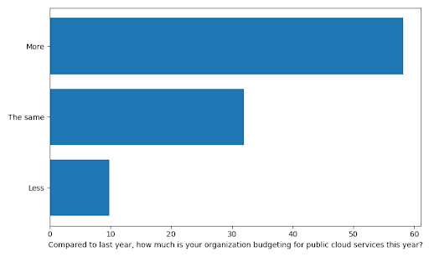
Cloud costs
https://cloudtweaks.com/2023/08/no-backing-away-from-cloud/

Slide 45
Cloud Costs
28% of the respondents said that they manage the number of instances in use dynamically, adding and terminating them as needed. Workloads that don’t vary day to day and hour to hour are the exception, not the rule, and we suspect that many companies do a poor job of managing their fleet of instances–and the ability to size infrastructure dynamically has always been a key selling point for the cloud.
An expanding tools ecosystem, including container orchestration tools like Kubernetes, can do a lot to keep an “instance farm” under control.
A third (34%) of the respondents are using cost optimization tools; all of the major cloud providers provide these tools, in addition to third-party vendors.

Slide 46








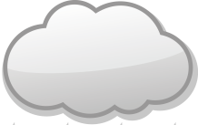








What is IoT?
Internet of Things (IoT), also known as Internet of Everything (IoE), refers to the network of devices having IP addresses and the capability to sense, collect, and send data using embedded sensors, communication hardware and processors
In IoT, the term thing is used to refer to a device that is implanted on natural, human-made, or machine-made objects and has the functionality of communicating over the network
Industrial Devices
Smart
Watch
Wearable Devices
Tools
Manufacturing
Wearable
Transportation
TVs
IoT
Health
Checkup
Monitoring
Devices
Thermostat
Healthcare Devices
Drugs
Energy
Home Devices

Slide 47
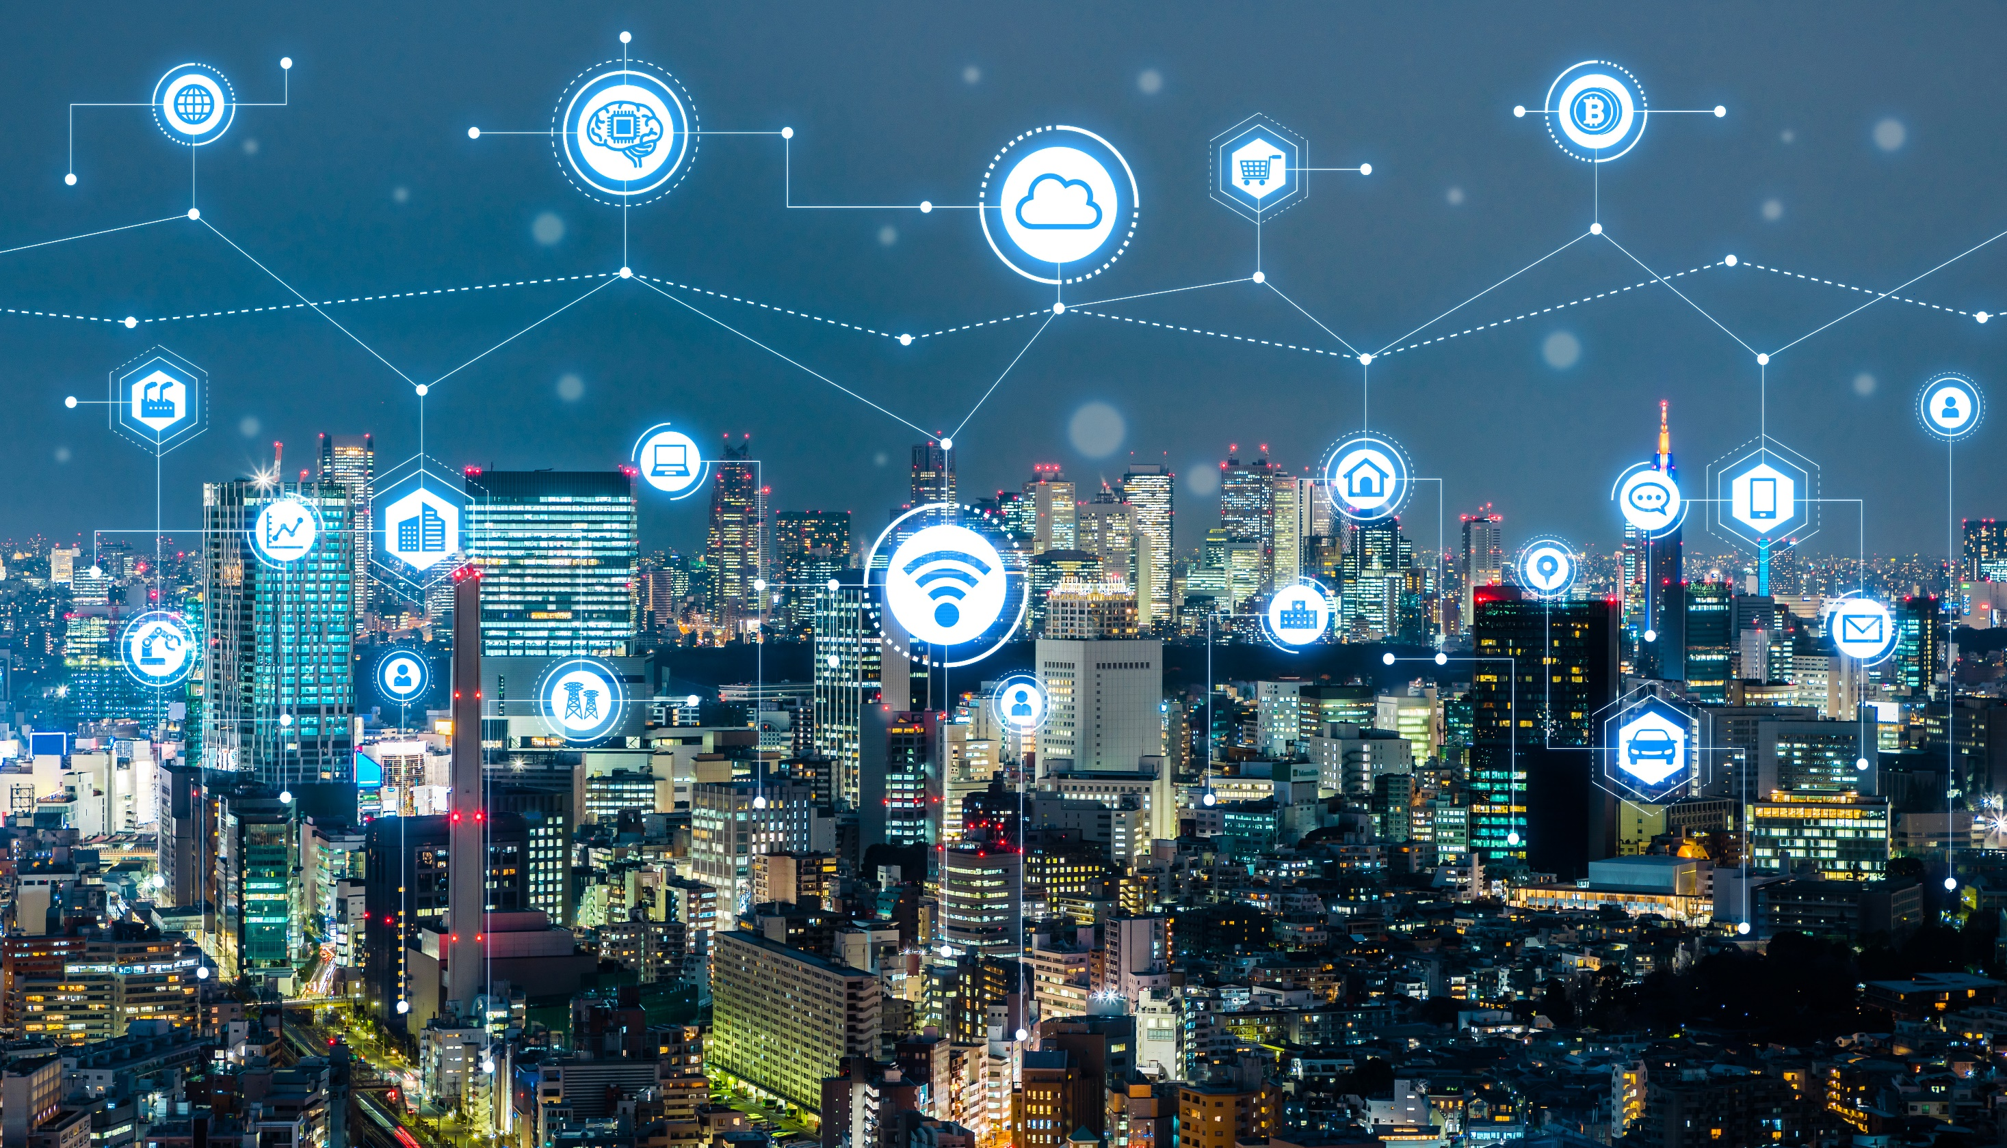
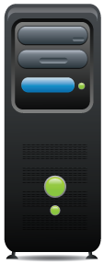


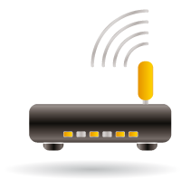

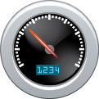



How the IoT Works
Humidity/Moisture
Store Data
Data Storage/ Cloud Server
Send Data Analysis
Temperature
Send Data
Receive Command
IoT Gateway
Pressure
Get Data Analysis
Internet
Send Command
Sound/Vibration
IoT Devices
Remote Control using Mobile App

Slide 48
IoT Application Areas and Devices
Service Sectors | Application Groups | Locations | Devices
Buildings | Commercial/Institutional | Office, Education, Retail, Hospitality, Healthcare, Airports, Stadiums | HVAC, Transport, Fire & Safety, Lighting, Security, Access, etc.
 | Industrial | Process, Clean Room, Campus
Energy | Supply/Demand | Power Gen, Trans & Dist, Low Voltage, Power Quality, Energy management | Turbines, Windmills, UPS, Batteries, Generators, Meters, Drills, Fuel Cells, etc.
 | Alternative | Solar Wind, Co-generation, Electrochemical
 | Oil/Gas | Rigs, Derricks, Heads, Pumps, Pipelines
Consumer and Home | Infrastructure | Wiring, Network Access, Energy management | Digital Cameras, Power Systems, MID, e-Readers, Dishwashers, Desktop Computers, Washing Machines/Dryers, Meters, Lights, TVs, MP3 Devices, Games Consoles, Alarms, etc.
 | Awareness & Safety | Security/Alerts, Fire Safety, Elderly, Children, Power Protection
 | Convenience & Entertainment | HVAC/Climate, Lighting, Appliance, Entertainment
Healthcare and Life Science | Care | Hospital, ER, Mobile, POC, Clinic, Labs, Doctor Office | MRI Machines, PDAs, Implants, Surgical Equipment, Pumps, Monitors, Telemedicine, etc.
 | In Vivo/Home | Implants, Home, Monitoring Systems
 | Research | Drug Discovery, Diagnostics, Labs
Transportation | Non-Vehicular | Air, Rail, Marine | Vehicles, Lights, Ships, Planes, Signage, Tolls, etc.
 | Vehicles | Consumer, Commercial, Construction, Off-Highway
 | Trans Systems | Tolls, Traffic mgmt., Navigation
http://www.beechamresearch.com

Slide 49
IoT Application Areas and Devices (Cont’d)
Service Sectors | Application Groups | Locations | Devices
Industrial | Resource Automation | Mining, Irrigation, Agricultural, Woodland | Pumps, Valves, Vats, Conveyors, Fabrication, Assembly/Packaging, Vessels/Tanks, etc.
 | Fluid/Processes | Petro-Chem, Hydro, Carbons, Food, Beverage
 | Converting/Discrete | Metals, Papers, Rubber/Plastic, Metalworking electronics, Assembly/Test
 | Distribution | Pipelines, Conveyance
Retail | Specialty | Fuel Stations, Gaming, Bowling, Cinemas, Discos, Special Events | POS Terminals, Tags, Cash Registers, Vending Machines, Signs, etc.
 | Hospitality | Hotels Restaurants, Bars, Cafes, Clubs
 | Stores | Supermarkets, Shopping Centers, Single Site, Distribution, Centers
Security / Public Safety | Surveillance | Radar/Satellite, Environ., Military Security, Unmanned, Fixed | Tanks, Fighter Jets, Battlefields, Jeeps, Cars, Ambulance, Homeland Security, Environment, Monitor, etc.
 | Equipment | Weapons, Vehicles, Ships, Aircraft, Gear
 | Tracking | Human, Animal, Postal, Food, Health, Baggage
 | Public Infrastructure | Water, Treatment, Building, Environ. Equip. & Personnel, Police, Fire, Regulatory
 | Emergency Services | Ambulance, Police, Fire, Homeland Security
IT and Networks | Public | Services, E-Commerce, Data Centers, Mobile Carriers, ISPs | Servers, Storage, PCs, Routers, Switches, PBXs, etc.
 | Private Enterprise | IT/Data Center Office, Privacy Nets
http://www.beechamresearch.com

Slide 50
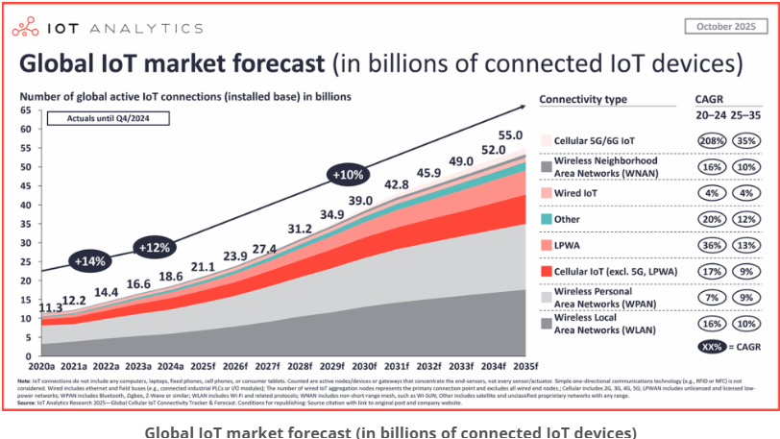

Slide 51
IoT Statistics
Total Connected Devices ~21.1 billion (as of Fall 2025)
Enterprise Spending Growth 10% (in 2024, expected to accelerate in 2025)
Market Value (Revenue) Projected to reach over $1 trillion in 2025
Top Connectivity Tech Wi-Fi (32%), Bluetooth (24%), Cellular (22%)
Top Enterprise Use Cases Real-time tracking/inventory, energy monitoring
Top Consumer Use Cases Internet-connected TVs (58% of EU users in 2024)

Slide 52
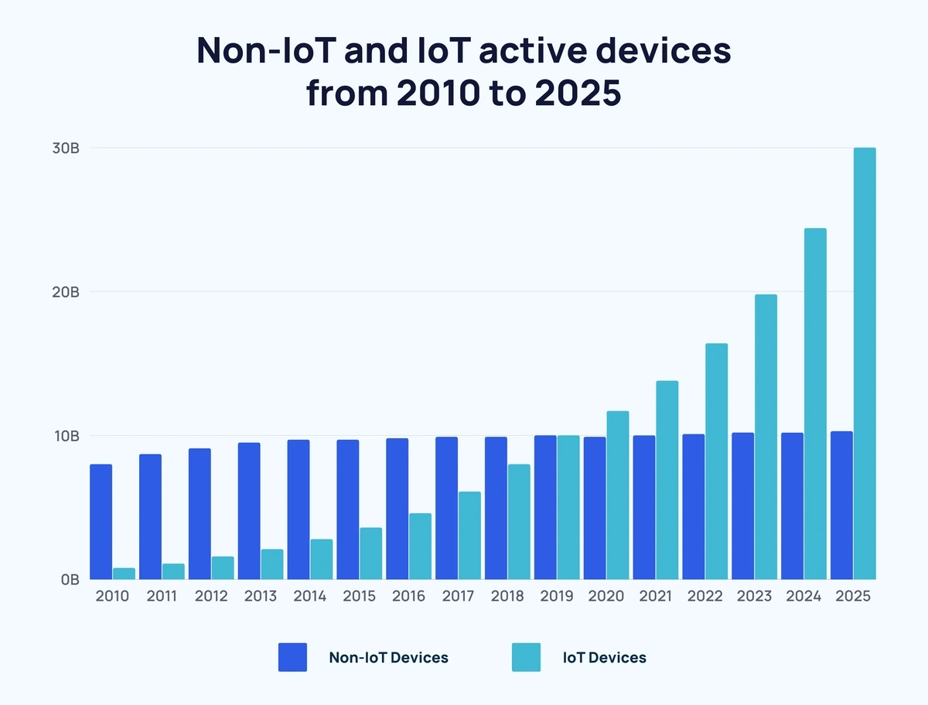

Slide 53
Management and Governance
Governance
Who controls I T infrastructure?
How should I T department be organized?
Centralized
Central I T department makes decisions
Decentralized
Business unit I T departments make own decisions
How are costs allocated between divisions, departments?

Slide 54
Making Wise Infrastructure Investments
Under-investment and over-investment can hamper firm performance
Rent-versus-buy
Cloud computing
Security requirements
Impact on business processes and workflow
Outsourcing

Slide 55
Total Cost of Ownership (T C O) Model
Analyzes direct and indirect costs
Hardware, software account for only about 20% of T C O
Other costs: Installation, training, support, maintenance, infrastructure, downtime, space, and energy

Slide 56
Competitive Forces Model for I T Infrastructure Investment
Market demand for firm’s services
Firm’s business strategy
Firm’s I T strategy, infrastructure, and cost
Information technology assessment
Competitor firm services
Competitor firm I T infrastructure investments

Slide 57
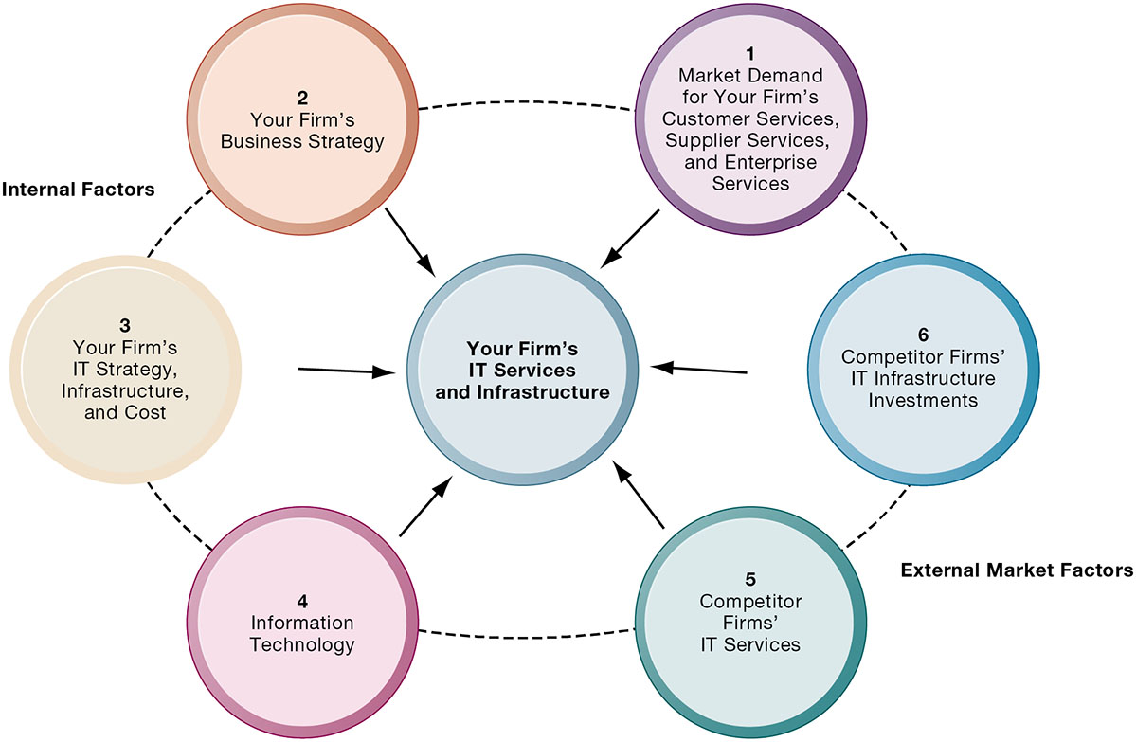
Competitive Forces Model for I T Infrastructure

Slide 58
Conlusion
Technology is rapidly changing
IT infrastructure crutial segment
Companies are forced to follow trends
Business strategy main drive

Slide 59
Hvala na pažnji!

