Slide 1
Managing information systems
Mr.sc Dražen Pranić
Notes:
Ažurirati naziv kolegija.

Slide 2
Agenda
Top 10 Strategic Technology Trends

Slide 3

Introduction

Slide 4
Top 10 Strategic Technology Trends
https://www.gartner.com/en/articles/top-technology-trends-2026
https://www.youtube.com/watch?v=5dgpcQXq1eo&list=PLk5mazZ3BVLLivwO_n81aM3IZqRFKs0eh

Slide 5
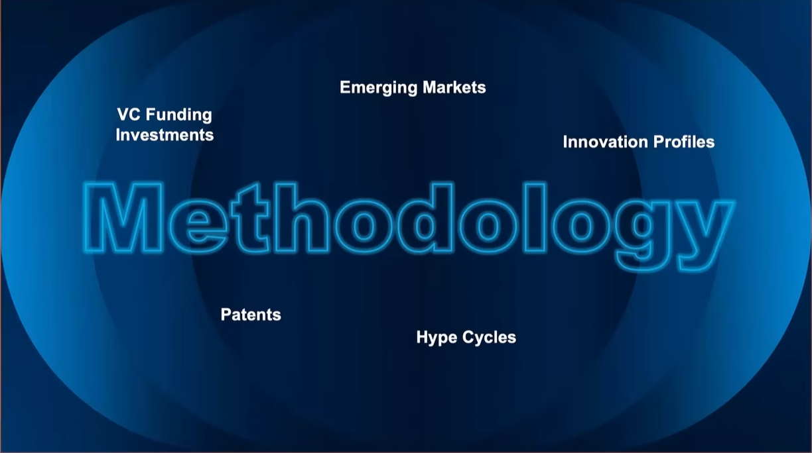

Slide 6
Navigating an AI-powered, hyperconnected world
Technology leaders face a pivotal year in 2026, where disruption, innovation and risk are accelerating at unprecedented speed.
The Gartner Top 10 Strategic Technology Trends for 2026 are more than technology shifts — they are catalysts for business transformation, demanding a C-Level response.
This year’s trends reflect the realities of an AI-powered, hyperconnected world where no single capability is enough.

Slide 7
Navigating an AI-powered, hyperconnected world
They are organized into three themes that define how leading organizations will innovate, compete and protect value:
The Arhitect - Build secure, scalable and adaptive digital foundations with AI-native development platforms, AI supercomputing and confidential computing.
The Synthesist - Orchestrate diverse technologies — from
multiagent systems to domain-specific language models and physical AI — to unlock new sources of value.
The Vanguard - Elevate trust, governance and security through preemptive cybersecurity, digital provenance, AI security platforms and geopatriation.

Slide 8
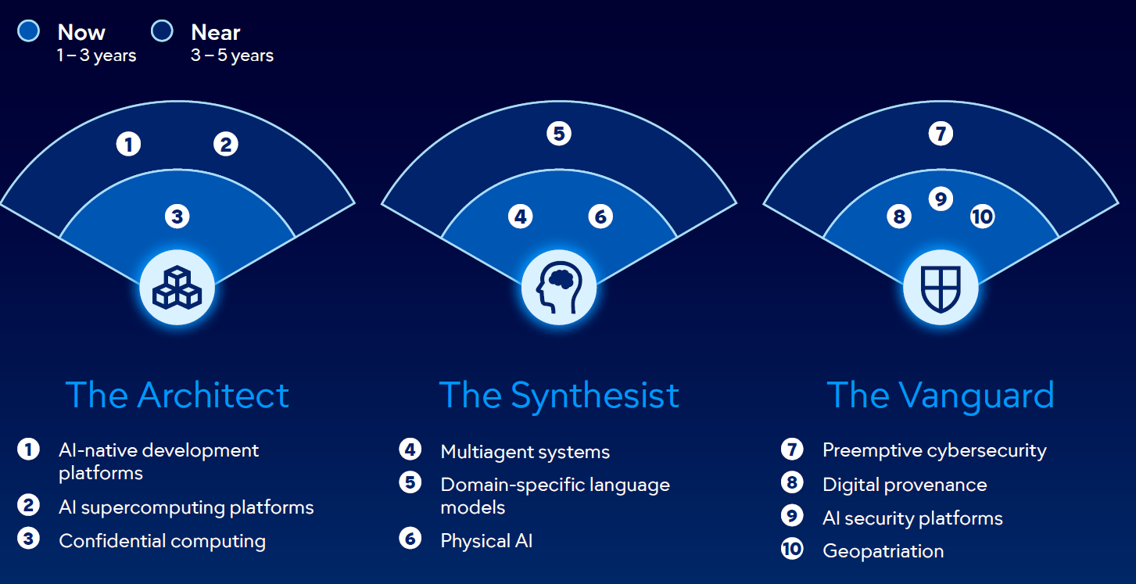

Slide 9
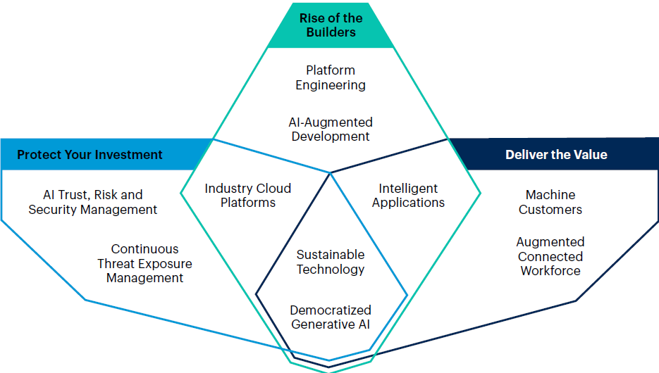
Top 10 Strategic Technology Trends 2025

Slide 10
AI-native development platforms
What is it?
AI-native development platforms use generative AI to create software faster and easier than ever before.
These platforms range from “one-shot” tools that generate software from a single prompt, through “vibe coding” tools that enable software development without deep technical knowledge, to AI agents orchestrated together to create software.

Slide 11
AI-native development platforms
Why trending?
CIOs are enthusiastic about faster software delivery and
productivity gains, while CEOs and CFOs recognize cost-saving
potential.
AI-native development platforms empower “tiny teams”
to build more applications with the same resources — enabling,
for example, five teams of two to deliver five applications at
once.
This trend helps CIOs address backlogs and shift the
„build vs. buy” equation toward building.

Slide 12
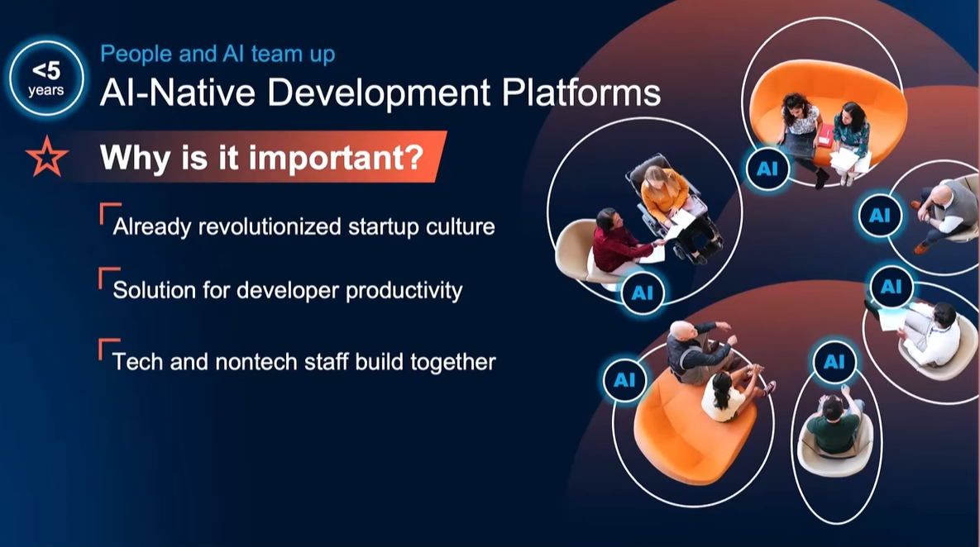

Slide 13
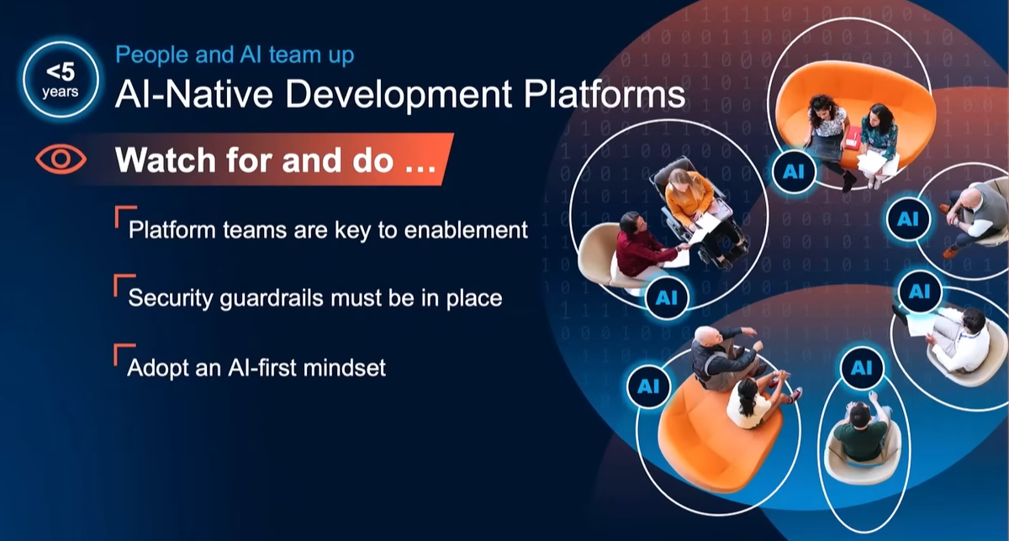

Slide 14
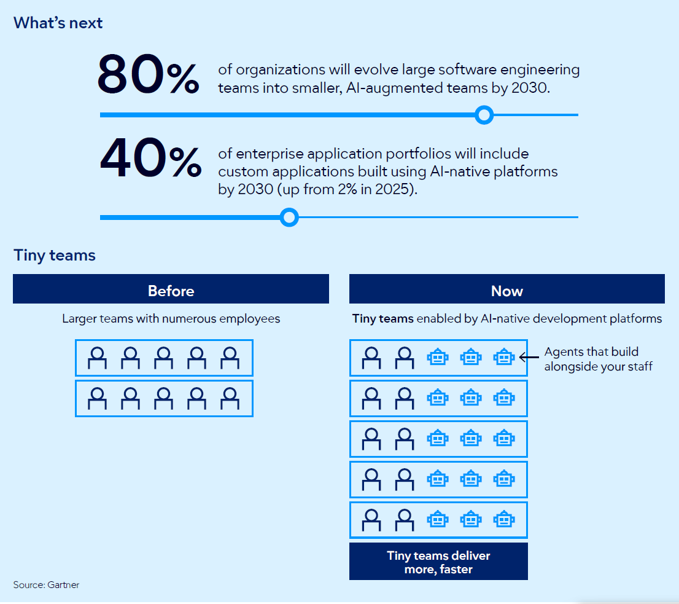

Slide 15
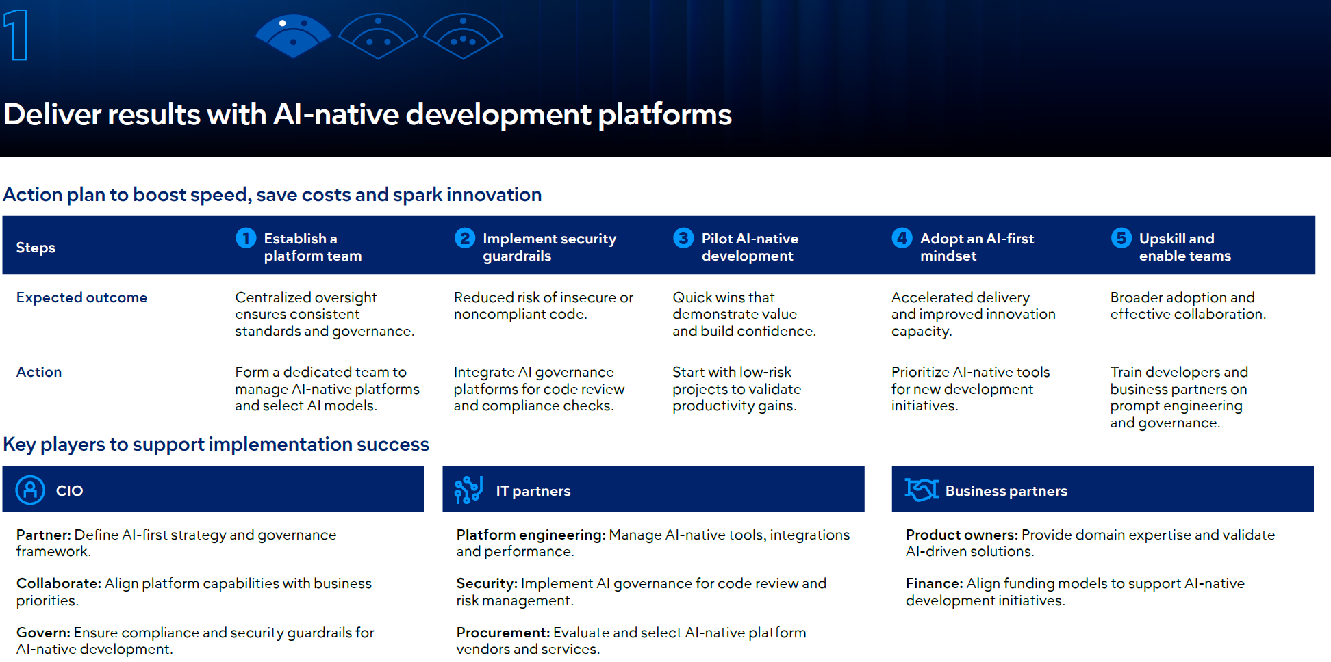

Slide 16
AI-native development platforms
Integrate AI governance platforms for code review and compliance checks.
Train developers and business partners on prompt engineering and governance.
https://generative-ai-course.hks.harvard.edu/2-using-genai/class-4

Slide 17
AI Agents
Agentic AI refers to software programs that are designed to independently make decisions and take actions to achieve specific goals.
These programs combine various AI techniques with features like memory, planning, sensing the environment, using tools and following safety guidelines to carry out tasks to reach

Slide 18
AI Agents
They don’t require explicit inputs and don’t produce predetermined outputs.
Instead, they can receive instructions, create a plan and use tooling to complete tasks, and produce dynamic outputs.
By 2028, 33% of enterprise software applications will include agentic AI, up from less than 1% in 2025, enabling 15% of day-to-day work decisions to be made autonomously.

Slide 19
AI Agents
Are LLM-based agents like ChatGPT considered intelligent agents in AI?
As of 2025, standalone LLM-based systems such as ChatGPT or Gemini are not intelligent agents in the strict AI sense, because they do not possess intrinsic agency, self-defined goals, or autonomous long-term planning. They remain reactive systems, generating outputs in response to user prompts based on probabilistic token prediction. However, when LLMs are integrated into agentic architectures that include planning, memory, tool execution, and feedback loops, they can function as components of intelligent agents, with agency emerging from the surrounding system rather than the LLM itself.

Slide 20
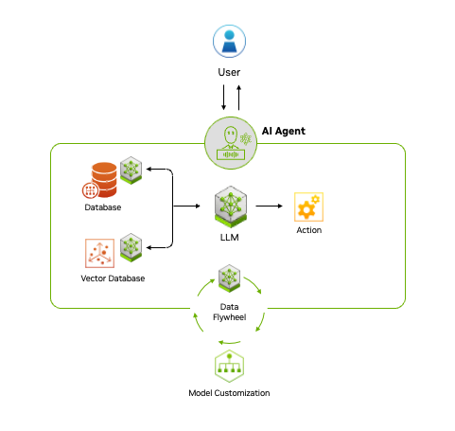
AI Agents
https://blogs.nvidia.com/blog/what-is-agentic-ai/

Slide 21
AI Agents and software development
The Effects of Generative AI on High Skilled Work: Evidence from Three Field Experiments with Software Developers: https://papers.ssrn.com/sol3/papers.cfm?abstract_id=4945566
analyzed data from over 4,800 developers at Microsoft, Accenture, and another Fortune 100 company who were given access to GitHub Copilot.

Slide 22
AI Agents and software development
Productivity Boost: Developers using Copilot completed 26% more tasks on average.
Code Volume Increase: The number of weekly code commits increased by 13.5%.
Faster Iteration: The frequency of code compilation rose by 38.4%.
Quality Maintained: No negative impact on code quality was observed.
Junior Developer Advantage: Less experienced developers saw the largest productivity gains.

Slide 23
AI supercomputing platforms
What is it?
AI supercomputing platforms deliver the massive processing power needed to train and run advanced AI models.
These systems combine high-performance computing (HPC), specialized processors and scalable architectures to handle data-intensive workloads.
Why trending?
Demand for AI supercomputing is surging as organizations develop larger, more complex models that exceed traditional infrastructure limits.

Slide 24
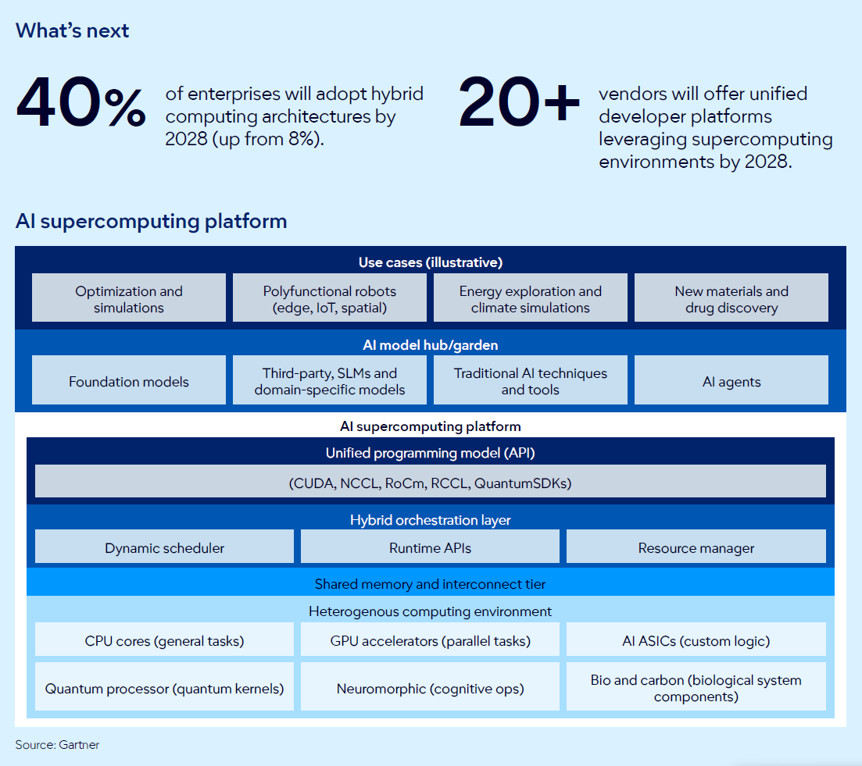

Slide 25
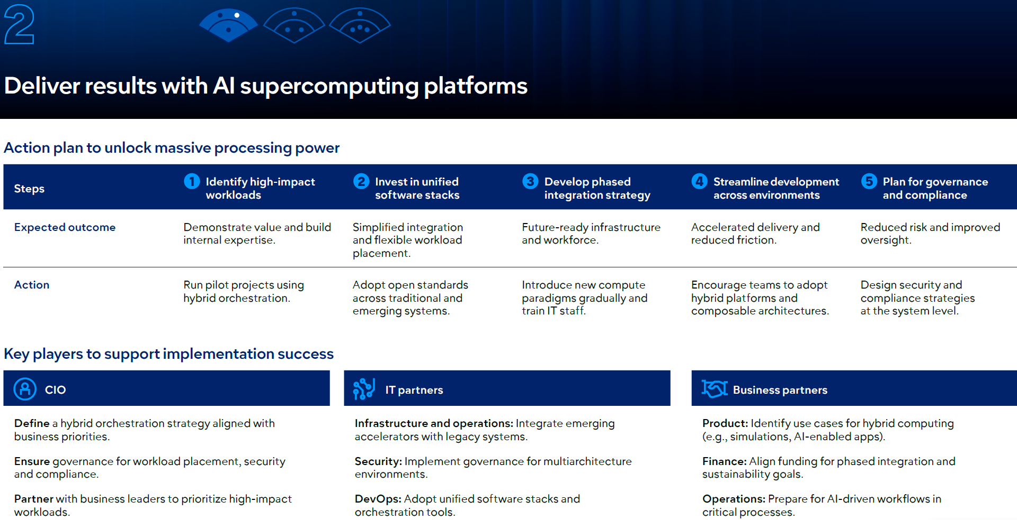

Slide 26
Confidential computing
What is it?
Confidential computing uses hardware-based trusted execution
environments (TEEs) to protect data while it’s being processed,
preventing unauthorized access — even from cloud providers.
Why trending?
Stricter privacy laws, data localization rules and AI adoption make in-use protection critical. Confidential computing enables secure cloud strategies and compliance for sensitive workloads.

Slide 27
Trusted Execution Environments (TEEs)
Isolation: The TEE is invisible to the rest of the system. Even the Operating System (OS), the Hypervisor, and the cloud provider’s administrators cannot see inside it.
Runtime Encryption: Data is decrypted only inside the enclave. If someone tries to perform a "memory dump" or an unauthorized process tries to peek at the RAM, they see only encrypted "garbage.„
Attestation: This is a critical Gartner-highlighted feature. It allows the workload to "prove" to the user that it is running on genuine, untampered hardware before any sensitive data is sent to it.

Slide 28
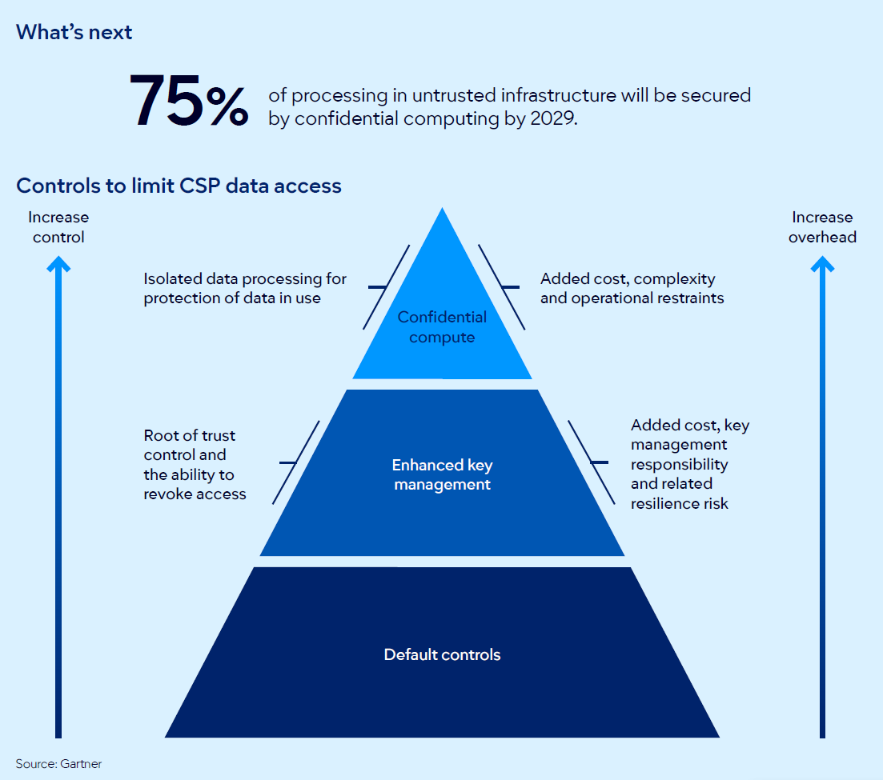

Slide 29
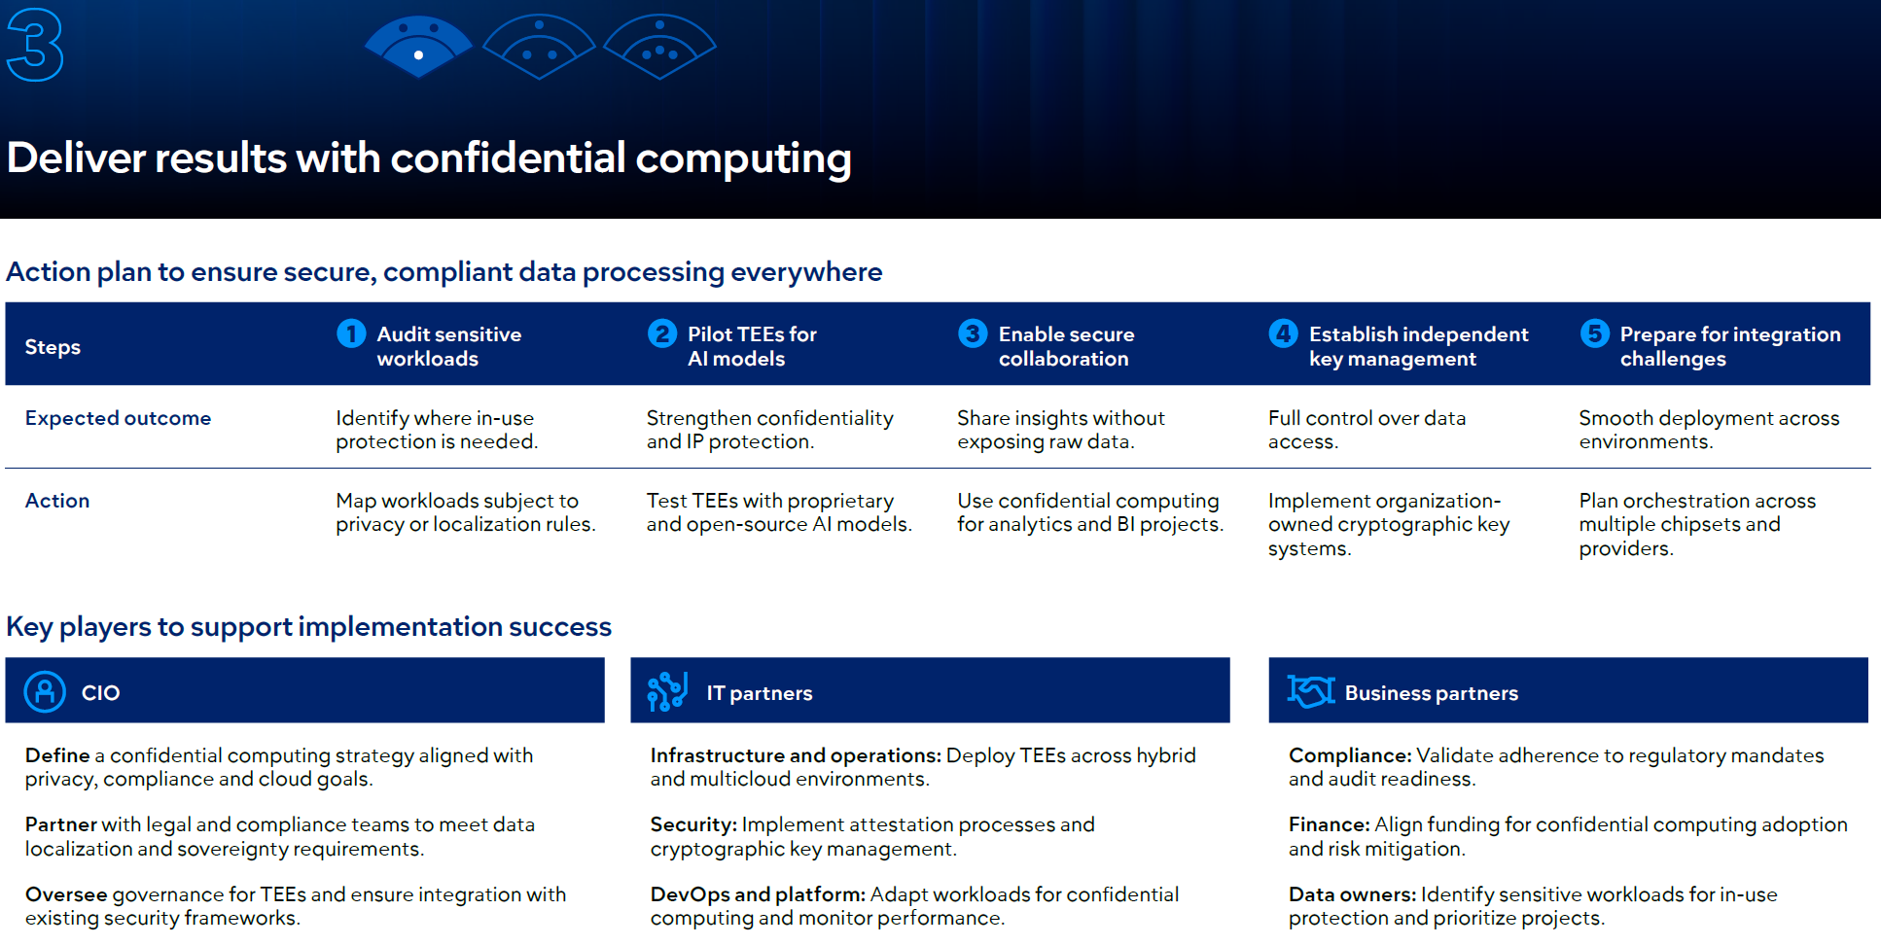

Slide 30
Confidential computing
Level 1: Default Controls (Base)
This represents the standard security features provided by a cloud provider out of the box. While necessary, they offer the lowest level of customer-led control over data access.
Level 2: Enhanced Key Management (Middle)
Capabilities: Provides a "Root of Trust" control and gives the organization the ability to revoke access to data.
Trade-offs: This level introduces added costs, increased responsibility for key management, and potential risks to operational resilience.
Level 3: Confidential Compute (Peak)
Capabilities: This is the highest tier, providing isolated data processing specifically for the protection of data in use. It ensures that data is encrypted even while being processed by the CPU.
Trade-offs: Implementing this requires navigating added costs, higher technical complexity, and specific operational restraints.

Slide 31
Multiagent systems
What is it?
Multiagent systems (MAS) use collections of specialized AI
agents that collaborate to complete complex workflows.
Each agent handles a specific task, improving efficiency and scalability compared to monolithic AI solutions.
Why trending?
As single-agent AI struggles with multistep processes, MAS
enable modular automation and cross-platform integration.
We report a 1,445% surge in MAS inquiries from 1Q24 to 2Q25,
signaling rapid enterprise interest.

Slide 32
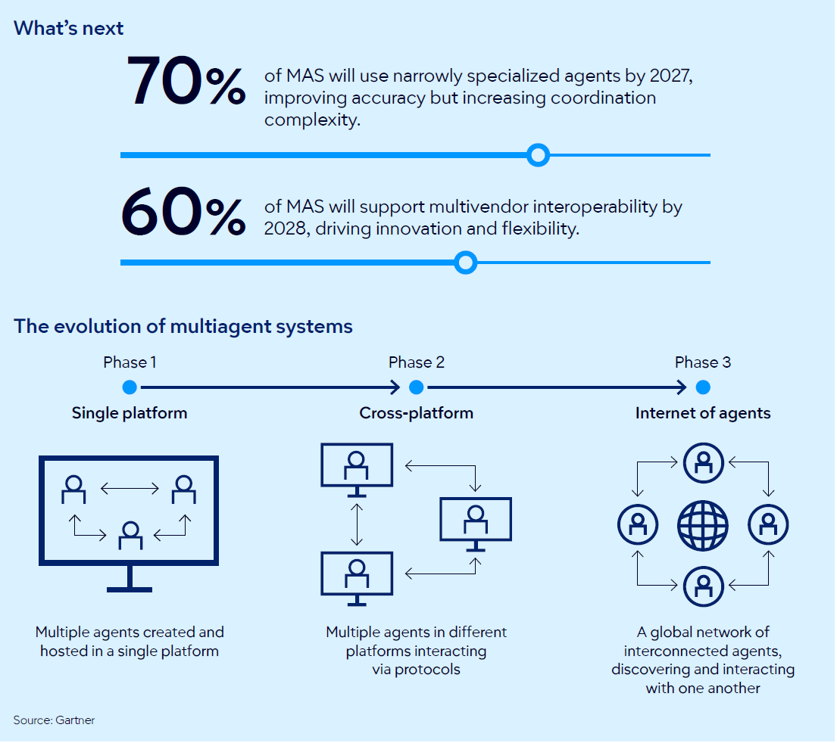

Slide 33
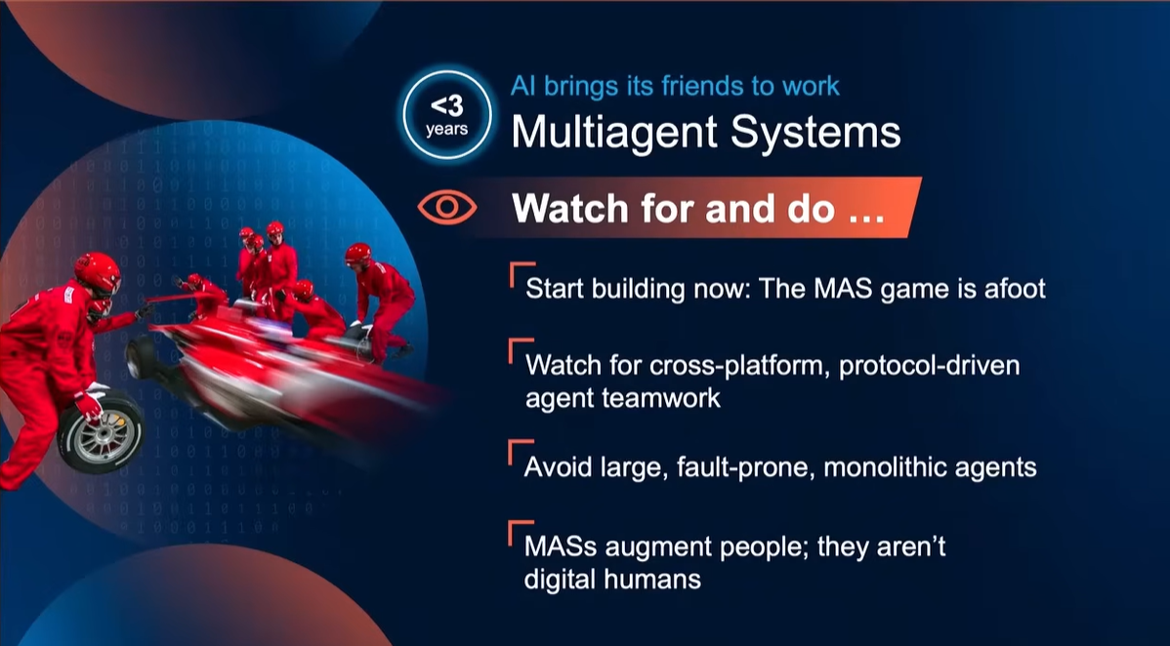

Slide 34
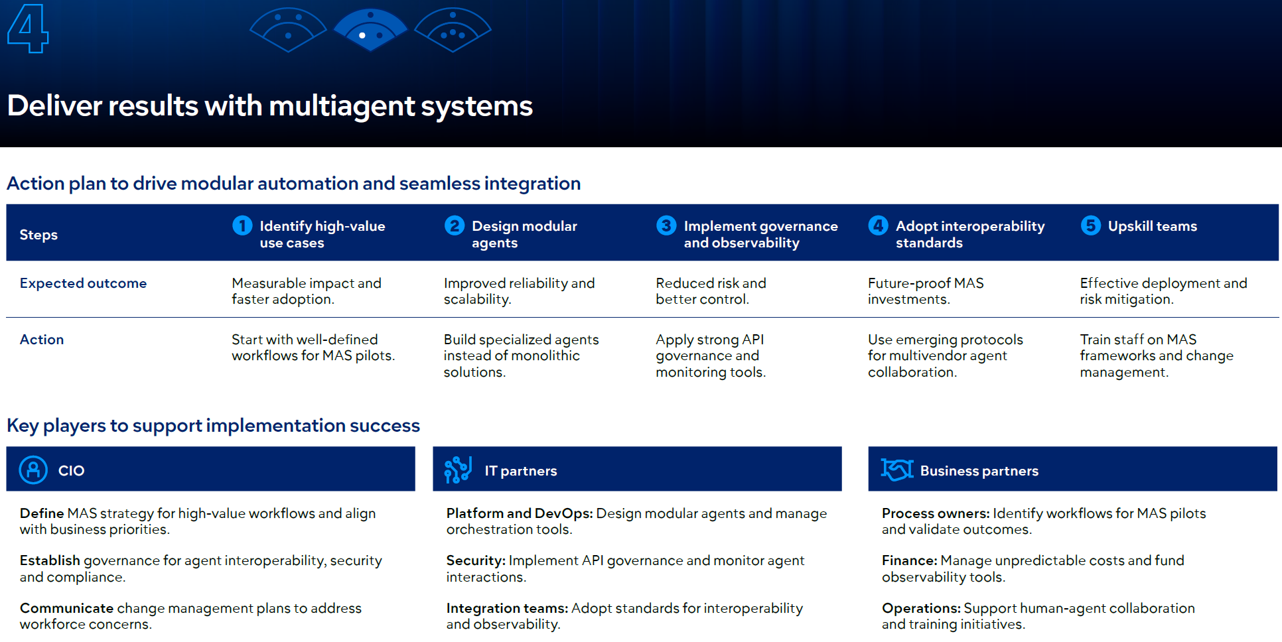

Slide 35
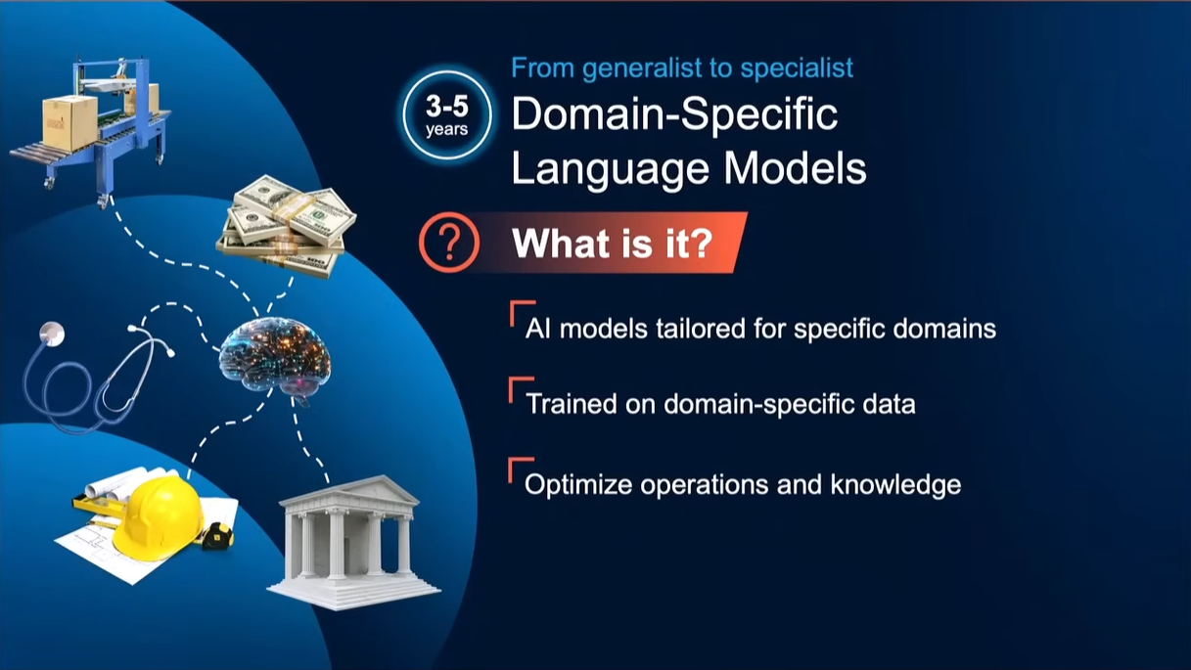

Slide 36
Domain-specific language models
What is it?
Domain-specific language models (DSLMs) are AI models trained on specialized datasets for specific industries or business functions, delivering higher accuracy and compliance than generic large language models (LLMs).
Why trending?
CIOs need measurable business value from AI. DSLMs reduce errors, accelerate deployment and cut costs for critical workflows like finance, healthcare and HR.

Slide 37
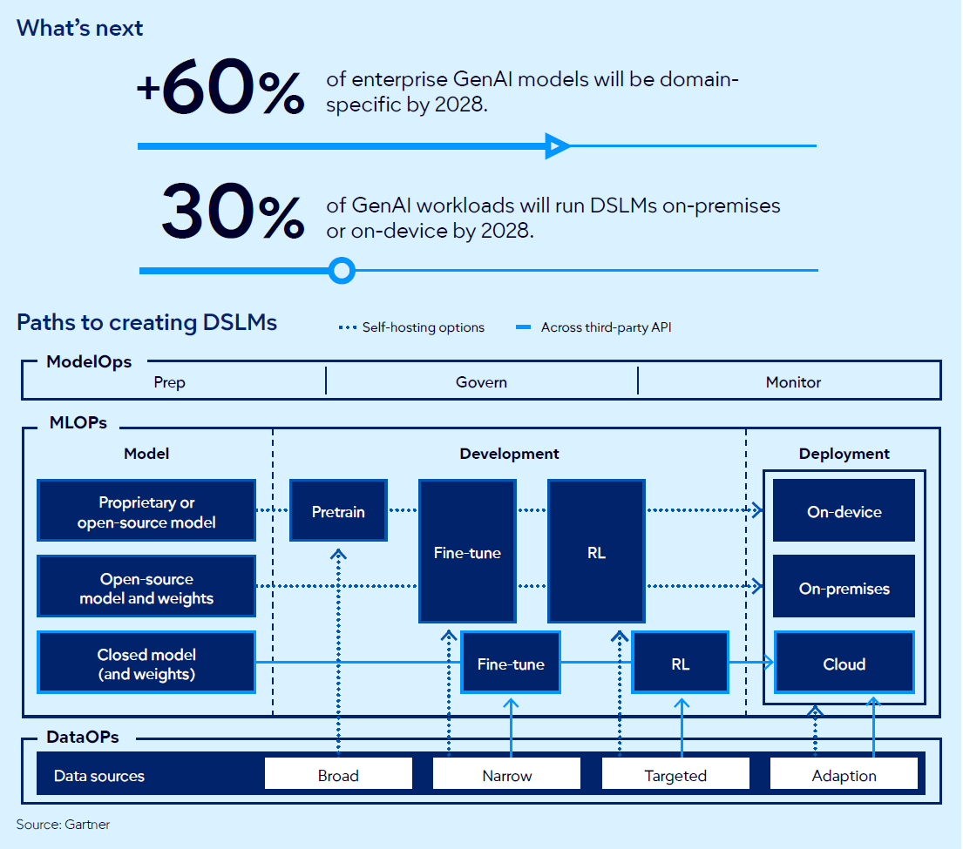

Slide 38
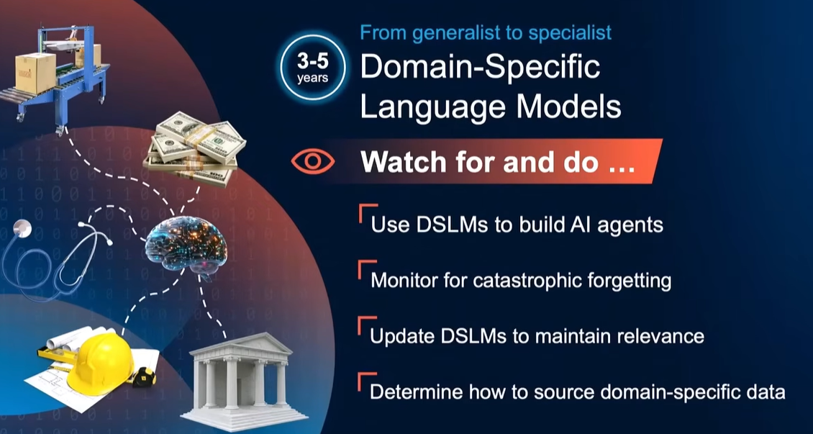

Slide 39
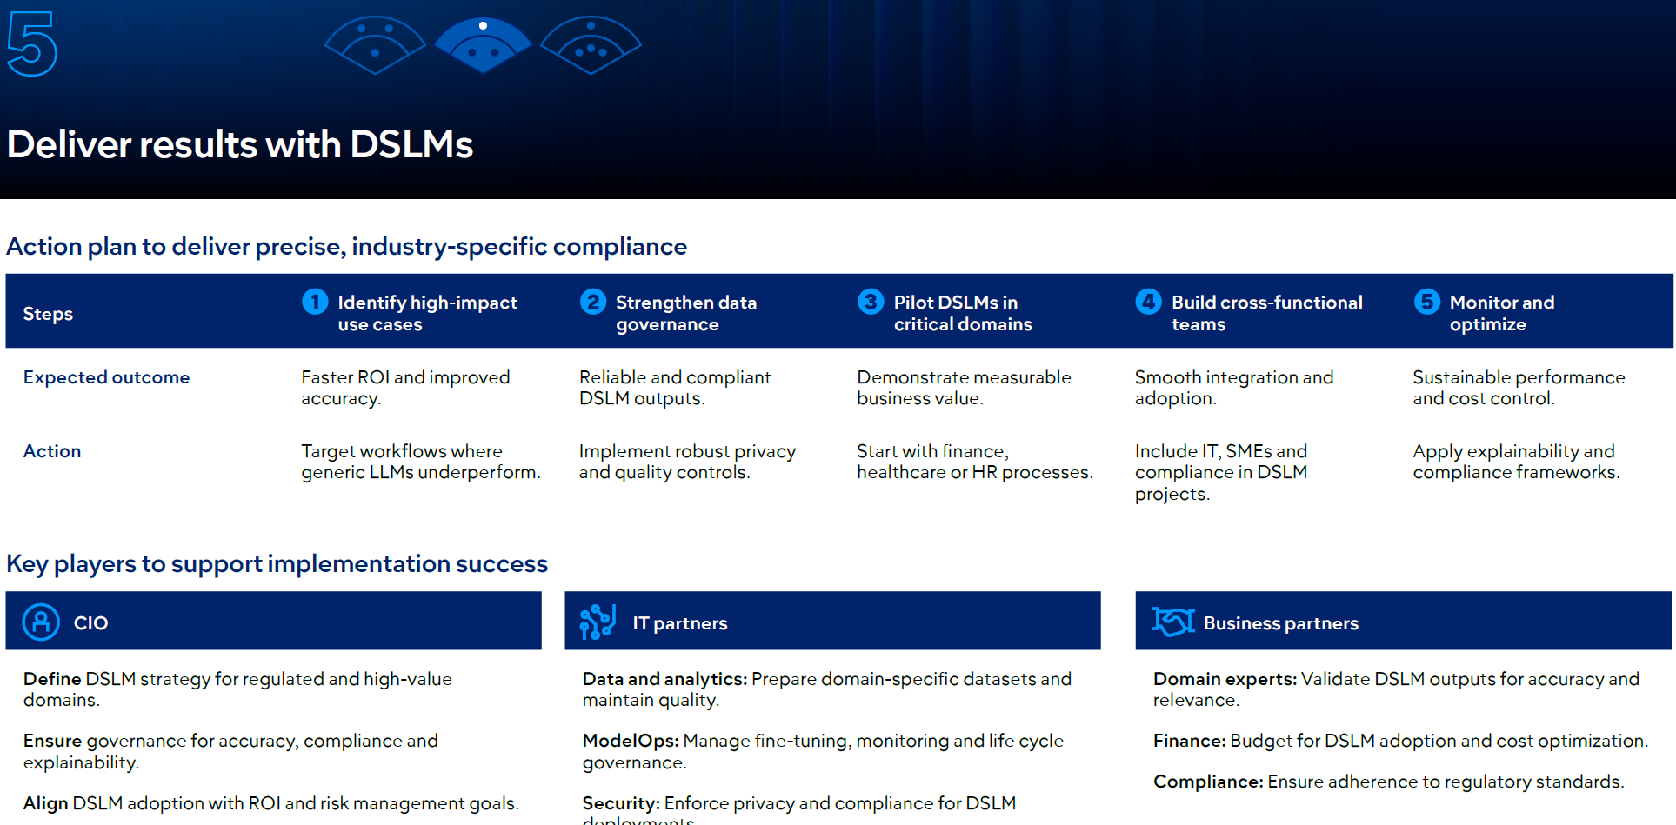

Slide 40
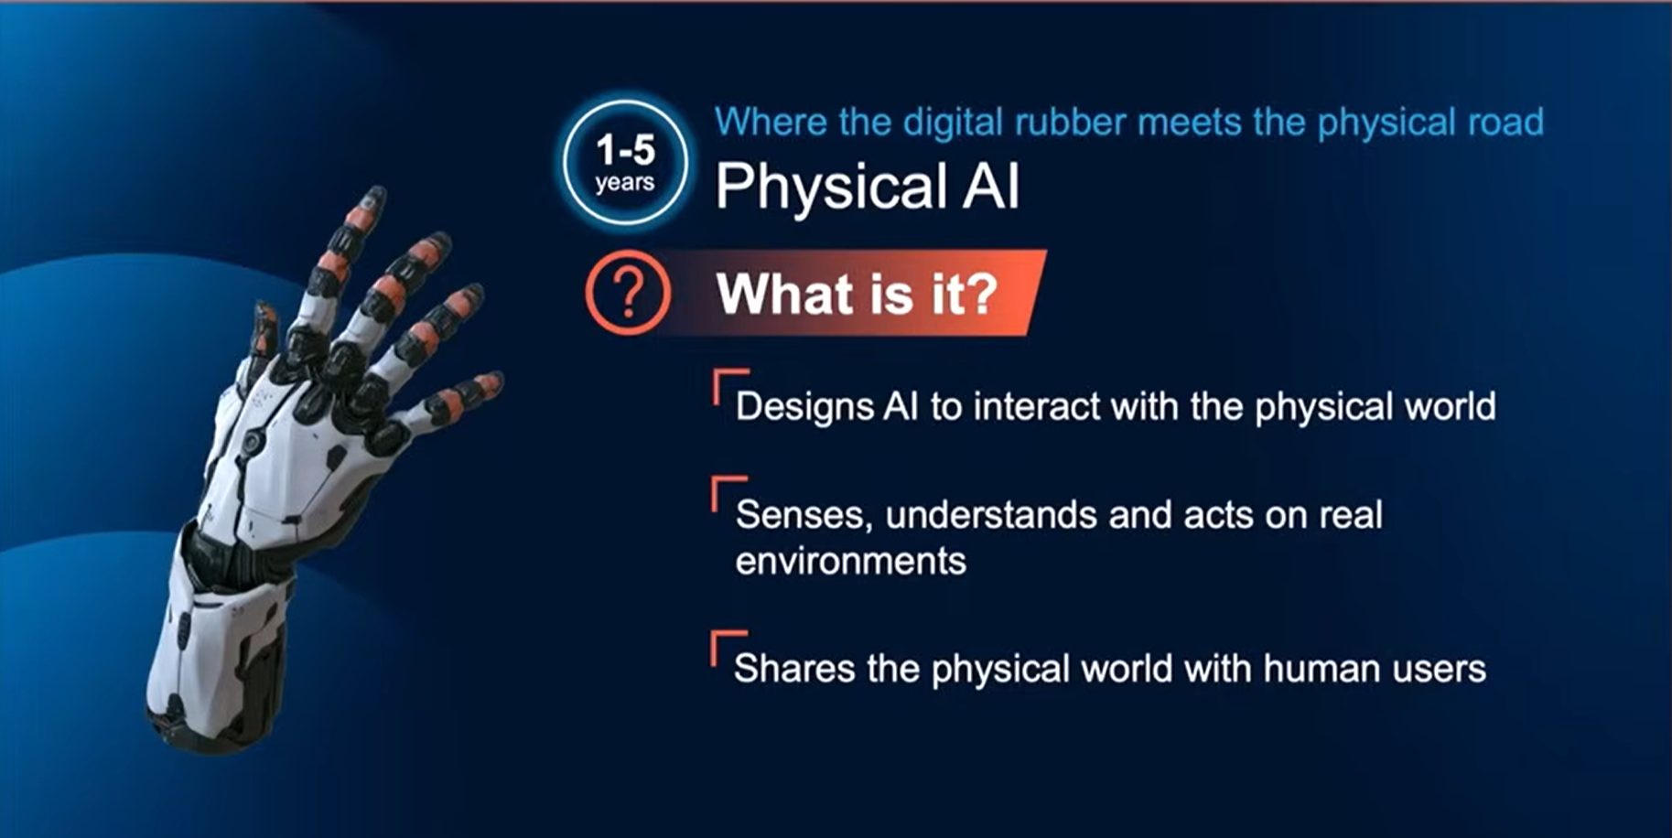

Slide 41
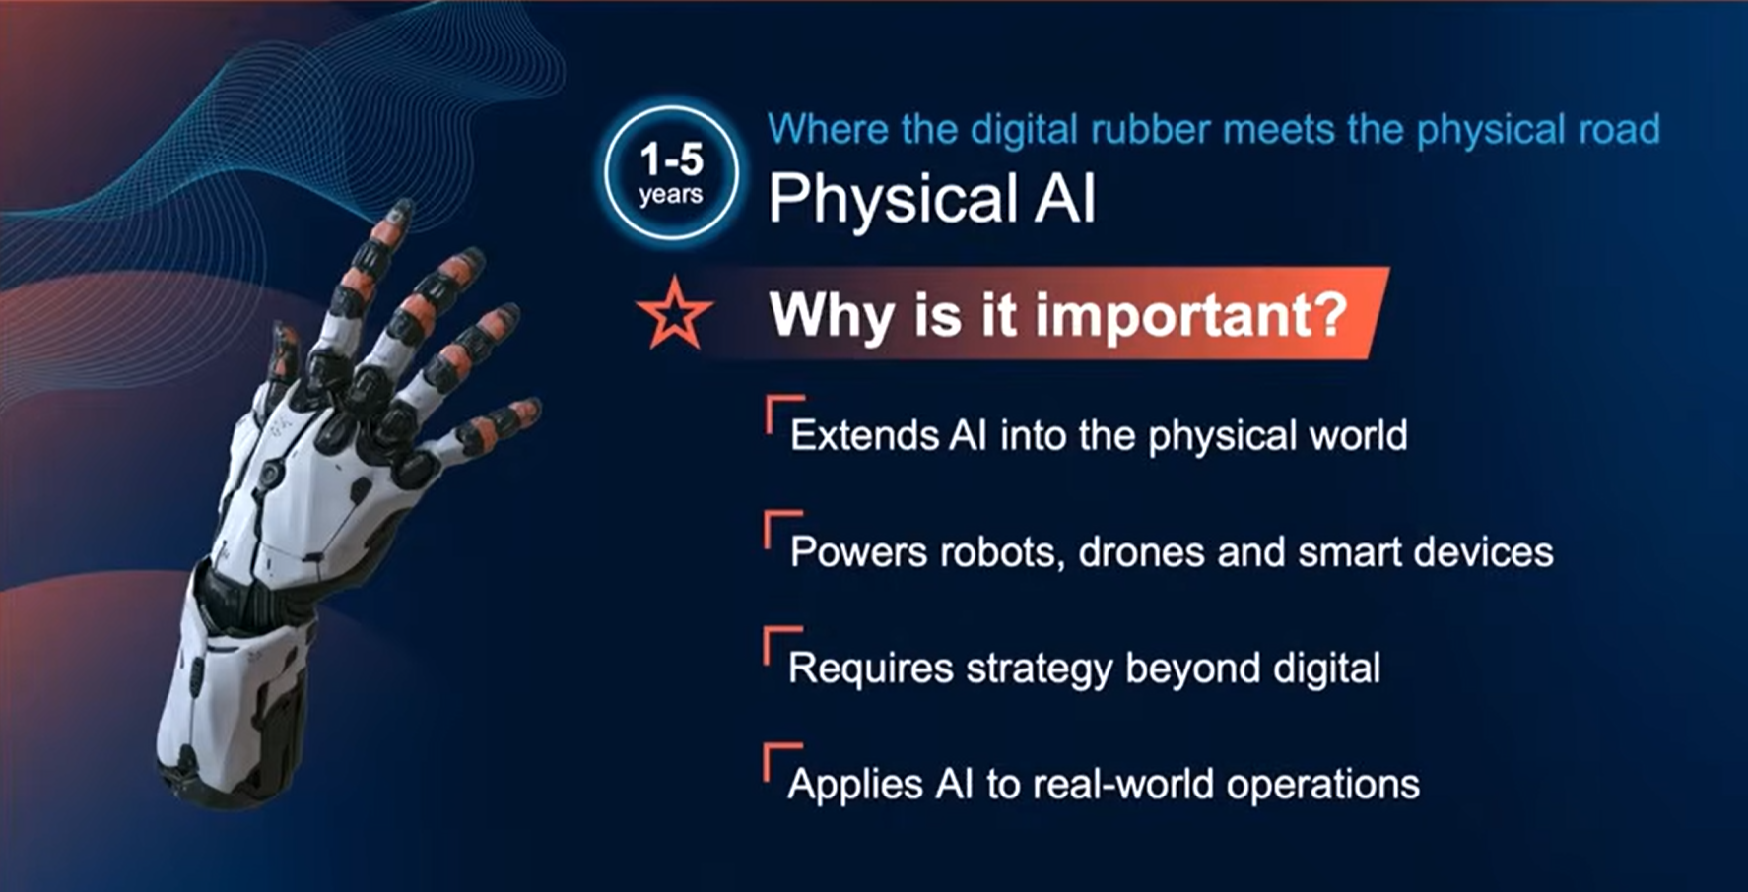

Slide 42
Physical AI
What is it?
Physical AI brings intelligence into the real world through robots, drones, vehicles and smart devices that sense, decide and act.
These systems combine sensors, actuators and AI models to automate physical tasks.
Why trending?
Organizations want the productivity of digital AI applied to physical environments.

Slide 43
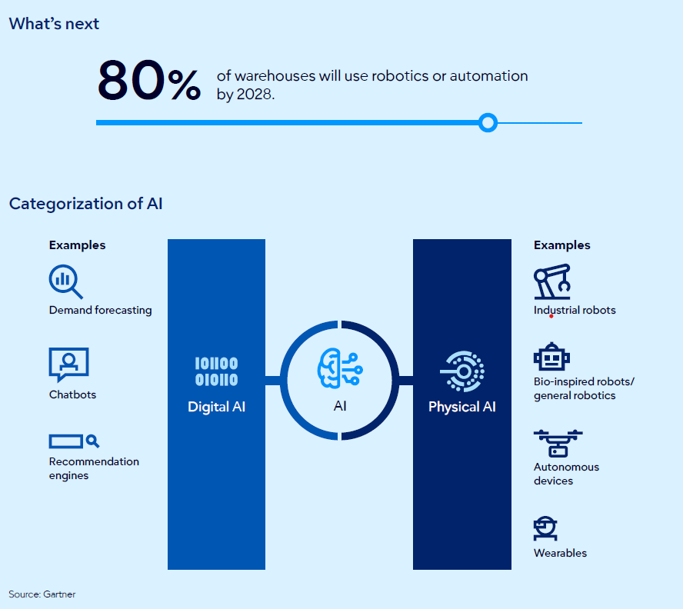

Slide 44
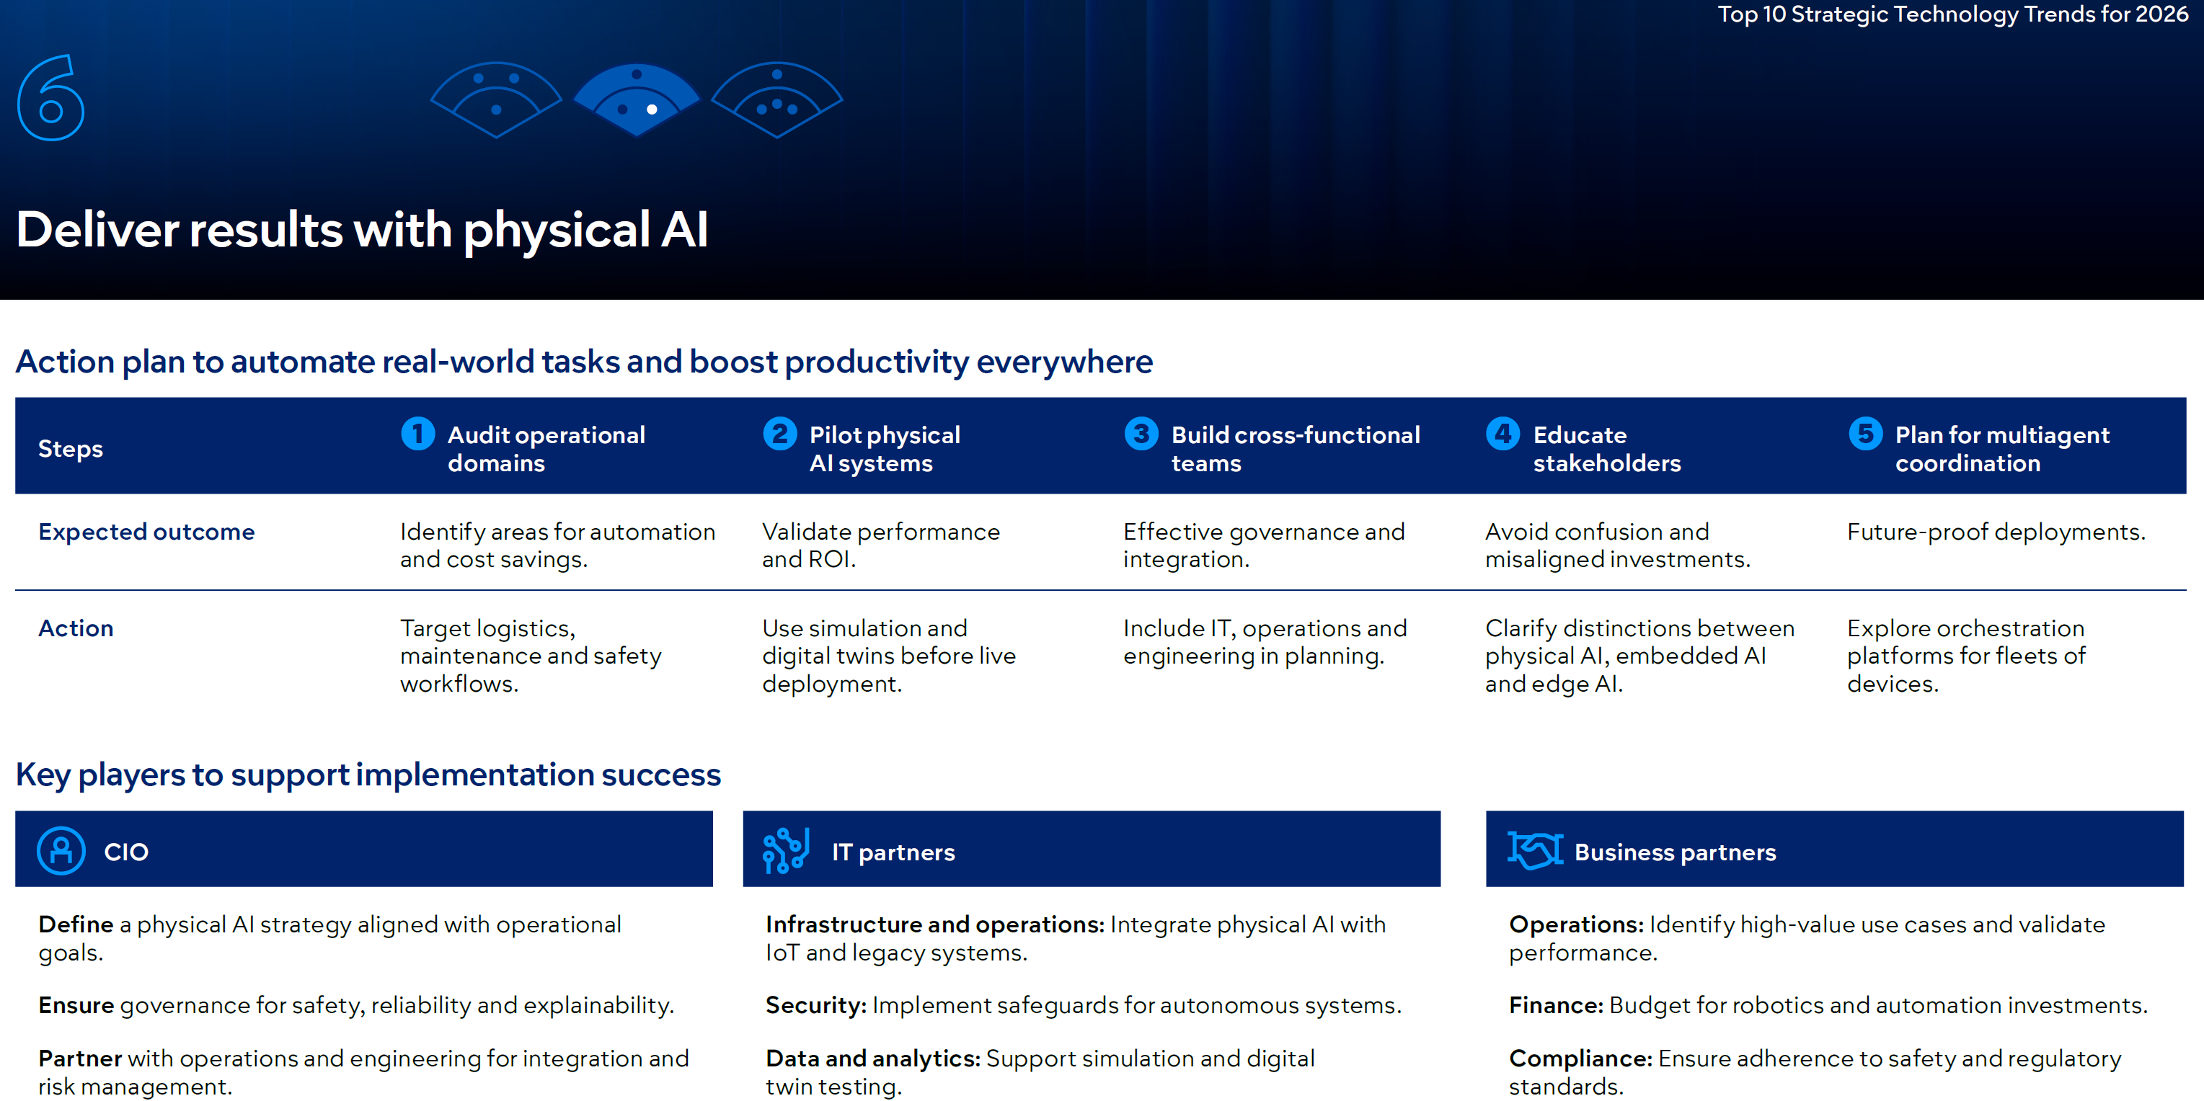

Slide 45
Physical AI examples
https://www.youtube.com/watch?v=Yu8I93xJ3pY
https://www.youtube.com/watch?v=I44_zbEwz_w
…

Slide 46
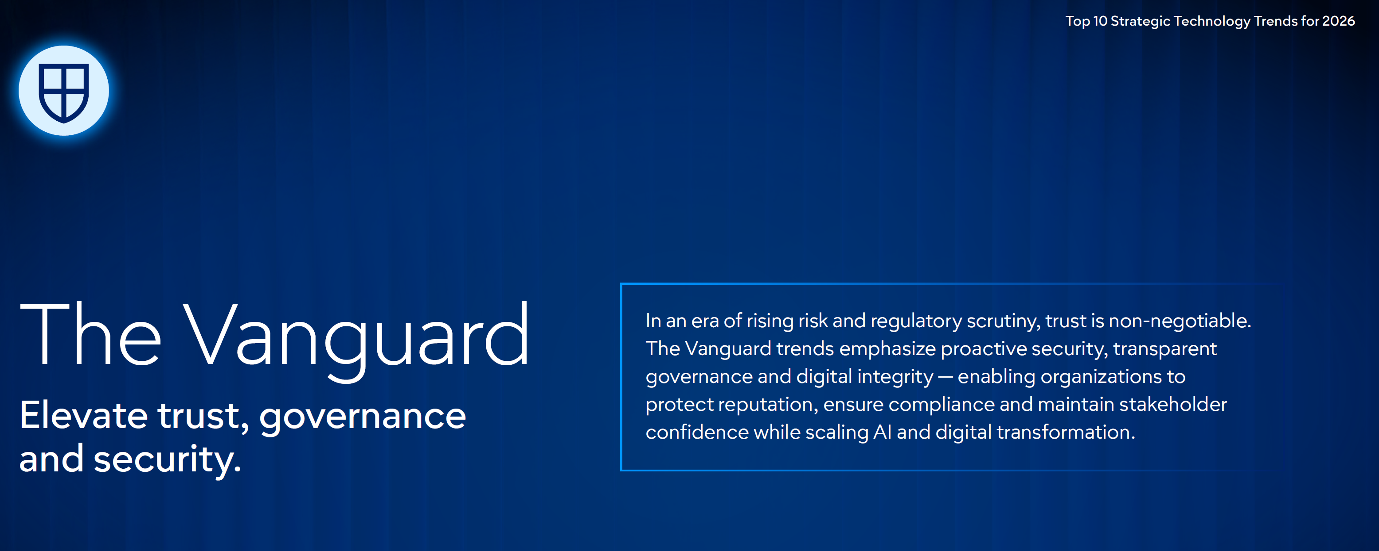

Slide 47
Preemptive cybersecurity
What is it?
Preemptive cybersecurity (PCS) uses advanced AI-driven techniques to anticipate, disrupt and neutralize cyberattacks before they occur — moving beyond traditional detection and response.
Why trending?
AI-powered threats are growing exponentially, targeting networks, applications and IoT systems. By 2029, technology products lacking preemptive cybersecurity will lose market relevance as proactive defense becomes a universal requirement

Slide 48
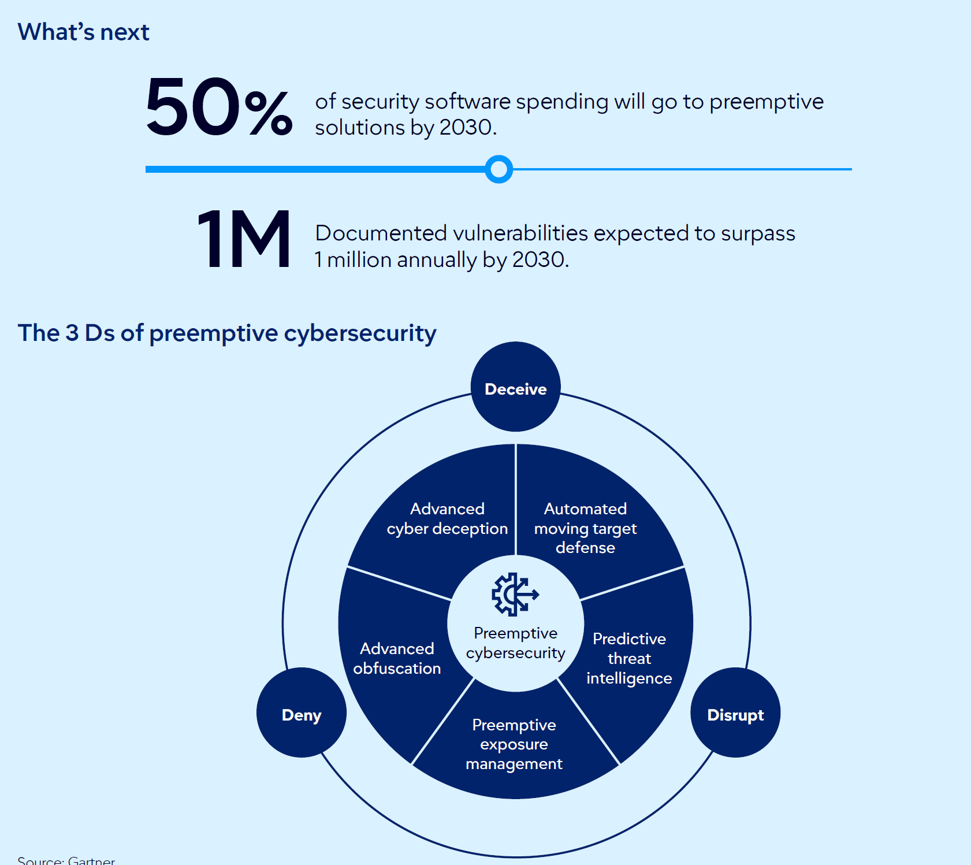

Slide 49
Preemptive cybersecurity
AI puts cyberattacks in overdrive.
Traditional detection-and-response cybersecurity methods can’t keep up with the surging threats from bad actors leveraging AI.
Product leaders who fail to invest in preemptive cybersecurity capabilities risk career-impacting cyber incidents and the potential for damaging market share losses within the next two to four years.

Slide 50
Advanced obfuscation technologies
Bar intruders from accessing emerging technology solutions within the global attack surface grid by using a combination of automated exposure management and advanced obfuscation technologies, which can continuously find and patch vulnerabilities while concealing code and sensitive data with advanced encryption techniques.

Slide 51
Preemptive Exposure Management
Preemptive Exposure Management is a cybersecurity model that continuously discovers vulnerabilities, validates risk, and remediates exposures automatically before attackers can exploit them.

Slide 52
Preemptive Exposure Management
Scenario 1: Exploitable Zero-Day
A newly disclosed vulnerability in a widely used library is added to CISA’s KEV list.
Traditional model: The team is alerted, waits for a patch, and spends days deploying.
Preemptive model: The platform detects affected systems, applies a virtual patch, and starts monitoring exploit attempts within hours.
Scenario 2: Misconfigured Cloud Storage
A security rule change leaves an S3 bucket publicly exposed.
Traditional model: It’s flagged during a scan, added to a ticket queue, and fixed days later.
Preemptive model: The platform detects the exposure in real time and automatically revokes public access while logging the action for audit.

Slide 53
Advanced cyber deception (ACD)
Solutions leverage a variety of deceptive elements to lure attackers away from critical systems and essentially create a “cyber minefield” for attackers.
These platforms create realistic decoys, such as fake servers, applications or files, that mimic production systems, enticing attackers to interact with them.
By analyzing attacker behavior on these decoys, organizations can then quickly gain valuable insights into attacker tactics and techniques and then use that information in real-time to immediately improve their overall security defenses.
https://canary.tools/

Slide 54
Automated moving target defense (AMTD)
Solutions operate by constantly changing a system’s configuration, making it a “moving target” for attackers
This often involves AI and machine learning to adapt to intelligence collected on new emerging threats and optimize defense strategies.
To further deceive attackers, AMTD is often combined with the use of advanced cyber deception to add even more layers of “moving targets.”

Slide 55
Predictive threat intelligence (PTI).
These platforms continuously collect information from a wide variety of sources — like security alerts, public online discussions, the dark web and records of past cyberattacks.
Then, using a combination of advanced analytics, AI and machine learning, PTI solutions sift through all that data to spot emerging threats, understand how hackers operate and find weaknesses before they can be exploited.
PTI platforms can also predict which threats are most likely to target your specific organization. They do this by considering things like what business you’re in, the technology you use and how visible you are online.

Slide 56
Automated exposure management.
These solutions offer capabilities for continually assessing attack surfaces, and prioritizing vulnerabilities and exposures for remediation.

Slide 57
Digital provenance
What is it?
Digital provenance verifies the origin and integrity of software, data and media, using tools like bills of materials (BOMs), attestation databases and watermarking. It ensures transparency and trust in systems built on third-party components and AI-generated content.
Why trending?
Organizations face rising risks from code tampering, abandoned open-source projects and deepfake-driven disinformation.

Slide 58
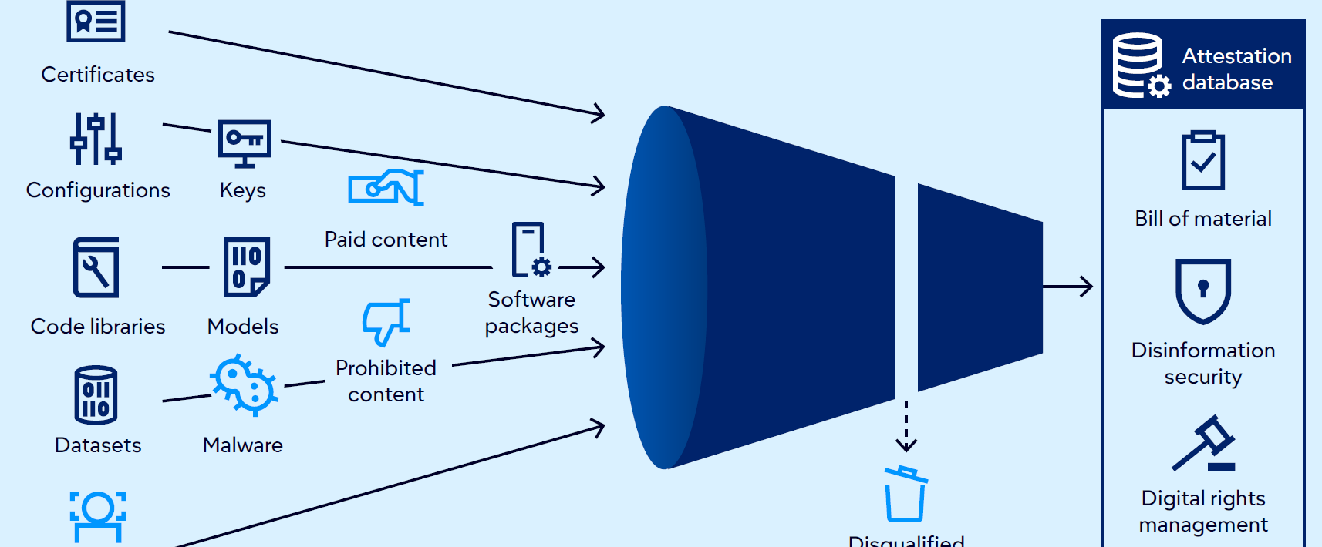
Digital provenance

Slide 59
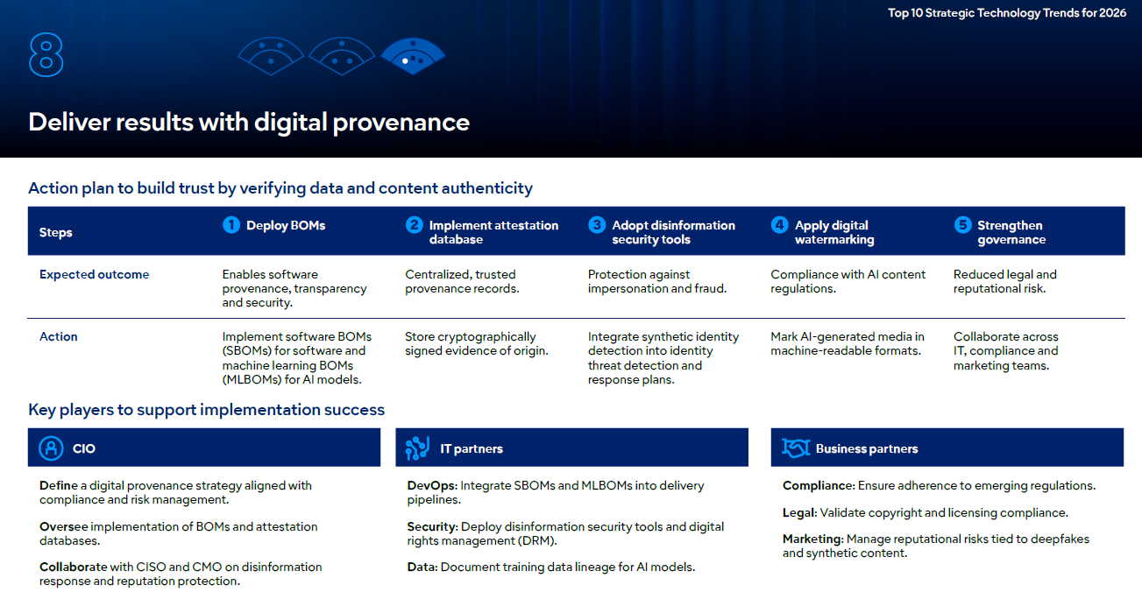

Slide 60
AI security platforms
What is it?
AI security platforms (AISPs) consolidate controls to secure both third-party AI services and custom-built AI applications. They address AI-native risks like prompt injection, rogue agent actions and data leakage.
Why trending?
As AI adoption accelerates, traditional security tools fail to protect AI workflows.

Slide 61
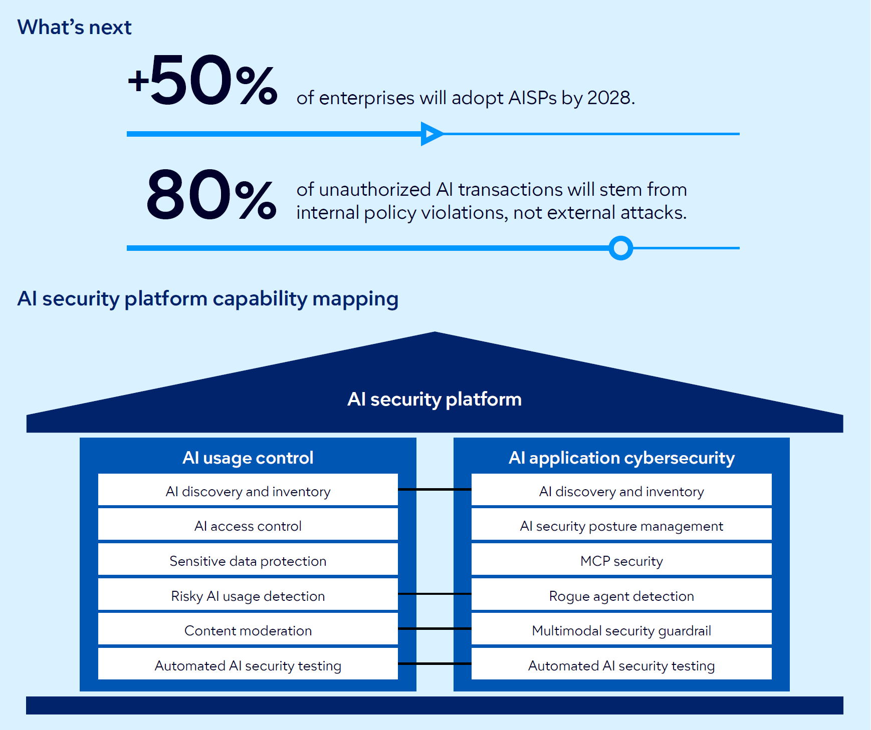

Slide 62
Geopatriation
What is it?
Geopatriation is the relocation of workloads from global hyperscale clouds to sovereign or local environments to reduce geopolitical risk. It includes strategies like redeploying to sovereign cloud regions or repatriating workloads on-premises.
Why trending?
Geopolitical turbulence and regulatory mandates are driving organizations to reassess cloud dependencies.

Slide 63
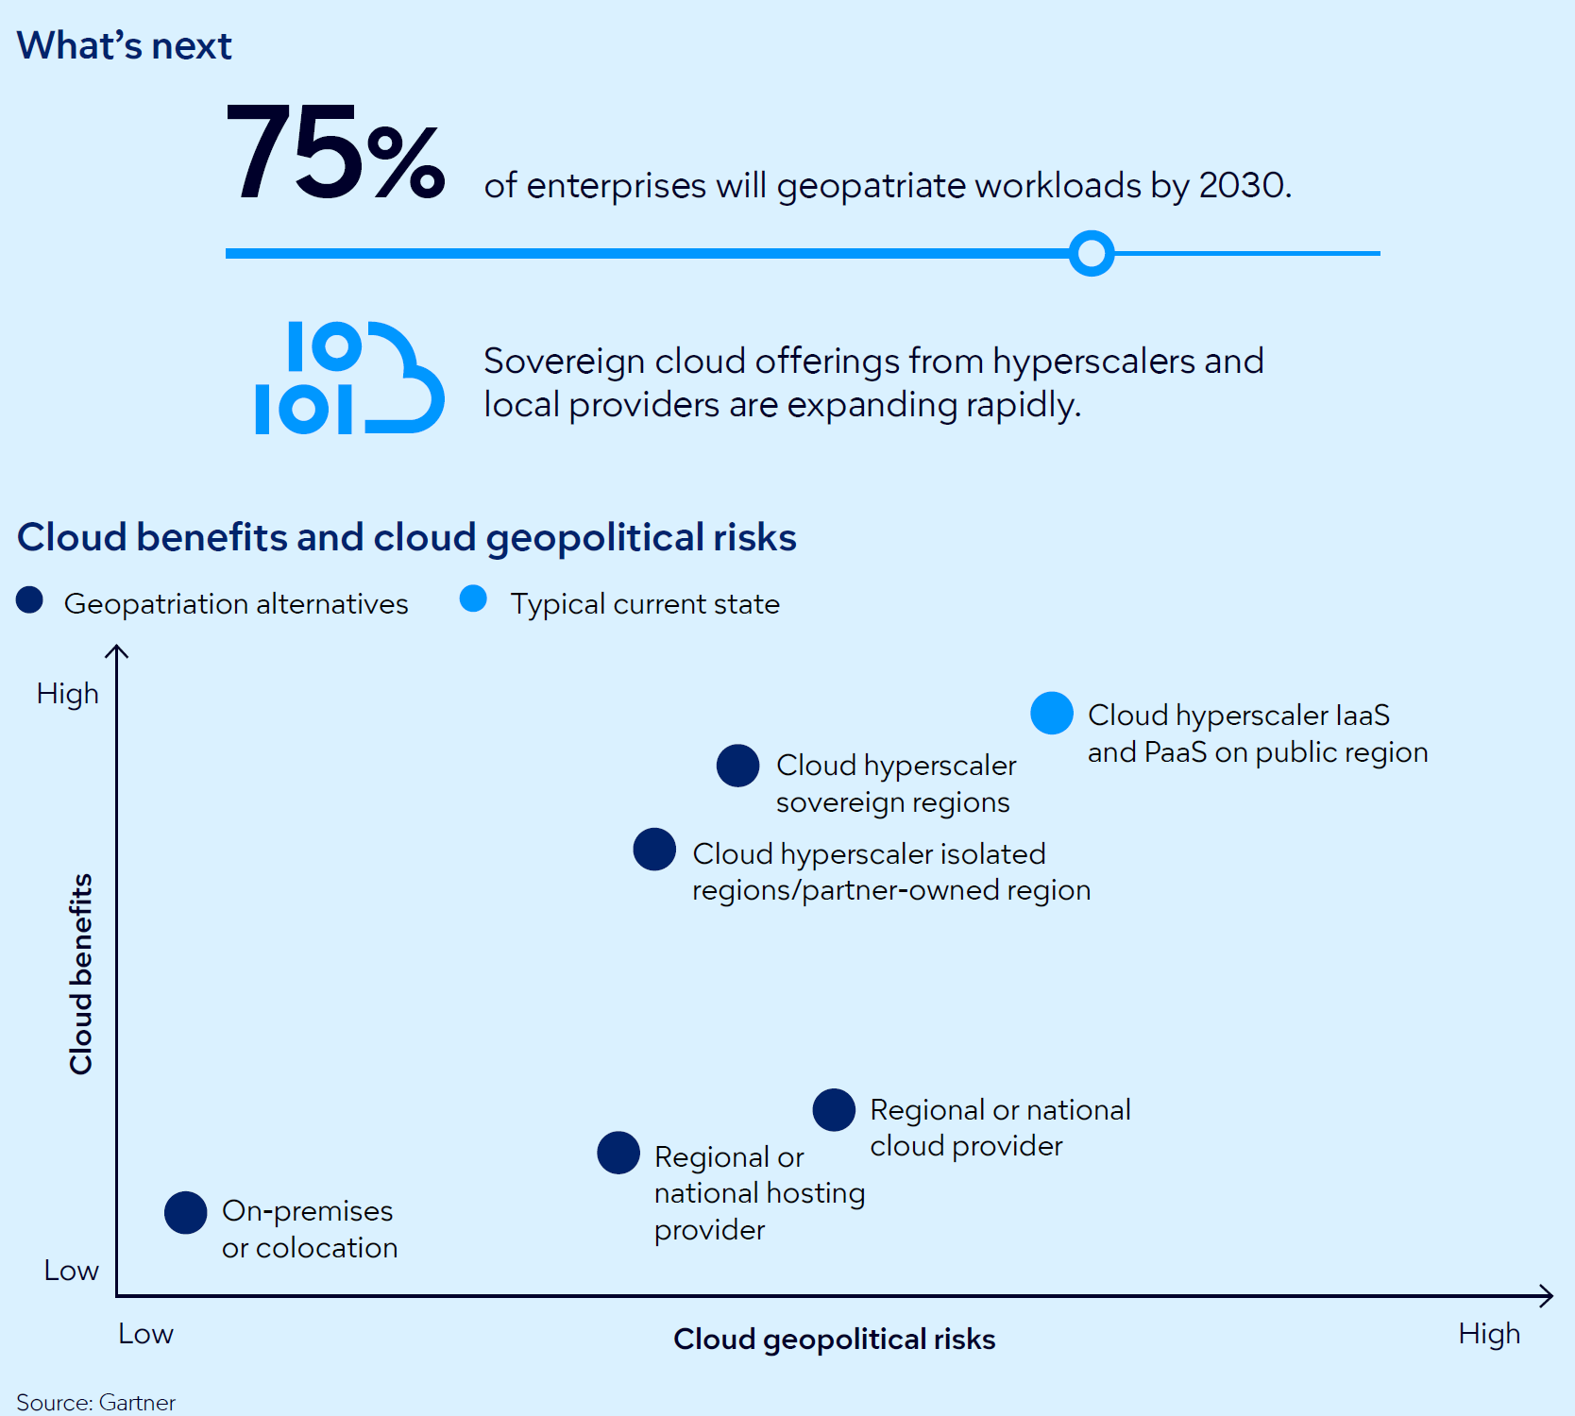

Slide 64
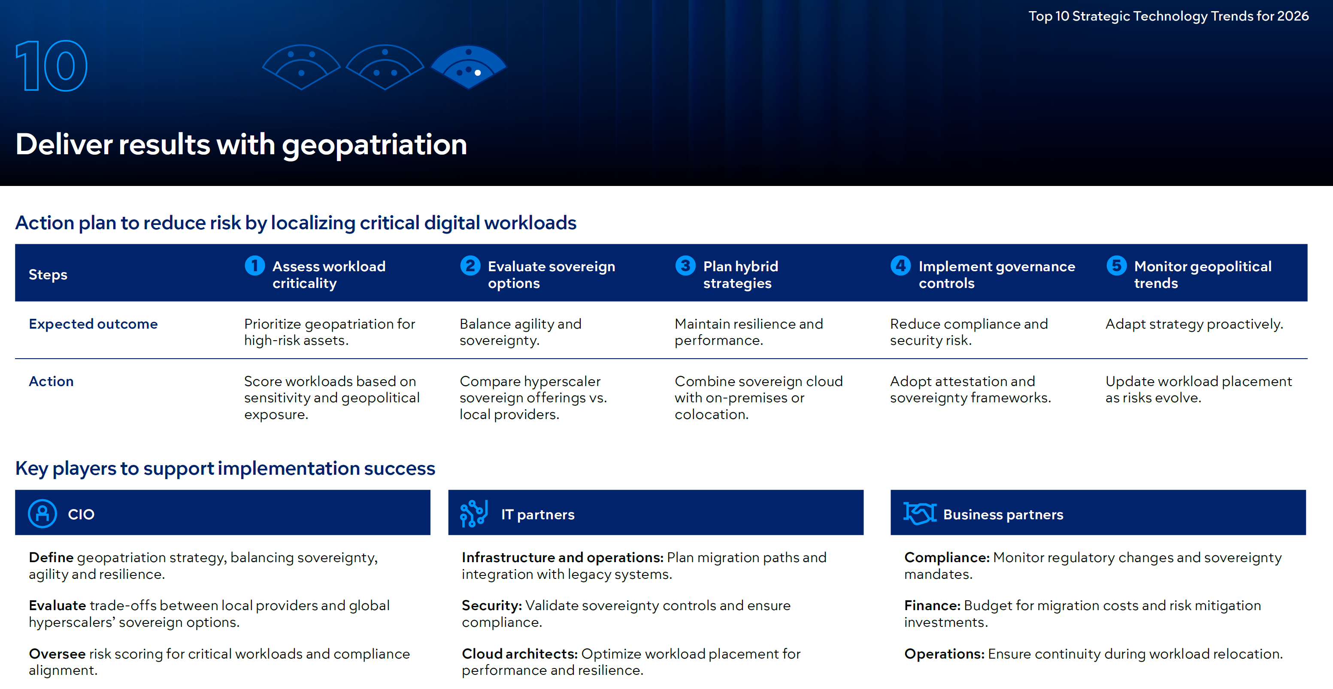

Slide 65

Trend Category | Gartner | McKinsey | Forrester
Primary AI Focus | Multiagent Systems (MAS): Autonomous agents that collaborate to solve complex business goals. | Agentic Reality Check: Moving from pilot projects to a "silicon-based workforce" that learns and adapts. | AI Pragmatism: A shift from "flair to function," focusing on hard-hat work and measurable ROI.
Development | AI-Native Platforms: Software built by AI for AI, enabling "vibe coding" (natural language prompts). | Human-Machine Co-creation: A total dissolution of the boundary between operator and creator. | Low-Code/No-Code: Democratizing app creation so business analysts can act as developers.
Cybersecurity | Preemptive Defense: Using AI to predict and neutralize threats before they even strike. | Strategic Necessity: Cybersecurity as a core business investment rather than a cost center. | AI Risk Management: Board-level governance to fight deepfakes and automated social engineering.

Slide 66
PwC’s 29th Global CEO Survey
PWC questioned 4,454 chief executives across 95 countries and territories about their strategic priorities and outlook
30% report increased revenue from AI in the last 12 months
26% are seeing lower costs
56% say they’ve realised neither revenue nor cost benefits
only 12% said they had both decreased costs and increased revenue using AI in the last 12 months

Slide 67
Hvala na pažnji!

