Slide 1
Managing information systems
Mr.sc Dražen Pranić
Notes:
Ažurirati naziv kolegija.

Slide 2
Agenda
Information systems and ethics
Data privacy
GDPR

Slide 3
Meta and fraud
https://www.reuters.com/investigations/meta-is-earning-fortune-deluge-fraudulent-ads-documents-show-2025-11-06/
Meta internally projected late last year that it would earn about 10% of its overall annual revenue – or $16 billion – from running advertising for scams and banned goods, internal company documents show.
On average, one December 2024 document notes, the company shows its platforms’ users an estimated 15 billion “higher risk” scam advertisements – those that show clear signs of being fraudulent – every day. Meta earns about $7 billion in annualized revenue from this category of scam ads each year, another late 2024 document states.

Slide 4
Meta and fraud
Much of the fraud came from marketers acting suspiciously enough to be flagged by Meta’s internal warning systems. But the company only bans advertisers if its automated systems predict the marketers are at least 95% certain to be committing fraud, the documents show.
If the company is less certain – but still believes the advertiser is a likely scammer – Meta charges higher ad rates as a penalty, according to the documents. The idea is to dissuade suspect advertisers from placing ads.

Slide 5
Meta and fraud
The documents further note that users who click on scam ads are likely to see more of them because of Meta’s ad-personalization system, which tries to deliver ads based on a user’s interests.
A May 2025 presentation by its safety staff estimated that the company’s platforms were involved in a third of all successful scams in the U.S. Meta also acknowledged in other internal documents that some of its main competitors were doing a better job at weeding out fraud on their platforms.
“It is easier to advertise scams on Meta platforms than Google,” concluded an internal Meta review in April 2025 of online communities where fraudsters discuss their trade.

Slide 6
Meta and fraud
Meta’s acceptance of revenue from sources it suspects are committing fraud highlights the lack of regulatory oversight of the advertising industry, said Sandeep Abraham, a fraud examiner and former Meta safety investigator who now runs a consultancy called Risky Business Solutions.
“If regulators wouldn’t tolerate banks profiting from fraud, they shouldn’t tolerate it in tech,” he told Reuters.

Slide 7
1. Meta GDPR fine- €1.2 billion
In May 2023, in a groundbreaking decision in the past five years of GDPR enforcement, the Irish Data Protection Commission (DPC) imposed a historic fine of €1.2 billion on US tech giant Meta.
This record-breaking fine was issued for transferring personal data of European users to the United States without adequate data protection mechanisms and serves as a significant milestone in data protection regulation.
Meta, the parent company of popular platforms like Instagram and WhatsApp, has been penalized for failing to comply with the European Union’s General Data Protection Regulation (GDPR). Still, this fine highly surpasses all other fines.
As Meta plans to appeal the decision, the outcome of this legal battle will have far-reaching implications, shaping the future of data transfers and privacy rights in the digital age.

Slide 8
2. Amazon GDPR fine – €746 million
The fine was issued due to a complaint filed by 10,000 people against Amazon in May 2018 through a French privacy rights group that promotes and defends fundamental freedoms in the digital world- La Quadrature du Net.
The CNPD opened an investigation into how Amazon processes personal data of its customers and found infringements regarding Amazon’s advertising targeting system that was carried out without proper consent.

Slide 9
3. Meta GDPR fine – €405 million
On September 5, 2022, Ireland’s Data Protection Commission (DPC) issued a €405 million GDPR fine to Meta Ireland concerning the lawfulness of processing children’s personal data following the legal bases of performance of a contract and legitimate interest.
The DPCs’ investigation focused on teenagers between the ages of 13 and 17, the operation of Instagram business accounts, and how such accounts automatically displayed children’s contact information (email addresses and/or phone numbers) publicly.

Slide 10
5. TikTok GDPR fine- €345 million
The Irish Data Protection Commission (DPC) concluded its investigation in September 2023, examining TikTok’s data practices between July 31 and December 31, 2020, particularly concerning young users.
The inquiry assessed various aspects, including platform settings, age verification, and communication with child users. The DPC’s decision revealed multiple GDPR breaches related to data processing, transparency, and fairness.

Slide 11
6. Linkedin GDPR fine – €310 million
The investigation, initiated by a complaint from French nonprofit La Quadrature Du Net, revealed LinkedIn’s misuse of user data for behavioral analysis and targeted advertising.
Alongside the fine, the DPC issued a reprimand and ordered LinkedIn to revise its data practices. This case highlights the importance of transparency, fairness, and lawful data processing under the GDPR.

Slide 12
Google paid penalty of $391.5 million for tracking Android users location
https://www.thecybersecuritytimes.com/google-paid-penalty-of-391-5-million-for-tracking-android-users-location/
As per the investigation and the final report, though users did turned off their location tracking, Google used the ‘Web & App activity’ to track the user location and history, which allowed them to collect, store and process the end-user data without their consent.
“....However, the transparency requirements of this settlement will ensure that Google not only makes users aware of how their location data is being used, but also how to change their account settings if they wish to disable location-related account settings, delete the data collected and set data retention limits.”

Slide 13
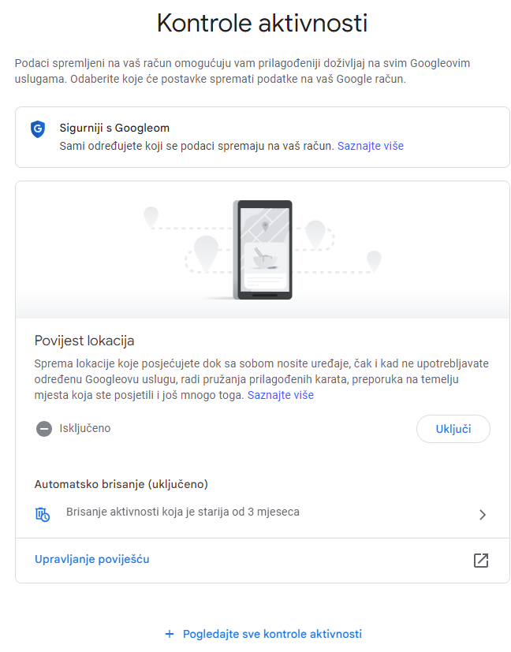

Slide 14
Your Mobile Phone: Big Brother’s Best Friend
Mobile location tracking systems
Demonstrates how technological innovations can be a double-edged sword
Data privacy issues

Slide 15
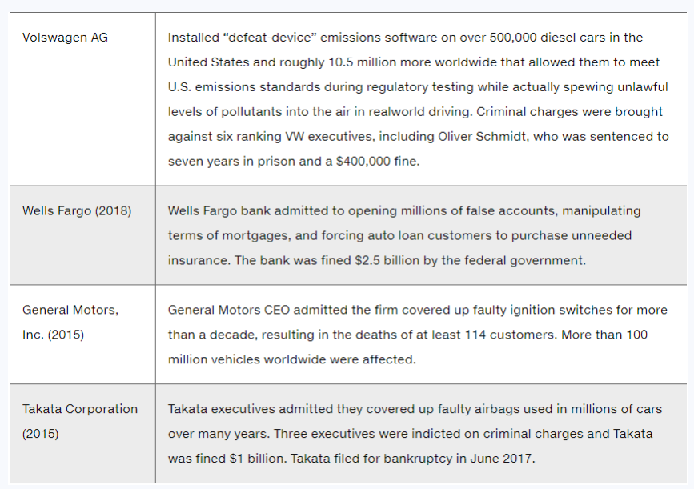
Dieselgate 30 mlrd$
2.7 mlrd$

Slide 16
A Model for Thinking About Ethical, Social, and Political Issues
Society as a calm pond
I T as rock dropped in pond, creating ripples of new situations not covered by old rules
Social and political institutions cannot respond overnight to these ripples—it may take years to develop etiquette, expectations, laws
Requires understanding of ethics to make choices in legally gray areas

Slide 17
Top AI Statistics for 2025
17.5% of the world’s AI market revenue is generated in the United States alone.
280 million companies around the world are using AI in at least one business function.
378 million people globally are actively using AI tools.
By 2030, AI is expected to create 170 million new jobs and replace 92 million, leading to a net gain of 78 million jobs globally.
In Q2 2025, global venture funding for AI totaled $91 billion, up from $82 billion a year earlier.

Slide 18
The Ethical Challenge of Artificial Intelligence
Algorithms increasingly decide what we see, buy, and believe.
People begin to trust automated systems more than their own judgment.
Emotional distance and dependency on machines weaken human empathy.
“The real risk is not that computers will think like humans, but that humans will think like computers.” – Sydney J. Harris

Slide 19
Negative Influence on Humans and Society
Loss of critical thinking: Overreliance on AI weakens creativity and independent thought.
Bias and discrimination: AI reflects and amplifies human prejudice in hiring, policing, and credit scoring.
Erosion of privacy: Continuous data collection enables digital surveillance and manipulation.
Deepfakes and misinformation: AI-generated lies damage trust, democracy, and social cohesion.
Dehumanization: People are treated as data points, not individuals.

Slide 20
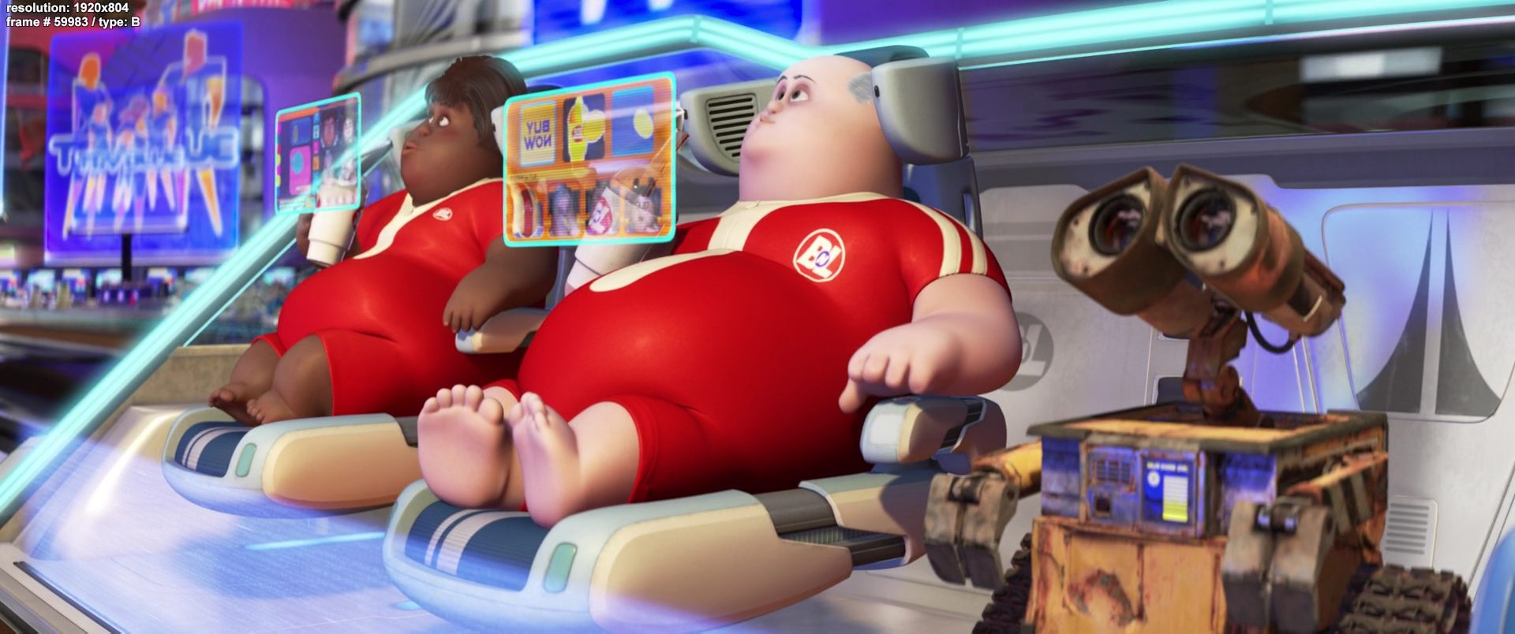
Long-Term Societal Risks
Job displacement: Automation replaces human workers faster than societies can adapt.
Social inequality: Access to AI benefits is uneven — the digital divide deepens.
Manipulation of behavior: Algorithms shape opinions, emotions, and elections.
Loss of accountability: “The algorithm did it” becomes an excuse for unethical outcomes.
Existential risk: Advanced AI could act beyond human control if values misalign.

Slide 21
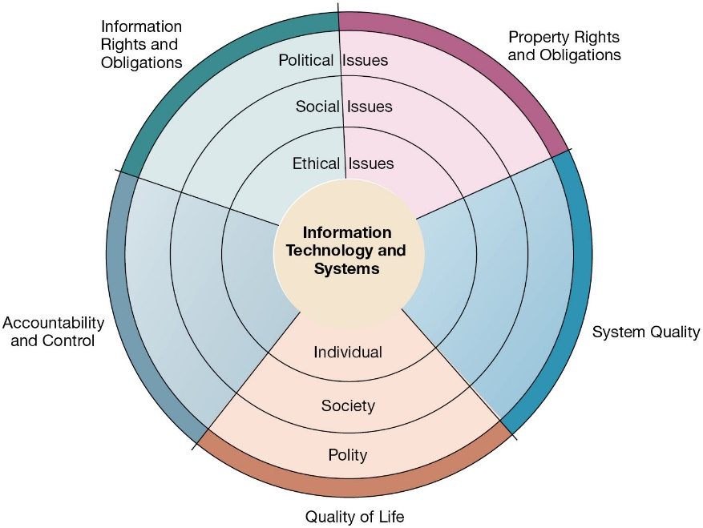
The Relationship Between Ethical, Social, and Political Issues in an Information Society

Slide 22
Five Moral Dimensions of the Information Age
Information rights and obligations
What information rights do individuals and organizations possess with respect to themselves?
Property rights and obligations
How will traditional intellectual property rights be protected in a digital society?
Accountability and control
Who can and will be held accountable and liable for the harm done...?
System quality
What standards of data and system quality should we demand to protect individual rights and the safety of society?
Quality of life
What values should be preserved in an information- and knowledge-based society?

Slide 23
Key Technology Trends That Raise Ethical Issues
Computing power doubles every 18 months
Data storage costs rapidly decline
Data analysis advances
Networking advances
Mobile device growth impact
AI

Slide 24
Advances in Data Analysis Techniques
Profiling
Combining data from multiple sources to create dossiers of detailed information on individuals
Nonobvious relationship awareness (N O R A)
Combining data from multiple sources to find obscure hidden connections that might help identify criminals or terrorists

Slide 25
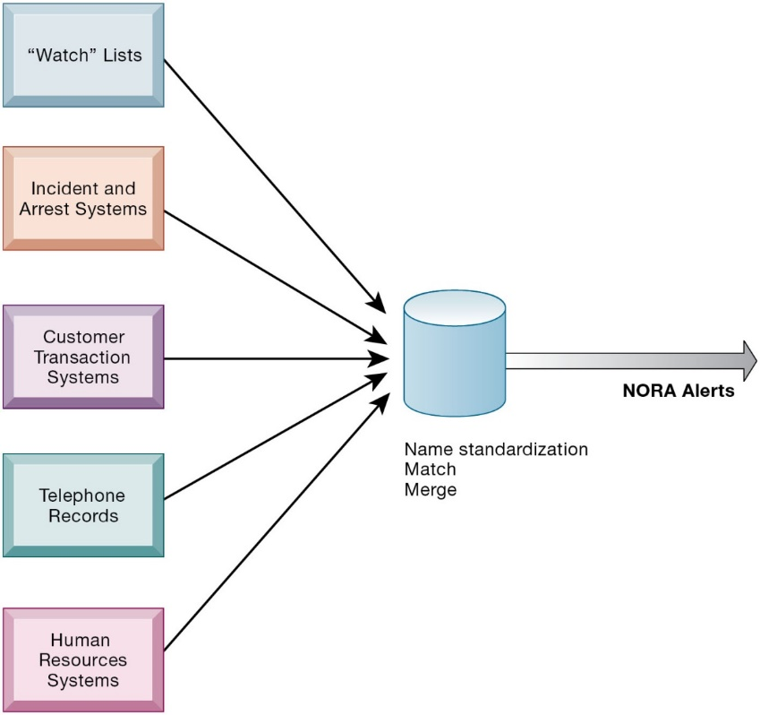
Nonobvious Relationship Awareness (N O R A)

Slide 26
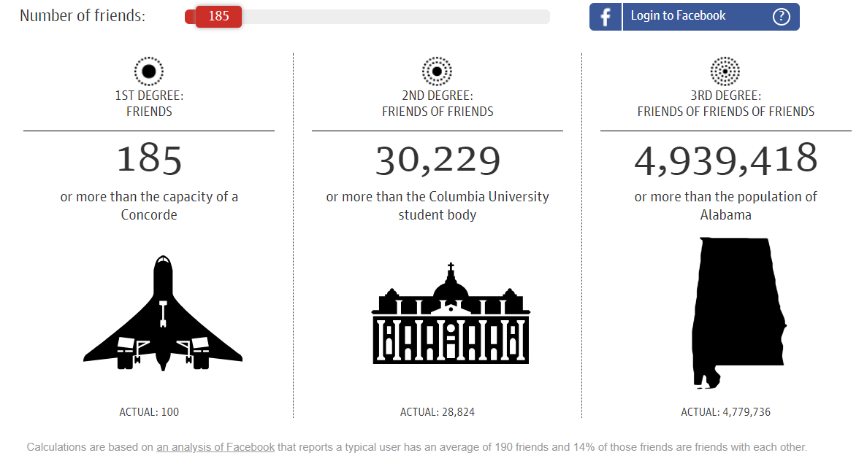

Snowden case
https://www.theguardian.com/world/interactive/2013/nov/01/snowden-nsa-files-surveillance-revelations-decoded#section/2
„... The agency is allowed to travel "three hops" from its targets — who could be people who talk to people who talk to people who talk to you.”

Slide 27
Basic Concepts: Responsibility, Accountability, and Liability
Responsibility
Accepting the potential costs, duties, and obligations for decisions
Accountability
Mechanisms for identifying responsible parties
Liability
Permits individuals (and firms) to recover damages done to them
Due process
Laws are well-known and understood, with an ability to appeal to higher authorities

Slide 28
Professional Codes of Conduct
Promulgated by associations of professionals
Medicine
Audit
Board
...
Promises by professions to regulate themselves in the general interest of society

Slide 29
Real-World Ethical Dilemmas
One set of interests pitted against another
Examples
Monitoring employees: Right of company to maximize productivity of workers versus workers’ desire to use Internet for short personal tasks
Facebook provides useful services for users but monitors user behavior and sells information to advertisers and app developers

Slide 30
Privacy
Privacy – challenge in a connected world
In a digital era people easily give up from privacy
Small benefits
I accept button
Complicated privacy policies

Slide 31
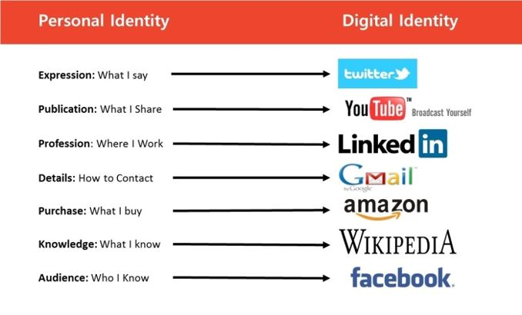
Exposing privacy

Slide 32
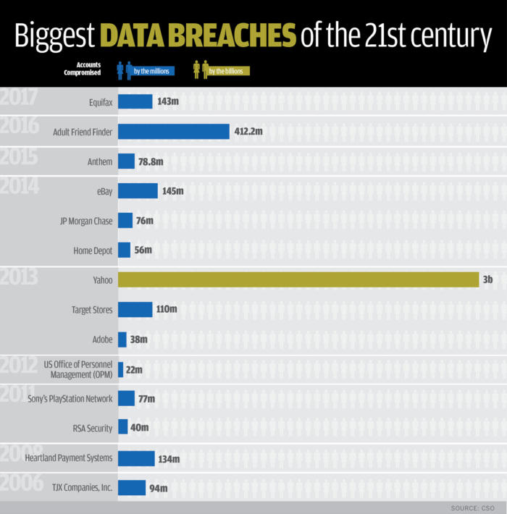

Slide 33
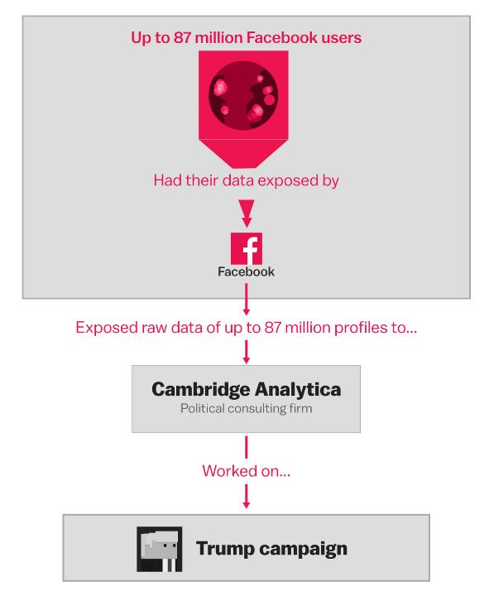

Slide 34
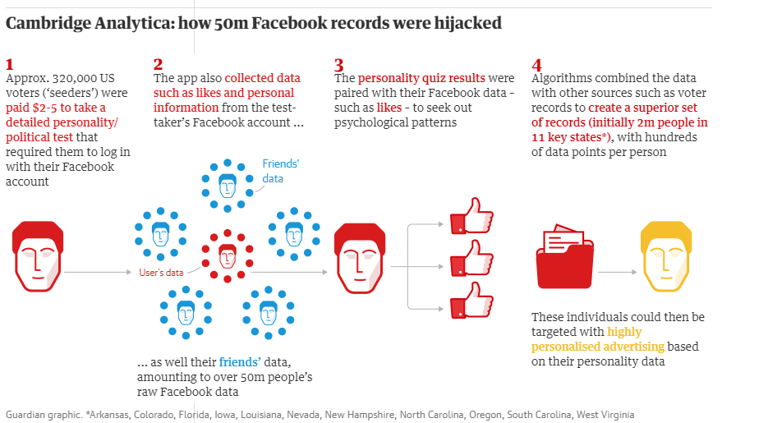

Slide 35
This Is Your Digital Life
This Is Your Digital Life", developed by data scientist Aleksandr Kogan and his company Global Science Research (GSR) in 2013.
The app consisted of a series of questions to build psychological profiles on users, and collected the personal data of the users' Facebook friends without their explicit consent.
https://www.washingtonpost.com/business/economy/facebook-had-a-closer-relationship-than-it-disclosed-with-the-academic-it-called-a-liar/2018/03/22/ca0570cc-2df9-11e8-8688-e053ba58f1e4_story.html

Slide 36
Facebook approach
Partnerships with academics such as Kogan, have been an integral part of Facebook’s broader effort to demonstrate that the social network is a potent force in society and a tool of social insight.
Many academics partner with Facebook because the social network will not give them access to the data they seek unless the research is conducted jointly, and some researchers have raised concerns that Facebook is creating a conflict of interest for them.

Slide 37
Michal Kosinski – personality app
How many likes is needed?
Colleagues
Friends
Parents
Partners
10
70
150
300

Slide 38
Fines
Facebook agreed to pay a $5 billion fine to the Federal Trade Commission (FTC) in 2019 for violating its privacy laws in connection with the Cambridge Analytica data scandal. The FTC alleged that Facebook had deceived users about their ability to control the privacy of their personal information.
Aleksandr Kogan college career was finished
Cambridge Analytica closed its business

Slide 39
General Data Protection Regulation (G D P R)
Requires unambiguous explicit informed consent of customer
E U member nations cannot transfer personal data to countries without similar privacy protection
Applies across all E U countries to any firms operating in E U or processing data on E U citizens or residents
Strengthens right to be forgotten
The less severe infringements could result in a fine of up to €10 million, or 2% of the firm’s worldwide annual revenue from the preceding financial year, whichever amount is higher.
The more severe infringements could result in a fine of up to €20 million, or 4% of the firm’s worldwide annual revenue from the preceding financial year, whichever amount is higher

Slide 40
What is personal data?
Any information that can be used to identify a living person - directly and indirectly – or that relates to them.
What does that mean?
This could be: name, an identification number, or location data, like an IP address.
It could also include other information that leads to an individual being identified (which could be: physical, genetic or cultural).
More care needs to be taken with sensitive personal data eg. health data, religious beliefs
What is personal data?

Slide 41
What is data privacy all about?
What is data privacy all about?
Being open with people about how we use their information
Not keeping their information longer than necessary
Making sure it is accurate
Making sure that it is safe
Knowing what information we’ve got and what we can do with it (eg. sharing)
Recognising a breach and knowing what to do

Slide 42
Lawful bases for collecting personal data
Consent – the individual has given consent to the processing of their personal data for a specific purpose (mostly marketing activities)
Performance of a contract – if the processing is necessary for the performance of a contract with the individual in order to take steps at the request of the individual prior to entering into a contract
Legitimate Interest – if the processing is necessary for the purposes of the legitimate interests pursued by the controller or by a third party (your company or your data processor), except where such interests are overridden by the interests or fundamental rights and freedoms of the individual which require protection of personal data.
Vital Interest– processing is necessary in order to protect the vital interests of the individual or another natural person (to protect someone’s life).
Legal Obligation – processing is necessary for compliance with a legal obligation. For example, tax laws or employment laws.
Public Task – processing is necessary to perform a task in the public interest or for the exercise of the functions of official authority, and the task or function has a clear basis in law.

Slide 43
Meta case
https://www.reuters.com/technology/facebook-owner-faces-eu-ban-targeted-advertising-norway-says-2023-11-01/
https://about.fb.com/news/2023/10/facebook-and-instagram-to-offer-subscription-for-no-ads-in-europe
The European data regulator has agreed to extend a ban imposed by non-EU member Norway on "behavioural advertising" on Facebook and Instagram to cover all 30 countries in the European Union and the European Economic Area, it said on Wednesday.
The ban on such advertising, which targets users by harvesting their data, is a setback for U.S. tech giant Meta Platforms (META.O), the owner of the two social media services, which has opposed efforts to curb the practice.

Slide 44
Meta case
To comply with evolving European regulations, we are introducing a new subscription option in the EU, EEA and Switzerland. In November, we will be offering people who use Facebook or Instagram and reside in these regions the choice to continue using these personalised services for free with ads, or subscribe to stop seeing ads. While people are subscribed, their information will not be used for ads.

Slide 45
Meta case
People in these countries will be able to subscribe for a fee to use our products without ads. Depending on where you purchase it will cost €9.99/month on the web or €12.99/month on iOS and Android. Regardless of where you purchase, the subscription will apply to all linked Facebook and Instagram accounts in a user’s Accounts Center.

Slide 46
Meta case
We believe in an ad-supported internet, which gives people access to personalised products and services regardless of their economic status. It also allows small businesses to reach potential customers, grow their business and create new markets, driving growth in the European economy. And like other companies we’ll continue to advocate for an ad-supported internet, even with our new subscription offering in the EU, EEA and Switzerland. But we respect the spirit and purpose of these evolving European regulations, and are committed to complying with them.

Slide 47
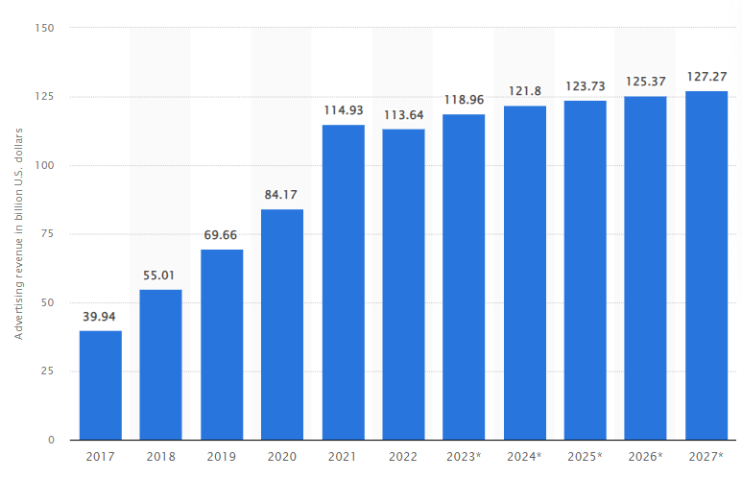

Slide 48
Pay or OK?
In a significant decision on 23 April 2025 (Case DMA.100055), the European Commission found that Meta's ‘consent or pay’ model, as implemented in the period from November 2023 to November 2024, on its Facebook and Instagram platforms, was not compliant with the Digital Markets Act (DMA) and fined Meta EUR200m (although the sanctioned non-compliance period only comprises the period from March 2024).
the key issue lies in the distinction between general (contextual) ads and personalized (behavioral) ads

Slide 49
Third option
https://www.facebook.com/help/825123042877166

Slide 50
Internet Challenges to Privacy (1 of 2)
Cookies
Identify browser and track visits to site
Tracking pixels
Tiny graphics embedded in e-mails and web pages
Monitor who is reading email message or visiting site
Web tags
Small pieces of code that are used on websites to collect data. When a particular action is performed on a website, web tags record relevant data and send it to a third party.
Google services and behavioral targeting

Slide 51
Am I Unique?
https://amiunique.org/

Slide 52
Cookie Consent Tools
Used for Cookies Opt-in/Opt-out
Enable creation of cookie policies
https://www.algebra.hr/en/
https://www.hrvatskitelekom.hr/
https://www.cookiemetrix.com/display-report/www.algebra.hr/9ff0f2fa85f33073b7f8a369db250314

Slide 53
Property Rights: Intellectual Property
Intellectual property
Tangible and intangible products of the mind created by individuals or corporations
Protected in four main ways:
Copyright
Patents
Trademarks
Trade secrets

Slide 54
Challenges to Intellectual Property Rights
Digital media different from physical media
Ease of replication
Ease of transmission (networks, Internet)
Ease of alteration
Compactness
Difficulties in establishing uniqueness

Slide 55
Computer-Related Liability Problems
If software fails, who is responsible?
If seen as part of a machine that injures or harms, software producer and operator may be liable
If seen as similar to book, difficult to hold author/publisher responsible
If seen as a service, would this be similar to telephone systems not being liable for transmitted messages?
Notes:
U

Slide 56
Self-driving cars liability
When a self-driving vehicle causes a car accident, who is liable for damages?
Self-Driving Car Accident: Manufacturer Liability or Personal Liability?
https://byrddavis.com/who-is-liable-when-a-self-driving-car-causes-a-crash/

Slide 57
Hvala na pažnji!

