Slide 1
Managing information systems
Mr.sc Dražen Pranić
Notes:
Ažurirati naziv kolegija.

Slide 2
Agenda
ISO 20000
ISO 27001
NIS2/DORA

Slide 3
Amazon outage
On October 20, 2025, Amazon Web Services experienced a fifteen-hour outage that affected over one thousand companies, generated six and a half million user reports worldwide, and cost the global economy more than one billion dollars.
Financial institutions faced severe disruptions: Coinbase halted cryptocurrency trading, freezing billions in customer assets; Robinhood users were unable to execute trades; and major UK banks such as Lloyds and Bank of Scotland locked customers out of online banking. Payment processors Venmo and Square suffered transaction failures, leading to missed payment deadlines and significant reputational damage that can take years to recover.
In healthcare, the impact extended into patient safety. United Healthcare’s provider search tool malfunctioned, Medicare enrollment systems went offline, and claims processing and electronic health record systems became unavailable — preventing clinicians from accessing critical patient information. Studies estimate that downtime costs medium to large hospitals between $300,000 and $500,000 per hour.

Slide 4
Amazon Outage Root Cause
A "Race Condition" Bug: Two automated systems within AWS's internal DNS (Domain Name System) tried to update the addresses for the core DynamoDB database at the same time.
The Unintended Outcome: One system, encountering a delay, was overwritten by the other. This led to an empty or incorrect DNS record for a critical database endpoint in the US-EAST-1 region.
Automation Failed to Recover: The automated repair systems, relying on the same faulty logic, failed to fix the error.
Manual Intervention Required: Engineers eventually had to step in and disable the automation manually to begin the recovery process.

Slide 5
Amazon Outage Root Cause
The Goal: Automated efficiency. To manage its massive infrastructure, AWS uses automated systems. For DynamoDB, two of these systems, the "DNS Planner" and "DNS Enactor," constantly work together to ensure all the correct DNS records are in place for the service's hundreds of thousands of endpoints.
The Trigger: An unusual delay. On October 19, one of the DynamoDB DNS Enactor programs experienced an unusually high delay.
The Race Condition: While the first program was delayed, a second DNS Enactor program sped ahead, implemented a newer DNS plan, and began cleaning up outdated plans. At the exact same time, the first, much-delayed Enactor finally got its turn and applied its very old plan over the top of the newer one.
The Erased Records: The second Enactor, performing its cleanup, detected the older plan and correctly identified it as stale. But because the logic was faulty, it accidentally deleted the associated DNS entry entirely, which removed all IP addresses for the DynamoDB endpoint in that region.
The Cascade: Since the system's "phone book" entry for DynamoDB was now blank, other AWS services, such as EC2 and Network Load Balancers, could no longer find or communicate with the critical database service. This domino effect spread rapidly across the US-EAST-1 region, bringing down everything that depended on it.
The Failed Recovery: Complicating matters, AWS's automated systems, which are designed for self-healing, became part of the problem. Some load balancers, receiving no response from DynamoDB, began marking perfectly healthy servers as unhealthy and removing them from service. This amplified the outage instead of fixing it.
The Manual Fix: Engineers had to step in manually to stop the faulty automation and correctly re-enter the DNS records to finally bring the service back online.

Slide 6
Naknada štete
AWS ne nudi financijsku naknadu (“damages”) u klasičnom smislu, nego kredit koji se može iskoristiti za buduće račune (service credit).
Tipično, visina tog kredita ovisi o mjesečnoj razini dostupnosti (Monthly Uptime Percentage).
Primjer (za većinu servisa, npr. EC2, S3, RDS):< 99.0 % → 10 % kredita< 98.0 % → 25 % kredita< 95.0 % → 100 % kredita (za taj mjesec, ne više od mjesečne naknade).
Dakle, maksimalni povrat je ograničen na mjesečni iznos koji ste platili za taj servis, i ništa više.
Nema nadoknade za propuštene prihode, ugovorne kazne, reputacijske gubitke, niti sekundarne posljedice.

Slide 7
Naknada štete
„Service Credits are your sole and exclusive remedy for any unavailability or non-performance of AWS Services.”
AWS se pritom odriče odgovornosti za:
posredne i posljednične štete (indirect, consequential damages),
izgubljenu dobit, gubitak podataka, reputacije ili poslovne prilike,
sve situacije koje spadaju pod “force majeure” ili vanjsku infrastrukturu (npr. internet provider, DDoS, korisnička konfiguracija).

Slide 8
Naknada štete
WASHINGTON, Oct 25 (Reuters) - Delta Air Lines (DAL.N), opens new tab on Friday sued cybersecurity firm CrowdStrike (CRWD.O), opens new tab in a Georgia state court after a global outage in July caused mass flight cancellations, disrupted travel plans of 1.3 million customers and cost the carrier more than $500 million.
Delta's lawsuit filed in Fulton County Superior Court called the faulty software update from CrowdStrike "catastrophic" and said the firm "forced untested and faulty updates to its customers, causing more than 8.5 million Microsoft (MSFT.O), opens new tab Windows-based computers around the world to crash.„
May 19 (Reuters) - Delta Air Lines (DAL.N), opens new tab can pursue much of its lawsuit seeking to hold cybersecurity company CrowdStrike (CRWD.O), opens new tab liable for a massive computer outage last July that caused the carrier to cancel 7,000 flights, a Georgia state judge ruled.

Slide 9
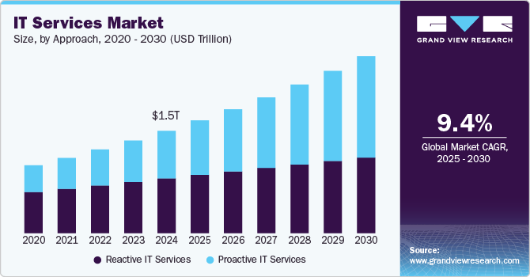

Slide 10
Key Market Trends & Insights
North Americas IT services market dominated the global market with a revenue share of over 35% in 2024.
The U.S. IT services market dominated the regional market in 2024.
By approach, the reactive it services segment dominated the market with a share of over 52% in 2024.
By type, the operations & maintenance segment dominated the market with the largest revenue share in 2024.
By application, the application management segment dominated the market with the largest revenue share in 2024

Slide 11
Key drivers of this growth
Adoption of cloud computing: Businesses are increasingly migrating to cloud-based solutions for scalability, flexibility, and cost-effectiveness.
Digital transformation: Enterprises across all sectors are undertaking large-scale digital initiatives, increasing demand for managed services, security, and consulting.
Rising demand for cybersecurity: With the growing complexity of cyber threats, organizations are increasing their budgets for advanced security services to protect sensitive data.
Integration of AI and automation: The use of artificial intelligence and automation is enhancing efficiency in IT operations, driving investment in AI-powered solutions.

Slide 12
ISO 20000:2018
ISO 20000:2018 norma organizacijama pruža skup zahtjeva za uspostavu, primjenu, održavanje i stalno poboljšavanje sustava upravljanja uslugama (SMS).
Usluga – sredstvo za isporučivanje vrijednosti korisniku, omogućavanjem ishoda koje korisnik želi postići.
Upravljanje uslugama – skup sposobnosti i procesa za usmjeravanje i kontroliranje aktivnosti i resursa organizacije u svrhu planiranja, projektiranja, prijelaza, isporuke i poboljšavanja usluga radi isporuke vrijednosti.
Sustav upravljanja uslugama – služi za usmjeravanje i kontroliranje aktivnosti upravljanja uslugama u organizaciji

Slide 13
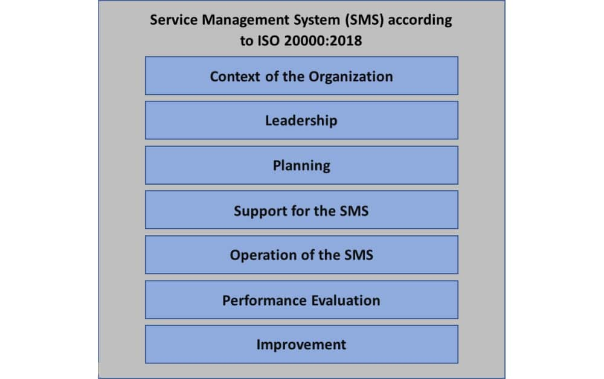

Slide 14
Kontekst organizacije
Razumijevanje organizacije: Identificiranje unutarnjih i vanjskih čimbenika (npr. strateški ciljevi, poslovno okruženje) koji utječu na sustav upravljanja uslugama (SMS).
Interne i vanjske prilike i rizici: Definiranje rizika i prilika povezanih s uslugama.
Relevantne zainteresirane strane: Prepoznavanje klijenata, dobavljača i drugih strana te njihovih zahtjeva.
Definiranje opsega SMS-a: Precizno određivanje koje usluge i procesi ulaze u sustav upravljanja uslugama.

Slide 15
Vodstvo
Predanost vodstva: Osiguravanje da najviše rukovodstvo aktivno podržava i preuzima odgovornost za SMS.
Politika upravljanja uslugama: Izrada i komunikacija jasne politike koja je u skladu s poslovnim ciljevima.
Dodjela uloga i odgovornosti: Jasno definiranje odgovornosti i ovlasti za svaki proces unutar SMS-a.

Slide 16
Upravljanje životnim ciklusom IT usluge
Norma osigurava strukturirano upravljanje uslugama kroz cijeli njihov životni ciklus, od planiranja do povlačenja.
Dizajn i tranzicija usluga (8.5):
Upravljanje promjenama: Proces kontrole i odobravanja svih promjena na uslugama kako bi se minimalizirao rizik za poslovanje.
Dizajn i tranzicija: Planiranje, testiranje i uvođenje novih ili izmijenjenih usluga.
Upravljanje izdanjima i implementacijom: Kontrolirani proces uvođenja novih izdanja i verzija usluga u produkciju.

Slide 17
Upravljanje životnim ciklusom IT usluge
Isporuka i podrška (8.6):
Upravljanje incidentima i zahtjevima: Postupci za brzo rješavanje incidenata i ispunjavanje zahtjeva korisnika.
Upravljanje problemima: Proces pronalaska i rješavanja temeljnih uzroka problema.
Poboljšanje (Poglavlje 10):
Kontinuirano poboljšanje: Fokus na stalnom unaprjeđenju svih procesa i usluga.

Slide 18
Integrirani procesi za učinkovitu isporuku usluga
Upravljanje portfeljem i katalogom usluga (8.2):
Upravljanje portfeljem: Definiranje kritičnih usluga.
Upravljanje katalogom: Održavanje točnog i dostupnog kataloga s informacijama o uslugama.
Upravljanje odnosima (8.3):
Upravljanje razinom usluga (SLA): Dogovaranje, mjerenje i praćenje razina usluga dogovorenih s korisnicima.
Upravljanje odnosima s dobavljačima: Učinkovito upravljanje odnosima s vanjskim pružateljima usluga.
Upravljanje kapacitetom i potražnjom (8.4):
Osiguravanje da su kapaciteti prilagođeni potražnji za uslugama.
Upravljanje imovinom i konfiguracijom (8.2):
Praćenje i kontrola IT imovine te konfiguracijskih stavki.
Upravljanje kontinuitetom i dostupnošću (8.7):
Planiranje i osiguravanje neprekidnog rada usluga i njihove dostupnosti.

Slide 19
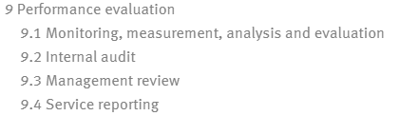
Performance evaluation
assess the performance of the SMS through monitoring, measurement, analysis, and evaluation of the system.
It is suggested managerial good practice to have both external and internal audits done on your organization’s SMS. But there are specific requirements in this clause for establishing an audit program and conducting internal audits at regular intervals.
Management review

Slide 20
ISO 20000-2:2019
ISO 20000-2:2019 is the code of practice for IT Service Management;
it is the guidance for the application of service management systems.
In other words, it helps you interpret the requirements of the standard.
It defines the best practice management processes, and it is very useful if you’re preparing to be audited against ISO 20000 or planning service improvements

Slide 21
ISO 20000 and ITIL
ISO 20000 is a standard and code of practice
ITIL is a best practice framework
ISO 20000 awards organizations with certification and ITIL does not
A good way to think of it is that ISO 20000 says what you need to do, while ITIL tells you how to do it.

Slide 22
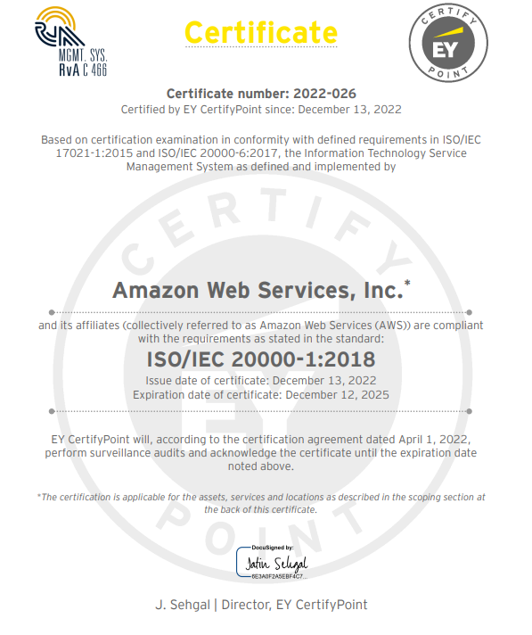
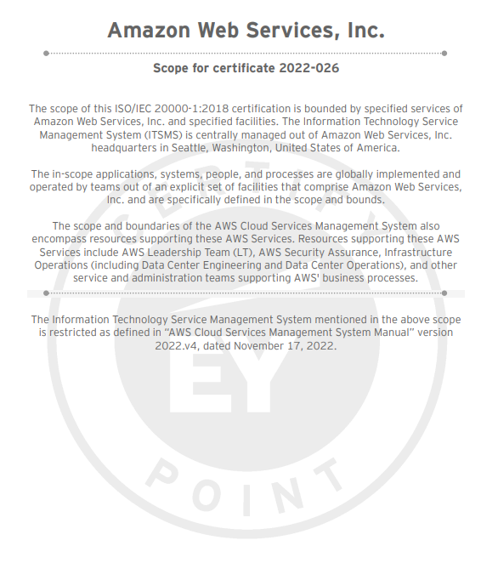

Slide 23
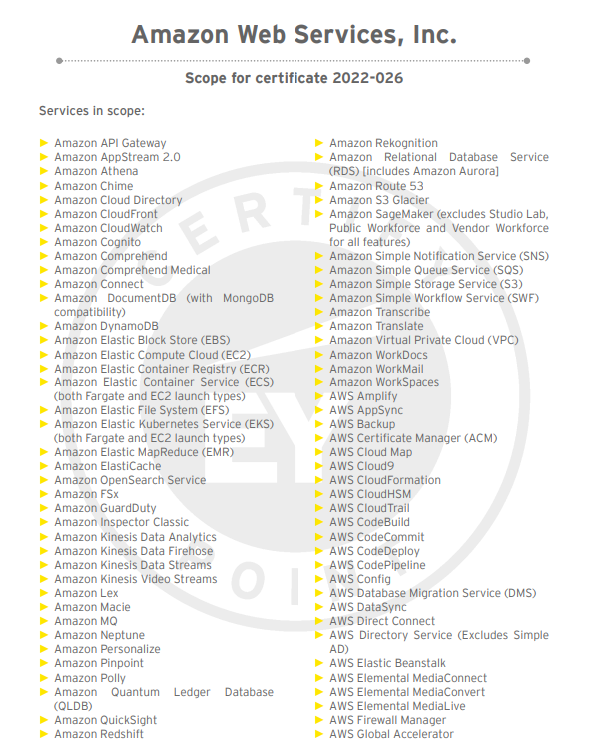
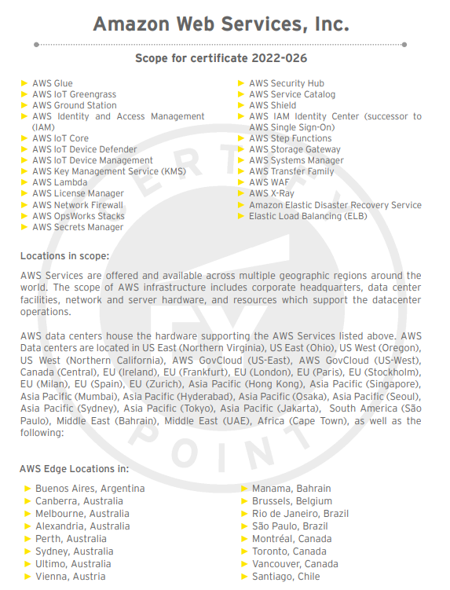

Slide 24
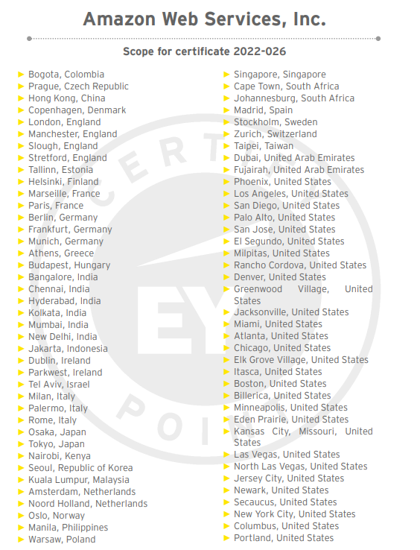
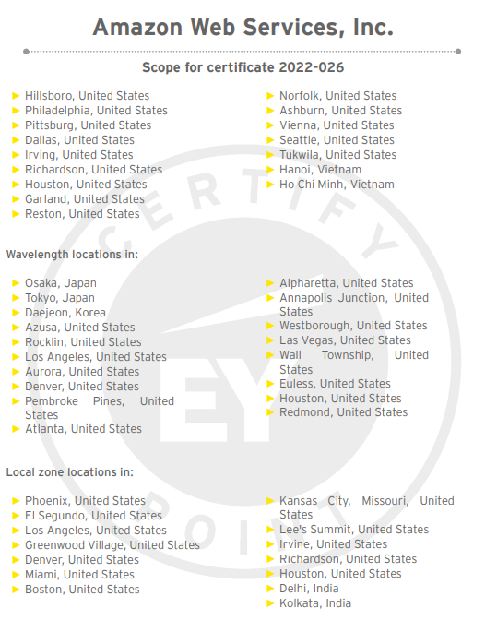

Slide 25
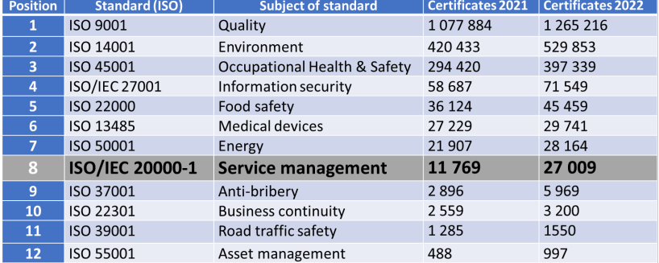

Slide 26
ISO 20000 (figures from 2023)
https://certikit.com/the-latest-iso-survey/
For ISO20000, China dominates the certification list absolutely, with nearly ninety percent of the certificates worldwide (24,152). After China (a long way after) comes the USA (360), India (314), Italy (192), Spain (172) and the UK (133).

Slide 27
ISO/IEC 27001:2022
Information Security Management System (ISMS)
Consists of two parts (ISO 27001 and ISO 27002)
A generic standard Applicable to all organizations → Regardless of size, type, or other characteristics of the organization
The only standard you can certify against
Useful for organizations providing external services and needing to demonstrate how they manage information security

Slide 28
ISO 27001:2022
The first (main) part consists of 11 clauses (0 to 10). The second part, called Annex A, provides the guidelines for 93 control objectives and controls.
Clauses 0 to 3 of the main part of the standard (Introduction, Scope, Normative references, Terms and definitions) serve as an introduction to the ISO 27001 standard.
Clauses 4 to 10, which provide the ISO 27001 requirements, are mandatory if the company wants to be compliant with the standard, and are examined in more detail later in this article.
Annex A of the standard supports the clauses and their requirements with a list of controls that are not mandatory, but that are selected as part of the risk management process.

Slide 29
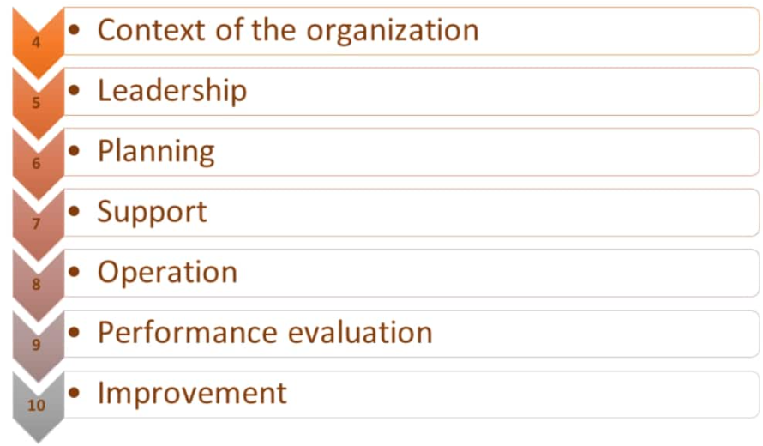

Slide 30
ISO 27001 Annex A / ISO 27002
Annex A (normative) Information security controls reference – This Annex provides a list of 93 safeguards (controls) that can be implemented to decrease risks and comply with security requirements from interested parties. The controls that are to be implemented must be marked as applicable in the Statement of Applicability.
The best way to understand Annex A is to think of it as a catalogue of information security controls you can select from – out of the 93 controls that are listed in Annex A, you can choose the ones that are applicable to your company’s scope.

Slide 31
ISO 27002
ISO/IEC 27002:2022 - Information security management systems – Code of practice for information security management
ISO 27002 has exactly the same structure as ISO 27001 Annex A: each control from Annex A exists in ISO 27002, but it has a much more detailed explanation on how to implement it.

Slide 32
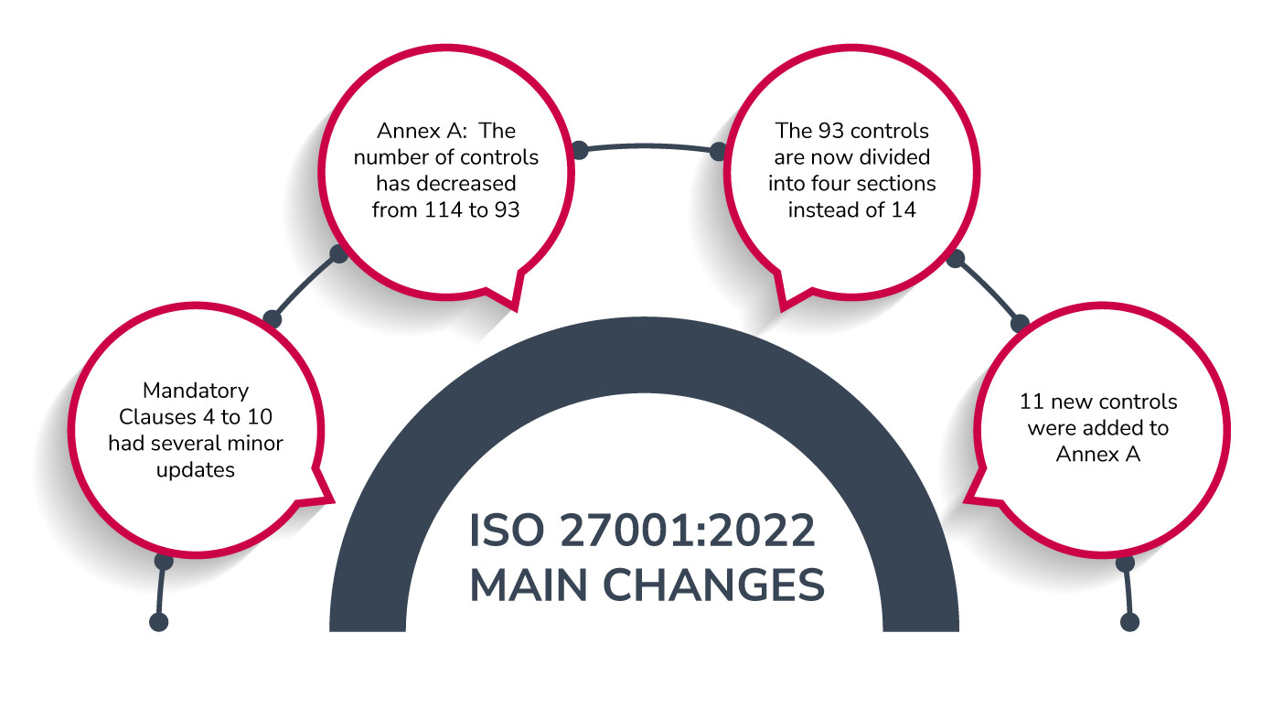

Slide 33
ISO 27022:2022
The new Sections and Controls of ISO 27002:2022 are:
Section 5: Organizational (37 controls)
Section 6: People (8 controls)
Section 7: Physical (14 controls)
Section 8: Technology (34 controls)

Slide 34
5 Organizational controls | 6 People controls | 7 Physical controls | 8 Technological controls
5.1 Policies for information security | 6.1 Screening | 7.1 Physical security perimeters | 8.1 User endpoint devices
5.2 Information security roles and responsibilities | 6.2 Terms and conditions of employment | 7.2 Physical entry | 8.2 Privileged access rights
5.3 Segregation of duties | 6.3 Information security awareness, education and training | 7.3 Securing offices, rooms and facilities | 8.3 Information access restriction
5.4 Management responsibilities | 6.4 Disciplinary process | 7.4 Physical security monitoring | 8.4 Access to source code
5.5 Contact with authorities | 6.5 Responsibilities after termination or change of employment | 7.5 Protecting against physical and environmental threats | 8.5 Secure authentication
5.6 Contact with special interest groups | 6.6 Confidentiality or non-disclosure agreements | 7.6 Working in secure areas | 8.6 Capacity management
5.7 Threat intelligence | 6.7 Remote working | 7.7 Clear desk and clear screen | 8.7 Protection against malware
5.8 Information security in project management | 6.8 Information security event reporting | 7.8 Equipment siting and protection | 8.8 Management of technical vulnerabilities
5.9 Inventory of information and other associated assets |  | 7.9 Security of assets off-premises | 8.9 Configuration management
5.10 Acceptable use of information and other associated assets |  | 7.10 Storage media | 8.10 Information deletion
5.11 Return of assets |  | 7.11 Supporting utilities | 8.11 Data masking
5.12 Classification of information |  | 7.12 Cabling security | 8.12 Data leakage prevention
5.13 Labelling of information |  | 7.13 Equipment maintenance | 8.13 Information backup
5.14 Information transfer |  | 7.14 Secure disposal or re-use of equipment | 8.14 Redundancy of information processing facilities
5.15 Access control |  |  | 8.15 Logging
5.16 Identity management |  |  | 8.16 Monitoring activities
5.17 Authentication information |  |  | 8.17 Clock synchronization
5.18 Access rights |  |  | 8.18 Use of privileged utility programs
5.19 Information security in supplier relationships |  |  | 8.19 Installation of software on operational systems

Slide 35
5 Organizational controls | 6 People controls | 7 Physical controls | 8 Technological controls
5.20 Addressing information security within supplier agreements |  |  | 8.20 Networks security
5.21 Managing information security in the ICT supply chain |  |  | 8.21 Security of network services
5.22 Monitoring, review and change management of supplier services |  |  | 8.22 Segregation of networks
5.23 Information security for use of cloud services |  |  | 8.23 Web filtering
5.24 Information security incident management planning and preparation |  |  | 8.24 Use of cryptography
5.25 Assessment and decision on information security events |  |  | 8.25 Secure development life cycle
5.26 Response to information security incidents |  |  | 8.26 Application security requirements
5.27 Learning from information security incidents |  |  | 8.27 Secure system architecture and engineering principles
5.28 Collection of evidence |  |  | 8.28 Secure coding
5.29 Information security during disruption |  |  | 8.29 Security testing in development and acceptance
5.30 ICT readiness for business continuity |  |  | 8.30 Outsourced development
5.31 Legal, statutory, regulatory and contractual requirements |  |  | 8.31 Separation of development, test and production environments
5.32 Intellectual property rights |  |  | 8.32 Change management
5.33 Protection of records |  |  | 8.33 Test information
5.34 Privacy and protection of PII |  |  | 8.34 Protection of information systems during audit testing
5.35 Independent review of information security
5.36 Compliance with policies, rules and standards for information security
5.37 Documented operating procedures

Slide 36
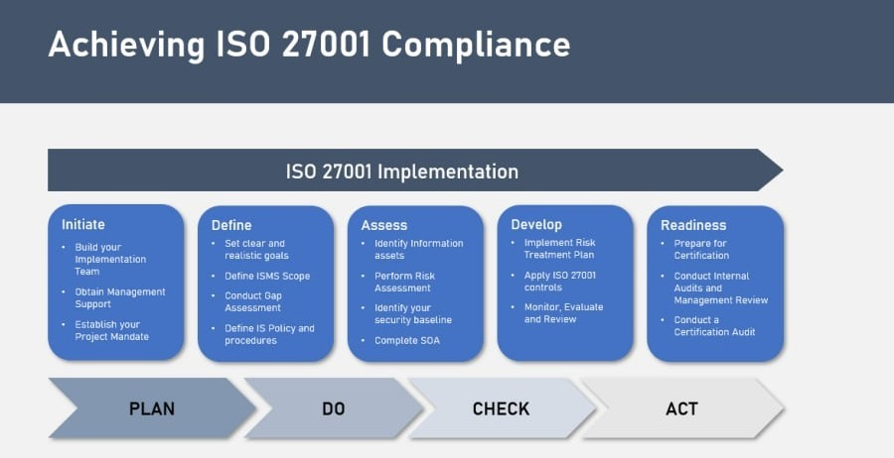

Slide 37
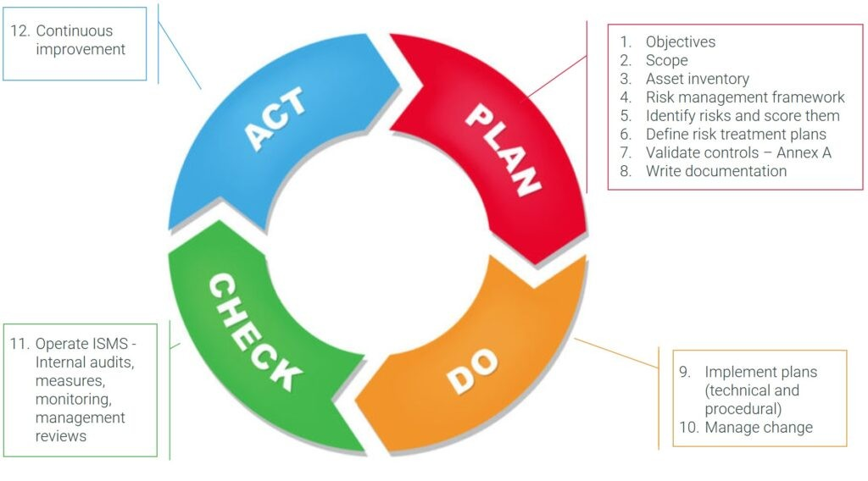

Slide 38
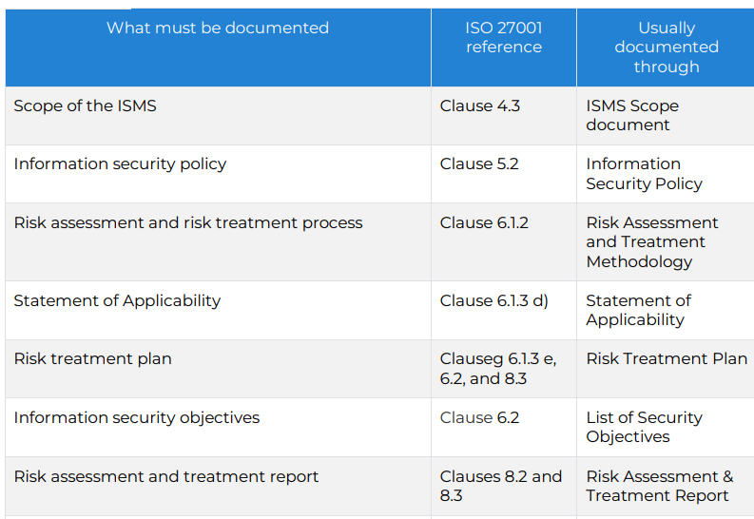
ISO 27001 obligatory documentation

Slide 39
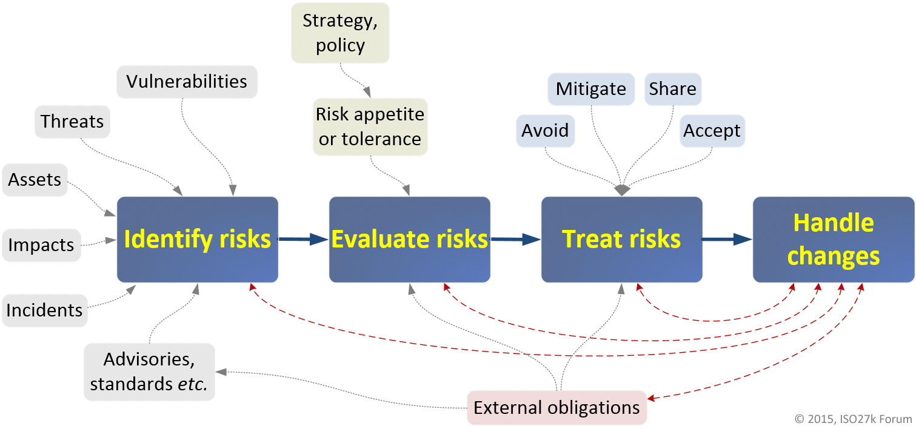

Slide 40
ISO 27001 certfication
ISO 27001 certification is valid for 3 years, but to maintain it, your auditor must return on an annual basis during the two calendar years following certification to reassess the continued conformance of your ISMS to the ISO 27001 standard.

Slide 41
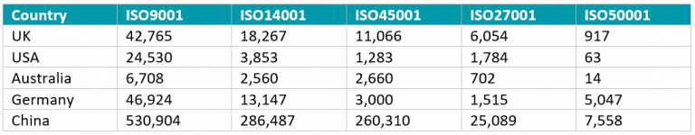

Slide 42
Why China Leads in ISO Certifications?
Strong government support: Certification is actively encouraged or required for public tenders, supplier registration, and industry licensing.
Massive industrial base: China has the world’s largest number of manufacturers, IT providers, and service organizations—many certify multiple sites under one company.
Competitive certification market: Numerous local accredited bodies make audits affordable and accessible, driving higher adoption rates.
Export-oriented economy: ISO certificates serve as proof of international quality and compliance, essential for global trade and foreign partnerships.
Cultural and reputational value: Certification is widely viewed as a mark of professionalism and credibility in both domestic and international markets.

Slide 43
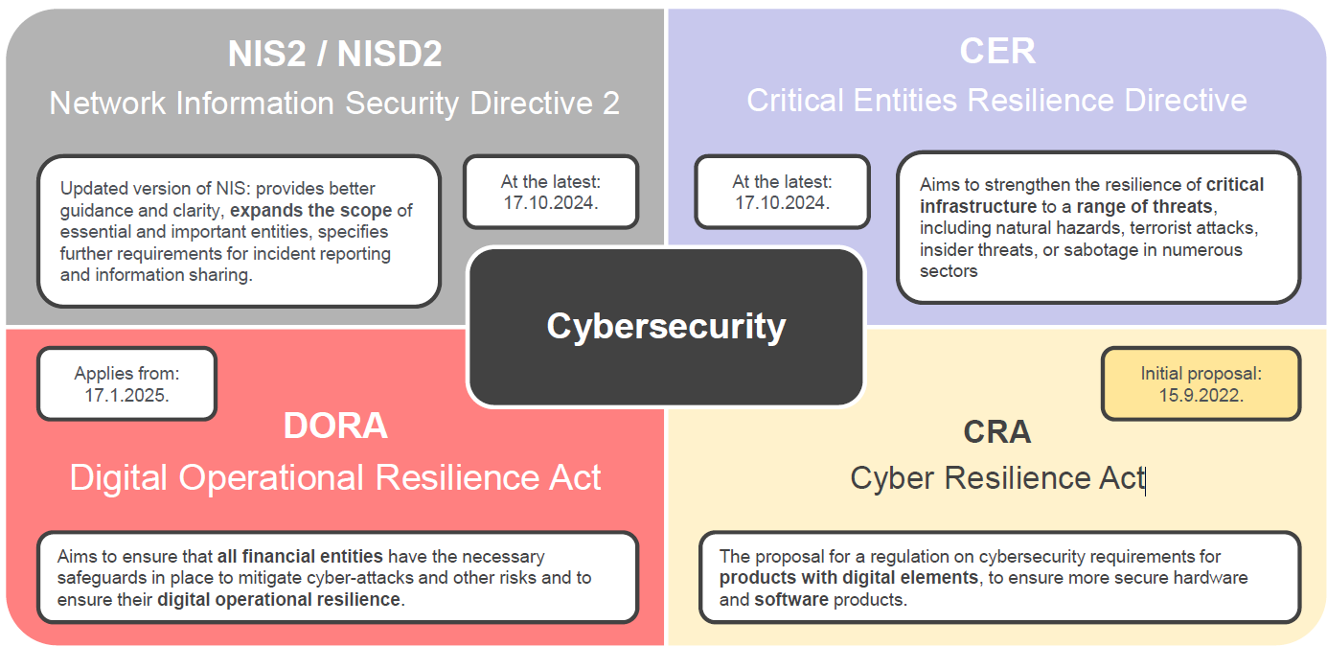

Slide 44
Cyber Resilience Act
https://www.consilium.europa.eu/en/policies/cybersecurity/timeline-cybersecurity/
The Cyber Resilience Act entered into force on 10 December 2024. The main obligations introduced by the CRA will apply from 11 December 2027.

Slide 45
Cyber Resilience Act
Two main objectives were identified aiming to ensure the proper functioning of the internal market:
create conditions for the development of secure products with digital elements by ensuring that hardware and software products are placed on the market with fewer vulnerabilities and ensure that manufacturers take security seriously throughout a product’s life cycle; and
create conditions allowing users to take cybersecurity into account when selecting and using products with digital elements.

Slide 46
Cyber Resilience Act
Four specific objectives were set out:
ensure that manufacturers improve the security of products with digital elements since the design and development phase and throughout the whole life cycle;
ensure a coherent cybersecurity framework, facilitating compliance for hardware and software producers;
enhance the transparency of security properties of products with digital elements, and
enable businesses and consumers to use products with digital elements securely.

Slide 47
NIS2/DORA
NIS2 is a directive, DORA is a regulation
A directive sets a course, and cannot be applied as it stands in every EU Member State. It must first be transposed into the national law of each country.
A regulation, on the other hand, applies unchanged in all Member States as soon as it comes into force. It is a binding legislative act, and must be enforced in its entirety.
GDPR?

Slide 48
NIS2/DORA timeline
The NIS2 Directive must be transposed into the national law of every EU country; it cannot be applied as such.
It was published in the EU’s Official Journal on December 27, 2022, and Member States have 21 months from that date to transpose it into national law – i.e. by October 2024
DORA: enforceable in all Member States on January 17, 2025

Slide 49
NIS2/DORA objectives
The NIS2 Directive harmonizes the global level of cybersecurity across the EU.
The DORA regulation aims to strengthen the digital operational resilience of the financial sector
the two texts complement rather than compete with each other
DORA is “lex specialis” of NIS2 for the financial sector

Slide 50
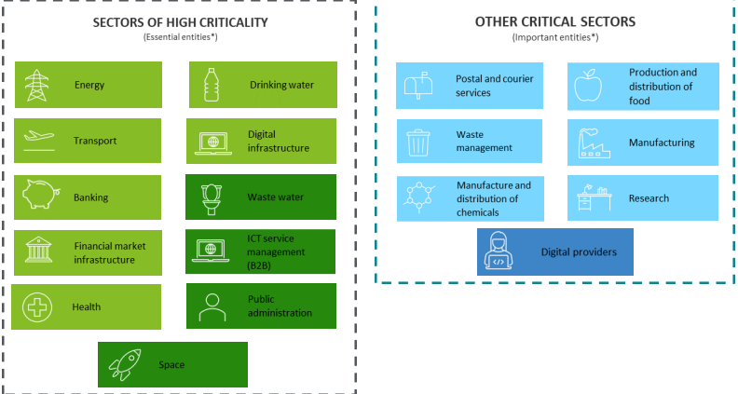
NIS2

Slide 51
NIS2 fines
Fines up to 10 million EUR or 2% of the total global annual turnover for essential entities
Fines up to 7 million EUR or 1.4% of the total global annual turnover for important entities
Management liability for infringements to the directive
Temporary bans against senior management
Temporary suspension of services

Slide 52
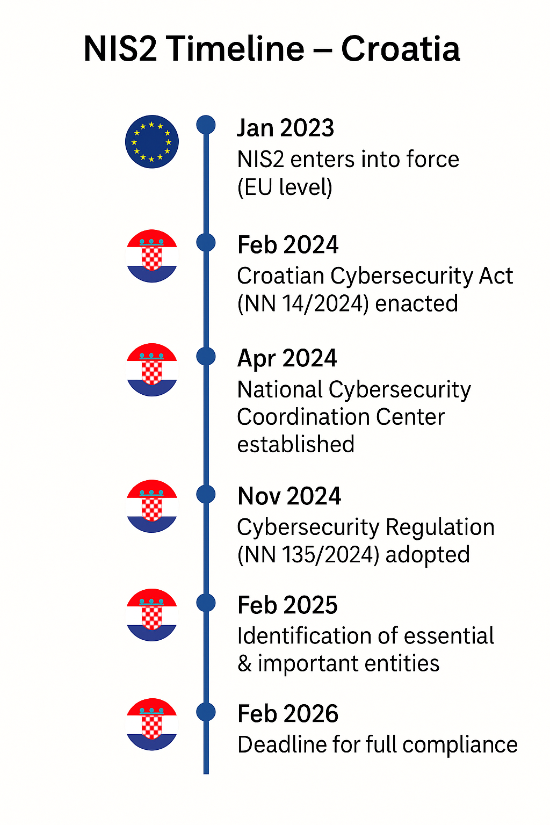
NIS2 in Croatia
1.2.2024 – adopted Cyber Security Law / Zakon o kibernetičkoj sigurnosti
https://narodne-novine.nn.hr/clanci/sluzbeni/2024_02_14_254.html
21.11.2024 – Rules for cyber security / Uredba o kibernetičkoj sigurnosti
https://narodne-novine.nn.hr/clanci/sluzbeni/2024_11_135_2217.html

Slide 53
NIS2 in Croatia
Risk assessment of entites
Low, medium and high
Security measures based on risk level
CIS Top 18 approach

Slide 54
1) Osnovna razina mjera upravljanja kibernetičkim sigurnosnim rizicima …predstavlja opći skup mjera kibernetičke sigurnosne prakse koji je moguće postići s lako dostupnim tehnologijama i dobro poznatim i dokumentiranim najboljim kibernetičkim sigurnosnim praksama, primjeren u slučaju subjekata čije djelatnosti pripadaju sektorima za koje nisu tipični ciljani kibernetički napadi a cilj primjene osnovne razine je zaštiti subjekt od većine globalno prisutnih kibernetičkih napada, …
(2) Srednja razina mjera upravljanja kibernetičkim sigurnosnim rizicima … predstavlja dopunjeni skup mjera kibernetičke sigurnosne prakse kojim se nadograđuje osnovna razina mjera upravljanja kibernetičkim sigurnosnim rizicima, a cilj primjene srednje razine je dodatno umanjiti rizike od ciljanih kibernetičkih napada koje provode kibernetički napadači prosječnih kibernetičkih vještina.
(3) Napredna razina mjera upravljanja kibernetičkim sigurnosnim rizicima … predstavlja dopunjeni skup mjera kibernetičke sigurnosne prakse kojim se nadograđuje srednja razina mjera upravljanja kibernetičkim sigurnosnim rizicima, a cilj primjene napredne razine je smanjenje rizika od naprednih kibernetičkih napada koje provode kibernetički napadači s naprednim vještinama i resursima.

Slide 55
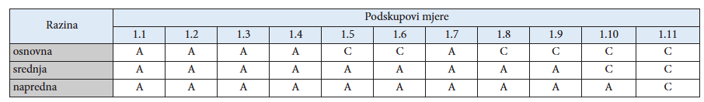
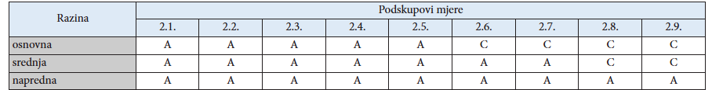
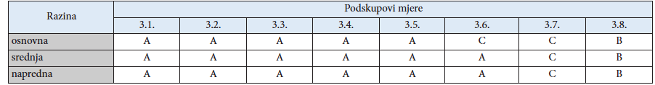
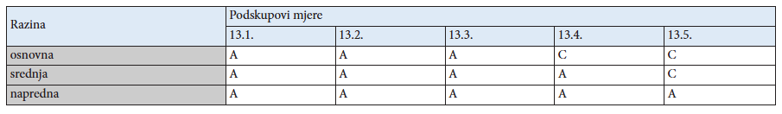

Slide 56
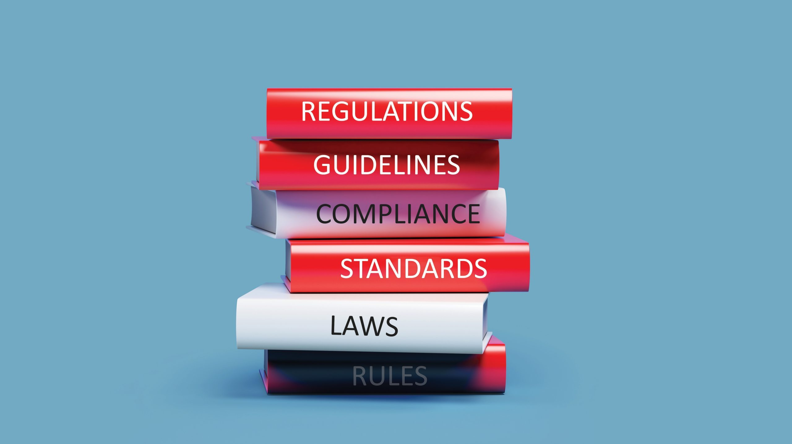


Slide 57
Hvala na pažnji!

