Slide 1
ENGLISH FOR IT
LO4 VOCABULARY
Video conferencing, and netiquette

Slide 2
In this lesson, you will:
Learn and use vocabulary related to different video conferencing systems
Discuss the “dos and don’ts” for online meetings
Learn the general netiquette in online environments

Slide 5
Video call vs video conference
Videotelephony (also known as video conferencing, video teleconferencing, or simply video call) is the two-way or multipoint reception and transmission of audio and video signals by people in different locations for real-time communication.
A videophone is a telephone with a video camera and video display, capable of simultaneous video and audio communication. Video conferencing implies the use of this technology for a group or organizational meeting rather than for individuals, in a videoconference.

Slide 6
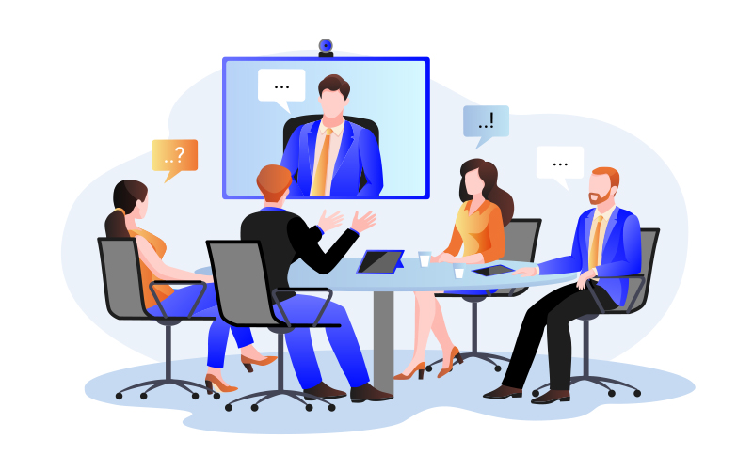

2 types of video conferencing

Slide 8
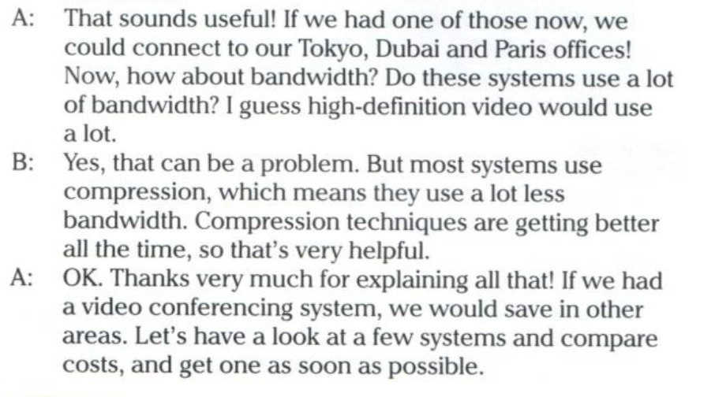

Slide 11
Answer key
Slide 6 | dedicated systems and desktop systems
Slide 7 | 1 dedicated system 2 remote control 3 MCU 4 (data) compression
Side 9 | more than two / more than one / more expensive / special room / HD monitors, video cameras, remote controls, MCU
Slide 10 | 2 maintenance would be expensive / 3 data wouldn’t transfer quickly enough; there wouldn’t be enough bandwidth; video wouldn’t transfer properly / 4 video conferencing would only work with two locations / 5 people wouldn’t know how to use the system properly / 6 there would be nowhere to go for the video conference; would have to hire a room each time/ 7 data would use too much bandwidth; bandwidth charges would be high

Slide 12
Let’s watch some videos and discuss
A Video Conference Call in Real Life
https://www.youtube.com/watch?v=JMOOG7rWTPg
Netiquette - The Dos and Don'ts of Online Meetings
https://www.youtube.com/watch?v=d-_wYdG873M

Slide 13
What is netiquette?
Study the Netiquette code here:
https://www.britannica.com/topic/netiquette

Slide 14
After reading the britannica.com entry, summarize in pairs what makes a good netiquette
Lurking
Reading the FAQs
Remember the Human
Avoid Flames
Avoid Shouting
Not a Homework Center
Composition Protocols

Slide 15
Resources:
Remacha, Infotech –Unit 18 (pp 91-92)
Pearson – Unit 6 – Interactions (pp 46-47)
https://www.youtube.com/watch?v=JMOOG7rWTPg
https://www.youtube.com/watch?v=d-_wYdG873M
https://www.britannica.com/topic/netiquette

Slide 16
#neverstoplearning

