Slide 1
ENGLISH FOR IT
LO 4 VOCABULARY
Jobs in ICT

Slide 2
In this lesson, you will:
identify jobs in ICT and discuss their responsibilities
discuss personal qualities and professional skills needed for a particular job in ICT
Listen to a job interview

Slide 3

Listen to 6 people introducing themselves. What jobs do they do?
database administrator
helpdesk supervisor
project manager
software developer
support technician
systems analyst

Slide 4
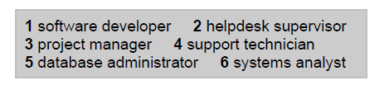
Check your answers

Slide 6
Check your answers
hardware engineer
software engineer
blog administrator
DTP operator
network administrator
webmaster
computer security specialist
help desk technician

Slide 7


Slide 8
Check your answers
Speaker 1: webmaster
Speaker 2: help desk technician
Speaker 3: hardware engineer
Speaker 4: computer security specialist

Slide 9
Which skills should these 3 IT experts have? Discuss in pairs.
(your choice) ________
Other skills: ________

Slide 11
Check your answers
Computer Sciences
Analyst programmer for a year
general commercial use
IBM mainframes
Microsoft Access and dBase 5
wants something more demanding and with more responsibility; wants to learn about a new industry

Slide 12
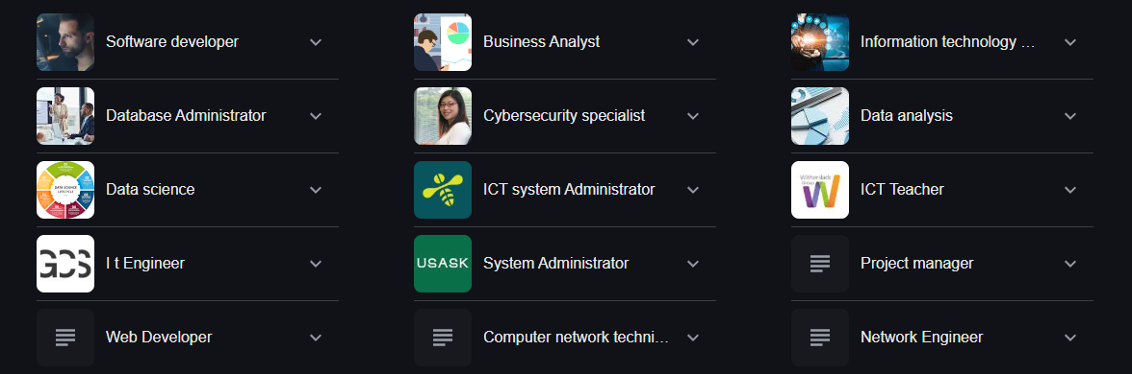
22 ICT jobs to consider (+salary info)
https://www.indeed.com/career-advice/finding-a-job/jobs-in-ict-industry

Slide 13
Resources:
Remacha, Infotech –Unit 26 (pp 129-133)
Hill, English for Information Technology 2. Pearson Education ELS - Unit 1 (pp 4-5)

Slide 14
#neverstoplearning

