Slide 1
ENGLISH FOR IT
LO 1 VOCABULARY
Computer Essentials - Hardware

Slide 2
Today you will:
Learn the difference between a computer and a computer system
Study the basic structure of a computer system
Study the differences between certain types of computer
Learn basic vocabulary for hardware
Talk about computer applications in everyday life

Slide 3
In pairs, discuss these questions:
What kind of a computer do you have at home, school or work?
How often do you use it? What do you use it for?
What is the difference between the computer and the computer system?
What are the main features of your computer system?

Slide 4
What is a computer?
A computer can be described as an electronic machine which can be used to store, process and display data. Computers are electronic and digital. The actual machinery of the computer, the wires, transistors and circuits, is called the hardware and the instructions and data are called the software.
Can you name different types of computers?

Slide 5
Different types of computer

Slide 6
True or False? Correct the false statements.
Do we still use PDAs today? What do we use instead?
Notes:
F
T
T
F
F
T
T
F
SMARTPHONES

Slide 7
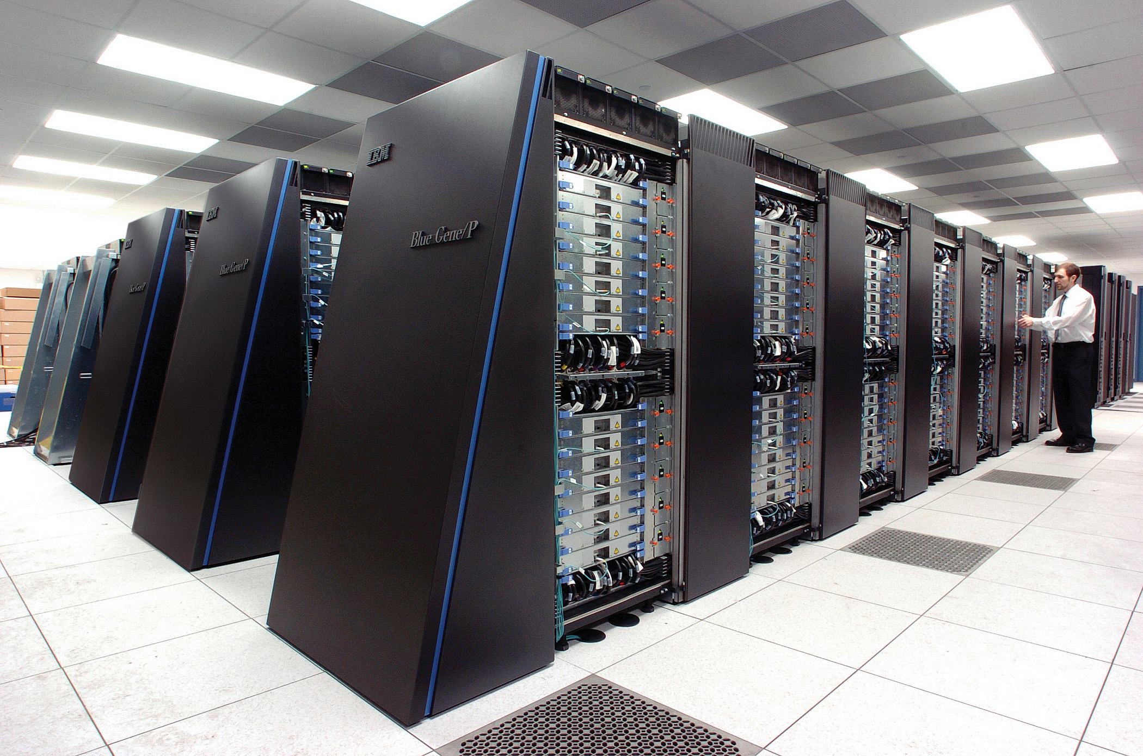
Supercomputer
A supercomputer is a fast computer that contains thousands of processors in it and that can perform trillions of calculations per second.
The speed of a supercomputer is measured in floating-point operations per second (FLOPS). The speed of the normal computer is measured in million instructions per second (MIPS).
Notes:
Initialisms:
floating-point operations per second (FLOPS)
million instructions per second (MIPS)

Slide 8
Supercomputer
Can you guess?
1. What are some uses of a supercomputer?
2. Which countries have the fastest supercomputers?
Read this article and check your guesses:
https://www.itrelease.com/2023/02/what-are-uses-and-examples-of-supercomputer/
Notes:
Uses of Supercomputer
Some uses of a supercomputer are:-
They are used in oil and gas exploration.
They are used in folding of proteins which helps in the development of different drugs.
They help to test aircraft and reduce costs in a space mission.
They help to precisely do weather forecasting.
Supercomputers can measure the interaction between molecules and help to discover new drugs and treatments.
They help to do cloud computing and big companies like Amazon and Google use supercomputers to provide their services to users.
They are used for image recognition, natural language processing and autonomous vehicles.
They help in experimenting with nuclear fusions and creating energy from nuclear experiments.
Supercomputers help researchers to develop applications for quantum computing.
They help banks and financial institutions to manage risk and make better investment decisions.
They help organizations to protect their systems from cyber-attacks and data loss.
Used in the entertainment industry to make complex animations in movies and video games.
They help to diagnose diseases and develop medicines.
They help scientists to predict the behaviour of the earth millions of years ago.
Helps to simulate traffic patterns and improve traffic efficiency.
They help to research materials at the atomic level.
They help to process a large amount of video and image data.
Supercomputers help to study the behaviour of stars and galaxies.
They help in the mining of bitcoins.
They help in understanding the behaviour of blood flow in the human body.
They are used to manage large databases.
Supercomputers help to predict the temperature of the earth in the coming years.
They help to track and manage airlines.
If we talk about the top ten fastest supercomputers then 5 of the top ten supercomputers belong to
5 the United States, 2 from China, 1 from Finland, 1 from Japan and 1 from France.

Slide 9
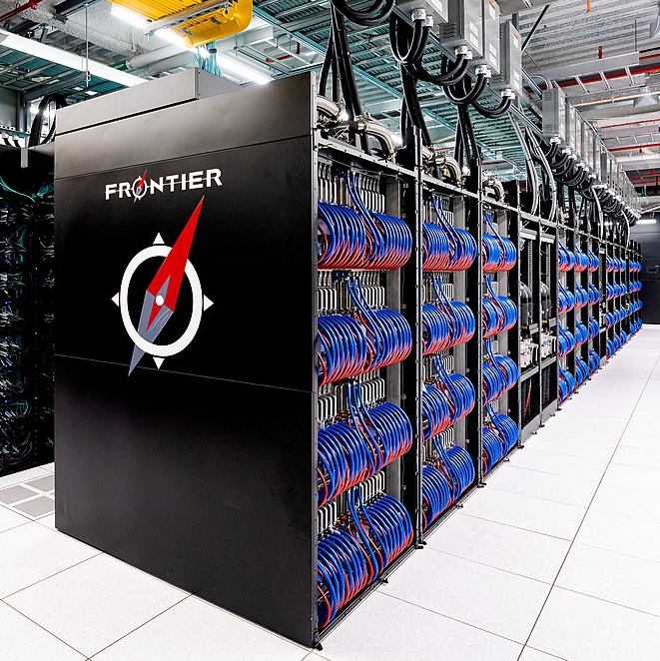
The fastest supercomputer today
Name: Frontier
Speed: capable of performing up to 2 quintillion calculations per second (2 exaFLOPS in computing power)
Estimated cost: US$600 million
Location: Oak Ridge National Laboratory and U.S. Department of Energy
Space: 680 m2 (7,300 sq ft)
Purpose: Scientific R&D
Notes:
Supercomputers today are used in the field of scientific research and development which includes transformative science — advancing knowledge in everything from medicine to biology to material science to deep space to climate change.

Slide 10
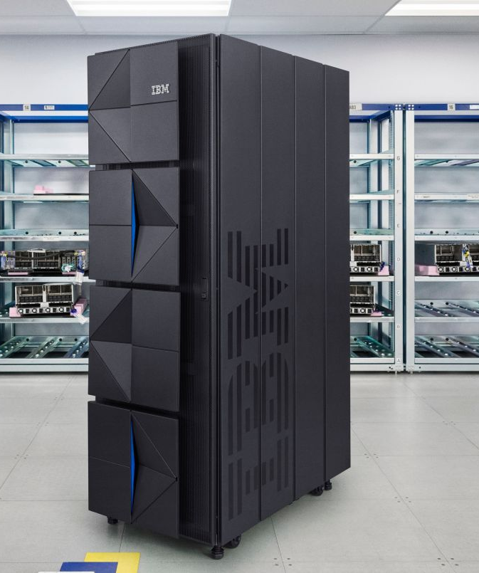
Mainframe
Mainframes are data servers designed to process up to 1 trillion web transactions daily with the highest levels of security and reliability.
Read this article on Mainframe
https://www.techopedia.com/definition/2157/big-iron
And answer the following questions:
What does Big Iron mean?
When were first mainframes introduced?
Which famous IT company still produces mainframes?
Why are mainframes sometimes referred to “dinosaurs”?
Are mainframes still used today and by whom?
the IBM z16 mainframe, 2008
Watch this video to learn more: https://www.ibm.com/topics/mainframe
Notes:
ANSWERS:
"Big iron" is slang for an extremely large, expensive and fast computer. It often refers to oversized computers. Originally, the phrase 'big iron' probably originates from early mainframes, which were very large computers with superior capabilities enclosed in room-sized metal frames.
In the 1960s and 1970s
IBM
Because tech experts in the early ‘90s predicted that big iron would eventually become extinct (hence the additional nickname of “dinosaurs”) by the end of that decade.
Yes. Today, big iron computers are high-performance rigs primarily used by large companies such as banks.

Slide 11
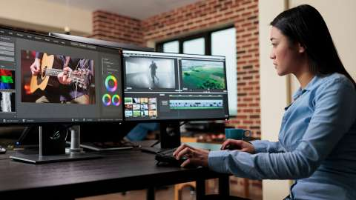
Workstation
Discuss these questions: Is a workstation the same as desktop computer? Can a gaming PC be a workstation?

Slide 12
Desktop vs. Workstation
Is a workstation a desktop?
A basic workstation can resemble a desktop PC with a tower, a mouse, and a keyboard. But it's what's inside that makes all the difference. With a large central processing unit (CPU) and massive storage space, a workstation can run multiple applications simultaneously at much faster speeds.
Can a gaming PC be a workstation?
Yes, absolutely. Gaming PCs basically are regular PCs, but with more robust hardware inside like specialized GPUs and CPUs. Also, they sometimes contain more RAM (random access memory) as well. This hardware is what enables it to handle very demanding video games and work tasks.
Notes:
INITIALISMS:
PC personal computer
CPU central processing unit
GPU – graphical processing unit
RAM – random access memory

Slide 13
So, what is the difference between a computer and a computer system?
A computer is just a machine! - an electronic machine which can accept data in a certain form, process it and give the results of processing in a specified format (such as information).
A computer system consists of 2 parts:
1. HARDWARE – any electronic or mechanical part that you can see or touch
2. SOFTWARE – a set of instructions, called a program, which tells the computer what to do

Slide 14
CPU= central processing unit
Which elements are outdated? What are their replacements today?
Notes:
Outdated:
CDs/DVDs – replacement: pendrives and cloud storage
External webcam – replacement EMBEDDED WEBCAM

Slide 15
webcam
screen /monitor
computer case
printer
DVD drive
USB port
CDs/DVDs
router
mouse
keyboard
Notes:
Initialisms:
CD – compact disc
DVD – digital versatile disc
USB – universal serial bus

Slide 16
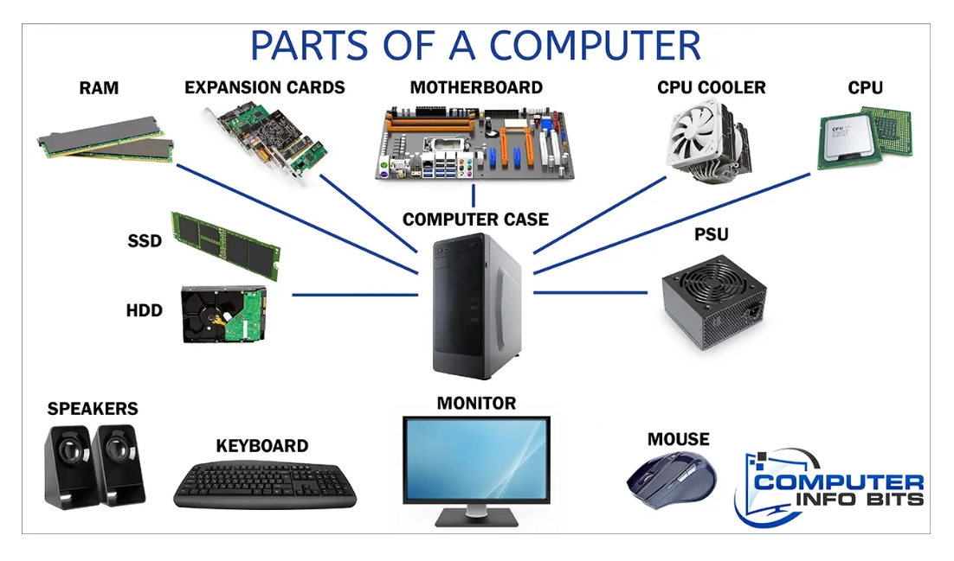
Notes:
Explanations:
COMPUTER CASE (OR SYSTEM UNIT) -This component holds all of the physical parts of a computer system. Cases come in all different sizes and shapes to accommodate various types of computer components and satisfy the consumer’s needs. Cases typically have extra connectors on the front of them for more convenience. USB ports and headphone jacks are commonly found.
THE MOTHERBOARD is the main board mounted directly inside the computer case. All other cards plug directly into the motherboard, hence its name.
It is a printed circuit board in which the CPU, RAM, drives, power supply, expansion cards, and more are plugged into it.
The CPU or central processing unit is basically like the brain of computer systems. It processes all the information on a computational level. It takes all the processes from the RAM and processes them to perform the tasks required by the computer system.
RAM is a data storage device that can provide fast read and write access. RAM is volatile memory, meaning it loses all the stored data when power is lost. The RAM keeps data ready for the CPU to process. It plugs directly into a long slot that has contacts on either side of the slot.
HDD - A hard drive is still found in many PCs to this day. A mechanical drive’s purpose is to store all your information for retrieval at any time.
An SSD is also a type of hard drive, but it doesn’t have any moving bits. It consists of a bank of flash memory that can hold a reasonable amount of information.
PSU - A power supply unit mounts inside the computer case. It converts the AC mains supply from the power cord from a wall socket and supplies the correct DC voltages to all the parts of a computer.
A MONITOR is an output device to visualize the graphics information sent from the computer’s GPU. There are various types of monitors on the market. An LED (Light Emitting Diode) backlit LCD (Liquid Crystal Display) monitor is the most commonly used with a modern PC.

Slide 17
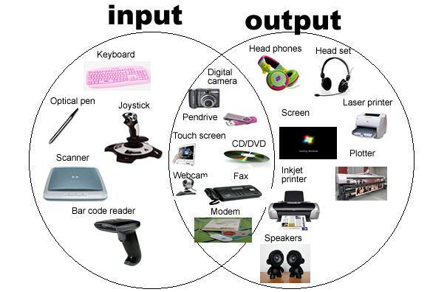
The central idea of a computing system is that input is processed into output.
Input is the data which is entered into the computer, and output is the result of processing done by the computer, usually printed out or displayed on the screen.
What input and output devices do you know?

Slide 18
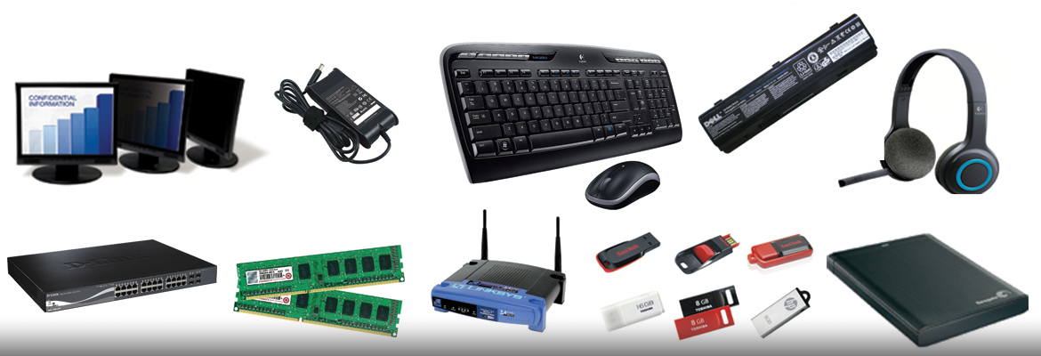
Peripherals
A computer peripheral is a device that is connected to a computer but is not part of the core computer architecture. The core elements of a computer are the central processing unit (CPU), power supply unit (PSU), motherboard and the computer case that contains those three components. Technically speaking, everything else is considered a peripheral device.
Can you name these peripherals?
Notes:
Answers (left to right)
First line: monitor/ screen /VDU (visual display unit); charger; keyboard and mouse; battery; headset (headphones do not have a microphone);
Second line: modem; SSD (solid state drive); router; pendrives (aka USB flash drives, USB memory sticks); external HDD (hard disk drive).
THE DIFFERENCE BETWEEN MODEM AND ROUTER: The modem brings the internet into your home; The router takes that internet and splits it so it can be shared by all the devices on your network.

Slide 19
In pairs, name these peripherals, decide if they are input or output devices and provide a definition

Slide 20
Check your answers here

Slide 21
In groups, discuss the roles of computer:
How do we use computers in these 3 categories?
Brainstorm and list as many computer uses/ applications as you can.
PERSONAL
COMMERCIAL /BUSINESS
EDUCATIONAL

Slide 22
Social networks (Insta, fb, Tick-tock, LinkedIn)
VoIP = Voice over Internet Protocol or IP Telephony (WhatsApp/ Viber/Skype) – online calls and voice messages
Search for info (search engines)
PERSONAL
Buy and sell things online (Amazon, e-bay)
Book a holiday or a flight (booking.com, sky scanner)
Entertainment: gaming, online music (Spotify), videos (YouTube),listening to podcasts, movies and series (Netflix), blogs
Using PIMs (personal information manager) to organize daily schedules or to-do lists
Keep in touch – email, texting

Slide 23
CAL = computer assisted learning; Online and distance learning
Do research
EDUCATIONAL
Software apps: word processing, databases, spreadsheets, presentation software…
VR – virtual reality
E-mail
Massive Open Online Courses (MOOCs) eg. Coursera
Messaging and videoconferencing apps (eg Teams, Zoom, Moodle…)
Using PIMs (personal information manager) to organize daily schedules or to-do lists
Enterprise Social Networking System (ESN), e.g. InfoEduka
Notes:
Note: In Online learning, the teaching and all forms of communication occur online. All the activities are carried out like offline learning but virtually. In distance learning, there is no interaction between the teacher and the Student

Slide 24
Design products, e.g. graphics programs- CAD (Computer Assisted Design)
Marketing
E-commerce – business conducted on the Internet
Do calculations, e.g. spreadsheet programs
COMMERCIAL /BUSINESS
Keep records, e.g. database programs
E-mail
Messaging and videoconferencing apps (eg Teams, Zoom, Moodle…)
Using PIMs (personal information manager) to make notes, arrange appointments etc.
Enterprise Social Networking System (ESN)

Slide 25
Do you remember what these initialisms stand for?
PC PDA FLOPS MIPS R&D CPU GPU | PSU SSD HDD PIM VoIP RAM USB | CAL MOOC ESN VR CAD CD DVD

Slide 26
For those who want more
Do exercises from the Vocabulary Book (pages 6-9) and check your answers in the answer-key section:
1.1 Hardware
1.2 Some useful verbs
1.3 The workstation
You can download the Vocabulary Book here:
https://www.scribd.com/document/266312924/Check-Your-English-Vocabulary-for-Computers-and-Information-Technology

Slide 27
Resources:
Remacha, Infotech - Unit 2 (pp 7-10)
Marks, Vocabulary Book – 1.1 Hardware, 1.2 Some useful verbs, 1.3 The workstation (pp 6-9)
Hill, English for IT 2 – Peripherals, p 34
https://www.techopedia.com/definition/2157/big-iron
https://www.itrelease.com/2023/02/what-are-uses-and-examples-of-supercomputer/
https://computerinfobits.com/parts-of-computer-and-their-functions/

Slide 28
#neverstoplearning

