Slide 1
Present Simple and Continuous
ENGLISH FOR IT
LO 2 GRAMMAR

Slide 2
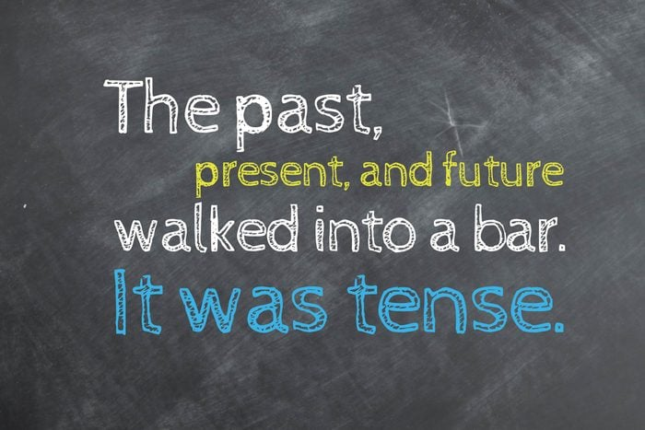

Slide 3
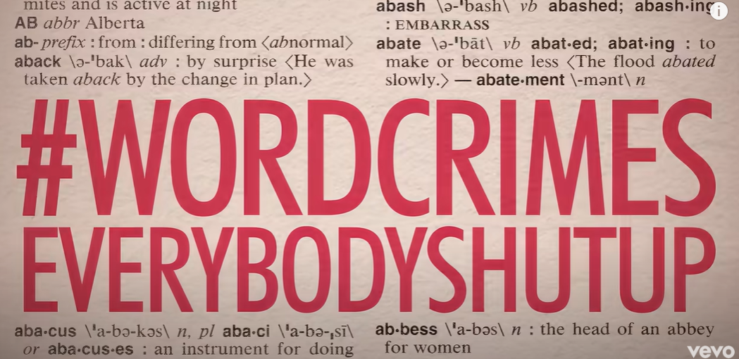
Why do we learn grammar?
https://www.youtube.com/watch?v=8Gv0H-vPoDc

Slide 4
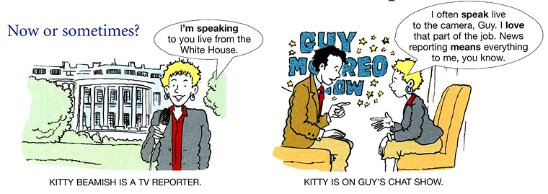
Present Simple vs Present Continuous

Slide 5
Present Simple vs Present Continuous
PRESENT SIMPLE – FORM
PRESENT CONTINUOUS – FORM
We use the base form of the verb → write, play, see, do, have, etc.
The form for he, she, it ends with –s → play – plays, cry – cries, switch – switches, be – is, do – does, have - has
Questions have do or does before the subject → Do you work? Does he/she work? Where do you work?
Negative statements have do not/don’t or does not/doesn’t after the subject → I don’t work. He/She doesn’t work.
** The verb to be → I am busy. He is not employed. Where are you from?
It is made up of two parts:
be + base form of verb + ing
We are working on a very interesting project.
The verb to be changes with different subjects!
Questions are created by moving the verb BE to the beginning of the sentence. → Are you working on something interesting at the moment? Why are you looking at me like that?
Negative statements are formed by adding not after the verb BE→ We are not/aren’t working on anything special at the moment.
Spelling rules: read – reading, play – playing, try –trying, leave – leaving, sit – sitting, die - dying

Slide 6
Present Simple vs Present Continuous
PRESENT SIMPLE | PRESENT CONTINUOUS
- things that are always true: I don’t drink coffee. | - things that are happening now: Look, Mary is drinking your coffee.
- things that happen all the time, repeatedly, often, sometimes, never, etc. The Sun rises in the east. I play tennis every Wednesday. | things that are happening around now: Peter is not working at the moment. I’m trying to eat more vegetables.
permanent situations: I live in the city of Zagreb. | things that are changing/ trends: Interest rates are rising again.

Slide 7
Present Simple vs Present Continuous
PRESENT SIMPLE | PRESENT CONTINUOUS
things that happen one after another I wake up at 7 every morning. Then I get up, take a shower and brush my teeth. | longer background situations, in contrast to a shorter one, esp. after while or when: I usually close my Internet browser when I’m working.
Always - meaning ‘every time’: I always make silly mistakes in exams. | Always - used to make complaints and criticisms: This computer is always crashing at the most inconvenient moments.
permanent quality (verb to be) I think she’s rude. | temporary behaviour I think she’s being really rude.

Slide 8
Verbs not often used in the present continuous
Some verbs are normally used in the present simple and not in the present continuous. Here are some of them:
know, suppose, think, understand (mental process verbs)
admire, adore, detest, hate, like, respect (verbs expressing feelings)
smell, taste (verbs describing the senses)
consist, contain, last (verbs describing permanent qualities)
promise, swear (speech act verbs)

Slide 9
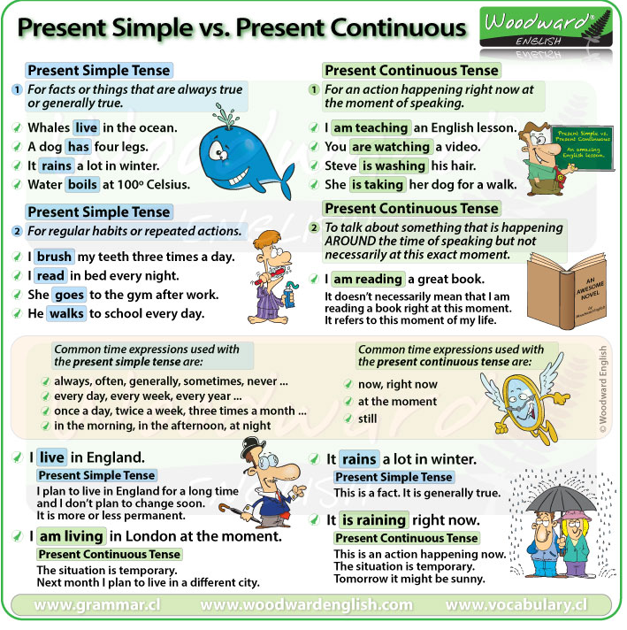
Summary chart

Slide 10
Sources for practice
https://test-english.com/grammar-points/b1/present-simple-present-continuous/
https://www.grammar.cl/Games/Present_vs_Progressive.htm
Murphy, R. (2019). English Grammar in Use (Units 1-4)

Slide 11
#neverstoplearning

