Slide 1
LO 2: Relative clauses

Slide 2
Relative clauses
are clauses that modify a noun or noun phrase and
are introduced by a relative pronoun (who, which, that,
whom, whose), a relative adverb (where, when, why), or
a zero relative.

Slide 3
TWO TYPES
DEFINING
&
NON-DEFINING

Slide 4
DEFINING
The person who prepared that report no longer works for us.
Makes clear exactly WHO or WHAT we are talking about.

Slide 5
NON-DEFINING
Carla Jensen, who prepared that report, no longer works for us.
Extra information about a person or a thing.
Carla Jensen no longer works for us.

Slide 6
Relative pronouns and adverbs
 | DEFINING and NON-DEFINING | DEFINING and NON-DEFINING | DEFINING ONLY!!!
 | personal | non-personal | personal and non-personal
SUBJECTIVE | WHO | WHICH | THAT
OBJECTIVE | WHO(M) | WHICH | THAT, no pronoun
GENITIVE | WHOSE | of WHICH / WHOSE
LOCATIVE |  | WHERE
TEMPORAL |  | WHEN

Slide 7
DEFINING
We use WHO/THAT to refer to people:
The security guard who/that works on the main gate used to be a policeman.
We use WHICH/THAT to refer to things. THAT is much more common.
Tha factory which/that produced the keyboards and the mouse could be shut down.

Slide 8
Subject / Object
We MUST use who, which or that when they are the subject of the defining realtive clause.
Investors who want a secure fixed rate should choose our ‘eSaver’ account.
We can leave out who, which or that when they are the object of the defining relative clause.
Where’s the email (that) I wrote yesterday?

Slide 9
NON-DEFINING
We must always use who / which in non-defining relative clauses.
DON’T USE ‘THAT’ IN NON-DEFINING RELATIVE CLAUSES!!!
USE COMMAS AROUND THIS TYPE OF RELATIVE CLAUSE!
Tesco, who control over 30% of the UK grocery market, are now entering the housing market.
(We can use who/which to talk about companies.)

Slide 10
WHOM
Often used immediately after a preposition.
The six prepositions most commonly used with whom are
of, to, for, with, from and by.
‘Saverphone’ allows consumers to chose the retailers from whom they wish to receive special offers.
We understand the needs of our customers, for whom flexibility is a top priority.

Slide 11
WHOM
In spoken and informal written English, it is much more common to use who / that (or no relative pronoun!) and to put the preposition at the end of the relative clause.
Let me introduce you to Claire, who I worked with at H&M.
Let me introduce you to Claire with whom I worked at H&M.
Are you the person (who/that) I should speak to about hiring the meeting room?

Slide 12
WHO vs WHOM
he, she, they (subjects) = WHO
Who was driving the car?
He was driving the car.
him, her, them (objects) = WHOM
You invited whom to dinner?
You invited her to dinner.
For whom was the audience applauding?
The audience was applauding for them.

Slide 13
WHOSE
We use it in both relative clauses to show possession (instead of her/their).
What was the name of the delivery company whose website we looked at yesterday?
I’d like to thank John Spencer, whose company sponsored the exhibition.

Slide 14
WHERE
We can use it in relative clauses about places, including non-physical ones.
Orders are placed directly with the factory where the model is manufactured.
The factory, where the strike began last April, is manned by about 250 employees.
Don’t use where with prepositions!
The office (which/that) I work in is very cold.
(not The office where I work in...)
*After words situation, point and stage:
They’ve reached a situation where they’ll have to negotiate.
We’re at a stage where things can still be changed.
We’re at a point where/when we can take a break to think about the options.

Slide 15
WHEN
We use it in relative clauses about time.
I won’t be there when the product is launched.
On December 21, when the product is launched, I shall be out of the country.
*We can also often use that (or no relative pronoun!) in relative clauses about time.
Do you remember the time (when/that) I spilled coffee over a client?

Slide 16
Some more examples...
The reason that/why the proposal collapsed wasn’t disclosed.
(not: the reason because)
We use THAT (or no preposition!) after all, each, every and compounds:
Computer users aren’t upgrading systems fast enough to absorb all the new products (that) firms are producing.
We have tried everything (that) we could.
You should create a separate CV for each company (that) you approach.

Slide 17
Using participles in relative clauses
When the verb in relative clause is continuous (-ing) or passive form (often –ed), we can leave out the relative pronoun when it is the subject of the clause and the verb be.
Can I speak to the person who is running the conference?
Can I speak to the person running the conference?
The items which were reduced are selling quickly.
The items reduced in the sale are selling quickly.

Slide 18
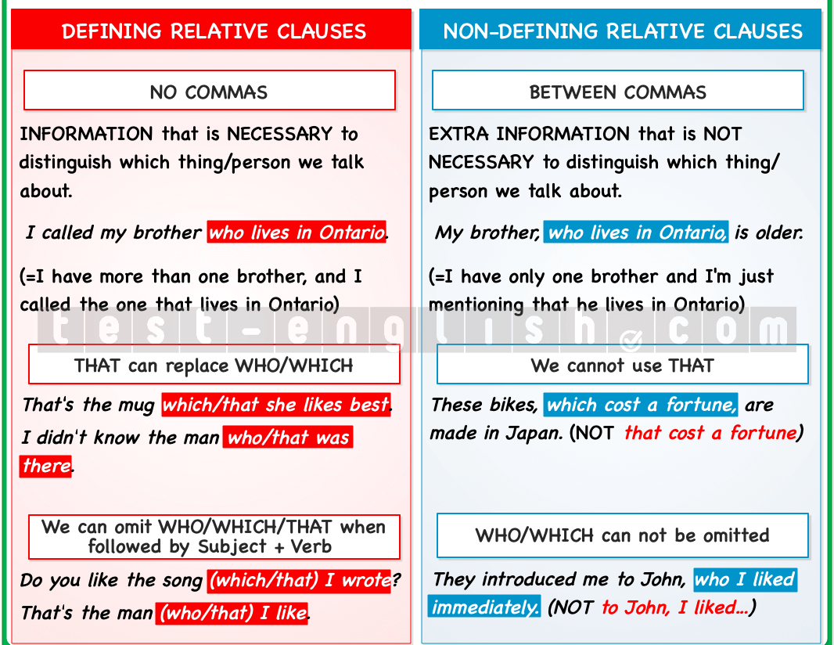
QUICK REMINDER - Defining vs. Non-defining Relative Clauses

Slide 19
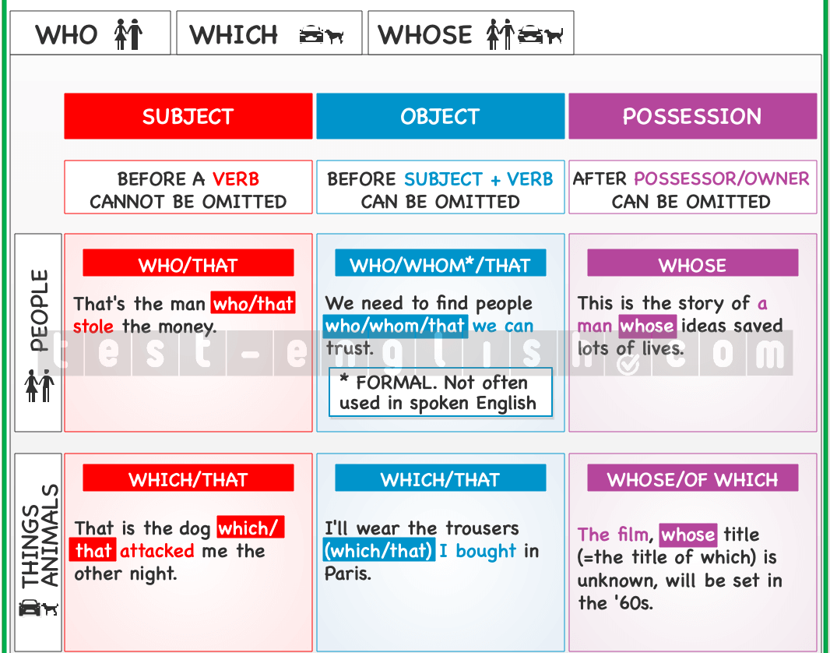
QUICK REMINDER – Relative Pronouns

Slide 20
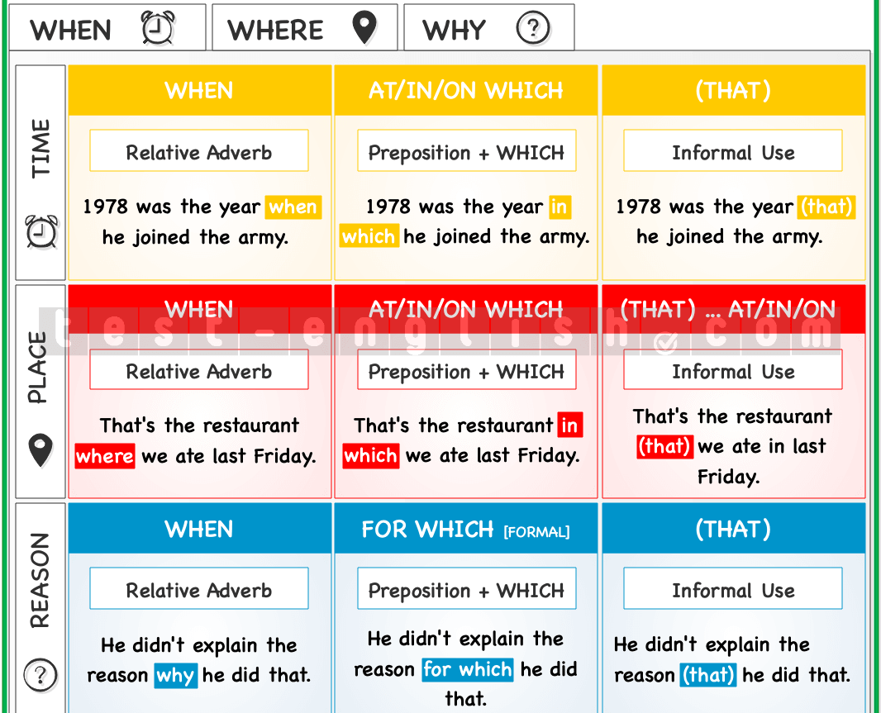
QUICK REMINDER – Relative Adverbs

Slide 21
Practice makes perfect ☺
https://test-english.com/grammar-points/b2/relative-clauses/
https://elt.oup.com/student/solutions/int/grammar/grammar_03_022e?cc=hr&selLanguage=hr
https://test-english.com/grammar-points/b1/defining-and-non-defining-relative-clauses/
https://www.myenglishpages.com/english/grammar-exercise-relative-clauses.php
https://www.englishexercises.org/makeagame/viewgame.asp?id=4219
More homework exercises available on IE ☺

Slide 22
#neverstoplearning

