Slide 1
English for the Media – LO 2 EXERCISES
Present Simple and Present Continuous

Slide 2

Resource: Murphy, R. (2019). English Grammar in Use. CPU.
Practice material with key
PRESENT
SIMPLE & CONTINUOUS

Slide 3
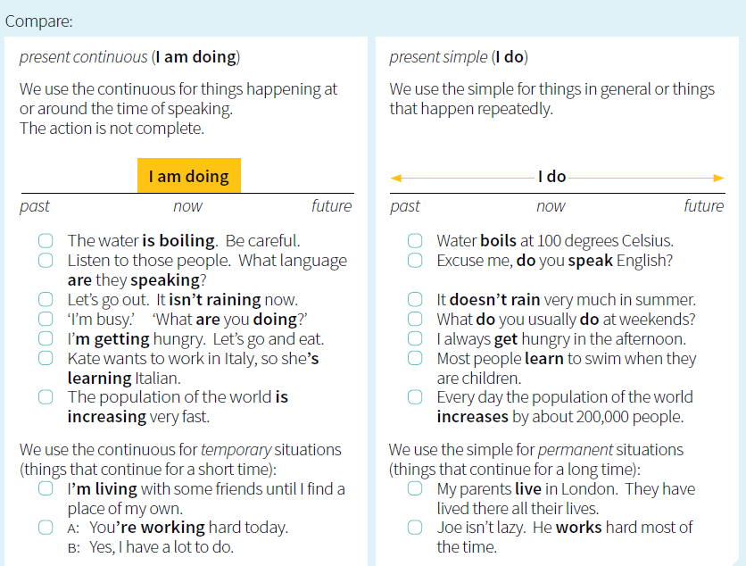
Rules

Slide 4
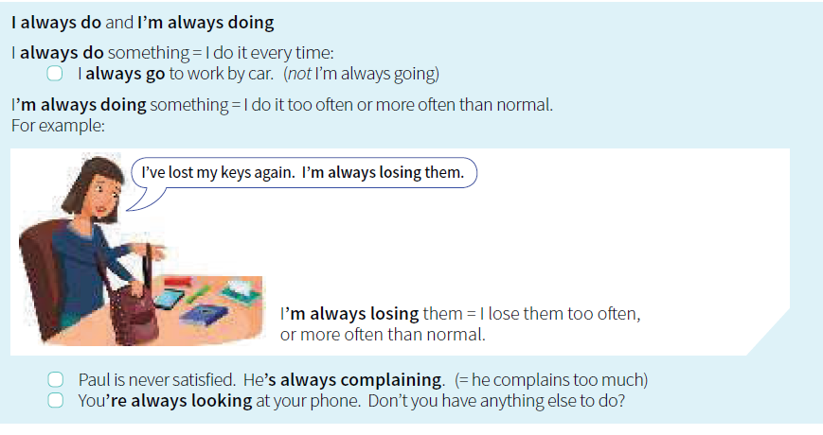

Slide 5
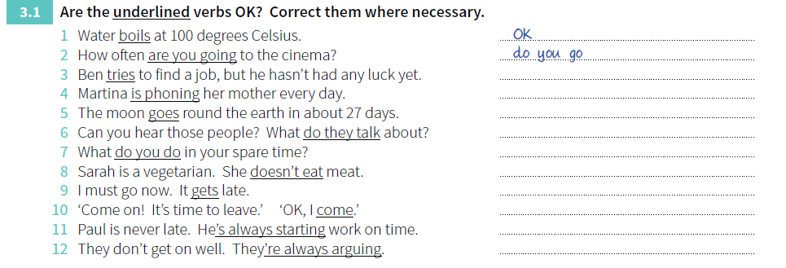
Exercises

Slide 6
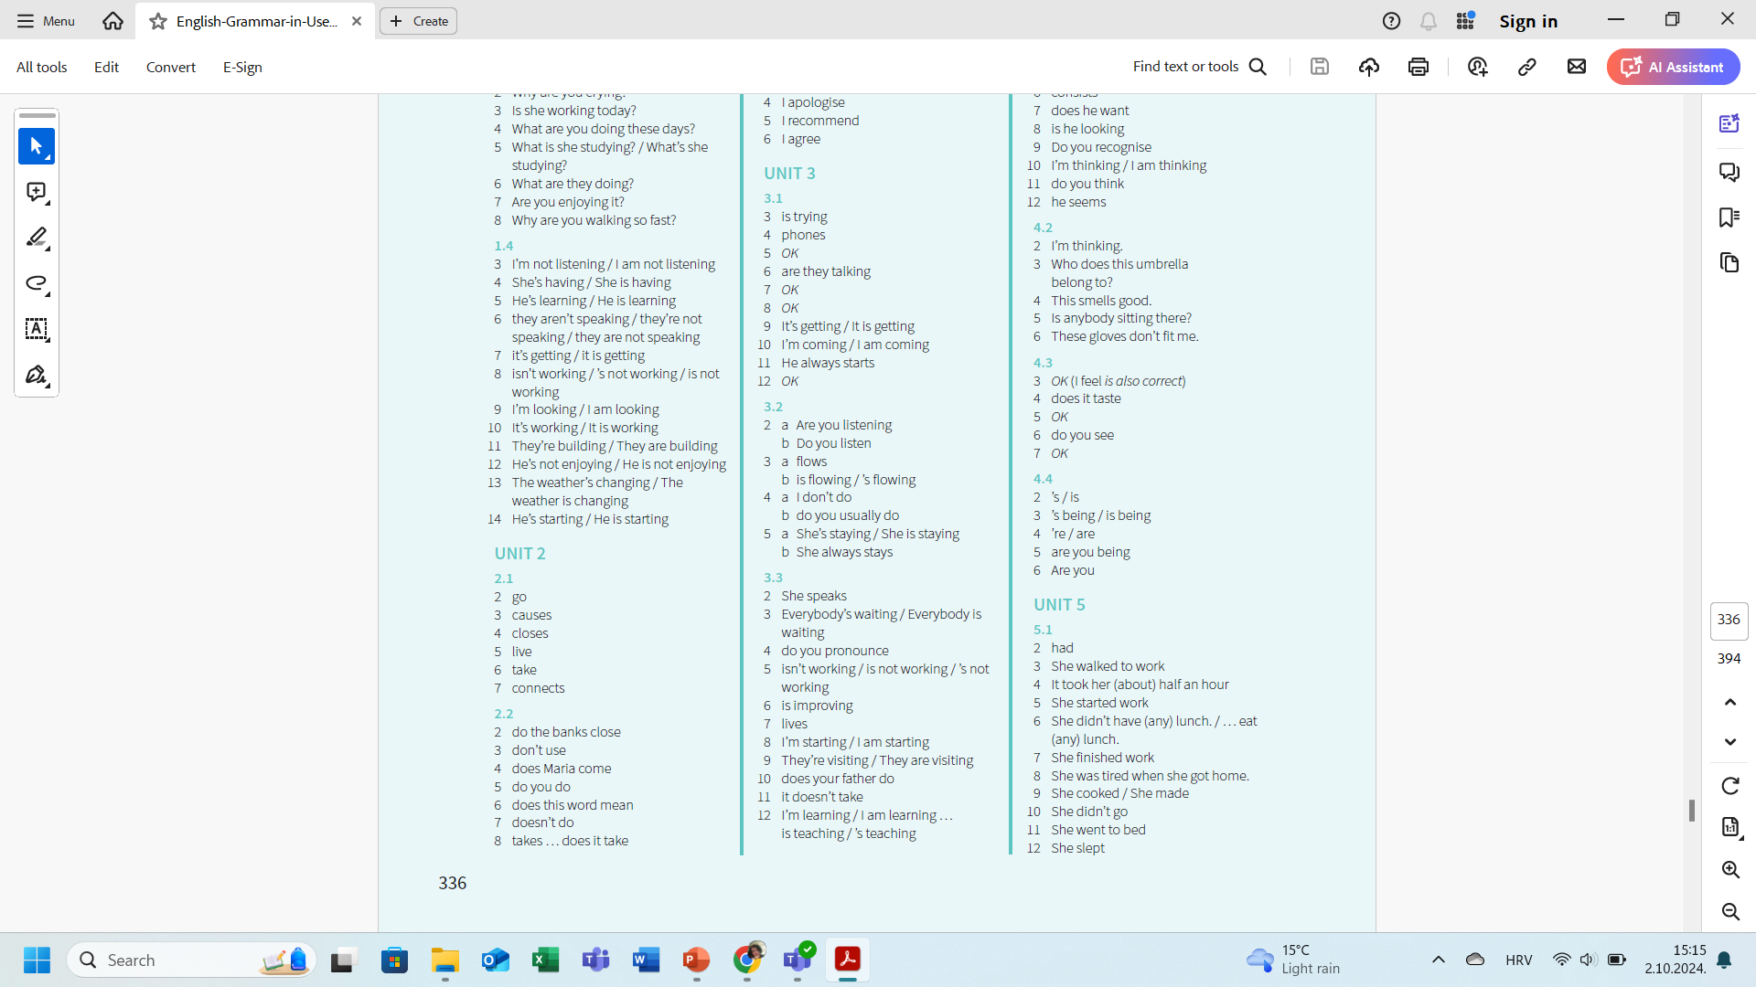
Key

Slide 7
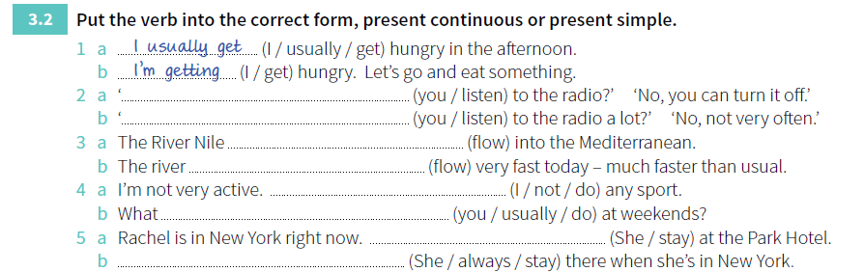
Exercises

Slide 8
Key

Slide 9
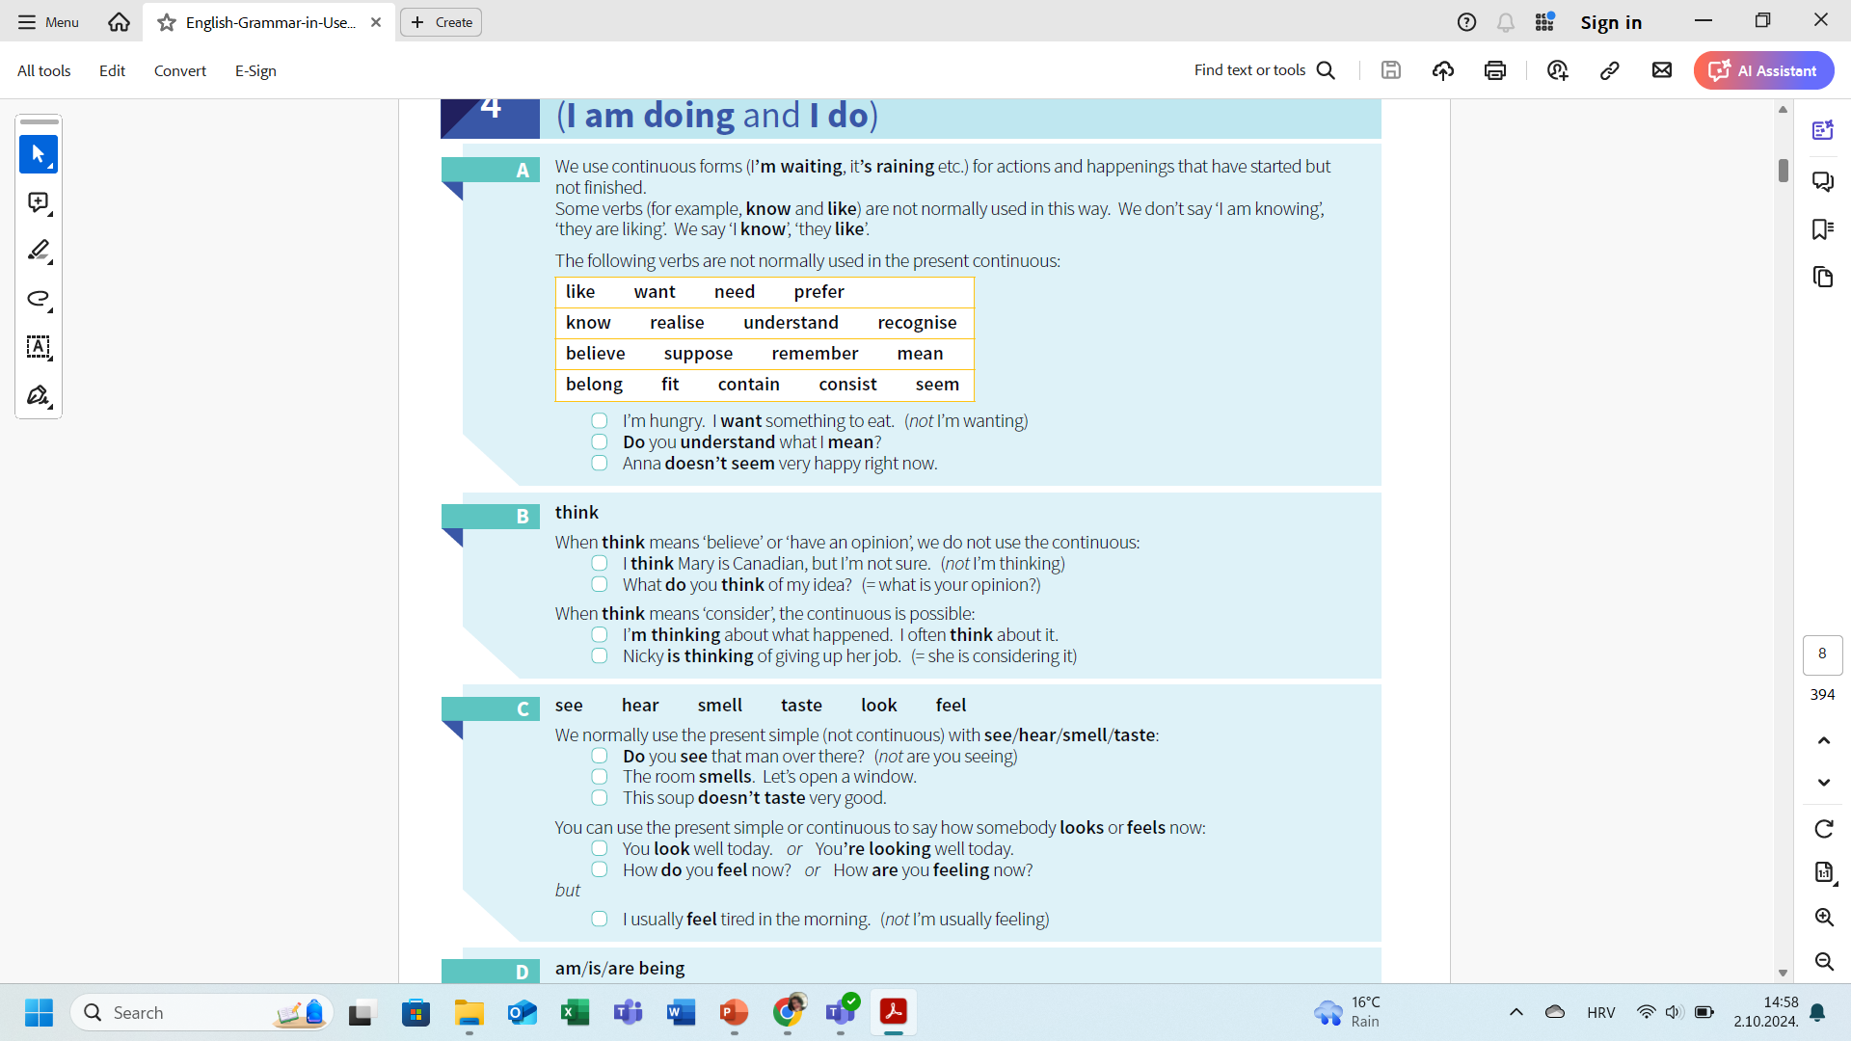
Rules

Slide 11
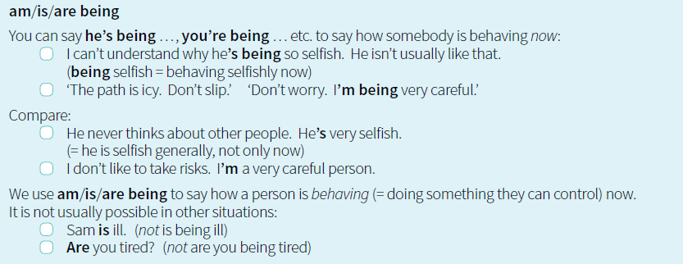

Slide 12
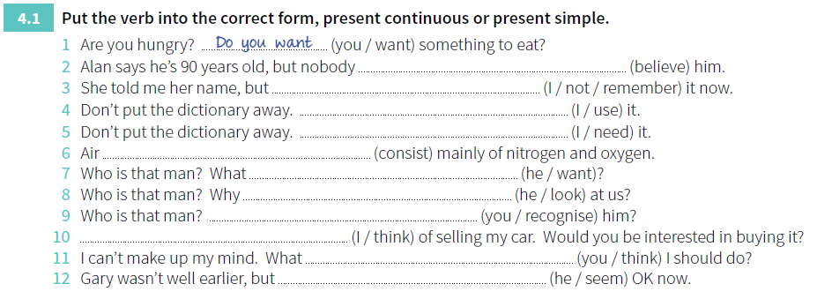
Exercises

Slide 13
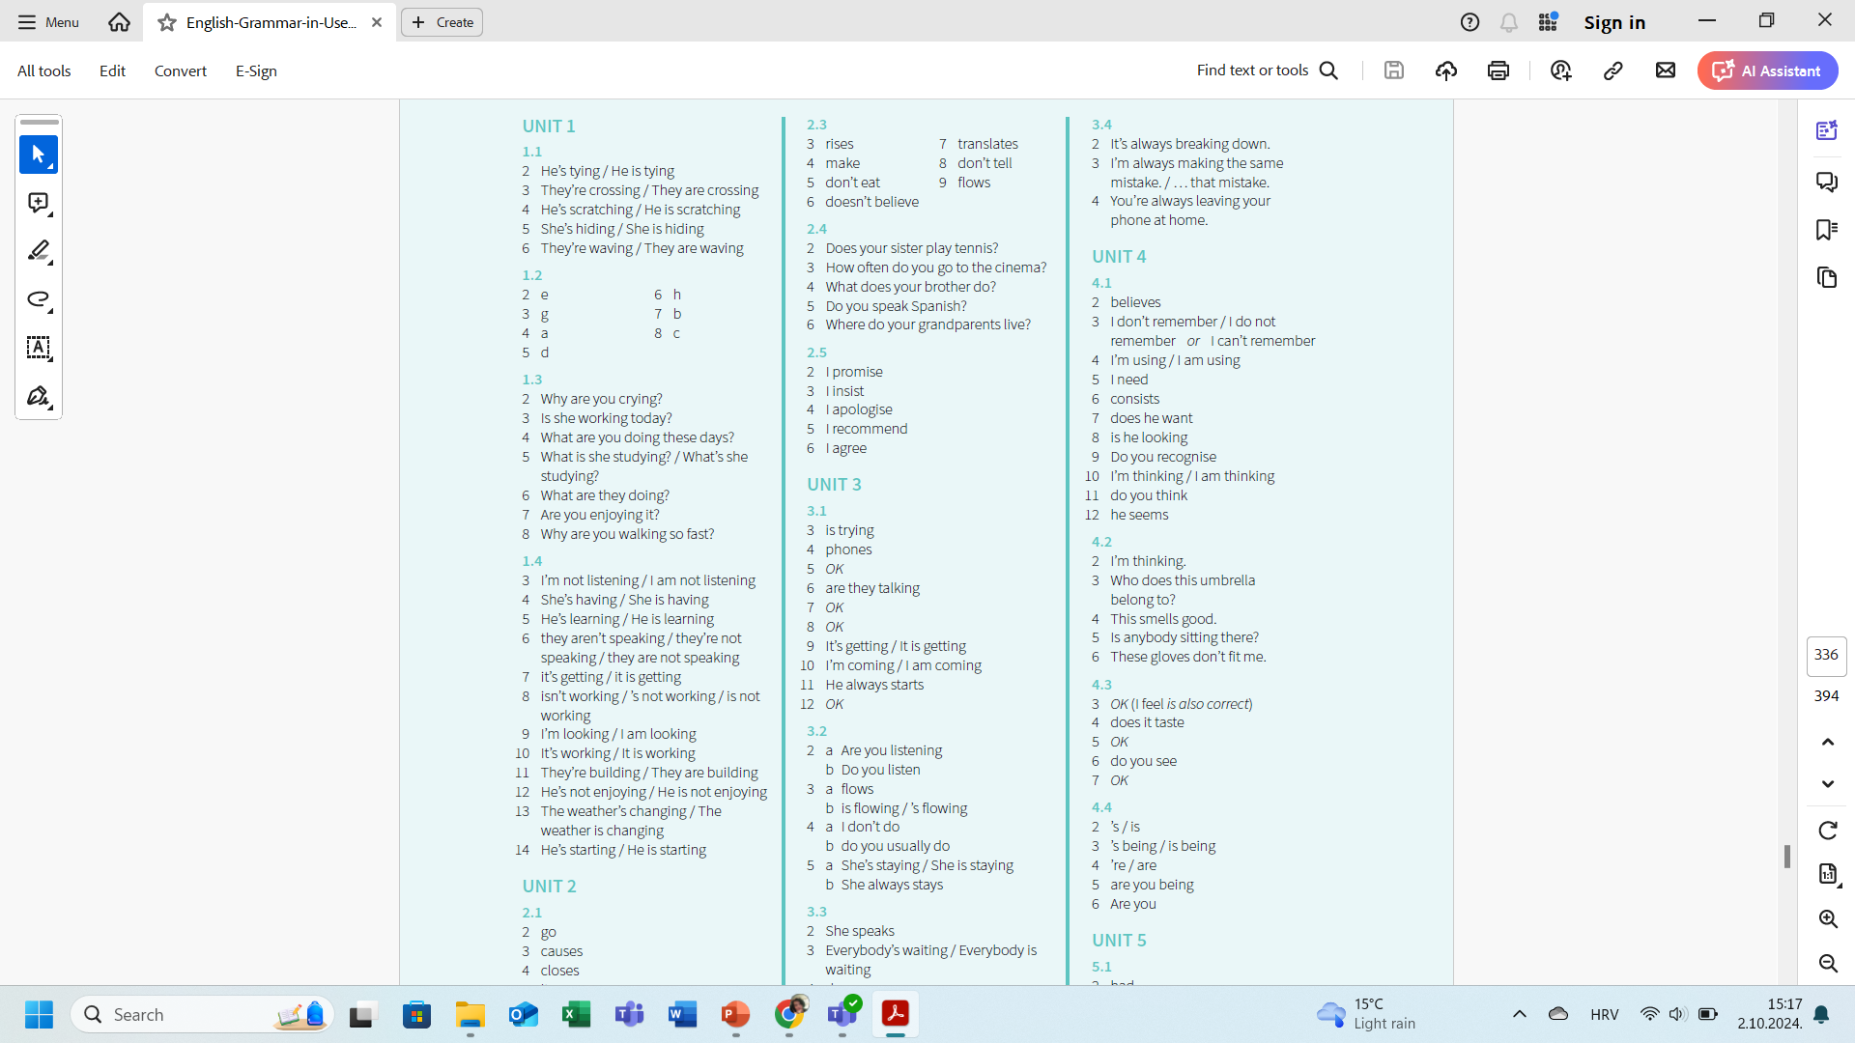
Key

Slide 14
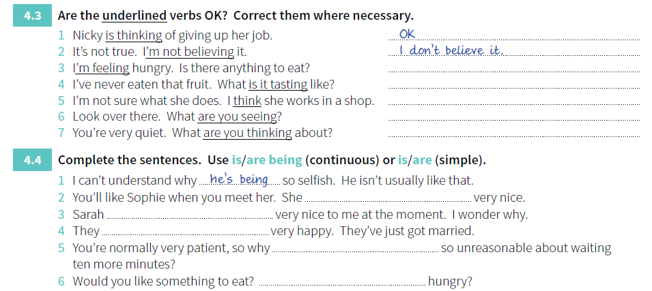
Exercises

Slide 15
Key

Slide 16

#keeponpracticing

