Slide 1
Građa računala
Sigurnost hardvera
(dodatna prezentacija)
Notes:
Ažurirati naziv kolegija.

Slide 2
Generalna sigurnost hardvera (The semiconductor security war)

Slide 3
RowHammer napadi

Slide 4
Uobičajene floskule
“Zaaaašto kompliciramo – idemo rješiti problem memorije tako da maknemo “sporu” DRAM memoriju, I idemo sve držati u brzoj, SRAM memoriji I cache memoriji”
Razmislimo zašto je ovo nepraktično I nemoguće za izvesti
Notes:
Why does it take 3-250 cycles to access RAM? (L1 L2 L3 DRAM)
And another, very important question/excuse - Why can’t I have a 4GB L1 cache?

Slide 5
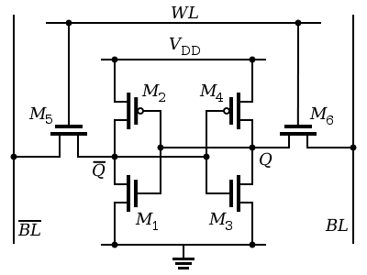
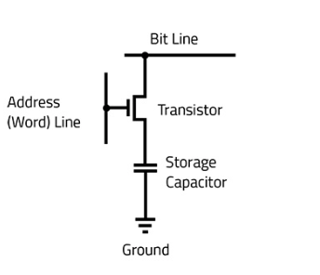
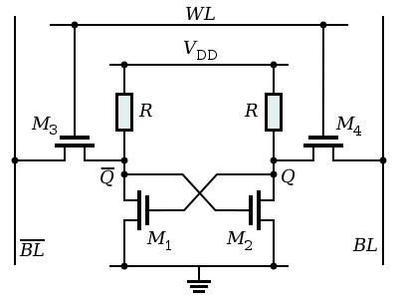
SRAM vs DRAM
Notes:
6 and 4-transistor SRAM vs DRAM
This is for one BIT!
A DRAM cell consists of a capacitor and an access transistor
It stores data in terms of charge status of the capacitor
A DRAM chip consists of (10s of 1000s of) rows of such cells
DRAM is based on storing a charge in a capacitor. It matters because capacitors can be made quite compact, and they hold a charge long enough to be useful. The basic idea is to split the memory address into two parts, which correspond to row/column coordinates in a grid of capacitors, each storing one bit.
There are row and column lines (wires) across the grid, and at each intersection is a capacitor which connects to the column bus through a transistor, which is gated by the row bus. The row portion of the memory address is decoded, and selects one row wire. This activates the transistor in all the row's storage cells (bits), so each capacitor's charge is "read out" through the column wire to a "sense amplifier" and then into a buffer. The second part of the address is decoded, and selects bits from the this read-out buffer. To write, the same sort of row/column selection happens, but to set a bit, charge into the capacitor.
Remember that capacitors are volatile, though: this means that each one has to be "refreshed" periodically (on the order of milliseconds). Essentially, this is done by reading each row, amplifying and writing it back, and cycling through all the rows.
The structure of a real DRAM chip is somewhat more complicated than this, since many of these simple 2D array structures exist on the chip, some operating in parallel and some selected by other portions of the memory address. The DRAM protocol is very low-level, though, so a CPU has to provide a very complicated controller to run through the various states - putting portions of the address on the memory bus, waiting specific numbers of clocks, then other signals, etc. Probably the most important single timing parameter is the amount of time between providing the address and receiving data in a read operation - this latency has improved over years and DRAM generations, but has actually fallen dramatically behind the speed of CPUs. (It's on the order of 50 ns, which is hundreds of CPU clock cycles...)

Slide 6
SRAM
Notes:
It’s obvious that this is WAY more complicated
But that’s not the point. The point is – why is that bad?
Well, this picture shows a pure digital logic device. This is a DISCREET component that can get us 0 or 1 out of it at all times.
But it also requires CONSTANT power (Vdd) – When discussing MOSFET’s, VDD is a DC voltage that is supplied to the drain of the transistor. When you’re testing and biasing transistors, this is a very important voltage because it determines how much AC signal can be amplified to in the transistor.
Also, as is obvious from the picture, it requires 6 transistors (the other design in the previous slide is 4 transistors), a whole bunch of complicated and overlapping wires, which make it very difficult to lay this out in a high-density way on a chip. If you know what you’re looking for, if you dissect a chip and look at it with a good electron microscope, there are always these pure, beautiful areas of the chip that are obviously cache memory (the same thing over and over again, technologically speaking).
The problem is that this is very power-hungry, which means it heats up, which is a problem for the heat dissipation. But at the same time, it’s fast, it’s a logic device, and that’s all great.
It’s also very expensive to make when compared to DRAM.

Slide 7
DRAM
Notes:
This, on the other hand, is basically an analog component. Yes, it does have the transistor, but the capacitor part is a purely analog component.
The capacitor stores a small number of electrons (0 or 1), which means that we don’t have to put power in it all the time (when we’re not accessing it), but it also drains away over time . That means we have to top it up. Remember that capacitors are volatile, this means that each one has to be "refreshed" periodically (on the order of milliseconds). Essentially, this is done by reading each row, amplifying and writing it back, and cycling through all the rows.. This wastes a humongous amount of time, costs an awful lot of energy, and introduces order-or-two-of-magnitude more latency in the process. That also wastes memory bandwidth. Every time we read from it, there’s an ADC process happening, and that’s always going to take time.
But, at the same time, this is WAY, WAY more simple circuit. We can easily produce it, we can lay many of them close and on top of each other at much, much higher density (it’s a much smaller circuit!) which, as a result, means that you can package your gigabytes of RAM much more easily.
Of course, then we need to remember what we already discussed – DRAM is not on-die, it’s physically separated, topologically AWAY from the CPU (propagation delay), connected to some sort of logic (memory controller), which further kills the BW and increases latency.

Slide 8
Primjer (Sandy Bridge arhitektura)
L1 cache size 32KB cca 3 cycles
L2 cache size 256KB cca 8 cycles
L3 cache size 10-20MB cca 35 cycles
Main memory – whatever GBs are supported/we put in, cca 250 cycles

Slide 9
Zašto nas to zanima?

Slide 10
Objašnjenje je jednostavno
Već smo ustanovili da je memorija usko grlo
Razvoj tehnologije za “izgradnju” memorije u smislu latencije nije nešto sa čime se trebamo pohvaliti u zadnjih 3 desetljeća
Što god da se moglo napraviti u smislu brzine, smanjenja cijene I povećavanja adresnog raspona (32, 64-bit) – to je bila cijena koju smo bili spremni platiti
Kako napreduje razvoj memorije, memorijske ćelije su sve bliže I bliže, što ima direktan utjecaj na performanse
Bilo bi “fora” kad bismo mogli zaobići osnove fizike, ali samo zato što to jaaaaako želimo, to ne znači da je to I moguće
Različiti ciljevi dizajna I potrebe tržišta su nas doveli do situacije da postoje ranjivosti kao Spectre, Meltdown I RowHammer
RowHammer je primjenjiv na sve vrste memorije, poglavito DDR3+ memorije
Što je novija memorija, situacija je obično gora
Notes:
DRAM capacitor charge leaks over time
Pravilo desne ruke
The memory controller needs to refresh each row periodically to restore charge
Activate each row every N ms
Typical N = 64 ms
Downsides of refresh
-- Energy consumption: Each refresh consumes energy
-- Performance degradation: DRAM rank/bank unavailable while refreshed
-- QoS/predictability impact: (Long) pause times during refresh
-- Refresh rate limits DRAM capacity scaling

Slide 11
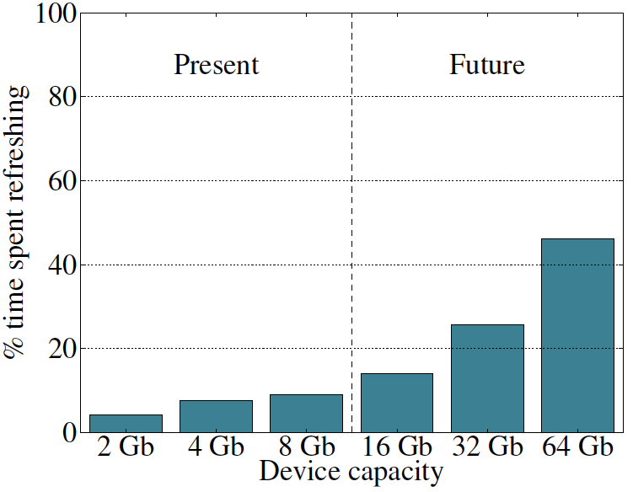
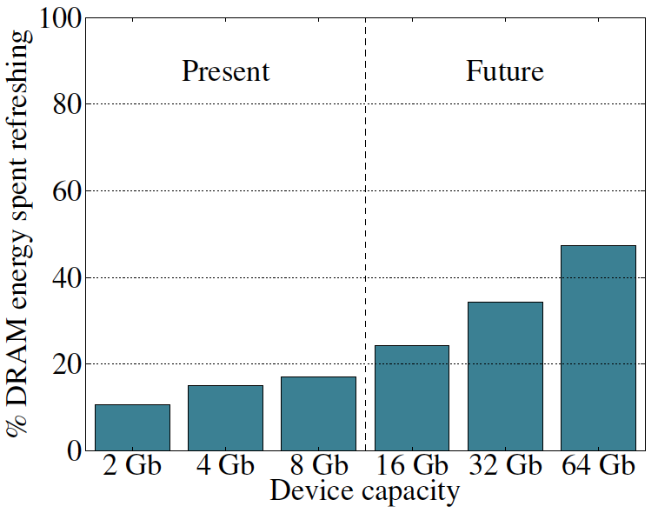
Refresh problemi – performanse I potrošnja energije
Notes:
Memory refresh is a crucial process used in dynamic random-access memory (DRAM) to preserve the data stored in memory cells. Here’s a breakdown of what it is, why it happens, and why it matters:
DRAM stores data using tiny electrical charges in capacitors—each bit (0 or 1) is represented by the presence or absence of charge in a cell. However, capacitors naturally leak charge over time, which means that unless the charge is restored periodically, the data will be lost.
Memory refresh is the process of reading and immediately rewriting the data in DRAM cells to restore the charge and thus keep the information intact.
The need arises from the physical limitations of DRAM technology:
DRAM cells are made from capacitors and transistors.
These capacitors leak electrical charge over milliseconds.
If they’re not refreshed, bits will “flip” and data will be lost.
Prevents Data Loss: Without refresh, the stored data would simply disappear after a short time.
Enables High-Density Storage: DRAM allows for denser memory than static RAM (SRAM), but only with refresh mechanisms.
Maintains System Stability: Corrupted memory from skipped refreshes could crash programs or operating systems.
Security Implications: Techniques like Rowhammer exploit the refresh mechanism—by rapidly accessing (or “hammering”) rows of memory, an attacker can induce bit flips in adjacent rows. This has enabled real-world security exploits and shows how critical controlled refresh is to system integrity.

Slide 12
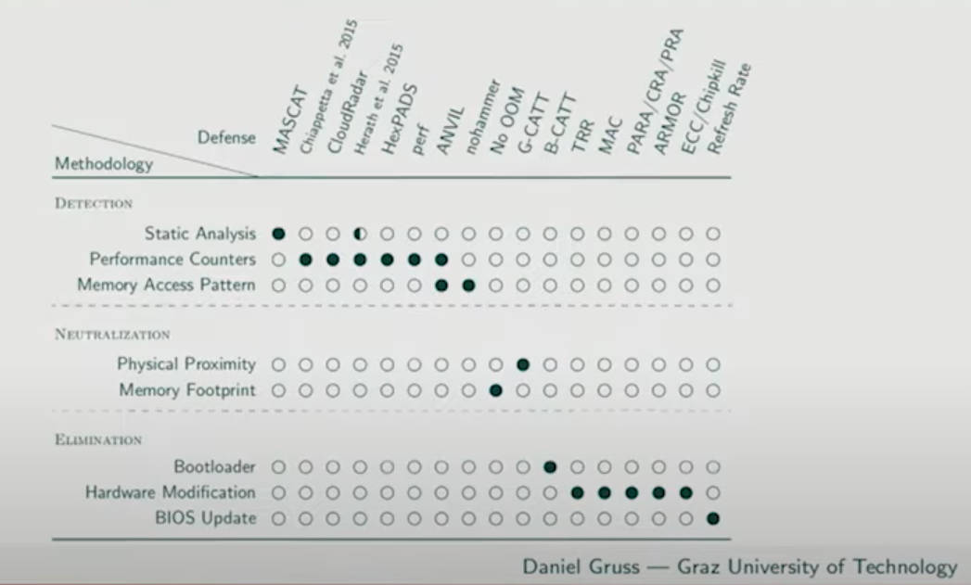
Sustavi za detekciju, neutralizaciju I eliminaciju RowHamer ranjivosti
Notes:
Discovered even earlier but gaining prominence around 2014–2015, Rowhammer is a DRAM-level attack that flips bits in adjacent memory rows by repeatedly accessing a single row. It proved that memory hardware itself could be a vector for privilege escalation attacks. Later iterations, such as SpecHammer, merged Spectre with Rowhammer to bypass existing Spectre defenses by inducing bit flips in shared memory variables (Tobah et al., 2022).
As these exploits were publicized, researchers explored related vectors:
Flush+Reload and Prime+Probe attacks exploit cache timing differences for data leakage (Mushtaq et al., 2020).
LoJax, a UEFI rootkit, demonstrated the feasibility of persistent, firmware-level malware (Wu, 2019).
New attacks emerged against cryptographic workloads on patched systems, revealing significant performance overhead and raising questions about the trade-offs between security and efficiency (Alhubaiti & El-Alfy, 2019).
🔧 Hardware-Level Solutions
1. TRR (Target Row Refresh)
Mechanism: Refreshes adjacent rows when a row is activated frequently.
Strengths: Transparent to OS, already adopted in DDR4/DDR5.
Weaknesses: Vulnerable to bypasses like Half-Double attacks (Hassan et al., 2021).
2. PARA (Probabilistic Adjacent Row Activation)
Mechanism: Randomly refreshes adjacent rows upon row access.
Strengths: Simple, requires no tracking.
Weaknesses: Not deterministic; attackers can bypass with enough iterations (Demirseren & Vakilinia, 2024).
3. CRA/PRA (Counter/Priority-based Row Activation)
Mechanism: Counters track row access frequency; mitigation activates above a threshold.
Challenge: Limited counter availability restricts accuracy and security at low thresholds (Jaleel et al., 2024).
4. MAC (Memory Access Control)
Mechanism: Uses access control techniques to limit hammering.
Note: Conceptual overlap with hybrid row-migration and restriction systems (e.g., Blockhammer).
5. ECC / Chipkill
Mechanism: Error-correcting code schemes fix a limited number of bit errors.
Weaknesses: Cannot correct multi-bit flips from aggressive hammering (Kim et al., 2020).
6. Refresh Rate Increase
Mechanism: More frequent refresh cycles reduce vulnerability.
Tradeoff: High power and performance cost; not future-proof against lower thresholds (Loughlin et al., 2021).
🧠 Software and Hybrid Mitigation Techniques
7. ANVIL
Mechanism: Monitors memory access patterns with performance counters.
Strengths: Detects hammering without hardware change.
Weaknesses: Limited by accuracy of counters and false positives (Aweke et al., 2016).
8. NoHammer
Mechanism: Uses last-level cache (LLC) to delay aggressor access.
Strengths: 6% higher performance than baseline; no refresh overhead.
Weaknesses: May still suffer in heavy workloads (Lee et al., 2023).
9. G-CATT / B-CATT
Mechanism: Memory isolation at OS level; allocates attacker and victim rows separately.
Strengths: Blocks cross-domain bit flips.
Weaknesses: Requires kernel-level changes, not always complete (Gruss et al., 2017).
10. CloudRadar / Hexpads / Perf / ARMOR
Status: Not directly mentioned in recent literature—likely represent internal/proprietary or experimental monitoring approaches using hardware performance counters and ML techniques.
11. MASCAT (likely a misreference)
May refer to cache-based monitoring systems, similar to NoHammer/ANVIL/ARMOR.
📊 Emerging and Advanced Defenses
12. REGA
Mechanism: Adds in-DRAM refresh generation upon activation.
Strengths: Effective even at low thresholds (e.g., 261 activations).
Tradeoffs: Requires hardware redesign (Marazzi et al., 2023).
13. Rubix / Rubix-D
Mechanism: Randomizes physical row mapping to confuse attackers.
Performance: Reduces Blockhammer slowdown from 600% to 3% (Saxena et al., 2024).
14. QPRAC (Priority Queue for PRAC)
Mechanism: Uses per-row activation counting with queue prioritization.
Strengths: Secures at ultra-low thresholds (as low as 71 activations).
Weaknesses: Requires DDR5 PRAC support (Woo et al., 2025).
15. START
Mechanism: Tracks aggressors in LLC, scales to any threshold.
Advantage: 5x less overhead vs traditional SRAM counters (Saxena & Qureshi, 2023).
Feel free to check Daniel Gruss’s lecture from the IEEE symposium on Security and Privacy
https://www.youtube.com/watch?v=_JPhsqJzV5I
Ideal mechanism issues a refresh command to a row only right before the row can potentially experience a RowHammer bit flip

Slide 13
Spectre i Meltdown

Slide 14
Kakvi su to napadi?

Slide 15
Meltdown i Spectre napadi
Netko nam može pokrasti tajne podatke sa sustava, iako:
  Program I podaci rade u skladu sa pravilima
  Hardver radi kako treba
  Ne postoje softverske ranjivosti aplikacije ili operacijskog sustava

Slide 16
Meltdown i Spectre
Hardverske ranjivosti koje su prisutne na manje-više svim računalnim čipovima koji su proizvedeni unatrag dva desetljeća
Iskorištavaju spekulativno izvršavanje
  Reminder: tehnologija koju moderni procesori koriste za dostizanje boljih performansi
  Izvršava se dio koda prije nego što znamo da li je to potrebno
    I sami to radimo vrlo često, jer to štedi vrijeme
    I procesori to rade, iz istog razloga

Slide 17
Spekulativno izvršavanje
Razmatrajmo ovaj kod
if (account-balance <= 0) {
// do something
} else if (account-balance < 1M) {
// do something else
} else {
// do something else
}
Pogađa se koji kod će biti izvršen I izvršava se
- Poboljšanje performansi, zato što treba puno vremena za pristup memoriji
Ako je pogađanje pogrešno, brišu se krive instrukcije I izvršava ispravan kod

Slide 18
Korisnik ne vidi spekulativno izvršavanje
ISA
(Instruction Set Architecture)
Sučelje/”ugovor” između softvera I hardvera.
Programer pretpostavlja da hardware zadovoljava uvjete ISA-e..
Problem
Algorithm
Program/Language
System Software
SW/HW Interface
Mikroarhitektura
Implementacija ISA-e
Micro-architecture
Logic
Programer(ka) također pretpostavlja da će
kod biti izvršen KAKO JE NAPISAN (potpuno
pogrešno)
Devices
Mikroarhitektura instrukcije izvršava
Drugačijim redoslijedom (spekulativno)
ali daje identične rezultate koje
programer(ka) očekuje.
Electrons

Slide 19
Meltdown and Spectre
Netko nam može pokrasti tajne podatke sa sustava, iako:
  Program I podaci rade u skladu sa pravilima
  Hardver radi kako treba
  Ne postoje softverske ranjivosti aplikacije ili operacijskog sustava
Zašto?
  Spekulativno izvršavanje ostavlja tragove tajnih podataka u cache memoriji procesora
    Podaci kojima se ne bi trebalo pristupiti da nema spekulativnog izvršavanja
  Maliciozni program može provjeravati sadržaj cache memorije da bi došao do zaključka gdje se nalaze tajni podaci kojima ne bi smio moći pristupiti
  Maliciozni program također može prisiliti drugi program da spekulativno izvrši kod koji ostavlja tragove (tajne podatke)

Slide 20
Cache memorija procesora kao side-channel za napade
Spekulativno izvršavanje ostavlja podatke u cache memoriji procesora
  Gledano iz aspekta dizajna I arhitekture, potpuno korektno ponašanje
  Nuspojava je side-channel – kanal kroz koji netko sa “većim znanjem” može doći do tajnih podataka
Kroz cache memoriju “cure” podaci, pošto procesor u cache memoriju privremeno pohranjuje podatke sa kojima radi u fazi spekulativnog izvršavanja

Slide 21
Više o Spectre I Meltdown napadima
Source: https://googleprojectzero.blogspot.ch/2018/01/reading-privileged-memory-with-side.html

Slide 22
Hvala na pažnji!
Notes:
https://www.youtube.com/watch?v=0U7511Fb4to

